Slide 1


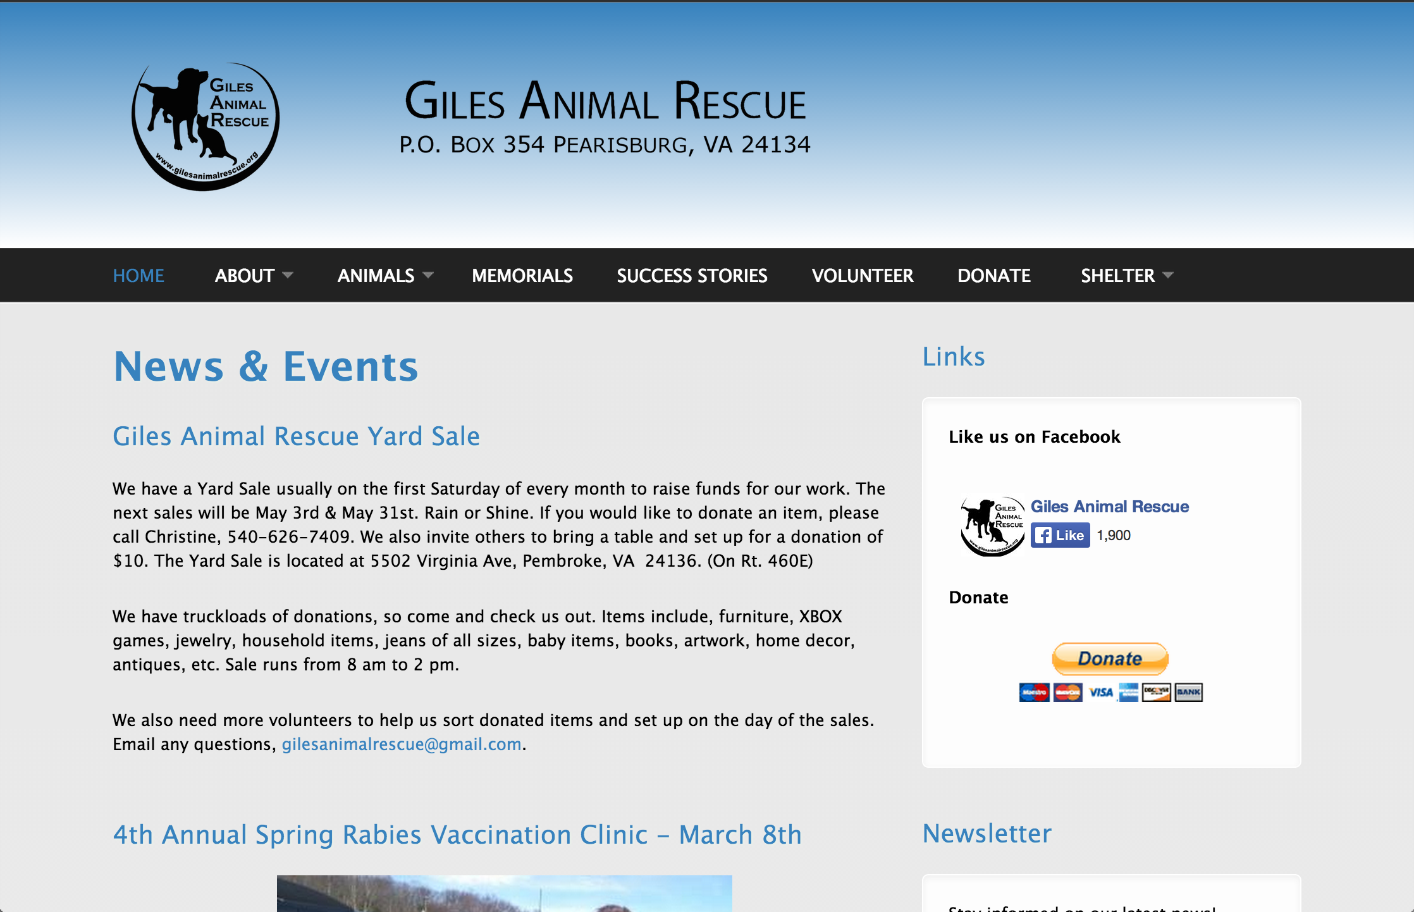
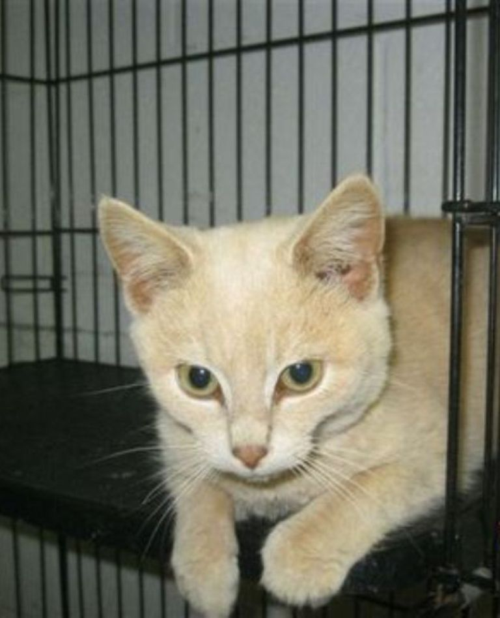
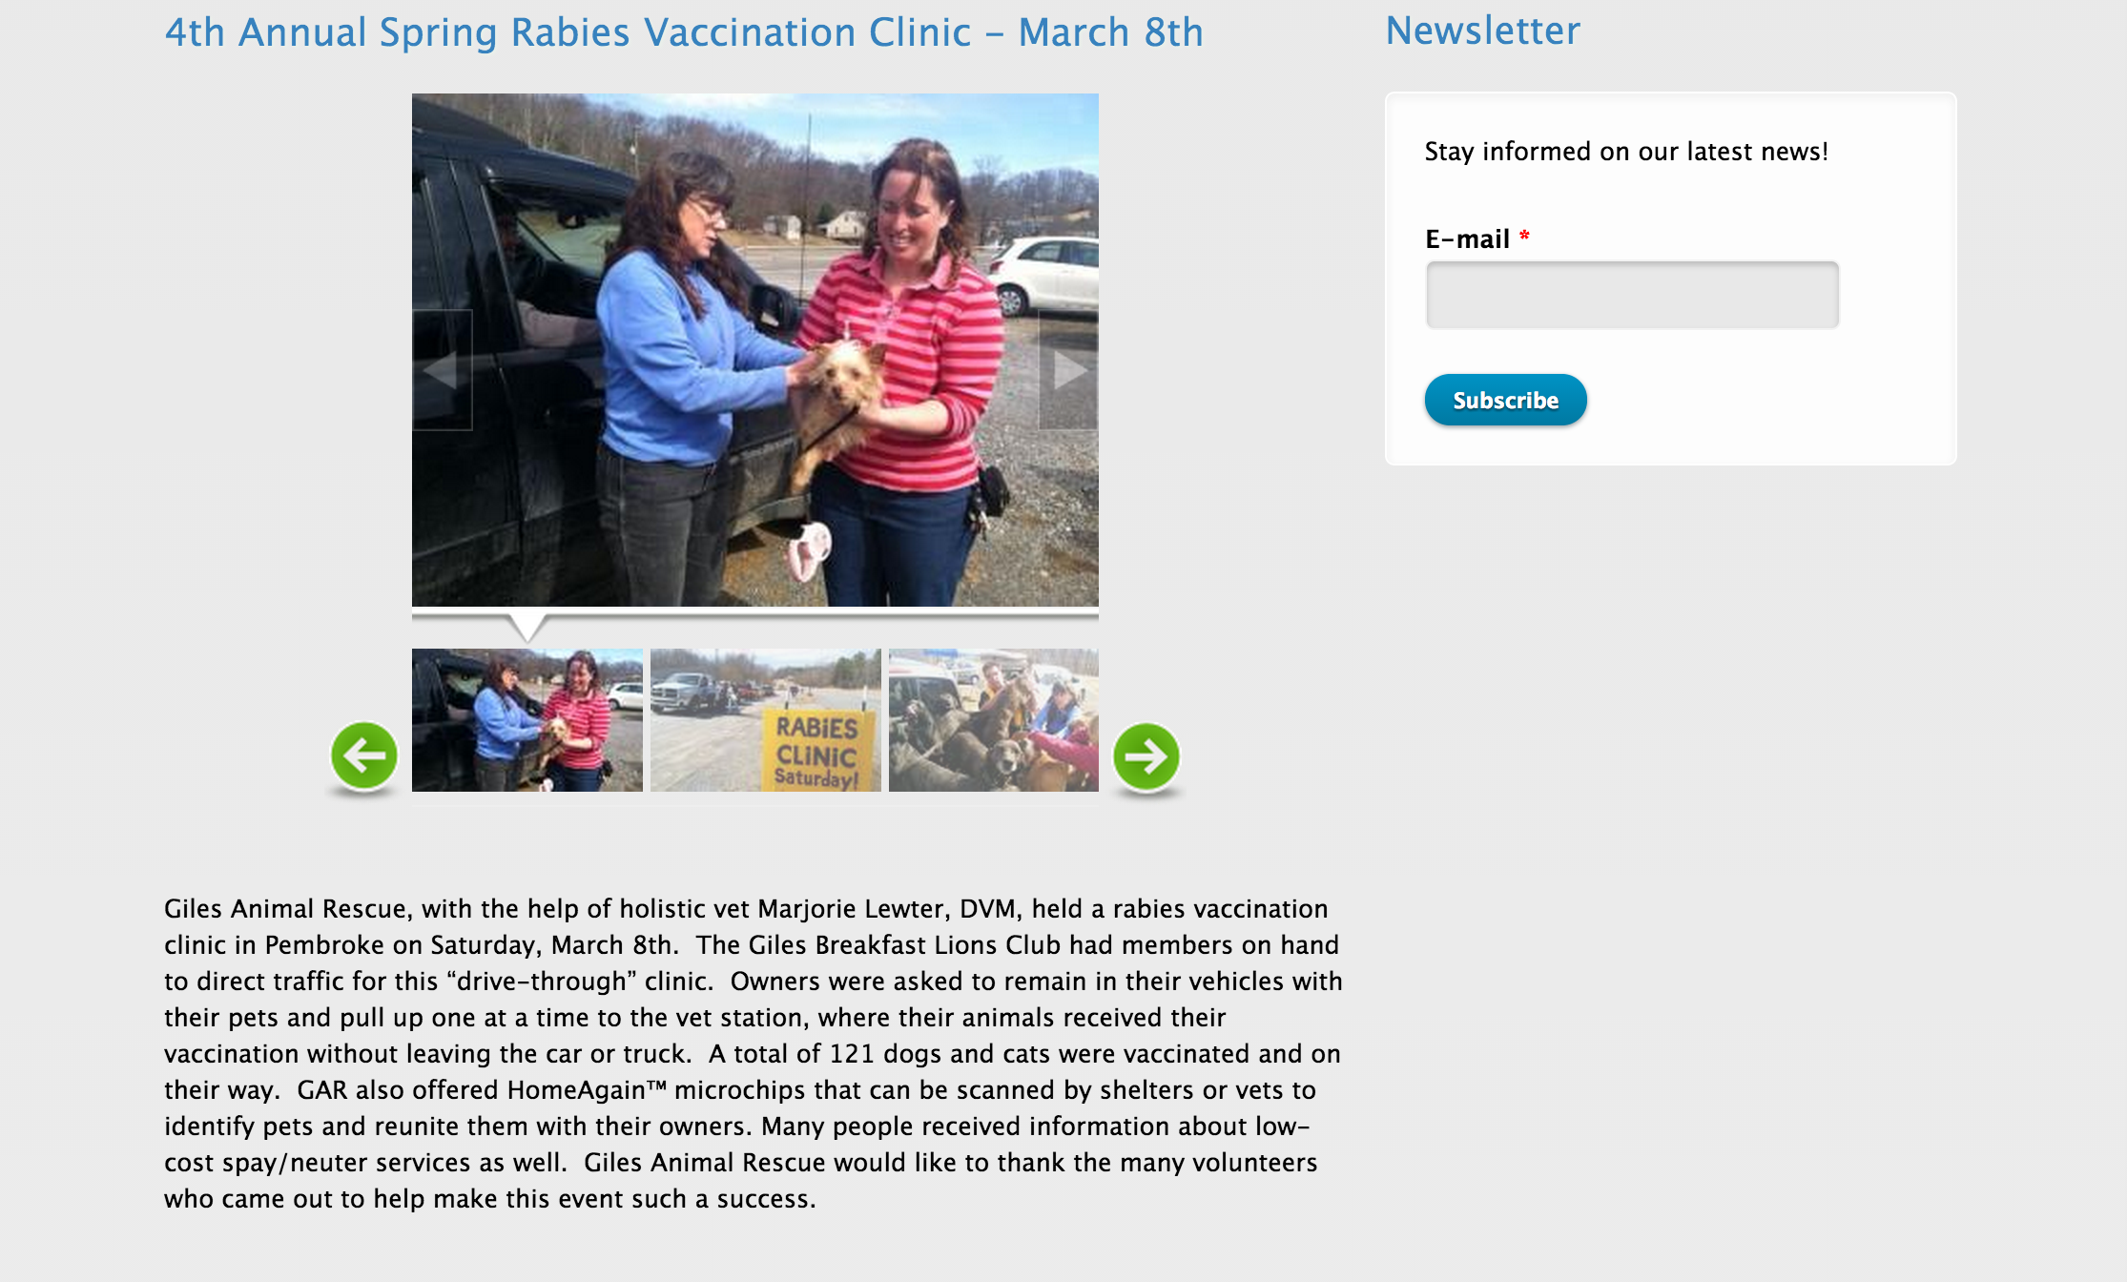
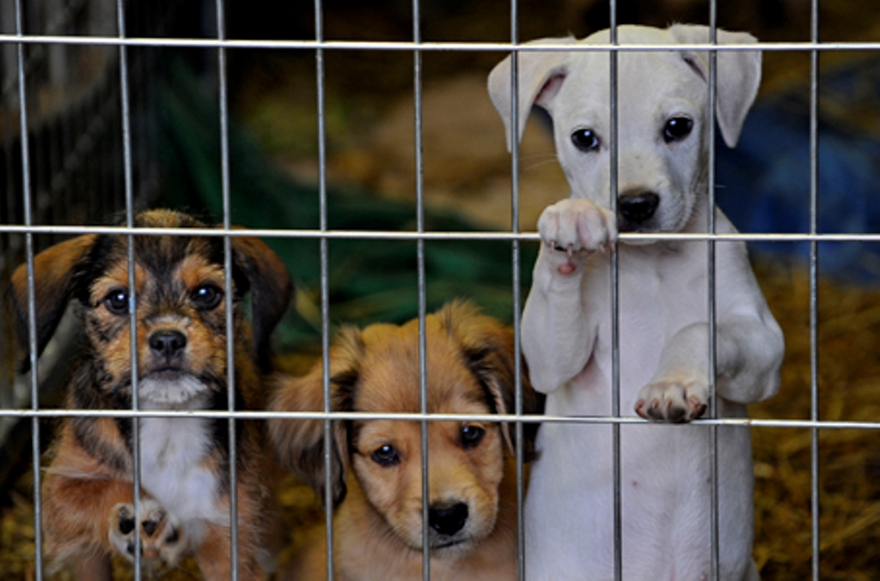
Website Redesign Project
Creating Intuitive Content Management
Jackie Falatko, Devin Henslee
Instructor: Dr. Edward Fox, Department of Computer Science
CS4624 Multimedia/Hypertext/InformationAccess; April 24, 2014
Introduction
Intuitive Content Management
Our client, Christine, is the president of the non-profit Giles Animal Rescue, which helps homeless, neglected, and abused pets in Giles County. The organization has a Drupal website that several groups of students have worked on, but it still needed bug fixes and feature expansion. Our goal is to make all the changes she asked for, as well as create a website content management environment that is easy to maintain. We don’t want her to have to find more volunteers to help with the website after we complete our work.
We worked closely with her, meeting every other Wednesday to demonstrate our changes. We will continue to receive feedback on the changes, propose new changes, and get tasked with more changes in the following weeks. Most changes involved text formatting issues and adding images to pages. Additionally, we changed settings in Drupal to make adding and editing content easy, and set up an account with an organization that offers free hosting for nonprofits.
Christine is unfamiliar with Drupal and website hosting so we are trying to do everything we can to make maintaining her site as easy and intuitive as possible:
Better Backend Management:
Hosted previously on GoDaddy
Moved to Bluehost through Grassroots, which serves nonprofit organizations
Included a cPanel interface to easily manage, update, and backup the site
Created a subdomain for adding and testing new features before pushing to site
Consistent Text Formatting:
Changed content boxes to Filtered HTML to resolve formatting inconsistencies
Newsletter Subscription Administration:
Previously, newsletter subscribers were collected but couldn’t be accessed, so:
Created instructions on exporting subscriber email addresses,
Developed a system for admins to email subscribers directly from the Drupal module
Display Modifications
We focused primarily on our client’s objectives, mostly fixing bugs and display issues. These changes include:
Modified search/filter on Adoptable Animals
Removed metadata from News Events
Added pictures to the Volunteer, Donate, and About Us pages
Added the ability to enlarge pictures by clicking on pictures using the Colorbox module
Created a separate tab for:
  information about the shelter
  contact information
  map of the location
  links to shelter website
  shelter adoption procedures
Adjusted the Links block by:
  separating the “Like us on Facebook” text with the “Like” button, from the
  “Donate” text followed by the donate form
Modified how picture galleries were being displayed for all picture content types
Added a traffic counter to most website pages
Modified status of adoptable pets to better reflect the animals’ current status
Made a new picture size standard
Added new menus
Conclusion
Overall, our client has been very pleased with our changes and is excited about the future of her website. Display changes have increased the overall look and quality of the website. Pages now have uniform formatting and display features. Additionally, since content management is very hard for our client, after moving to the new host she will be able to easily perform Drupal updates.
We feel that we have put forth our best effort over the course of this semester. We are proud to have assisted such a great organization that helps save unfortunate animals. We hope that our changes will aid them with their mission.
Acknowledgements
Animal pictures: Christine Link-Owens
Paw Prints: buckmountainaussies.com
Project support: Dr. Fox
WWW.GILESANIMALRESCUE.ORG

