Slide 1
Virginia Tech
University Libraries
Discovery Teams
Spring 2012
Team Members
Connie Stovall
Tracy Gilmore
Wendy Gentry
Neal Henshaw
Knowledge is power!
Team Theme - Knowledge Creation

Slide 2
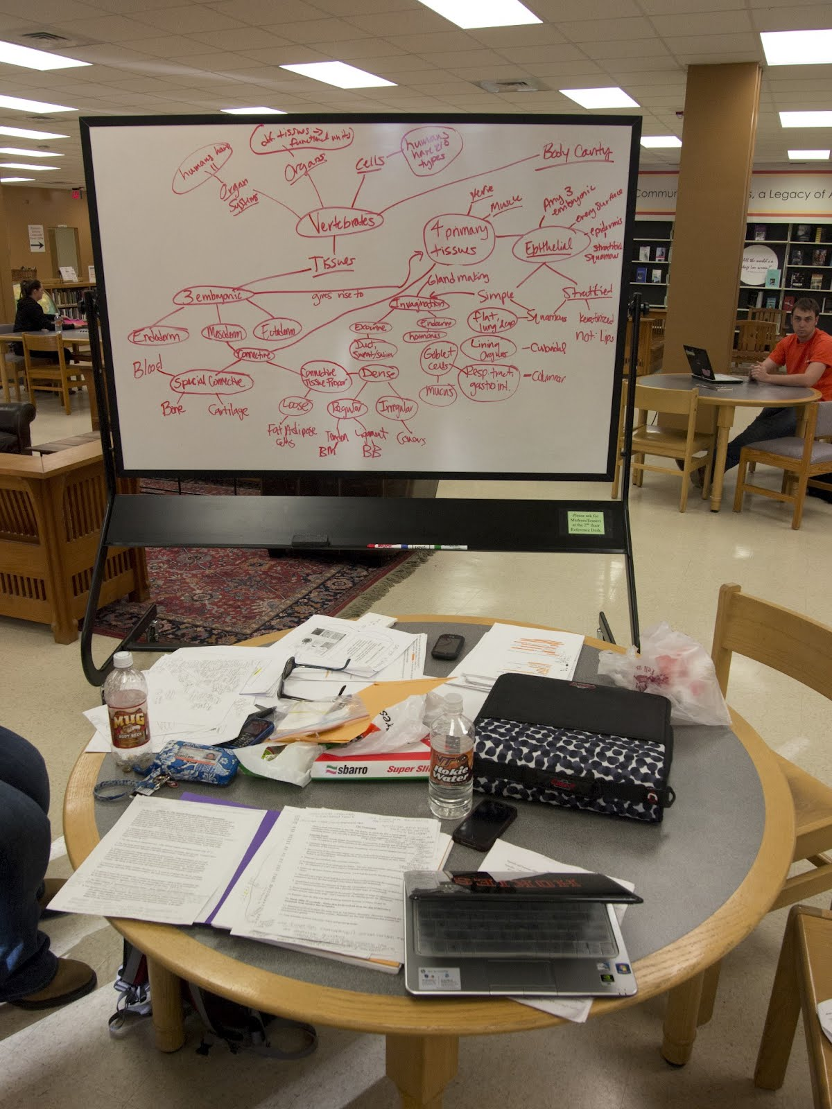
KEY OBSERVATIONS RELATED
TO KNOWLEDGE CREATION
For Groups
  Whiteboards essential
  Room to spread out
For Individuals
  Proper software
  Convenient electrical outlets
  Others present studying, but quiet and private
  Comfortable chairs

Slide 3
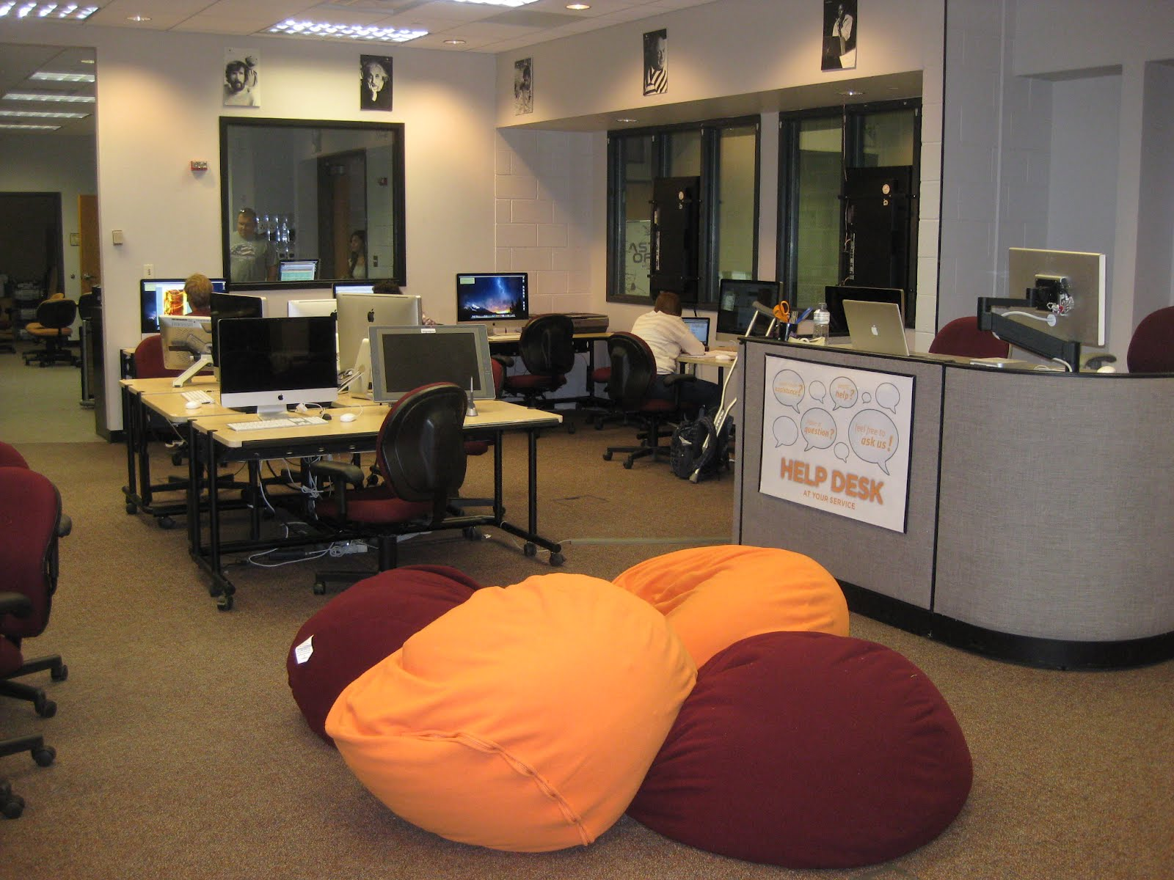
SURPRISING OBSERVATIONS / COMMENTS
How little actual “Knowledge Creation” was taking place. Most kids were just doing homework or studying for tests.
Spontaneous Study Groups were formed – the students did not know each other previously, but found they were studying common material.
How important “Comfy Chairs” were to individuals.
How motivated students were simply by being around others who were studying.

Slide 4
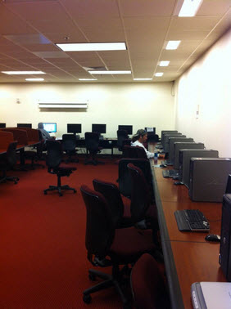
“WHY THIS SPACE?”
Comfy chairs
Noise level
Brightness
Convenient electrical outlets
Room to spread out
Proper equipment (computers, software, dry erase boards)
Coffee convenient (For those in coffee shops)
Printing

Slide 5
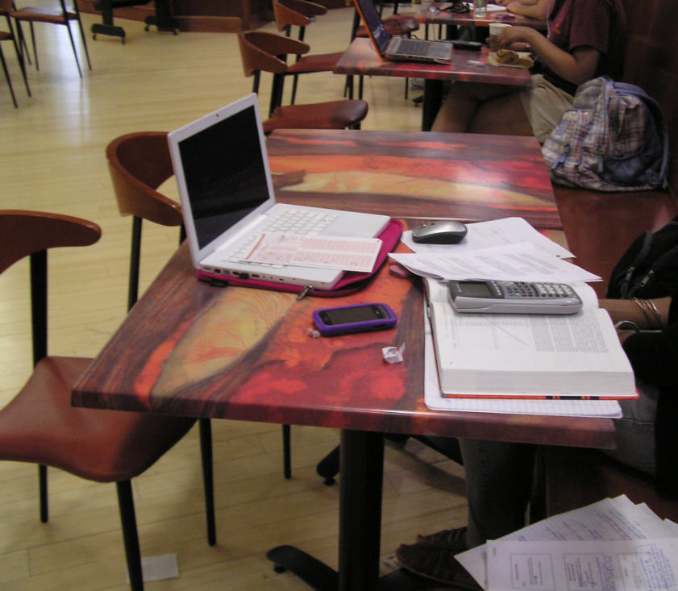
“WHY OTHER SPACES?”
Athletes preferred the stadium, because of the presence of their friends (other teammates)
Proximity to their college labs, subject-specific help
Likes the social aspects of the coffee shop
Ambiance

Slide 6
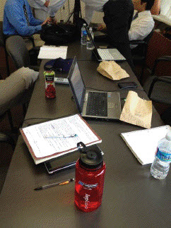
“WHAT HAPPENS IN THIS SPACE?”
Groups:
  Spread materials on tables
  Shared ideas via whiteboards
  Group discussions
  Group work on computers/software
Individuals:
  Spread out materials
  Quietly study while listening to music

Slide 7
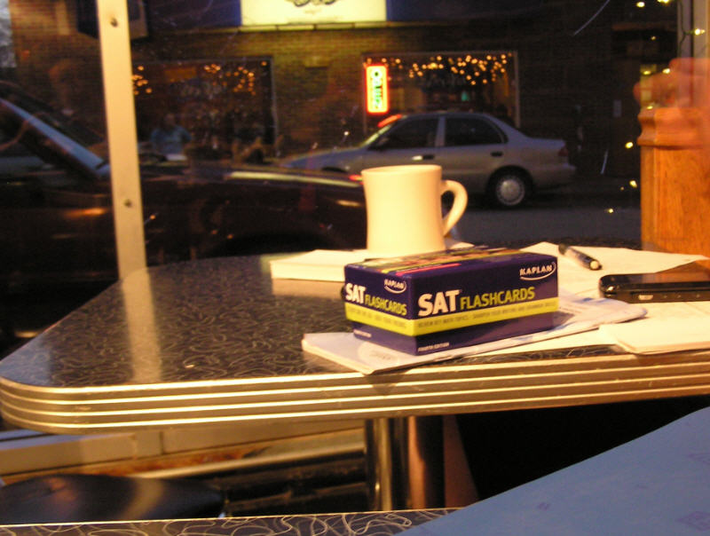
THINGS TO FOLLOW-UP ON
Snack machines
Software packages (video editing, Photoshop, desktop publishing, etc.)
Configurable furniture (single to group and back)
Creating ambiance

