Slide 1

Authoritative Venues
Ali Youssef, Bella Marku, Kyle Forst, Tanner Spicer
CS 4624: Multimedia, Hypertext, and Information Access Capstone
Dr. Edward A. Fox
Virginia Tech, Blacksburg, 24061
April 22, 2021
Notes:
bella

Slide 2
Presentation Outline
Background Research
Project Requirements
Deliverables
Data and Results
Live Demo
Testing and Assessment
Timeline and Lessons Learned
Conclusion
Acknowledgements and References
Notes:
bella

Slide 3
Background Research
Choosing a publication venue for Computer Science research can be difficult and overwhelming
Both conferences and journals are valid venues
Cons of each venue:
  Conferences: lack of thoroughness in review
  Journal: slow review and publish time
Some websites exist that rank venues, but none exist that provide customized recommendations
Notes:
bella

Slide 4
Project Requirements
Harinni Kumar, a former grad student at VT, developed a basic venue recommender system
Goal: work with Dr. Cliff Shaffer and Harinni Kumar to further develop and refine the venue recommender
Impact: Helps researchers decide where to submit their findings and measures which venues are more impactful
Notes:
bella

Slide 5
Project Deliverables
Recommender Web Application
Repository of Code and Documentation
Final Report
A functioning web application, hosted 24/7 on one of Virginia Tech’s virtual machines
Located on Github with clear organizational structure and thorough README file. Source code written in Python.
Includes information about the completion process, a User’s Manual, and a Developer’s Manual
Notes:
tanner

Slide 6
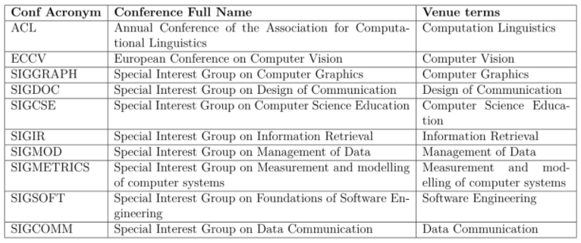
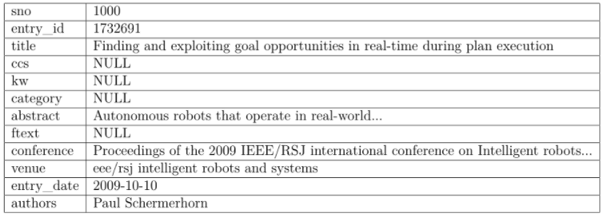
Venue Data
Conference to Venue Mapping
Format of Paper Data
Notes:
tanner

Slide 7
Ranking System Implementation
Input: a paper title and abstract
Output: a list of venues, grouped by topic, that are relevant to the paper
Chosen approach for improved ranking system:
Individual venues within each group will have their h5-index listed (number of N papers published with at least N citations in the last 5 years)
Notes:
ali

Slide 8
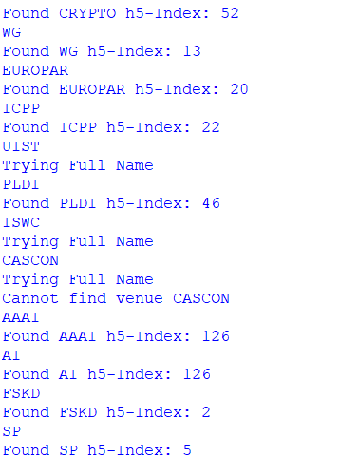
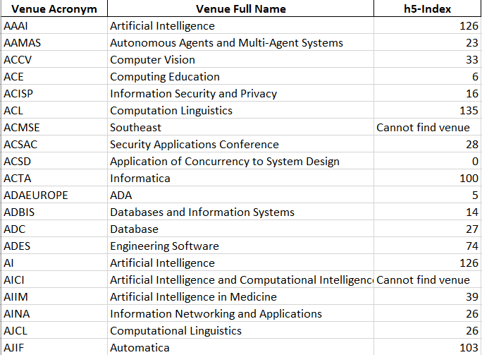
Scraping H5-Index Data
Running the scraping program
Data is stored in an Excel file
Notes:
ali

Slide 9
Flask Website Implementation
Recommender UI is currently implemented using Flask, a Python web application framework
VM reserved via VT’s Computer Science Research Virtual Machines program (CSRVM)
DNS name: authvenue.cs.vt.edu
Virtual machine specifications:
  4 cores
  x86_64 architecture
  16 GB RAM
  1 TB Disk Space
  CentOS 7
Notes:
ali

Slide 10
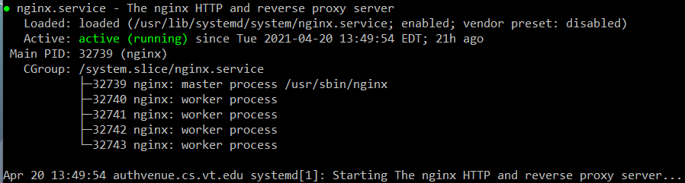
Flask Website Implementation
Web Server: NGINX
Web Server Gateway Interface: Gunicorn

Slide 11
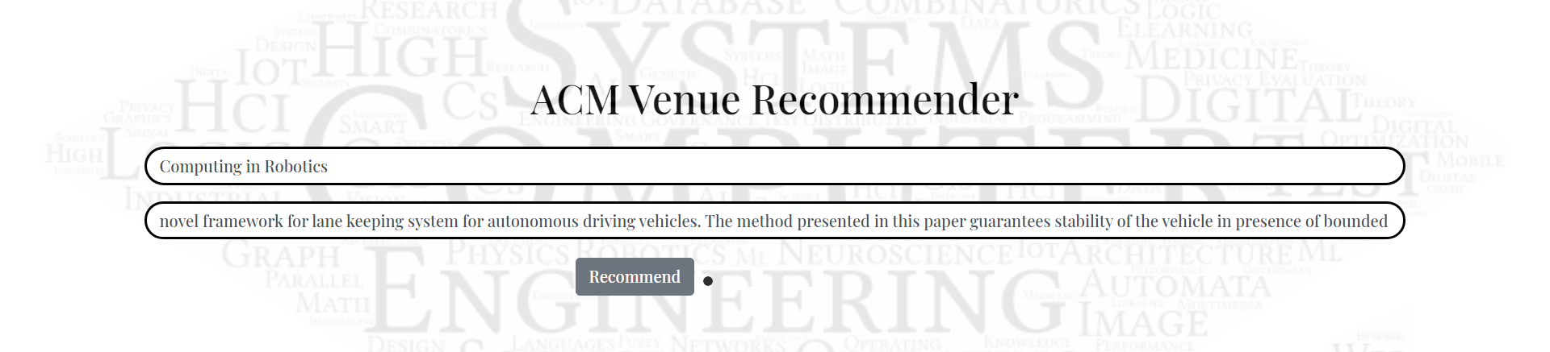
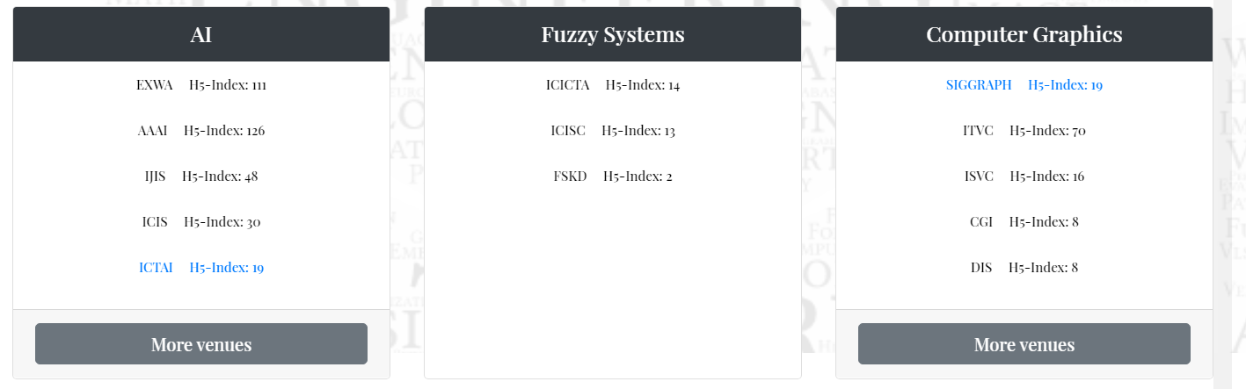
Website Layout
User inputting paper title and abstract
Results shown after running recommender
Notes:
ali

Slide 12
Testing and Assessment
Tested functionality in different web browsers on both mobile and desktop
Tested with nonsensical/irrelevant input to ensure the application does not break
Accuracy of output checked using confusion matrices
Notes:
kyle

Slide 13
Timeline Overview
January
Initial meetings and preliminary research
Initial communications with Dr. Shaffer and original problem statement
Research on possible pre-existing solutions and/or useful resources and APIs
February
Change in direction and additional client
Research found pre-existing solutions
Introduced to second client Harinni to expand upon her existing grad project
Getting data and updating our project direction
March
Initial work on models and virtual machine
Walkthrough of code with Harinni
Work on models and ranking system for the recommender
Receiving the virtual machine for hosting the web application
April
Completion of ranking system and web application
Completion of ranking system for the recommender
Development and deployment of Flask web application on the virtual machine
Final meetings with Dr. Shaffer and Harinni
Notes:
kyle

Slide 14
Lessons Learned
Had to narrow scope of project and remove plans to adjust machine learning models
New skills: Keras, NGINX, web scraping
Weekly team meetings were key in making progress
Improvements we could have made:
  Communicate with sponsors more frequently
  Designate more time towards working with machine learning models
Notes:
kyle

Slide 15
Conclusion
Recommender website is functional and provides relevant venues and their h5-indices for CS researchers looking to publish their work
Website hosted on VT virtual machine and can be easily updated or adjusted in the future
Ideas for the future:
  Improve on machine learning models like originally planned
  Add more information specific to CS education as originally suggested by our sponsor
Notes:
tanner

Slide 16
Acknowledgements
Harinni Kumar, graduate of VT’s Computer Science and Application MS program. “ACM Venue Recommendation System” thesis submitted May 2020.
Dr. Cliff Shaffer, Associate Department Head for Graduate Studies and Professor of Computer Science at Virginia Tech.
Notes:
tanner

Slide 17
References
Kumar, H. 2020 “ACM Venue Recommendation System.” Thesis for Master of Science in Computer Science and Application. May 13, 2020.
Ellingwood, Justin. “How To Serve Flask Applications with uWSGI and Nginx on CentOS 7”. Digital Ocean, March 20, 2015.
SteelKiwi Inc. “Flask vs. Django: How to Understand Whether You Need a Hammer or a Toolbox.” Medium, October 4, 2019.
Notes:
tanner

