Slide 1
Text Classification
CS5604 Information Retrieval and Storage – Spring 2016
Virginia Polytechnic Institute and State University
Blacksburg, VA
Professor: E. Fox
Presenters:
Hossameldin Shahin
Matthew Bock
Michael Cantrell
May 3rd, 2016

Slide 2
Agenda
Background
Problem Statement
Requirements and Design
Implementation Details
Evaluation
Conclusion and future work

Slide 3
Background
Classification is the process of determining which predefined class or set of classes a document can be sorted into.
In our case:
  Classes based on IDEAL project collections
  Binary classification (relevant or nonrelevant to the collection)

Slide 4
Problem Statement
For every tweet in a collection of tweets, determine the likelihood that tweet is actually relevant to the collection
Twitter hashtags do a good job of naturally filtering tweets
  Still a significant amount of spam or otherwise irrelevant tweets
Write this probability to a column in HBase for use by other teams in their systems

Slide 5
Problem Statement
@JoelOsteen: There will be storms in life but they are only temporary. Praying for our friends in
Houston and Texas. #HoustonFlood
Relevance probability: ~0.92
#houstonflood #cambodia #GetStupid Watched a video *Car insurance quotes online* GREAT!
Here: https://t.co/zChGDwQ8g9 http://t.co/nmq8Eiq8Np
Relevance probability: ~0.08

Slide 6
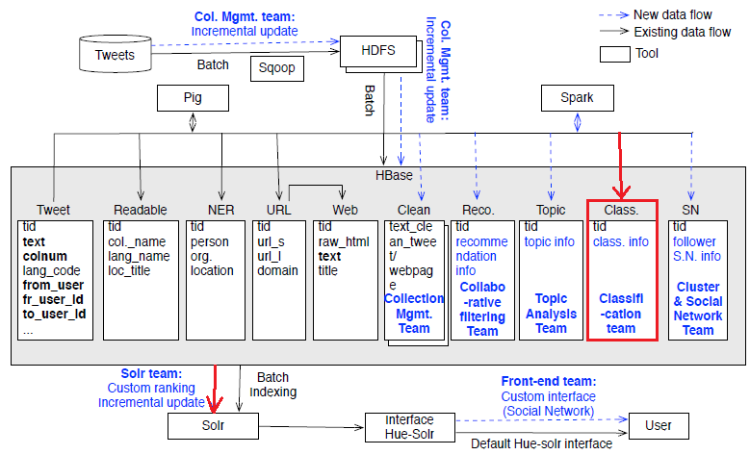
Problem Statement

Slide 7
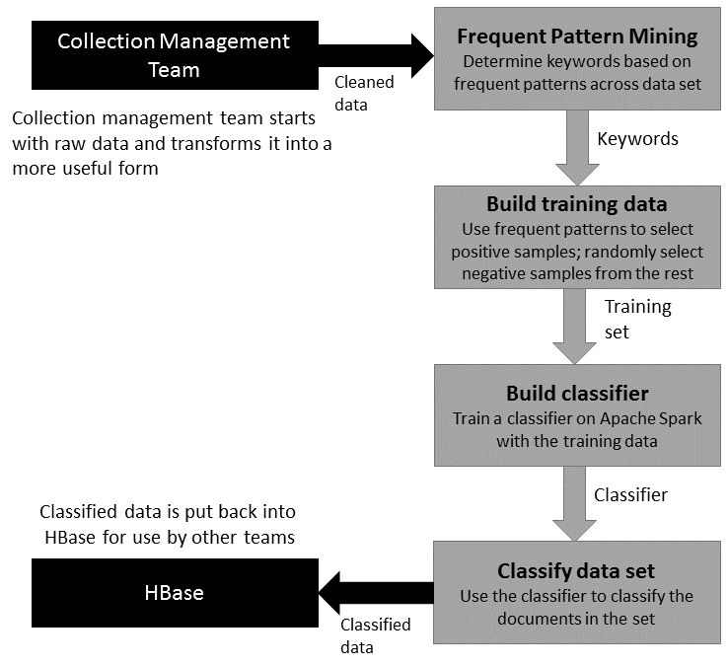
Requirements and Design
Feed cleaned text from Collection Management team into FPM process
Run tweet data through our process (described in more detail later)
Write probabilities back to Classification:Relevance column HBase for other teams to use

Slide 8
Implementation Details
Spark v1.6
  IPython notebook
  Cluster vs. VM (Thanks to IT Security Lab at VT)
Training data preparation
End-To-End workflow
Logistic regression classifier

Slide 9
Prepare Training data
To train a binary classifier we need to prepare a training data
  Manual labeling: Requires a huge work
  Semi-Automated
    Query Solr for positive data set
    Use Frequent Pattern Mining to discover frequent itemsets
  Automated: Not feasible

Slide 10
Frequent Pattern Mining
FPM is an algorithm for frequent itemset mining and association rule learning over transactional databases.
FPM has two steps:
  Identify the frequent individual items
  Extend them to larger and larger item sets as long as those item sets appear sufficiently often in the database (minimum support)

Slide 11
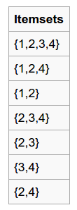
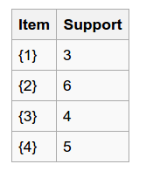
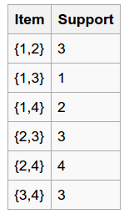

Frequent Pattern Mining (Example)
→
→
→
Minimum Support = 3

Slide 12
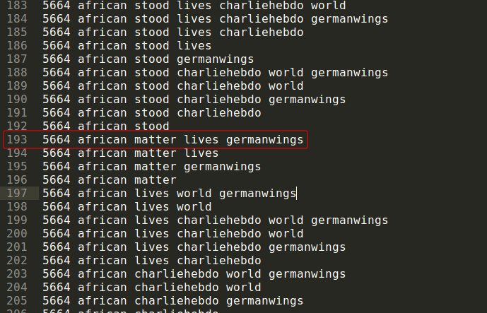
Frequent Pattern Mining (#GermanWings)

Slide 13
Workflow

Slide 14
Which Classifier to use?
How much training data do you have?
None | Manually written rules Amount of work required is huge Hand crafting rules produce high accuracy
Very little | High bias models (e.g. Naïve Bayes) Semi-supervised training methods (Boosting, EM) (Ch-16)
Reasonable | Best situation! Can use any model
Huge | The most accurate results Expensive and impractical ( SVMs train time or kNN test time) Naïve Bayes might become the best choice again!

Slide 15
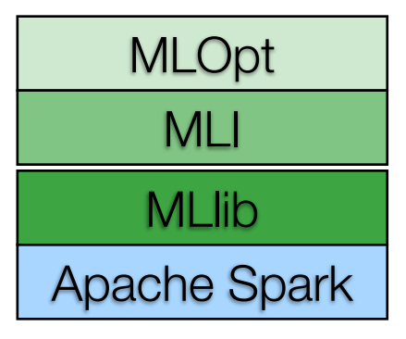
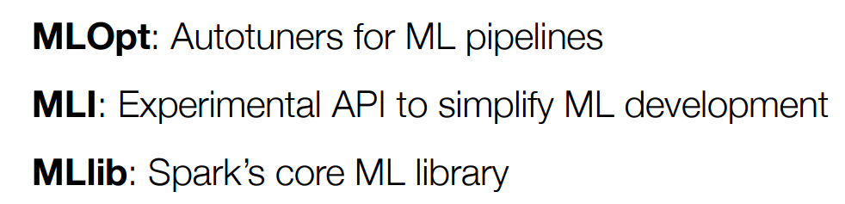
Why Logistic Regression?
Current Spark Architecture:

Slide 16
Evaluation
Constructed 7 Surveys for manual labelling
  675 tweets labelled from wdbj7shooting collection
  Ideally 3 responses per 100 tweets
16/21 responded to surveys
  All but one survey had multiple responses
  Some didn’t label all tweets on form

Slide 17
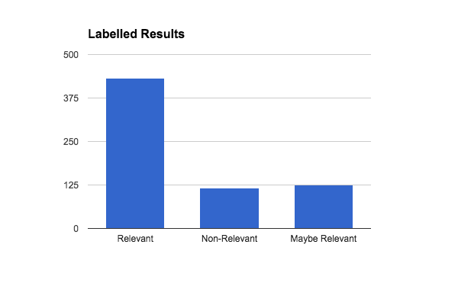
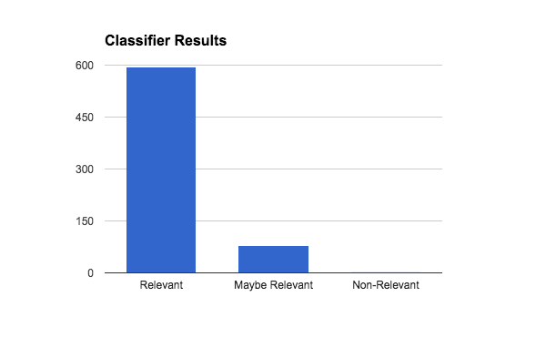
Survey Results
Classifier marks more as Relevant than labelled results
Very few marked as Non-Relevant

Slide 18
Conclusion and Future Work
Evaluation shows that classifier accuracy could be improved, but trends similarly to manually labelled results
  More structured evaluation should be performed to validate results of initial evaluation
  Relevance thresholds may need to be determined for each collection
Our design will make it easy to apply our system to other collections in the future
First priority for future work is to put more time into web page processing
  Our system should cover web pages with minimal modifications, but we have not done much testing

Slide 19
Acknowledgments
NSF grant IIS - 1319578, III: Small: Integrated Digital Event Archiving and Library (IDEAL).
Dr. Fox
GRAs
  Mohamed Magdy Farag
  Sunshin Lee
Other teams

Slide 20
Thank you!
Questions?

