Slide 1
Product Defect Mining
Grant Golden, Jack Hall, Thomas Nguyen, Tianchen Peng, Elizabeth Villaflor, Shauicheng Zhang
CS 4624: Multimedia, Hypertext, and Information Access
Virginia Polytechnic Institute and State University
Blacksburg, VA 24061
Instructor: Dr. Edward A. Fox
Client: Xuan Zhang
Spring 2017

Slide 2
Overview
Project Goal
Problems Faced
Summary of Deliverables
Lessons Learned
Acknowledgements

Slide 3
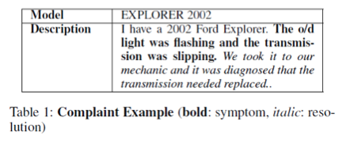
Project Goal
Use a machine learning algorithm to recognize and identify the different entities that make up a product defect review.
Notes:
If given the description, algorithm should be able to identify that the sentence in bold was a “symptom” sentence (i.e. outlines defect/issue) and the italicized sentence is a “resolution” sentence
Two more interesting aspects of the project, data collection via a web crawler and the actual machine learning/classifier training

Slide 4
Problems Faced
Agreement on label definitions
What counts as a “resolution”? What should be ignored?
Finding forums with a sufficient number of unique posts (at least 1000 desired)
Finding forums that included solutions for most of the posts
Lack of previous experience with machine learning/classifier training

Slide 5
Summary of Deliverables
Collected Datasets:
Apple Community: 10,942 records
  MacBook Air, MacBook Pro, iTunes
Dell Alienware: 22,726 records
Samsung: 12,000+ records
Asus
  Still being crawled, number of collected records unknown
  Around 1 million available

Slide 6
Summary of Deliverables (cont.)
Labeled Datasets and Scripts
  Scripts: split records into single sentences, count number of labeled records, calculate percentage of matching labels between two datasets
  Dataset labels are within 90% matching between two people
Classifier Training Script
Linear SVC Algorithm

Slide 7
Classifier Training Result Summary
Precision: 75-80%
Recall: 75-80%
F1-Score: 70-75%
Classes with fewer sentences performed worse
Statistics were generally lower when predicting “resolution” sentences, since there were fewer present in the labeled dataset

Slide 8
Lessons Learned
Quantity over quality
Resolutions don’t necessarily need to be correct
The more data available, the better the classifier results
Previous experience helpful
A lot of time dedicated to research, took away from actual classifier training

Slide 9
Acknowledgements
Thanks to Xuan Zhang for all of his patience, support, and willingness to teach throughout this semester.

