Slide 1
Social Interactome Recommender Team Final Presentation
Sarah Devlin, Mary Kwiatkowski, Bridget Larcher,
Timothy Tran, Matt Blumen, Wilson Rhodes
CS 4624: Multimedia, Hypertext, and Information Access
Virginia Tech, Blacksburg, VA 24061
May 2, 2017

Slide 2

Overview
Social Interactome
Project Deliverables
Two Methods
  Top-Down
  Diffusion
Lessons Learned
Friendica Logo
Notes:
Social Interactome: research project that examines how social networks can be used to help substance abusers recover from their addiction.
The goal of the project was to evaluate friendships and the homophily-based measures that two recovery buddies have in common and see how it contributes to their relationship.

Slide 3
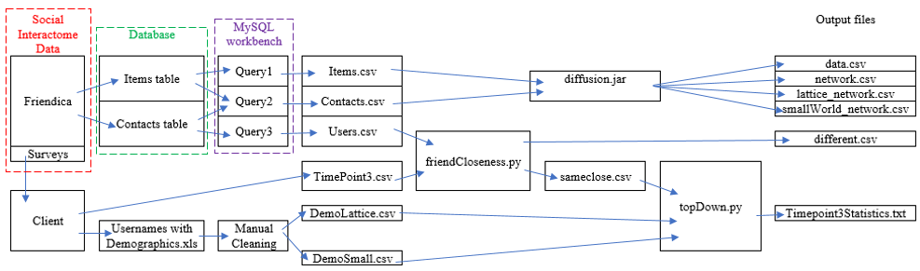
Dataflow Diagram
Notes:
As you can see from the diagram, we had two different sources of information that were used in our code.
The information collected from Experiment 1 Replicate 2 was stored in a database we could query, and there were also a number of surveys that were taken separately from which we could access from our Client.
These surveys required manual cleaning, mostly due to some formatting issues, as well as automated cleaning for the accuracy of user input.
The TopDown method relied on the completion of automated cleaning, but the diffusion code relied solely on clean data from the database and required no additional cleaning.
This allowed us to divide and conquer the two methods to produce the output as efficiently as possible.

Slide 4
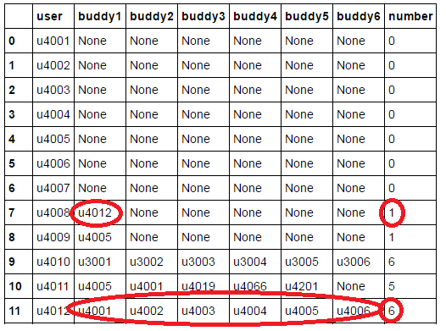
Data Cleaning
1536 total buddy pairs
  900 correctly reported buddies
  288 incorrectly reported buddies
  approx 348 non-answers
5 very close, 50 somewhat close
Sample Data from ‘different’ cleaning Dataframe
Notes:
At the start of the study, users filled out a survey, asking to report their 6 assigned buddies. In order to help make top-down analysis more accurate we needed to check and clean this survey data.
We compared the survey buddy results with the actual buddies assigned in the database. From this we were able find 288 incorrectly listed buddies. This allowed us to ignore the data from users that were proven to be inaccurate. We noticed some trends in the incorrect data, for example users were more likely to report 5 or 6 incorrect buddies than just one or two. This trend can be seen in the sample data shown to the right.
The survey also asked the users to enter the “closeness” they felt toward their six buddies on a scale of not close, somewhat close, and very close. Based on the cleaning of the data we narrowed down all the entries to only 5 very close and 50 somewhat close pairs.

Slide 5
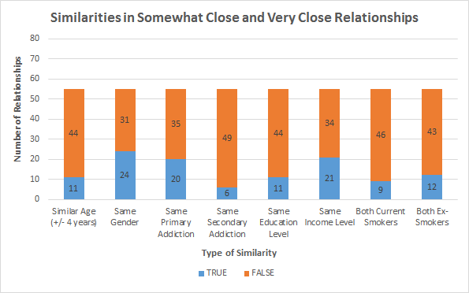
Top-Down
The Demographic Similarities Compared to the Total Number of Close Users in both Networks
Notes:
After Mary cleaned the data, it was given to me to work on what we called the topDown approach. Using the data, I looked at users who identified recovery buddies as “somewhat close” or “very close”. Among these relationships, I compared the users’ demographic information looking for trends.
We expected more strong trends or clear similarities between users, but some false data we got made that difficult. The number of somewhat and very close relationships was also pretty low, making it difficult to do anything with a sample size this small.
We also didn’t implement ordinality in this comparison, for example someone in the lowest income bracket and the second lowest are considered not similar in the same way that someone in the lowest income bracket and the highest income bracket would also not be considered the same. In the future we want users that are closer on the income spectrum to be viewed as more similar to each other.

Slide 6
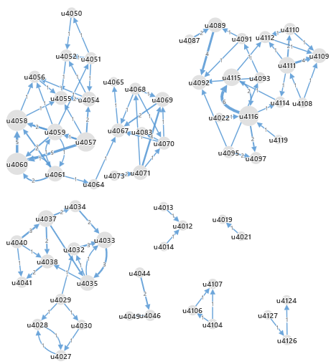
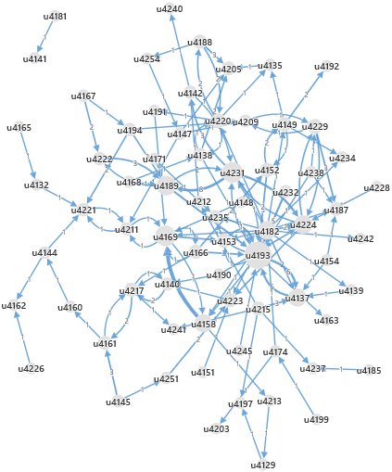
Diffusion
Diffusion network diagram - Lattice Organization Diffusion network diagram - Small World organization
Notes:
Diffusion, in the context of our project, is the spread of activity from one user to another. We measured the number of times each user participated in the same activity after one of their recovery buddies had.
You can see these relationships in the network diagrams shown here, where the size of the node varies depending upon the amount of diffusion that user experiences. You can identify the users that have the most impact on their buddies’ participation in friendica.
It was really interesting to see how one activity in particular could diffuse through a group of buddies. Its also interesting to see how the diffusion mimics the structure of the network.
In Lattice, users are connected with many overlapping friends, which can be seen by many of these little diffusion networks.
In Small world, users are connected so that the net distance from one friend to another is minimized, which you can see from the large interconnected network.

Slide 7
Lessons Learned
Changing of goals and requirements require additional communication
Team size can be a disadvantage without structured roles
Being provided with some false data meant cleaning and working with limited data
Notes:
There were 3 major lessons we learned from problems we encountered over the course of our project:
Problem: One problem that we ran into was that our requirements changed over the course of the semester. We were originally going to extend a previous team’s friend-recommending algorithm, but as needs changed, we shifted to more of an analysis role. From there, we focused on our top-down and diffusion methods to evaluate friendships using homophily-based measures.
Solution: Since our requirements changed so much, we met with our client, Prashant, very often towards the end of the semester.
Problem: The size of our team was another drawback. This had to do with communication, scheduling meetings, and delegation of work. It was also difficult for us to all meet at once and maintain focus.
Solution: We learned to delegate work based on our team members’ capabilities and schedules making use of frequent communication and doodle polls. With more organized structure of roles and clearer communication, we overcame our initial work stagnation.
Problem: We had access to little applicable data: a single survey with self-reporting, and only 256 participants. We were provided with some data that we could not use because the participants entered false information. This may have been because portions of the experiment were incentivised. Some of the entries were missing and some survey participants disregarded instructions and put unrelated data.
Solution: We wrote code to clean and remove false data. As Mary mentioned, approximately one fourth of our data was incorrect and had to be removed. Of the remaining records, only 55 suited our needs and had self-reported friendships.

Slide 8
Acknowledgements
Citations
Client: Prashant Chandrasekar
Professor: Dr. Edward A. Fox
Social Interactome Team
Grant: National Institute of Health #1R01DA039456-01
https://github.com/tttran/SIFriendRecommender
https://github.com/friendica/friendica/tree/develop/images
https://vtechworks.lib.vt.edu/handle/10919/70956

