Slide 1
Knowledge Graph Service Registration
By Daniel Olsen and Daniel Weedon
CS 4624 Multimedia, Hypertext, and Information Access
Professor Edward A. Fox
Virginia Tech, Blacksburg VA, 24061
April 22, 2021

Slide 2
Outline
What is a Knowledge Graph?
Project Description
Knowledge Graph Backend
Python API
Backend Challenges
Front-end Visualization
Front-end Goal
Front-end Challenges
Acknowledgements/References

Slide 3
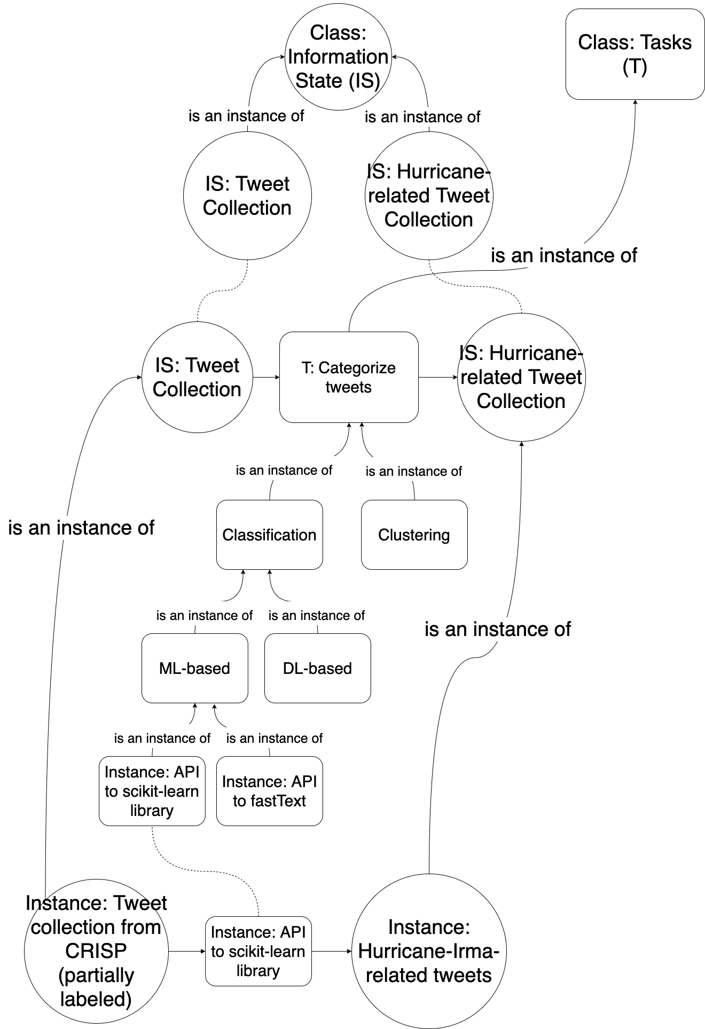
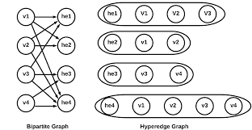
What is a Knowledge Graph?
Graph based data model
Visualizes entities and their connects to each other
Can use hyperedges
  Many entities connected with 1 edge
  Not 1 to 1
N. Imam, S. M. S. Hasan, and R. Kannan, “A Scalable Parallel Hypergraph Generator (HyGen),” http://www.mlgworkshop.org/, 2020. [Online]. Available: http://www.mlgworkshop.org/2020/papers/MLG2020_paper_5.pdf. [Accessed: 28-Apr-2021].

Slide 4
Project Description
This project was a two-component project with the goal of building a Knowledge Graph database that represents how user information goals are connected to one another.
This Knowledge Graph is connected to a workflow management system that allows developers to register their services and visualize the graph.

Slide 5

Knowledge Graph Backend
The knowledge graph database was built using Grakn
Grakn is a tool used to build knowledge graphs through Entity-Relationship (ER) models and can utilize:
Type hierarchies
Hyper-relations (hyper-edges)

Slide 6
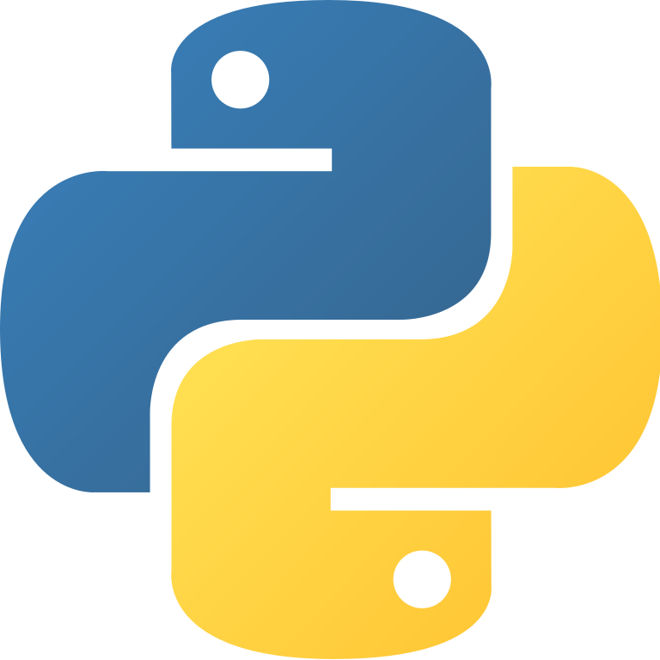
Python API
A Python API was made using Flask 1.1.2 and is used to communicate with the database. A client can use this API to to access the knowledge graph and manipulate data within through numerous operations:
Create and remove files (nodes)
Create and remove tasks (edges)
Search for files/tasks/both based on multiple attributes
Find the path between 2 nodes

Slide 7
Backend Challenges
Learning Grakn (and Grakl)
Developing an efficient schema
Learning Flask
API Remake

Slide 8
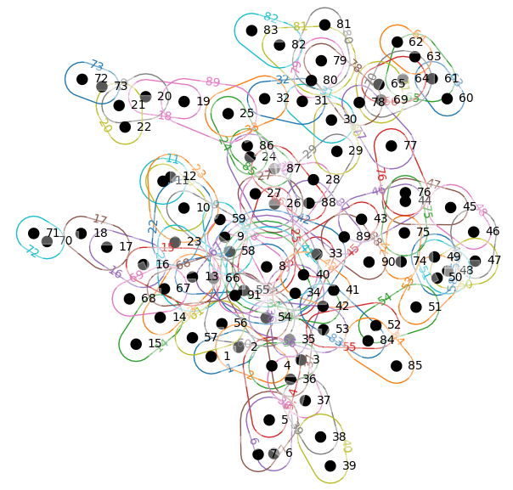
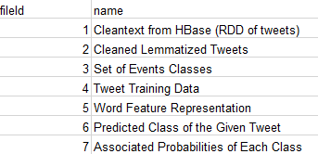
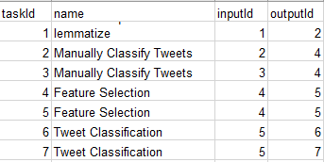
Front-end Visualization
HyperNetX library
Representation
  Nodes = Files
  Edges = Service/Task
  Combined = Workflow
Figure 2: Node data
Figure 3: Part of Edges data
Figure 1: Entire “Rubber-band” hypergraph w/sample data

Slide 9
Front-end Goals
This part of the project is meant to give developers a way to view the knowledge graph and provide them the ability to add their containerized service to the knowledge graph.
Visualize the Knowledge Graph
Connect to backend via Python API
Integrate with prior work
Service Registration form (Another VT student’s project)

Slide 10

Front-end Challenges
Attempting to use prior work
Learning React
Researching visualization methods
Finding the right library for hypergraphs
Learning HyperNetX library
Getting Python and React to work together

Slide 11
Acknowledgements/References
Acknowledgements
Prashant Chandrasekar
References/Resources
https://vtechworks.lib.vt.edu/handle/10919/19081
http://hdl.handle.net/10919/98239
https://grakn.ai/grakn-core
https://github.com/graknlabs
https://vtechworks.lib.vt.edu/handle/10919/101526
https://git.cs.vt.edu/cs-5604-fall-2020/fe/team-fe-repo/-/tree/knowledgeGraph
https://github.com/pnnl/HyperNetX

