Slide 1
A Graph Representation of the Genomes Collected in a Viral Outbreak
Michele Ambrose, Jake Fisher, Jared Hubert, Drew Pompeii, Caroline Turner
Dr. Edward Fox
CS 4624 Multimedia, Hypertext, and Information Access
Virginia Tech, Blacksburg VA, 24061, 4/29/21
Notes:
Caroline

Slide 2
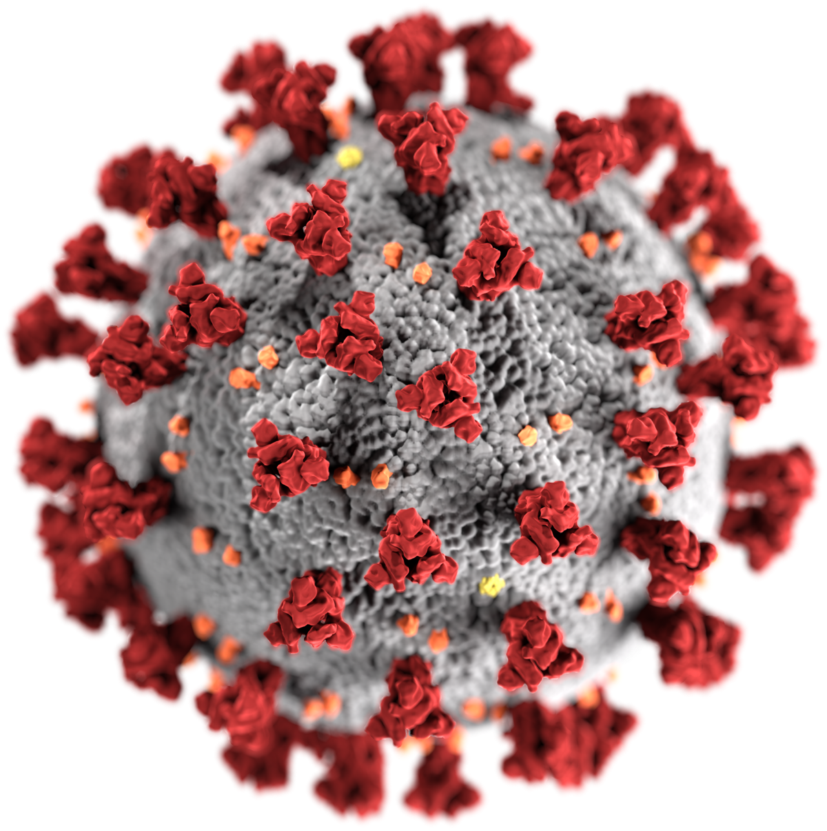
Outline:
Project Overview
User Walkthrough
Back-End Work
Genome Alignment
Challenges Overcome
Moving Forward
Acknowledgements/References
Notes:
Caroline

Slide 3
Project Overview
SARS-CoV-2 sequencing and alignment
Graph Visualization
Data Storage and Retrieval
Notes:
Caroline

Slide 4
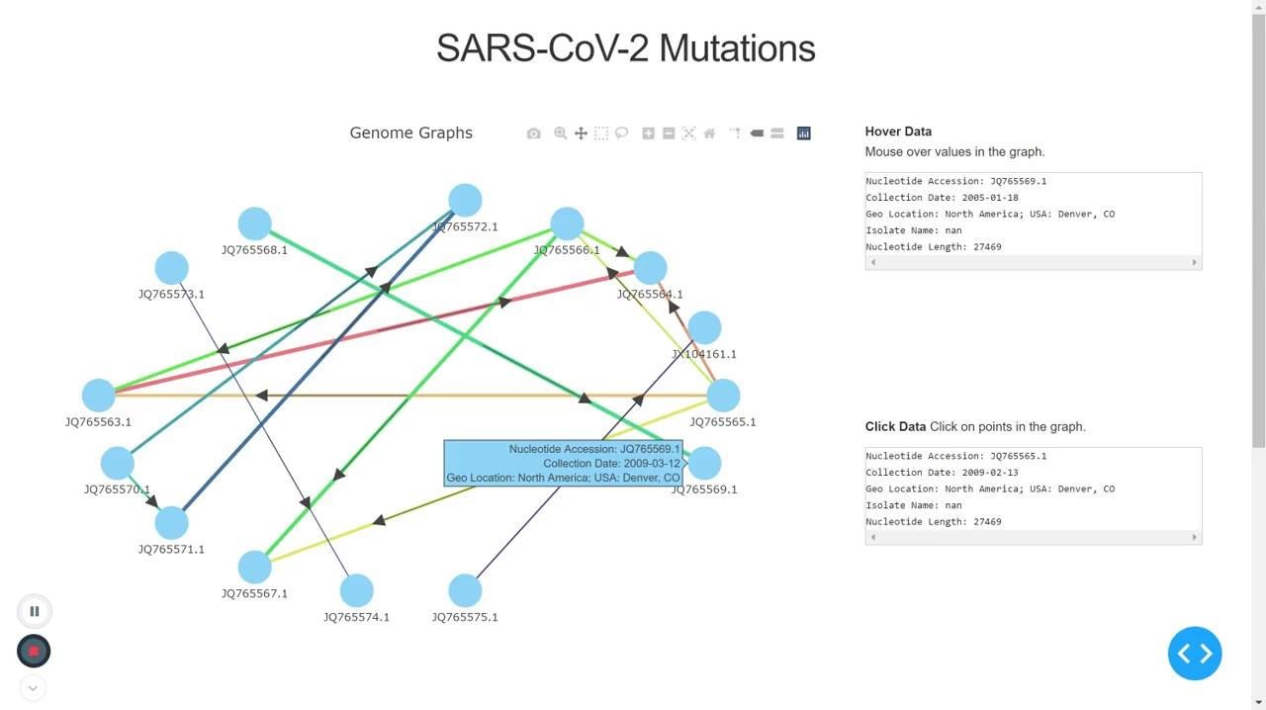
User Walkthrough - Graph Interaction
Notes:
Caroline

Slide 5
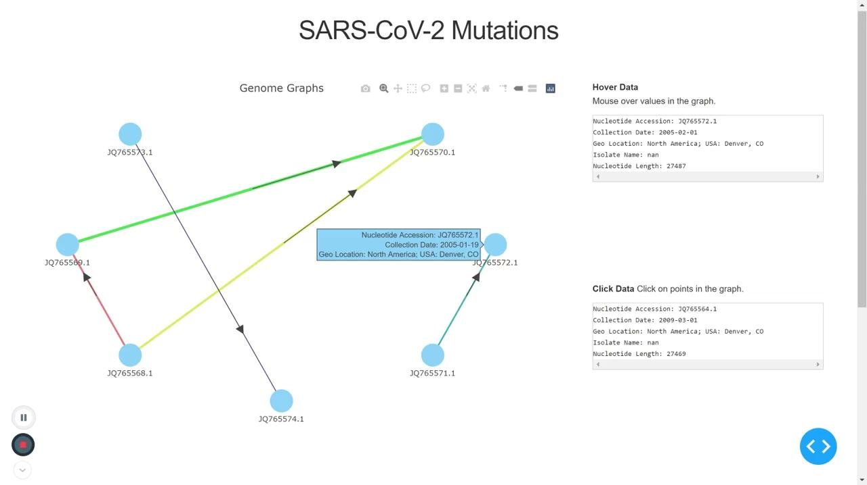
User Walkthrough - Data Manipulation
Notes:
Caroline

Slide 6
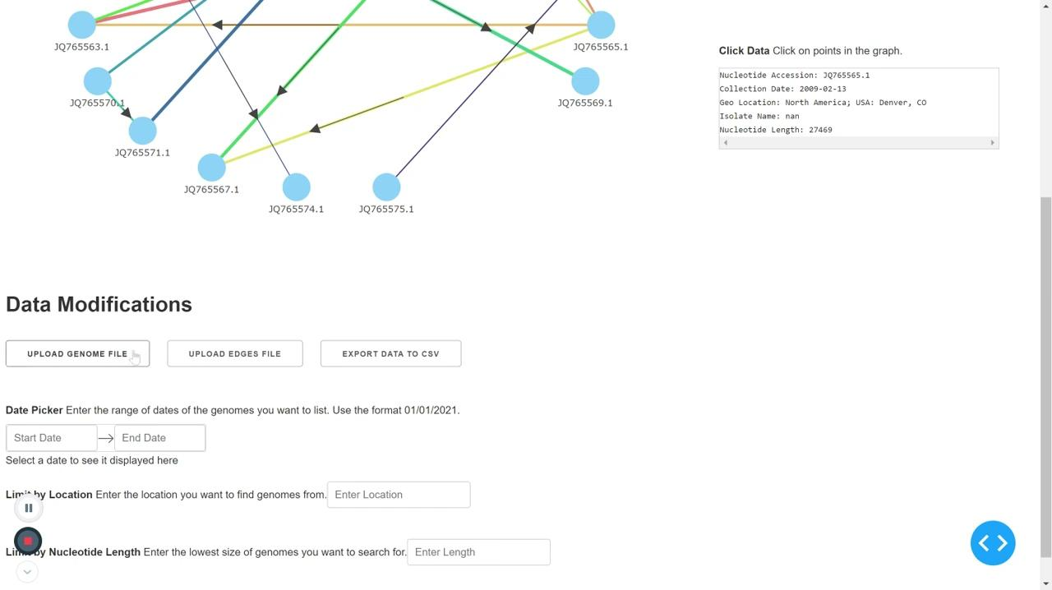
User Walkthrough - File Import/Export
Notes:
Caroline

Slide 7
Back-End Work
Parse through imported FASTA file to obtain genome names and sequences
Implementation to add, remove, search of genomes in CSV file
Able to search and obtain genome by type, name, sequence
Alignment
Parse to obtain name, sequence, etc.
Align and trim genome
Add to CSV file
FASTA File
Notes:
Drew. Should we make blue? Or leave idk

Slide 8
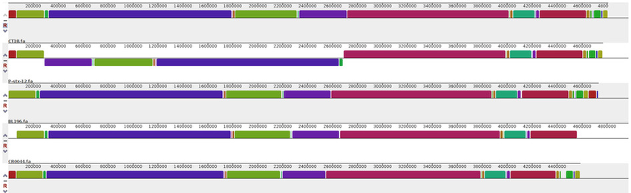
Genome Alignment
The arrangement of genome sequences to identify regions of similarity
Purpose: Aid in function prediction
  Show homology between related members
  Investigation or prediction possibilities
MUMmer4
Notes:
Drew

Slide 9


Challenges Overcome
Lack of knowledge about genomes
Learning new coding languages and APIs
Issues with working online
Notes:
Jared - Issues with online work: harder to communicate, wifi issues, screen sharing,

Slide 10
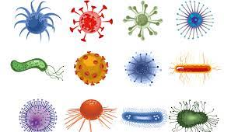
Moving Forward
Applied to different viruses and types of genomes
Auto-populate extraneous columns
  Allow for choice of data
  Multichoice menus
Increased speed of trimming and aligning
JQ3756f.1
Genome Name:
Isolate Name:
Bioproject:
PD2710
US State:
Taxonomy Number:
Notes:
Jared - Analyzing data by isolate or type of mutation could be really valuable with the spread of covid variants and their effectiveness against vaccines. Remove uploaded files or store them.
-remC
ould be really valuable with the spread of Covid variants and their effectiveness against vaccines

Slide 11

Acknowledgements References
Client: Dr. Lenwood S. Heath - Virginia Tech Computer Science Department
Resources: Python, NCBI, BLAST, MUSCLE
https://towardsdatascience.com/python-interactive-network-visualization-using-networkx-plotly-and-dash-e44749161ed7
https://labarchives.kayako.com/Knowledgebase/Article/View/407
https://imb.uq.edu.au/article/2020/04/difference-between-bacteria-and-viruses
https://en.wikipedia.org/wiki/Pandas_(software)
https://rapids.ai/plotly.html
Notes:
Jared

