Slide 1
Information Storage and Retrieval(CS 5604)
Collaborative Filtering
4/28/2016
Tianyi Li, Pranav Nakate, Ziqian Song
Department of Computer Science
Blacksburg, Virginia – 24061
Dr. Edward A. Fox
Virginia Tech
Notes:
We are collaborative filtering TEAM, you can also call us recommendation team. I am ziqian,....

Slide 2
Agenda
Role and goal
User-based recommendation
  Recommendation process
  Algorithm
  Implementation
Item-based recommendation
  Overview
  Algorithms and Implementation
Build Process
Notes:
Here is our outline for today. We will first briefly talked about our team’s role and goal. Then our two main method of recommendation, user-based rec and item based rec. At the end, we will talk about our buid process.

Slide 3
Project goal
Our project is to serve the Integrated Digital Event Archiving and Library (IDEAL) project.
IDEAL project provides services for searching, browsing, analysing, and visualization of over 1 billion tweets and over 65 million webpages.
Building a recommendation system and recommending tweets and webpages to assist users searching and browsing the IDEAL collection.
  User-based recommendation
  Item-based recommendation
Notes:
The goal our project is to serve the Ideal project. Ideal projects provide services for searching, browsing,analysing, visualization for a huge amount of tweets and webpages. The work of our team will be recommending tweets and webpages to the users who are searching and browsing the ideal data collection. In order to accomplish this task, we will be using two main methods. User-based recommendation and item-based recommendation.

Slide 4
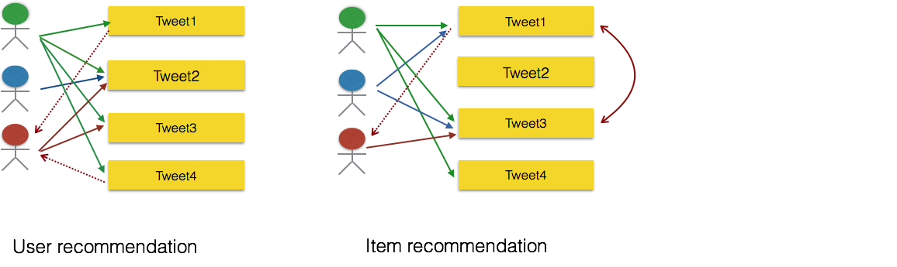
User-based recommendation vs. Item-based recommendation
Clicking history
User-item matrix determining relationships between user and item.
Content similarity
Build an item-item matrix determining relationships between pairs of items.
Notes:
Using tweets as an example I want to explain the two types of recommendation
For user-based recommendation, we are considering the user’s preference. In our project, we use clicking history to indicate the user’s preference. In the figure, each solid arrow show the users clicking history, dot arrow shows our recommendation. Based on clicking history, we can build a user-item matrix to determine relationships between user and items, then recommend item to user. If you look at the figure, user green click the tweet 1 2 3 4, user red click tweet2 and 3, so in user recommendation we may think user red also will like tweet1 and 4 because other user click them together.
For Item-based recommendation, we only look at content similarity between tweets/webpages and build a item to item matrix. For example, if we know the the content of tweet 1 and 3 are very similar from our item-item matrix. When user red clicked tweets 3 , we will recommend tweet1 to user red because the content are similar.

Slide 5
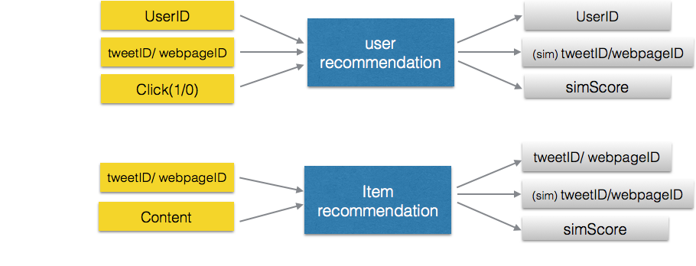
Data requirement
Notes:
This figure shows the input and output data of both recommendation system.
For user recommendation, we have three data input, userID, tweet or webpageID, click or not, indicate by 1/0. The output of our recommender is userID, similar tweets or webpages, and similar score.
However, for item recommendation, our input is tweet or webpageID and the content of the tweets or webpages. Our output is tweet or webpage id, similar tweet/ webpage, similar score.

Slide 6
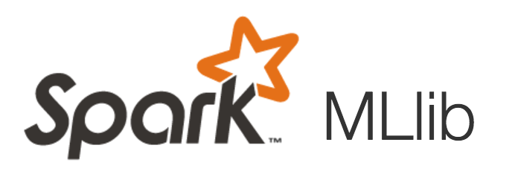

User-based recommendation
val data = sc.textFile("fakeUser.data")
val ratings = data.map(_.split(',') match { case Array(user, item, rate) => Rating(user.toInt, item.toInt, rate.toDouble)})
// Build the recommendation model using ALS
val rank = 10
val numIterations = 10
val model = ALS.train(ratings, rank, numIterations, 0.01)
val productuser=model.recommendProductsForUsers(3).collect()
Notes:
Here comes the section of user recommendation.
We are using spark Machine learning Llibrary and ALS(alternating least squares) algorithm to do our user recommendation.
Our input data is fake user data. We generate the random user data by ourselves. In a format that is same as the previous slides.
After we load the data into hdfs, we create a new RDD, process user data to a format that is required by ALS,
Then, train the model using ALS and make recommendation.
we define the number of latent variable, number of iterations, and our confidence baseline when we train the model. We make prediction of the top 3 tweets that user may like.
This is a flow of user-recommendation process. Tianyi will introduce more details about the algorithm and design.
we create a new RDD(resilient distributed dataset).// Which is required by spark.
recommendProductsForUsers: build in function for als
Latent Variable: variables

Slide 7
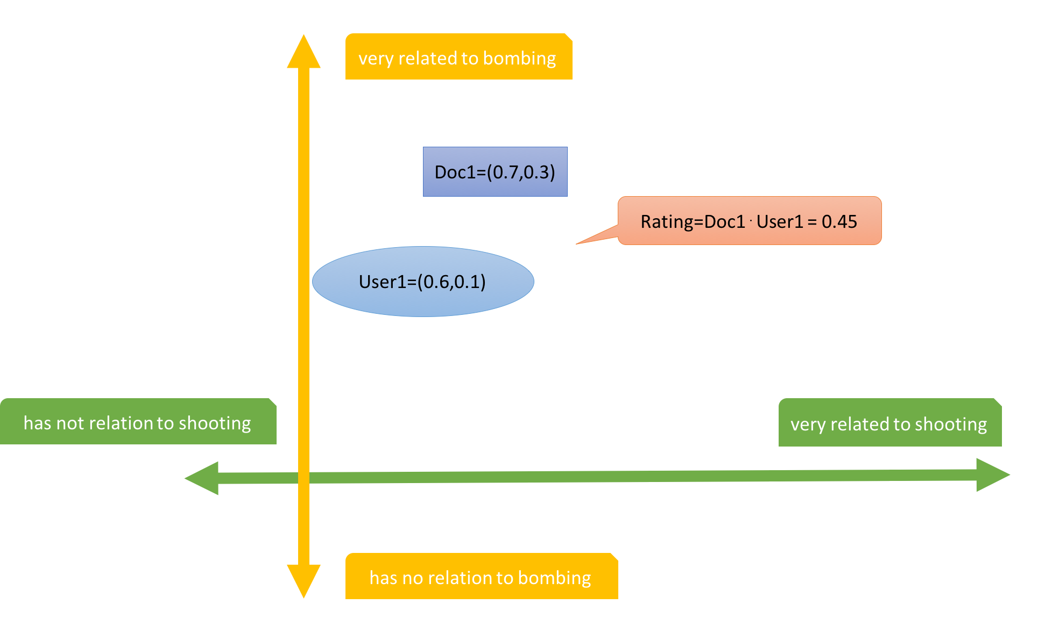
Algorithm: Recommendation strategy
Neighborhood methods
Latent factor models
Notes:
Thank you Ziqian. The two primary areas of collaborative filtering are the neighborhood methods and latent factor models. We used latent factor models for this project. This strategy tries to explain the ratings by characterizing both items and users on a number of factors inferred from the ratings patterns. For our our project, our factors are all the collection topics. Here is a example showing an example for a two-dimensional factor space, bombing and shooting. For a given document we rate how it relates to a certain collection topic; for a given user, we rate how much he or she is interested in this topic. The rating of this document for this user is thus the dot product of the document vector and user vector. We can compute ratings of multiple documents for one or more users through matrix multiplication.

Slide 8
Algorithm: Matrix factorization
ALS (alternating least squares)
  Parallelization
  Implicit data
Notes:
In reality, our factor vectors will be drawn from high dimensional space depending on the number of topics we have. The matrix will be in high dimension too. Some of the most successful realizations of latent factor models are based on matrix factorization. We used the ALS algorithm from Spark, which means alternating least squares. We won’t go through the math details here, here are two advantages of it:parallelization (because the computation are independent) and good performance for systems centered on implicit data

Slide 9
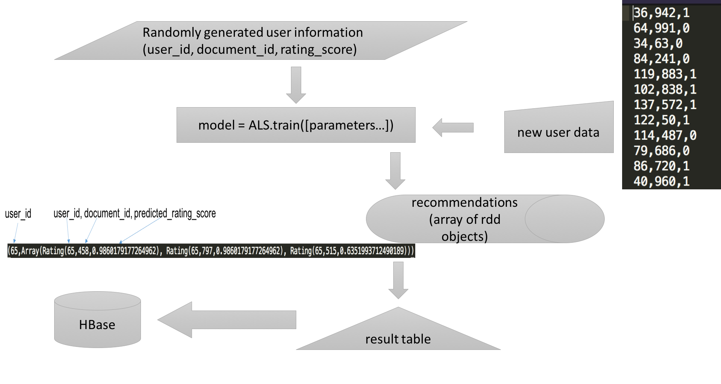
Implementation
Notes:
Now let me briefly talk about our implementation. We randomly generated some user information, and trained a model with them using ALS training function. When new user data come in, we put the data into the model and get recommendations for the new users. Since the raw output of the system is arrays of resilient distributed dataset, we also need to convert the data format before upload them into HBase. This is our user-based recommendation. I will now hand over to Pranav, and he will talk about our item-based recommendation.

Slide 10
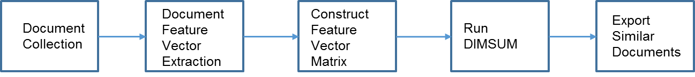
Item-based recommendations
Recommendations based on the text of the documents
Useful for retrieving related documents
System Pipeline

Slide 11
Implementation details
Document preprocessing - Word lemmatization
Feature extraction and transformation using TF-IDF method
Repartitioning the RDD to increase parallelization
DIMSUM algorithm by Twitter!
Results collection and post-processing
Configuration parameters for spark job - Similarity threshold (DIMSUM), spark executor memory, shuffle memory size
Notes:
The threshold parameter is a trade-off knob between estimate quality and computational cost.
Setting a threshold of 0 guarantees deterministic correct results, but comes at exactly the same cost as the brute-force approach. Setting the threshold to positive values incurs strictly less computational cost than the brute-force approach, however the similarities computed will be estimates.
The sampling guarantees relative-error correctness for those pairs of columns that have similarity greater than the given similarity threshold.

Slide 12
Build process
Code compilation
JAR file creation
SBT script
Spark-submit
Evaluation - Mean squared error (MSE)

Slide 13
Acknowledgement
We want to thank Dr. Fox and our GRAs Mohamed Magdy Farag and Sunshin Lee for guiding and advising us.
Also grateful for the effort by Front-end and Solr team to communicate and provide the data we needed to implement the system.
We thank the whole class for discussing the problems and learning about information retrieval together.
NSF grant IIS - 1319578, III: Small: Integrated Digital Event Archiving and Library (IDEAL).

Slide 14
Thank you!
Q&A

