Slide 1

In the Highways and the Hedges
Library Support for OER Adoption Efforts at Higher Education Institutions
Across Virginia
Anita Walz, Tara Cassidy, and Olivia Reinauer
Charleston Library Conference, Charleston, SC Nov 6, 2015

Slide 2
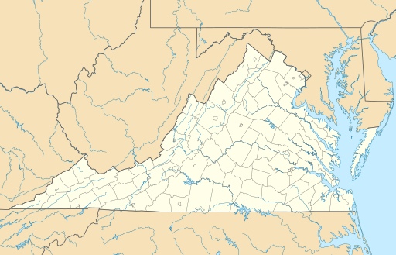
Presenters
Anita Walz
Open Education, Copyright, and Scholarly Communications Librarian
Virginia Tech
Tara Cassidy
Coordinator of Library Services
Virginia's Community Colleges
Olivia Reinauer
Reference Librarian
Tidewater Community College
“USA Virginia Location Map” by Alexrk2 is licensed CC BY 3.0

Slide 3

What are Open Educational Resources?
Image: Public Domain

Slide 4
Open Educational Resources are:
Teaching, learning, and research resources...
http://www.hewlett.org/programs/education/open-educational-resources

Slide 5
Open Educational Resources include:
Full courses, course materials, modules, textbooks, streaming videos, tests, software, and any other tools, materials, or techniques used to support access to knowledge.
http://www.hewlett.org/programs/education/open-educational-resources
Notes:
Not just textbooks.
Electronic, print, born digital or have license applied after the fact by their copyright owner.

Slide 6
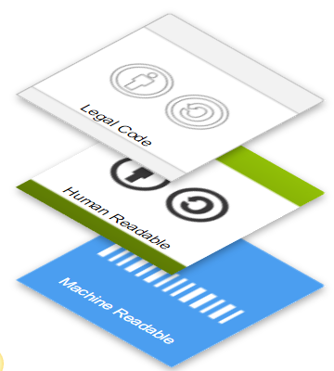
Open Educational Resources
. . . reside in the public domain or have been released under an intellectual property license that permits their free use and re-purposing by others.
http://www.hewlett.org/programs/education/open-educational-resources
CC BY http://creativecommons.org/licenses/

Slide 7
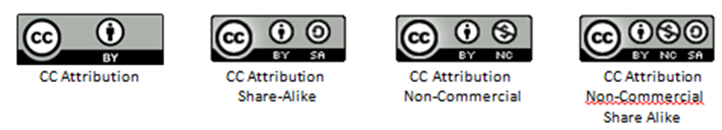
Most popular licensing scheme: Creative Commons
Copying / distributing materials with CC licenses
always requires attribution and
allows anyone to remix and redistribute a work
http://www.creativecommons.org/licenses
https://wiki.creativecommons.org/wiki/Best_practices_for_attribution

Slide 8
Like Open Access publications, OER are:
Gratis (nominal cost for print)
Libre (5 Rs: Retain, Reuse,
Revise, Remix, Redistribute)
Wiley, David (2014) CC BY http://opencontent.org/blog/archives/3221
Notes:
“Openly licensed” is more than “free online.”
“Open Access” confusion.

Slide 9


Slide 10

Has the cost of required textbooks caused you to:
63.6% Not purchase the required textbook
49.2% Take fewer courses
45.1% Not register for a specific course
33.9% Earn a poor grade
26.7% Drop a course
17.0% Fail a course
© Creative Stall, PK “Unknown Book” CC-BY

Slide 11
Impacts of costs & Opportunities
Student learning & academic achievement
Student retention
Student debt
AND leveraging innovative licensing and enabling new approaches for teaching & learning

Slide 12


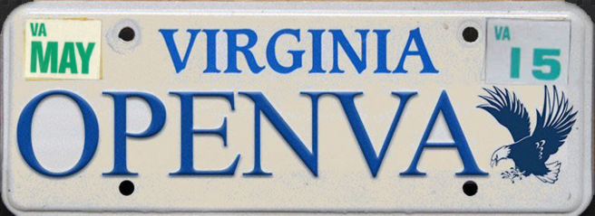

Virginia Higher Education Open Ed initiatives
2010 - Nine courses (School of Business) Core curriculum
2011 - Chancellor’s Retreat idea - Entire Assoc of Science in Business (22 courses)
2013 - “Z-Degree” Implemented
2013 & fwd - Virginia’s Summit on Open & Digital Learning
&
2014
Zx23 VCCS
2015 - Expanding the “Z-Degree” across 15+ VCCS Colleges (100+ courses)
Logos are the property of their respective institutions.
Notes:
In the fall of 2013, Tidewater Community College took an unprecedented step:
Inspired by a presentation at a retreat organized by Dr. Glenn DuBois, chancellor of the Virginia Community College System, Tidewater piloted an entire business degree using open-educational resources (OER). We call it the Z-Degree – z for “zero textbooks.” Not only business courses are included, but also all of the general education courses a student needs to complete the academic program.
Z Degree is the nation's first textbook-free degree, an Associate of Science degree in Business Adminsitration available through Tidewater Community College.
• There are No textbook costs
• All course content is openly licensed
• Courses are offered at all campus locations

Slide 13
Institution-specific OER initiatives underway
Raising Awareness, plus:
Notes:
In addition to “awareness raising” …

Slide 14



Institution-specific OER initiatives underway
2015 - Virginia Tech - offers workshops and stipends for open textbook review
2015 - Virginia Tech - revision & update of openly licensed textbook underway
2015 - “Provost’s Creative Adaptation Fund” - Swem Library & Dept. of Academic Tech
18 projects $1,000 each -- Teaching with OER & library-subscribed resources
2015 - Virginia Community College System launches Zx23 Project
Logos are the property of their respective institutions.
Notes:
In addition to “awareness raising” …

Slide 15
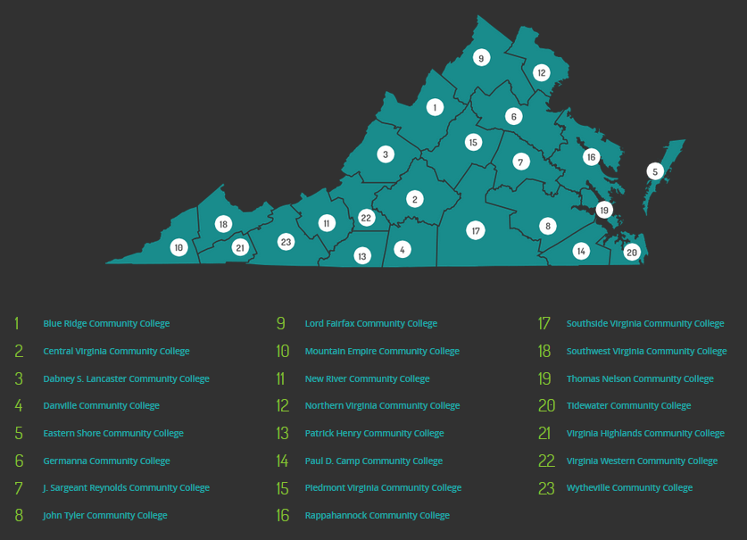


+
+
= Zx23 Project
Image credit
Logos are the property of their respective institutions.
Notes:
Map image credit: Virginia's Community Colleges. Find a Virginia Community College screenshot. Retrieved Nov 04, 2015, from http://www.vccs.edu/about/where-we-are/college-locator/
VCCS EdTech Blog: Zx23 Grantees - http://edtech.vccs.edu/oer/z-x-23-project/zx23-grantees/

Slide 16


Building a supportive, flexible, cross-institutional librarians+ training community
Intro to OER Workshops
Networking
Listservs & awareness
Peer Groups (virtual & real)
Resource sharing (events)
Collaboration beyond librarians
Encouraging librarians+ to:
Explore
Collaborate
Learn
Teach
Leverage workflows & skills
Lead
Public Domain image
Logos are the property of their respective institutions.

Slide 17
Rationale, risks, and rewards for the librarian as OER consultant, trainer, and advocate

Slide 18
Complementary Values
Access
Privacy
Democracy
Social Responsibility
Professionalism
Public Good
ALA Core Values
Diversity
Service
Preservation
Intellectual Freedom
Education/Lifelong Learning

Slide 19

Skillset & Infrastructure
Navigating Copyright
Searching
Metadata
Evaluating
Relationships
Publishing Knowledge
Technology
Public domain image

Slide 20

Risks
“Storm on the horizon” by the_tahoe_guy is licensed CC BY 2.0
Notes:
More work? Staffing, training, budget; threat to subscription/collection investment; legal; more momentum toward digital; “OER blinders”

Slide 21

Opportunities
Image: CC0
Notes:
Altruistic - knowledge sharing, supporting student learning, fits with open access; High visibility, demonstrate value; networking/partnerships; solve the textbook issue; curriculum involvement

Slide 22

Growing Pains
© James Keuning "Headache” CC BY 3.0
Notes:
"Headache" by Noun Project user James Keuning, US used under Creative Commons Public Domain license.

Slide 23

Some assembly required
Culture change
Uneven infrastructure
What does open mean?
© Emily van den Heever "Alert” CC BY 3.0
Notes:
"Alert" by Noun Project user Emily van den Heever, US under Creative Commons Attribution 3.0 license.

Slide 24


Silos, silos, everywhere
Communication
Workload & processes
Quality OER
© icon 54 “Silo Storage,” Sarah Tan “silo,” David Waschbüsch “silo,” Lance Weisser “Data,” “Data,” CC BY 3.0
Notes:
“Silo Storage” by Noun Project user icon 54, used under Creative Commons Attribution 3.0 license.
“silo” by Noun Project user Sarah Tan, US used under Creative Commons Attribution 3.0 license.
“silo” by Noun Project user David Waschbüsch, DE used under Creative Commons Attribution 3.0 license.
“Data” by Noun Project user Lance Weisser, US used under Creative Commons Attribution 3.0 license.
“Data” by Noun Project user Lance Weisser, US used under Creative Commons Attribution 3.0 license.

Slide 25

Overcoming our training
Copyright, right?
Citing v. attribution
Unlearning the tendency not to share
© Rodrigo De Araujo E Silva "Judo Instructor” CC BY 3.0
Notes:
"Judo Instructor" by Noun Project user Rodrigo De Araujo E Silva, AU used under Creative Commons Attribution 3.0 license.

Slide 26

Successes
2-yr ‘Z’ proliferation
Tech integration
Enthusiasm and buy-in
© Jon Prepeluh "team" CC BY 3.0
Notes:
"Team" by Noun Project user Jon Prepeluh, DE used under Creative Commons Attribution 3.0 license.

Slide 27

Student benefits
Tidewater is beginning to see data on Z-Degree outcomes
Savings
Satisfaction
Success
© mathieu dedebant "students" CC BY 3.0
'Z-Degree Program Successes'
Notes:
Tidewater Community College 'Z-Degree Program Successes'
"students" by Noun Project user mathieu dedebant used under Creative Commons Attribution 3.0 license.

Slide 28

New networks & collaborations
Textbook affordability
Cross-institutional conversations
Interest from libraries of all types
© Wilson Joseph "HR" CC BY 3.0
Notes:
"HR" by Noun Project user Wilson Joseph, used under Creative Commons Attribution 3.0 license.

Slide 29

Librarian OER Leaders
Building expertise
Support & training
Developing policy
© Wilson Joseph "people" CC BY 3.0
SCHEV Open Virginia Advisory Committee and Library Advisory Committee
Notes:
SCHEV Open Virginia Advisory Committee and Library Advisory Committee
"people" by Noun Project user Wilson Joseph, US used under Creative Commons Attribution 3.0 license.

Slide 30





What seems to be working?
CC0 image
Image: CC0
“Excitement ”by Alexandre Normand is CC BY 2.0
“Leadership” by Pedro Ribeiro Simoes is CC BY 2.0
Image: CC0

Slide 31

Questions & Discussion
Tara Cassidy: tcassidy@vccs.edu
Olivia Reinauer: oreinauer@tcc.edu
Anita Walz: arwalz@vt.edu
Image source
Notes:
Please see conference paper (posted in Charleston Conference archive in December) for additional detail, or contact any of the presenters.

