Slide 1
Adult Day Video Assessment
Christopher Beemsterboer, Tyler Zebina
CS4624 - Multimedia Hypertext, and Information Access
Dr. Edward Fox
Virginia Tech
Blacksburg VA, 24061
May 19, 2019

Slide 2
Outline
Testing and Assessment
Deliverables
Accomplishments
Lessons Learned
Ideas for the Future
Acknowledgements

Slide 3
Testing and Assessment
We met with our client to test and assess our video footage. We asked the following assessment questions to receive feedback on our work.
How is the video quality?
Is the video cropped well?
How is the audio quality?
Is the voice of the interviewer audible?
Our client was satisfied overall, but suggested we crop the frame for two of the interviews. We used this feedback and cropped the footage in the final version.

Slide 4
Deliverables
ADS_Video_Assessment.iso
All_Assessments.MOV, Geriatric_Depression_Scale.MOV’, Mini_Mental_Status.MOV, Life_Satisfaction.MOV, Quality_Of_Life.MOV, and Montreal_Cognitive.MOV
Developer_Manual.pdf
We are delivering a full quality Blu-Ray .iso file, each of the raw .MOV files of the assessments, and a developers manual. The developers manual will explain how to use the video, as well as provide instructions related to video player and codec compatibility.

Slide 5
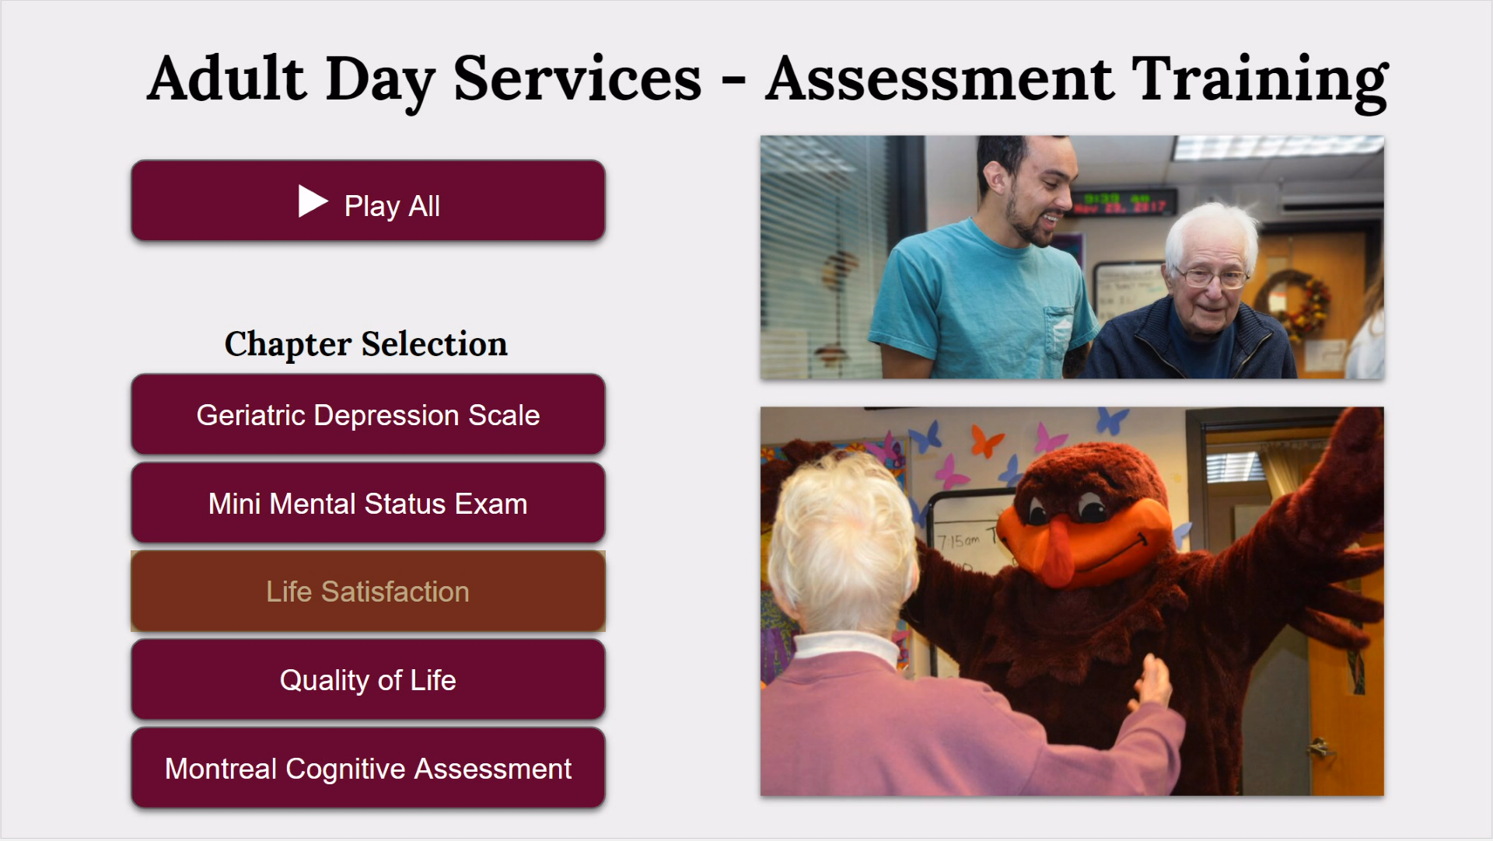
Menu System

Slide 6
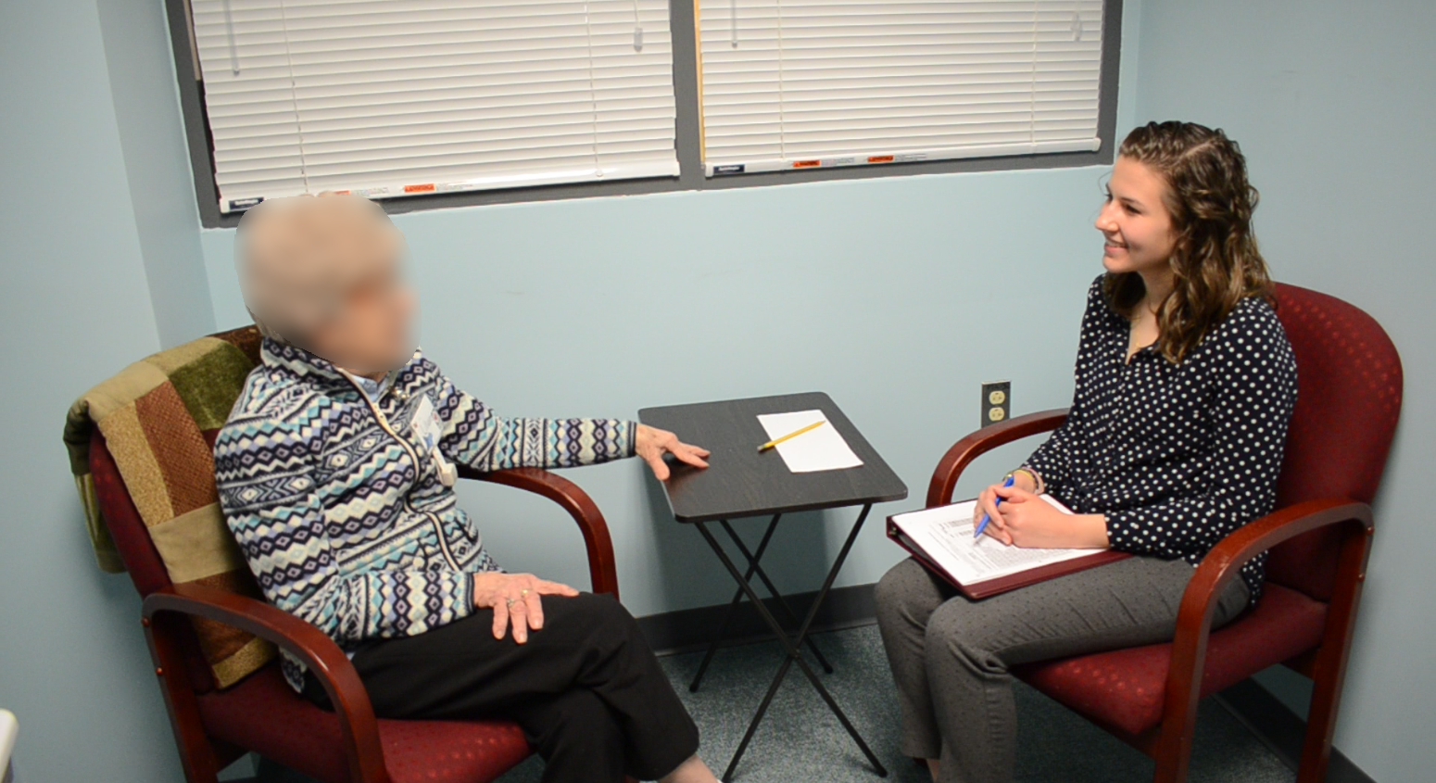
Video

Slide 7
Accomplishments
Creating a menu system that delivers a smooth UI to allow for easy navigation between each assessment video.
Collected video footage with good lighting that focuses on the interviewer.
Collected audio with minimal feedback that is easy to listen to.
Captured the exact atmosphere that our client asked for.
Edited and clipped flies focused on the medium of delivery (file size, file type).
Utilized professional level software (Adobe Encore, Photoshop, and Premiere) in an effort to deliver the best product.
Learned about Adult Day Services.
Collaborated with a great organization and met a lot of wonderful people.

Slide 8
Lessons Learned
Built-in camera audio is not sufficient for recording a high-quality video of an interview. We decided on using a standalone microphone before our first recording session.
We attempted to use free and simple DVD menu system creation software, but quickly realized that most do not support high-quality video. We used Adobe Encore to keep the resolution at 1080p and gain the ability to export the project to many different formats.
We learned that it was more efficient to utilize our own equipment rather than renting from the library to increase availability and allow for more flexible recording schedules.

Slide 9
Ideas for the Future
An idea we had for the future would be to make a complete training tool for all current and future ADS employees not just focused on the five interview assessments.
Training Application
Training Website
Quizzes to test acquired knowledge

Slide 10
Acknowledgements
Ila Schepisi, Advanced Instructor, Adult Day Services
schepisi@vt.edu
Sara Amos, Memory Masterclass Instructor, Adult Day Services
sara17@vt.edu
Adult Day Services
102 Wallace Hall 295 West Campus Drive Blacksburg, VA 24061, USA

