Slide 1
Sterile Neutrino Searches
Jonathan Link
Center for Neutrino Physics, Virginia Tech
Frontiers of Liquid Scintillator Technology
March 18, 2016

Slide 2
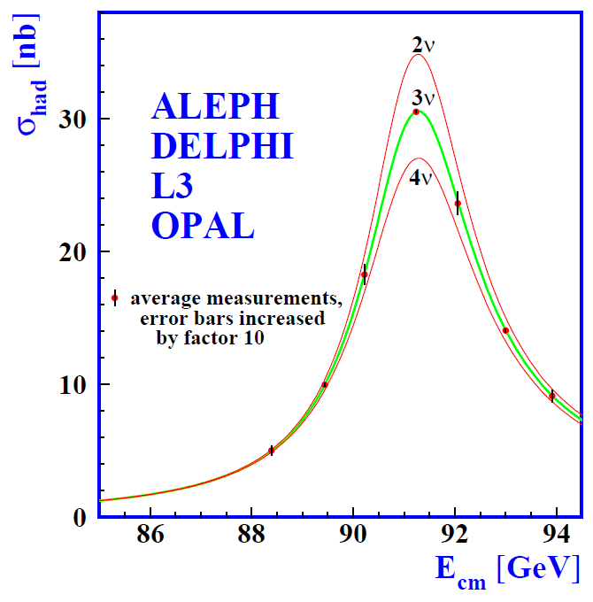
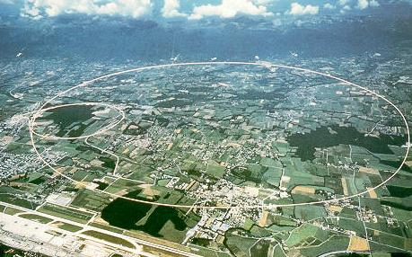
Sterile Neutrinos
A sterile neutrino is a lepton with no ordinary electroweak interaction except those induced by mixing.
Active neutrinos:
LEP Invisible Z⁰ Width is consistent with only three light active neutrinos
Phys.Rept. 427, 257 (2006)
Notes:
Sterile neutrinos are present in most extensions of the standard model and in principle can have any mass. Very heavy sterile neutrinos are used in the minimal type I seesaw model and play a pivotal role in leptogensis.
Of course this is not the sterile neutrino we’re talking about here. Such a heavy sterile neutrino would not mix with the light active flavors. Somewhat more complex models can be constructed to include sterile neutrinos.

Slide 3
Sterile Neutrinos
Three neutrinos allow only 2 independent Δm² scales.
A sterile neutrino is a lepton with no ordinary electroweak interaction except those induced by mixing.
ν₄
ν₃
Atmospheric
Δm₂²
Sterile
mass²
Δm₃²
ν₂
Solar
ν₁
Δm₁²
mass²
ν₃
Atmospheric
But the sterile Δm² is at a completely different scales.
Δm₂²
ν₂
Solar
ν₁
Δm₁²

Slide 4
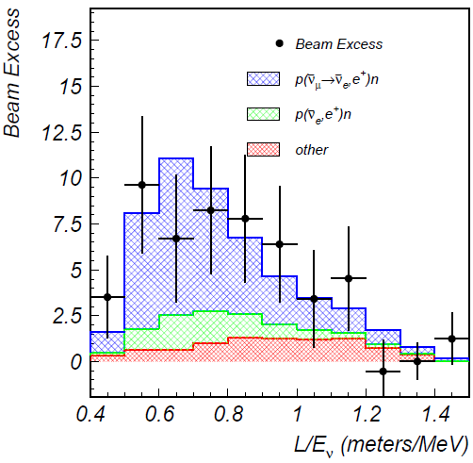
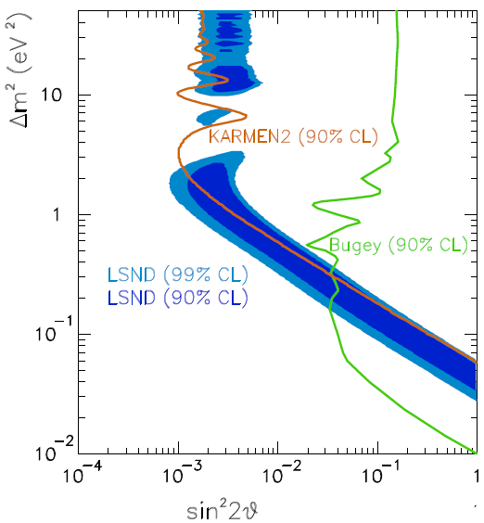
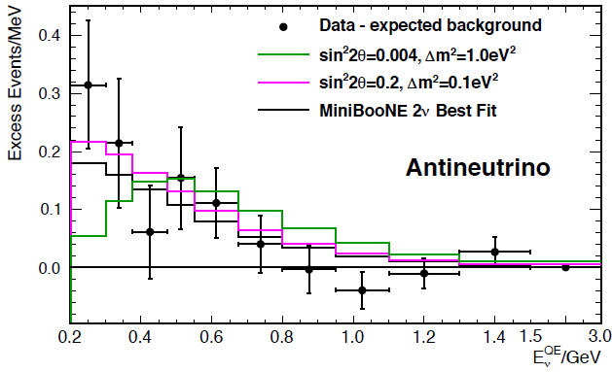
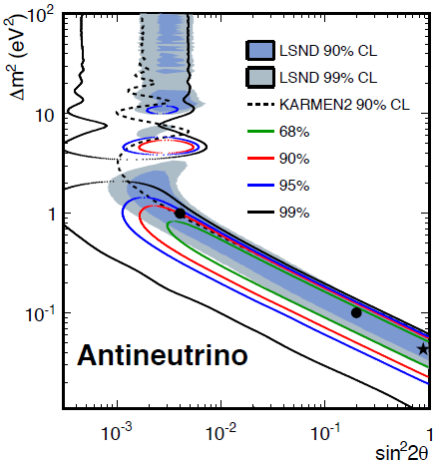
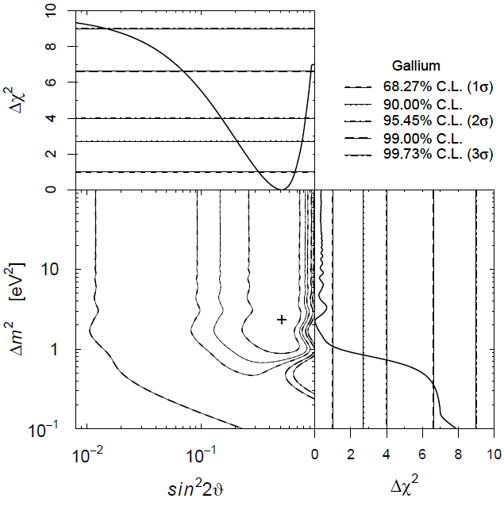
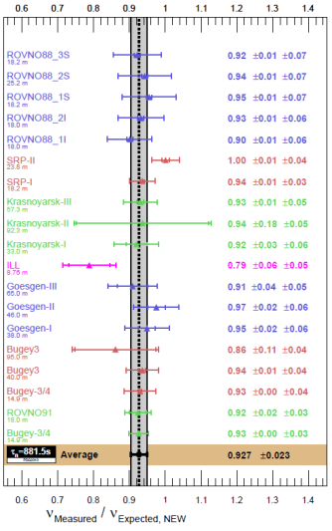
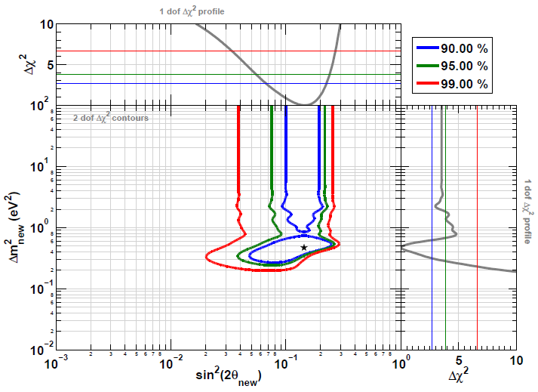
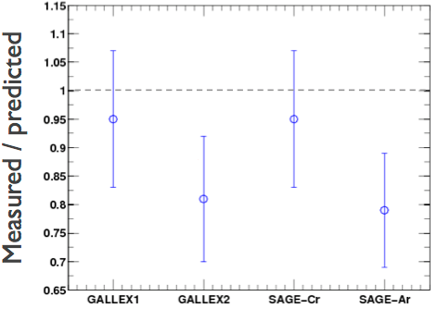




The Evidence for Sterile Neutrinos
LSND (${\overline{ν}}_{μ}→{\overline{ν}}_{e}$)
MiniBooNE (${\overline{ν}}_{μ}→{\overline{ν}}_{e}$)
Event Excess:
32.2 ± 9.4 ± 2.3
Event Excess: 78.4 ± 28.5
Aguilar-Arevalo et al., Phys.Rev.D64, 112007 (2001)
Aguilar-Arevalo et al., Phys.Rev.Lett. 110, 161801 (2013)
Gallium Anomaly ($ν_{e} Disappearance$)
Reactor Anomaly (${\overline{ν}}_{e}$ Disappearance)
Giunti and Laveder, Phys.Rev.C83, 065504(2011)
Mention et al., Phys.Rev.D83 073006 (2011)

Slide 5
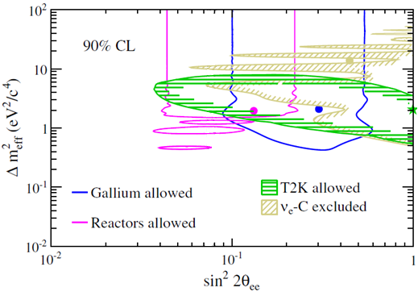
T2K Near Detector ν_{e} Disappearance
Although the T2K beam is predominantly a ν_{μ} beam, the small ν_{e} component can be used in the near detector for a ν_{e} disappearance search.
Phys.Rev. D91, 051102(R) (2015)
T2K actually reported this as a limit, but their limit was weaker than expected and their result is completely consistent with the prevailing ν_{e} disappearance anomalies.

Slide 6
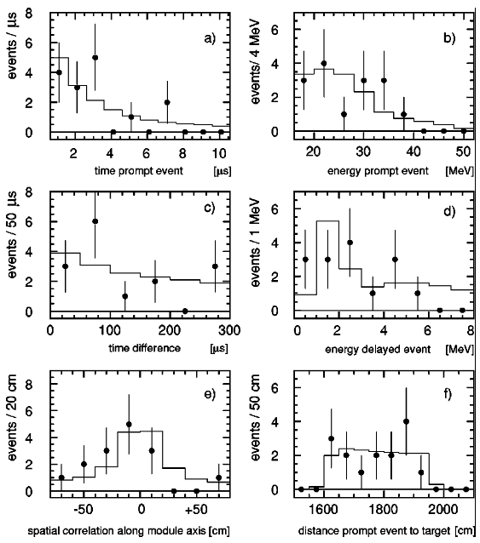
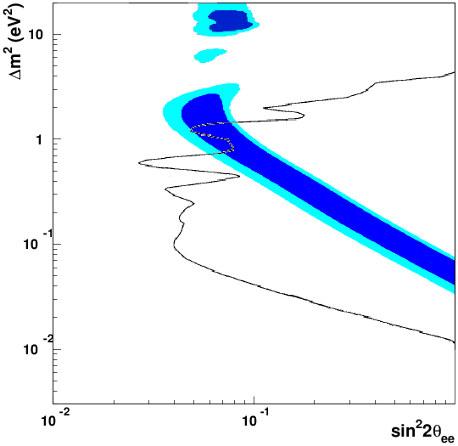
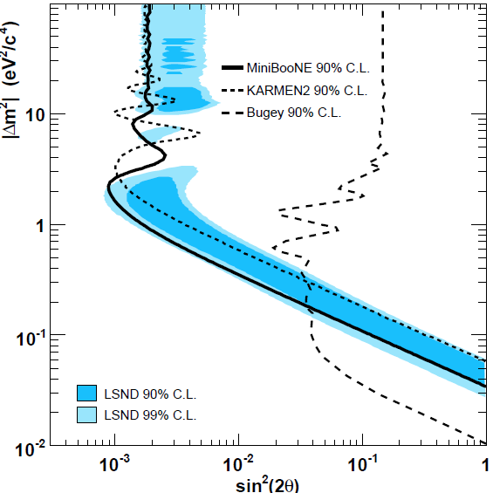

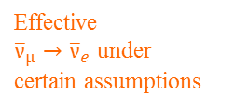
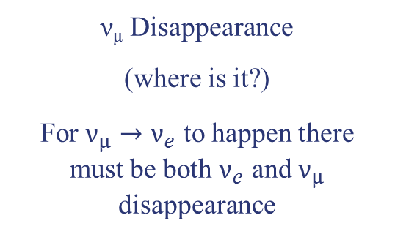


Evidence Against the ~1 eV² Sterile Neutrino
KARMEN (${\overline{ν}}_{μ}→{\overline{ν}}_{e}$)
Bugey Reactor (${\overline{ν}}_{e}$ Disappearance)
KARMEN (90% CL)
Effective
${\overline{ν}}_{μ}→{\overline{ν}}_{e}$ under
certain assumptions
No ${\overline{ν}}_{e}$ Excess
Armbruster et al., Phys.Rev.D65 112001 (2002)
Achkar et al., Nucl.Phys.B434, 503 (1995)
MiniBooNE (ν_{μ} → ν_{e} Appearance)
ν_{μ} Disappearance
(where is it?)
For $ν_{μ}→ν_{e}$ to happen there must be both $ν_{e}$ and $ν_{μ}$ disappearance
Phys.Rev.Lett. 98, 231801 (2007)

Slide 7




Relating Appearance and Disappearance Probabilities
With a single sterile neutrino we get a 4×4 PMNS mixing matrix and 3 independent Δm²s.
m₄
U_{e4}²
U_{μ4}²
U_{τ4}²
U_{s4}²
+ + + = 1 (PMNS Unitarty)
The appearance probability (ν_{μ}→ν_{e}):
Sterile
$$∆m_{43}^{2}$$
P_{μe} =
sin²2θ
sin²(1.27Δm₄₃²L/E)
4U_{e4}² U_{μ4}²
The ν_{e} disappearance probability:
m₃
P_{ee} = P_{es} + P_{eμ} + P_{eτ}
P_{ee} ≈ P_{es}
= 4U_{e4}² U_{s4}² sin²(1.27Δm₄₃²L/E)
Atmospheric
The ν_{μ} disappearance probability:
$$∆m_{32}^{2}$$
m₂
Solar
P_{μμ} ≈ 4U_{μ4}² U_{s4}² sin²(1.27Δm₄₃²L/E)
m₁
$$∆m_{21}^{2}$$
Notes:
Because P(mu, e) depends on both U(e,4) and U(mu,4), you can have nu_e disappearance without nu_e appearance, but you can’t have nu_e appearance without nu_mu disappearance.

Slide 8
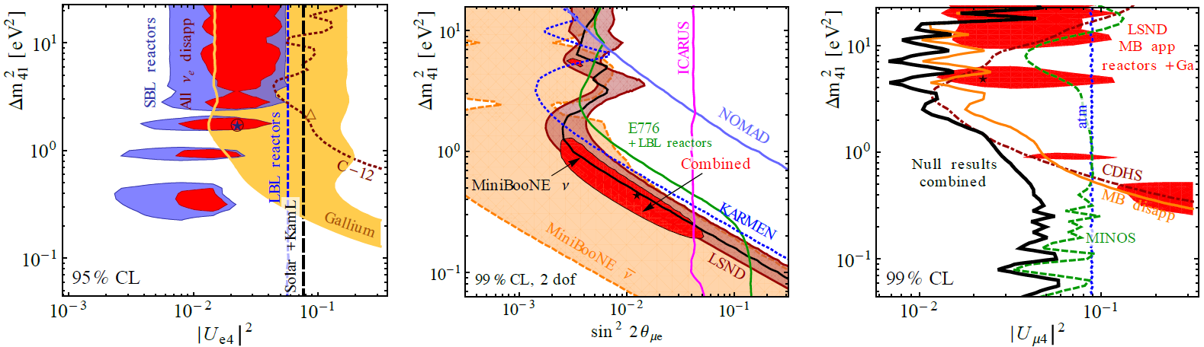

Appearance vs. Disappearance
Since any 4th mass state is predominantly sterile (U_{s4} ≈1),
$$P_{μe}≈\frac{1}{4}{ P}_{ee}×P_{μμ} \text{or} \text{sin}\text{2}\text{θ}\text{μ}\text{e} \text{= }\frac{1}{4} \text{sin}\text{2}\text{θ}\text{ee} \text{sin}\text{2}\text{θ}\text{μμ}$$
Since P_{μe} depends on both U_{e4} and U_{μ4}, you can have ν_{e} disappearance without ν_{e} appearance, but you can’t have ν_{e} appearance without ν_{μ} disappearance.
The absence of ν_{μ} disappearance is a huge problem for the LSND and MiniBooNE signals, while the ν_{e} disappearance anomalies are consistent with all existing data.
ν_{e} Disappearance ν_{μ}→ν_{e} Appearance ν_{μ} Disappearance
Global fit from Kopp et al. JHEP 1305, 050 (2013)

Slide 9
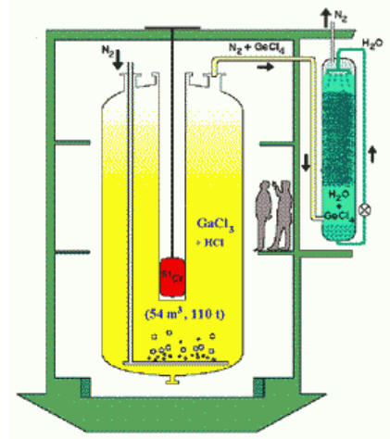
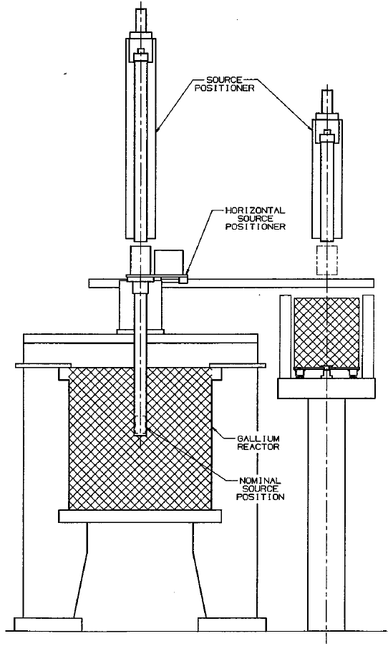
The GALLEX and SAGE Source Experiments
The solar radiochemical detectors GALLEX and SAGE used intense EC sources (⁵¹Cr and ³⁷Ar) to calibrate the ν_{e} detection efficiency.
GALLEX Sources: 1.7 MCi of ⁵¹Cr
1.8 MCi of ⁵¹Cr
SAGE Sources: 680 kCi of ⁵¹Cr
409 kCi of ³⁷Ar
Neutrinos interact in the CC process, ν_{e}+⁷¹Ga→⁷¹Ge, and are detected by the decay of ⁷¹Ge.

Slide 10
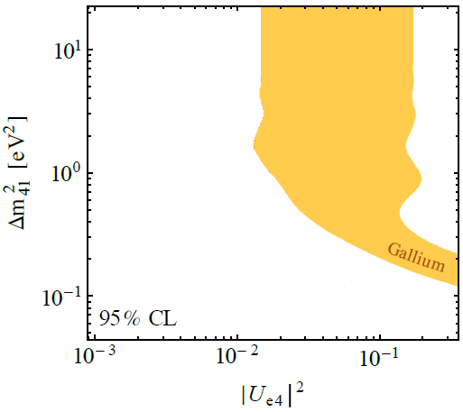
The Gallium Anomaly
New calculations of the Ga-ν_{e} cross section suggest that the observed rates in GALLEX and SAGE are low. This may be explained as oscillations.
Phys.Rev.C83, 065504 (2011)
Kopp, Machado, Maltoni and Schwetz, JHEP 1305, 051 (2013) 1303.3011 [hep-ph]
PLB 420, 114 (1998)
PRC 73, 045805 (2006)
PLB 342, 440 (1995)
PRL 77, 4708 (1996)
Average ratio of measurement to predicted
R=0.86±0.05
Or even worse (better?)
R=0.76 .
(Bahcall)
(Haxton)
+0.09
−0.08

Slide 11
Ideas for Short-Baseline Source Experiments
There are lots of ideas for short-baseline radioactive source experiments. Most use detectors designed (and funded) to do other physics.
Generally these proposals require excellent low energy sensitivity. IsoDAR may be the best candidate for WbLS.
Source Experiment Proposals | Source | Detector
LENS-Sterile (Phys.Rev.D 75, 093006, 2007) | ⁵¹Cr | LENS (Solar)
Zoned Radio-chemical (arXiv:1006.2103 [nucl-ex], 2010) | ⁵¹Cr | SAGE (Solar)
CeLAND (Phys.Rev.Lett. 107, 201801, 2011) | ¹⁴⁴Ce | KamLAND (Reactor)
Neutral Current Coherent (Phys.Rev.D 85, 013009, 2012) | ³⁷Ar | Bolometers (DM)
IsoDAR (Phys.Rev.Lett. 109, 141802, 2012) | ⁸Li | KamLAND (Reactor)
SOX (JHEP 1308, 038, 2013) | ⁵¹Cr & ¹⁴⁴Ce | Borexino (Solar)
Liquid Xe + Source (JHEP 1411, 261, 2014) | ⁵¹Cr | LZ (DM)

Slide 12
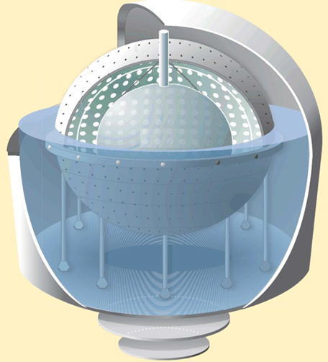
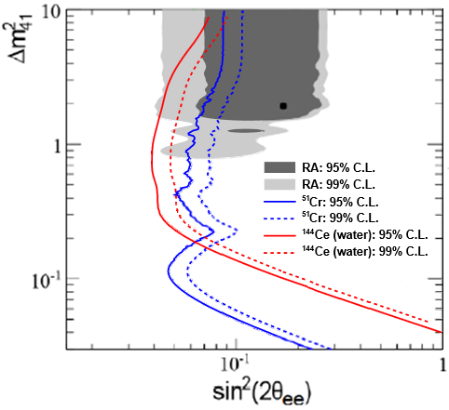
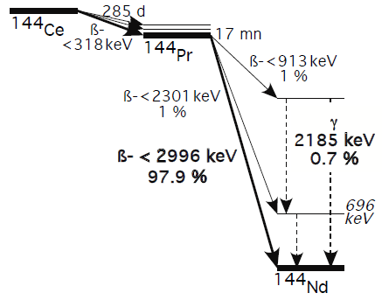
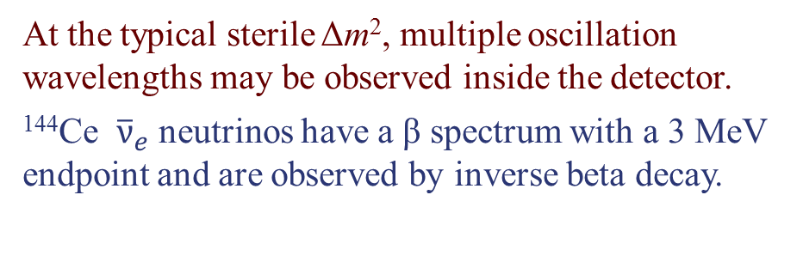
Source Experiment: SOX
Combines the Borexino detector with a ¹⁴⁴Ce ${\overline{ν}}_{e}$ source and/or a ⁵¹Cr $ν_{e}$ source.
At the typical sterile Δm², multiple oscillation wavelengths may be observed inside the detector.
¹⁴⁴Ce ${\overline{ν}}_{e}$ neutrinos have a β spectrum with a 3 MeV endpoint and are observed by inverse beta decay.
JHEP 1308, 038 (2013)
¹⁴⁴Ce-¹⁴⁴Pr Decay
8.25 m
Source
See talk by Marco Pallavicini

Slide 13
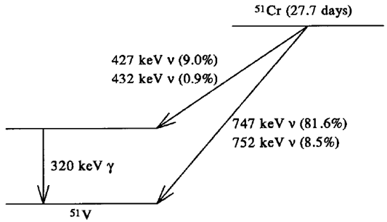
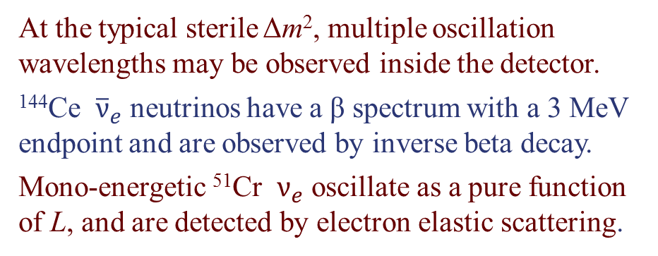
Source Experiment: SOX
Combines the Borexino detector with a ¹⁴⁴Ce ${\overline{ν}}_{e}$ source and/or a ⁵¹Cr $ν_{e}$ source.
At the typical sterile Δm², multiple oscillation wavelengths may be observed inside the detector.
¹⁴⁴Ce ${\overline{ν}}_{e}$ neutrinos have a β spectrum with a 3 MeV endpoint and are observed by inverse beta decay.
Mono-energetic ⁵¹Cr $ν_{e}$ oscillate as a pure function of L, and are detected by electron elastic scattering.
JHEP 1308, 038 (2013)
⁵¹Cr Decay
8.25 m
Source
See talk by Marco Pallavicini

Slide 14
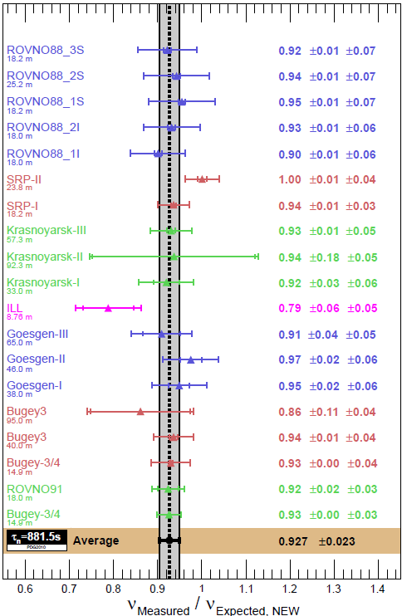
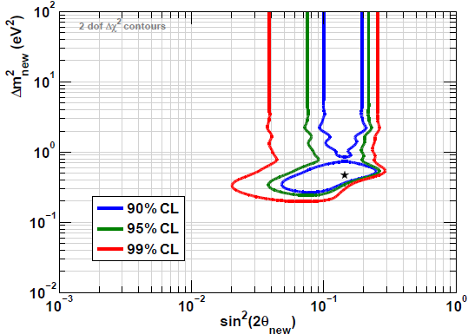
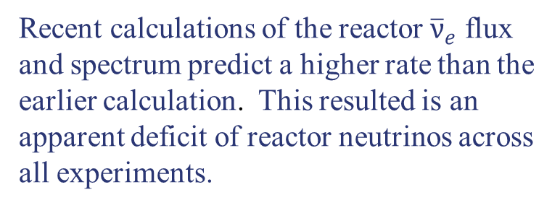
Reactor Anomaly (ν_{e} Disappearance)
Recent calculations of the reactor ${\overline{ν}}_{e}$ flux and spectrum predict a higher rate than the earlier calculation. This resulted is an apparent deficit of reactor neutrinos across all experiments.
Mention et al., Phys.Rev.D83 073006 (2011)
Rate only analysis

Slide 15
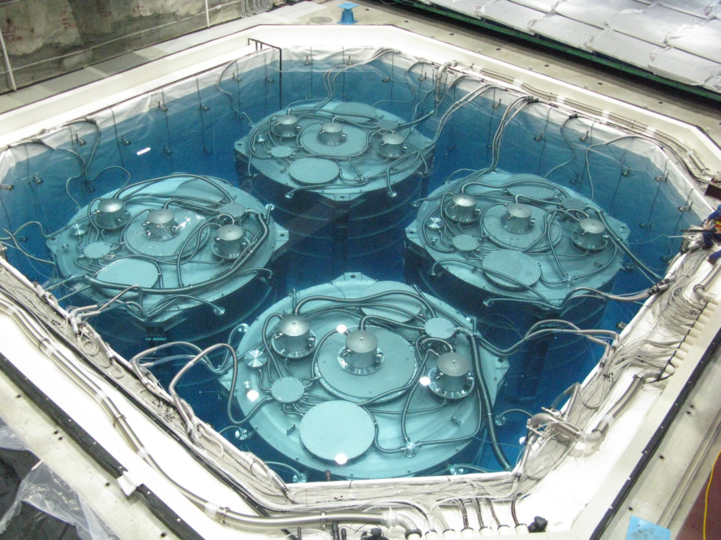
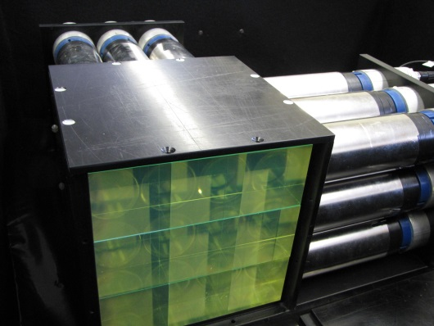
Keys to a Short-Baseline Reactor Experiment
Daya Bay
Unlike the reactor θ₁₃ experiments, short-baseline reactor experiments are done
  on the surface
  with small detectors
  without space for massive clean shielding
  and gamma catchers
Reducing random coincidence backgrounds is the most significant challenge.
Dealing with Random Coincidence Backgrounds:
Neutron and gamma shielding
Unbiased spatial resolution Segmentation
High neutron capture efficiency and purity
Gd and ⁶Li
MicroCHANDLER
See talk by Karsten Heeger

Slide 16
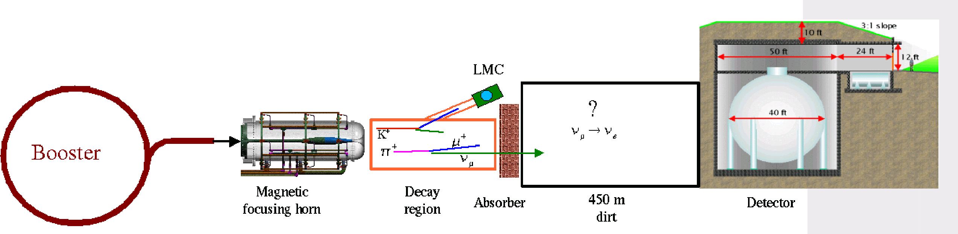
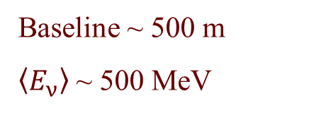

MiniBooNE ν_{μ}→ ν_{e} Appearance
(──) (──)
MiniBooNE used a π⁺ (π⁻) decay in flight beam and a liquid Cherenkov detector (pure mineral oil) to search for $ν_{e} ({\overline{ν}}_{e})$ appearance in a $ν_{μ} ({\overline{ν}}_{μ})$ beam.
There was some intrinsic scintillation to the mineral oil, but it was not a significant contributor to improving particle ID or energy resolution.
Baseline ~ 500 m
$\left\langle E_{ν}\right\rangle$ ~ 500 MeV
ν_{μ}→ν_{e}?

Slide 17
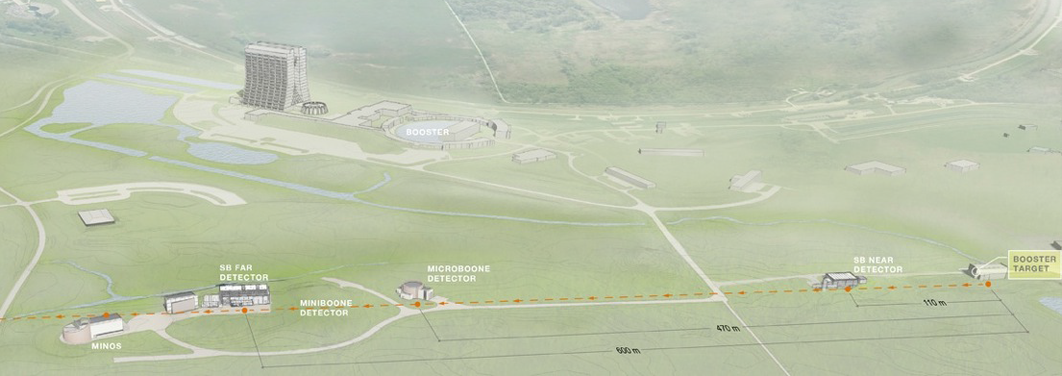
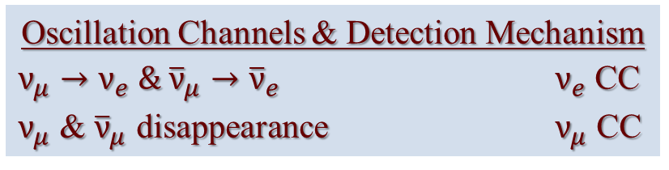
The Fermilab Short-Baseline Program
 | Baseline | Mass
SBND | 110 m | 112 t
MicroBooNE | 470 m | 89 t
ICARUS | 600 m | 476 t
Oscillation Channels & Detection Mechanism
$ν_{μ}→ν_{e} \&$ ${\overline{ν}}_{μ}→{\overline{ν}}_{e}$ $ν_{e}$ CC
$ν_{μ}$ & ${\overline{ν}}_{μ}$ disappearance $ν_{μ}$ CC
The liquid argon TPC pattern recognition is expected to significantly reduce misID backgrounds.
The near detector provides an inclusive measure of beam and misID backgrounds.
The ICARUS T600 at a third baseline significantly boosts the statistics and the dynamic range in L/E.
See talk by Marco Pallavicino

Slide 18
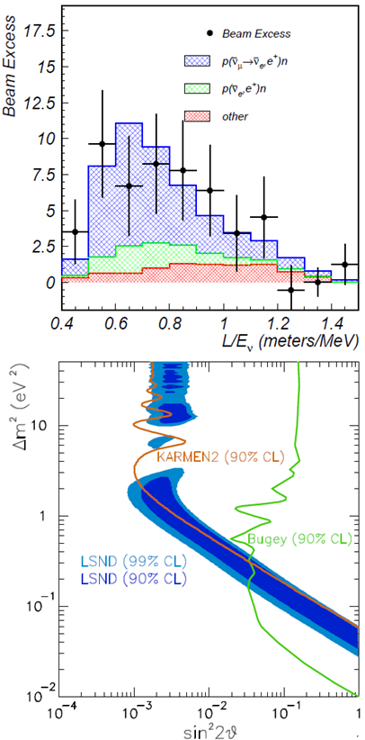
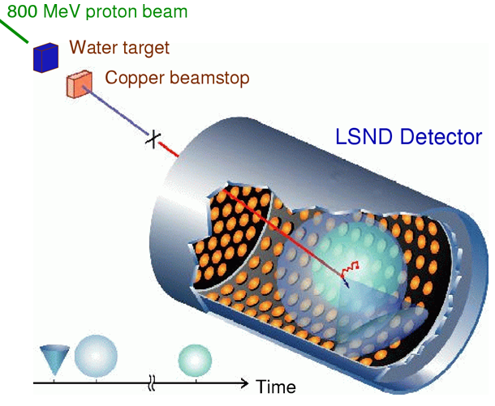
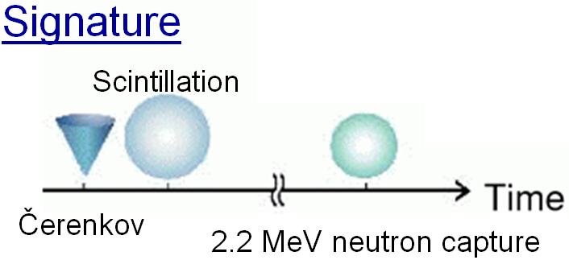
LSND ν_{μ}→ ν_{e} Appearance
Phys.Rev.D64, 112007 (2001)
Energy range: 20 to 55 MeV
Baseline: 30 m
L/E ~ 1 m/MeV
Event Excess: 32.2 ± 9.7
Golden Mode:
ν_{e} p→ e⁺ n
π⁺→ μ⁺ ν_{μ}
Inverse β-decay
Stopped Pion Beam
e⁺ ν_{μ}ν_{e}
Signature
Scintillation
Čerenkov
2.2 MeV neutron capture

Slide 19
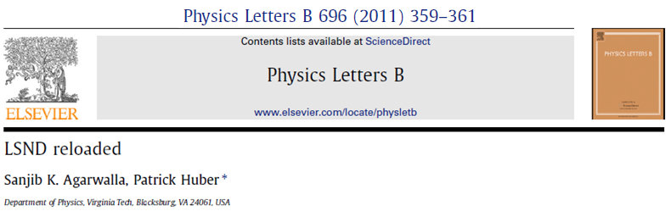
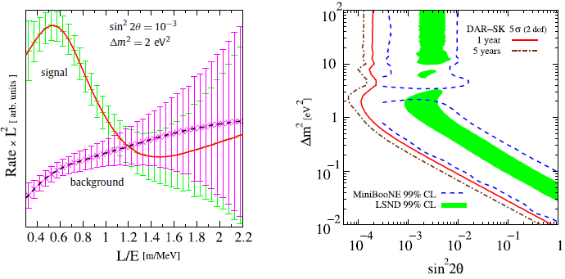
Water-based Scintillator: What is it Good For?
Cost-effectively instrumenting large volumes:
Pairing a Daδelus-like cyclotron stopped-pion source with a Gadolinium-enhanced Super-K (GADZOOKS!).

Slide 20
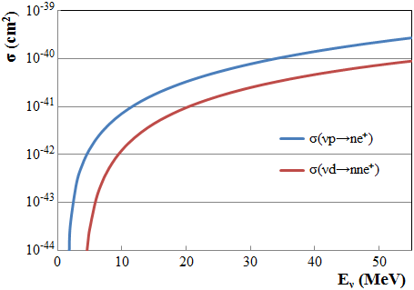

Water-based Scintillator: What is it Good For?
Water can be made heavy:
  And inverse beta decay in deuterium has a double neutron tag:
  Can we use this to reduce backgrounds in IBD experiments?
  In order of increasing ${\overline{ν}}_{e}$ energy:
    ¹⁴⁴Ce source experiments
    Reactor experiments
    IsoDAR (⁸Li)
    Stopped pion experiments
${\overline{ν}}_{e}+ {}_{}^{2}H→2n+e^{+}$
¹⁴⁴Ce source experiments
Reactor experiments
IsoDAR (⁸Li)
Stopped pion experiments
Anyone up for a heavy-water, stopped-pion beam experiment with water-based liquid scintillator?

Slide 21
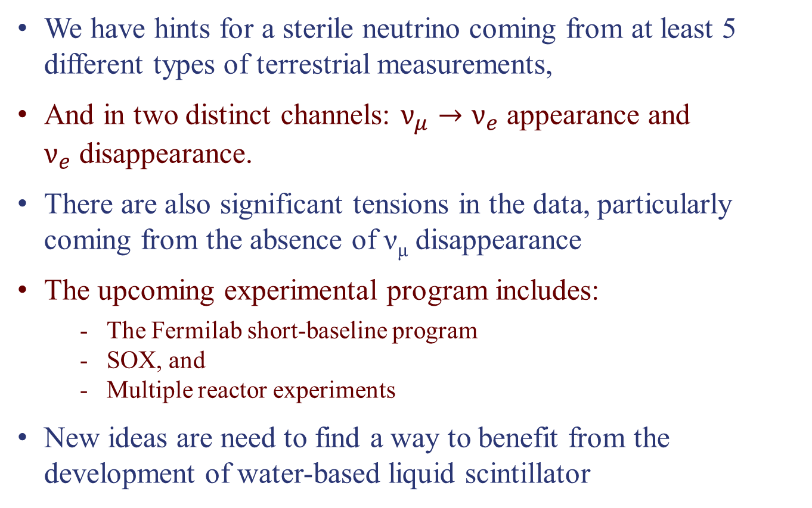
Conclusions
We have hints for a sterile neutrino coming from at least 5 different types of terrestrial measurements,
And in two distinct channels: $ν_{μ}→ν_{e}$ appearance and $ν_{e}$ disappearance.
There are also significant tensions in the data, particularly coming from the absence of ν_{μ} disappearance
The upcoming experimental program includes:
  The Fermilab short-baseline program
  SOX, and
  Multiple reactor experiments
New ideas are need to find a way to benefit from the development of water-based liquid scintillator

