Slide 1

Final Presentation
Team 2 - Search and Recommendation
CS5604: Information Storage and Retrieval
Instructor: Edward A. Fox, SME: Satvik Chekuri
Team: Jason Banuelos, Mahesh Maddhuru, Ujjwal Maheshwari, Nikhil Ram, Aseem Khandelwal, Harsha Bhamidipati
November 30, 2023
Virginia Tech, Blacksburg, VA - 24061

Slide 2
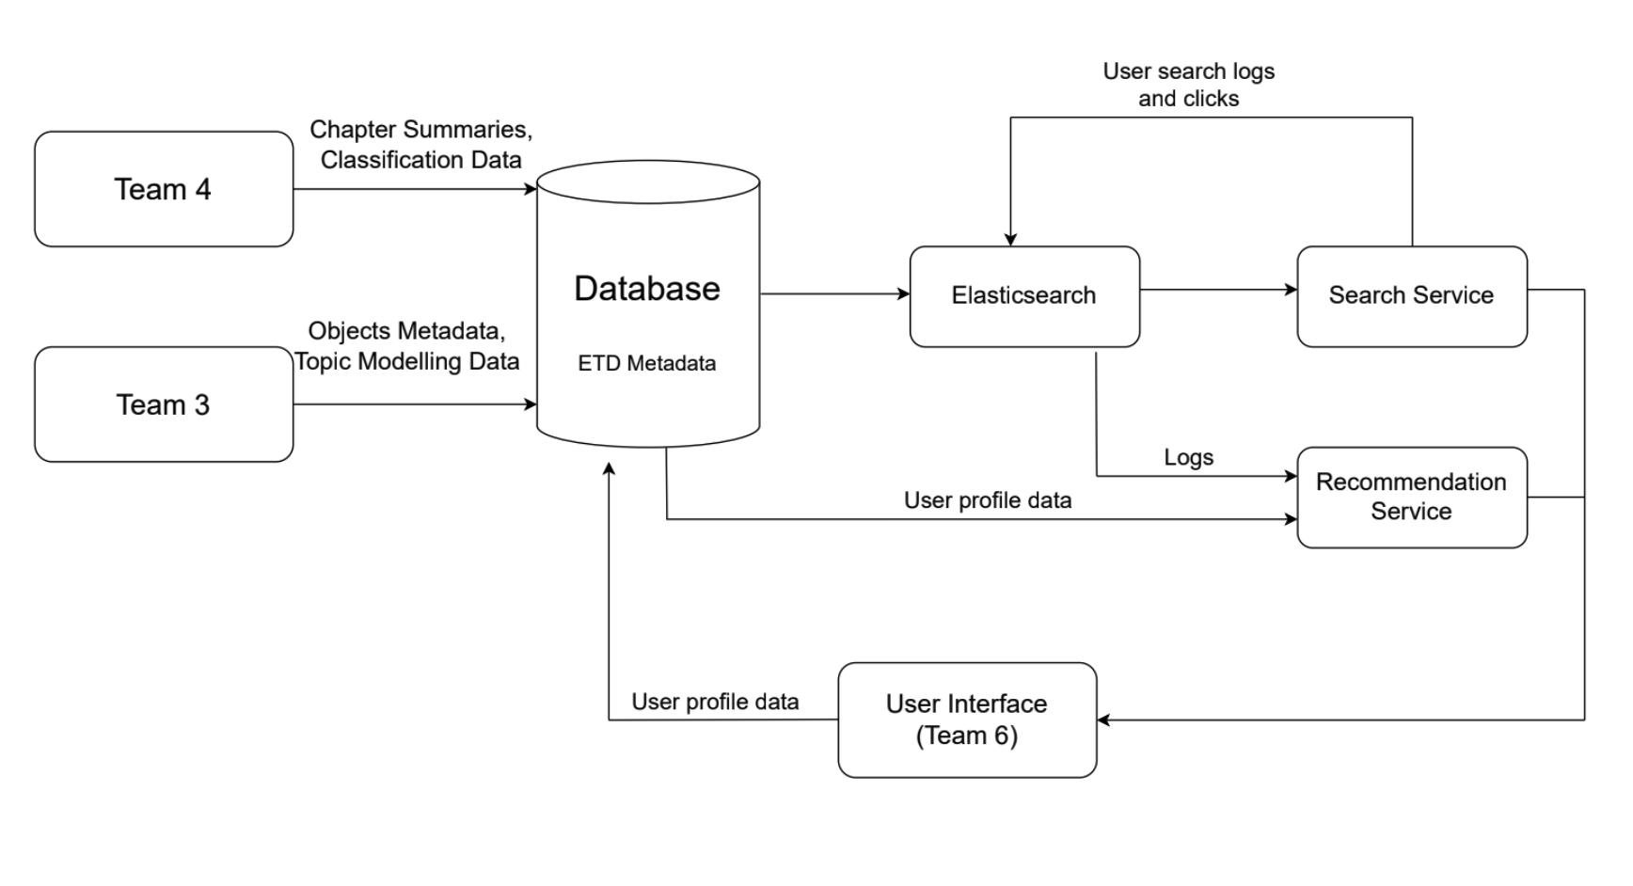
The flow of data between teams.

Slide 3
Search

Slide 4
Quote Callout
Summary of search tasks
Reviewed and changed the index schema for ETD metadata and chapter summaries.
Fixed the search service APIs to serve frontend interface.
Implemented code to support creation of embeddings which are used in kNN search.
Wrote new indexing script for new APIs and database schema.
Processed 500K ETDs and indexed the filtered metadata.
Improved search relevance by implementing Reciprocal Rank Fusion (RRF).

Slide 5
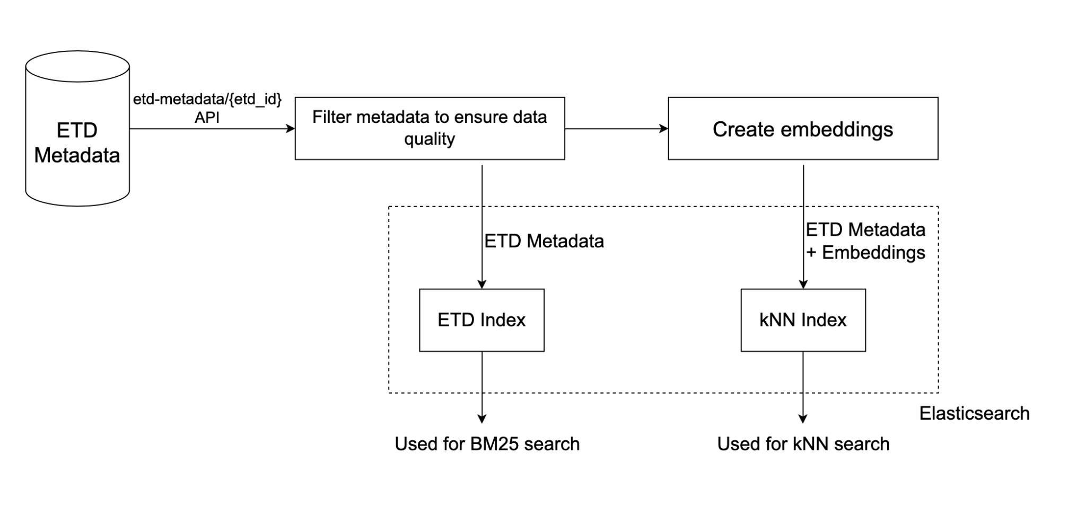
ETD indexing flow

Slide 6
Quote Callout
New indexing script and embeddings model
Processed 500K ETDs. 182,689 failed title/abstract validation.
The entire pipeline takes 45 hours and 50 minutes.
Network calls and creation of embeddings using E5-large-v2 model are the time consuming processes.
Tried multithreading the code but didn’t work.
Solution: Run multiple processes in parallel with different offsets and sizes.

Slide 7
Quote Callout
Security incident with Elasticsearch
The Elasticsearch instance in endeavour was a victim of a ransomware attack. The attack took place twice.
The attackers deleted all of our existing data and demanded crypto currency in exchange for restoring our data.
With the help of Team 5, we were able to enable security for the instance.
Kibana and Elasticsearch APIs are now secure and cannot be accessed without authentication.
We haven’t noticed any unusual activity since enabling security.

Slide 8
Quote Callout
Search Algorithms
Best Matching 25 (BM25)
k-Nearest Neighbors (kNN)
Combined Method - Reciprocal Rank Fusion (RRF)

Slide 9
Quote Callout
Best Matching 25 (BM25)
Default search method for Elasticsearch.
Utilizes term weighting to assign different weights to terms based on their frequency in an ETD.
Scaling to 500K ETDs:
  minimal performance impact, response time increased from average 300ms to 3-4 seconds.

Slide 10
Quote Callout
k-Nearest Neighbors (kNN)
kNN is used for semantic-based retrieval.
ETDs are represented as vectors, and similarity is measured using distance metrics (e.g., cosine similarity).
Scaling to 500K ETDs:
  Timeout Handling: Extended ElasticSearch timeout from 30 to 180 seconds to prevent timeouts.
  Adjusted k from 100 to 10, reducing response time significantly from an average of 1.5 minutes to about 16 seconds.
  This came with a potential trade-off with accuracy, though not thoroughly assessed.

Slide 11
Quote Callout
Combined Method - Reciprocal Rank Fusion
RRF combines rankings from different algorithms by considering the reciprocal ranks of documents.
Utilized Reciprocal Rank Fusion to integrate BM25 and kNN results.
Combining different methods helps diversify search results and amplify the ETDs that are consistently ranked higher by all methods.
Scaling to 500K ETDs:
  Average response time = ~kNN response time

Slide 12
Experimenter

Slide 13
What are experiments?
Experiments in our context are specialized search trials designed to enhance and evaluate the effectiveness of information retrieval from Electronic Theses and Dissertations (ETDs) for an user with Experimenter role.

Slide 14
Quote Callout
Search experiments allow experimenters to index custom vectors for each ETD, enabling a hybrid search approach that combines k-Nearest Neighbors (kNN) with traditional keyword search.
The goal is to analyze and improve the relevance and accuracy of search results by leveraging advanced text embedding models.
An Experimenter can Create, Run and Delete the experiments based on his liking.
Search on Collection: A method enabling hybrid searches on indexed ETDs to create and experiment with specific collections, refining retrieval techniques.

Slide 15
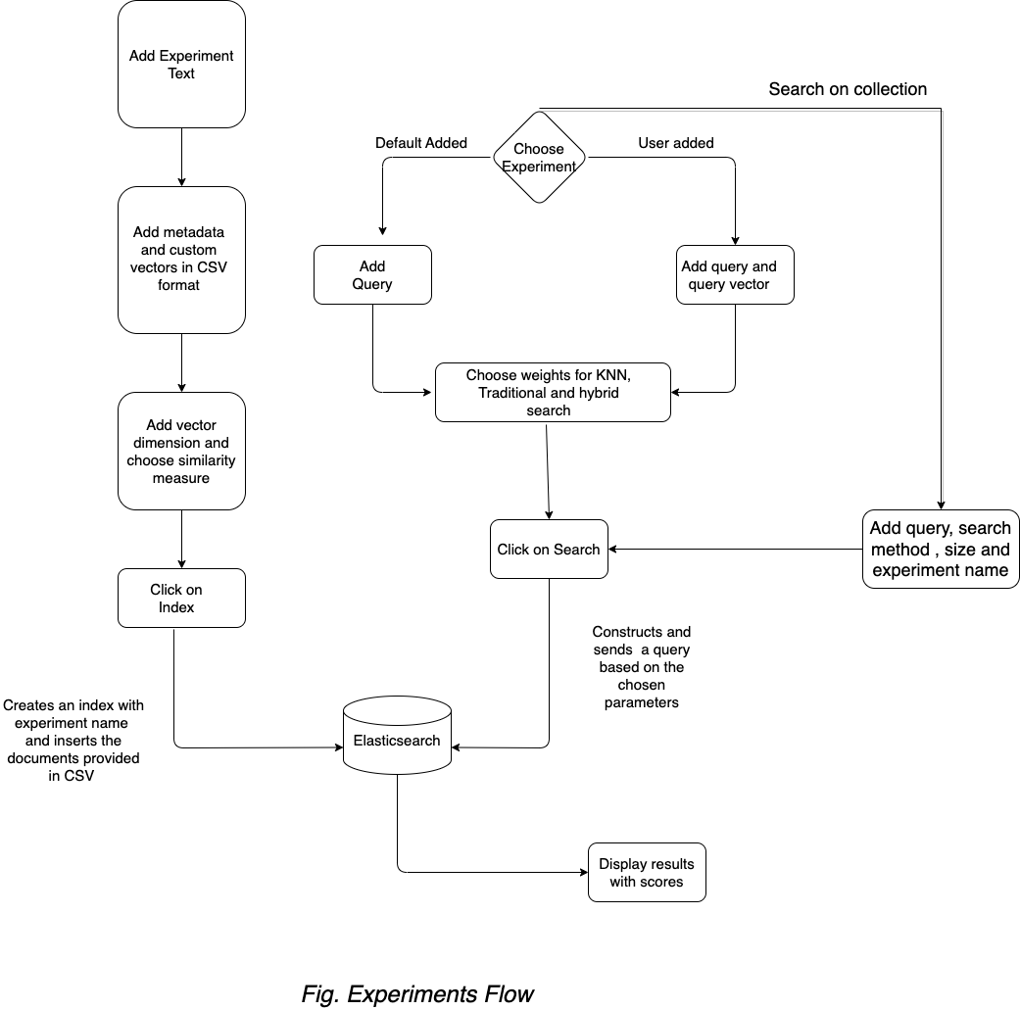

Slide 16
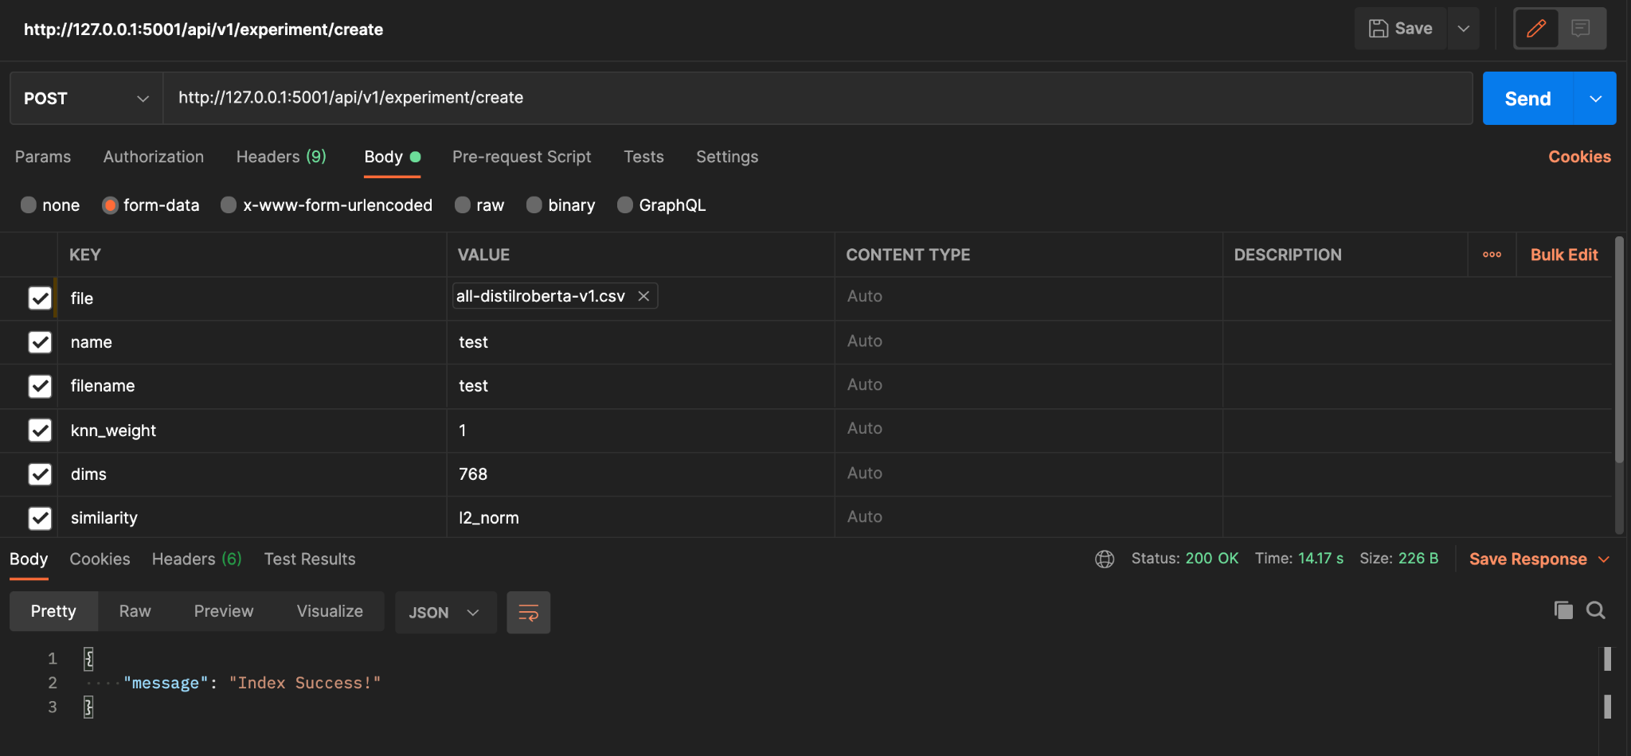
Quote Callout
Creating an experiment

Slide 17
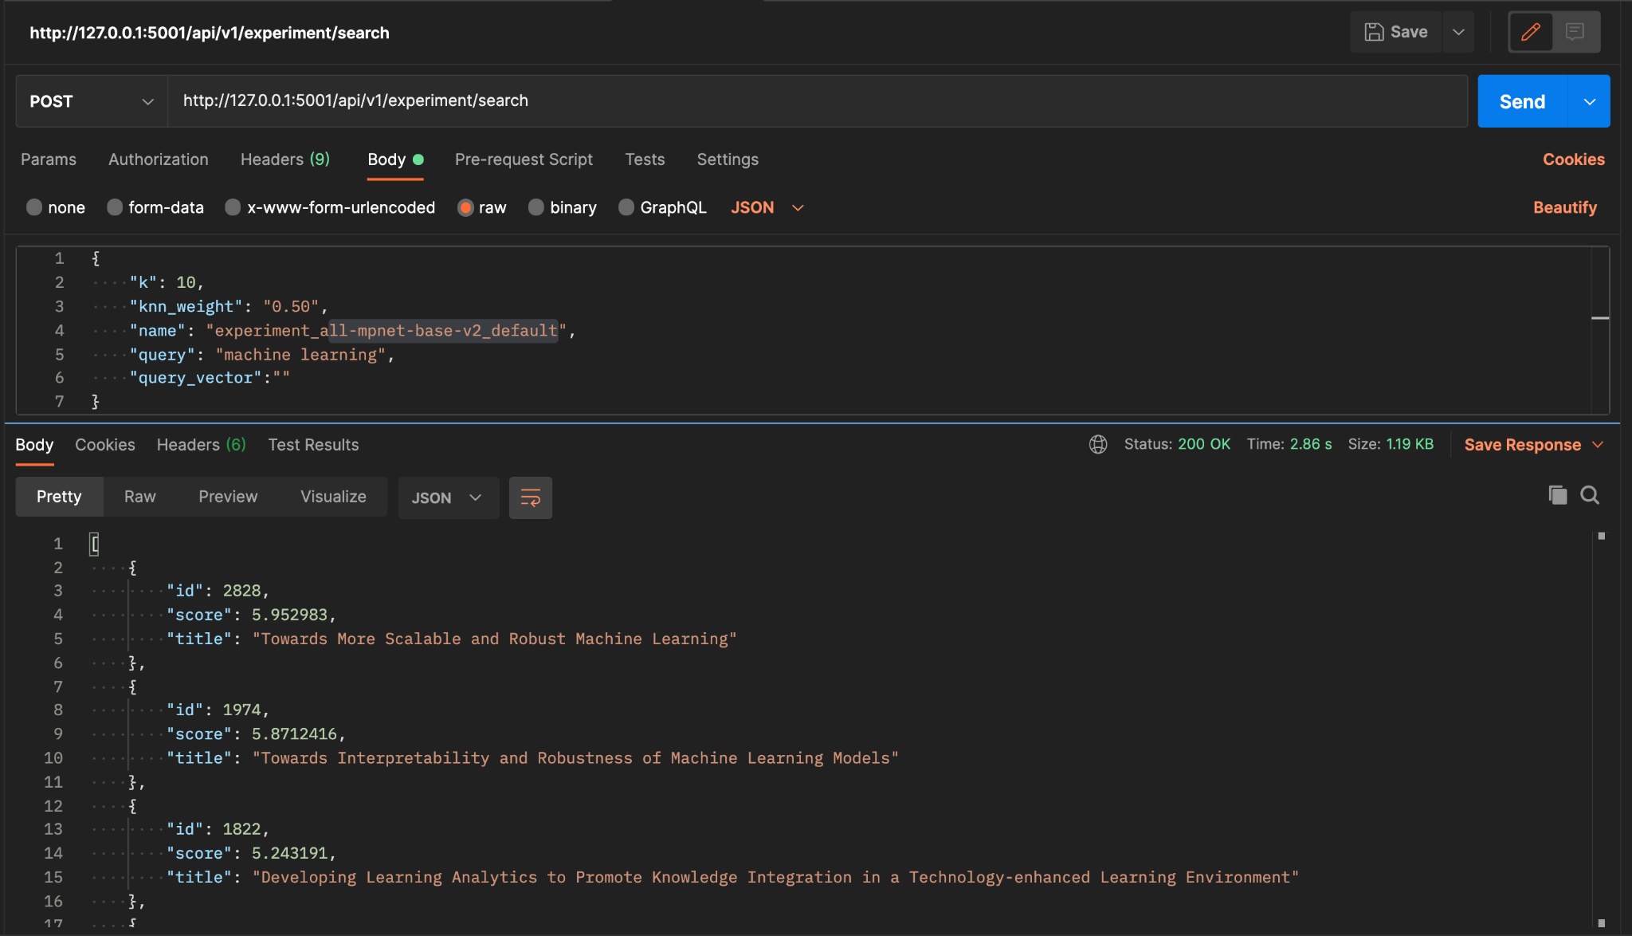
Quote Callout
Running a search experiment.

Slide 18
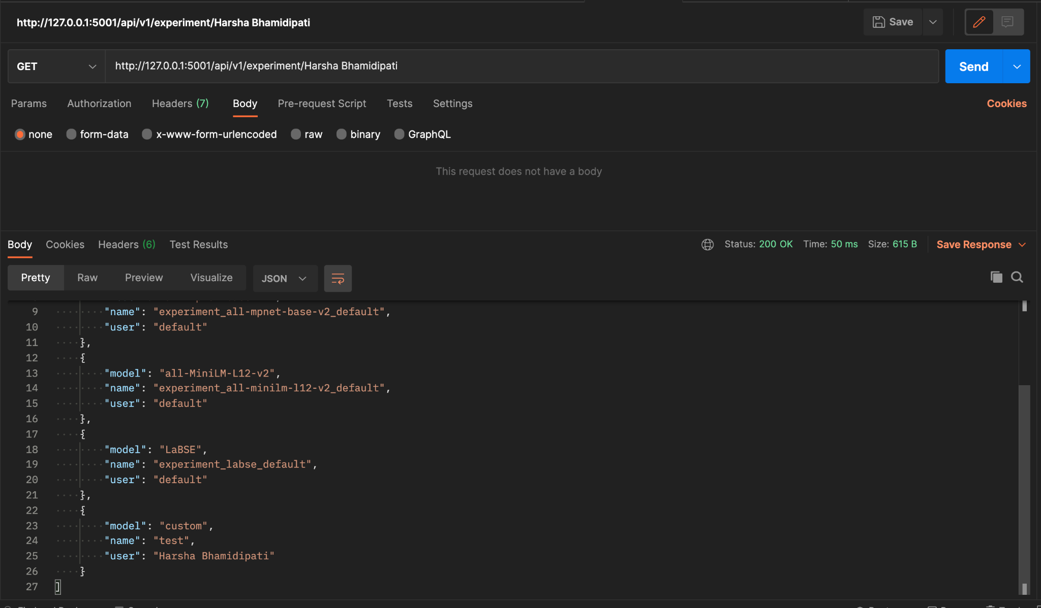
Quote Callout
Listing the user created experiments

Slide 19
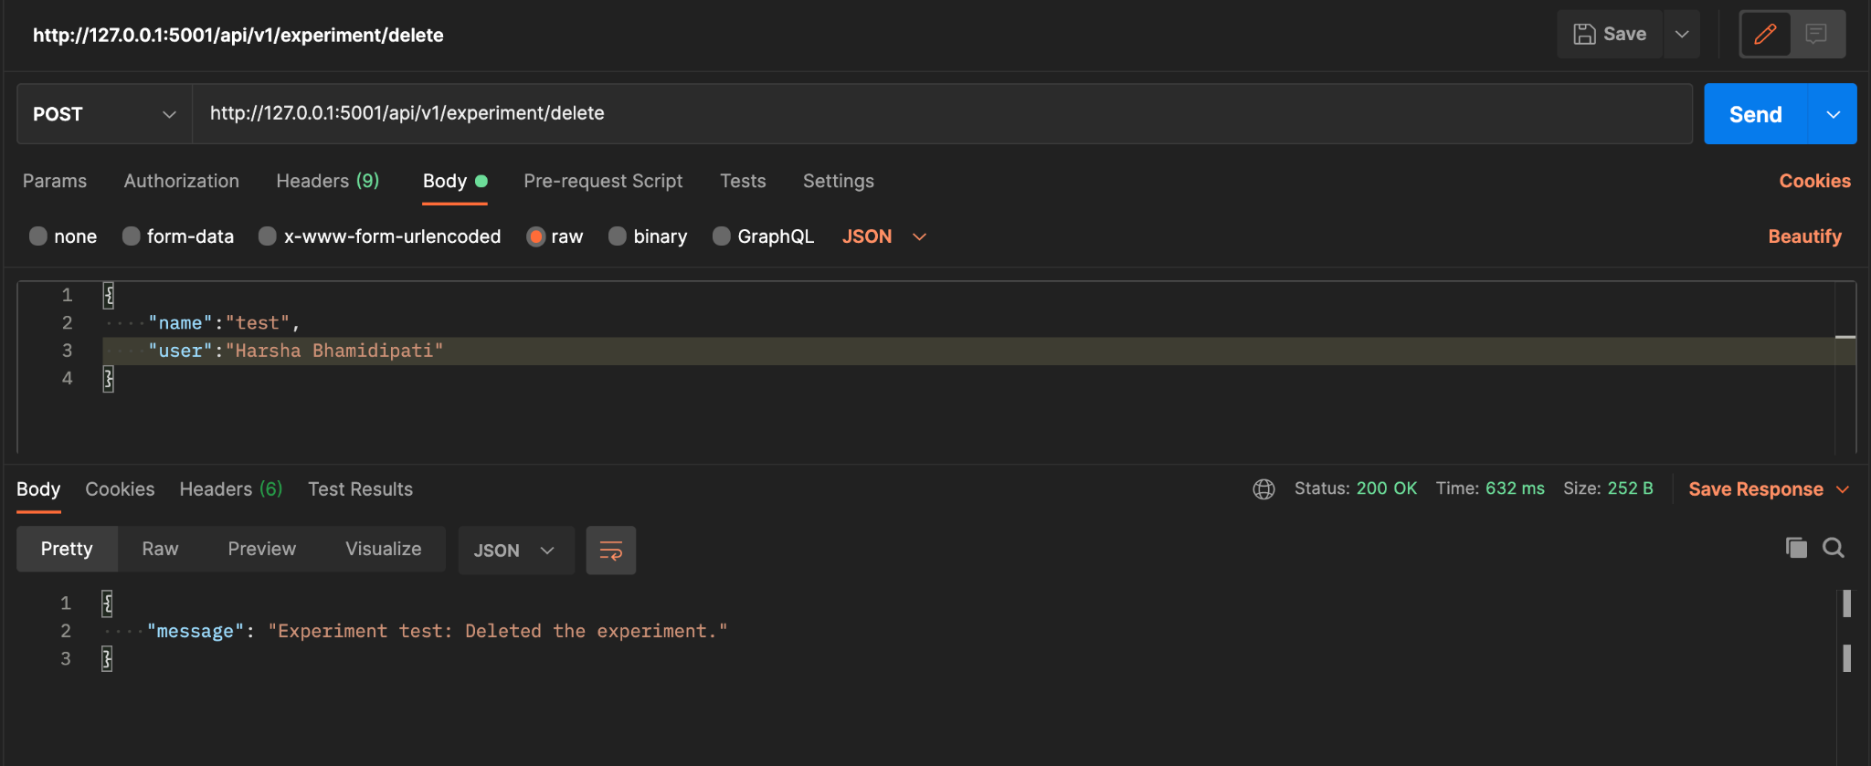
Quote Callout
Deleting the user created experiment

Slide 20
Logging

Slide 21
Quote Callout
Why did we implement logging?
Capturing User Engagement: To capture user actions, preferences, and interactions with the system.
Personalized Recommendations: By analyzing logs of user interactions, recommendation systems can tailor suggestions to individual preferences, enhancing user satisfaction and engagement.
Streamlined Error Debugging: Facilitate service level error debugging.
Enhanced Performance Monitoring: Logging facilitates the monitoring of system performance and the identification of potential issues or anomalies.

Slide 22
How did we implement logging?
Index creation: Established an Elasticsearch index structure, featuring a versatile "meta" field for dynamic log data inclusion.
Logging service creation: Deployed a dedicated logging service ensuring systematic log handling functions.
API Integration for Logging: Integrated logging mechanisms into APIs.
Log-Specific Kafka Topic Implementation: Established a Kafka topic named 'logs' to automatically store bulk log data from authorized sources.

Slide 23
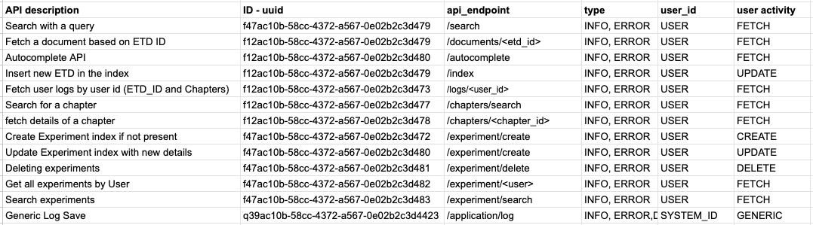
Quote Callout
Integrated endpoints

Slide 24
Recommendation

Slide 25
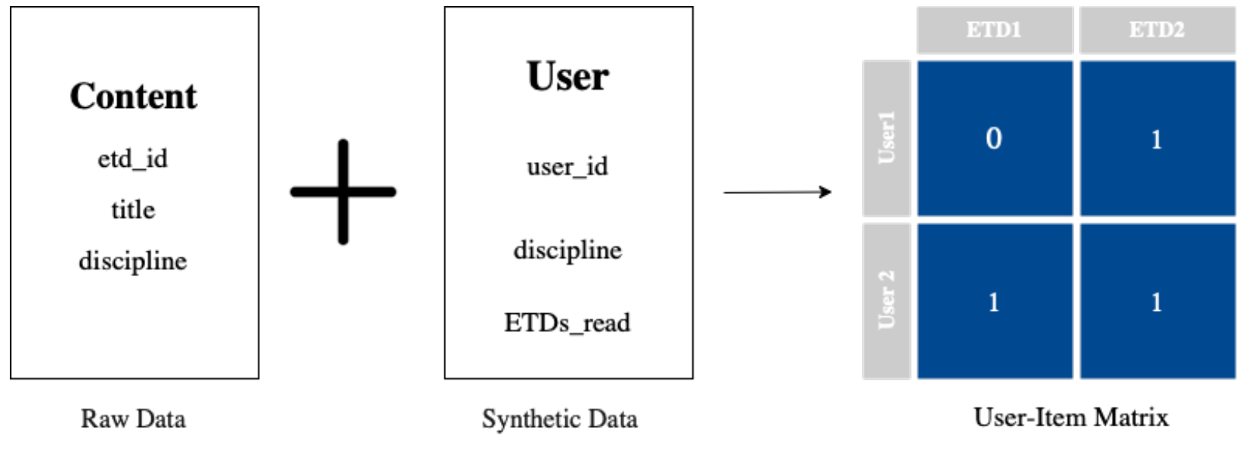
Recommendation system
Started out trying to improve the original system, which was a single user-item model.
Model was an autoencoder that had a one-hot user-item matrix as its input and output.

Slide 26
Recommendation system
Autoencoder was a good model choice, but their architecture wasn’t really scalable because of fixed model I/O vs. non-fixed number of users and ETDs.
Use of a one-hot matrix was also questionable since the number of times a user clicked on an ETD could potentially inform the user’s level of interest in the content.
Since they had no real user data, they had to use synthetic data for initial model training.

Slide 27
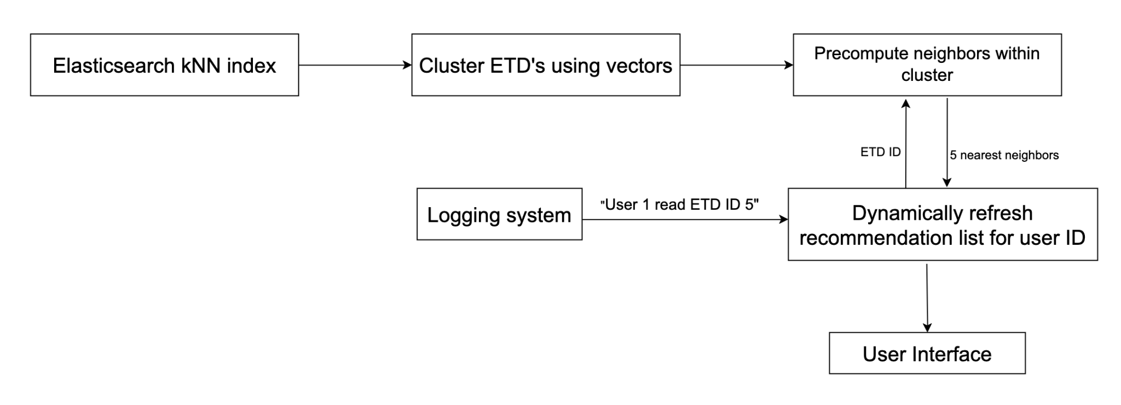
New Recommendation system

Slide 28
New Recommendation system
Initial setup
  Embeddings for all ETDs are pulled from the kNN Elasticsearch index.
  Use K-means clustering to create clusters.
  Inside each cluster, compute cosine similarity.
  Initially, the categories and topics selected by users will be used to generate recommendations.
When user clicks on an ETD
  The ETD ID and user ID is sent to the recommendation server.
  The 5 nearest neighbors of the ETD ID will be obtained from the cluster.
  The existing recommendations will be pushed down by 5 places. The newly obtained neighbors will become the top 5 recommendations.

Slide 29
Future Work

Slide 30
Quote Callout
Improve kNN search performance.
Shard Elasticsearch indexes for better search performance.
Reduce time taken to index data into Elasticsearch.
Add more options for search experiments.
Create test routines for search and recommendation APIs.
As user data becomes available, cluster it to form User-User relations.
Implement a User-Item model using LightFM.

Slide 31
Thank you!
Any Questions?

