Slide 1
Wind Forecast Improvement Project-2
Improving Model Physics in Complex Terrain
Melinda Marquis, Joe Olson, James Kenyon, Stan Benjamin, Jim Wilczak, Laura Bianco, Irina Djalalova, Katherine McCaffrey, Yelena Pichugina, Bob Banta, Aditya Choukulkar Richard Echman, Andy Clifton, Jacob Carley, Joel Cline.

Slide 2
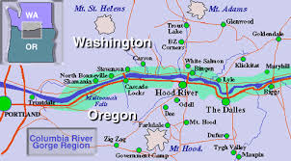
Outline
WFIP2 Goals
Team and Sub-Team Structures
Meteorological Challenges in the Columbia River Gorge
Goals of Sub-Teams
Columbia River Gorge Region

Slide 3
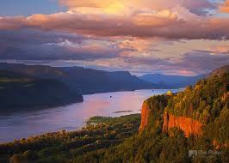
Overview
Columbia River Gorge http://www.chipphillipsphotography.com
A 4-year (2014-2018), DOE-led project to improve short-term weather forecast models and increase understanding of physical phenomena such as stability, turbulence, and low-level jet that affect wind energy generation in regions of complex terrain, such as coastlines, mountains, and canyons.
WFIP2 Team members include those from a team led by Vaisala, four DOE labs (NREL, LLNL, PNNL, and ANL), and NOAA.
A field campaign in the Columbia River Gorge 2015 – 2017.
Sub-teams: experimental design, instruments, modeling, data, uncertainty quantification, verification and validation, decision support
A steering committee with representatives from DOE HQ, Vaisala, DOE labs, and NOAA.

Slide 4
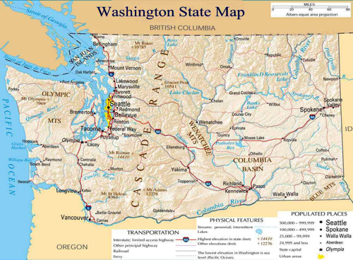
Wind Forecast Improvement Project-2 (WFIP2): Goals
Improve the understanding and modeling of physical phenomena in complex terrain that impact wind speeds & direction at hub heights.
  WRF, RAP/HRRR/HRRRnest
  0-15 hour, and Day-ahead
Develop decision support tools, e.g., probabilistic forecast information, uncertainty quantification and forecast reliability for system operations. Won’t interfere with private sector role.
Physical phenomena such as stability, turbulence, mountain wakes, and gap flows.

Slide 5
WFIP-2 Team and Sub-Teams
DOE FOA Awardee – Vaisala –
leads a team including individuals from:
Univ. Colorado
NCAR
Sharply Focused
Lockheed Martin
Texas Tech University
University of Notre Dame
DOE National Labs: NREL, PNNL, LLNL, ANL
NOAA (OAR: ESRL and ARL; NWS: NCEP)

Slide 6
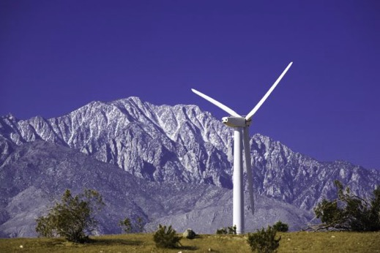
Sub-Teams
Experimental Science Design
Instrument
Modeling
Data
Uncertainty Quantification
Verification and Validation
Decision Support Tools

Slide 7
Time Line
Apr 2014 – Sept. 2015
FOA published
DOE selected awardee
Award negotiated
Early planning meetings and site visits
Land-use agreements and leases completed
Instruments deployed
Oct 2015 – Mar 2017
Field campaign
Up to 18 months to ensure coverage of all four seasons
April 2017 – Mar 2018
Remove campaign instruments
Data analysis
Write final report

Slide 8
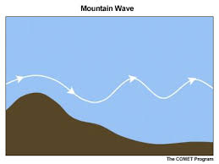
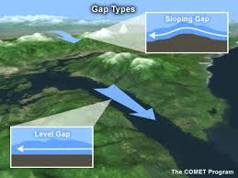
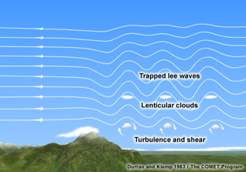
Complex flow features in Columbia River Gorge
• Frontal passages with terrain and pre-existing air masses
• Strong cross barrier flow
• Mountain Waves
• Topographic Wakes
Convective outflow
• Marine Pushes

Slide 9
Frontal systems with terrain and pre-existing air-masses
Warm front, overrunning of cold air. NWP often over-mixes BL, leading to premature descent of windy air down to turbine level.

Slide 10
Strong Cross Barrier Flow
Trapped lee waves and mountain wakes. NWP captured the mountain wave, but missed the amplitude and structure.

Slide 11
Convective Outflows
NWP missed the convective outflow. NWP development has been focused on protection of life and property, not on non-severe convective outflow characteristic in PNW.

Slide 12
Experimental Design
A network of instruments to measure meso-alpha scale (200-2000 km) variability in a region with many wind plants. This will provide insight into large-scale gradients and help refine the inflow boundary conditions for the modeling portion of WFIP2.
A transect that is roughly perpendicular to the linear aspect of the network in #1 (above). This will allow for observation of features both perpendicular to the Cascade Mountains (e.g. topographic wakes) and parallel to the mountains (e.g. mountain waves).
A supersite near the intersection of the two transects. This will allow detailed observation of surface and boundary layer processes.
Some instruments will be located further afield to ensure the applicability of the project science to other areas of complex terrain.
Team: Jim McCaa (Vaisala) and Julie Lundquist (CU) = Co-Leads
Keith Barr (Lockheed Martin), Bronko Kosovic (NCAR),Justin Sharp (Sharply Focused), Joe Fernando (Notre Dame), Rich Coulter and Rao Kotamarthi (ANL), Jeff Mirocha and Sonia Wharton (LLNL), Andy Clifton (NREL) and Larry Berg & Will Shaw (PNNL), Joe Olson, Jim Wilczak, Bob Banta, Yelena Pichugina, Laura Bianco, Irina Djalalova, Alan Brewer (NOAA)
Notes:
(6.3 sq km; approx. circle of ~2 km diameter )

Slide 13
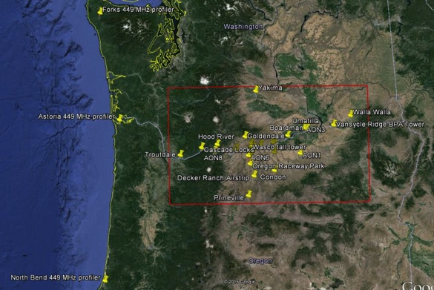
Instrument Team
Jim Wilczak (lead; NOAA), Joe Olson (deputy; NOAA), Larry Berg (PNNL), Mikhail Pekour (PNNL), Bob Banta (NOAA), Sonia Wharton (LLNL), Andy Clifton (NREL), Dave Jager (NREL), Dave Cook (ANL), Justin Sharp (Vaisala), Jim Bickford (Vaisala), Eric Stephan (PNNL), Leon Benjamin (NOAA), Bob Lipschutz (NOAA), Kirk Clawson (NOAA/ARL), Laura Bianco (NOAA), and Kathy Lantz (NOAA).
WFIP2 Study Area

Slide 14
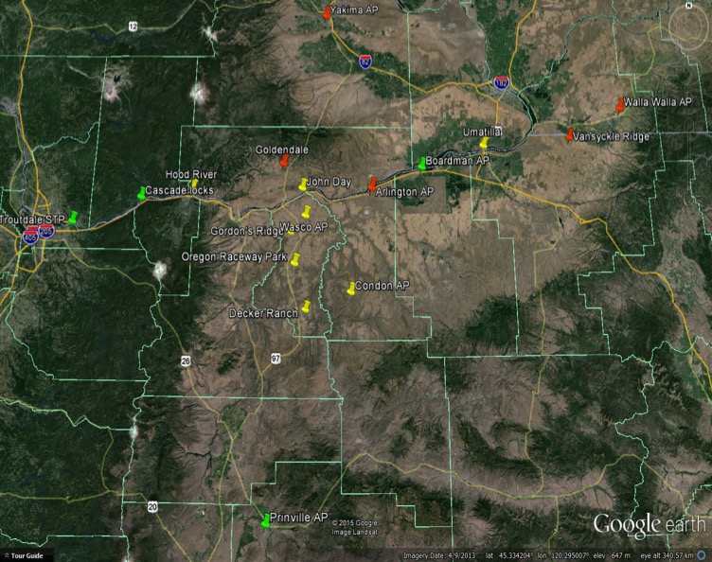
Planned Instrument Layout
ANL/Cook
WPR, sodar, SM
ANL/Cook
WPR, sodar, MB, SM
PNNL/Morris
MB, SM
ANL/Cook
WPR, sodar, MB, SM
PNNL/Morris
MB, SM
PNNL/Morris
PR, sodar, MB, SM
LLNL/Wharton
WPL
NOAA/King
MB, SM
NOAA/Clawson
WPR, sodar, SL, MB, SM
Vaisala/Pierce
SL, WPL
LLNL/Wharton
WPL, SL
NOAA/King
WPR, WPL, PR, MB, SM
NOAA/King
WPR, WPL, sodar, PR, SL, Ceil, MB, SM
PNNL/Morris
Sodar
NREL/Clifton
WPR, sodar, PR, MB, SM
PNNL/Morris
Sodar
NOAA/King
WPR, sodar, SM
Slide courtesy of Jim Wilczak
Notes:
~ 5 sodars on the W-E transect
Star = supersite near Wasco airport

Slide 15
Instrument | Number of Each | Notes
Ceilometer | 1
Profiler - Lower PBL - Wind - Sodar | 8 | Top out at between 200-500 m
Profiler - Lower Trop - Wind - 915 MHz | 8 | Winds 2-4 km ; RASS temp 0-1km; several incl sfc met (2m T,RH,p; 10m wind)
Profiler - Tropospheric - T/H - Radiometer | 4 | Tops out at 10 km
Scanning Doppler Lidar (Halo) | 2 | 3 km range
Sfc Met - Hi-res micorbarograph | 10
Sfc Met - Short Met Tower | 6 | 3m height, equipped with RM Young prop and vane anemometers, as well as instruments for temperature and humidity. Some also have broad-band radiometers and barometers.
Profiler - Lower PBL - Wind - Sodar (8/10 are Triton) | 10
Scanning Doppler Lidar (Windcube 200S) | 2 | 3 km range
Profiler - Lower PBL - Wind - Lidar (Windcube) | 4 | Tops out at 200 m
Scanning Doppler Lidar (WindTracer WTX) | 1 | Typical range 18 km
Profiler - Lower PBL - Wind - Lidar - ZephIR 300 | 1 | 10m to 300m
SURFRad mobile units | AOD | Solar irradiance (GHI, DNI, GDI) plus full surface radiation budget: downwelling & upwelling SW and LW) radiation, SW components (total, direct and diffuse solar irradiance), AOD, spectral solar irradiance, broadband and spectral surface albedo, cloud fraction, and sky images.

Slide 16
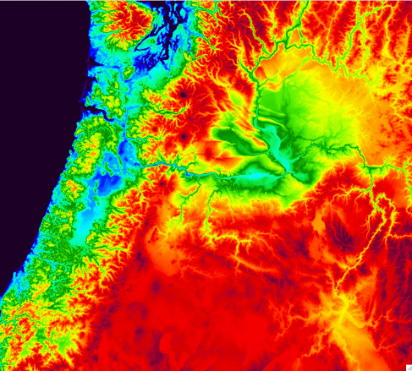
Modeling Team
Joseph Olson (co-lead; NOAA-ESRL), Jim McCaa (co-lead; Vaisala),
Larry Berg (DOE-PNNL), Bob Banta (NOAA-ESRL), Rick Eckman (NOAA-ARL), Mark Stoelinga (Vaisala), Branko Kosovic (NCAR), Virendra Ghate (DOE-ANL), Scott Collis (DOE-ANL), Rao Kotamarthi (DOE-ANL), Katie Lundquist (DOE-LLNL), Jeff Mirocha (DOE-LLNL), John Brown (NOAA-ESRL), Jaymes Kenyon (NOAA-ESRL), Caroline Draxl (DOE-NREL), Will Shaw (DOE-PNNL), Jerome Fast (DOE-PNNL), Julie Lundquist (CU/NREL), Wayne Angevine (NOAA-ESRL),Jian-Wen Bao (NOAA-ESRL), Sara Michelson (NOAA-ESRL), Brian Ancell (TTU)
HRRRnest (750 m)
Image courtesy of Joseph Olson.
Notes:
750 m
Pacific NW for WFIP2 only
Run only twice daily at the moment (06 and 18 Z).

Slide 17
Modeling Goals
The focus is on short-term (0-15 hr) forecasts but benefits are expected to extend to next day forecasts.
Model improvements are expected at very high-resolution (≤ 3 km grid spacing to 750m) as well as coarse resolution models (>10 km grid spacing) and in between.
Therefore, the model development team needs to develop scale-aware physical parameterizations that can adaptively represent the subgrid-scale processes across all scales.
Due to the complex processes and multi-scale feedbacks, biases in boundary layer winds can originate from many different components of the model.
Therefore, the focus of the model development efforts must stretch beyond the surface layer and boundary layer parameterizations to include those related to cloud physics (fog, stratus, and shallow cumulus) and radiative processes as well.

Slide 18
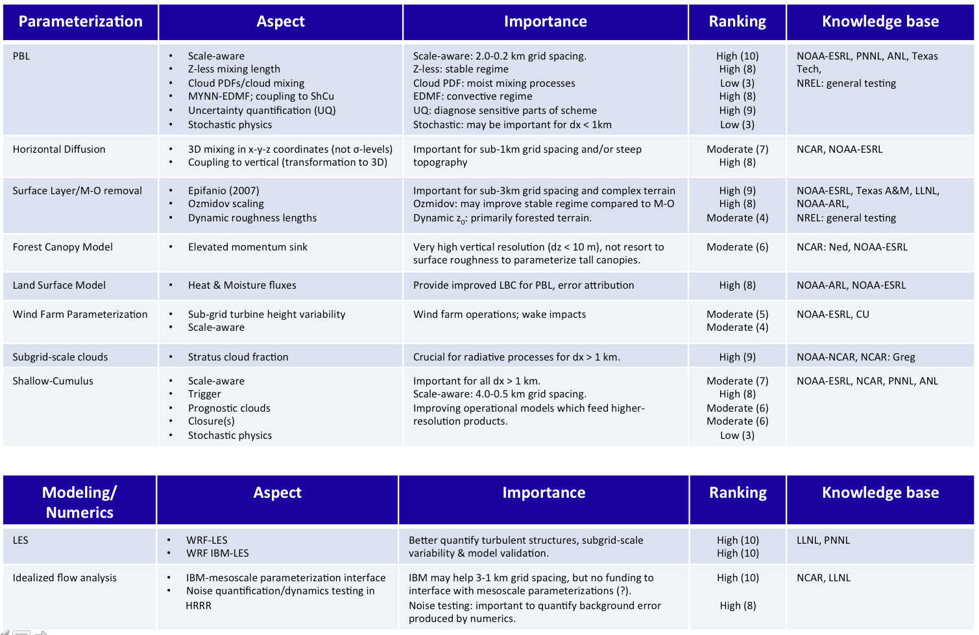
Slide courtesy of Joseph Olson.

Slide 19
Data Team
It is the role of the data team to ensure that this data is received, quality controlled and organized in the most effective way so that it can be retrieved and analyzed by other teams and delivered to project partners with minimal friction and/or duplication of effort.
  Members: Kyle Wade (lead, Vaisala), Justin Sharp (Sharply Focused)
  Eric Stephan, Chitra Sivaraman, Matt MacDuff (PNNL)
  Irina Djalalova, Leon Benjamin, Aditiya Choukulkar (NOAA)
  _{Scott Collias (ANL)}
  _{Vera Bulaevskaya (LLNL)}
  _{Andy Clifton (NREL)}

Slide 20
FIELD OBSERVATIONS
FORECAST/VERIFICATION
ANL
Data Team
NWP
VAISALA
PNNL
NREL
a2e DAP
(PNNL)
NOAA
LLNL
UND
CU
DSS Tools
Wind Farms
For more info about DAP visit: https://a2e.pnnl.gov/about/dap

Slide 21
Uncertainty Quantification (UQ) in WFIP2
UQ is the science of the quantitative characterization and reduction of uncertainties
  Models such as WRF have a large number of tunable parameters
  UQ techniques allow us to selectively sample the parameter space and better understand the model’s sensitivity to the values of the parameters
  UQ can also be applied to complex measurement systems
DOE supported UQ studies are already underway for the Columbia Gorge (Berg et al. this session)
  Informing experimental design through the identification of key parameters in WRF
  Providing advice on the deployment of instruments to better constrain parameters, such as measurements TKE and TKE dissipation rate through the depth of the boundary layer
Team Members: Larry Berg (lead; PNNL), Vera Bulaevskaya (alternate lead; LLNL), Brian Ancell (TTU), Bob Banta (NOAA), Emil Constantinescu (ANL), Matt Churchfield (NREL), Eric Grimit (Vaisala), Jim Wilczak (NOAA), and Yun Qian (PNNL)

Slide 22
Application of UQ in WFIP2
Compare model uncertainty to long-term measurements from number of different platforms, including Doppler lidar and radar wind profiler
Apply a wide range of different UQ techniques
Extend UQ analysis to multiple seasons
Use UQ analysis to help guide parameterization development
  Highlight key parameters for further study or improved treatment
Relate uncertainty to terrain elevation and/or slope
Preliminary example of simulated (256 WRF simulations with varying PBL parameters) and tower observed variability of wind speed during May 2011 at the Columbia Basin Wind Energy Study (CBWES) site, which was conducted within the WFIP2 domain.
Slide courtesy of Larry Berg
Notes:
The figure corresponds to the first bullet point and is really an example taken from CBWES, a DOE field study conducted in the Gorge during 2010 and 2011. Red line is the result of 256 month-long simulations using WRF with different parameter values and black line is taken from the sonic anemometer mounted near the top of a tall (approximately 62 m) tower.

Slide 23
Verification & Validation Team
Goal: Define a strategy that the WFIP2 participants will follow, ensuring that effects (individually and/or in total) of the model improvements have been quantified and documented.
Team Members: Andy Clifton (Lead, NREL), Larry Berg (Deputy, PNNL), Eric Grimit (Vaisala), Rao Kotamarthi (ANL), Jeff Mirocha (LLNL), Katie Lundquist (LLNL), and Joe Olson, Aditya Choukulkar, Laura Bianco, Yelena Pichugina (NOAA).

Slide 24
Verification and Validation

Slide 25
Decision Support Tools
Lead to greater situational awareness and reduced decision-making time on the part of electric power system operators and wind power producers.
Algorithms to detect phenomena based on enhanced HRRR forecasts and the uncertainty estimates made using the methods implemented by the Uncertainty Quantification (UQ) team.
These tools will allow for the best use of the mesoscale models and not interfere with the private company roles of individual wind plant decision making.
Members: Eric Grimit (Lead; Vaisala), Bri-Matthias Hodge (NREL), Yun Qian (PNNL), Jim Wilczak (NOAA).

Slide 26
Steering Committee
Ensure the successful execution of the WFIP2 effort.
Provide high-level (big picture) project management to facilitate coordination across WFIP2 teams and affiliations.
Anticipate and mitigate risks to the project, catalyze productivity of the WFIP2 teams, and ensure the project stays on schedule, scope and on budget.
Joel Cline( Lead, DOE), Brad Ring (DOE Contracts), DOE Labs (Will Shaw), Jim Bickford (Vaisala), and Melinda Marquis (NOAA).

Slide 27
Summary
4-year (2014-2018), DOE-led project to improve short-term weather forecast models and increase understanding of physical phenomena such as stability, turbulence, and low-level jet that affect wind energy generation in regions of complex terrain, such as coastlines, mountains, and canyons.
WFIP2 Team members include those from a team led by Vaisala, four DOE labs (NREL, LLNL, PNNL, and ANL), and NOAA.
A field campaign in the Columbia River Gorge will support these goals.
Sub-teams for experimental design, instruments, modeling, data, uncertainty quantification, verification and validation, decision support tools will work those WFIP2 goals.
wfip.windforecast.org

Slide 28
Marine Pushes
Marine push follows a period of above-average temperatures - with high pressure inland and offshore flow. The high pressure then moves inland and a weather disturbance from the west (Pacific) yields an influx of cool, cloudy air. When this air moves inland, strong winds occur on the eastern side of mountain passes and gaps.

