Slide 1

Unity Crash Course for VT Gaming Capstone
Final Presentation
John McElmurray
Github: jm991
Julian Adams
Github: throughbeingjulian
Client: Yong Cao, Vinny Argentina,Dane Webster
(Game Capstone professors)

Slide 2
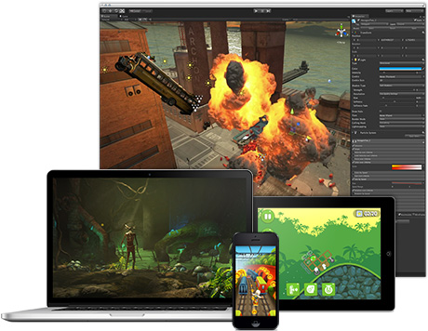
What is Unity?
Unity is a free game engine aimed at democratizing game development.
Using Unity, you can publish your game on the following platforms:
  Xbox 360
  PS3
  iPhone
  Android Phones
  Unity Web Player
  Etc…
Notes:
Julian
Unity is a free game development ecosystem:
It has a powerful rendering engine
with a complete set of tools and rapid workflows to create interactive 3D content

Slide 3
Motivation and Project Goal
When we took CS 4644, we found it difficult start game programming coming from a software engineering education.
To get students up and running in Unity as quickly as possible with open source starter project and code.
To provide a detailed video tutorial series.

Slide 4
Project Deliverables
17 Video Tutorials
GIT Revision Control
  GitHub Client (Windows)
  SourceTree Client (Mac)
  Setting Up Unity Source Control
Camera Tutorials
  Third Person Camera
    Behind The Back Camera
    Free Roaming Camera
  First Person Looking Camera
Mecanim Tutorials
  Animation Blend Trees
  Character Locomotion
User and Developers Manual
Open Source Project Maintained on GitHub Server
Notes:
Game Cameras are under appreciated

Slide 5
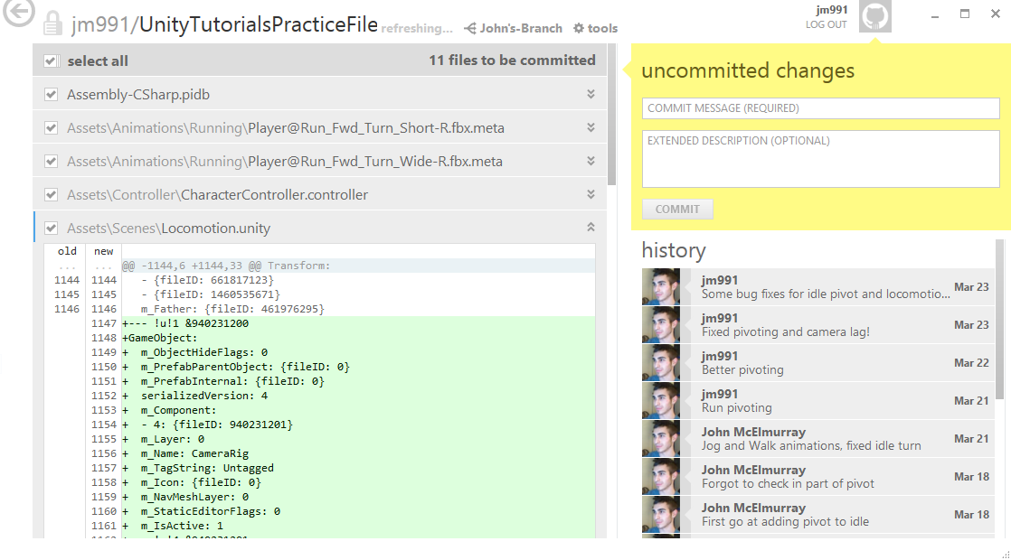
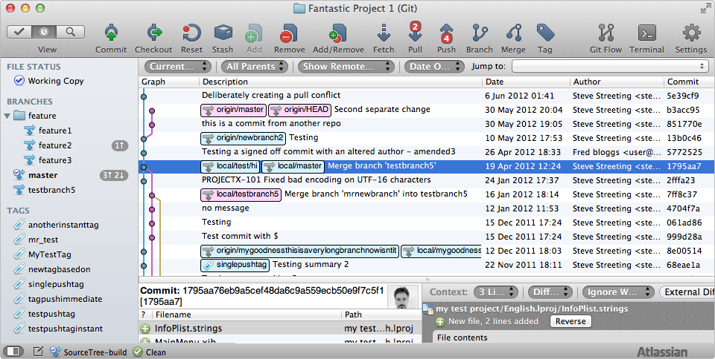
GIT Tutorials
Merging, Branching, Collaboration
Cloud Backup
Feature Branches For Guilt-Free Experimentation

Slide 6
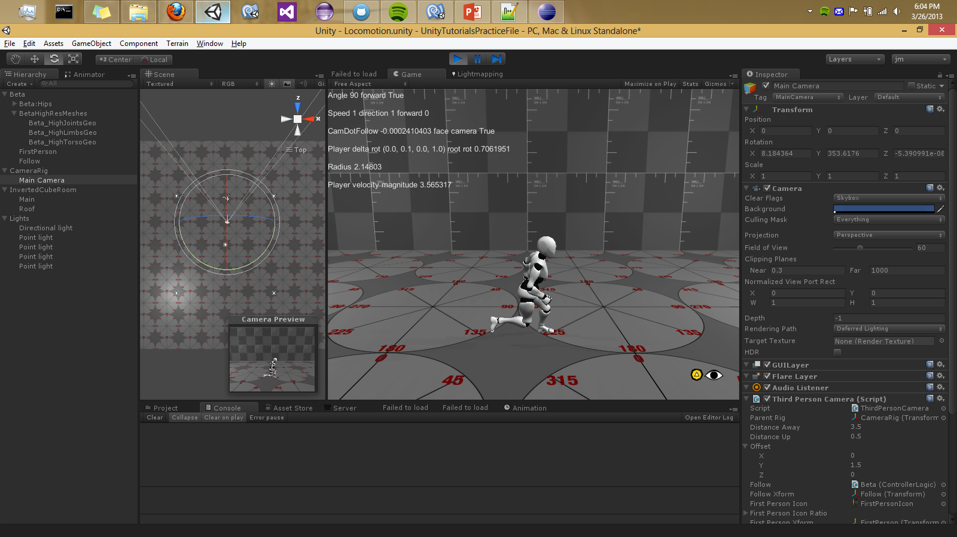
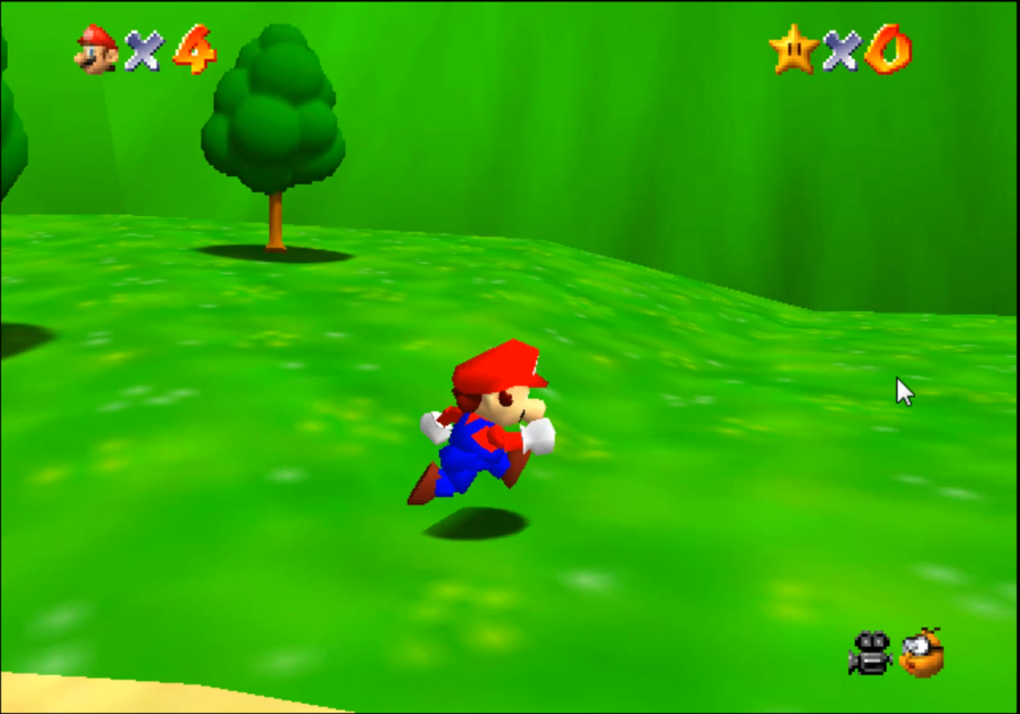
Camera Tutorials
There isn’t a good solution in Unity Asset Store
First person, and 3rd person elements
  Flexible and useful for any 3d project
Notes:
Tutorials:
Follow Behind Camera
Compensating for wall collisions
Targeting / Camera Repositioning
First Person Look
Camera Polishing
Free Third Camera Mode

Slide 7
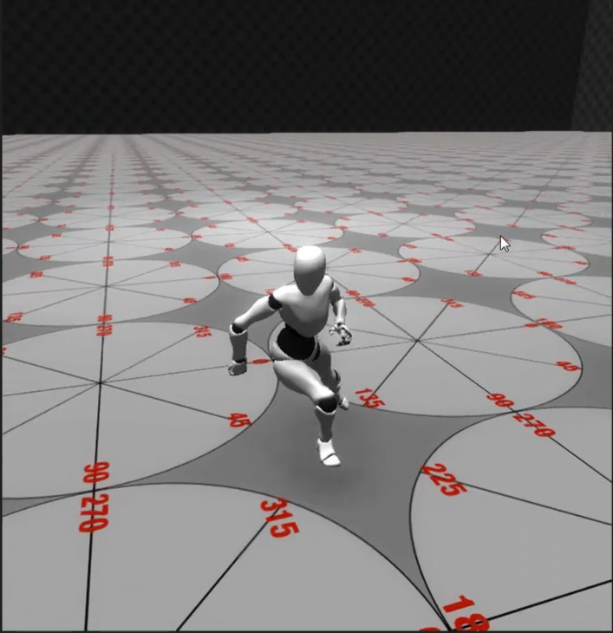
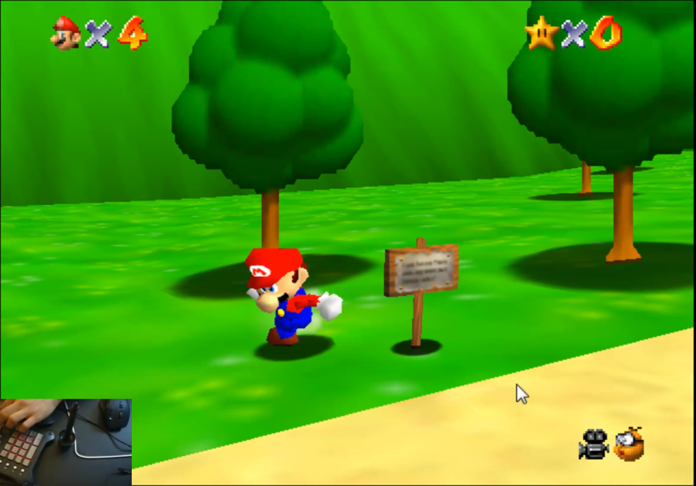
Mecanim Tutorials
Animation retargeting with Mecanim saves time
Takes advantage of free Unity animations (free programmer art)
Notes:
Mecanim: Up and Running
Creating Basic running and idle nodes
Controller Logic Basic running and idle
Blending blend tree walk, run, job, sprint
Pivoting from idle and moving states
Using state and transtion intromation
Jumping and animation clip curves

Slide 8
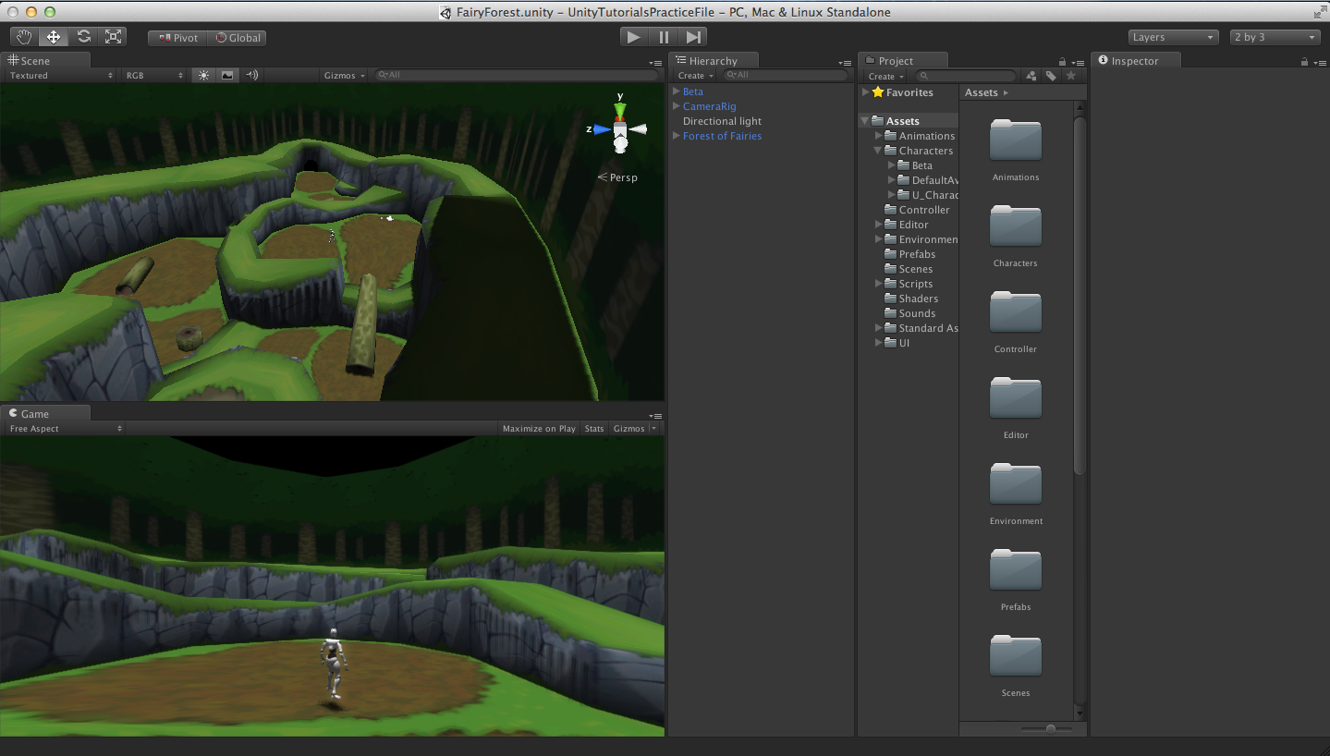
Live Demo

Slide 9
Guide for Future Developers
Mass Effect style over the shoulder camera
Gears of War weapon crosshair targeting camera
  Resource reference asset store soldier
Mecanim 2D blend trees
Using the camera frustum to keep camera viewing volume in the game scene.

Slide 10
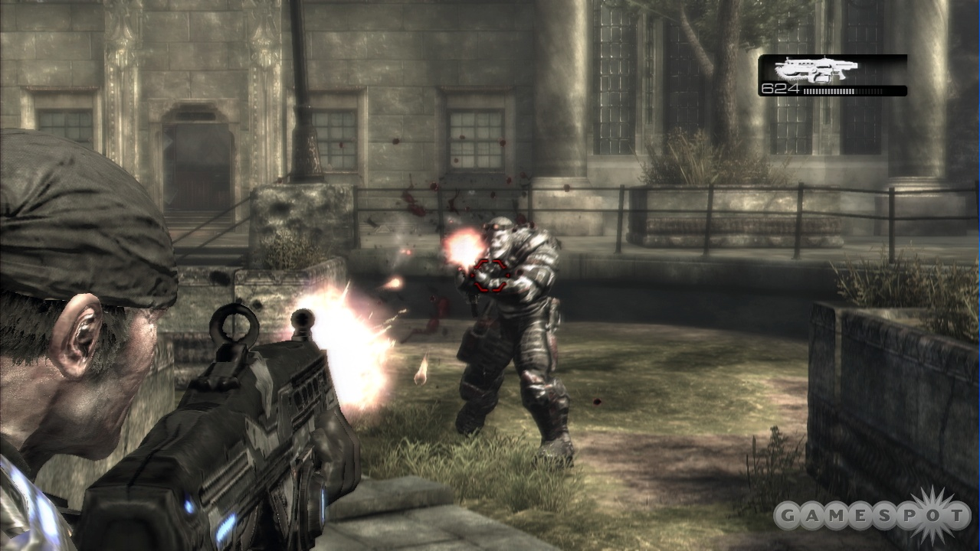
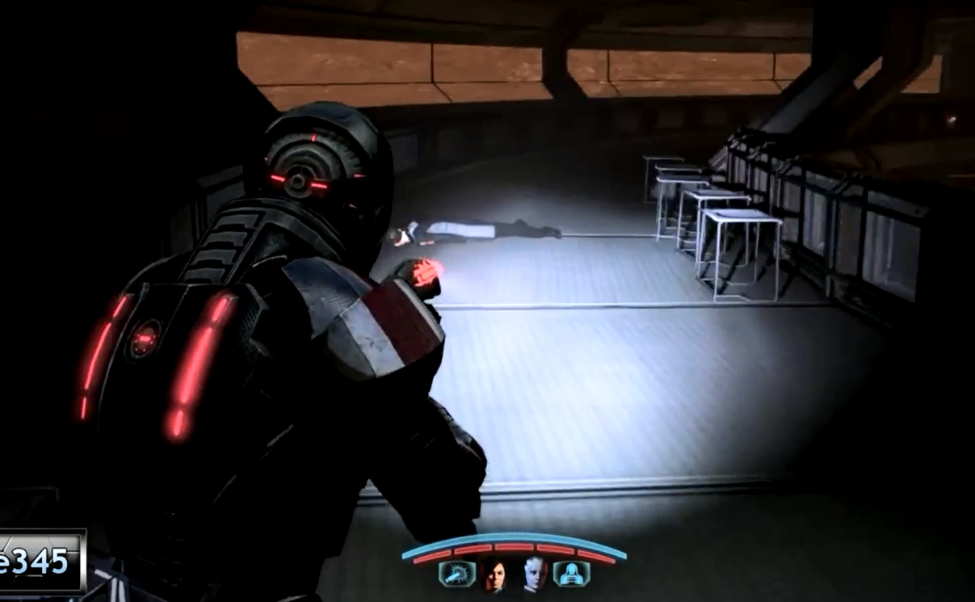
Future Camera Tutorials
Mass Effect over the shoulder camera
Weapon crosshair targeting camera
Notes:
Basing camera algorithm on popular games such as Mass Effect

Slide 11
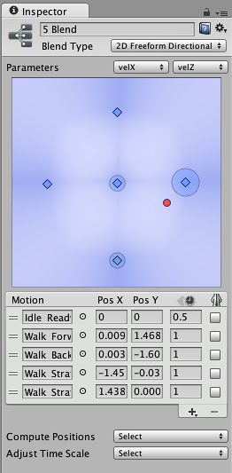
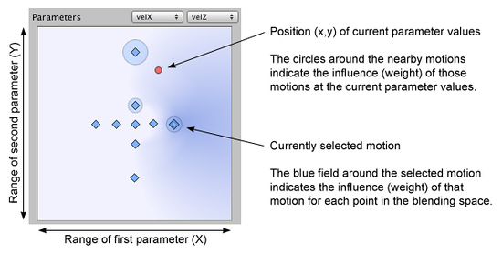
Mecanim 2D Blend Trees

Slide 12
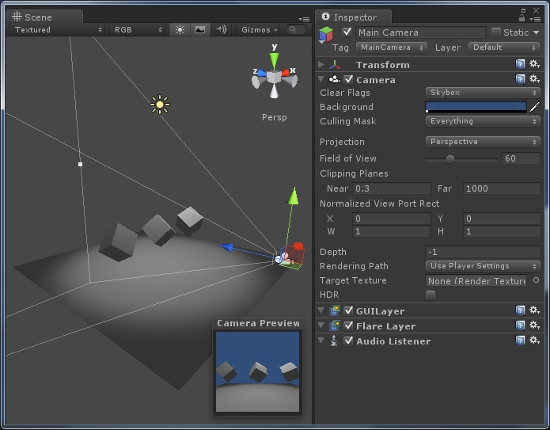
Camera Frustum Camera Viewing Volume

Slide 13
Questions?

