Slide 1

AI in Research Libraries: Supporting Research in the Age of AI
Slides were modified following presentation to add additional links promised, a discussion summary slide, and to increase accessibility.
Virginia (Ginny) Pannabecker | vpannabe@vt.edu
Assistant Dean and Director, Research Collaboration and Engagement
University Libraries, Virginia Tech
April 8, 2025 | For the AI in Research Operations LinkedIn Group Organized by Anna Aston, Imperial College, London

Slide 2
Agenda
How Libraries are Leading the Way in AI for Research
Strategies & Policies | Partnership & Services
All Group check-in: Fellow Librarians, what examples have you seen at your institution or in our profession?
Small Group breakout discussions
Small Group report backs
Wrap up

Slide 3


Libraries in Research Institutions
Image generated via prompt to Microsoft Copilot
Notes:
Image generated by Copilot within Power Point

Slide 4



Libraries partner for research across institutional levels & areas
Office of Research, Office of the Provost, Faculty Affairs
→ Research Information Management systems, Open Access and Data Sharing policies, Research Funding, Research Impact
Colleges, Departments, Programs
→ Research skills in curriculum, Guest lectures, Training for faculty, graduate students, undergraduates
Individual Researchers, Research Teams, Community
→ Consultations, Research partnership, Tools and methods, Events

Slide 5



Strategies & Polices

Slide 6
Libraries influencing policies and strategies
Professional Communities
Association of Research Libraries – Guiding Principles
ACRL *draft* AI Competencies for Academic Library Workers
ACRL AI Discussion Group – Join us!
Responsible AI in Libraries and Archives IMLS funded project
AI policies across the globe: Implications and recommendations for libraries - Leo Lo
Social Intelligence in the Age of AI – Alexia Hudson-Ward
The Artificial Intelligence Disclosure (AID) Framework – Kari Weaver
Restricting Innovation: How Publisher Contracts Undermine Scholarly AI Research – Rachael Samberg
Fair use rights for text and data mining and artificial intelligence for research and teaching
Institutional
Vendor licensing text for research use
Use of AI for research – promoting institutional and external policies (including journal policies)
AI literacy, training, evaluation guidance for use case, accuracy, reliability, biases
Selection and testing of tools
Digital literacy for AI use – critical thinking and evaluation
Research intelligence for success in emerging areas, including AI
Development and experimentation
AI in Research policy example from the Office of Research and Innovation at Virginia Tech, Guidance: Using Artificial Intelligence During Research Activities
Notes:
Librarians and information professionals have a deep understanding of how search tools have developed, and are experienced in evaluating and supporting others in evaluating the use of tools and their outputs for different contexts, and for biases – critical evaluation

Slide 7

Partnership & Support for Research

Slide 8
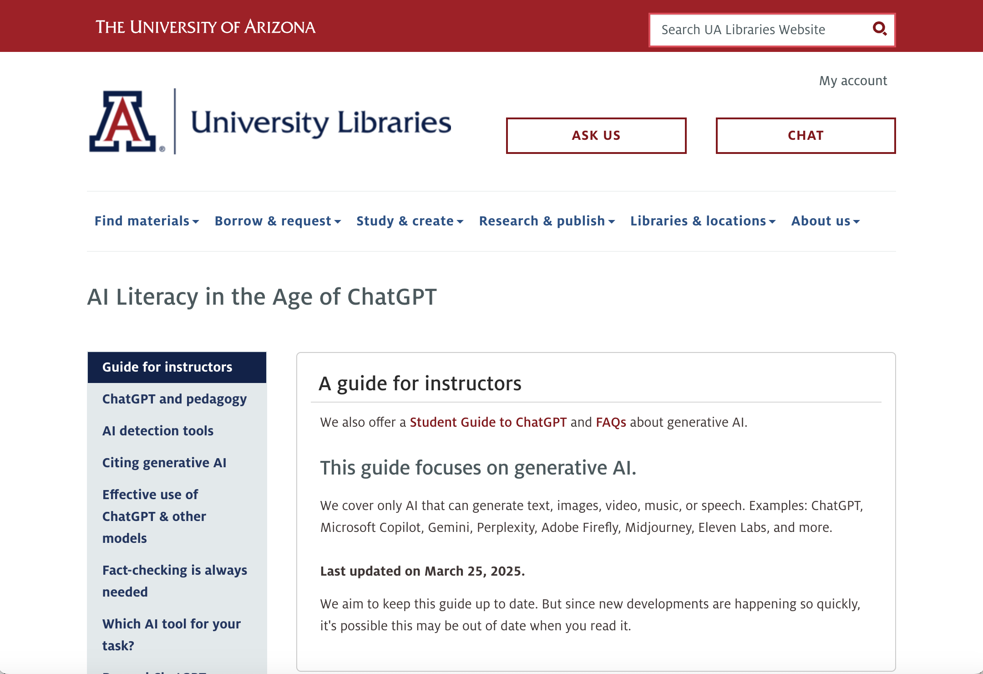
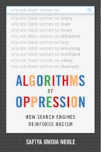
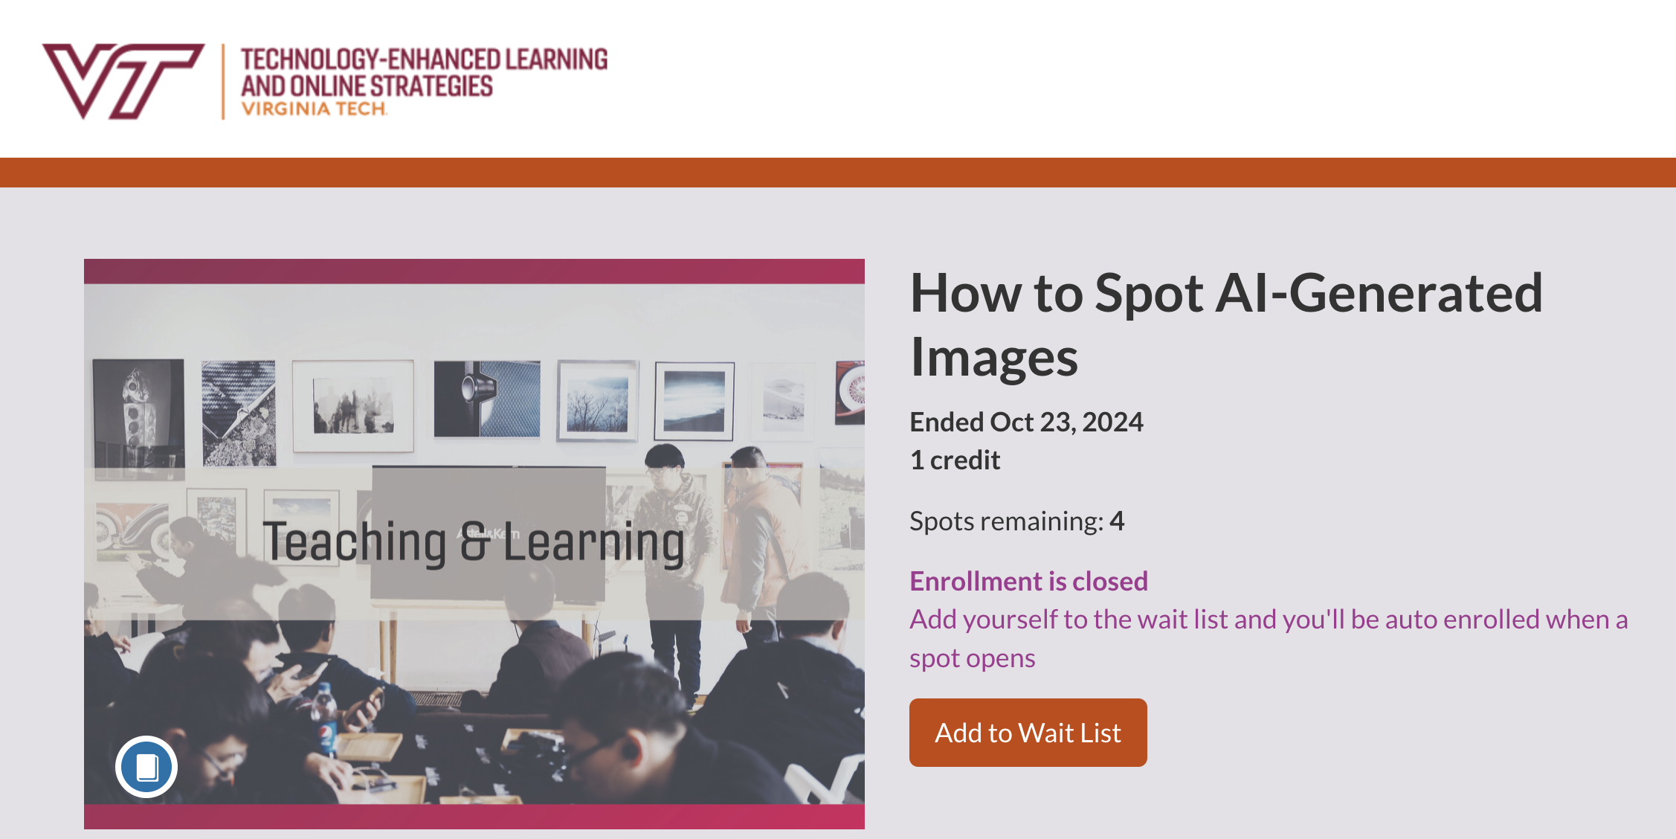
Digital and AI Literacy ----------------- Evaluating AI for context and outputs
AI Literacy in the Age of ChatGPT – University of Arizona
Algorithms of Oppression
How Search Engines Reinforce Racism
- Safiya Umoja Noble
Digital Literacy at University Libraries Virginia Tech
Julia Feerrar
Holistic approaches to digital literacy: Perspectives from library partners - Kirsten Dean, Julia Feerrar, Katlyn Griffin, Kelsey Hammer
Kayla McNabb, Assistant Director, Teaching and Learning Engagement at University Libraries at Virginia Tech

Slide 9
Evidence Synthesis -------------- Literature Reviews (1 of 2 slides)
Evidence Synthesis
Developing novel approaches for comprehensive, systematic reviews
Guides and research on comparing AI tools
Cozette Comer and Bipasha Banerjee at University Libraries at Virginia Tech are developing project-specific AI approach for screening records for relevance in large reviews
Journal of the Medical Library Association
Example journal policy on AI use in journal submissions and recent articles on AI and evidence synthesis
JMLA policies on use of AI
Topic specific screening tools
Making the most of Artificial Intelligence and Large Language Models to support collection development in health sciences libraries

Slide 10
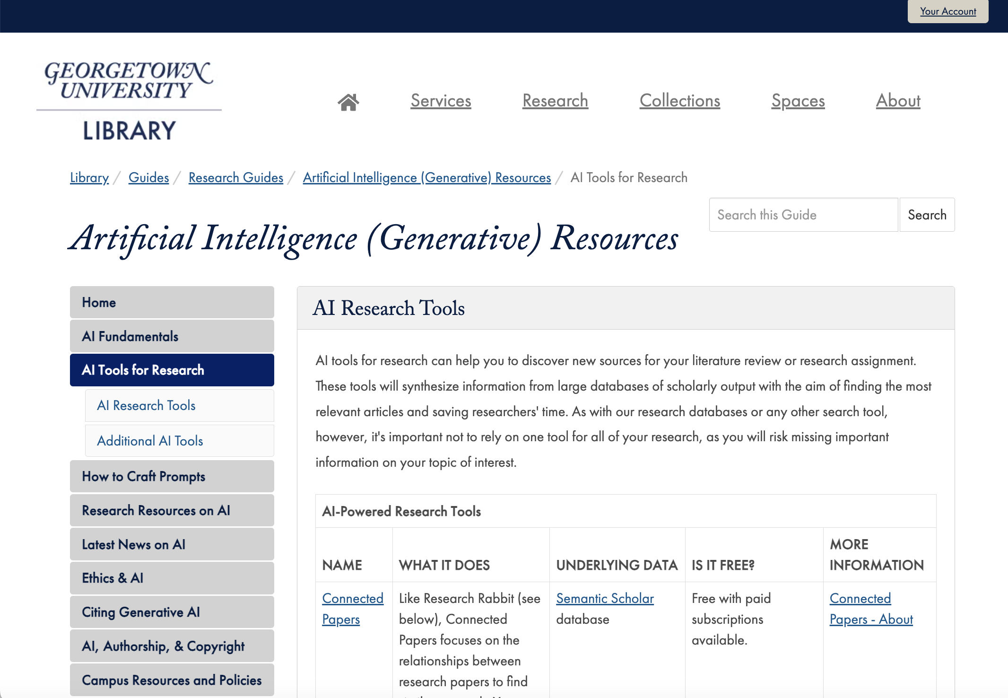
Evidence Synthesis -------------- Literature Reviews (2 of 2 slides)
Georgetown University Library – guide on Artificial (Generative) Resources
– AI Research Tools page with comparison chart
Rapid Research Results / General Literature Reviews
Variety of tools, guides, research, and presentations from libraries and librarians provide considerations and tips
AI Tools for Researchers and Publishing Tips provided by Sarah Over of University Libraries at Virginia Tech
Empowering Research: Unveiling the Potential of Elicit, Consensus, and ResearchRabbit - Breanne Kirsch – review of tools including licensing options; a presentation from the Generative AI in Libraries conference, inaugural year

Slide 11
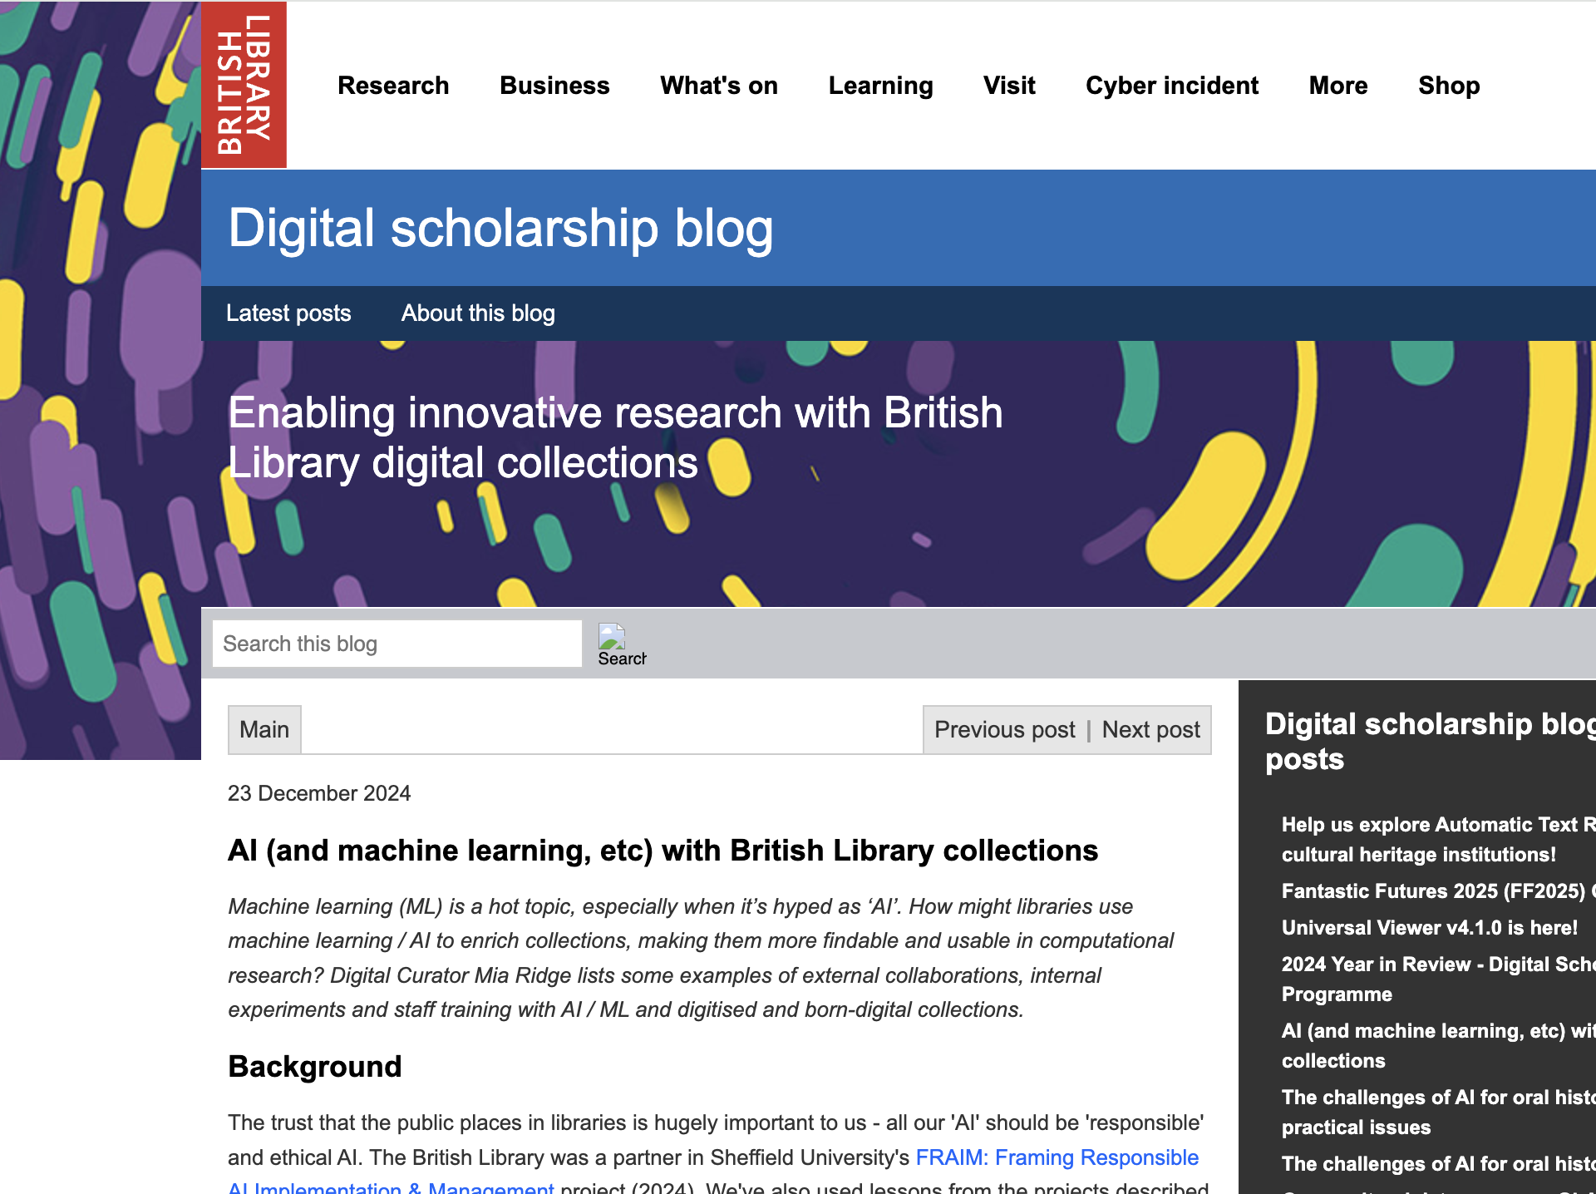
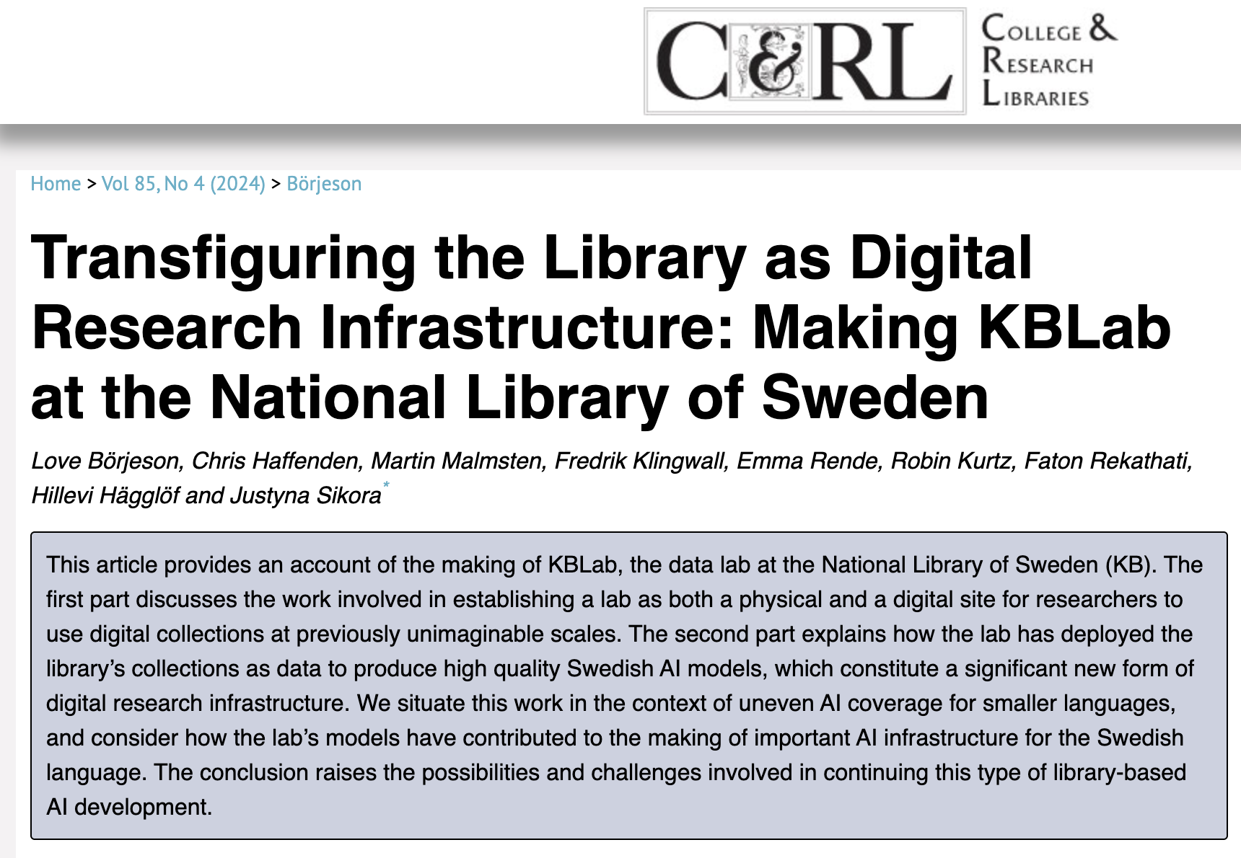
Textual & Image Analysis ------------------ Transcripts, Sentiment, Big Datasets or Collections
Transfiguring the Library as Digital Research Infrastructure: Making KBLab at the National Library of Sweden
AI and Machine Learning with British Library Collections
Jason Higgins, University Libraries at Virginia Tech – AI for processing transcriptions of oral histories
Chreston Miller, University Libraries at Virginia Tech - Machine Learning and Natural Language Processing for sentiment analysis of social media posts
Bill Ingram | University Libraries at Virginia Tech - Machine Learning, AI to analyze large document databases, such as Theses and Dissertations archives (GitHub)
Yinlin Chen, University Libraries at Virginia Tech – AI and deep learning for large biomedical image dataset curation with librarian review

Slide 12
Approaches to Improve and Scale Chat Reference and Research Assistance
Assessing Chat Research Tools to Improve the Tools or to increase Successful Interactions
John DeLooper and Michelle Ehrenpreis - Artificial Intelligence in the Library: Assessing Chatbots and ChatGPT – presentation at ACRL 2025
Jason Coleman - How to Augment Retrieval Augmented Generation. Generative AI in Libraries 2024 virtual conference. Improving results from Generative AI research tools
Developing Chat Bots
Sharesly Rodriguez, Nick Szydlowski and Jessie Cai* Library-Led AI: Building a Library Chatbot as Service and Strategy – paper in ACRL 2025 conference proceedings

Slide 13
All Group Check-In
Fellow Librarians, what examples have you seen at your institution or in our profession?

Slide 14


Small Group Break Outs
How do you interact with libraries in your work or institution?
Select a group member to take notes and one to report back
What library-led AI or research support initiatives have been most valuable to research?
What would you like to see from libraries as AI continues to evolve?

Slide 15

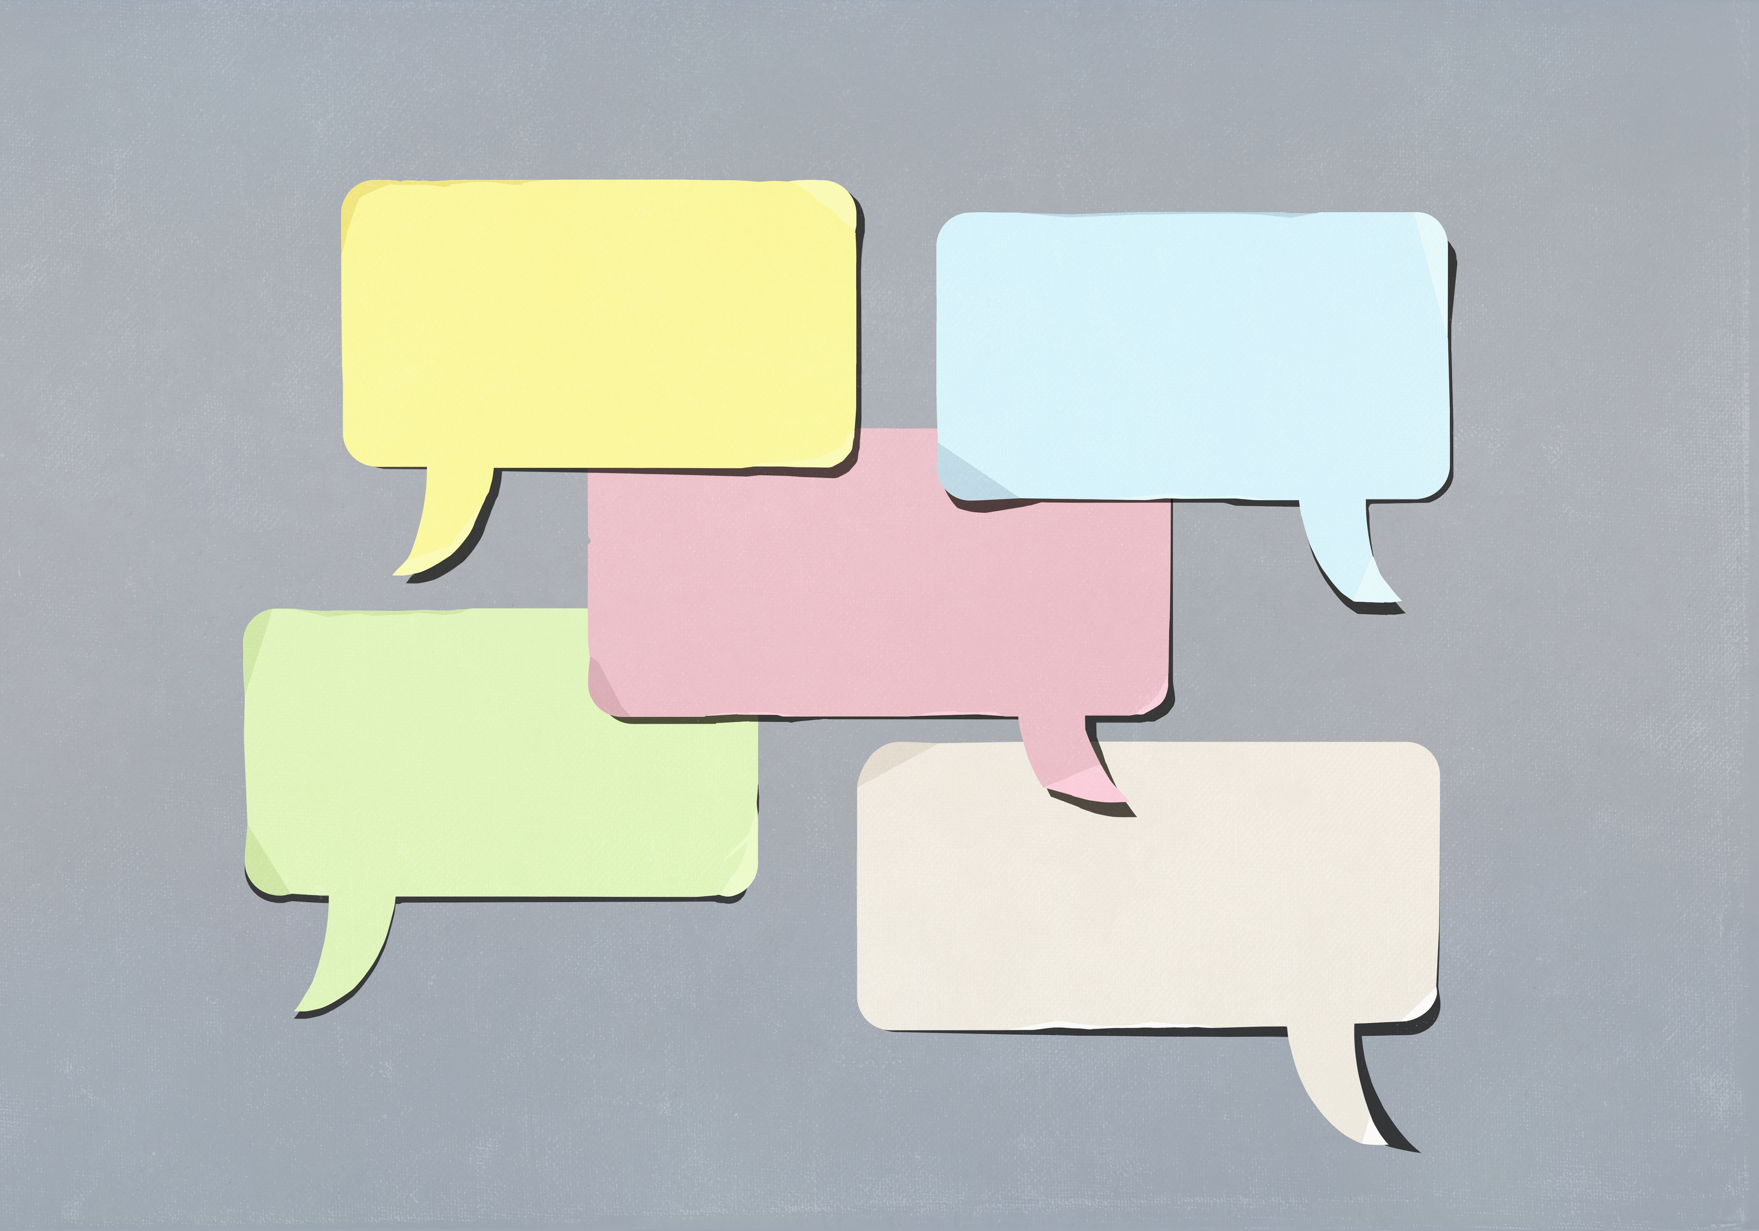
Group Report Backs
How do you interact with libraries in your work or institution?
What library-led AI or research support initiatives have been most valuable to research?
What would you like to see from libraries as AI continues to evolve?
Notes:
https://padlet.com/vpannabe/how-do-you-interact-with-libraries-in-your-work-or-instituti-abj4f8nvibe9hme7

Slide 16
Librarians and Information Professionals in the Age of AI -- Discussion Summary
Librarians and information professionals, in partnership with communities, have deep expertise and experience in human engagement with information. In methods for discovering, accessing, organizing, critically appraising, synthesizing, and sharing information; and in information systems and technology.
In the age of artificial intelligence, we are deeply involved and embedded in exploring new research techniques, using machine learning, natural language processing, developing large language models or small language models-based AI tools for specific research endeavors.
As reflected in this discussion, we are integral partners in AI literacy, prompt engineering training, in thinking through responsible AI use, critical evaluation of AI tools, and how to work with our communities to promote reflection on selecting methods and tools for context and reliability, with data security in mind; and to gauge the biases that may be inherent in AI models, considering how these will affect results and how to mitigate these effects.
As we move forward, libraries are sharing insights in scholarship and practice: on complex contractual agreements, intellectual property considerations, AI to increase efficiency of large dataset curation, AI for accessibility of digital materials, AI and challenges with machine translation, making space for those who prioritize methods that avoid AI use, and more. I'm excited to see what we all do in this space working together.

Slide 17

Thank you!
Image by Alexa from Pixabay

