Slide 1
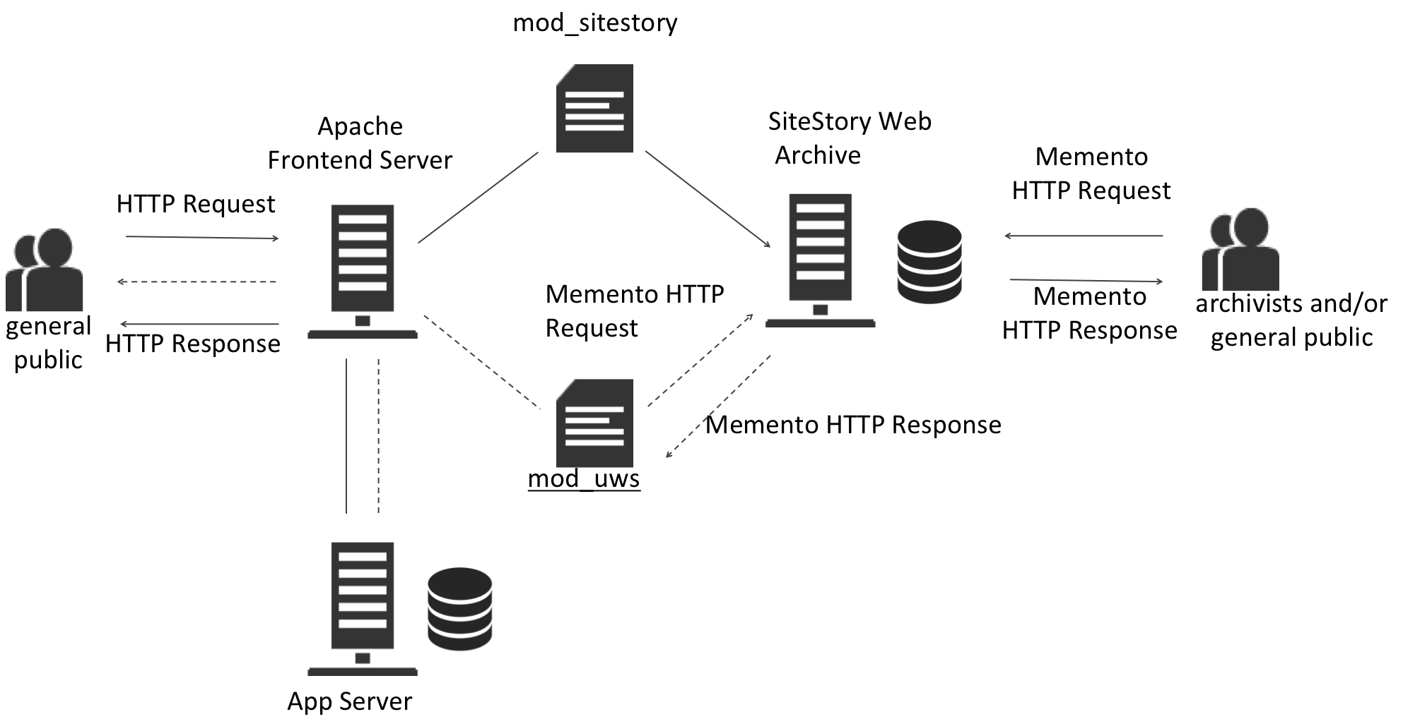
Using Transactional Web Archives To Handle Server Errors
Zhiwu Xie¹, Prashant Chandrasekar², and Edward A. Fox²
¹University Libraries and ²Department of Computer Science, Virginia Tech, Blacksburg, VA, USA
Motivation
The low coverage of existing web archives may be attributed to the crawler-based web archiving approach that dominates the web archiving community. More comprehensive web history is only possible by shifting to transactional web archiving. However archiving web transactions requires cooperation from the website owner. Typical IT operations are preoccupied with their immediate needs and pay little attention to services whose benefits are longer term. It is therefore crucial to expand the value proposition of web archiving beyond the pledged altruistic cause and make transactional web archives immediately useful to day-to-day IT operations.
Approach
Build a UPS-like service for websites, which leverages the transactional web archive as the “battery”. We present a web archiving application intended to improve website uptime, a core quality of service indicator for web operations. It takes the most recently archived representation of a web resource to handle application server failures. Webmasters benefit from this application because they gain precious time to recover from application server failures without disrupting the majority of their users’ web experience.
Benefits
1) Mask website downtime from the end users
2) Allows time for webmaster to fix server errors
3) More comprehensive web archiving than crawlers
4) More persistent than web cache
5) Finer granularity than regular backups
System Architecture
Assuming the typical 3-tier web server architecture, we includes SiteStory, a transactional web archiving tool developed by Los Alamos National Laboratory. SiteStory has two components: mod_sitestory, an Apache module installed and configured as part of the Apache frontend server, and SiteStory Web Archive, a Java application run in a Tomcat container that uses Berkeley DB to store the archived web content.
We then develop mod_uws, another Apache module installed in the same fromend server to handle server errors.
Error Handling Workflow
The user sends a request to the frontend server
The request is sent to the App Server
The App Server returns 5xx error
mod_uws intercepts the error
mod_uws sends a Memento request to the SiteStory archive
The SiteStory archive returns the most recently archived Memento
mod_uws returns the Memento to the user

