Slide 1
VR4GETAR
CS4624: Multimedia, Hypertext and Information Access
Instructor & Client: Dr. Edward Fox
Team members: Jishnu Renugopal, Christian Richardson, Willem Schmidt,
Mattin Zargarpur, Kevin Zhang, Haiyu Zhao
Virginia Tech, Blacksburg, VA 24061

Slide 2
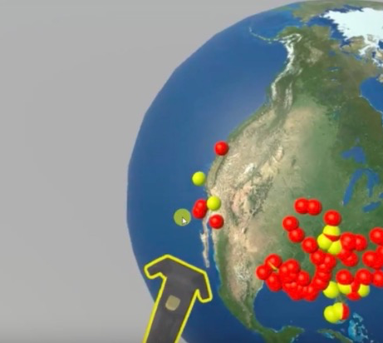
Overview
Global Event and Trend Archive Research
VR interface for GETAR
Tweets, Images
NSF - IIS-1619028 and 1619371

Slide 3
Features
Tweets (with location)
Pictures (with location)
Aggregation of Data Points
Collections
Persistence

Slide 4

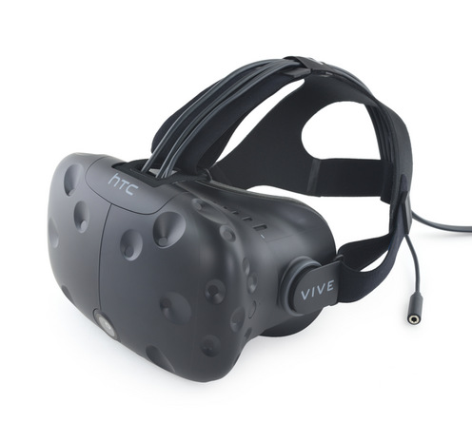

Tools
Unity, C#
HTC Vive
GitHub

Slide 5

Feedback from Dr. Fox
Create and modify use cases
Build an application prototype
Implement use cases
Change design appropriately

Slide 6
Data flow
JPEG images with naming schema for location
ImageData
(JPEG wrapper)
IDATA (Generalized interface for tweets and images)
DataLoader
Tweets in CSV files with location
TextData (Tweet wrapper)
Tweets and Images are placed on Globe
PointGenerator

Slide 7
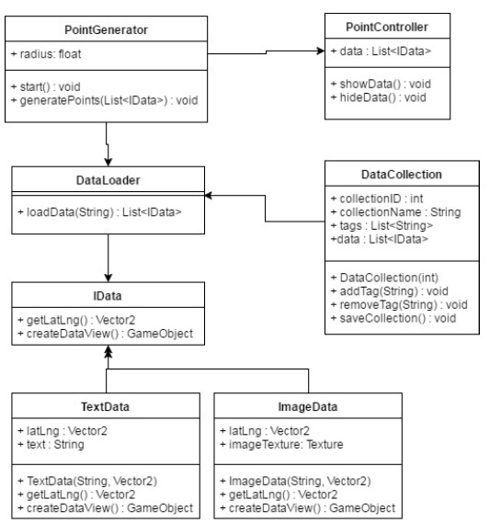
Implementation Design

Slide 8
Demo
https://www.youtube.com/watch?v=0zCEVdCprrA

Slide 9

Questions?

Slide 10
References
Carbotte, K. (2016, April 05). The HTC Vive Review. Retrieved May 02, 2017, from http://www.tomshardware.co.uk/htc-vive-virtual-reality-hmd,review-33520.html
Agile. (2015, September 07). Retrieved May 02, 2017, from https://www.umsl.edu/~sauterv/analysis/Fall2013Papers/Buencamino/AgilePMB.html

