Slide 1
Facebook Historical
Jon Conlen, Matthew Jehnke, Yifan Zhou, Sourabh Shetty, Huanbo Fu
Multimedia/Hypertext - CS4624
Dr. Edward Fox
Virginia Tech Blacksburg VA 24061
April 30, 2019

Slide 2
Outline
Feedback
Website overview
Left To Do
Lessons learned
Acknowledgements
References

Slide 3
Feedback
Who is the user base?
How does the search work?
Did you only realize recently the client didn’t want Facebook?

Slide 4
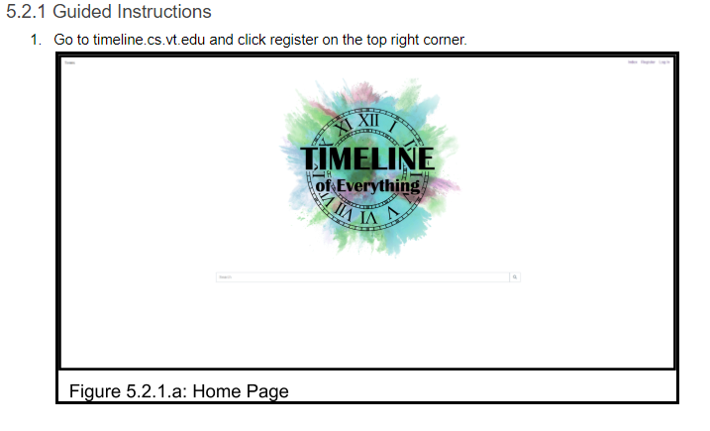
Feedback
User Testing
Guided + Unguided +

Slide 5
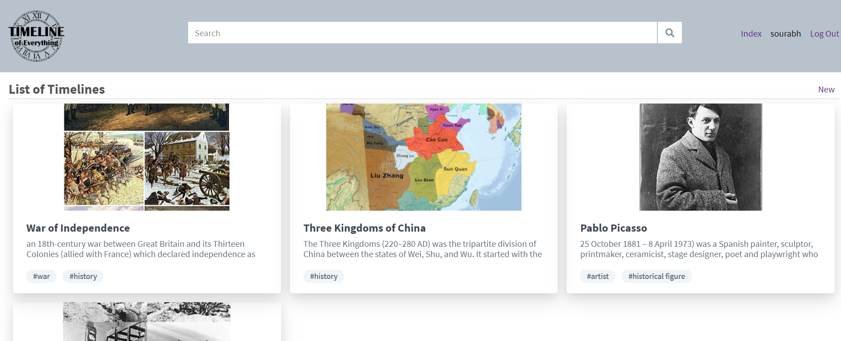
New Feature: Tagging

Slide 6
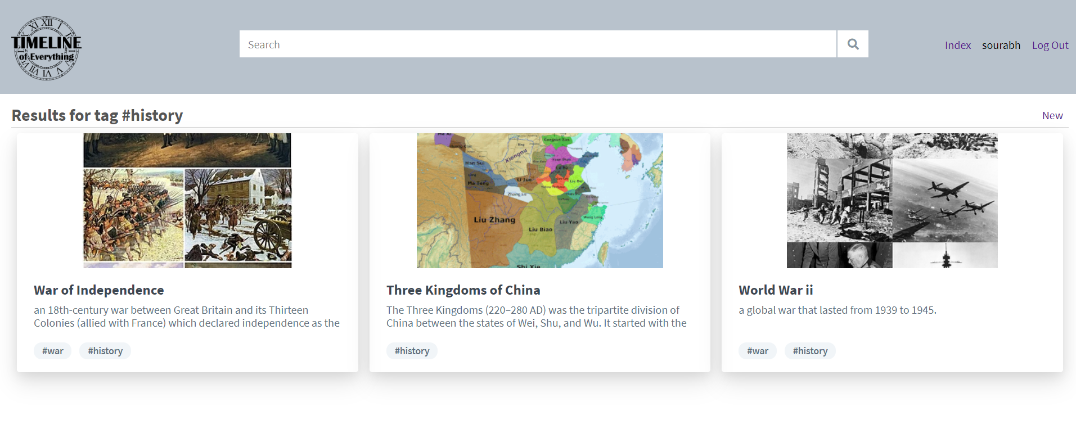
New Feature: Tagging

Slide 7
Website
http://timeline.cs.vt.edu/

Slide 8
Left To Do
Refine style
Add public / private timelines/events
Improve security
Update timeline.cs.vt.edu
Create a separate page for search
Populate database with more examples

Slide 9
Lessons learned
Schedule time to work on the project
Choose the right tool
Design UI/UX before implementation

Slide 10
Acknowledgements
Client: Eric Van de Velde

Slide 11
References
https://timeline.knightlab.com/
http://visjs.org/

