Slide 1
Database Creation and Information Extraction from ETDs
Lamont Banks
Joseph Luke
Client: Venkat Srinivasan
Virginia Tech, Blacksburg, VA
CS 4624, Spring 2013

Slide 2
Project Description
Create a database of data extracted from graduate dissertations to be used for determining why students pursue research.
CRA – Computing Research Association
ETD – Electronic Thesis and Dissertation

Slide 3
XML Tags
<?xml version="1.0"?>
<!-- Basic Information -->
<title />
<research_category />
<author />
<institution />
<submission_year />
<advisor />
<!-- Undergraduate Information -->
<undergraduate_institute_name />
<undergraduate_institute_degree />
<!–- Social -->
<num_acknowedgements_colleagues />
<num_acknowledged_friends />
<!-- Research funding -->
<acknowledged_funding_org_1 />
<acknowledged_funding_org_2 />
<acknowledged_funding_org_3 />
<!-- Research History -->
<prior_research_area_1 />
<prior_research_area_2 />
<!-- Work History -->
<prior_workplace_1 />
<prior_workplace_2 />
<prior_worlplace_3 />
<!-- Origins -->
<country />
<city />
<province_state />

Slide 4
Tagging Documents
ETD Resources
  University repositories
    Virginia Tech
    North Carolina State University
    Wake Forest University, Florida State University, etc.
Manual data extraction
Challenges
  Missing data
    No resume, acknowledgements, biography
  Insufficient information

Slide 5
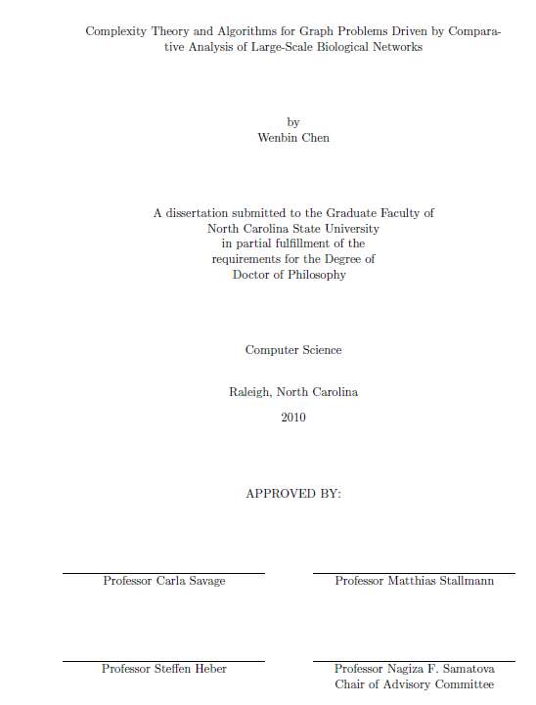
General ETD Structure
Abstract
Title Page
Biography
Acknowledgements
Resume

Slide 6
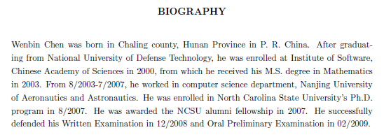
General ETD Structure (cont’d)
Abstract
Title Page
Biography

Slide 7
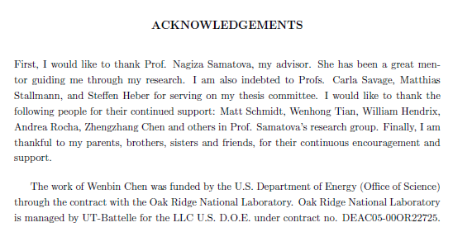
General ETD Structure (cont’d)
Abstract
Title Page
Biography
Acknowledgements
Resume (not often)

Slide 8

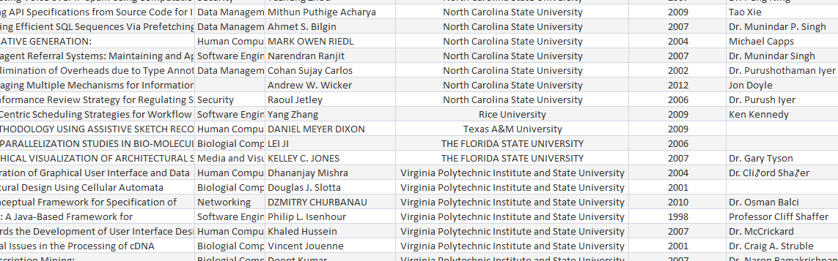
Database
Microsoft Access 2013
  Convenience
  Not limited to Access
~100 ETDs currently stored

Slide 9
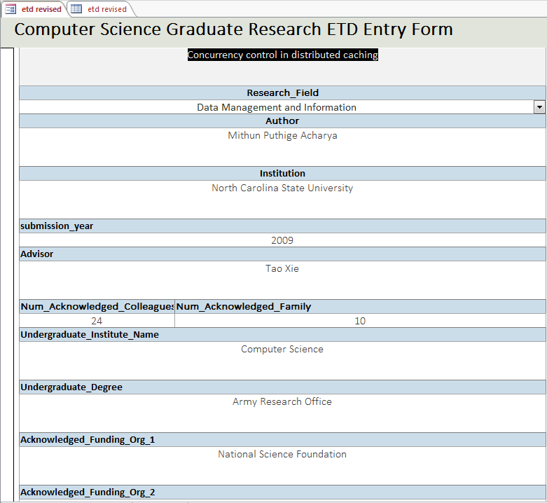
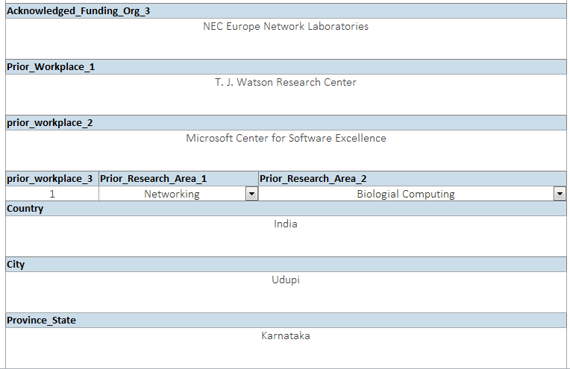
Database (cont’d)

Slide 10
Database Statistics (cont’d)

Slide 11
Database Statistics (cont’d)

Slide 12
Database Statistics (cont’d)

Slide 13
Future
More entries
Expand database structure
Expand XML tags
Process using WEKA

Slide 14
Questions?

