Slide 1
Graduate Education Programs in Wind Energy in North America and Europe
James F. Manwell, UMass Amherst
Jon G. McGowan, UMass Amherst
Andrew H. P. Swift, Jr., Texas Tech
Thomas L. Acker, Northern Arizona Univ
NAWEA Education Committee
Virginia Tech, Blacksburg, VA
June 10, 2015

Slide 2
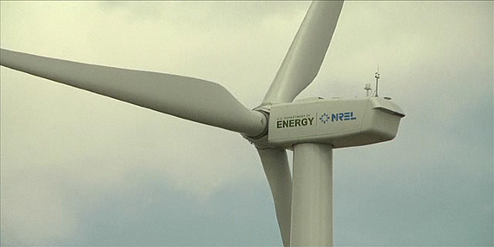
Outline
Motivation
Review of Grad programs
Collaborative MOU

Slide 3
Why Focus on Education?
Need for new and expanded academic programs
Expanding Workforce
New Technologies: Labs, Industry, Academia
Environment
Regulatory and policy
New business and operational paradigms
Grid integration and adaptation
Increased reliability, durability, performance
Drive to reduce costs

Slide 4
US Wind Education: 45 Univ

Slide 6
Observations
45 universities offering wind energy courses
6 graduate certificates in wind energy
  UMass-Amherst, Texas Tech, Penn St, Iowa, Delaware, Clemson
Courses taught across all 45 universities
  30 offer UG courses (maybe as many as 44); of these 22 offer only 1 UG; 8 offer more than 1 UG
  17 offer Grad courses (maybe as many as 20); of these 11 offer only 1 Grad (3 of these are co-convened UG/Grad); 7 offer more than 1 Grad course (4,3,3,3,3,3,2)
  5 online courses (3 UG, 2 Grad)

Slide 7
Mexico
Mexican Center of Innovation in Wind Energy 32 organizations including14 universities

Slide 8
Canada
12 Canadian universities with renewable or sustainable energy programs

Slide 9
European Wind Education
Significant number of universities offer undergrad, MS and PhD level courses in wind energy
Most significant of these programs are:
1) European Wind Energy Master
2) European Academy of Wind Energy
3) European Master in Renewable Energy
See Moses Kärn presentation

Slide 10
University Course Offerings
Univ A
Intro to Wind Energy
Wind Turbine Structures
Univ B
Intro to Wind Energy
Wind Turbine Design
Univ C
Intro to Wind Energy
Univ D
Wind Power Development
Wind Energy Regulation and Policy
Intro to Wind Energy

Slide 11
Collaborative Offerings
Univ A
Intro to Wind Energy
Wind Turbine Structures
Univ B
Wind Turbine Design
Univ C
Grid Integration of Wind and Solar
Univ D
Wind Power Development
Wind Energy Regulation and Policy
Wind Energy Controls
Wind Resource Assessment & Modeling
Courses available online at each university participating in the collaboration

Slide 12
MOU: The Equal Exchange
10 Pay Tuition
10 Pay Tuition
5 Pay Tuition
5 Pay Tuition
Univ A
Intro to Wind Energy
5 from Univ B
Univ B
Wind Turbine Design
5 from Univ A
Univ C
Grid Integration of Wind and Solar
5 from Univ A
Univ D
Wind Power Development
5 from Univ C
Wind Energy Controls
5 from Univ B
Wind Resource Assessment & Modeling
5 from Univ D
No $$ exchanged between universities. Equal number students over a few years

Slide 13





This Work Supported by

Slide 14
Thank You
Jim, Jon, Andy, Tom Contact Info

Slide 16
European Wind Energy Master
Two year Master of Science with four specializations: 1) wind physics, 2) rotor design, 3) electric power systems and 4) offshore engineering.
There are four partner universities
  Delft University of Technology (coordinator)
  Technical University of Denmark
  Carl von Ossietzky University of Oldenburg
  Norwegian University of Science and Technology.
Scientific staff in wind energy of 250 full time equivalents (FTEs) and more
130 PhD students; 110 MSc students annually

Slide 17
Snapshot of other programs
European Academy of Wind Energy
  39 member institutions, most universities
European Master in Renewable Energy
  postgraduate educational experience
  four main topic areas, including:
    wind energy
    solar photovoltaics, solar thermal
    renewable energy grid integration
    ocean energy
  Several universities participating
Large number of different courses in RE and Wind Energy

Slide 18
US Renewable Energy Centers
Institution | Institution
Alfred University | Purdue University
Appalachian State University | Rensselaer Polytechnic Institute
Arizona State University | SUNY Environmental Science and Forestry
Boston University | Texas Tech University
Calhoun Community College | The University of Arizona
California Institute of Technology | University of California, Berkeley
Clarkson University | University of California, Riverside
Colorado State University | University of California, San Diego
Confederation College | University of California, Santa Barbara
Eastern Connecticut State University | University of Central Florida
Eastern Illinois University | University of Delaware
Florida Atlantic University | University of Florida
Grand Valley State University | University of Hawaii at Manoa
Humboldt State University | University of Louisville
Indiana University-Purdue University Indianapolis | University of Maryland, College Park
Iowa State University | University of Massachusetts Amherst
Kansas State University | University of Massachusetts Dartmouth
Lehigh University | University of Michigan
Massachusetts Institute of Technology | University of Minnesota, Morris
Mesalands Community College | University of Nevada, Las Vegas
Michigan Technological University | University of Nevada, Reno
Mississippi State University | University of North Carolina at Chapel Hill
Montana State University | University of North Dakota
National Central University | University of South Florida
North Carolina State University | University of Southern California
Northwestern University | University of Toledo
Oregon State University | Washington University in St. Louis
Pace University | Western Michigan University
Pennsylvania State University

Slide 19
Why we are here
The ultimate objective of the NAWEA educational programs is to realize a future where wind energy is a main stream electrical generation technology, providing affordable, reliable, clean energy with no water consumption and minimal environmental impacts.

