Slide 1

Chapter 8
Management and Leadership
(c) Virginia Tech, Department of Management, Pamplin College of Business. CC BY NC SA 4.0.
Available from: http://hdl.handle.net/10919/105157

Slide 2
Objectives
Identify and apply the four interrelated functions of management: planning, organizing, leading, and controlling.
Understand the process by which a company develops and implements a strategic plan.
Explain how managers direct others and motivate them to achieve company goals.
Describe the process by which a manager monitors operations and assesses performance.
Explain what benchmarking is and its importance for managing organizations.
Describe the skills needed to be a successful manager

Slide 3
Management
Not what It used to be
Autocratic
Employees paid to work, not to think
Not able to participate ot lead
No ability to grow

Slide 4
Today’s Manager
Younger and more progressive
  Growing numbers of women
  Fewer from elite universities
Emphasis is on teams and team building
Managers need to be skilled communicators and team players

Slide 5
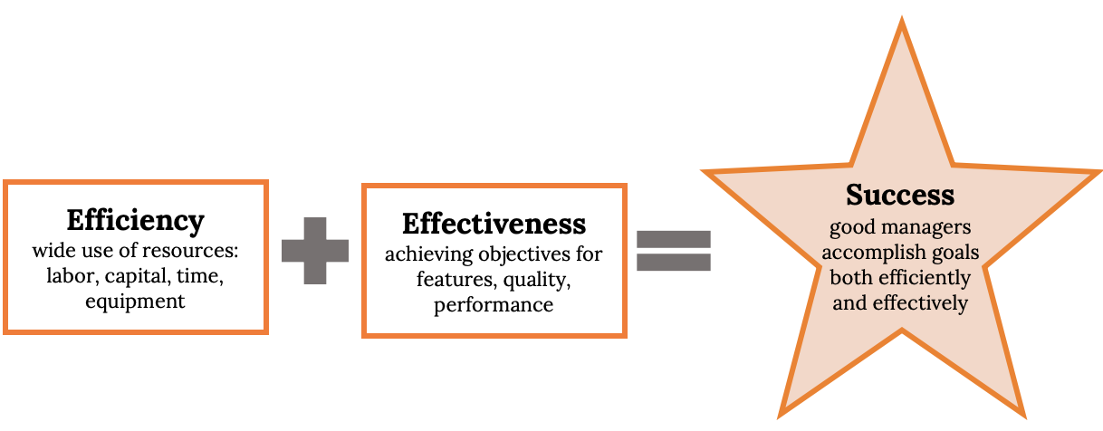
How To Be A Successful Manager
Figure 8.1: How to Become a Successful Manager

Slide 6
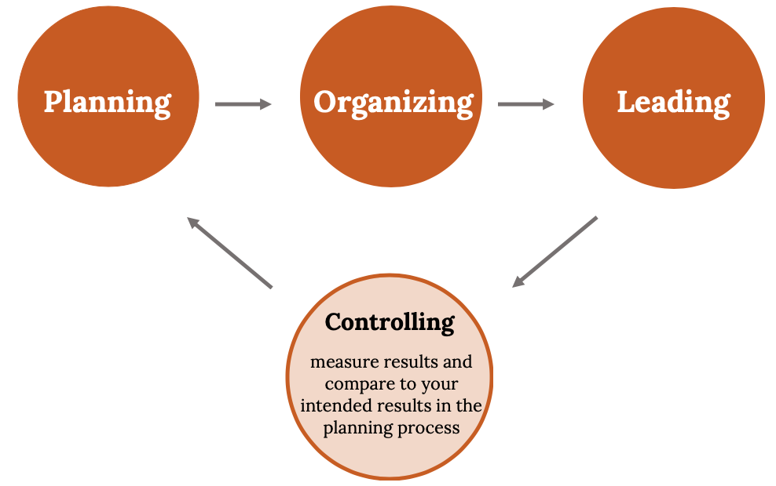
Should You Make The Leap
Figure 8.2: The Management Process

Slide 7
Developing A Strategic Plan
Write a Mission Statement
Define Core Values
Conduct a SWOT Analysis*
Set Goals & Objectives
Develop Tactical & Operational Plans

Slide 8
Planning
Step 1: Developing a Strategic Plan
What is Strategic Planning
A process that establishes an overall course of action for an organization
  Why does the organization exist?
  What value does it create?

Slide 9
Planning– Developing A Strategic Plan
Vision Statement
More than a goal, it’s a broad explanation of where the organization is trying to go.
What’s is its main goal?
What does the organization want to become?
Realistic yet aspiration

Slide 10
Examples of Vision Statements

Slide 11
Planning – Developing A Strategic Plan
Mission Statement
Outlines the organization's fundamental purposes
Why does this organization exist?

Slide 12
Examples of Mission Statements

Slide 13
SWOT – Strengths, Weaknesses, Opportunities, Threats
SWOT Analysis
An assessment of your organization’s fit with its environment.
Analyze the Strengths, Weaknesses, Opportunities, and Threats of the organization.
Examination of external factors that could influence the company in either a positive or a negative way.
    Including economic conditions, competition, emerging technologies, laws and regulations, and customers’ expectation
    Strengths and Weaknesses – focus on the evaluation of the internal factors of the organization while Opportunities and Threats examine the external factors.

Slide 14
Planning – Setting Goals and Objectives
Goals are major accomplishments that the company wants to achieve over a long period.
Objectives are shorter-term performance targets that direct the activities of the organization toward the attainment of a goal.
They should be SMART Goals.
  Specific, Measurable, Attainable, Relevant, Time-bound
Clearly stated, achievable, and measurable: they should give target dates for the completion of tasks and stipulate who’s responsible for taking necessary actions

Slide 15
Goals and Objectives
Goals: Long Term Accomplishments and Company seeks to achieve
    Example: Achieve 10% Return on Sales 1st Five Years
Objectives: Short Term Performance Targets in Pursuit of Goals
Example: Year 1 Sales of $200,00 and profit of $20,000

Slide 16
Tactical and Operational Plans
Tactical Plans:
Shorter Components of the Overall Plan
5 One Year Tactical Plans
Operational Plans:
Short Duration –1-2 Months Typically
Very Detailed Action Steps

Slide 17
What If The Plan Doesn’t Work?
Guess what?
Even with great planning, things don’t always turn out the way they’re supposed to.
Perhaps your plans were flawed.
Maybe something in the business environment shifted unexpectedly.
Successful managers anticipate and plan for the unexpected.
Dealing with uncertainty requires contingency planning and crisis management

Slide 18
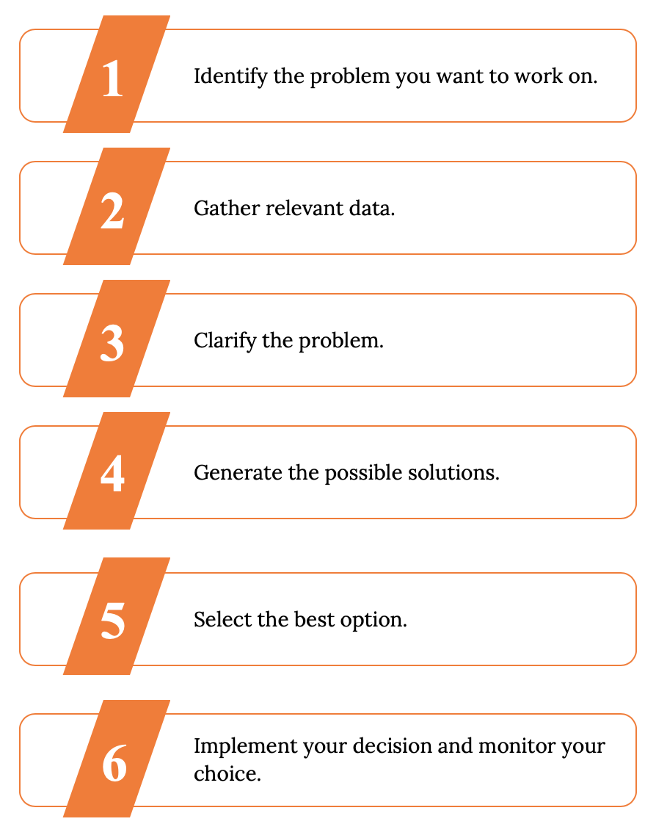
Problem Solving and Decision Making

Slide 19
Contingency Planning & Crisis Management
Managers identify those aspects of the business that are most likely to be adversely affected by change and then plan and practice accordingly.
Contingency Planning
Develop alternative courses of action in case an anticipated change does occur. Also, known as a Backup or fallback plan.
Crisis Management
How do you deal with emergencies Public Relations communications with employees, press, government and general public

Slide 20
Leading
Leaders must:
Communicate a vision and rally others around that vision.
Establish corporate values.
Promote corporate ethics.
Embrace change.
Stress accountability and responsibility

Slide 21
Leading
What do followers want from a Leader?
Respect
Acknowledgement/ recognition
Purpose
Ability to do their best
Know they are safe
One that cares

Slide 22
Leadership Styles
Over time, every manager refines his or her own leadership style, or way of interacting with and influencing others.
An autocratic manager tends to make decisions without input and expects subordinates to follow instructions.
Managers who prefer a democratic (also known as participative) style seek input into decisions.
A free rein manager provides no more guidance than necessary and lets subordinates make decisions and solve problems.
Transactional style managers exercise authority according to their rank in the organization, let subordinates know what’s expected of them, and step in when mistakes are made.
Transformational style managers mentor and develop subordinates and motivate them to achieve organizational goals

Slide 23
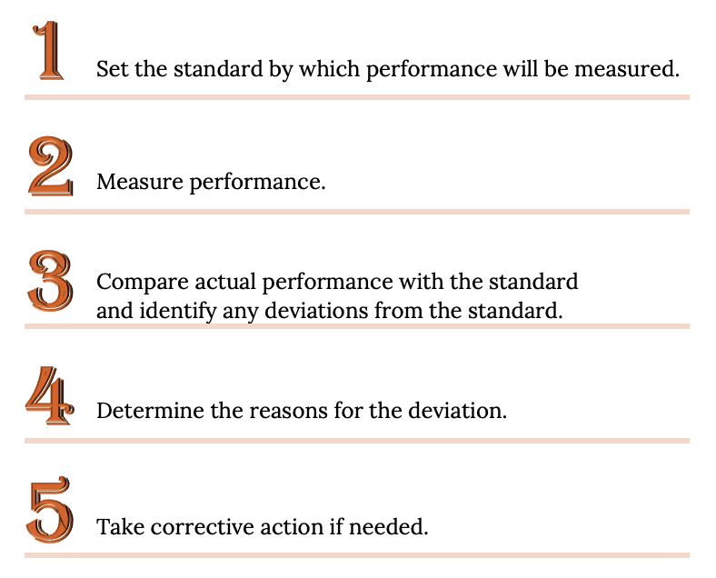
Controlling

Slide 24
Benchmarking
How are we doing? How do we know?
Benchmarking involves comparisons to other organizations’ practices and processes with the objective of learning and improvement in both efficiency and effectiveness.
Compare to competition or other industry likes
May evaluate similar companies
Collaborate with others ... Why?
Exchange Ideas
Improve Efficiency
Maybe Lower Co

Slide 25
Management Skills
Management Skills Needed for Success
Technical
  Ones you need to perform specific tasks (e.g. Accounting, Marketing)
Interpersonal
  Relational skills-the ability to get along with and motivate other people
Conceptual
  Ability to reason abstractly and analyze complex situations
Communication
  Ability to communicate, both orally and in writing
Time Management
Decision Making
  Ability to define a problem, analyze possible solutions, and select the best outcome

Slide 26
Takeaways
Management must include both efficiency (accomplishing goals using the fewest resources possible) and effectiveness(accomplishing goals as accurately as possible).
The management process has four functions: planning, organizing, leading, and controlling.
Planning for a business starts with strategic planning—the process of establishing an overall course of action.
A SWOT analysis assesses the company’s strengths and weaknesses and its fit with the external environment.
Benchmarking is a process for improving overall company efficiency and effectiveness by comparing performance to competitors.

Slide 27
Takeaways
A manager’s leadership style varies depending on the manager, the situation, and the people being directed. There are several management styles.
  An autocratic manager tends to make decisions without input and expects subordinates to follow instructions.
  Managers who prefer a democratic style seek input into decisions.
  A free rein manager provides no more guidance than necessary and lets subordinates make decisions and solve problems.
  Transactional style managers exercise authority according to their rank in the organization, let subordinates know what’s expected of them, and step in when mistakes are made.
  Transformational style managers mentor and develop subordinates and motivate them to achieve organizational goals.

Slide 28
Chapter 8
Q&A
(c) Virginia Tech, Department of Management, Pamplin College of Business. CC BY NC SA 4.0.
Available from: http://hdl.handle.net/10919/105157

