Slide 1

Creating Digital Learning Objects for Use in Large Lecture Classes
*Deborah J. Good, Dept. Human Nutrition, Foods, and Exercise, Virginia Tech
Sina Gallo, Dept. Nutrition and Food Studies, George Mason University
Jeremy Akers, Dept. Health Sciences, James Madison University
*Anita R. Walz, University Libraries, Virginia Tech
Deyu Hu, Technology-Enhanced Learning and Online Strategies, Virginia Tech
*Lujean Baab, Technology-Enhanced Learning and Online Strategies, Virginia Tech

Slide 2
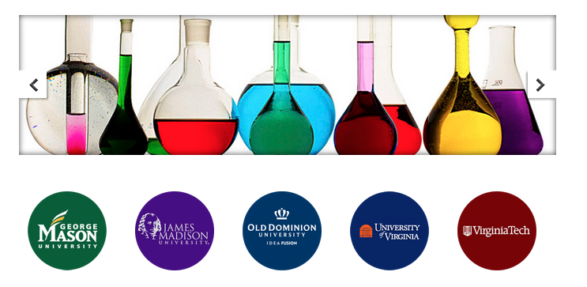
Today we will…
Talk about the project
Funded by 4VA grant
Data from control subjects will be presented
Demonstrate the Digital Learning Object (DLO)
You will get to play with the DLO
Share challenges and Lessons Learned
Recommendations for building a DLO
Future Directions
Questions/Comments
Notes:
Debby to present outline for presentation

Slide 3
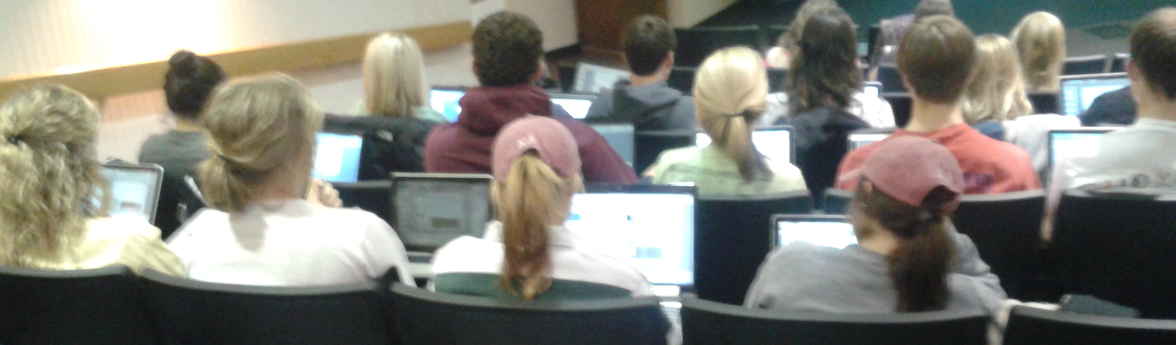
Large Lecture Classes may inhibit active learning
HNFE 3026
~250 students, Human Nutrition, Foods and Exercise required junior/senior level course on Micronutrients.
No textbook
Uses systems-based approach
Students who want to learn more are on their own.
Notes:
Lujean to present/edit

Slide 4
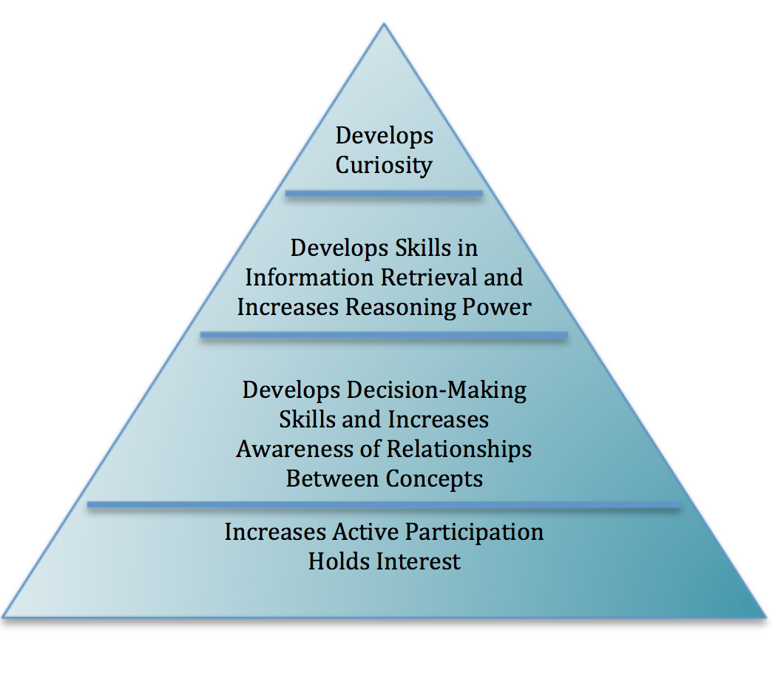
Guided Discovery
Teaching/lecturing ≠ learning
Application of classroom content to real-world issues through guided inquiry.
Unstructured inquiry can be frustrating to students - guides help!
DISCOVERY
LEARNING
GUIDED
Notes:
Lujean to present

Slide 5
Digital Learning Object-Project Goals
To develop an interactive digital learning object (DLO) for use in a nutrition/micronutrients courses
To assess control and exposed students for computer usage, learning styles, content knowledge
Collaboration with GMU and JMU
To make the DLO freely accessible and reusable

Slide 6
The project timeline
Fall 2014
Nov 2014
Jan 2015
Feb 2015
May 2015
July 2015
Aug
2015
Fall
2015
Spring 2016
Weekly to alternate weekly working meetings
Monthly
working meetings
Grant writing
4VA award
$$
Initial planning meeting
Working version ready
VT focus group
Summer II class
JMU class use and assessment
VT and GMU Class use and assessment
Control students assessed
Notes:
Debby (or Lujean?) to discuss timeline for project

Slide 7
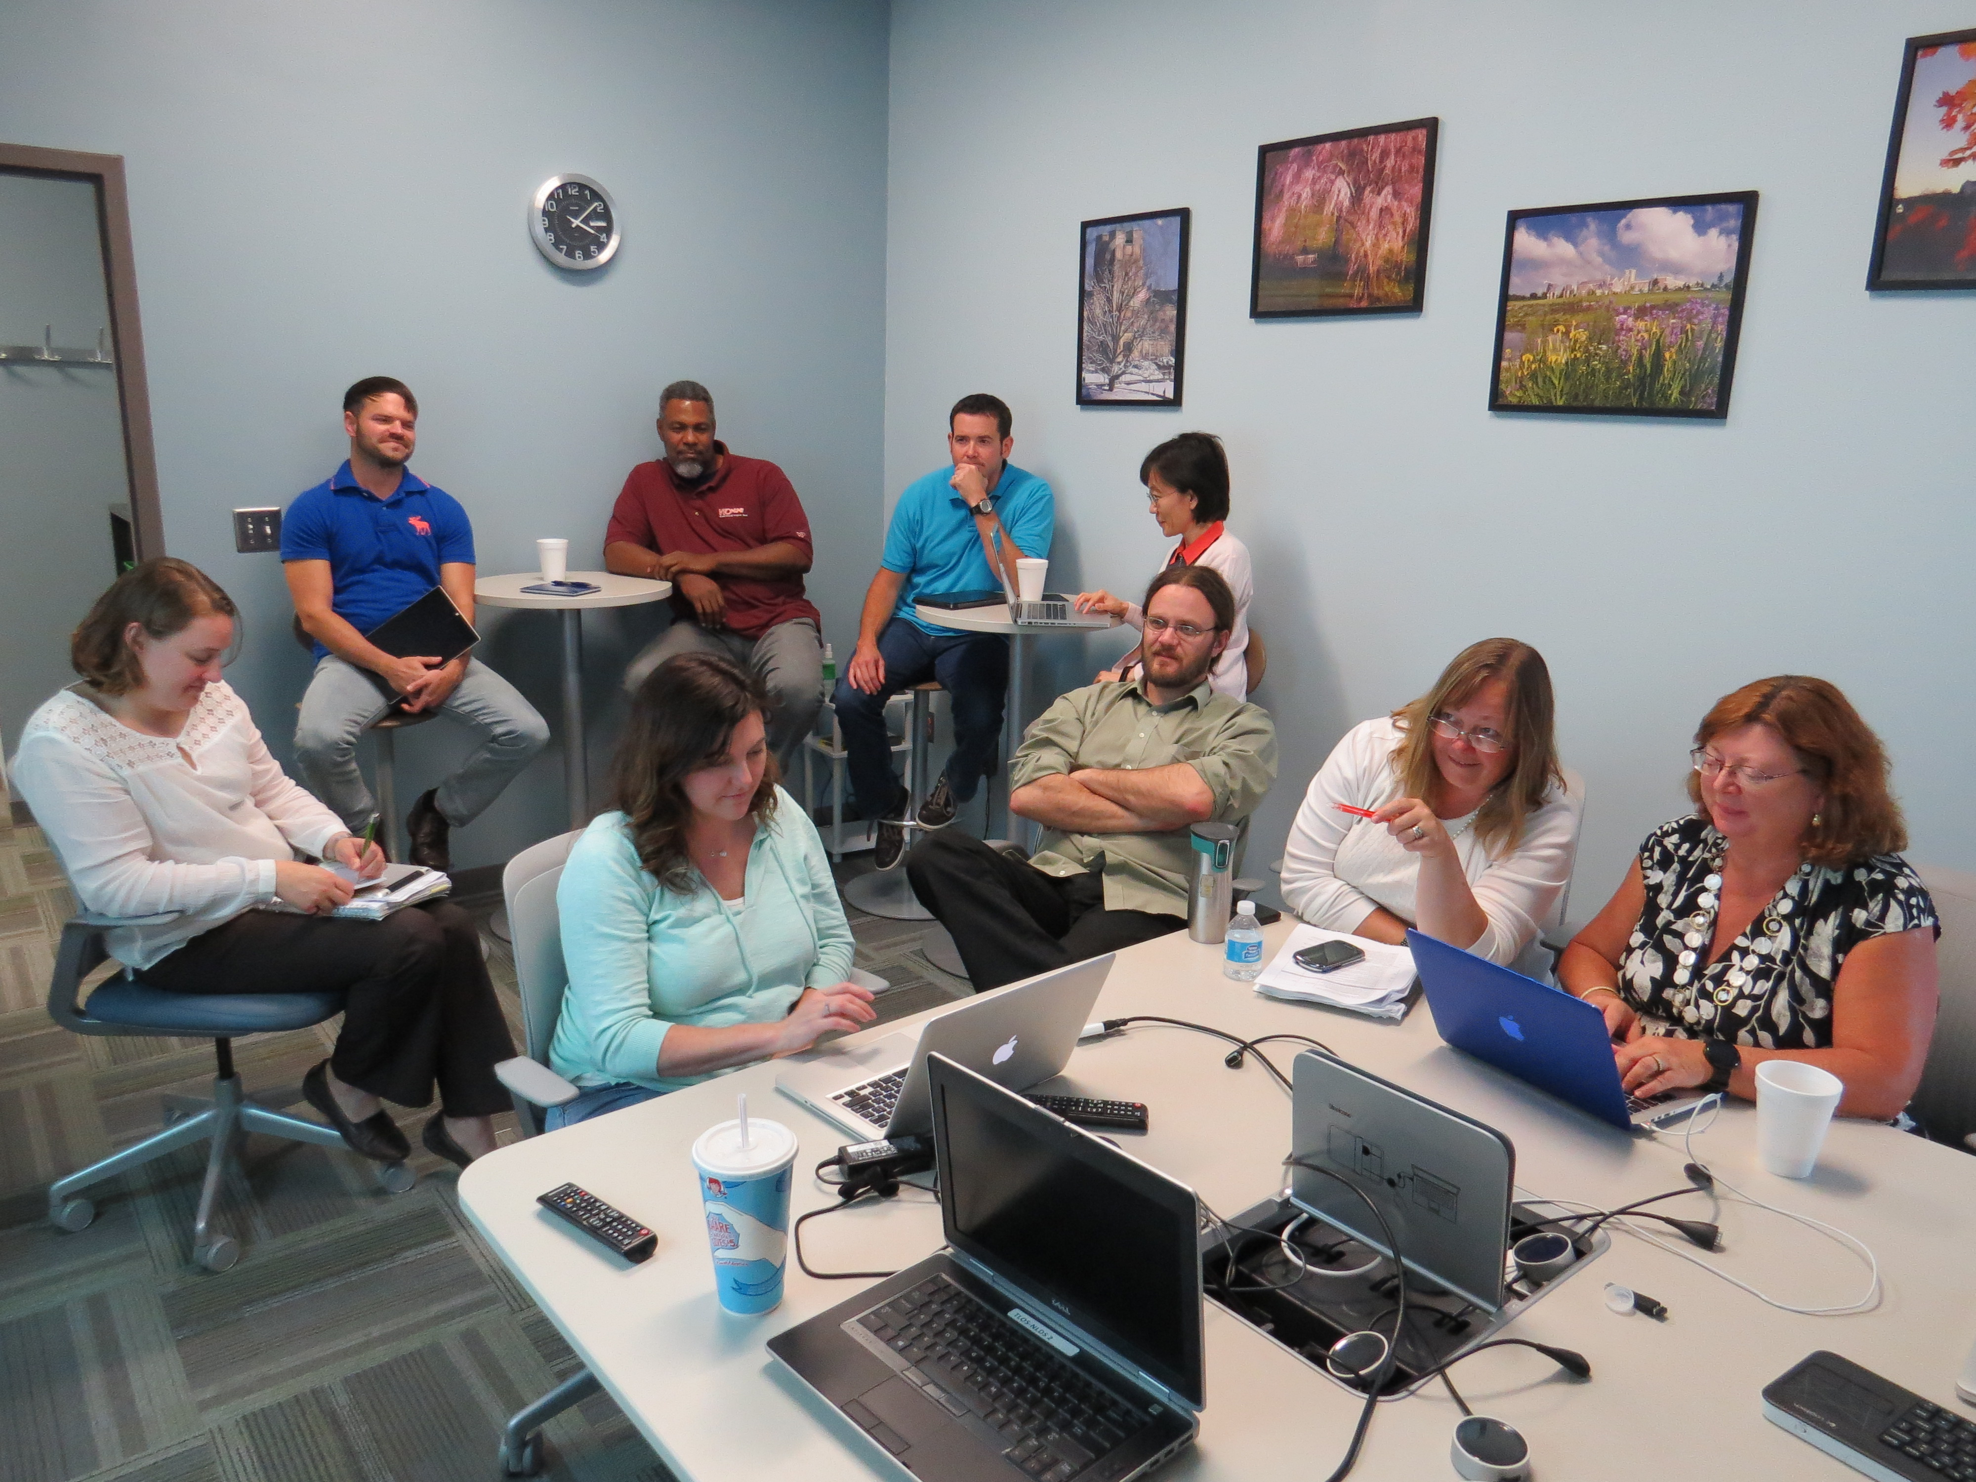
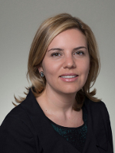
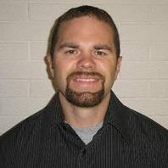
Team Effort!
Eric Gilmore-database design/programming
(TLOS)
Daron Williams
Instructional Design (TLOS)
Sina Gallo-content knowledge
(GMU)
Jonathan Fink Instructional Design
(TLOS)
Deyu Hu-Statistics and computer usage survey design (TLOS)
Anita Walz-IP, copyright and open licensing (Library)
Lujean Baab
Project Manager
(TLOS)
Deborah Good-content knowledge
(HNFE)
Oddbjoern Hestnes-programming
(TLOS)
Jeremy Akers-content knowledge
(JMU)
Cindy Keister-graphics and web design (TLOS)
Notes:
Debby to name individuals involved and their role

Slide 8
Demographics Control Subjects*
Categories | Virginia Tech | JMU | GMU
Total Number | 152 | 5 | 26
Age | 21.36 ± 0.91 | N.D. | 32.38 ±11.86
Gender | female = 112 (73.7%) male = 40 (26.3%) | female = 4 (80%) male = 1 (20%) | female = 23 (88.5%) Male = 3 (11.5%)
Academic Level | Juniors = 56 Seniors = 94 Graduate students = 2 | Graduate students =5 | Junior =1 Graduate students =25
* For this presentation, data from VT students was used for all analyses, while data from JMU and GMU students were used only for the skeletal system questions analysis
Notes:
Debby to present

Slide 9


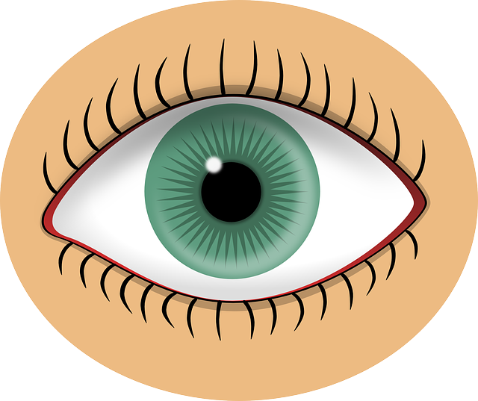
Learning Styles
In researching online learning, (Nguyen and Zhang-2011) found that “tactile” learners did not like the inability to immediately ask questions.
Many researchers said that more studies with control groups need to be done (Rohrer and Pashler (2012)
Research indicates that adult students learn to adapt or compensate for their learning styles to accommodate a wider range of learning experiences (Baab 2008)
Notes:
Lujean to present

Slide 10
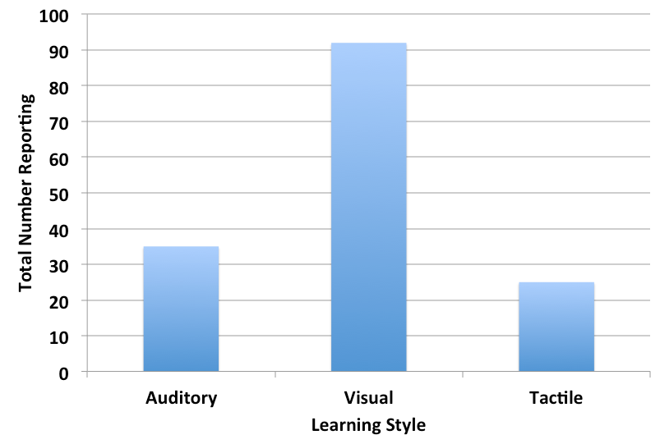
Most are Visual Learners
No correlation with gender
Question:
Will visual learners prefer or learn better with the DLO?
Graph shows total numbers of VT students only in each category reported
Notes:
Debby to present (Deyu statistical analysis)

Slide 11
Learning Style is NOT correlated with…
behavior-based computer skills.
if object should be for fun, explanation of materials, or both.
interest in educational games.
how often they play games.
confidence in using educational game.
experience in educational games.
confidence in using computer for class.
confidence in using social media.
different ways to use internet.
# of social media platforms used.
using of Facebook.
technology self efficacy.
*correlation analysis/Chi Square
Notes:
Debby to present (Deyu correlation analysis/Chi Square)

Slide 12
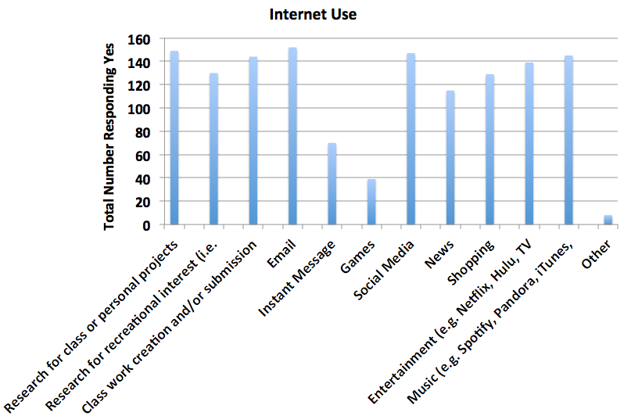
Varied uses for Internet
Few use games
No correlation with gender
Internet activity = 8.99 ± 1.3 different uses/person
Graph shows total numbers of VT students only in each category reported
Notes:
Debby to present. Deyu did statistical analysis
Main points listed—with emphasis on the fact that few in the control group list gaming as something they use the internet for—thus for this group it is good that we did not use games.

Slide 13
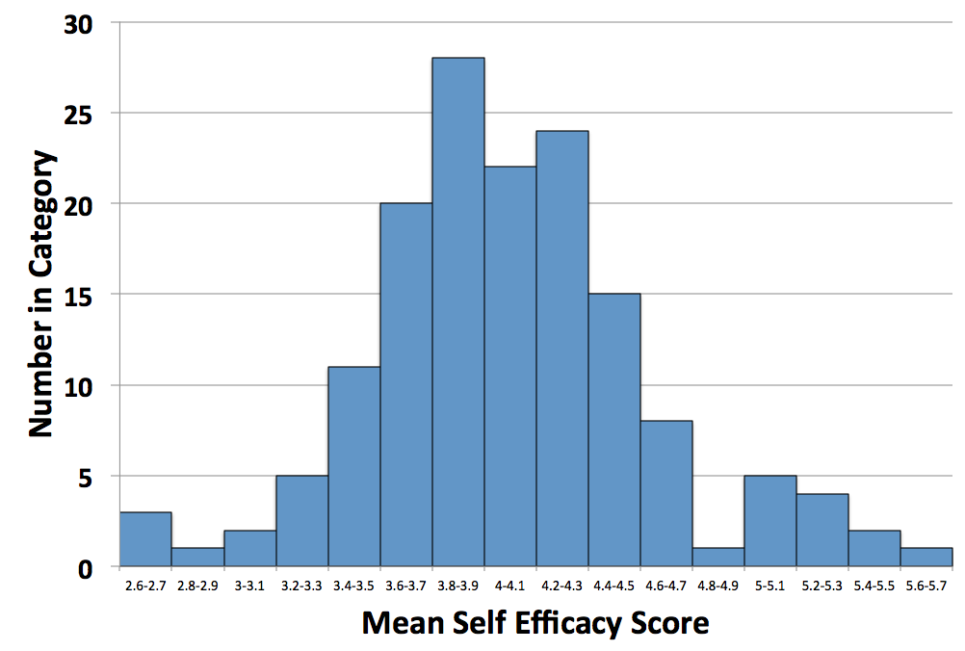
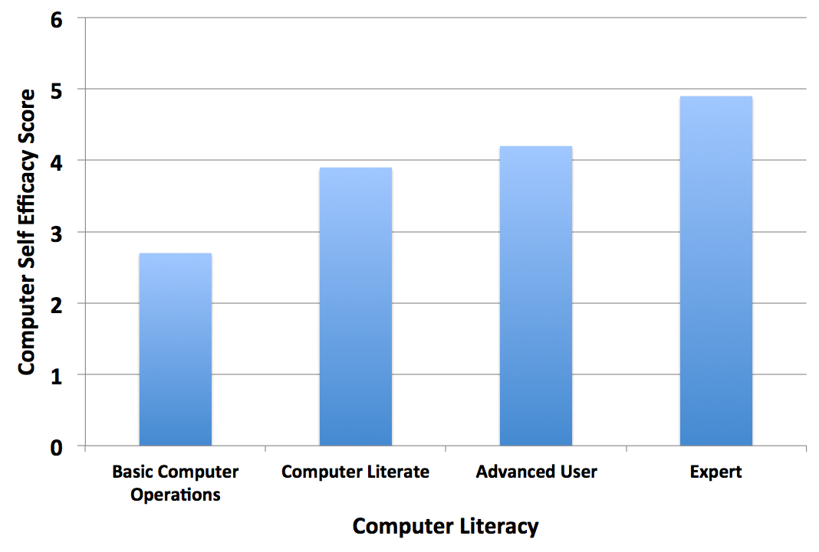
Computer and Technology Self Efficacy
Mean self efficacy score follows a normal distribution
Computer literacy is highly corrected with computer self efficacy
***
(Top) Total numbers of VT students only in each category reported; (Bottom) Score of VT students only, based on a set of technology/computer use questions; One-way ANOVA
Notes:
Debby to present Basically, computer self-efficacy follows a normal distribution, but computer literacy is highly correlated with computer self efficacy score. Self efficacy score was determined using a set of technology/computer use questions (listed in appendix)

Slide 14
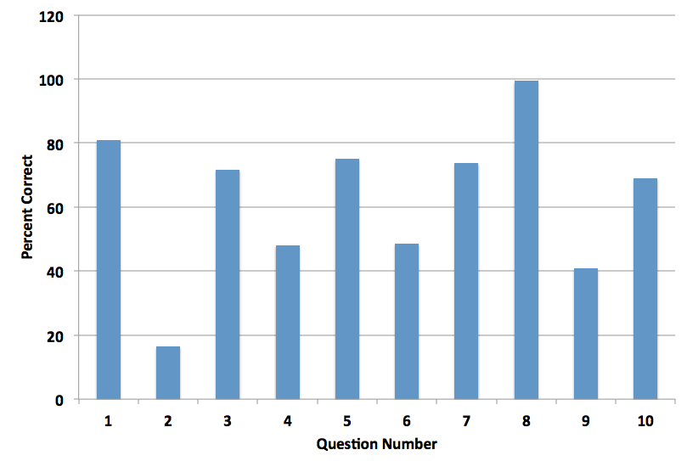
Skeletal System Knowledge
True/False: Once absorbed Vitamin D travels to the liver. There it is converted to calcidiol by the enzyme 1, 25 hydroxylase
ANSWER: False
99% VT students got this correct
42% GMU students got this correct
20% JMU students got this correct
Which of the following substances enhances calcium absorption?
ANSWER: Lactose
16% VT students got this correct
81% GMU students got this correct
0% JMU students got this correct
Cells that produce new cartilage/bone are called______.
ANSWER = Osteoblasts
75% VT students got this correct
61% GMU students got this correct
100% JMU students got this correct
Graph shows total numbers of VT students only for each question, pop-ups show comparison with GMU and JMU students
Notes:
Debby to present
Variation in knowledge across questions dependent on material taught at each institution
Question 8—taught at VT, but not at GMU and JMU
Question 2-taught at GMU but not at VT and JMU
Question 3-taught at VT, GMU and JMU, but JMU students had better retention of information

Slide 15
Summary of Data
No major gender differences
No learning differences with technology/computer/internet use
Computer literacy did influence computer/technology self efficacy.
Quiz answer frequencies were used in developing specific content for the DLO
E.g. lactase increasing calcium absorption
E.g. osteoblasts producing bone/cartilage
E.g. Vitamin D synthesis
Notes:
Debby to present
Should be no more than 20 minutes into presentation at this point

Slide 16
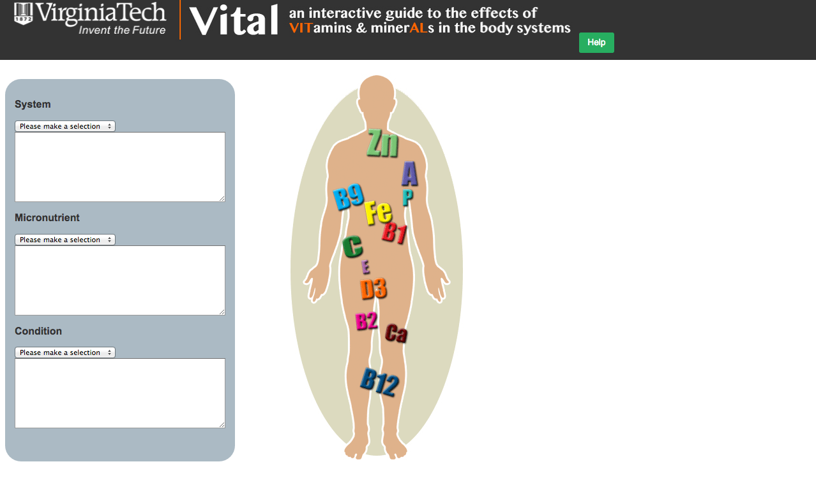

http://tinyurl.com/vtvital
Notes:
This is where the participants get to play with the DLO--~5 minutes then start on next section while they continue to play

Slide 17
Building the DLO
How we did it!

Slide 18
Building our DLO
$$
Content experts
Instructional design
Graphic and web designers
Copyright and fair use
Legal concerns
Database and programmers
Survey development and data analysis
Project management
Notes:
Debby, Lujean and Anita to present

Slide 19
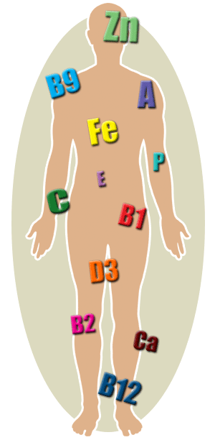
Discussion
Challenges and lessons learned
Copyright/Fair Use
Open Access versus Freely accessible
Recommendations for building a DLO
Future directions
Questions/Comments
Notes:
Anita-Copyright challenges and fair use issues for this project—quick summary
Debby and Lujean-Recommendations for building a DLO—quick summary
All-Future directions—quick summary

Slide 20
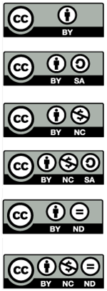
Options for authoring . . . and using and editing others’ work
Goals:
Sharing (at no additional cost to students)
Sharing (so that others may “reinvent” and reuse)
Options for licensing the work:
Copyright © All Rights Reserved
Open licenses: http://CreativeCommons.org
Public Domain
Constraints:
VT Intellectual Property Policy is unclear about sharing outside of the University
Our Preference:
Creative Commons Attribution Non-Commercial (CC BY NC)
Allows royalty-free modification and redistribution with attribution required.

Slide 21
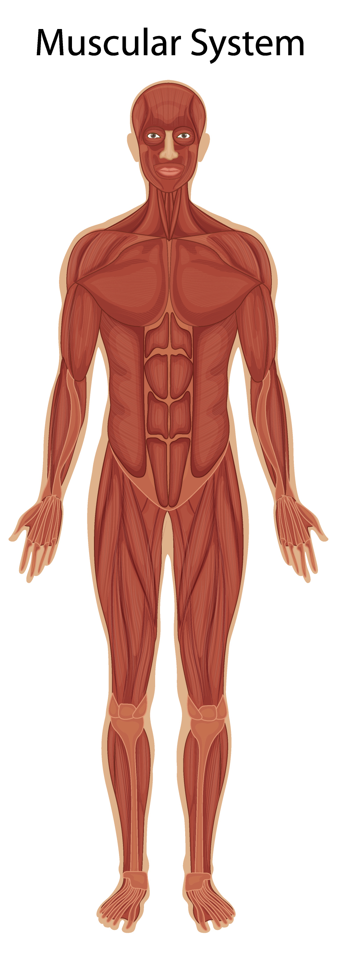
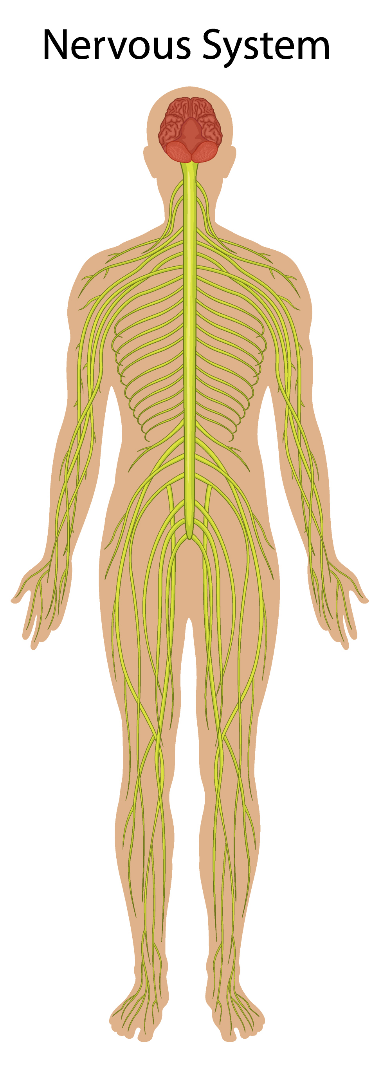
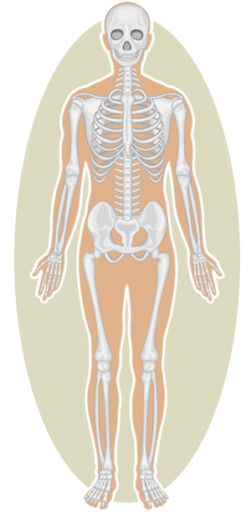
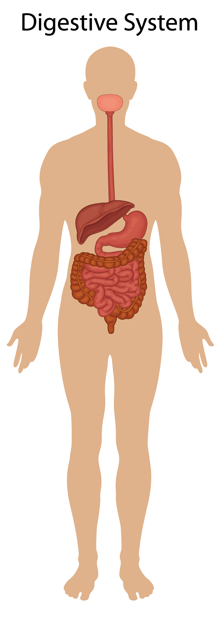
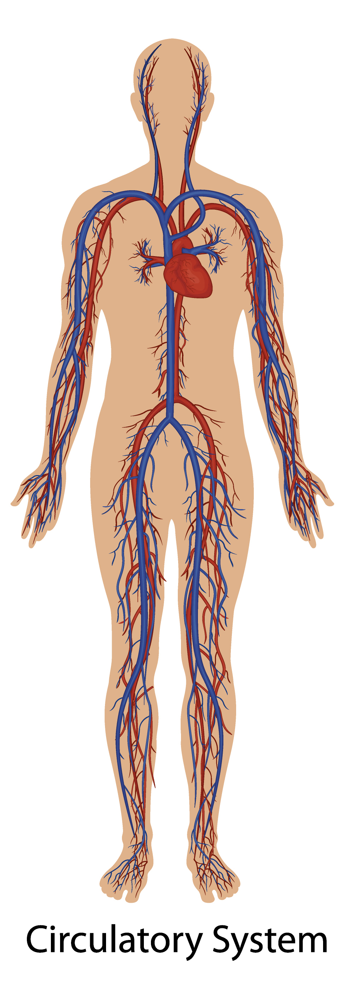
MORE CONSTRAINTS
Finding suitable openly licensed images and code
Time to commission CC or openly licensed works
License terms restrict the sharing of works
RESULTS
© Deborah Good CC BY-NC-ND License options for use beyond these purposes may be negotiated upon request
Human Body Systems illustration ©colematt. Used with Permission.
Computer code © Python/Django. Used with Permission.
GOALS MET
Sharing (at no additional cost to students) “Free online”
Sharing (so that others may “reinvent” and reuse) “Openly licensed” or OER

Slide 22
Recommendations for Building a DLO
Figure out what your demographic looks like
Do they play games?
What is their computer self-efficacy?
?
Find money
Assemble your team
Time and energy

Slide 23
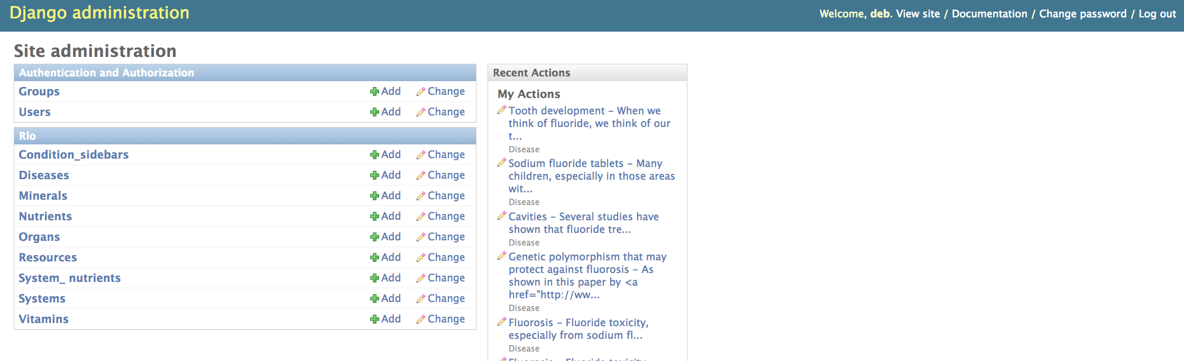
Future updates
Nervous System
Digestive System
Blood and Body Fluids
Musculature System

Slide 24
Acknowledgements
4-VA Collaborative
4-VA Grants Initiative at Virginia Tech (DJG, LB, AW)
Matching money to GMU (Sina Gallo) and JMU (Jeremy Akers)
Claire Gilbert, 4VA Deputy Coordinator, VT
Teggin Summers, Innovation Space, VT
Mark Sumner, CALS IT (iPADS)

Slide 25
Appendix
Questions used in survey available
Survey reliability metrics available
Learning style inventory weblink available
Contact Deborah J. Good goodd@vt.edu 540-231-0430 for more information

Slide 26
References
Large classroom picture taken by Dr. Deborah Good, 2013
Learning styles graphic creating using the following free to share/modify graphics:
Hand: License: CC0 Public Domain, Free for commercial use / No attribution required,https://pixabay.com/en/hand-outline-print-mold-fingers-305612/
Eye: License: CC0 Public Domain, Free for commercial use / No attribution required,https://pixabay.com/p-38039/?no_redirect
Ear: CC BY-SA 3.0, File:00-Oreille-ear.jpg, Uploaded by Tatmouss, Created: July 5, 2011, https://en.wikipedia.org/wiki/Hearing#/media/File:00-Oreille-ear.jpg
Keyboard “inquiry” picture: CC by 2.0,https://www.flickr.com/photos/jakerust/16226078303
4VA logo picture from : http://4-va.org/
Human Body: (need reference/company that we paid)

Slide 27
Extra slides/data
Not being presented

Slide 28
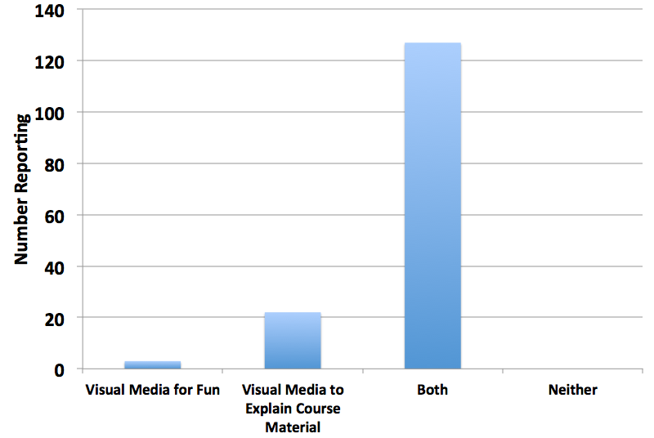
Internet use and Interest in Educational Media
**
Significantly more students wanted both a fun site and one to explain course materials
QUESTION
If a website used for a course included visual media, which would be most helpful to you?
Graph shows total numbers of VT students only in each category reported; significance by one-way ANOVA
Notes:
Debby to present

