Slide 1

Using Maintenance Options to Optimize Wind Farm O&M
Xin Lei, Peter Sandborn, Navid Goudarzi, Roozbeh Bakhashi, Amir Kashani-Pour
Center for Advanced Life Cycle Engineering (CALCE)
Mechanical Engineering Department
University of Maryland
NAWEA 2015
June 11, 2015

Slide 2
Introduction
Operation and Maintenance (O&M) is a large contributor to the life-cycle cost of wind farms, therefore the prediction and optimization of maintenance activities provides a significant opportunity for life-cycle cost reduction.
Maintenance practices for turbines include:
  Scheduled preventive maintenance
  Corrective maintenance
  Predictive maintenance based on prognostics and health management (PHM) or condition monitoring (CM)
This paper applies the concept of predictive maintenance options to both single wind turbines and wind farms managed via power purchase agreements (PPAs) to determine the optimum maintenance dates
Notes:
Syndrome (noun) = A group of symptoms that collectively indicate or characterize a disease, psychological disorder, or other abnormal condition.
Syndromic (adj)
2

Slide 3
Prognostics and Health Management (PHM)
Establish failure warnings and a remaining useful life (RUL)
Use the RUL estimate to drive actions to manage systems in such a way as to minimize the life-cycle cost of the system
Maintenance options address how you get “value” from the RUL
Individual turbine
Wind farm
Notes:
Syndrome (noun) = A group of symptoms that collectively indicate or characterize a disease, psychological disorder, or other abnormal condition.
Syndromic (adj)
3

Slide 4


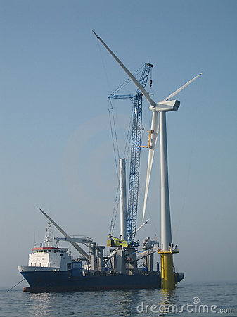
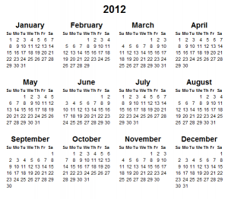
Maintenance Options
Predictive Maintenance Opportunity
Predicted Remaining Useful Life (RUL)
Options:
Maintain at earliest opportunity
Wait until closer to the end of the RUL to maintain
Run to failure for corrective maintenance
Options:
Switch to a redundant subsystem (if any)
Slow down
Shut down
Do nothing
If I could determine the value of each of the options, I would have a basis upon which to make a decision about what action to take in response to the RUL prediction

Slide 5
A Real Options View of Predictive Maintenance
Real Options: The flexibility to alter the course of action in a real assets decision, depending on future developments.
    The buyer of the (call) option gains the right, but not the obligation, to engage in the transaction at the future date
Predictive maintenance opportunities triggered by RUL predictions can be treated as Real Options
  Buying the option = paying to add PHM into wind turbine subsystems
  Exercising the option = performing predictive maintenance prior to failure
  Exercise price = predictive maintenance cost
  Value returned by exercising the option = revenue lost (negative) + cost avoidance (positive) due to predictive maintenance
  Letting the option expire = do noting and run the turbine to failure then perform corrective maintenance

Slide 6
Predictive Maintenance Value Simulation for a Single Turbine
Revenue Lost due to predictive maintenance
  Representing the value of the part of the RUL thrown away
Cost avoidance due to predictive maintenance including:
  Avoided corrective maintenance cost (parts, service, labor, etc.)
  Avoided revenue lost during downtime for corrective maintenance
  Avoided under-delivery penalty due to corrective maintenance (if any)
  Avoided collateral damage
  Predictive Maintenance Value = Cost Avoidance + Revenue Lost
Benefit obtained from predictive maintenance at optimum point in time
Cost avoidance by predictive maintenance
Revenue lost due to predictive maintenance
Predictive maintenance value
Time
Time
Time
Day 0
Day 0
Day 0
End of RUL
End of RUL
End of RUL

Slide 7
Path Generation
Path = starting at the RUL indication (Day 0), it is one possible way that the future could occur
The revenue path represents the possible revenue due to uncertain wind resources
The cost avoidance path represents how the RUL is used up and varies due to uncertainties in the predicted RUL
Each path is a single member of a population of paths representing a statistically significant set of possible future turbine states

Slide 8

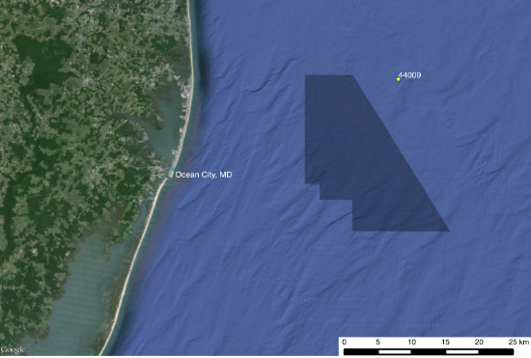
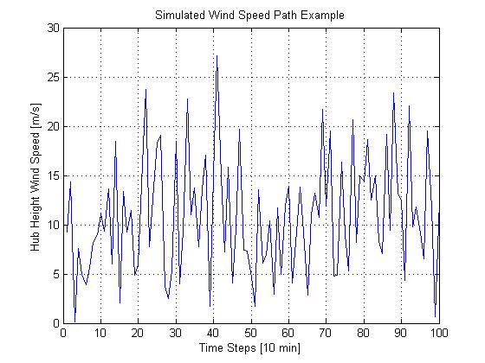
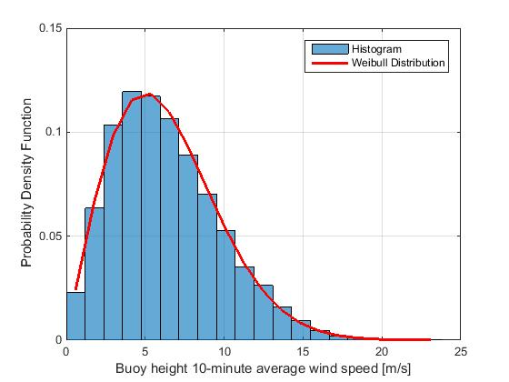
Wind Speed and TTF Simulation
Wind turbine: Vestas V112-3.0 MW Offshore
Wind speed simulation
  2003 to 2012 wind data of NOAA Buoy 44009 (in the Maryland Offshore Wind lease area) fitted with Weibull Distribution
  Monte Carlo simulation used to get buoy height wind speed paths
  Power Law used to transfer buoy height wind speed to hub height
Time to Failure (TTF)
  Wind speed → rotor rotational speed → RUL consumption rate → TTF
  Represents how the RUL is used up for the subsystem with the RUL prediction (assuming turbine fails thereafter)
  Uncertainties in the predicated RUL (in cycles) and wind considered
Location of NOAA Buoy 44009
Hub height simulated wind speed
Weibull fitted wind speed PDF
(UMCP/AOSC: Zeng, Martin; MDA Inc.: Kirk-Davidoff)

Slide 9
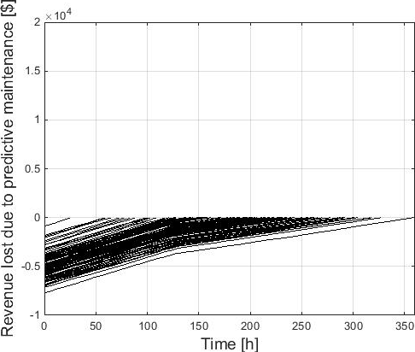
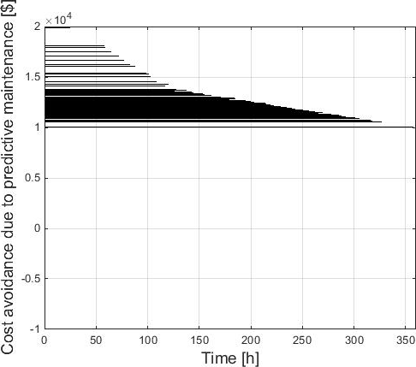
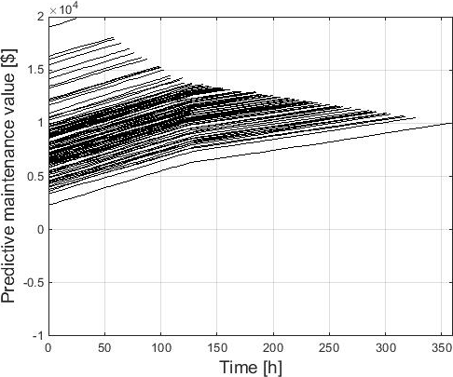
Predictive Maintenance Value Simulation for a Single Turbine (continued)
Considering the uncertainties in the RUL predictions and future wind speeds:
Path terminate at different times due to RUL uncertainties
Paths change slope because annual energy delivery target (from PPA) has been reached)
Revenue lost paths
Cost avoidance paths
Predictive maintenance value paths

Slide 10
Predictive Maintenance Option Valuation for a Single Turbine (continued)
Predictive maintenance can only be performed on specific dates
On each date, the decision-maker has flexibility to determine whether to implement the predictive maintenance (exercise the option) or not (let the option expire)
This makes the option a sequence of “European” style options that can only be exercised at specific points in time in the future
Real Option Analysis (ROA) is performed for the option valuation:
  Predictive maintenance option value = max[(predictive maintenance value - predictive maintenance cost) , 0]
Predictive maintenance cost
Predictive maintenance value
Predictive maintenance option value
Time
Time
Day 0
Day 0
Predictive maintenance opportunities

Slide 11
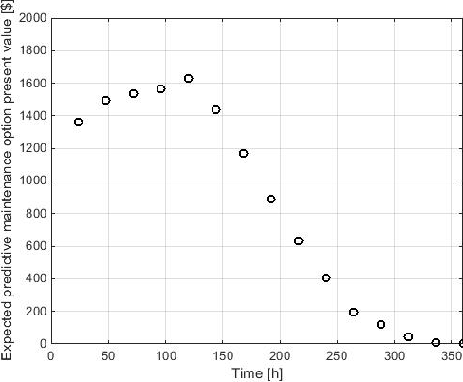
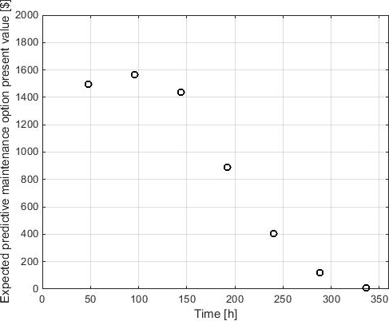
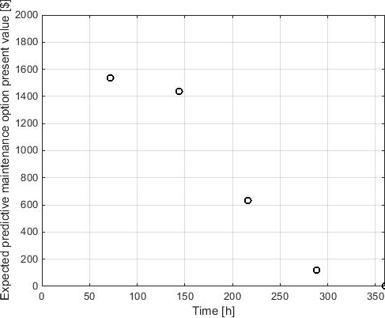
Predictive Maintenance Optimization for a Single Turbine (continued)
On each predictive maintenance opportunity date, ROA is implemented on all paths and the results are averaged to get the expected predictive maintenance option value
This process is repeated for all maintenance opportunity dates to determine the optimum maintenance date
Predictive maintenance possible every day
Optimum maintenance date: Day 5
Predictive maintenance possible every 2 days
Optimum maintenance date: Day 4
Predictive maintenance possible every 3 days
Optimum maintenance date: Day 3

Slide 12
Extension to Wind Farms
A wind farm may consist of hundreds of individual wind turbines
Wind farms are typically managed via outcome-based contracts (e.g., a Power Purchase Agreements)
Maintenance will be performed on multiple turbines (and multiple turbine subsystems) on each maintenance visit to the farm because,
  Expensive resources are required (e.g., cranes, helicopters, vessels)
  Maintenance windows are limited due to the harsh environments
Therefore, we must be able to determine the best maintenance date for multiple activities by accumulating the option values

Slide 13
Power Purchase Agreement (PPA)
A long term outcome-based contract between the wind energy seller and the energy buyer
PPA modeling:
  Contract energy price
    Wind farm annual energy delivery target agreed to by the seller and buyer
    Contract energy price applies for each MWh before the target is met
  Over-delivery energy price
    Over-delivery energy price applies for each MWh exceeding the target
    Over-delivery energy price lower than the contract energy price
  Under-delivery penalty
    Buyer buys energy from other sources (e.g., burning coal/oil) with replacement energy price for each MWh under-delivered
    Seller compensates buyer for each MWh under-delivered with a compensation energy price (equals to the difference between the replacement energy price and the contract energy price)

Slide 14

PPA Example
Seller: PPM Energy, Inc. (now Iberdrola Renewables)
Purchaser: City of Anaheim, CA
20-year agreement signed in 2003
Contract energy price: $53.50/MWh of delivered energy
Constant energy delivery requirement in each hour
From the contract: 3.1.2 Sources of Electric Energy and Environmental Attributes
  “Seller may obtain electric energy for delivery at the Delivery Point from market purchases or from any other source or sources or combination thereof as determined by Seller in its sole discretion”
Nothing in the contract says “only when the wind blows” or “only if the turbines are running”

Slide 15
Wind Farm Example
Assume a 5-turbine-farm managed via a PPA, Turbines 1 & 2 indicate RULs on Day 0, Turbines 3, 4 & 5 operate normally
Predictive maintenance value paths of all turbines with RULs need to be combined together
    Because maintenance will be performed on multiple turbines on each visit
  The PPA will influence the combined predictive maintenance value paths
  Revenue Lost due to predictive maintenance is influenced by:
    Contract energy price
    Over-delivery energy price
    Wind farm annual energy delivery target
    Wind farm cumulative energy delivery from the beginning of the year to Day 0
  Cost Avoidance due to predictive maintenance is influenced by:
    Contract energy price
    Over-delivery energy price
    Compensation energy price
    Wind farm annual energy delivery target
    Wind farm cumulative energy delivery from the beginning of the year to Day 0

Slide 16
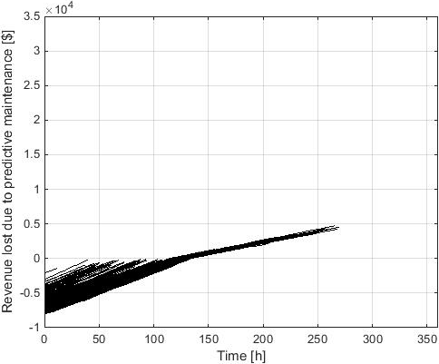
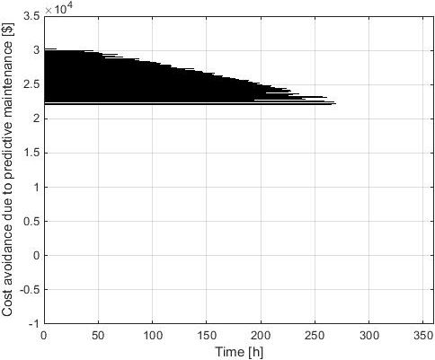
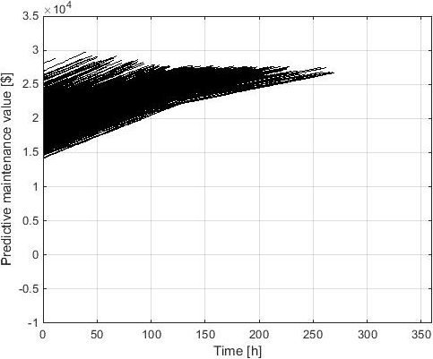
Predictive Maintenance Value Simulation for a Wind Farm
Considering the uncertainties in RUL predictions and future wind speeds:
Revenue lost paths
Cost avoidance paths
Predictive maintenance value paths

Slide 17
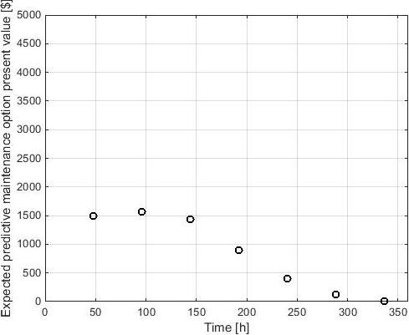
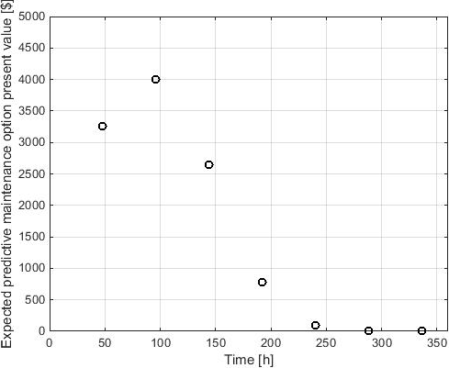
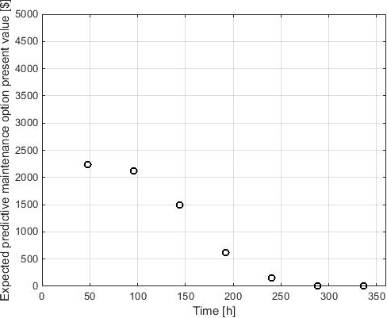
Predictive Maintenance Value Simulation for a Wind Farm (continued)
Optimum maintenance plan for the turbines with RULs in a farm subject to a PPA may not be the same as individual turbines managed in isolation
Turbine 1 managed in isolation
5-turbine-farm, Turbines 1 & 2 have RULs, the other 3 turbines work normally
Predictive maintenance possible every 2 days
Optimum maintenance date: Day 4
Turbine 2 managed in isolation
Predictive maintenance possible every 2 days
Optimum maintenance date: Day 4
Predictive maintenance possible every 2 days
Optimum maintenance date: Day 2

Slide 18
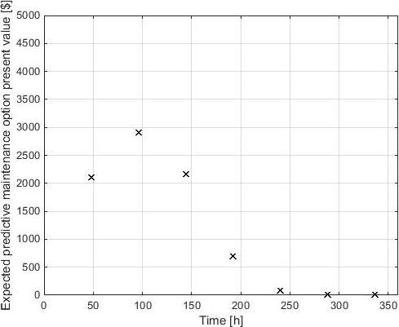
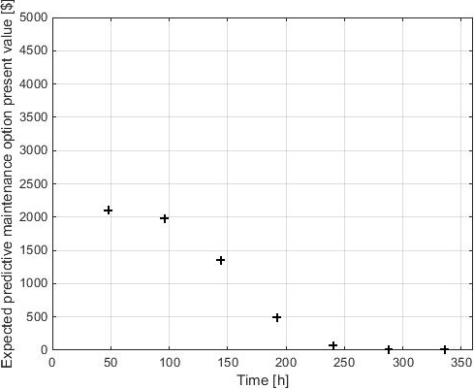
Predictive Maintenance Value Simulation for a Wind Farm (continued)
When the number of turbines down changes, optimum predictive maintenance date may also change:
5-turbine-farm, Turbines 1 & 2 have RULs, 0 turbines down
1 turbine down
2 turbines down
Predictive maintenance possible every 2 days
Optimum maintenance date: Day 4
Predictive maintenance possible every 2 days
Optimum maintenance date: Day 4
Predictive maintenance possible every 2 days
Optimum maintenance date: Day 2

Slide 19
Summary
The work in this paper enables optimum maintenance scheduling for wind farms with PHM that are subject to a PPAs that may include variable prices and penalties
Optimum maintenance scheduling = maintenance dates and actions that minimize the life-cycle cost and maximize the revenue generated for the wind farm
Uncertainties in wind and the accuracy of the RULs forecasted by the PHM approach are included
The optimum maintenance plan for the turbines with RULs in a farm subject to a PPA may not be the same as individual turbines managed in isolation

