Slide 1

The Team
Ernesto Cortes
Kipp Dunn
Sar Gregorczyk
Alex Schmidt
Project Info
Multimedia, Hypertext, and Information Access
Instructor: Edward A. Fox
Virginia Tech,
Blacksburg VA 24061
05/01/2018
Opinion Mining & Summarization
Notes:
Sar

Slide 2
Presentation Outline
Our Mission
Web-Crawler
Database and Web-app
Summarization
Demo
Lessons Learned
Contributions
References
Questions
Notes:
Sar

Slide 3
Our Mission
Opinion Mining Project
Create a suite of tools:
  Web-Crawler
  Database
  Summarization Toolkit
  Web Server
Notes:
Sar

Slide 4
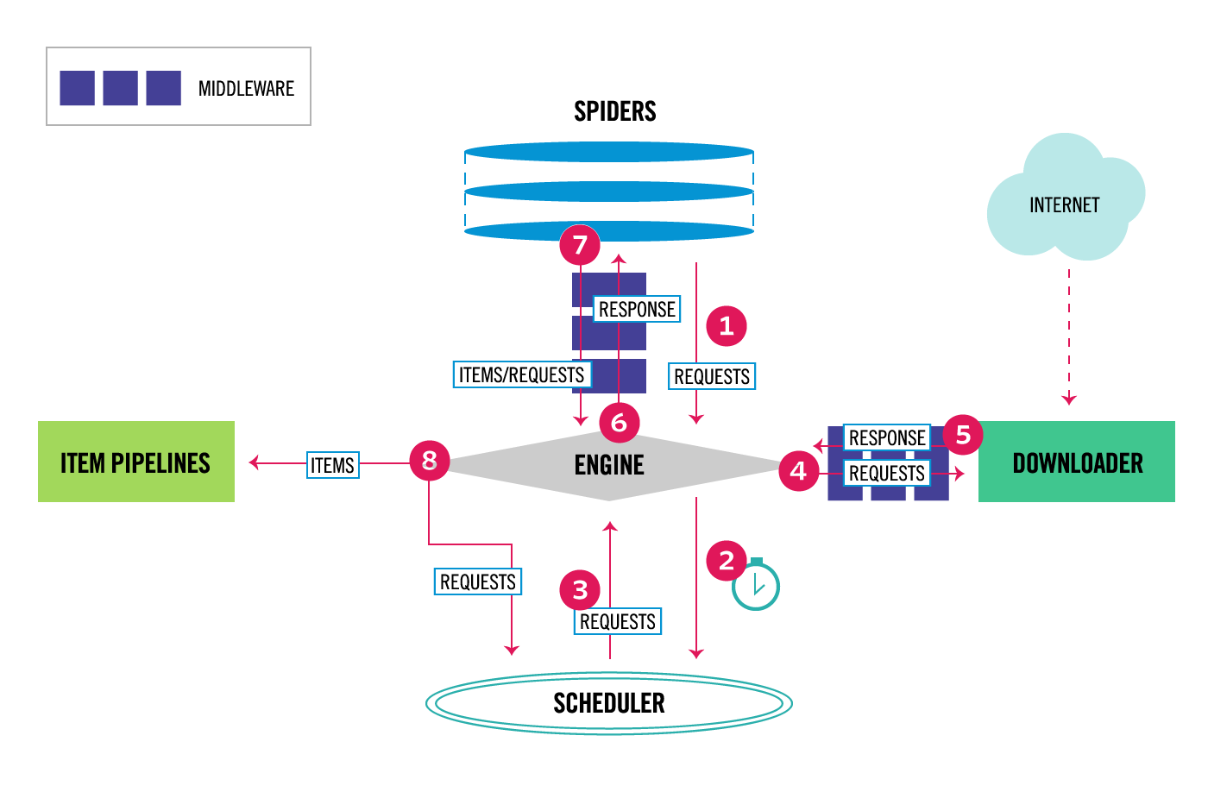
Web-Crawler (Scrapy)
Current Status
Web Server Integration
Documentation
Future Plans
Additional sources
Source: https://doc.scrapy.org/en/latest/topics/architecture.html
Notes:
Ernesto

Slide 5
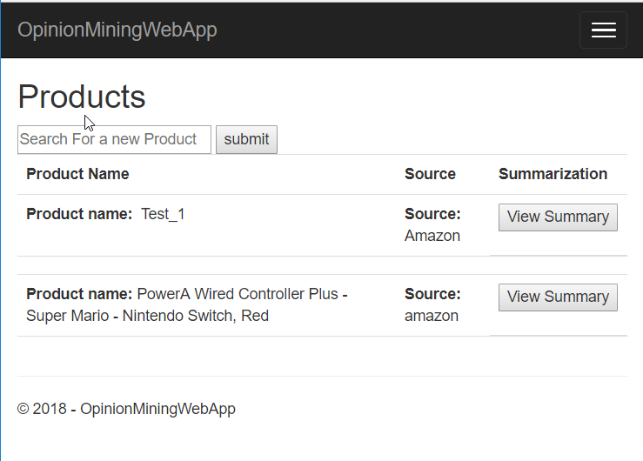
Database and
Web Application
Current Status
Integration with NLP tools
Updated UX and UI
Future Plans
Data Sanitization
Crawling and NLP options
Better UI and UX
Notes:
Kipp
Relational DB because:
Link information between tables
Add new tables
Design:
By separating the data, we have the ability to easily add information to a source or a specific product without changing thousands of different entries in a table.

Slide 6
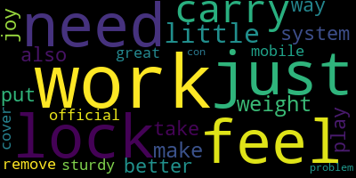
Summarization:
Extract Reviews with highest helpfulness
Build 5 corpuses for each rating level
Database
Extractive Summarization
Keyword Extraction
Lemmatize and remove stopwords
LDA Topic Modeling
Notes:
Schmidt
We have done: extractive summarization, keywords, topic modeling (similar to keyword extraction however views the document more completely to get groupings of related words instead of just individual words)
Next: automate word cloud generation, webapp integration, refinement.
Future: abstract summarization training and integration.

Slide 7
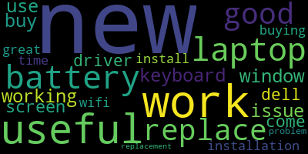
Summary Example for Dell Inspiron:
WIndows 10 works beautifully on this laptop, On the flip side I think the product that I have got has some inherent issue with the in-built speakers. Especially the driver under network section with name - Intel PROSet/Wireless 3165 WiFi Driver I downloaded the above driver on a different computer and ported to this new Dell laptop via flash drive.After installing above driver, this product starts connecting to Wifi and then I felt that I can use this laptop. To correct the problem, perform the following steps (assuming your laptop will not stay connected to the internet long enough to download the updated driver): 1. However, Dells very helpful tech synced….

Slide 8
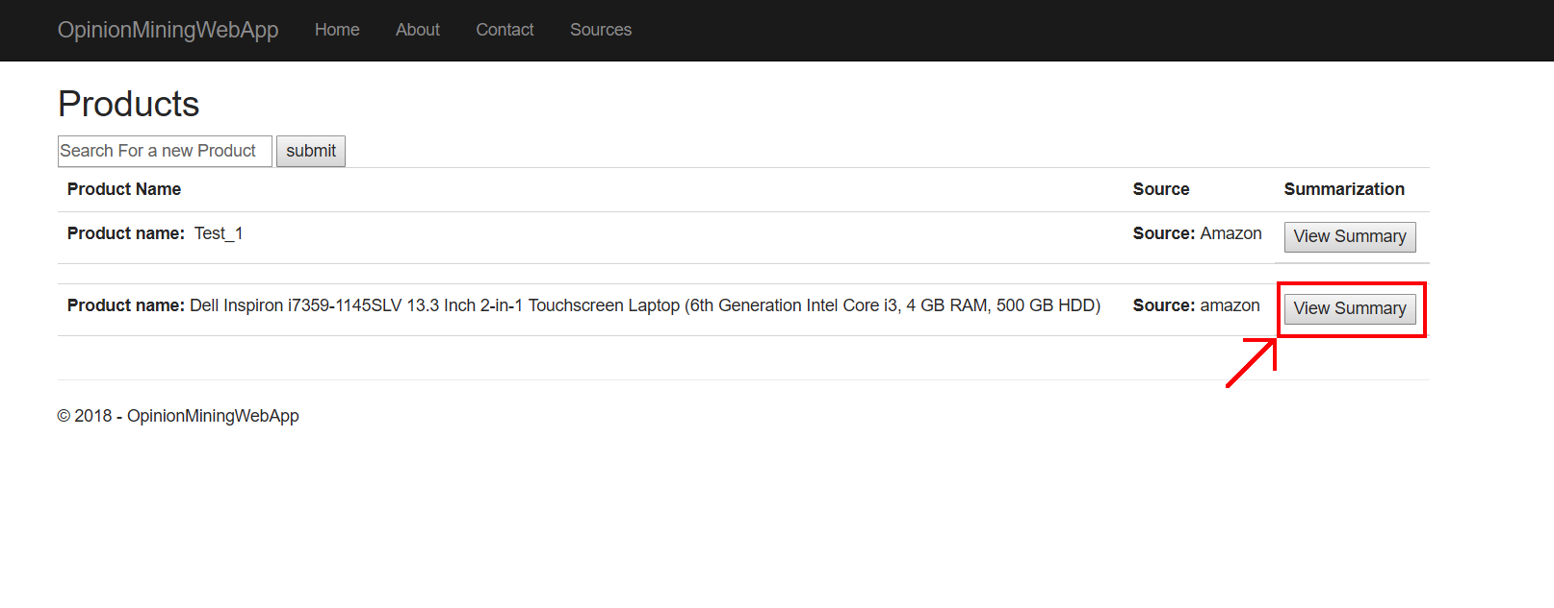
Final Product
Product Selection Screen

Slide 9
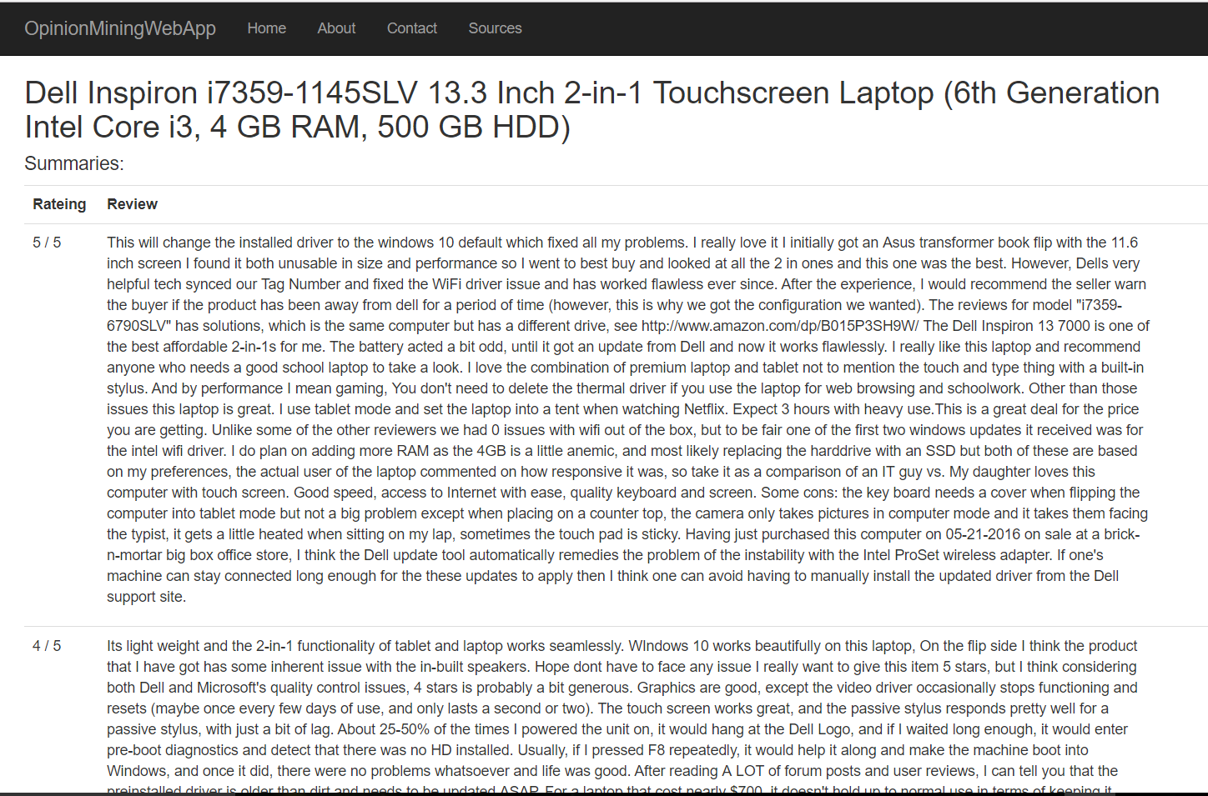
Final Product
Individual Product

Slide 10
Lessons Learned
Design time is important
Open-source libraries are your friends
The client can be a great resource
Notes:
Sar

Slide 11
Contributions
Kipp Dunn: Web Application & DB Lead
Alex Schmidt: Summarization Tools Lead
Ernesto Cortes: Web Crawler Lead
Sar Gregorczyk: Documentation Lead and Team Coordination
Notes:
Sar

Slide 12
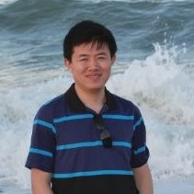
Acknowledgements
Our client: Xuan Zhang
Currently taking the Ph.D program at the Computer Science Department of Virginia Tech. My research area is Natural Language Processing. The research projects I have been involved include:
1) Product defect identification based on probabilistic graphical model
2) Unsupervised events extraction based on topic modeling and named entity recognition
3) Adverse events recognition based on classification and data under-sampling

Slide 13
References
https://mysql-net.github.io/MySqlConnector/tutorials/net-core-mvc/
Gensim: https://radimrehurek.com/gensim/
https://rare-technologies.com/text-summarization-with-gensim/
Scrapy: https://scrapy.org/
Notes:
Sar

Slide 14
Questions?
Notes:
Sar
Ta aon cheiste agat?

