Slide 1



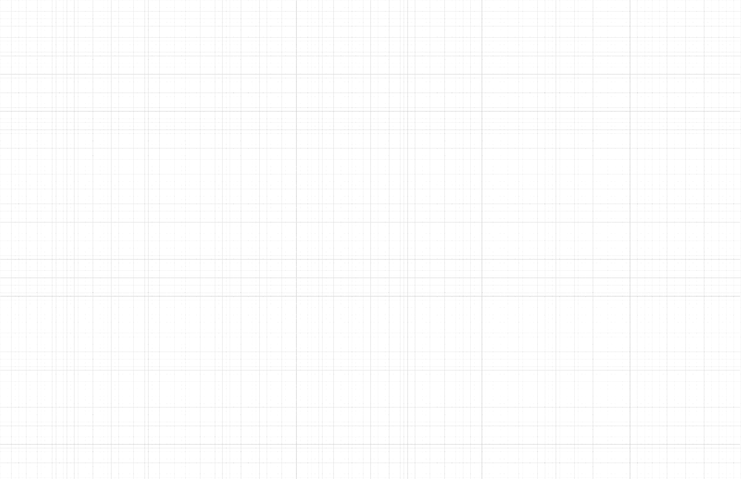
S2022 VIDEO UDL + AEM PROJECT
Team 19: Tyler Esposo, Matthew Ho, Sydney Huynh,
Catherine Lee, Joshua Protacio, and Daniel Stricoff
CS4624: Multimedia, Hypertext and Information Access
Instructor: Edward A. Fox
Virginia Tech, Blacksburg VA 24061
4 May 2022

Slide 2
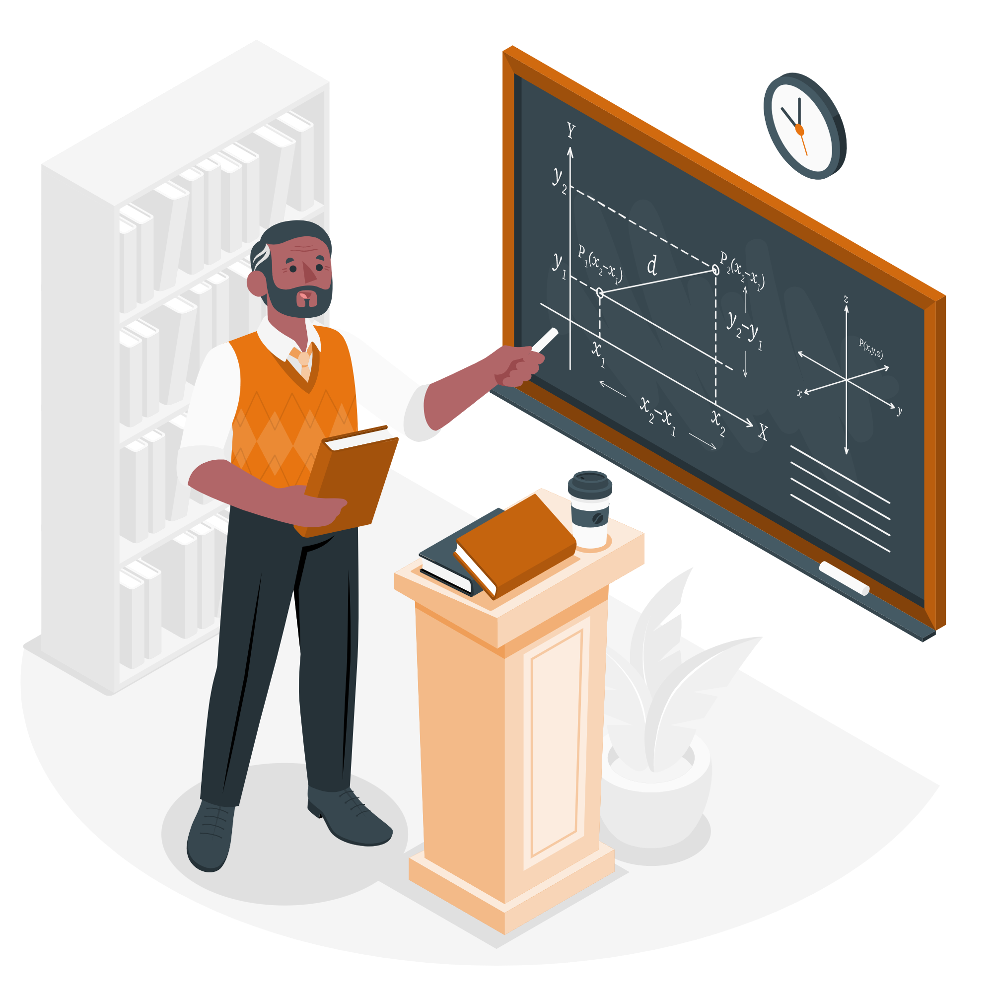
OVERVIEW
Goal & Objectives
Design
Implementation
Lessons Learned
Future Work

Slide 3
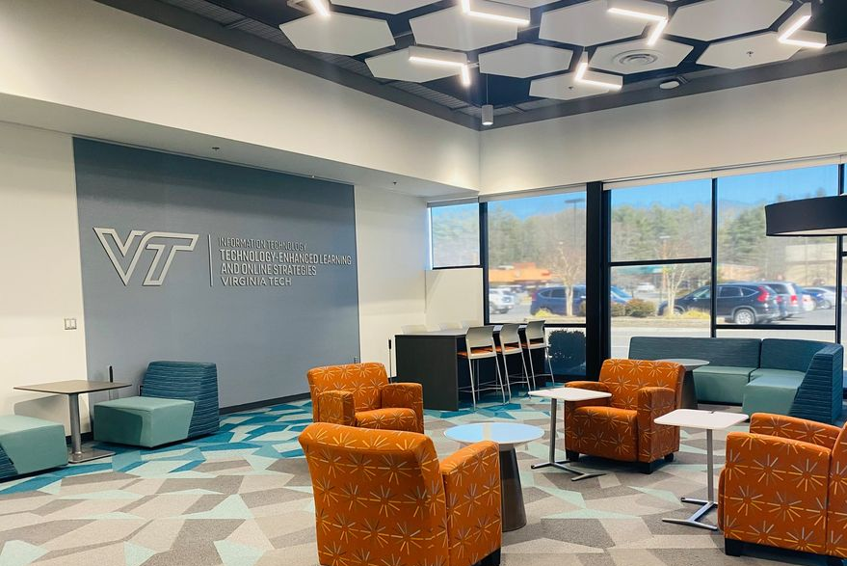
PROJECT GOAL
Create a promotional and information video, highlighting accessibility best practices, tools, and strategies used at Virginia Tech.
01
/
Goals & Objectives

Slide 4
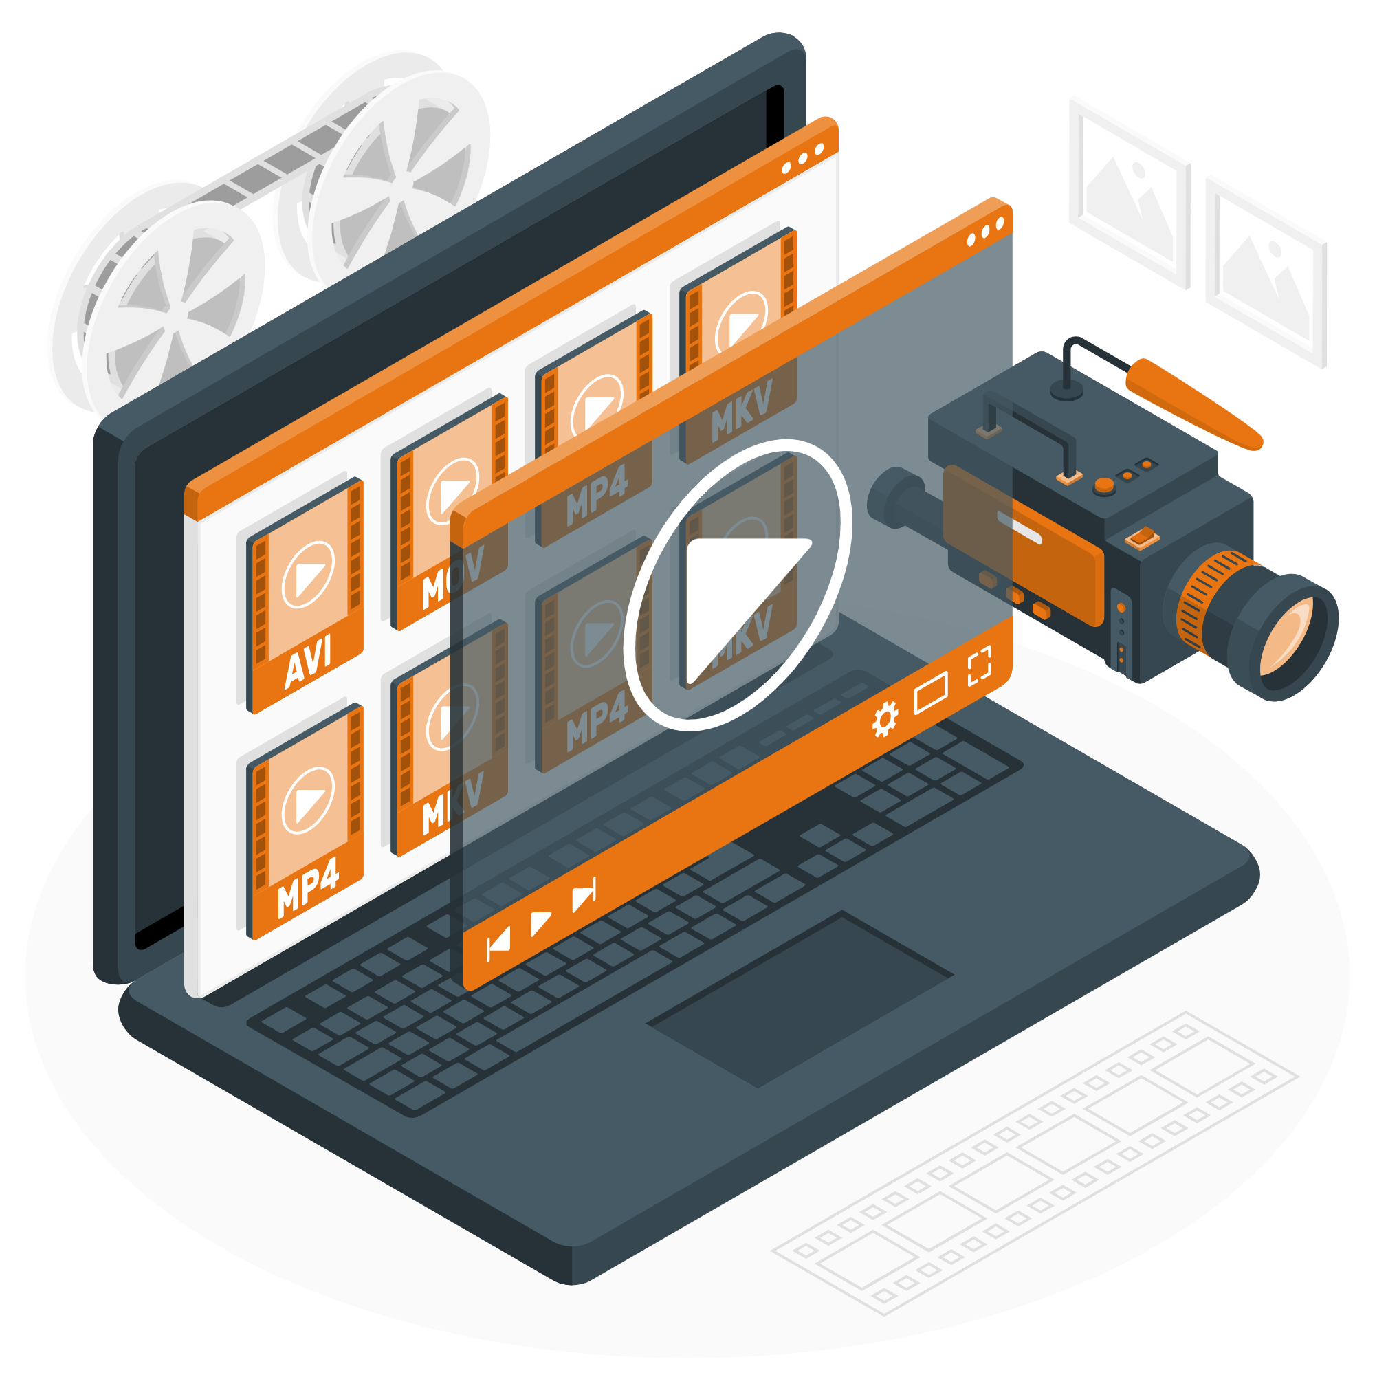
OBJECTIVES
Video Length < 10 minutes.
Include closed captioning and audio description.
Capture testimonials from faculty and students.
Design informational graphics about UDL and AEM.
Encourage faculty to enroll in UDL and AEM.

Slide 5

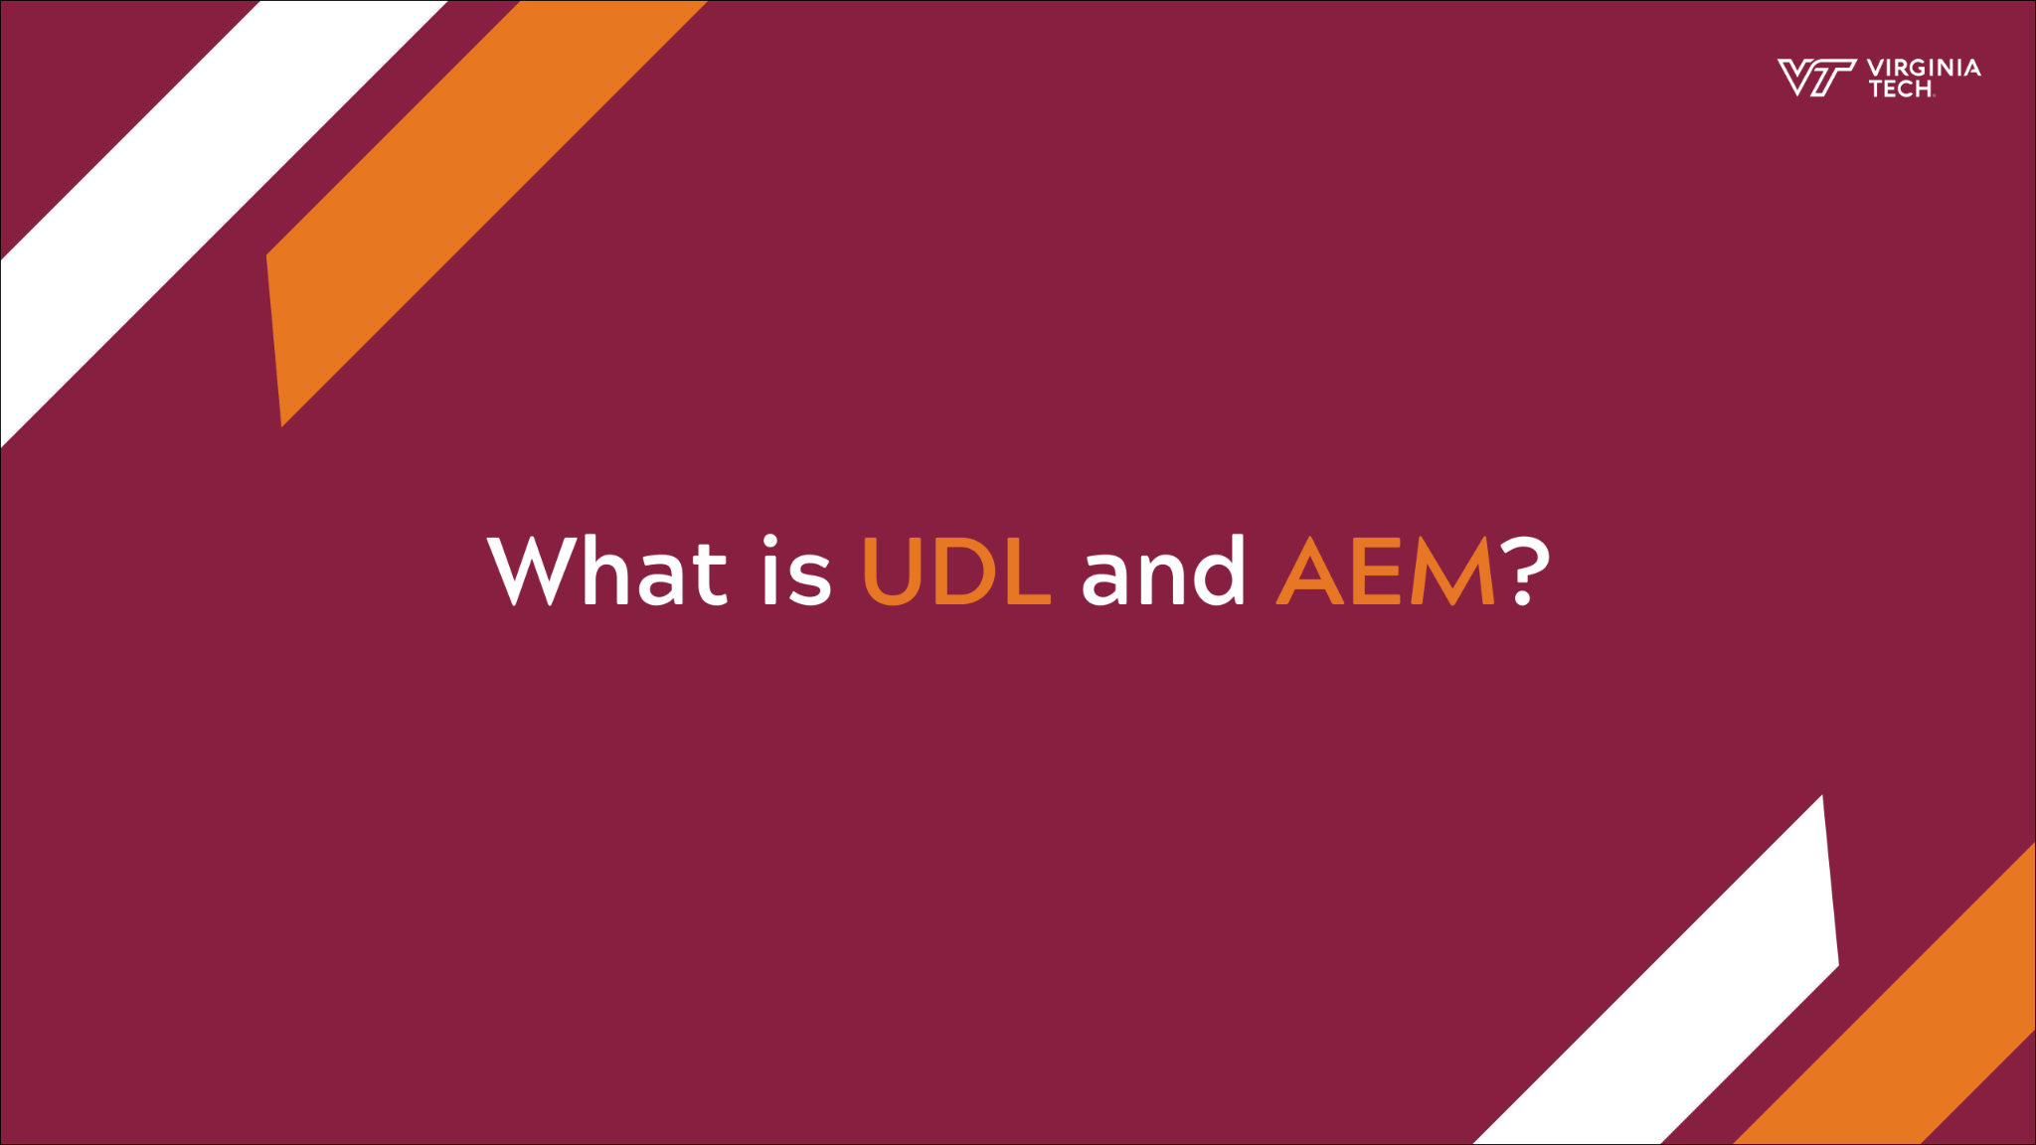
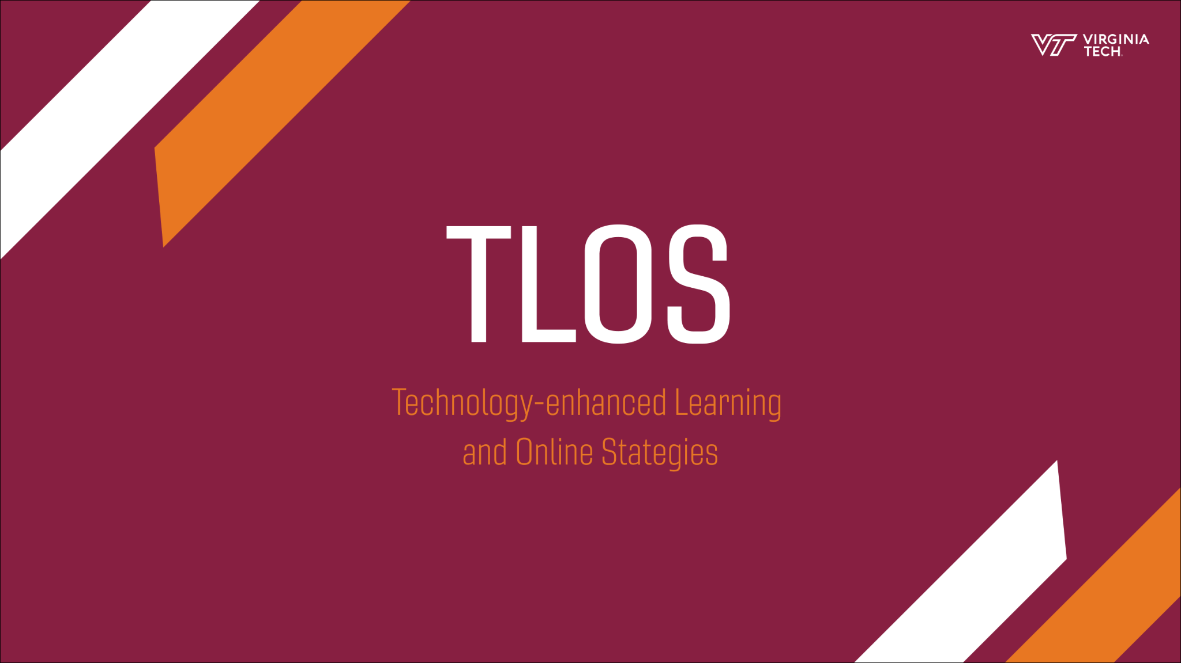


DESIGN: GRAPHICS
21 graphics includings:
  Intro/Outro
  Transition
  Interviewee Introduction Graphic
  Definitions
  Questions
  Statistics
03
/
DESIGN

Slide 6
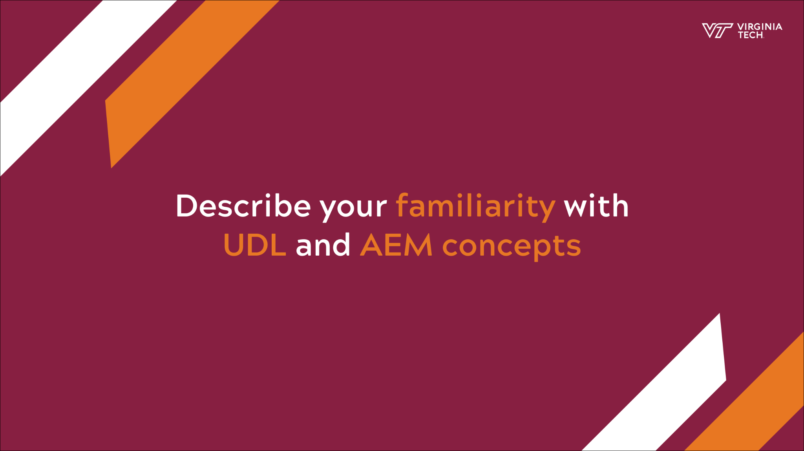
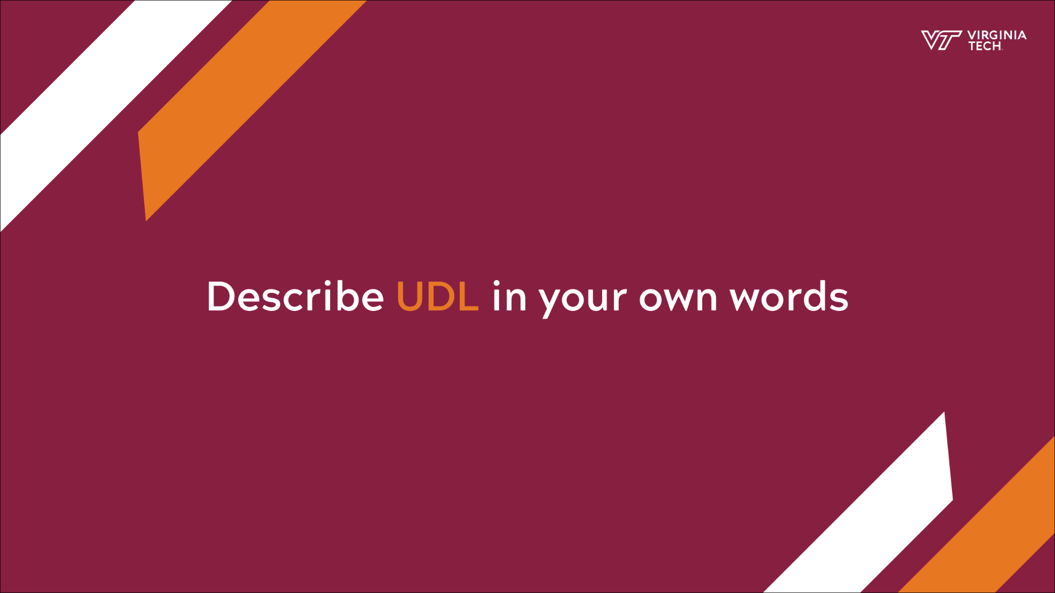
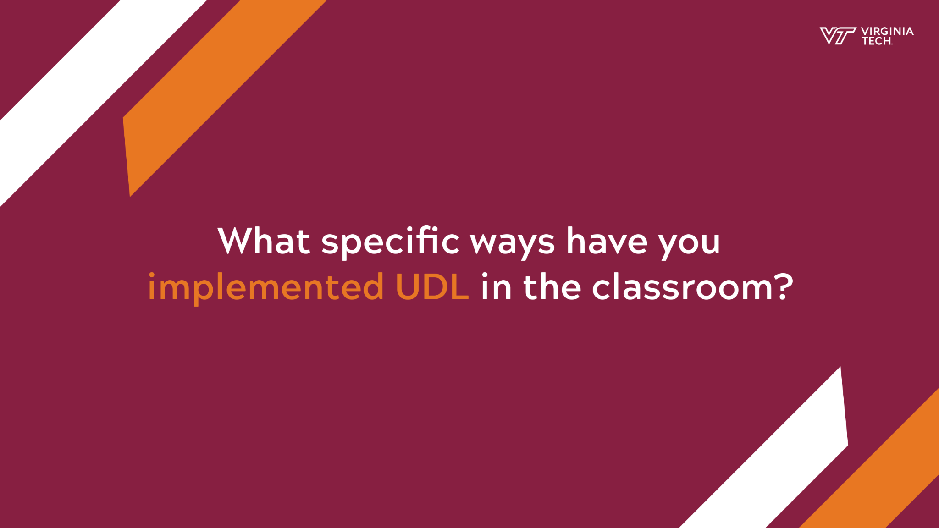
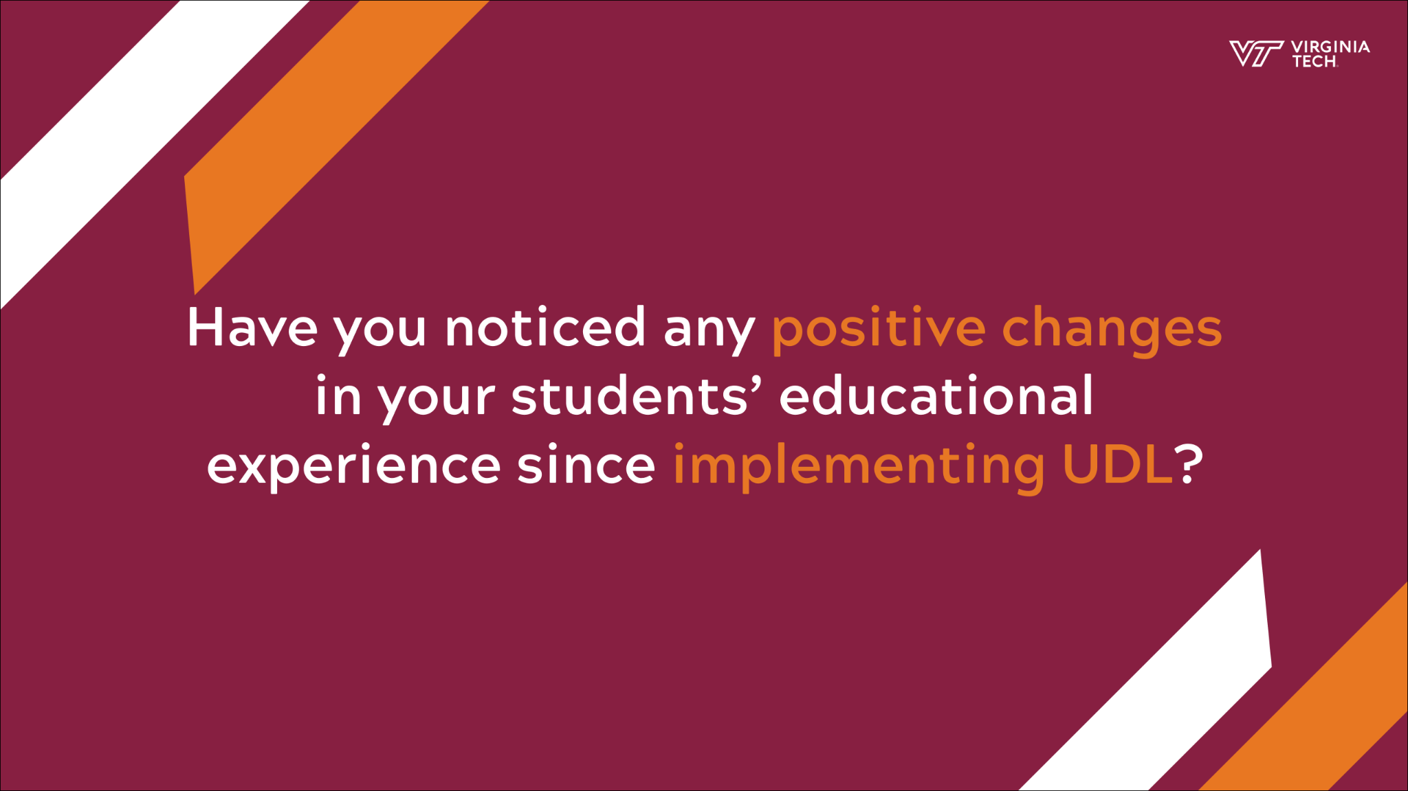

Slide 7
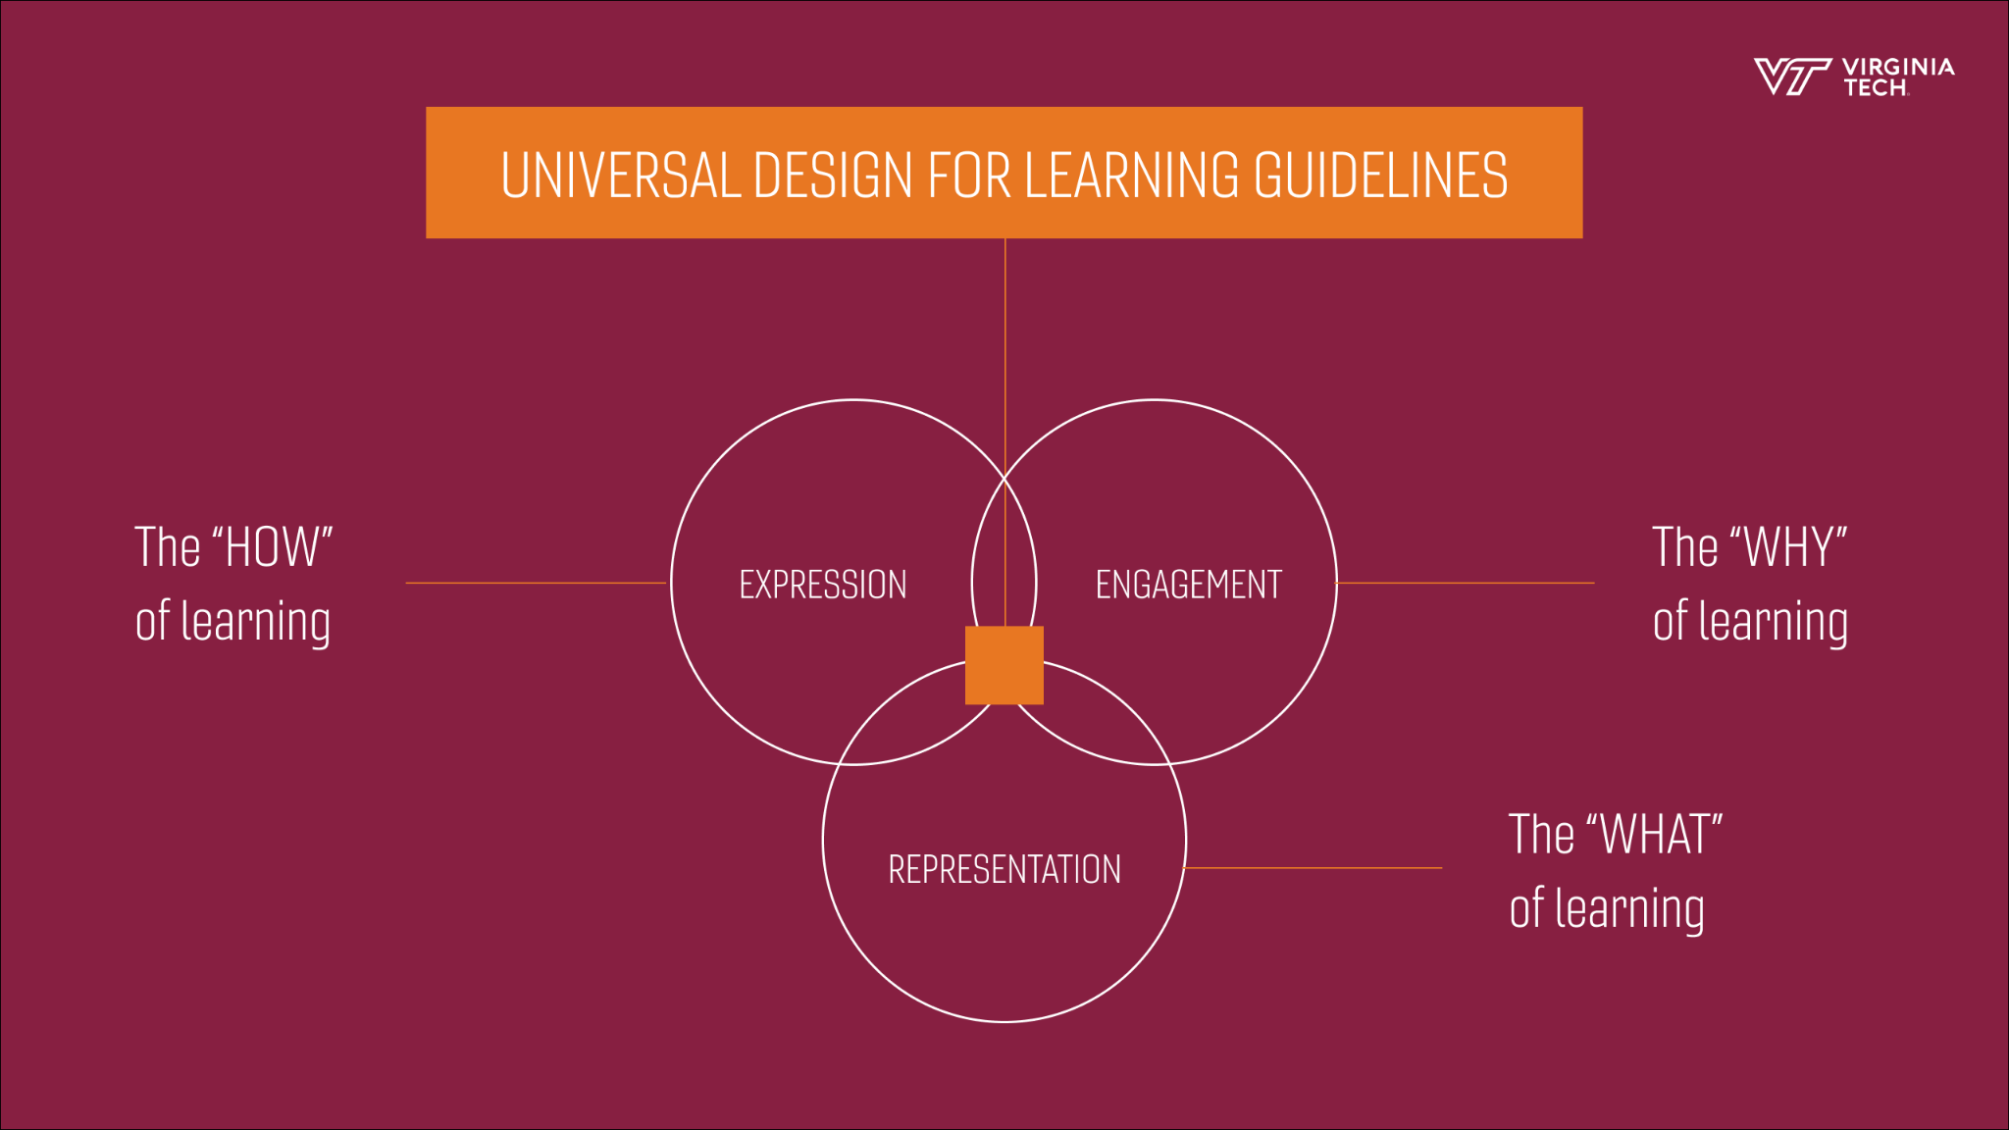
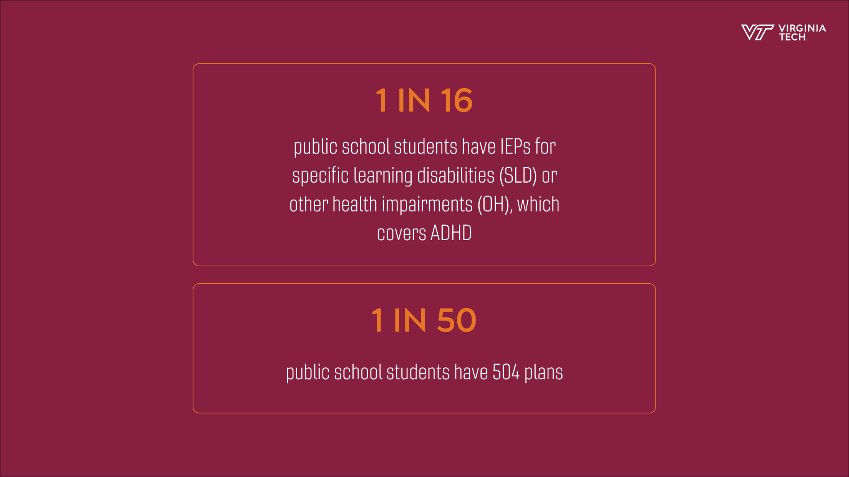
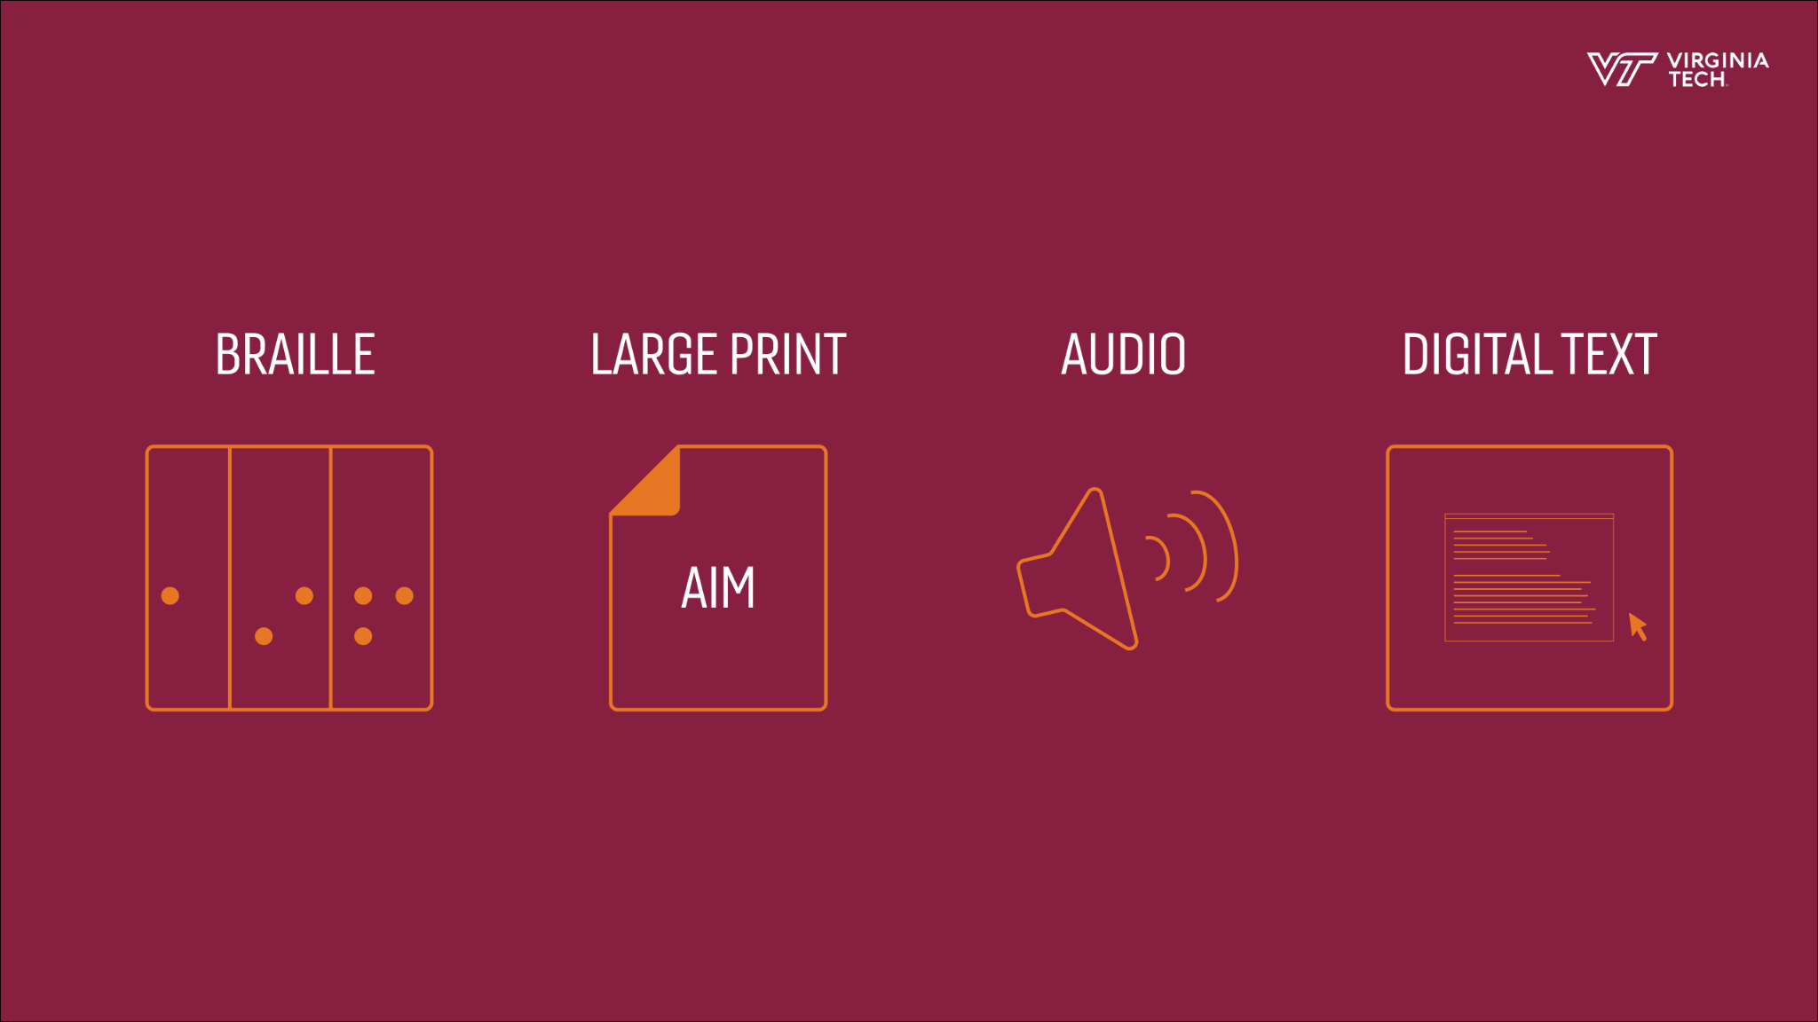
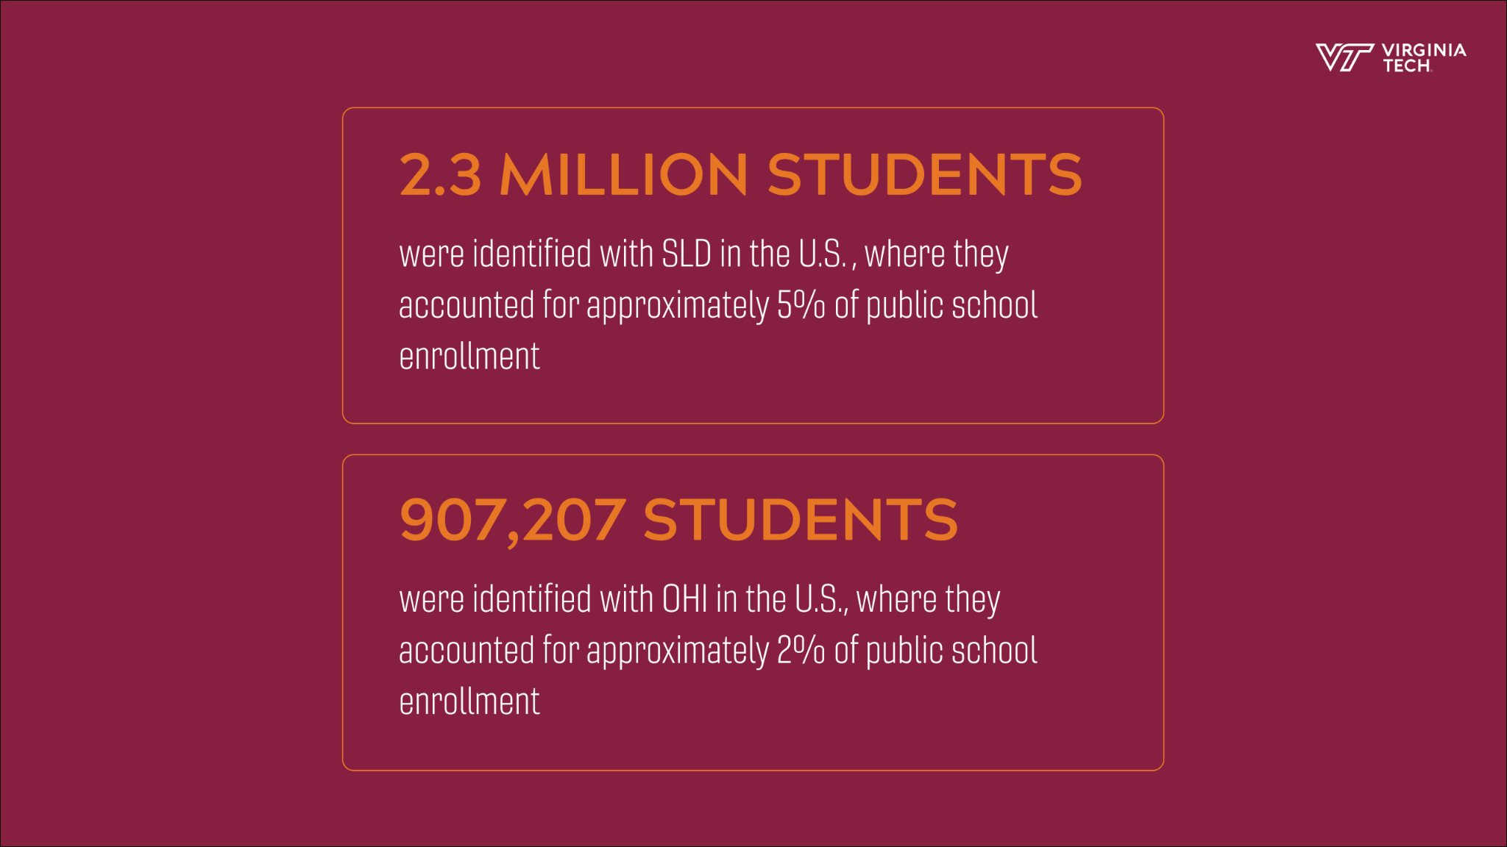

Slide 8
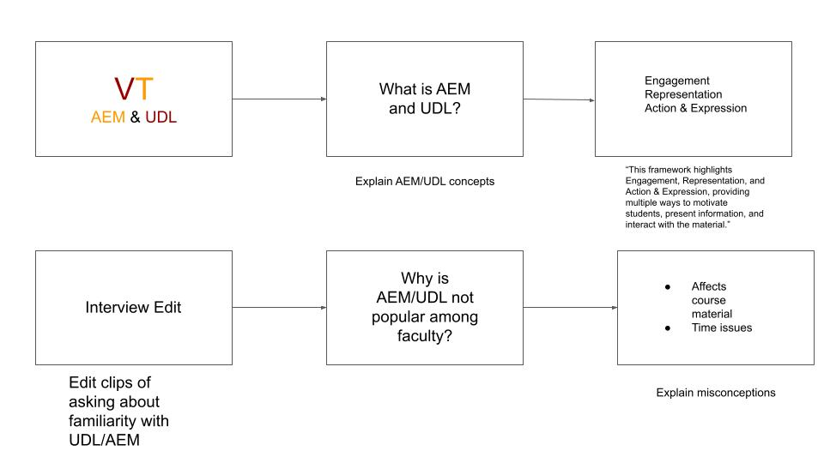
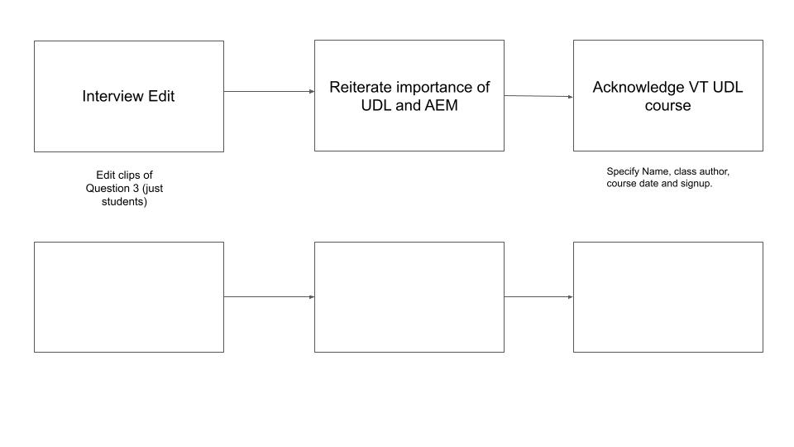
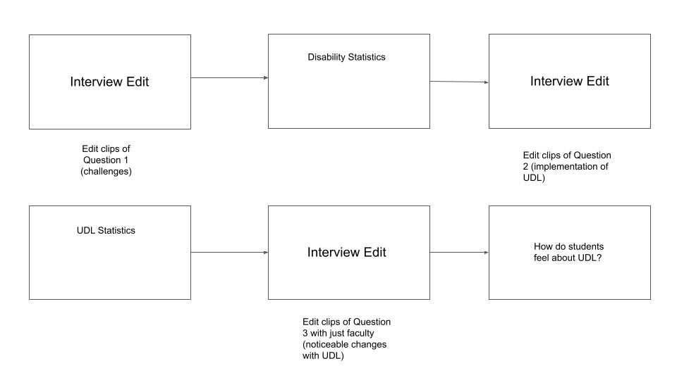
DESIGN: STORYBOARD

Slide 9
DESIGN - VIDEO DETAILS
Video Length: 8 minutes 3 seconds
People Interviewed:
  Carolyn Shivers, Assistant Professor
  Alicia Johnson, Visiting Assistant Professor
  Rachel Mirson, Teaching Assistant
  Nevada Kershner, Teaching Assistant
UDL Course found on the Technology-Enhanced Learning and Online Strategies (TLOS) Professional Development Website

Slide 10
IMPLEMENTATION
Camera and Microphone
  Visual and audio quality is paramount.
Graphics
  Visual appeal rather than just text filled slides.
Filming Conditions
  Room Setup
  Filming Angles
DaVinci Resolve

Slide 11
LESSONS LEARNED
Start working earlier
  Storyboard
  Video Production
  Interviews
Test equipment thoroughly
Gather more feedback

Slide 12
WORK COMPLETED
Video with a runtime of 8:03
  Consists of interviews, graphics, and audio
Interviewed 4 people consisting of faculty and students
  Each participant had taught or attended classes that employed UDL and AEM
Used 17 different graphics in the video

Slide 13
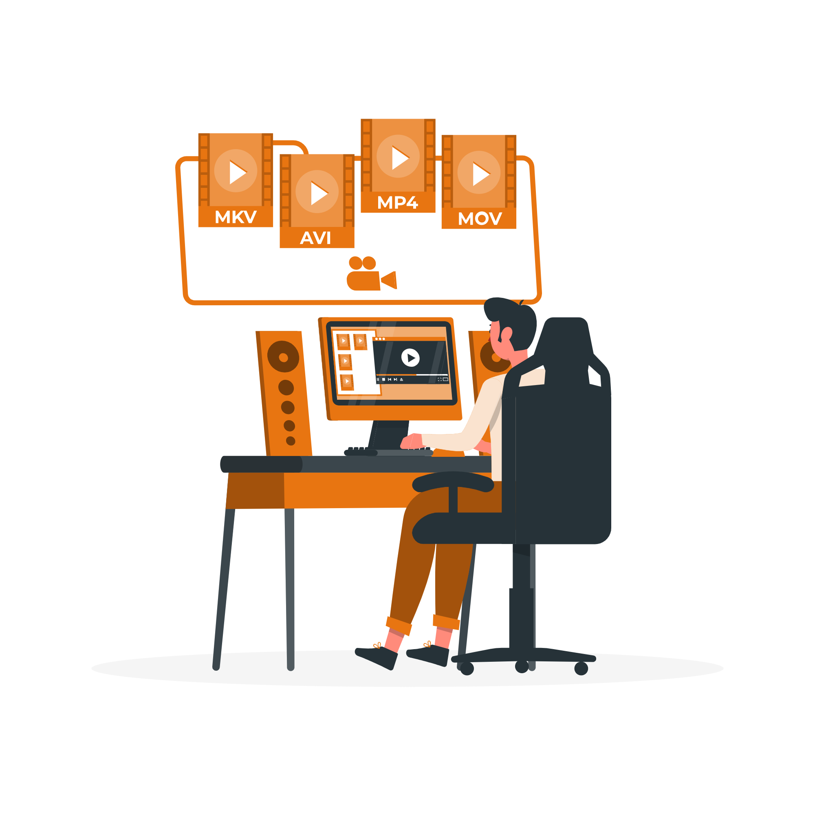
FUTURE WORK
Video Enhancements
  Increasing the video’s accessibility.
Video Circulation
  Promoting the video on various platforms.
Additional Videos
  Creating more videos with extra footage.
  Host a collection of small clips on a website.

Slide 14
UDL+AEM Information
Course Link
  https://profdev-lms.tlos.vt.edu/courses/2557
Virginia Tech Accessibility Portal
  http://vt.edu/accessibility
VT Accessible Technologies
  https://www.assist.vt.edu/

Slide 15

ACKNOWLEDGMENTS
Mark Nichols
Kimberley Homer
Edward Fox
Sr. Director Universal Design & Accessible Technologies
Accessible Technologies Analyst
Multimedia, Hypertext, and Information Access Capstone Course Professor

Slide 16
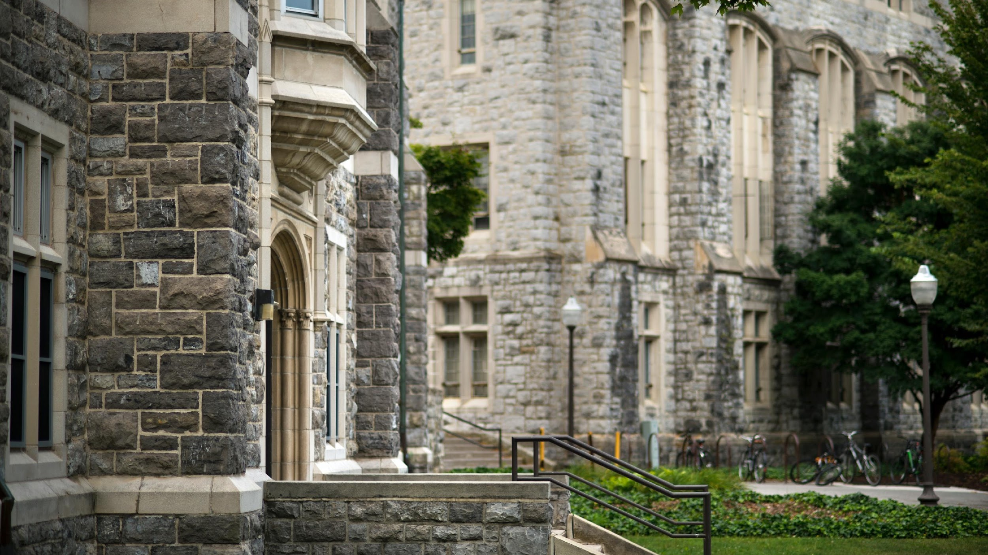
Accessible Technologies at Virginia Polytechnic Institute and State University. (2020, July 13). Making Technology Accessible. Accessible Technologies. Retrieved April 15, 2022, from https://www.assist.vt.edu/
CAST. (2022, January 20). What is accessibility? National Center on Accessible Educational Materials. Retrieved April 15, 2022, from https://aem.cast.org/get-started/defining-accessibility
Evmenova, A. (2018). Preparing Teachers to Use Universal Design for Learning to Support Diverse Learners. Journal of Online Learning Research . Retrieved April 15, 2022, from https://files.eric.ed.gov/fulltext/EJ1184985.pdf
He, Y. (2014, June 2). Universal Design for Learning in an Online Teacher Education Course: Enhancing Learners' Confidence to Teach Online. Retrieved April 15, 2022, from https://jolt.merlot.org/vol10no2/he_0614.pdf
Kumar, K. L., & Wideman, M. (2014). Accessible by design: Applying UDL principles in a first year undergraduate course. Canadian Journal of Higher Education, 44(1), 125–147. https://doi.org/10.47678/cjhe.v44i1.183704
Smith, F. G. (2012, August 31). Analyzing a college course that adheres to the Universal Design for Learning (UDL) framework. Journal of the Scholarship of Teaching and Learning. Retrieved April 15, 2022, from https://eric.ed.gov/?id=EJ992116
REFERENCES

