Slide 1
Deep Learning -
Predicting Accidents
Elias Gorine and Jacob Smethurst
CS 4624 - Multimedia, Hypertext, and Information Access
Dr. Edward A. Fox
Virginia Tech, Blacksburg, VA, 24061
May 6, 2020
Notes:
5s

Slide 2
Outline
Overview
Data
  Input
  Incident
Preliminary Results and Analysis
Future Plans
Lessons Learned
Acknowledgements
References
Notes:
JACOB ~20s

Slide 3
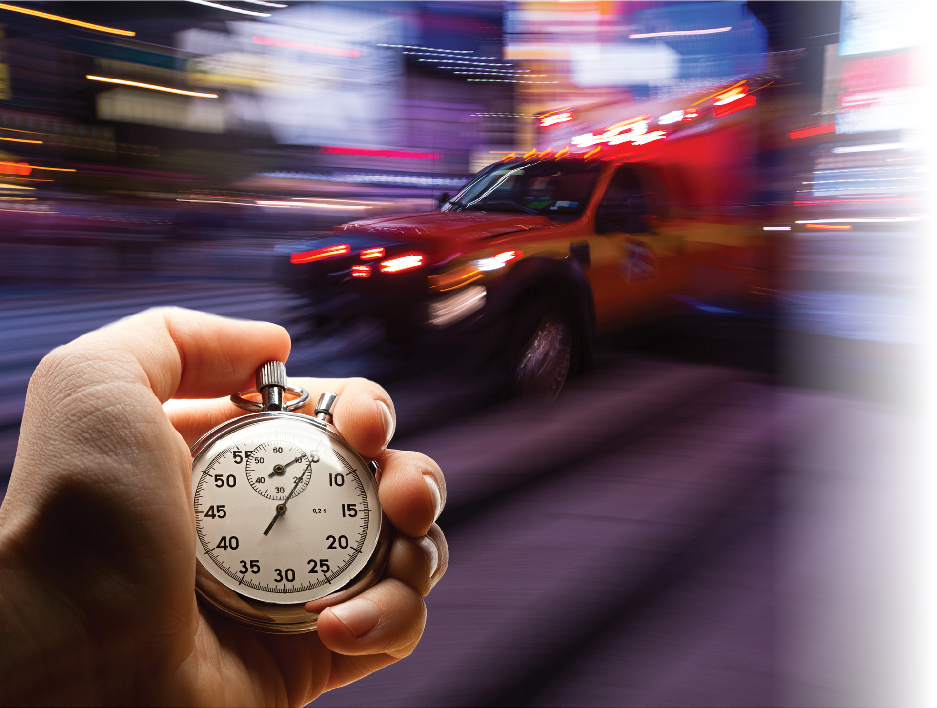
Overview
Help emergency responders respond to accidents faster

Slide 4
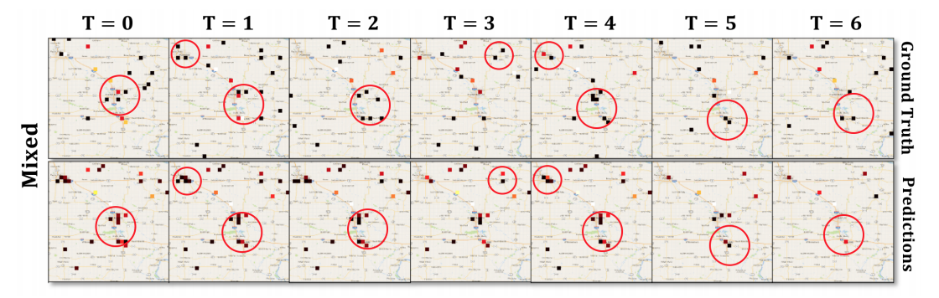
Differences From Other Works
Conv-LSTM paper (Zhuoning Yuan, Xun Zhou, Tianbao Yang) we previously referenced split up Ohio into a grid and predicted the number of accidents to happen per grid square
We want to predict time and location of accidents as this fits better for helping emergency responders

Slide 5
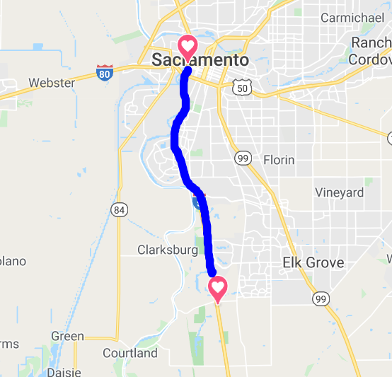
Input data: location and time scope
California I-5 North
Mile markers 504 through 520
  30 collection stations
July 2018 through November 2018

Slide 6
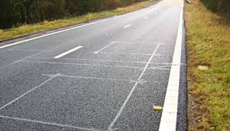
Input data: traffic
Speed
  MPH
Flow
  # of cars
https://encrypted-tbn0.gstatic.com/images?q=tbn%3AANd9GcQdjvwSOe-1gUgJFxJ8JZ6arzVzr4H7wG6QmW7VXgnbUWmdXR0m&usqp=CAU

Slide 7
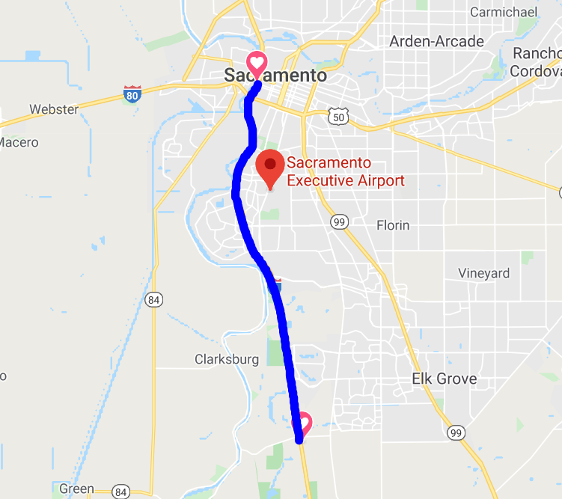
Input data: weather
Temperature
  Degrees C
Wind
  m/s
Precipitation
  mm

Slide 8
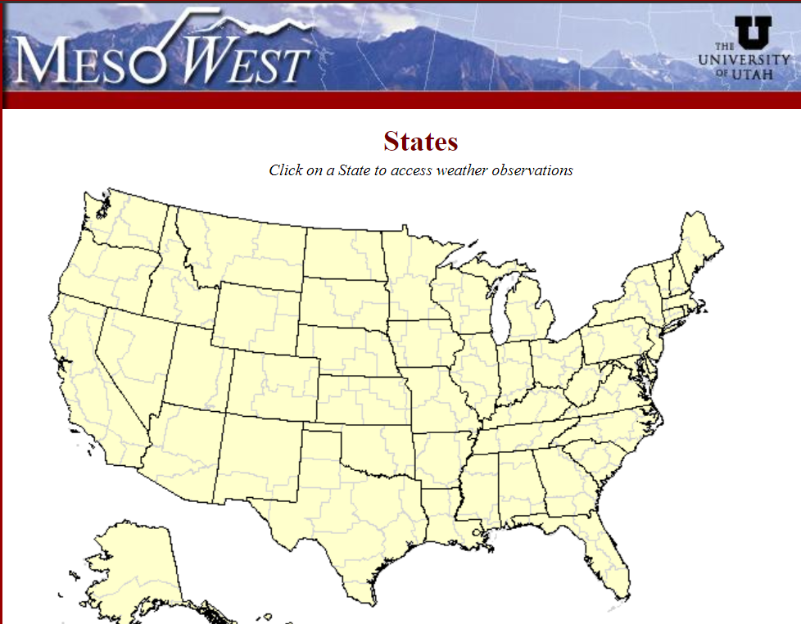
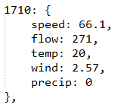
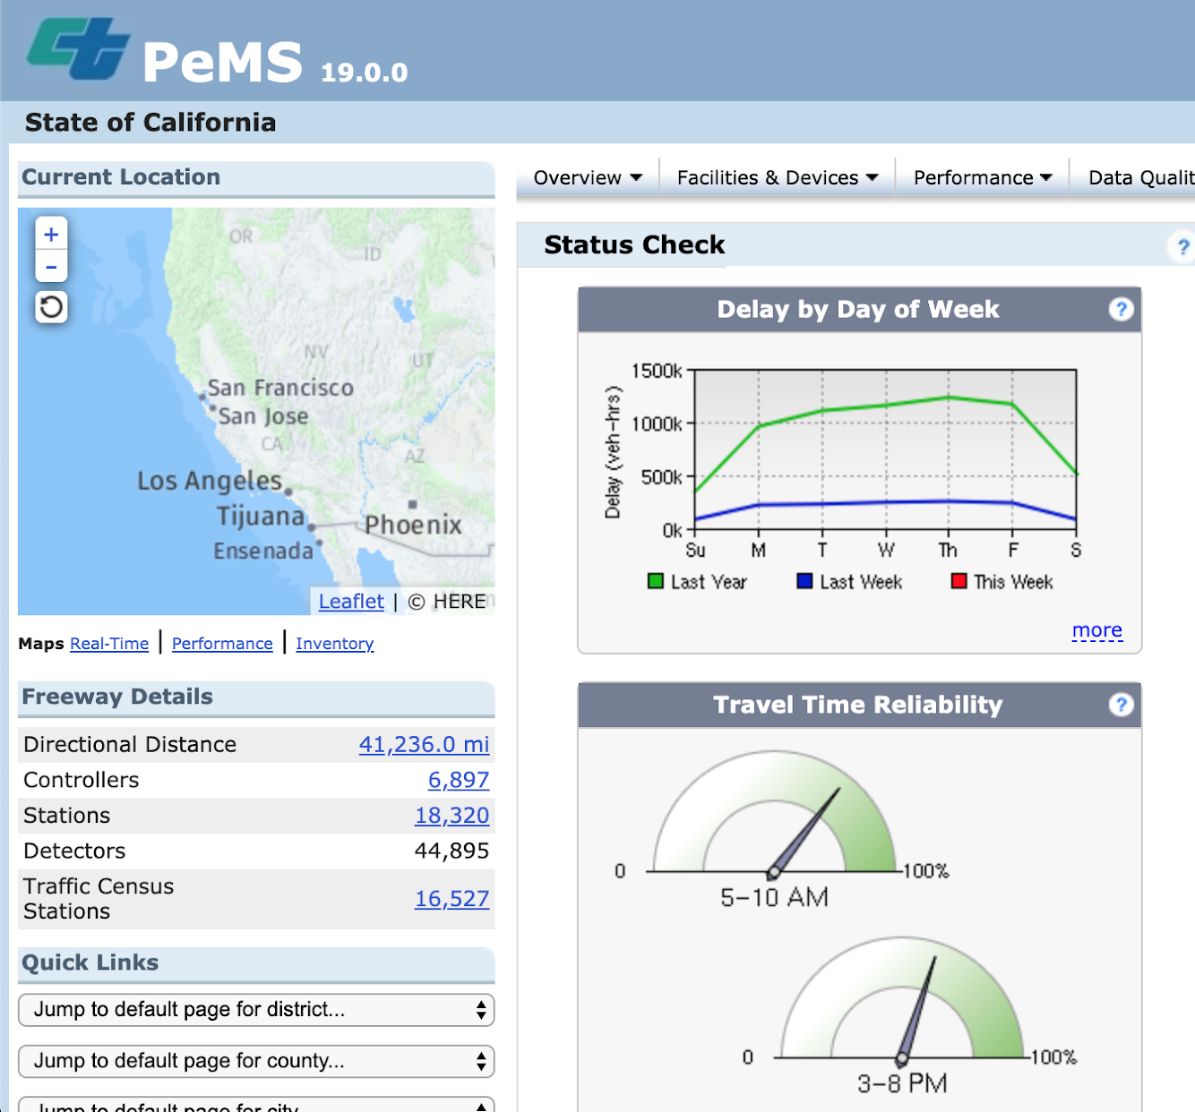
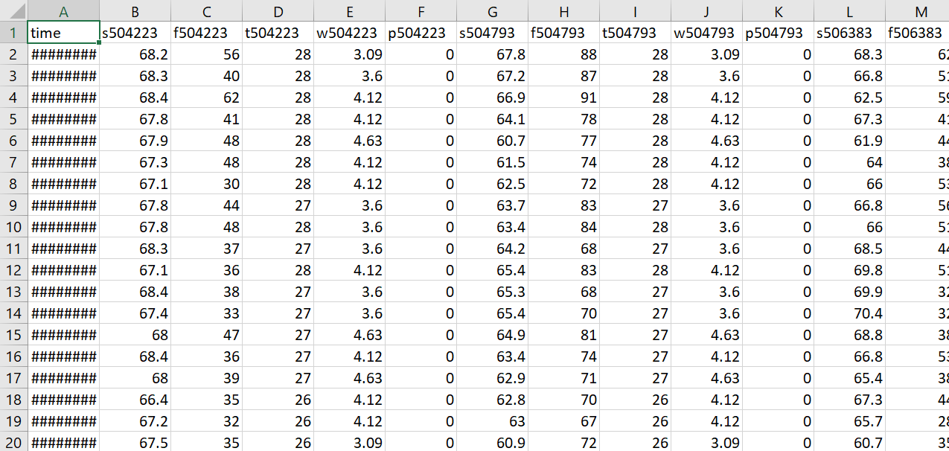

Input data: collection procedure

Slide 9
Input data: combined dataset
time | ... | s514662 | f514662 | t514662 | w514662 | p514662 | ...
. . .
07/01/2018 17:10 |  | 66.1 | 271 | 20 | 2.57 | 0
. . .

Slide 10
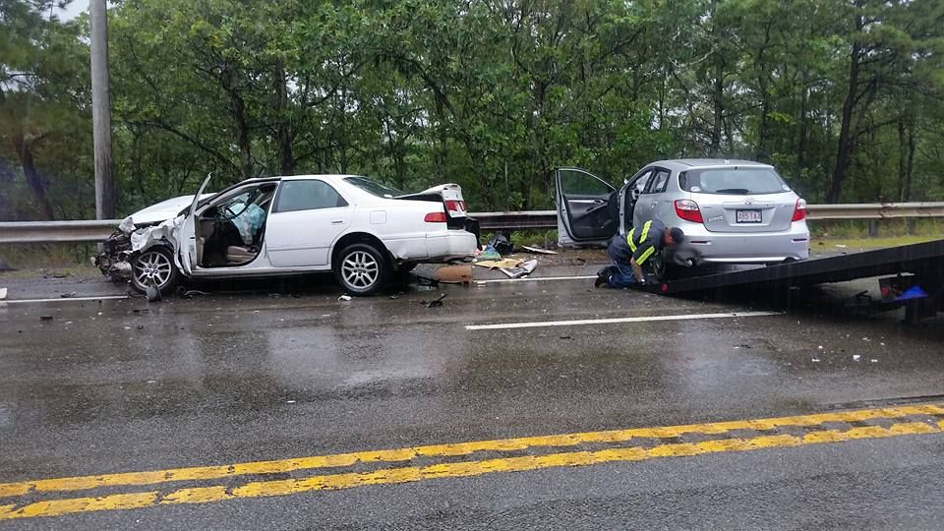
Incident data
Time
Mile-marker location
Incident type
https://bloximages.chicago2.vip.townnews.com/capenews.net/content/tncms/assets/v3/editorial/e/7d/e7dbdbfc-406e-11e5-9a00-27de674c5bef/55ca678e11c12.image.jpg

Slide 11
Autoencoder vs. Bidirectional model
Moved to bidirectional model because of inconsistencies
Auto-encoder takes speed of one point as input feature and trains model accordingly
When more features were added (like downstream speed) auto-encoder didn't work
Bidirectional model is faster for training compared to the other model as well
Notes:
in literature as being faster in training the model

Slide 12
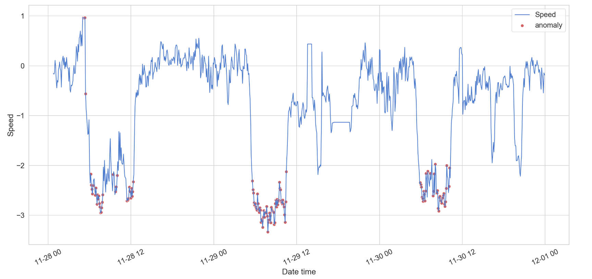
Notes:
Heres an example of the model trained on a subset of the data we have.
Red dots indicate anomalies captured by the model.
A detected anomaly should be followed by
an accident in the upstream

Slide 13
Incidents reported some time after the captured anomaly
the entire drop down and rise indicates an anomaly
Notes:
The model performs well in capturing extreme events (things like car accidents) - other things like hazards not necessarily reported as anomalies
Each of the troughs in the graph are made up of a number of captured points. We can think of them as a single anomaly. You’ll notice after each of these sets of captured anomalies, there is a incident reported some time after, that is indicated by the red arrows on this image.
Another point to mention is that the incidents are recorded at various time-distances from the captured anomaly.

Slide 14
Notes:
Want to create a function to aggregate all of these captured points into a single anomaly - we then want to match each of these single points to a corresponding incident.
We then want to scan the database for an incident some time after the captured anomaly and match the two together. With a high threshold this means the captured anomalies will likely be bigger accidents, with a smaller threshold they could be smaller incidents like hazards, which are also recorded in the DB.
match the detected anomalies to the incidents in the data set - should be followed by
an accident in the upstream

Slide 15
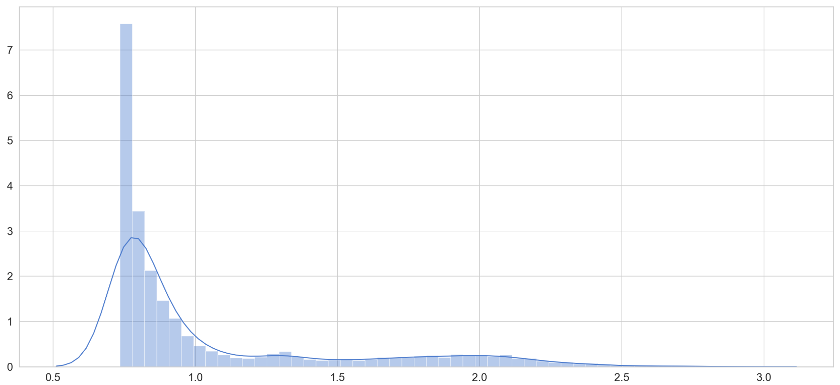
Threshold
Controls the severity of what the model considers to be an anomaly
A lower threshold would capture smaller disturbances, but could lead to more false-positives
Current threshold: 1.5
Notes:
The threshold is a constant value that affect the threshold of what the model considers to be an anomaly
Setting a lower threshold (say to 1.0), will result in the model capturing “smaller” disturbances which could indicate other type of incidents apart from car crashes - like a hazard in the road.
With a high threshold this means the captured anomalies will likely be bigger accidents, with a smaller threshold they could be smaller incidents like hazards, which are also recorded in the DB.
Current threshold captures “large” anomalies very well - things like car accidents
So a lower threshold value could be used to detect and predict smaller incidents and minor traffic hazards, but could also lead to more false positives. A higher threshold will lead to less false positives but risks ignoring some incidents

Slide 16
Bidirectional Model Overview
Performs well in capturing extreme events - hazards not necessarily reported as anomalies
Setting a smaller threshold allows the model to capture smaller points like road hazards
Need to aggregate captured points and match them to incidents in the DB
Notes:
Changing the threshold allows us to change what sort of anomalies are captured by the model.

Slide 17
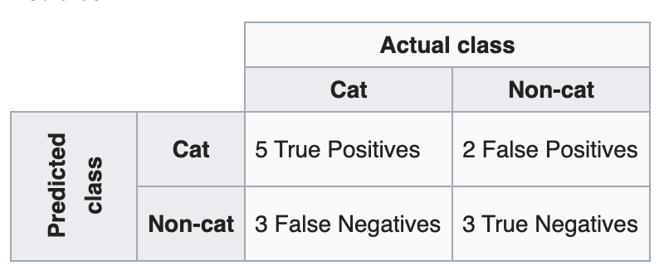
Future Plans
Filter data spatially and temporally so we can build a confusion matrix to identify
true positives, false negatives, etc.
“a confusion matrix, also known as an error matrix, is a specific table layout that allows visualization of the performance of an algorithm, typically a supervised learning one.” - Wikipedia
Notes:
Allows for a more detailed analysis of our model - it will help us identify how well it is performing and where it is going wrong

Slide 18
Things We Learned
Databases
Jupyter
Various Python libraries
Deep Learning
Long-term projects
Working remotely

Slide 19
Database Schema Overview
CREATE TABLE incidents_raw (
incident_id integer,
time timestamp,
duration integer,
freeway text,
ca_pm text,
abs_pm real,
source text,
area text,
location text,
description text
);
CREATE TABLE speed_raw (
time timestamp,
pm_abs real,
pm_ca text,
vds integer,
agg_speed real,
lane_points integer,
pct_obs real
);
CREATE TABLE flow_raw (
time timestamp,
pm_abs real,
pm_ca text,
vds integer,
agg_flow real,
lane_points integer,
pct_obs real
);
CREATE INDEX postmiles_index ON flow_raw(pm_abs);
CREATE INDEX postmiles_index_speed ON speed_raw(pm_abs);
CREATE INDEX postmiles_index_incidents ON incidents_raw(abs_pm);
5,707 Rows
7,593,230 Rows
7,615,378 Rows
Note: Using roughly two months of data on I5-N (California)
Notes:
SQLite database schema - indexes for faster to improve speed of data retrieval
5707 - incidents (Oct, Nov)
7615378 - speed
7593230 - flow

Slide 20

Acknowledgements
Farnaz Khaghani - Client
Dr. Edward A. Fox
https://media-exp1.licdn.com/dms/image/C4E03AQHvTldzxkRm2Q/profile-displayphoto-shrink_200_200/0?e=1590019200&v=beta&t=goWKseC89LpVBvhg6ByFsGE-T2n4Id-OedNOHIjbo0Q

Slide 21
References
Zhuoning Yuan, Xun Zhou, Tianbao Yang. 2018. Hetero-ConvLSTM: A Deep Learning Approach to Traffic Accident Prediction on Heterogeneous Spatio-Temporal Data. In KDD ’18: The 24th ACM SIGKDD International Conference on Knowledge Discovery & Data Mining, August 19–23, 2018, London, United Kingdom. ACM, New York, NY, USA, 9 pages. Retrieved April 29, 2020, from https://doi. org/10.1145/3219819.3219922
Brownlee, J. (2020, January 7). How to Develop a Bidirectional LSTM For Sequence Classification in Python with Keras. Retrieved April 29, 2020, from https://machinelearningmastery.com/develop-bidirectional-lstm-sequence-classification-python-keras/

