Slide 1
Extracting figures from scanned electronic theses and dissertations
M.S. thesis defense
Aug. 6, 2020
Virginia Tech
Blacksburg, VA 24061
Student: Sampanna Kahu (Dept. of Electrical and Computer Engineering)
Committee:
Dr. Edward A. Fox, Chair (Professor, Dept. of Computer Science, and by courtesy, ECE)
Dr. A. Lynn Abbott (Professor, Dept. of Electrical and Computer Engineering)
Dr. William Diehl (Assistant Professor, Dept. of Electrical and Computer Engineering)
Slide count: 57
Notes:
Welcome message:
Good afternoon and welcome everyone.
My name is Sampanna Kahu and in this meeting I will be presenting and defending my M.S. thesis titled “Extracting figures from scanned electronic theses and dissertations”.
I will be pausing after every few slides for any questions or comments.
But please feel free to let me know if you have questions.

Slide 2
Outline
Introduction
Research questions
Related work
Methodology
Data augmentation
Training at scale
Gold standard
Experiments
Experiments, results/discussion, answers to research questions.
Conclusions
Future work
Notes:
This is the outline of this presentation.
Introduction:
Explaining the title.
Figure extraction. What is it and why is it needed.
Scanned: What are scanned documents and why do we deal with them.
ETDs: What are ETDs and why do we deal with them.
Research questions.
We will pose the research questions that we aim to answer as part of this work.
Related work.
We mainly cover Deepfigures because this paper is the moe relevant to this work.
Dataset used.
Label generation pipeline.
Model architecture.
Methodology.
Data augmentation.
Training at scale.
Gold standard.
Experiments.
We discuss the various experiments we conducted, their results and the relevant discussion.
Conclusions.
Future work.

Slide 3
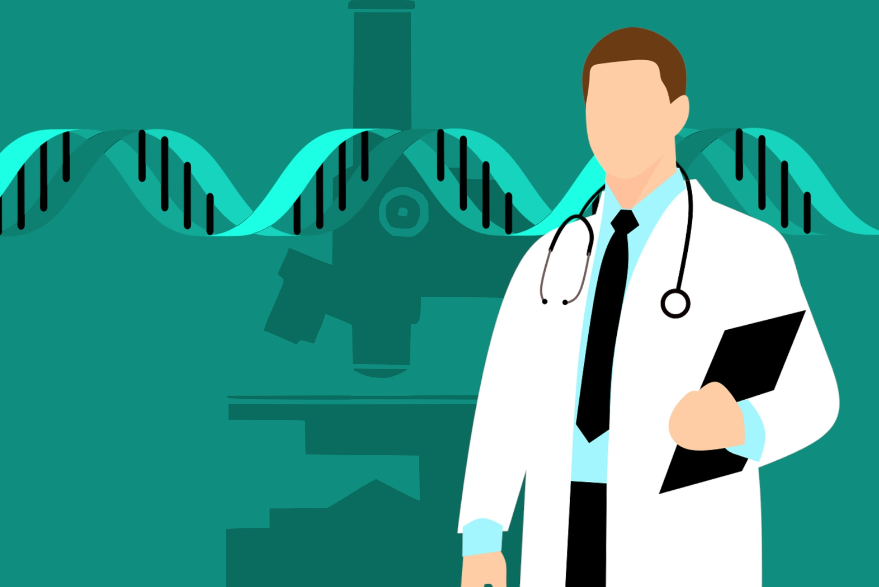


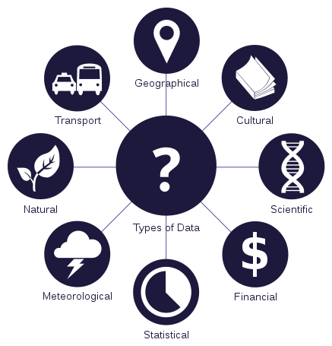

Introduction
Publish
Extracting figures* from scanned electronic theses and dissertations.
Vast majority of published research is in PDF.
Downstream tasks rely on accurate figure extraction
Figure extraction*
Scientific search and information extraction
Image sources: [1] https://pxhere.com/en/photo/1451109
[2] https://pixabay.com/illustrations/pdf-logo-adobe-filetype-mime-type-3383632/
[3] https://commons.wikimedia.org/wiki/File:Exclamation_Circle_Red.svg
[4] https://commons.wikimedia.org/wiki/File:Data_types_-_en.svg
[5] https://pxhere.com/en/photo/1565521
*Refers to both figure and table extraction in the rest of the presentation.
Notes:
Vast majority of research is published in PDF.
And several downstream tasks (such as searching and indexing, parsing plot and table data, etc) rely on accurate figure extraction.

Slide 4
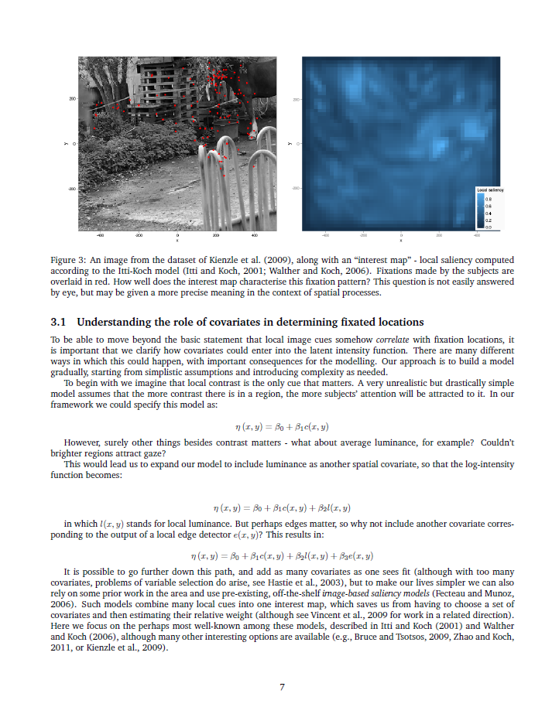
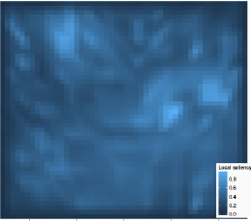
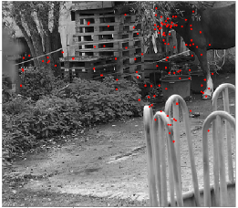
Introduction
Extracting figures from scanned electronic theses and dissertations.
Image sources: [1] Simon Barthelmé, Hans Trukenbrod, Ralf Engbert, and Felix Wichmann.2012. Modelling fixation locations using spatial point processes. (2012). arXiv:stat.AP/1207.2370 http://arxiv.org/abs/1207.23701 (Page no. 7)
Notes:
In short, figure extraction is basically being able to separate out the individual figures from the PDF file.

Slide 5
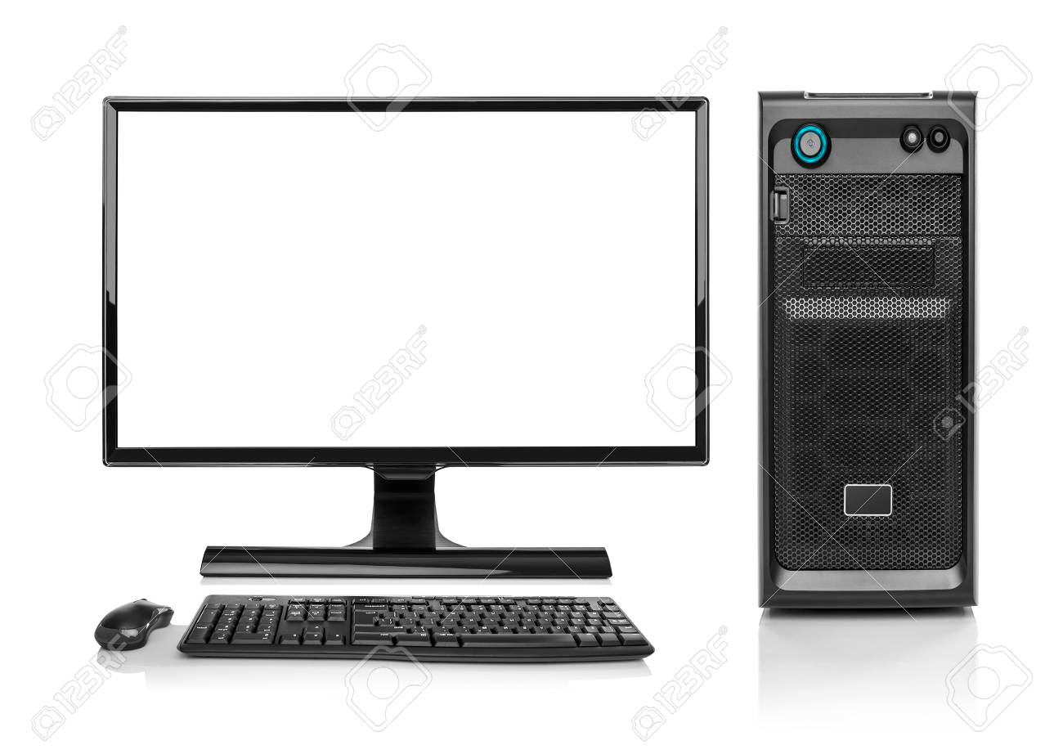


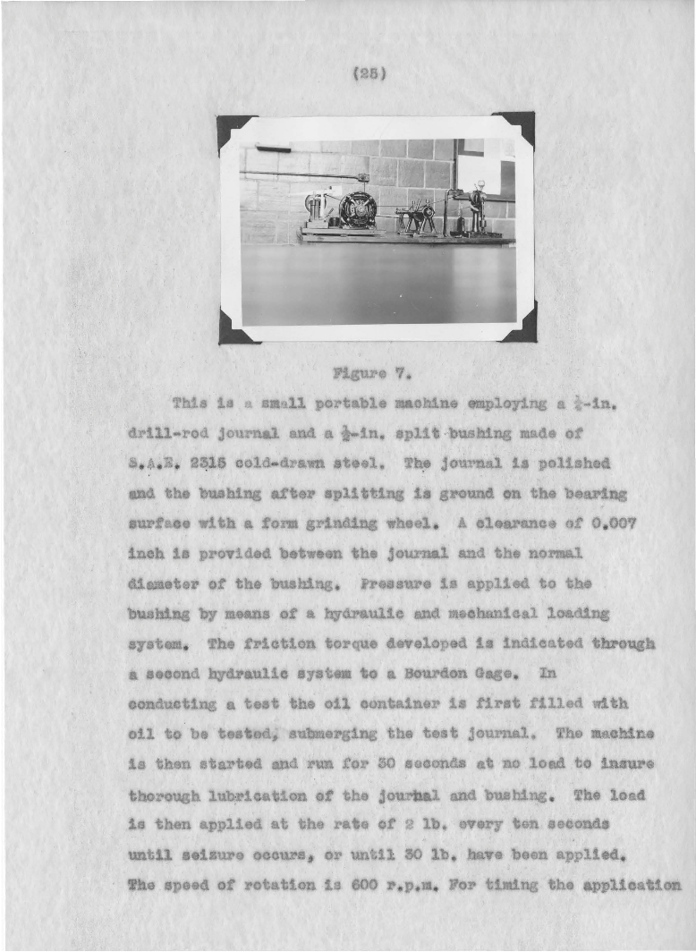
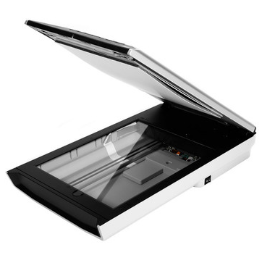
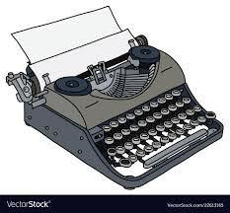
Introduction
Extracting figures from scanned electronic theses and dissertations.
Born digital PDF files: Contain the complete description to render its elements (text, fonts, vector graphics, raster images, etc.)
Scanned PDF files: Originally handwritten or typed using a typewriter. Later digitized using scanning devices.
Image sources: [1] Simon Barthelmé, Hans Trukenbrod, Ralf Engbert, and Felix Wichmann.2012. Modelling fixation locations using spatial point processes. (2012). arXiv:stat.AP/1207.2370 http://arxiv.org/abs/1207.23701 (Page no. 7)
[2] Walter Douglas Chiles. 1935. Effect of service on automobile crankcase oils. Ph.D. Dissertation. Virginia Agricultural and Mechanical College and Polytechnic Institute. http://hdl.handle.net/10919/56159
[3] https://www.123rf.com/photo_78921823_modern-desktop-pc-computer-isolated-.html
[4] https://www.brandeps.com/logo/M/Microsoft-Word-01
[5] https://i.stack.imgur.com/zHFFO.png
[6] https://www.vectorstock.com/royalty-free-vector/the-old-portable-typewriter-vector-22613165
[7] https://images.techhive.com/images/article/2016/01/flatbed-scanner-stock-100636615-large.jpg
Notes:
Born digital PDF files:
Usually typed using a computer.
Modern word processors such as Microsoft Word and LaTeX are usually used.
As a result, these files usually contain the complete description to render its component elements (text, fonts, vector graphics, raster images, etc.)
Scanned PDF files:
These files are usually first were written using a typewriter or perhaps even hand-written, and existed as paper hard copies.
But they were later digitized using scanning devices such as flatbed scanners. (Now-a-days, there are many automated devices that can automatically turn the pages of books to scan them.)
The scanned PDF files are usually older files. But there are exceptions.
Why we focus on scanned documents:
A large corpus of scientific documents exists in the scanned format.
Most of the modern techniques are designed for born-digital documents and don’t adapt well to scanned documents.

Slide 6
Introduction
Extracting figures from scanned electronic theses and dissertations.
This work focuses on ETDs, which are longer, book-length documents.
But can possibly be extended to other scientific documents.
ETD=Electronic Theses and Dissertations

Slide 7
Outline
Introduction
Research questions
Related work
Methodology
Data augmentation
Training at scale
Gold standard
Experiments
Experiments, results/discussion, answers to research questions.
Conclusions
Future work
Notes:
This is the outline of this presentation.
Introduction:
Explaining the title.
Figure extraction. What is it and why is it needed.
Scanned: What are scanned documents and why do we deal with them.
ETDs: What are ETDs and why do we deal with them.
Research questions.
We will pose the research questions that we aim to answer as part of this work.
Related work.
We mainly cover Deepfigures because this paper is the moe relevant to this work.
Dataset used.
Label generation pipeline.
Model architecture.
Methodology.
Data augmentation.
Training at scale.
Gold standard.
Experiments.
We discuss the various experiments we conducted, their results and the relevant discussion.
Conclusions.
Future work.

Slide 8
Research questions
RQ1: How well can existing methods perform figure extraction from scanned ETDs?
RQ2: Can this performance be improved by using simple data augmentation techniques and weight initialization from the original pre-trained model?
RQ3: Can this performance be improved by training on manually labelled data?
RQ4: Can this performance be improved by using transfer learning techniques?

Slide 9
Outline
Introduction
Research questions
Related work
Methodology
Data augmentation
Training at scale
Gold standard
Experiments
Experiments, results/discussion, answers to research questions.
Conclusions
Future work
Notes:
This is the outline of this presentation.
Introduction:
Explaining the title.
Figure extraction. What is it and why is it needed.
Scanned: What are scanned documents and why do we deal with them.
ETDs: What are ETDs and why do we deal with them.
Research questions.
We will pose the research questions that we aim to answer as part of this work.
Related work.
We mainly cover Deepfigures because this paper is the moe relevant to this work.
Dataset used.
Label generation pipeline.
Model architecture.
Methodology.
Data augmentation.
Training at scale.
Gold standard.
Experiments.
We discuss the various experiments we conducted, their results and the relevant discussion.
Conclusions.
Future work.

Slide 10
Related work - Deepfigures
Physics
Computer science
Download LaTeX files from arXiv dataset - from 900K documents.
Quantitative biology
others...
Noah Siegel, Nicholas Lourie, Russell Power, and Waleed Ammar. 2018. Extracting Scientific Figures with Distantly Supervised Neural Networks. CoRR abs/1804.02445 (2018). arXiv:1804.02445 Retrieved October 9, 2019 from http://arxiv.org/abs/1804.02445
Notes:
Deepfigures is the most relevant work to this work.

Slide 11
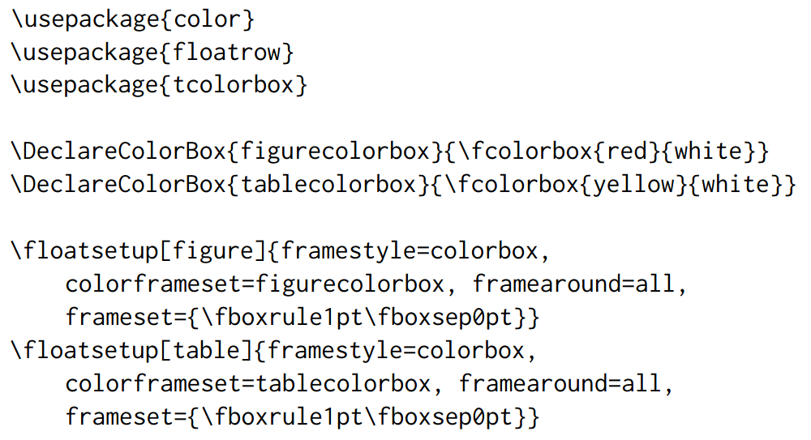
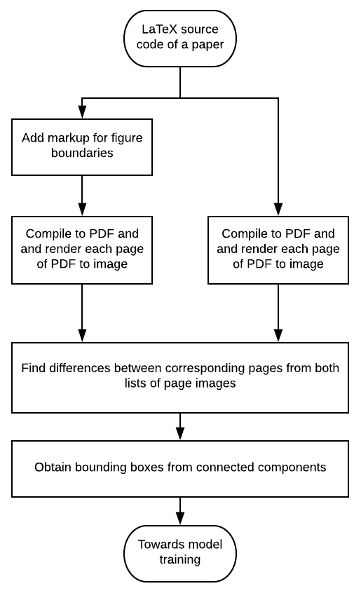
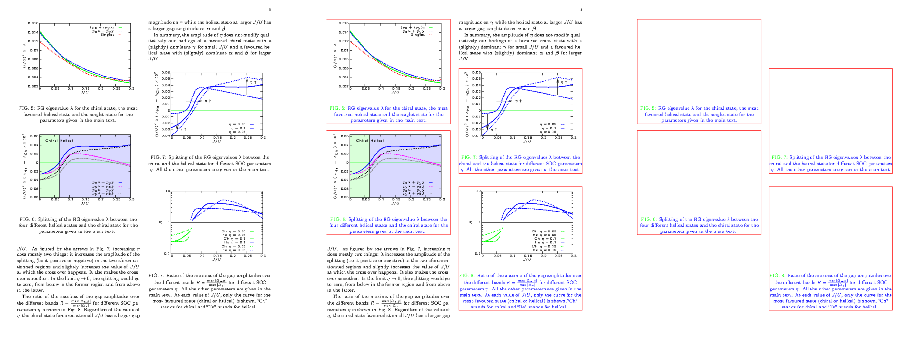
Image sources: [1] Noah Siegel, Nicholas Lourie, Russell Power, and Waleed Ammar. 2018. Extracting Scientific Figures with Distantly Supervised Neural Networks. CoRR abs/1804.02445 (2018). arXiv:1804.02445 Retrieved October 9, 2019 from http://arxiv.org/abs/1804.02445
Notes:
Deepfigures is the most relevant work to this work.

Slide 12
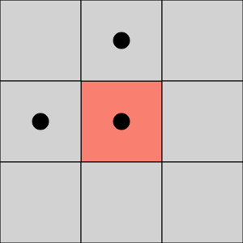
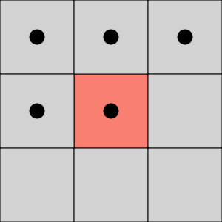
Related work - Deepfigures
Connected Component Labelling Algorithm: Assume that region pixels have the value 0 (black) and that background pixels have the value 255 (white).
Scan the image to find an unlabeled 0 (pixel and assign it a new label L.
Recursively assign a label L to all of its 0 neighbors.
Stop if there are no more unlabeled 0 pixels.
Go to step 1.
4-connectivity
8-connectivity
[1] https://en.wikipedia.org/wiki/Connected-component_labeling
[2] https://www.cse.unr.edu/~bebis/CS791E/Notes/ConnectedComponents.pdf

Slide 13
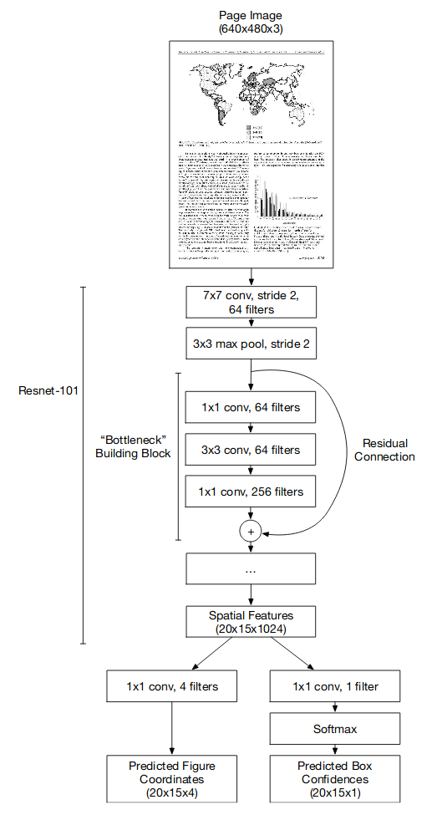
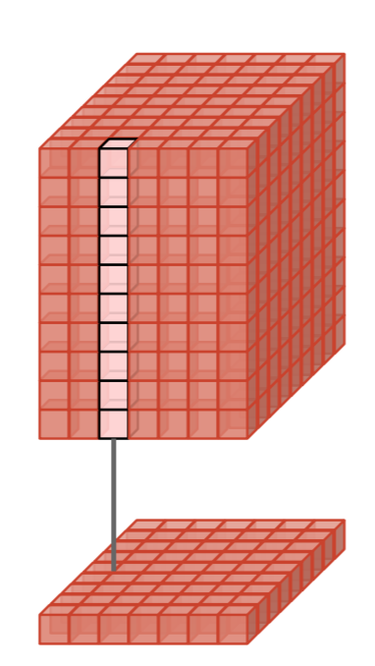
Related work - Deepfigures
The input page of the PDF (converted to an image 640x480)
The Resnet-101 model
Model | CS-Large | PubMed
Deepfigures | 0.849 | 0.806
F1-scores of Deepfigures on manually labelled datasets^{[1]} of born-digital documents.
[1] Noah Siegel, Nicholas Lourie, Russell Power, and Waleed Ammar. 2018. Extracting Scientific Figures with Distantly Supervised Neural Networks. CoRR abs/1804.02445 (2018). arXiv:1804.02445 Retrieved October 9, 2019 from http://arxiv.org/abs/1804.02445
Notes:
Deepfigures is the most relevant work to this work.

Slide 14
Outline
Introduction
Research questions
Related work
Methodology
Data augmentation
Training at scale
Gold standard
Experiments
Experiments, results/discussion, answers to research questions.
Conclusions
Future work
Notes:
This is the outline of this presentation.
Introduction:
Explaining the title.
Figure extraction. What is it and why is it needed.
Scanned: What are scanned documents and why do we deal with them.
ETDs: What are ETDs and why do we deal with them.
Research questions.
We will pose the research questions that we aim to answer as part of this work.
Related work.
We mainly cover Deepfigures because this paper is the moe relevant to this work.
Dataset used.
Label generation pipeline.
Model architecture.
Methodology.
Data augmentation.
Training at scale.
Gold standard.
Experiments.
We discuss the various experiments we conducted, their results and the relevant discussion.
Conclusions.
Future work.

Slide 15
Feature distributions (Born-digital vs. scanned)
Features: Font, line spacing, content layout, scanner noise, etc.
Goal: To make the first document look like the second.
Image sources: [1] Simon Barthelmé, Hans Trukenbrod, Ralf Engbert, and Felix Wichmann.2012. Modelling fixation locations using spatial point processes. (2012). arXiv:stat.AP/1207.2370 http://arxiv.org/abs/1207.23701 (Page no. 7)
[2] Walter Douglas Chiles. 1935. Effect of service on automobile crankcase oils. Ph.D. Dissertation. Virginia Agricultural and Mechanical College and Polytechnic Institute. http://hdl.handle.net/10919/56159
Notes:
Existing work mostly deals with born-digital documents.
The figure on the left is a page from a born-digital PDF from the arXiv dataset for which we there are techniques to generate labels for figure extraction. Therefore, training model for figure extraction (like Deepfigures) is possible. The figure on the right is a page from a scanned PDF, for which such a dataset does not exist (to the best of our knowledge).
However, our aim is to extract figures from scanned ETDs.
Therefore, we try to make the first document look like the second one so that we have enough data.
To do so, we first need to know what makes the two documents look different.
Features such as font, line-spacing, content layout, scanner noise, background, etc. seem to be major factors.
Therefore, we propose techniques to transform the born-digital PDFs on the left to make them look more like the scanned PDFs on the right.
This technique is also known as data augmentation.

Slide 16
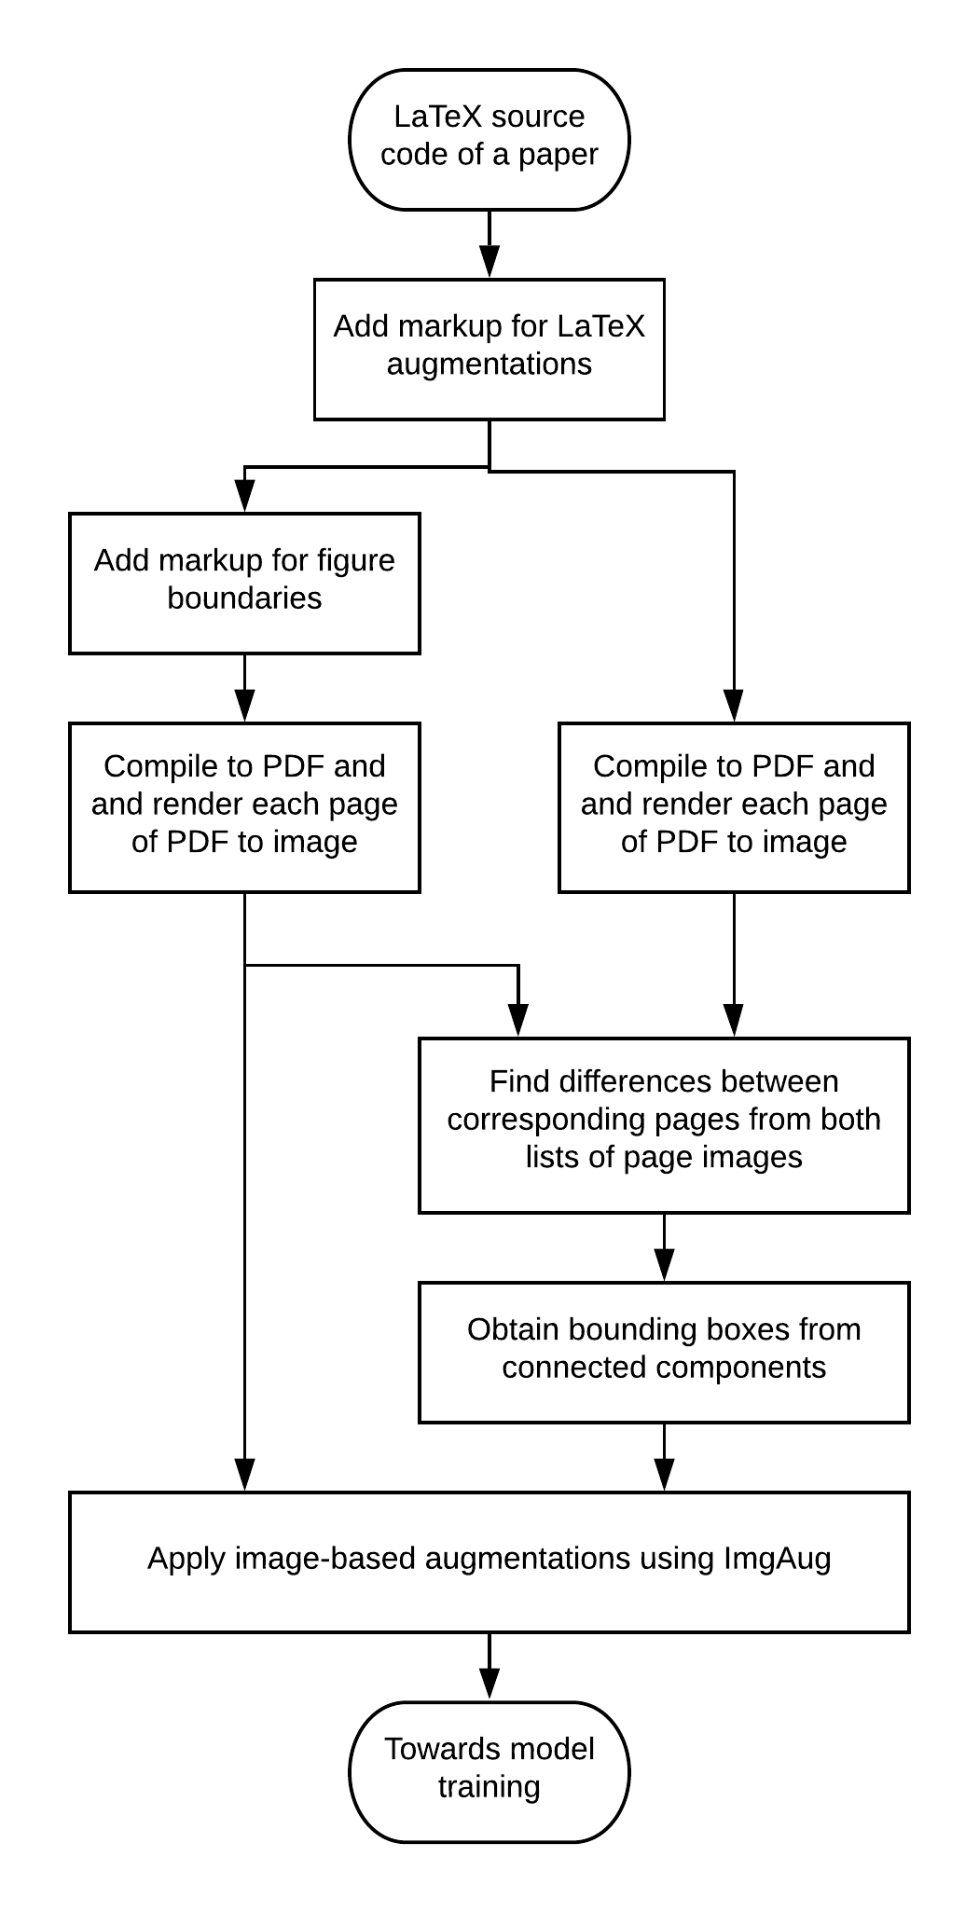
Data augmentation
The overall pipeline along with the data augmentation steps.
Notes:
Cue: Wait for questions after explaining this slide.

Slide 17



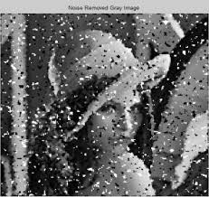
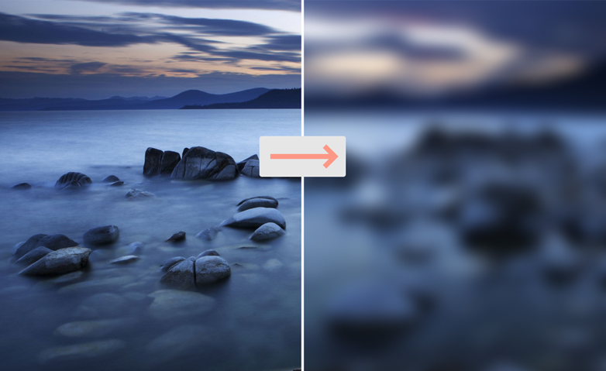
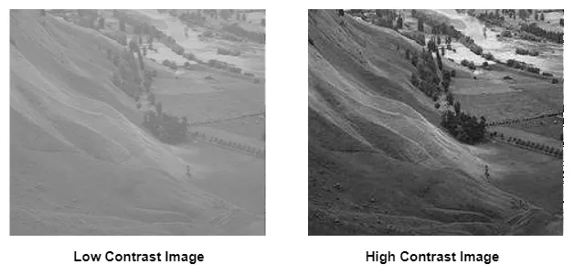
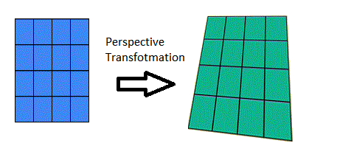
Data augmentation
Image-based data augmentations
Random affine rotation (limited to +/- 5 degrees)
Additive Gaussian noise
Salt-and-pepper noise
Gaussian blur
Linear contrast
Perspective transform

Slide 18
Data augmentation
LaTeX-based data augmentations
Following line was replaced: \documentclass[sigconf]{acmart} \documentclass[sigconf,12pt]{acmart}
Following code added at the beginning: \renewcommand\ttdefault{cmvtt} \renewcommand{\familydefault}{\ttdefault} \linespread{1.5}

Slide 19
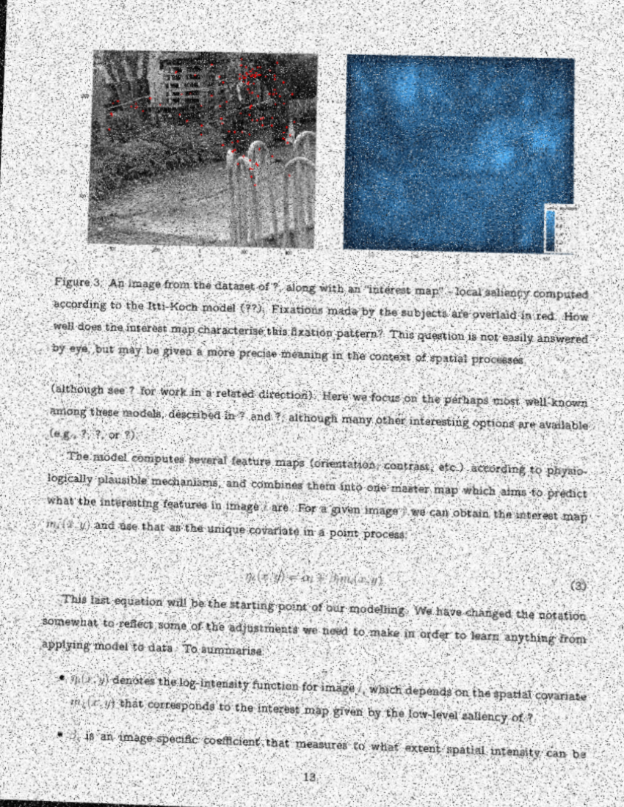
Data augmentation
Image sources: [1] Simon Barthelmé, Hans Trukenbrod, Ralf Engbert, and Felix Wichmann.2012. Modelling fixation locations using spatial point processes. (2012). arXiv:stat.AP/1207.2370 http://arxiv.org/abs/1207.23701 (Page no. 7)
[2] Walter Douglas Chiles. 1935. Effect of service on automobile crankcase oils. Ph.D. Dissertation. Virginia Agricultural and Mechanical College and Polytechnic Institute. http://hdl.handle.net/10919/56159

Slide 20
Training at scale
We primarily use the arXiv dataset:
Compressed size on disk: 1.3 TB.
Divided into 2600 files of 500MB each.
Each 500MB-file contains several hundred scientific documents along with their LaTeX source code.
Training deep learning models on a huge dataset is logistically challenging:
Not feasible to unzip and compile all LaTeX into PDFs before training.
Computationally expensive to do using a single thread.

Slide 21
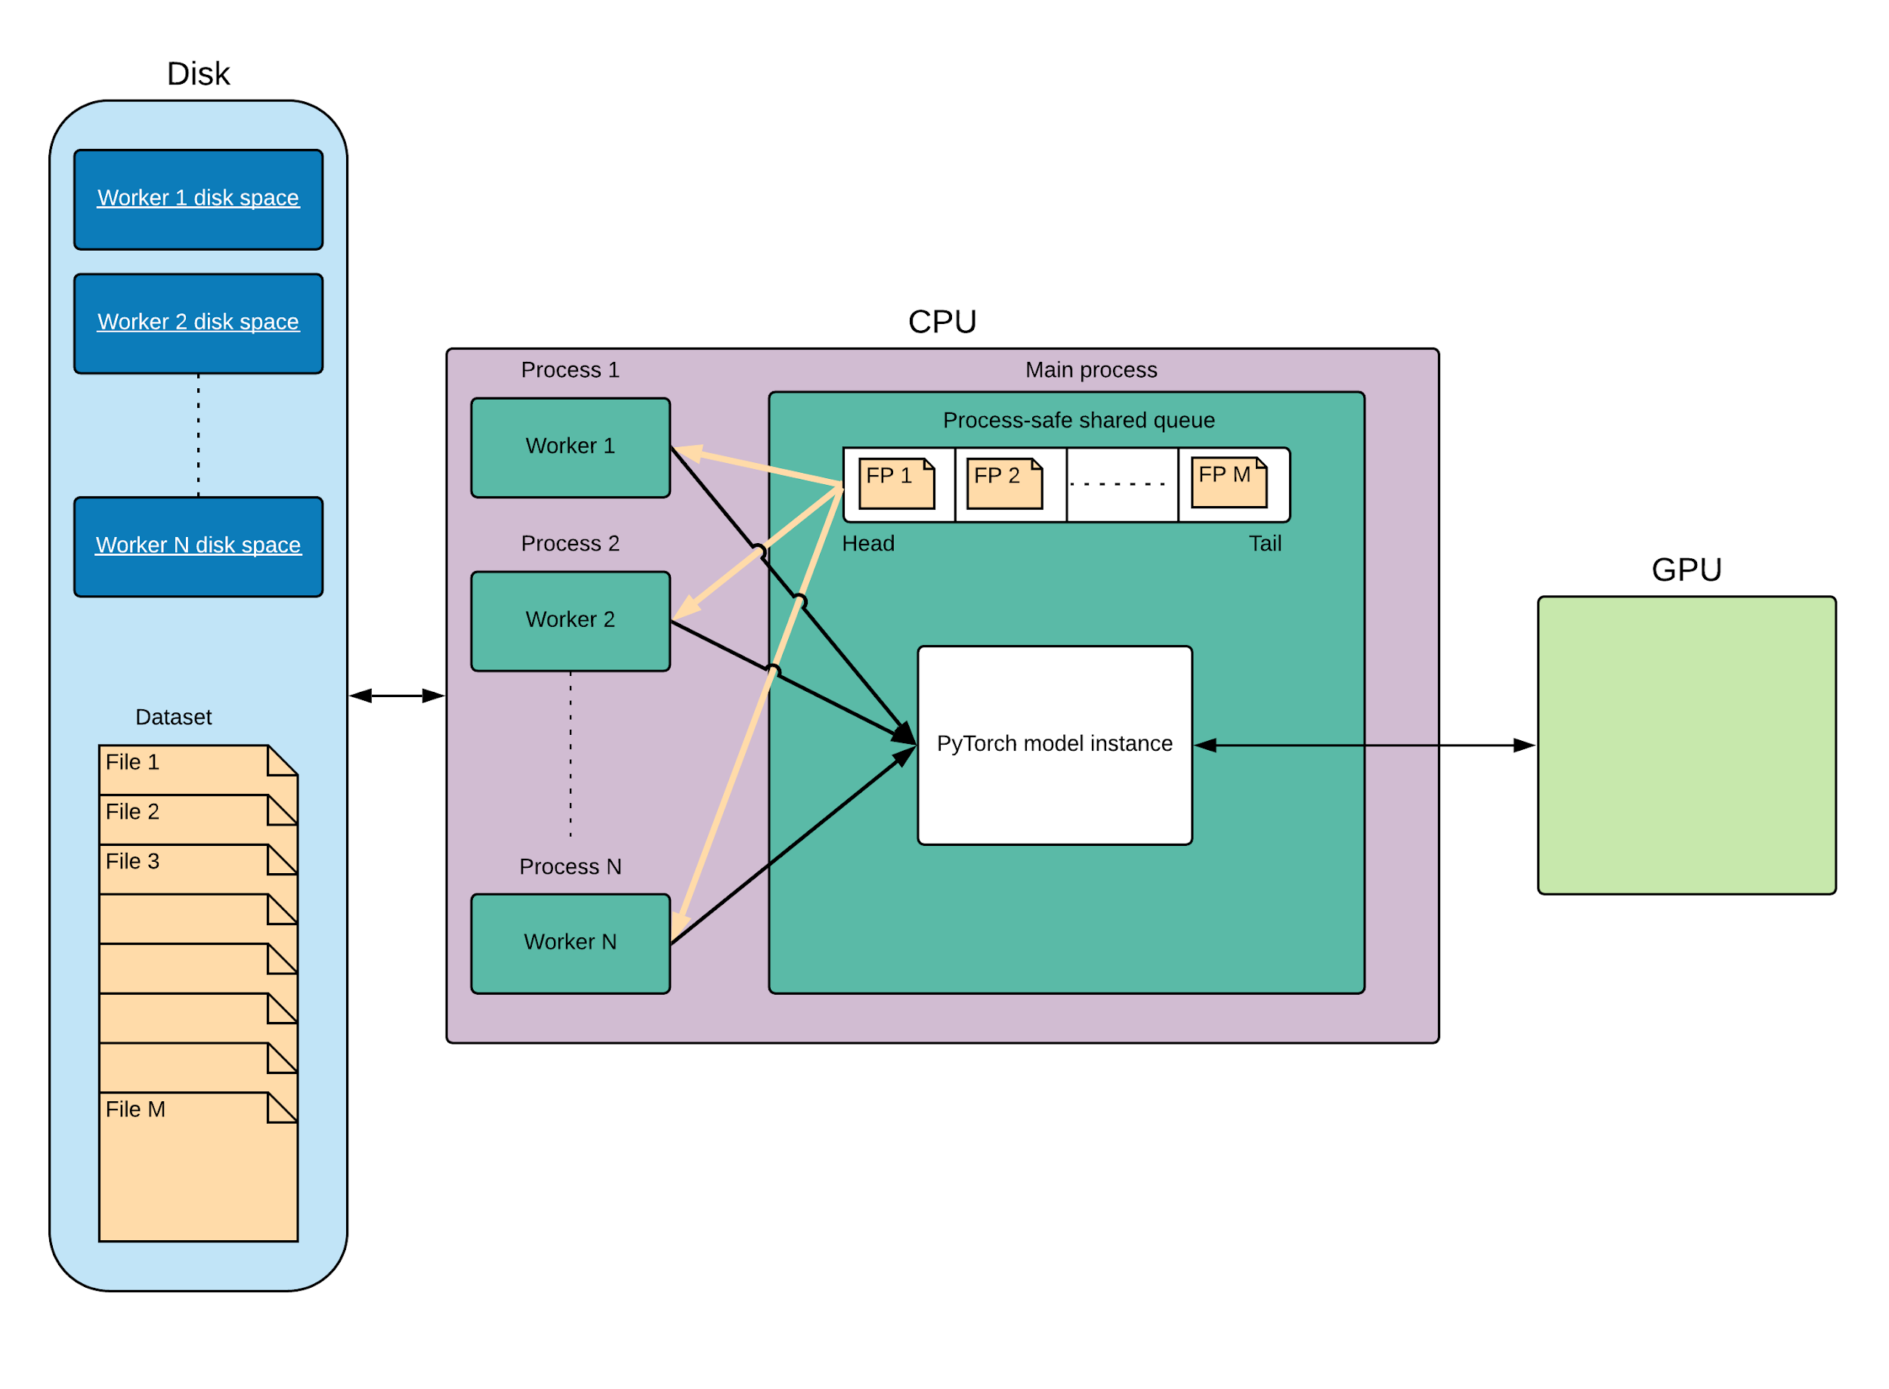
Notes:
We developed this training system to easily manage training deep learning models on the arXiv dataset.

Slide 22
Gold standard dataset
Since the labels of the arXiv dataset are self-generated, labels of the augmented dataset cannot be considered as ground-truth.
Thus, an evaluation set labelled manually needs to be created.
Val set (50%)
(used for selecting the best model out of all the model checkpoints)
Test set (50%)
(used for reporting the performance of the chosen best model)
Gold standard (70 ETDs, 10.1K pages, manually labelled, 3.3K figures)
Notes:
MIT DSpace was used because:
ETDs there are scanned.
ETDs there are organized by department and degree type.
ETDs there have metadata.

Slide 23
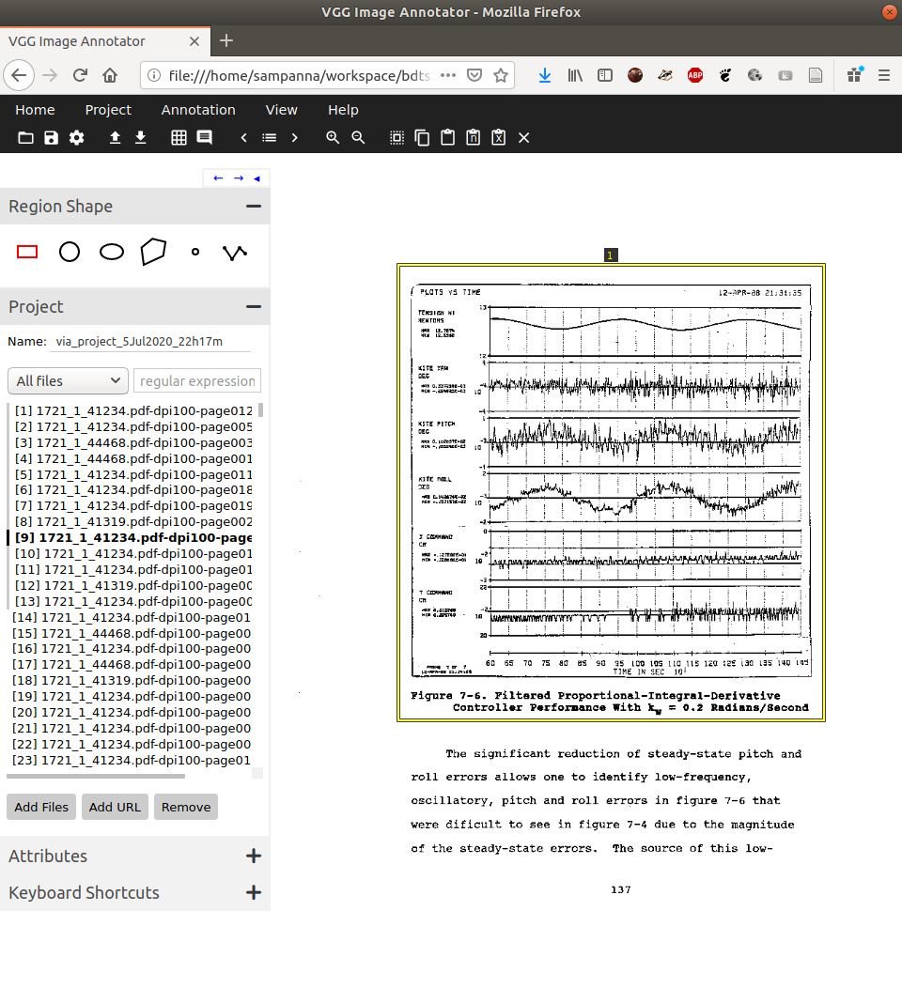
Gold standard dataset

Slide 24
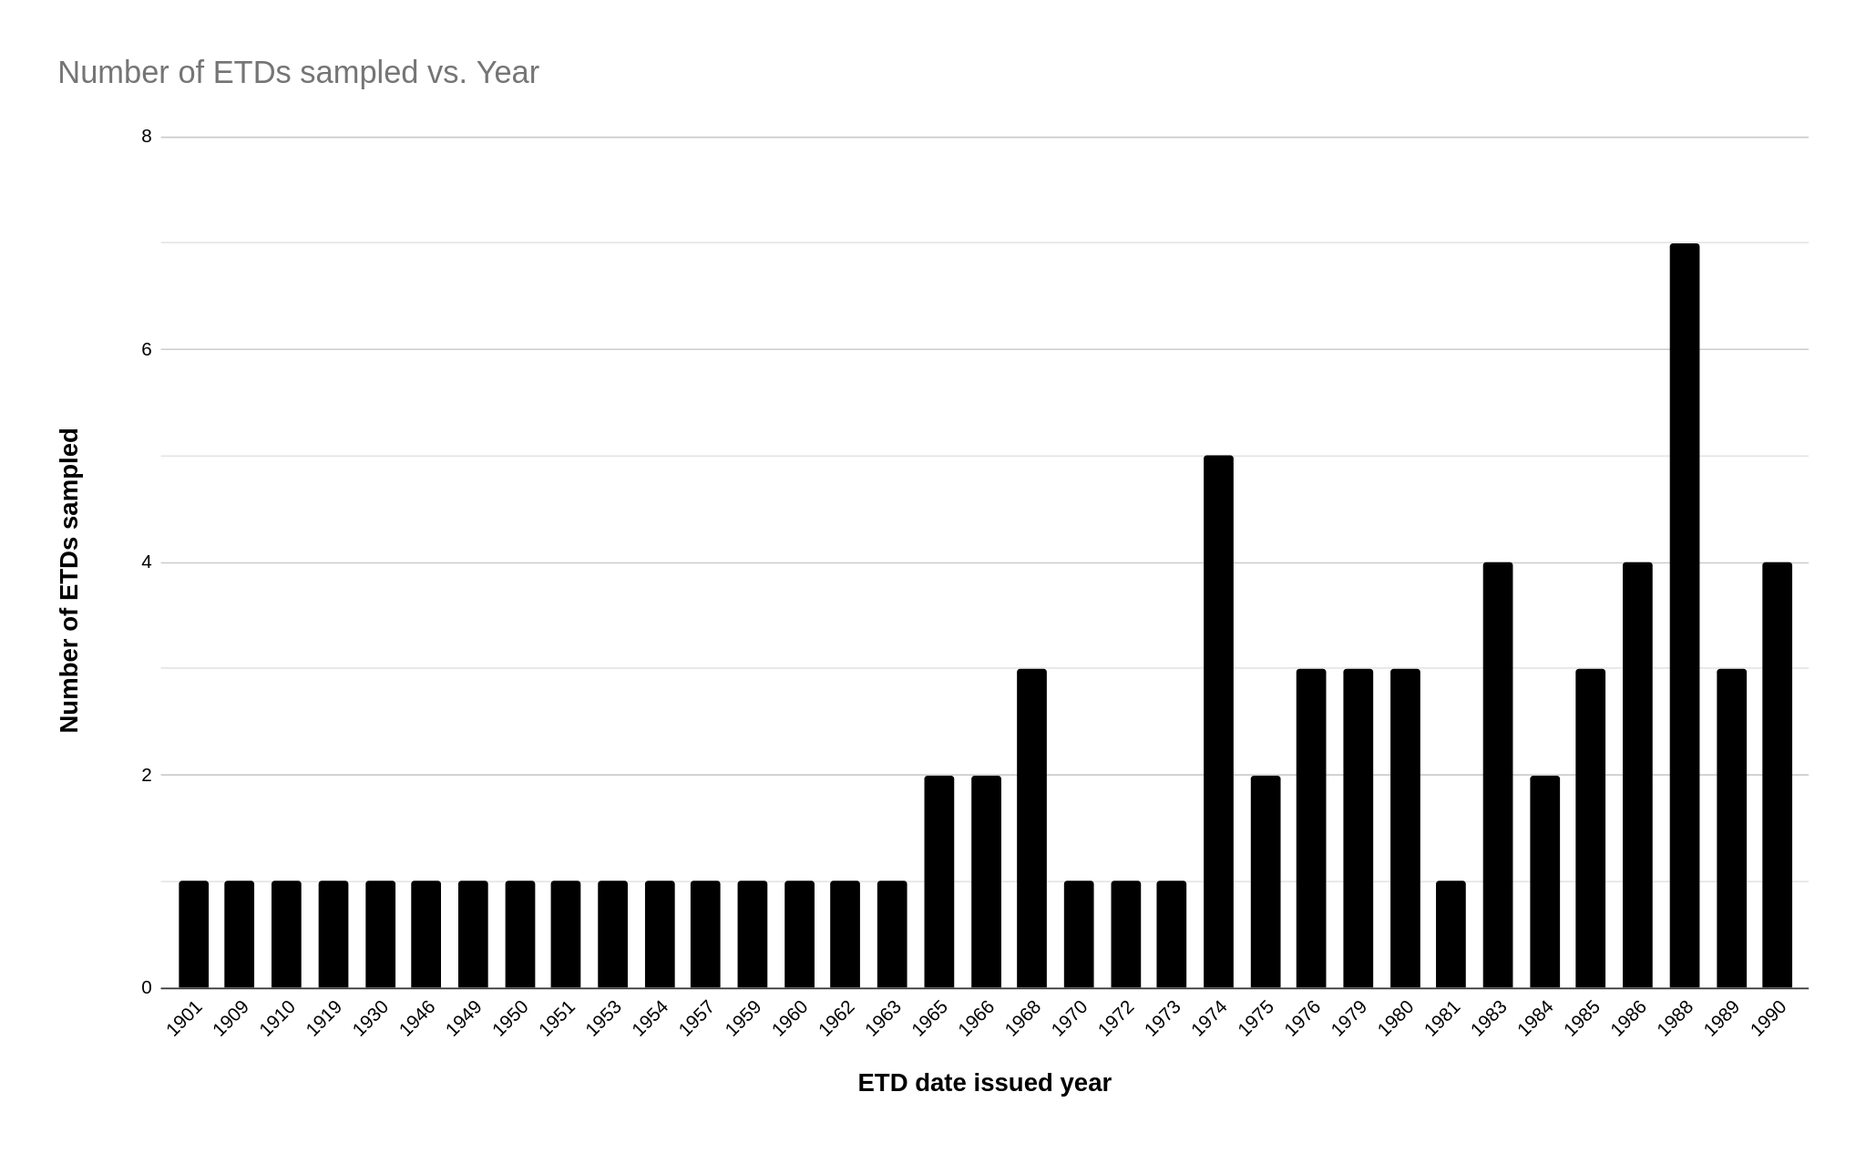
Gold standard dataset

Slide 25
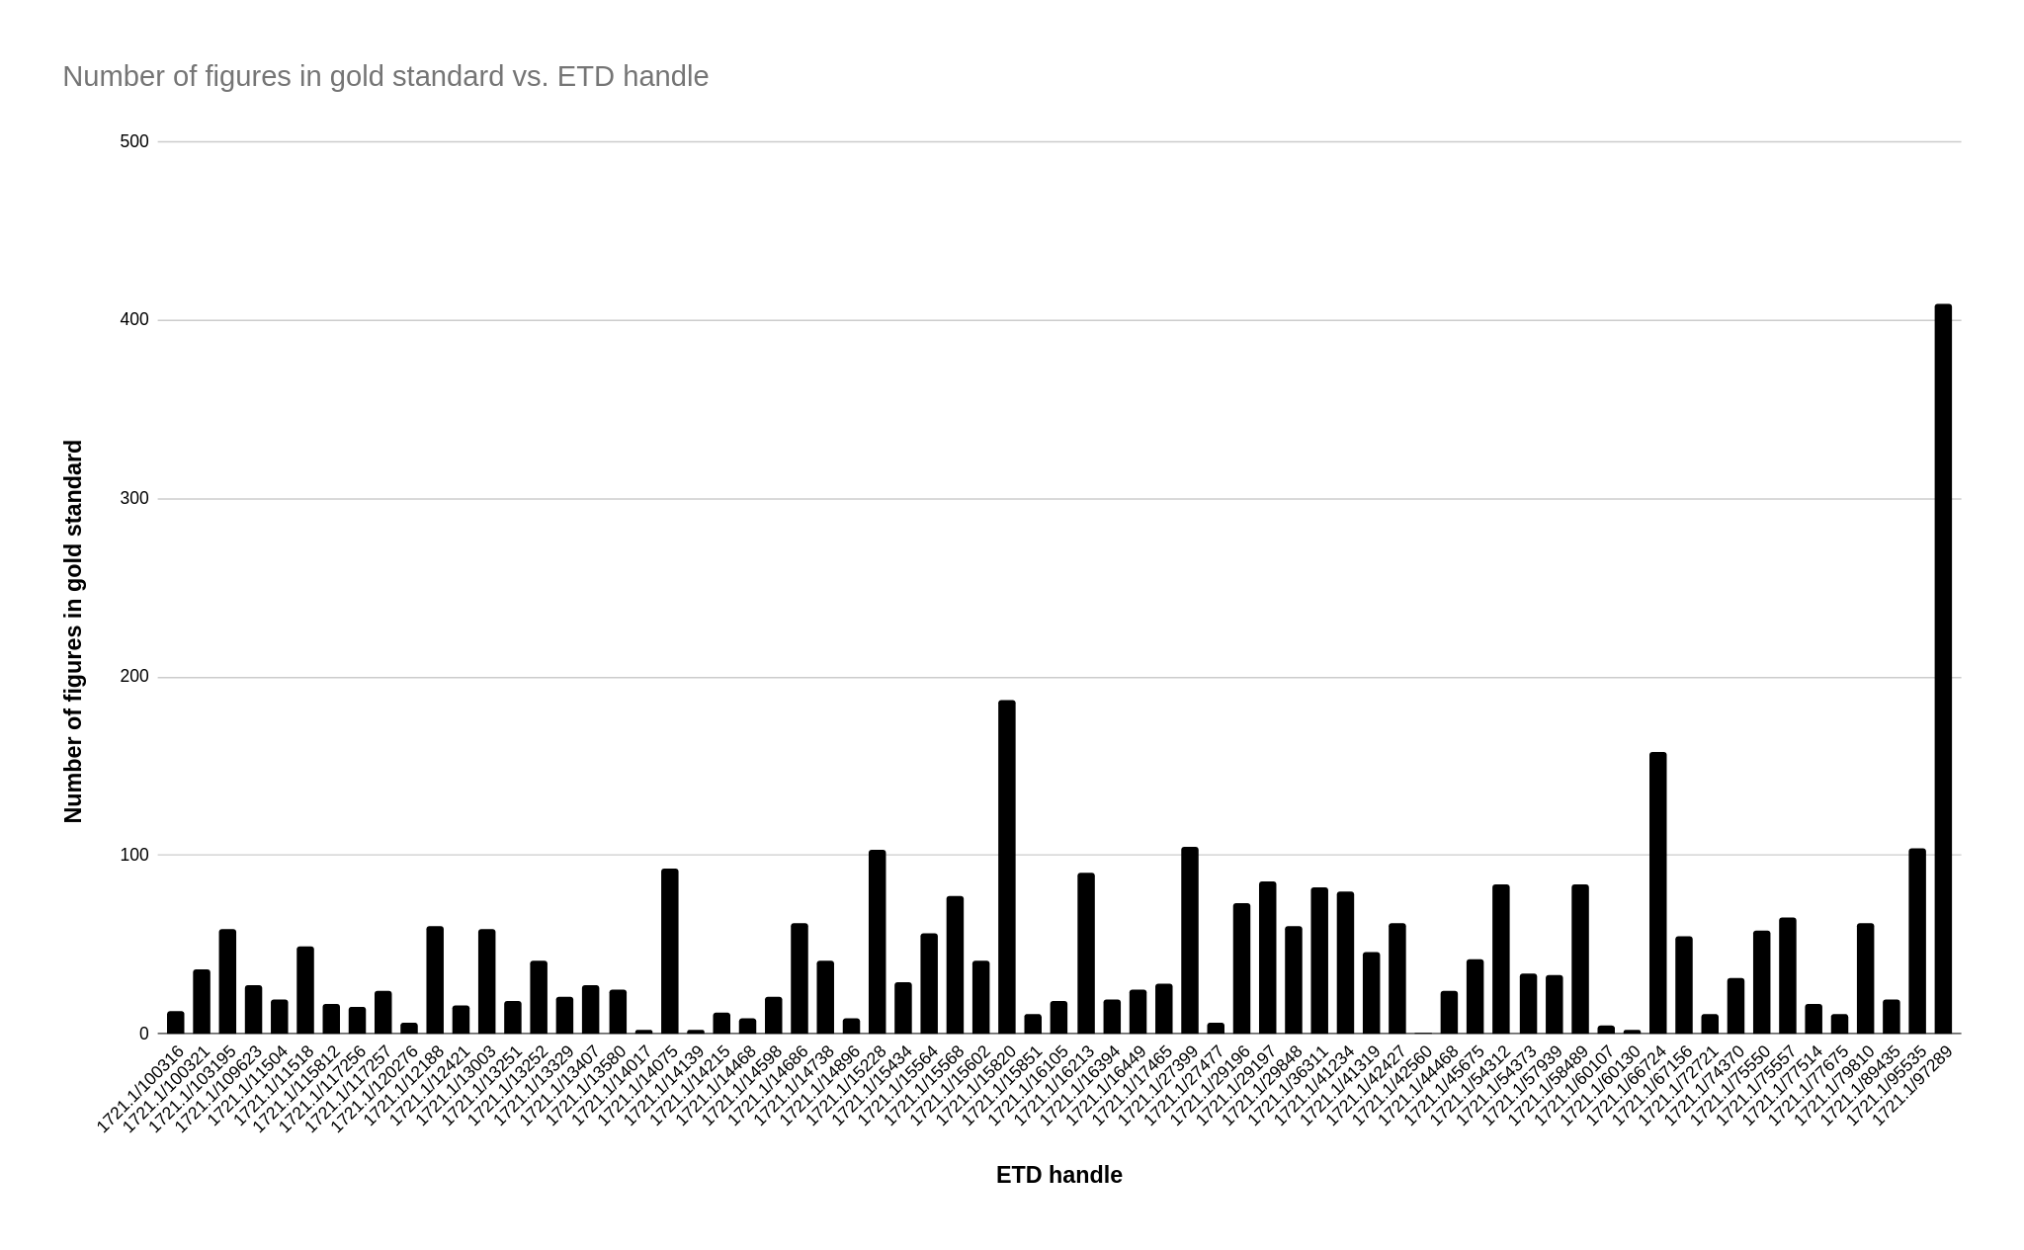
Gold standard dataset

Slide 26
Outline
Introduction
Research questions
Related work
Methodology
Data augmentation
Training at scale
Gold standard
Experiments
Experiments, results/discussion, answers to research questions.
Conclusions
Future work
Notes:
This is the outline of this presentation.
Introduction:
Explaining the title.
Figure extraction. What is it and why is it needed.
Scanned: What are scanned documents and why do we deal with them.
ETDs: What are ETDs and why do we deal with them.
Research questions.
We will pose the research questions that we aim to answer as part of this work.
Related work.
We mainly cover Deepfigures because this paper is the moe relevant to this work.
Dataset used.
Label generation pipeline.
Model architecture.
Methodology.
Data augmentation.
Training at scale.
Gold standard.
Experiments.
We discuss the various experiments we conducted, their results and the relevant discussion.
Conclusions.
Future work.

Slide 27
Exp1: Proof of concept
Experimental setup
Model: Deepfigures
Weight initialization: Pre-trained weights from Deepfigures
Data: About 2% of the original arXiv data with all transformations applied. Evaluated on an old scanned ETD from VTechWorks [1].
Duration: About 100K training steps.
Batch size: 1
[1] Walter Douglas Chiles. Effect of service on automobile crankcase oils. PhD thesis, Virginia Agricultural and Mechanical College and Polytechnic Institute, 1935. URL http://hdl.handle.net/10919/56159.
Notes:
Since this is a proof-of-concept, we:
Use only about 2% of the original data (50 ZIP files out of the 2600)
We evaluate only on one manually labelled scanned sample ETD from VTechWorks with 26 figures. Originally published in 1935.
Side note: The evaluation ETD contains some blue coloured blueprints. We ignore those pages for the purposes of this evaluation.
Optional: A batch of 1 is used because the authors of Deepfigures did not observe significant performance gains from larger batches, likely due to the inherent parallelism in sliding window detection.

Slide 28
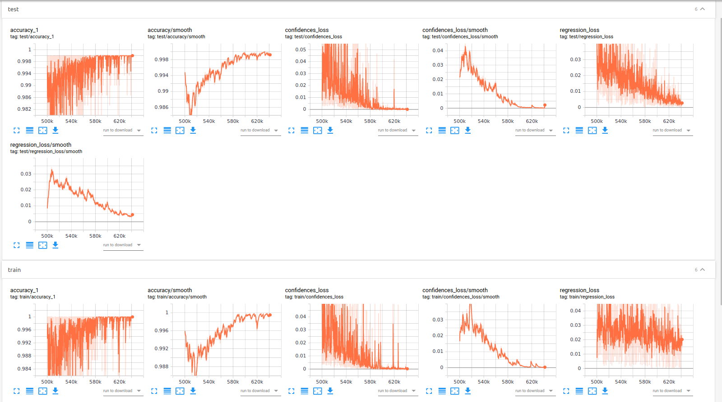

Slide 29
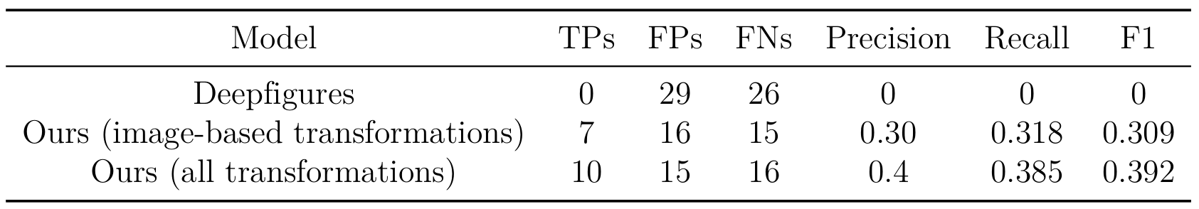
Exp1: Proof of concept
TP=True Positive, FP=False Positive, FN=False Negative
Observations:
Our models have a higher F1-score.
More augmentations result in a higher F1-score.
However:
This evaluation is only on a single ETD.
The TPs, FPs, FNs were manually calculated. We need better metrics.
Notes:
We evaluate only on one manually labelled scanned sample ETD from VTechWorks with 26 figures. Originally published in 1935.
The evaluation ETD contains some blue coloured blueprints. We ignore those pages for the purposes of this evaluation.
Higher is better:
True Positives
Lower is better:
False positives
False negatives

Slide 30
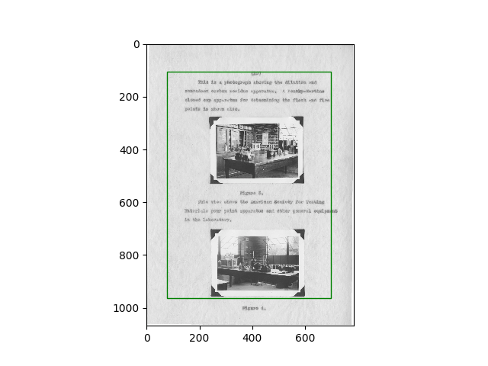
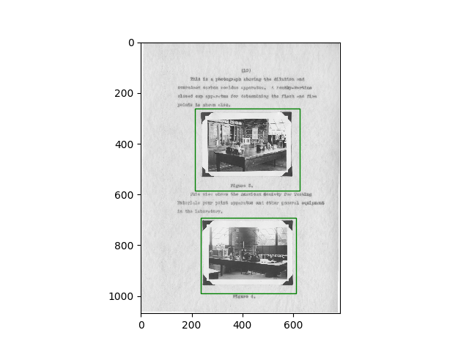

Exp1: Proof of concept
Original model
(Ours) Model trained on image-based transformations
(Ours) Model trained on all transformations
ETD source: Walter Douglas Chiles. 1935. Effect of service on automobile crankcase oils. Ph.D. Dissertation. Virginia Agricultural and Mechanical College and Polytechnic Institute. http://hdl.handle.net/10919/56159
Notes:
We evaluate only on one manually labelled scanned sample ETD from VTechWorks with 26 figures. Originally published in 1935.
The evaluation ETD contains some blue coloured blueprints. We ignore those pages for the purposes of this evaluation.
Higher is better:
True Positives
Lower is better:
False positives
False negatives

Slide 31
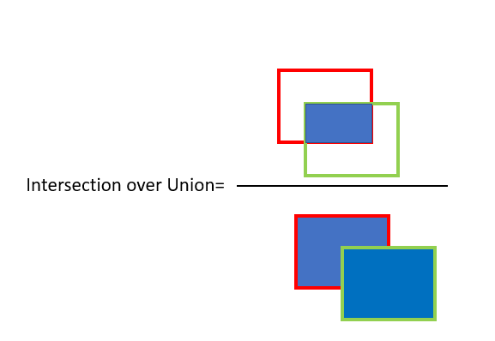
Exp2: Evaluate Deepfigures on gold standard
Better metric for TPs, FPs and FNs.
True Positive: IOU >= 0.8
False Positive: IOU < 0.8
False Negative: Ground truth exists but prediction is missing.
IOU=Intersection Over Union
Image sources: [1] https://www.pyimagesearch.com/wp-content/uploads/2016/09/iou_equation.png

Slide 32
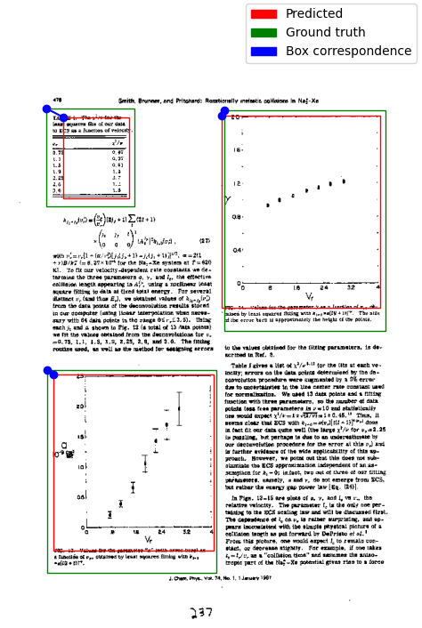
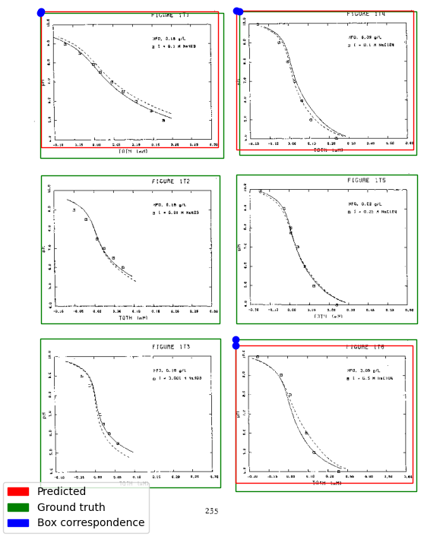
A page from a scanned ETD^{[1]} showing the predictions, ground truth and box correspondences.
Another page from a scanned ETD^{[2]} showing the predictions, ground truth and box correspondences.
Image sources: [1] https://dspace.mit.edu/handle/1721.1/15568
[2] https://dspace.mit.edu/handle/1721.1/97289
Notes:
To match the predictions, the closest ground truth box is matched with the predicted box.
this is an instance of the linear assignment problem and can be efficiently solved using the Hungarian algorithm.
This is also sometimes known as Jaccard similarity or cosine distance.
To put it in simpler terms, this involves matching the closest predicted box for each ground truth box.

Slide 33
Exp2: Evaluate Deepfigures on gold standard
Experimental setup:
Model: Deepfigures.
Weight initialization: Pre-trained weights from Deepfigures.
Data: Gold standard dataset. Used for evaluation.
IOU thresh: 0.8.

Slide 34
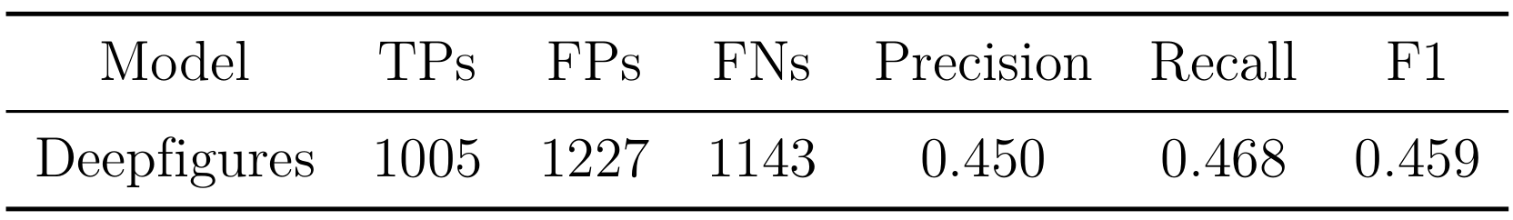
Exp2: Evaluate Deepfigures on gold standard
Results:
F1-score of 0.459.
This is the true performance of Deepfigures on scanned ETDs for figure extraction.
RQ1 answered: Existing methods for figure extraction from scanned ETDs perform with an F1-score of 0.459.

Slide 35
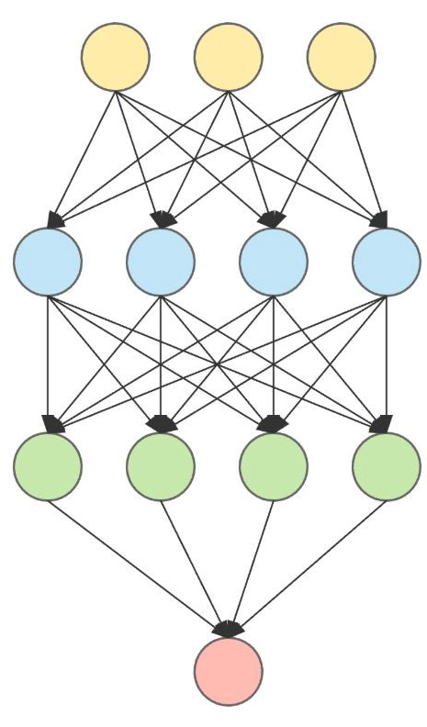
Exp3: Ablation studies
2^n combinations are possible for n transformations. (Enabled or disabled)
Leave-one-out ablation study:
train n separate models, where, for the n-th model, the n-th transformation is disabled.
Doesn’t guarantee an optimal combination.
Could give a general idea.
Model 1
Model 2
Model 3
Model n
Image sources: [1] https://www.kdnuggets.com/2019/02/neural-networks-intuition.html

Slide 36
Exp3: Ablation studies
Experimental setup
Model: Deepfigures.
Weight initialization: Pre-trained weights from Deepfigures
Data: Trained on the entire arXiv dataset with n-th transformation disabled. Evaluated on the gold standard (val split for choosing the best model, test split for reporting performance).
Duration: 24-hours. 16K steps.
Batch size: 1

Slide 37
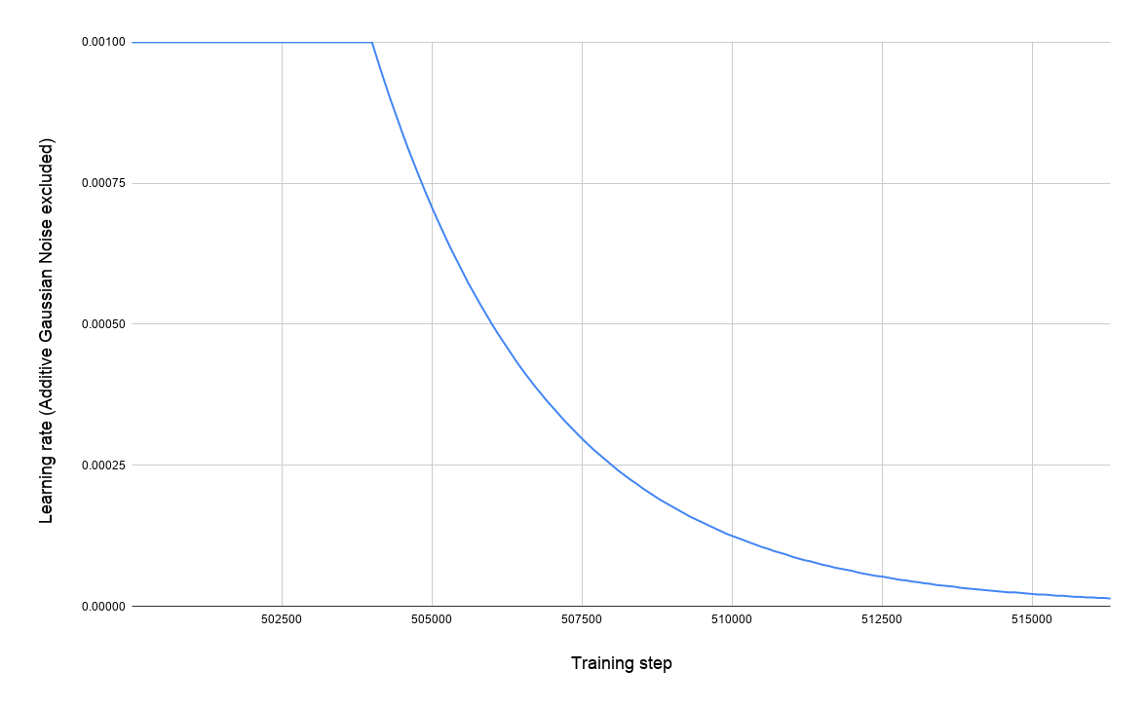
Exp2: Ablation studies

Slide 38
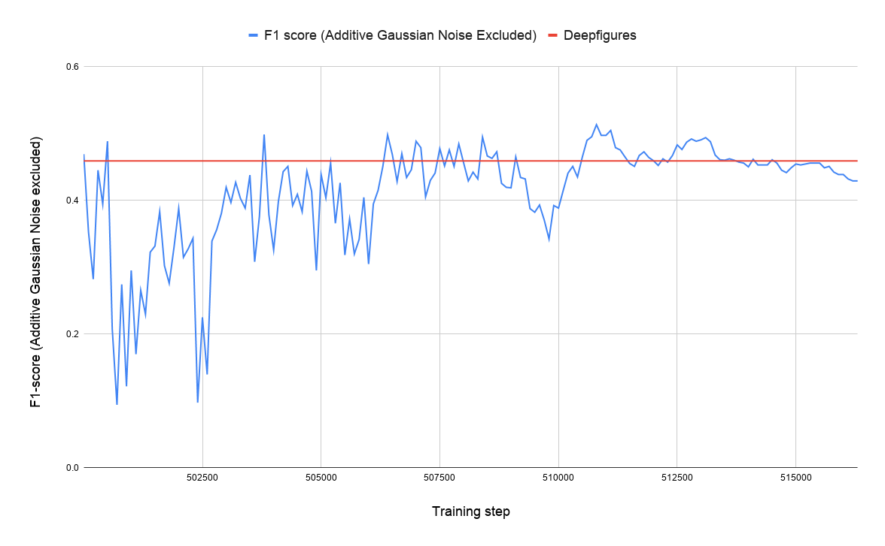
Exp2: Ablation studies

Slide 39
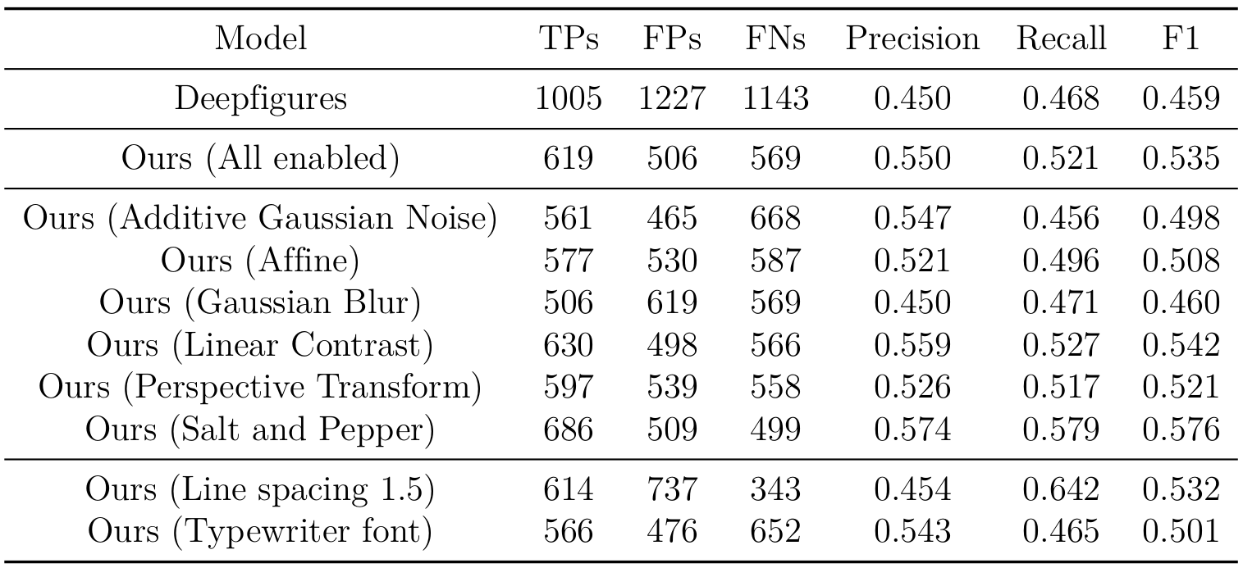
Exp3: Ablation studies
Notes:
*Cue animation* We observe that the F1-scores of almost all of our models surpass the F1-score of the original Deepfigures model. This observation supports to answer RQ2 affirmatively. (Remember RQ2: Can the performance of the original deepfigures model be improved using data augmentation and weight initialization?) It, however, is not enough to completely support an affirmative response to RQ2 since a single set of observations from one experiment is not statistically robust enough.
*Cue animation* The model in which Gaussian Blur was disabled has a score of 0.460. This is close to the F1-score of the original Deepfigures model (0.459). In all of the other models, Gaussian Blur was enabled, and their performance is significantly higher than the original Deepfigures model. Therefore, it is possible to say that Gaussian Blur is the most ‘helpful’ transform because disabling it decreases the performance and enabling it improves it. Again, since this just a single experiment, we cannot say that this conclusion is robust enough.

Slide 40
Exp3: Ablation studies
Results:
F1-scores of almost all our models are higher than the original Deepfigures model. This supports to answer RQ2 positively.
Our model with Gaussian Blur disabled has F1-score close to the original Deepfigures model. Indicates that Gaussian Blur could be the most `helpful’ transform.
However:
Since this is only a single set of observation, we conduct the next experiment to investigate further.
Notes:
In Experiment 3, the experimental setup is same as Experiment 2, except the training duration. We train for a longer duration.

Slide 41
Exp4: Ablation studies - longer training
Experimental setup
Model: Deepfigures.
Weight initialization: Pre-trained weights from Deepfigures
Data: Trained on the entire arXiv dataset with n-th transformation disabled. Evaluated on the gold standard (val split for choosing the best model, test split for reporting performance).
Duration: 72-hours.
Batch size: 1
Notes:
This experiment is similar to Exp3, where each model was trained for 24 hours. However, it is possible that 24 hours might not be sufficient for all the models to train fully. Further, getting an additional set of observations could help us make a more robust argument. Therefore, in this experiment, we re-run the ablation studies with the same hyper-parameters but for 72 hours each.

Slide 42
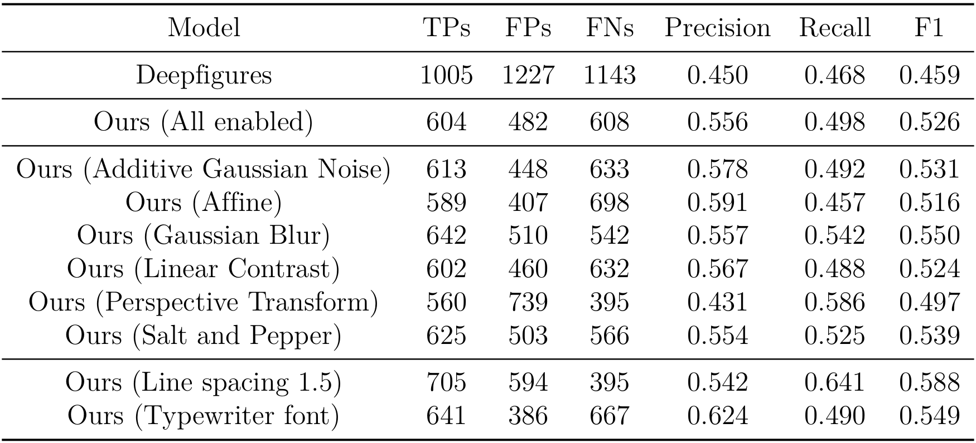
Exp4: Ablation studies - longer training
Notes:
Again, we observe that almost all of our models have a significantly higher F1-score than the original Deepfigures model. This observation is in agreement to the one made in Exp3. Therefore, based on these two affirmative observations, we can say with a greater confidence that using data augmentation helps improve the performance of the original Deepfigures model on scanned ETDs, thereby answering RQ2 affirmatively.
We further observe that the F1-score of the model in which Gaussian Blur is disabled is no longer the lowest performing model. In fact, it significantly outperforms the original deepfigures model. This is in contrast to the observation made in Exp3.
Further, in Exp3, the F1-score of the model in which Additive Gaussian Noise is disabled (0.498) is lower than the F1-score of the model in which Affine transform is disabled (0.508). However, in this experiment, that trend is reversed. Because of these contrasting observations, we cannot yet conclude that ablation studies help in identifying the relative ‘helpfulness’ of the various data transforms, and hence require more investigation.

Slide 43
Exp5: Training Deepfigures on the gold standard
Experimental setup
Model: Deepfigures.
Weight initialization: Pre-trained weights from Deepfigures
Data: Gold standard dataset. 80-20 random train-test split.
Duration: 2 hours
Batch size: 1

Slide 44
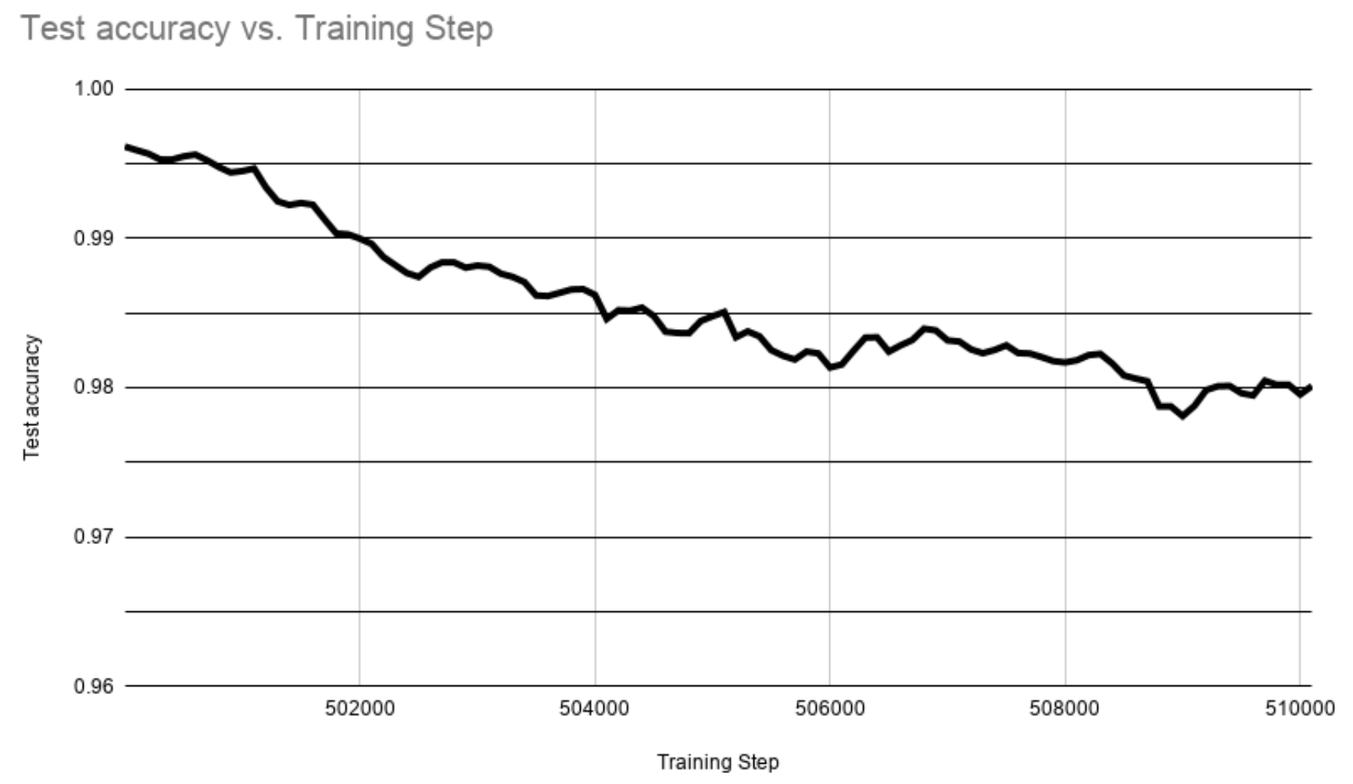
Notes:
This is a plot of the testing accuracy on y-axis and the training-step on the x-axis.
Optional: The training step starts from 500,000 because the original Deepfigures model was trained on 500,000 steps and we use it for weight initialization. In other words, when the authors of Deepfigures started training their model, its weights were randomly initialized. They trained it for 500,000 training steps (training batches). Since we use the Deepfigures’ model architecture and their released training weights for initializing our weights, in a way we are continuing their training from 500,000-th step onward (albeit on augmented data).
Remember that RQ3 aims to explore whether the performance of the original Deepfigures model can be improved by training it on the old standard dataset. However, as we can observe in the above plot, the test accuracy continues to drop down and does not improve. This suggests that the performance of for extracting figures is slowly worsening when trained on the gold standard dataset, thereby answering RQ3.
We speculate that this could have happened because of, but not limited to, the following two reasons:
Because of the weight initialization, the starting point of the model in the multidimensional curve of the loss function could be in a local minima. This could possibly make it difficult for the model to reach the minima for the gold standard dataset.
The gold standard contains about 10K images. Compared to the size of the arXiv dataset and based on the architecture of the Deepfigures model, this might not be sufficient to learn the task completely.

Slide 45
Exp6: Training Deepfigures on the gold standard (some layers training)
Experimental setup
Model: Deepfigures.
Weight initialization: Pre-trained weights from Deepfigures
Data: Gold standard dataset. 80-20 random train-test split.
Duration: 2 hours
Batch size: 1
Method: Freeze the weights of the ResNet backbone. Train only the last FC layers.
Image sources: [1] Noah Siegel, Nicholas Lourie, Russell Power, and Waleed Ammar. 2018. Extracting Scientific Figures with Distantly Supervised Neural Networks. CoRR abs/1804.02445 (2018). arXiv:1804.02445 Retrieved October 9, 2019 from http://arxiv.org/abs/1804.02445
Notes:
This experiment is similar to the previous one, except the following changes.
After initializing the weights with the original Deepfigures model, we freeze the weights of the ResNet-101 layers. And, during training, we only train the remaining Overfeat layers towards the end of the model.
The reasoning behind this is that the feature maps that were learned in the trained model do not need to be trained again if the new task is in a similar domain.
Optional: One of the advantages of this methods is that this usually requires lesser data for model convergence since only the last few layers are training.

Slide 46
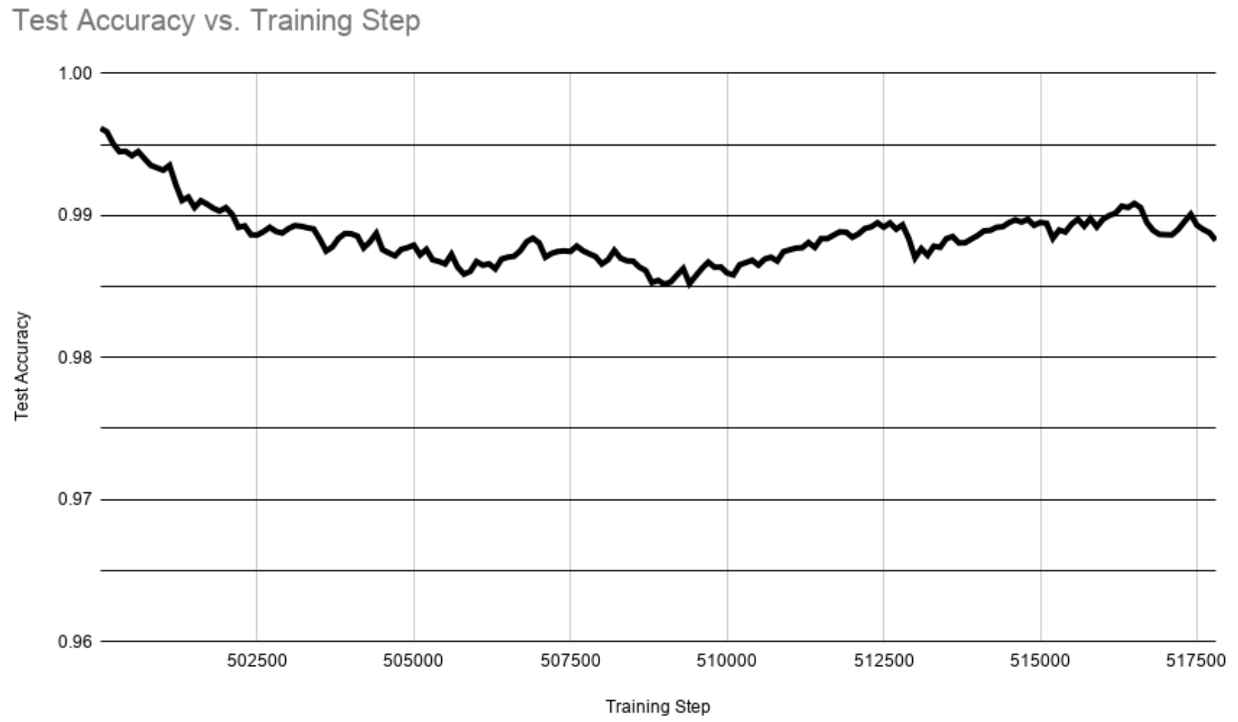
Exp6: Training Deepfigures on the gold standard (some layers training)
Notes:
This is a plot of the smoothed test accuracy against the training steps. We can again observe that the test accuracy decreases as the model training progresses. This means that the model’s performance is worsening. Contrary to expectation/hypothesis, although we are training only the last few layers, the performance of the model does not improve. This answers our RQ4 that training the final layers of the Deepfigures model (i.e. transfer learning) using the gold standard dataset does not improve the model performance.

Slide 47
Exp7: Training YOLOv5 on the gold standard
Experimental setup
Model: YOLOv5.
You Only Look Once. A popular objector detection model.
Released May 2020
Outperforms all previous YOLO versions.
Weight initialization: Random.
Data: Gold standard dataset. K-fold cross validation (K=8).
Duration: ~30 hours. 100 epochs.
Batch size: 8

Slide 48
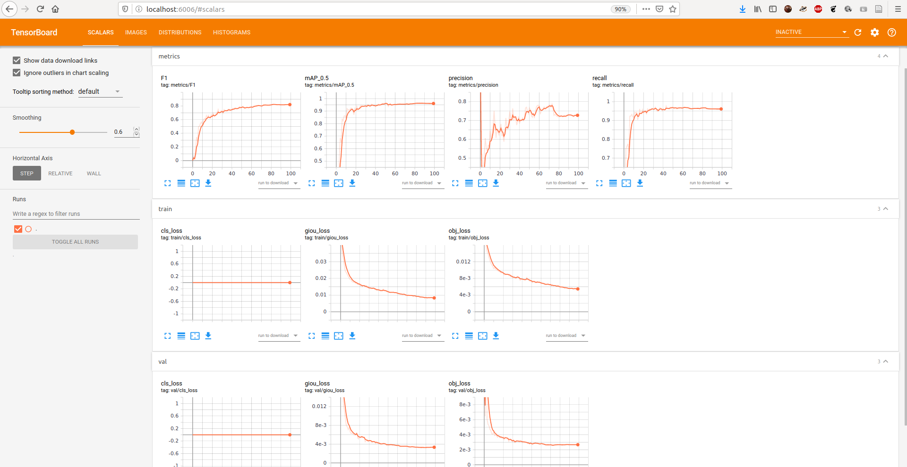

Slide 49
Exp7: Training YOLOv5 on the gold standard
Fold ID | Mean IOU | TP | FP | FN | Prec | Recall | F1
0 | 0.6282731795 | 298 | 100 | 45 | 0.7487437186 | 0.8688046647 | 0.8043184885
1 | 0.6511308301 | 262 | 39 | 57 | 0.8704318937 | 0.8213166144 | 0.8451612903
2 | 0.5854548651 | 381 | 127 | 170 | 0.75 | 0.6914700544 | 0.7195467422
3 | 0.8130208492 | 282 | 22 | 8 | 0.9276315789 | 0.9724137931 | 0.9494949495
4 | 0.7886945932 | 358 | 46 | 24 | 0.8861386139 | 0.9371727749 | 0.9109414758
5 | 0.7838215799 | 457 | 58 | 32 | 0.8873786408 | 0.9345603272 | 0.9103585657
6 | 0.7312581412 | 209 | 51 | 26 | 0.8038461538 | 0.8893617021 | 0.8444444444
7 | 0.6920578815 | 261 | 43 | 19 | 0.8585526316 | 0.9321428571 | 0.8938356164
Mean | 0.70921399 | 313.5 | 60.75 | 47.625 | 0.8415904039 | 0.8809053485 | 0.8597626966
Std. dev. | 0.0833932069 | 79.90172535 | 34.92747588 | 51.72713435 | 0.0665879393 | 0.08999876353 | 0.07326514907
Notes:
Observations:
This score beats the original Deepfigures’ F1-score on gold standard (0.459).
Conclusion:
The YoloV5 model architecture might have the ability to learn better since it is more recent.
The YoloV5 model was trained on the gold standard from scratch without initializing it’s weights from any pre-trained model. However, in Exp1, weights were initialized using the original Deepfigures model.

Slide 50
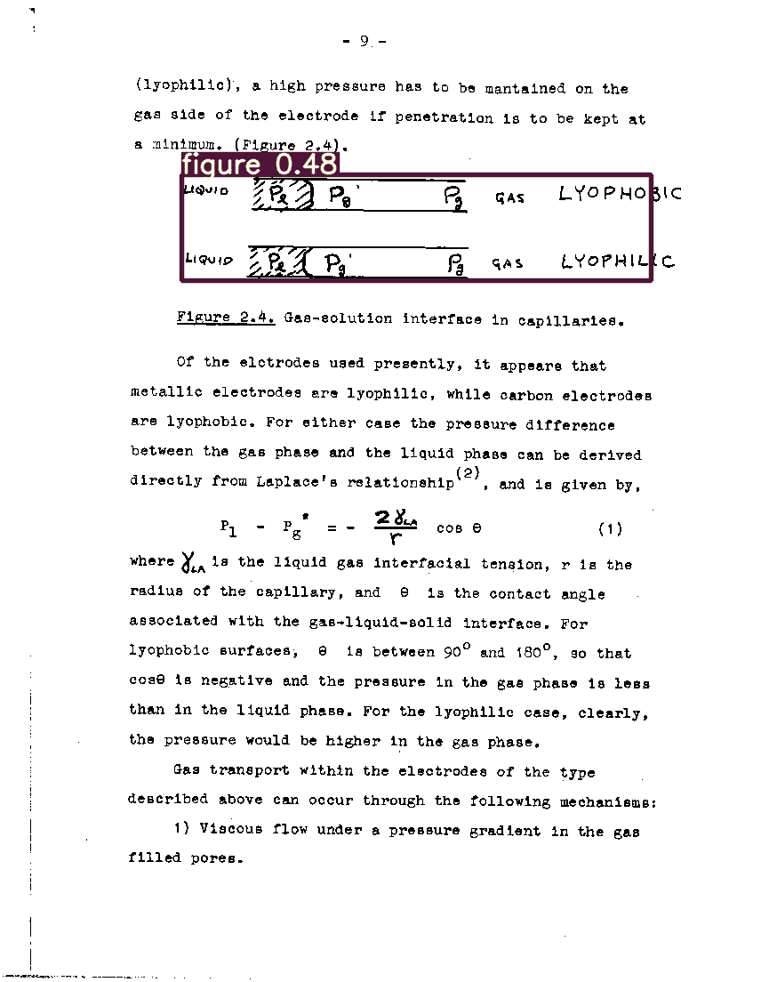
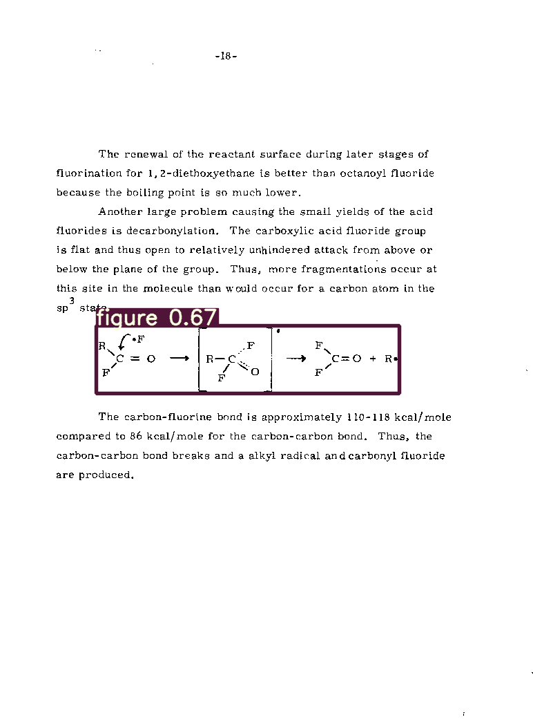
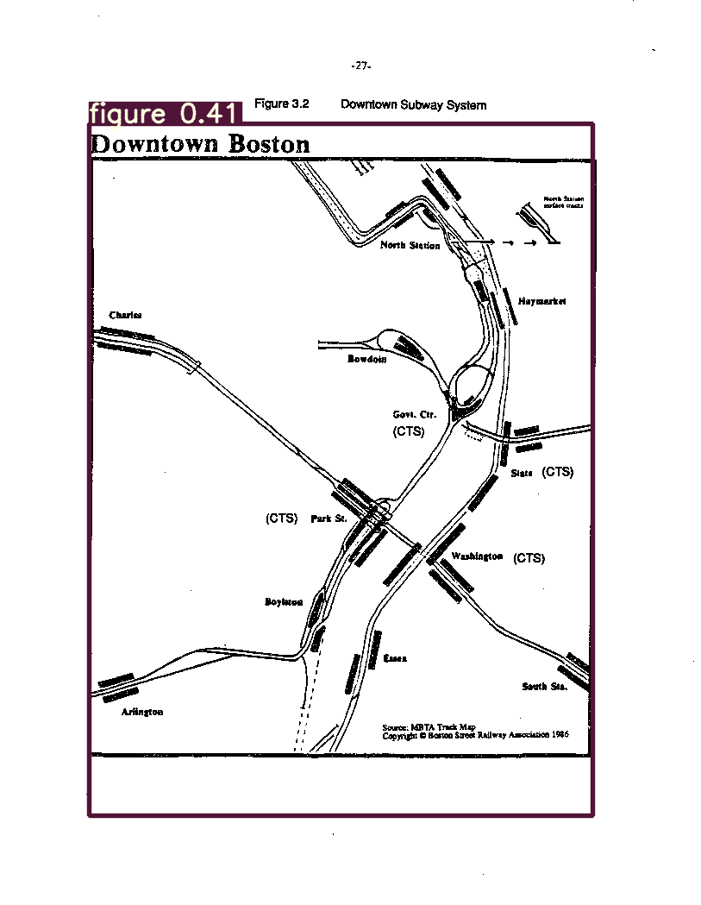
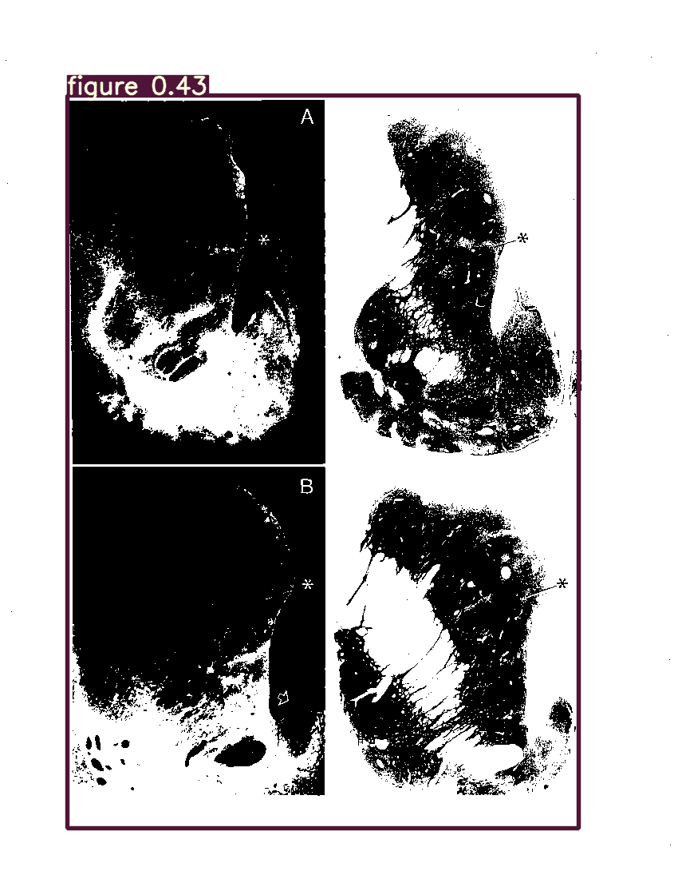
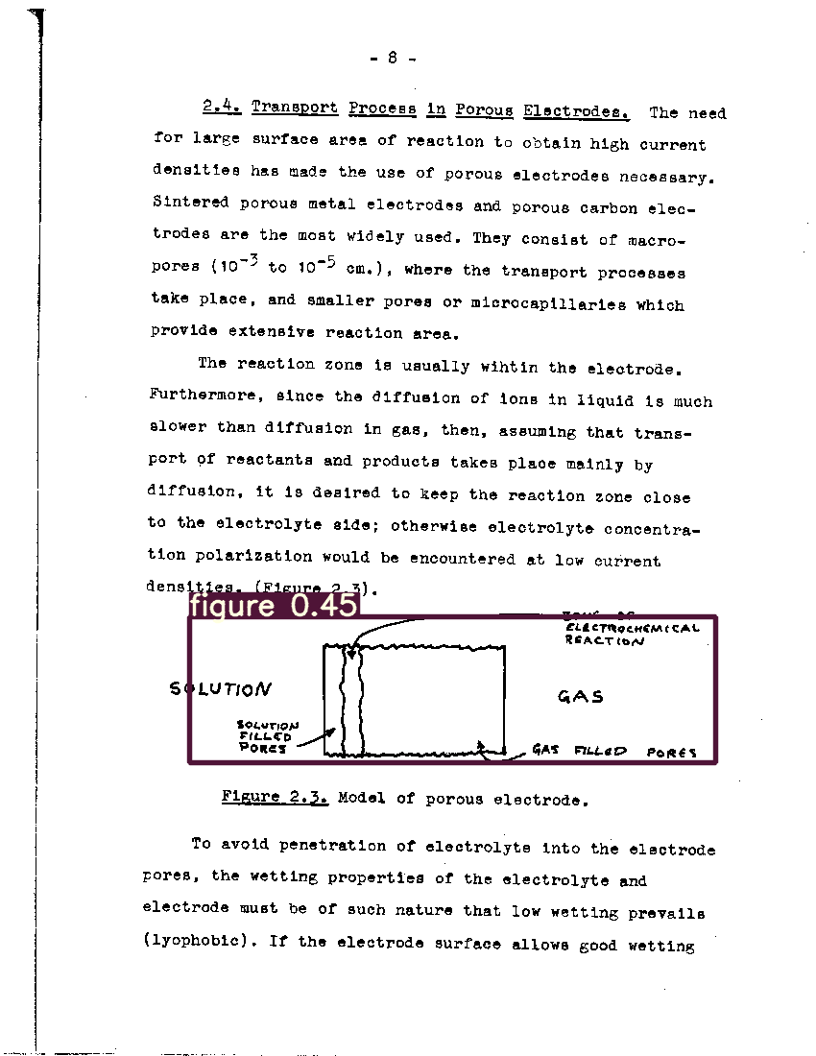
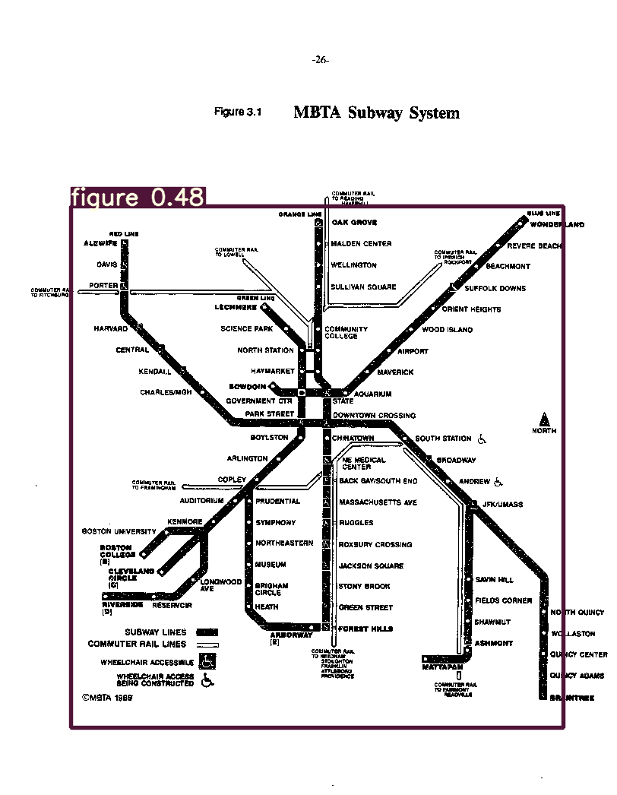
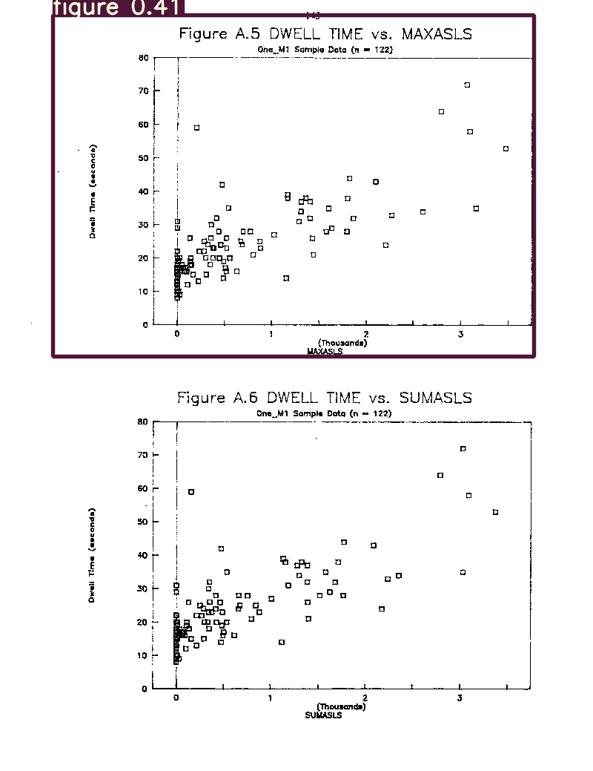
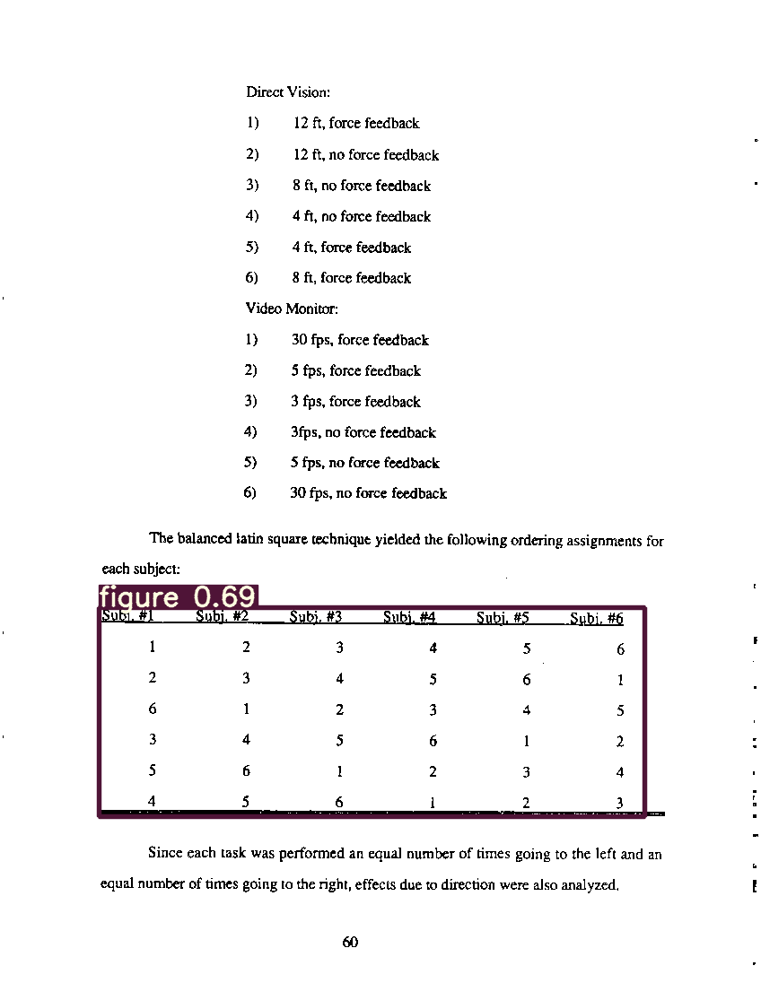
Notes:
These are some sample detections of the YOLOv5 model. The number labelled above each bounding box shows the confidence of prediction. The confidence threshold for detections is chosen as 0.4. The ideal value of this threshold can be found by plotting the precision recall curve, and is a part of our future work.

Slide 51









Slide 52
Answers to research questions
RQ1: How well can existing methods perform figure extraction from scanned ETDs? Ans: Deepfigures is able to extract figures from scanned ETDs with an F1-score of 0.459.
RQ2: Can this performance be improved by using simple data augmentation techniques and weight initialization from the original pre-trained model? Ans: Yes. In general, the Deepfigures model trained on born-digital ETDs performs better when further trained on augmented born-digital ETDs.
RQ3: Can this performance be improved by training on manually labelled data? Ans: Using the Deepfigures model architecture and weight initialization, we did not see an improvement. However, by training YOLOv5 with random weight initialization on manually labelled data (gold standard), the performance improved to an F1-score of 0.859 (std. dev. 0.07).
RQ4: Can this performance be improved by using transfer learning techniques? Ans: Using transfer learning techniques on the pre-trained Deepfigures model, we did not see any improvement.

Slide 53
Outline
Introduction
Research questions
Related work
Methodology
Data augmentation
Training at scale
Gold standard
Experiments
Experiments, results/discussion, answers to research questions.
Conclusions
Future work
Notes:
This is the outline of this presentation.
Introduction:
Explaining the title.
Figure extraction. What is it and why is it needed.
Scanned: What are scanned documents and why do we deal with them.
ETDs: What are ETDs and why do we deal with them.
Research questions.
We will pose the research questions that we aim to answer as part of this work.
Related work.
We mainly cover Deepfigures because this paper is the moe relevant to this work.
Dataset used.
Label generation pipeline.
Model architecture.
Methodology.
Data augmentation.
Training at scale.
Gold standard.
Experiments.
We discuss the various experiments we conducted, their results and the relevant discussion.
Conclusions.
Future work.

Slide 54
Conclusions
In this thesis, we focus on extracting figures from scanned ETDs.
We describe the research problem, formulate RQs, and review related work.
We propose LaTeX and image-based transformations.
We describe our system to apply these transformations at scale.
We curate a gold standard dataset for evaluation.
Finally, we describe the various experiments we conducted.
Notes:
Conclusions:
This research focuses on extracting figures from scanned (Electronic Theses and Dissertations) ETDs.
We begin by describing the research problem, formulating the research questions that we are trying to answer, and reviewing the various works from the literature relevant to this paper such as Deepfigures and PDFFigures2.
We also propose LaTeX-based and image-based data transformations to augment the training data and thereby bring the feature distribution of the born-digital ETDs closer to that of scanned ETDs.
To efficiently apply these proposed data transformations at scale, we discuss our system, which uses multiple parallel processes to pre-process the data for training.
All the data we use was generated from born-digital ETDs. Previously, there was no ground truth for evaluating the performance of our methods. Therefore, we curate a gold standard dataset consisting entirely of scanned ETDs and manually label it with bounding boxes around figures. This dataset consists of over 10k page images and 3.3k labels.
Finally, we describe the experiments we conducted to evaluate the performance of our proposed methods.
In some of our experiments, we are able to obtain a set of model weights which are able to achieve an F1-score on the hidden (test) set greater than the original Deepfigures model.
We also describe experiments in which we show that our approaches to training on the gold standard under the aforementioned experimental setup does not improve the performance, even after using transfer learning.

Slide 55
Outline
Introduction
Research questions
Related work
Methodology
Data augmentation
Training at scale
Gold standard
Experiments
Experiments, results/discussion, answers to research questions.
Conclusions
Future work
Notes:
This is the outline of this presentation.
Introduction:
Explaining the title.
Figure extraction. What is it and why is it needed.
Scanned: What are scanned documents and why do we deal with them.
ETDs: What are ETDs and why do we deal with them.
Research questions.
We will pose the research questions that we aim to answer as part of this work.
Related work.
We mainly cover Deepfigures because this paper is the moe relevant to this work.
Dataset used.
Label generation pipeline.
Model architecture.
Methodology.
Data augmentation.
Training at scale.
Gold standard.
Experiments.
We discuss the various experiments we conducted, their results and the relevant discussion.
Conclusions.
Future work.

Slide 56
Future work
Hyper-parameter tuning.
Visual similarity metric for choosing transformations.
More ablation studies.
Pre-training for unsupervised visual representation learning, and then fine-tuning using these visual representations.
Notes:
This research was conducted on a fairly large amount of data. The hyper-parameters we used were mostly the same as the ones used in Deepfigures [41]. However, since the task is now to extract figures from scanned ETDs, tuning the hyper-parameters might have improved the performance further; especially using a lower learning rate.
Further, the transformations tried out during the ablation studies were limited and chosen heuristically. A better approach would be to design a system to choose the transformations automatically. For example, some kind of function to measure the ‘visual’ similarity between two images of ETDs could help us choose transformations more effectively. This function to measure the similarity index could possibly be approximated by a machine learning model.
However, until we come up with such a function to measure the similarity, trying out more combinations of ablation studies could help us reach the optimal combination of transforms.
Another interesting way to make born-digital ETDs look like scanned ETDs could be the recent advances in style transfer using CycleGANs. Research has been done to make any painting or image look like it was painted by, for example, Van Gogh.

Slide 57
Thank you.
Questions are welcome.
Email: sampanna@vt.edu

