Slide 1
Aerodynamic Effects of Painted Surface Roughness on Wind Turbine Blade Performance
06/09/2015
Liselle A. Joseph
Aurelien Borgoltz
Matthew Kuester
William Devenport
Julien Fenouil
Special thanks to Wind Turbine Aerodynamics Team of GE Power and Water
Notes:
My name is Liselle Joseph and I am a PhD student here at Virginia Tech. I am also a member of the Centre for Renewable Energy and Aerodynamic Testing (CREATe).
Today I will be talking to you about the aerodynamic effects of painted surface roughness on wind turbine blade performance.
First I want to acknowledge my co-authors and extend a special thank you to the wind turbine aerodynamics team of GE power and water.

Slide 2
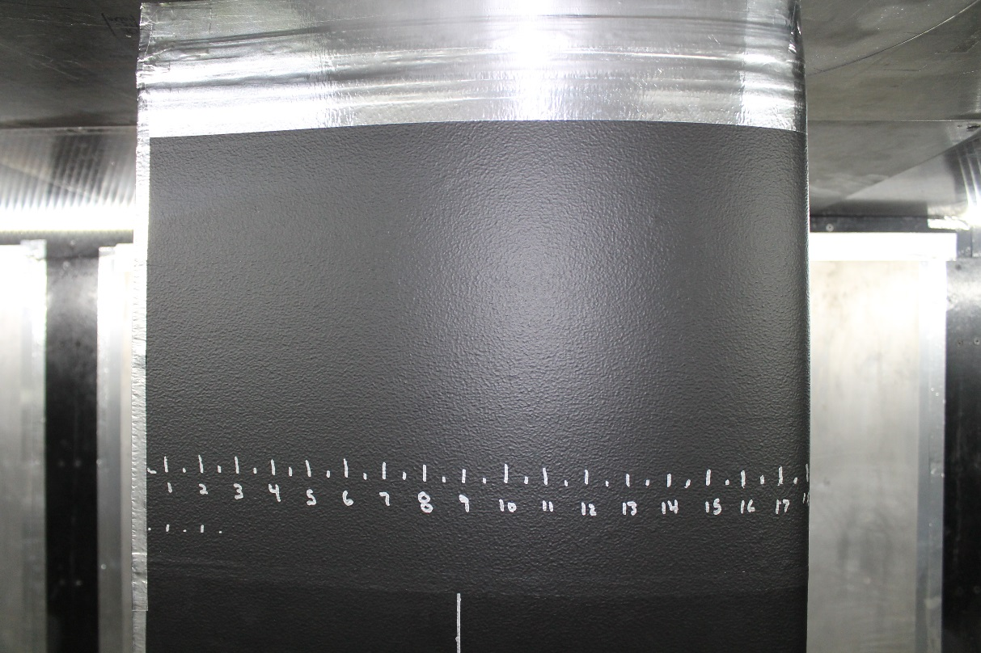
Importance of Roughness Effects
Roughness is known to
    decrease lift (Abbott and Von Doenhoff, 1959; Jones, 1936)
    Increase drag (Abbott and Von Doenhoff, 1959; Jones, 1936)
    Move transition forward (Timmer, 2004)
Roughness on wind turbine blades (icing, soiling, coat deterioration etc.) reduces performance (Sagol, 2013; Ehrmann, 2014; Dalili et al., 2009)
These are the main types of roughness currently under study
No work into the effect of orange-peel type roughness
    Likened to surface of an orange
    More wavy than peaky
    Produced from painting techniques and manufacturing processes
Notes:
In general, roughness is known to decrease lift, increase drag and move transition forward. This has been known as early as the 1930’s.
In regards to wind turbine blades, the same is true. However, most investigations have been into the effect of environmental roughness such as icing, insects and other residue and coat deterioration.
We have found no work to date into the effect of the unique type of roughness we will refer to as ‘orange-peel’ type roughness.
The image that is the background of this slide shows the orange-peel type of roughness under study.
This roughness is likened to the surface of an orange based on its look and feel, and thus the name.
In general this type of roughness tends to be more wavy than it is peaky and is categorized as 3D distributed roughness.
The source of this special kind of roughness is usually manufacturing processes and painting techniques.

Slide 3
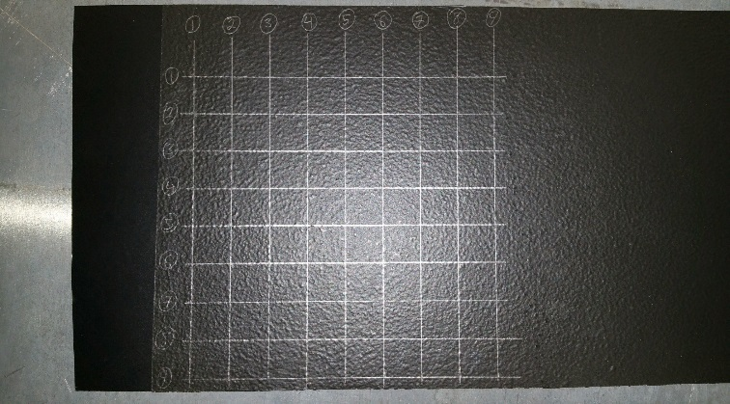
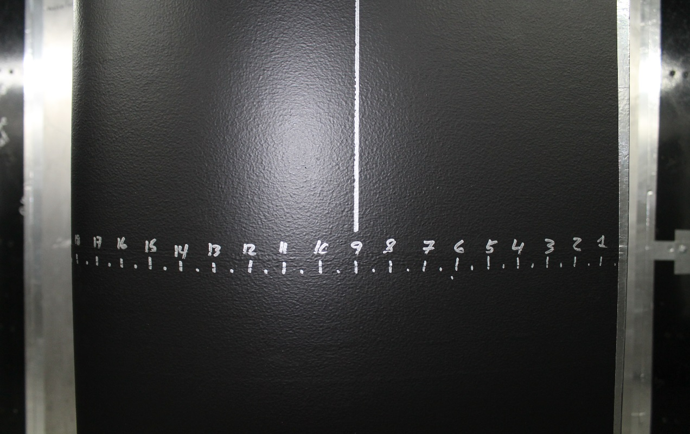
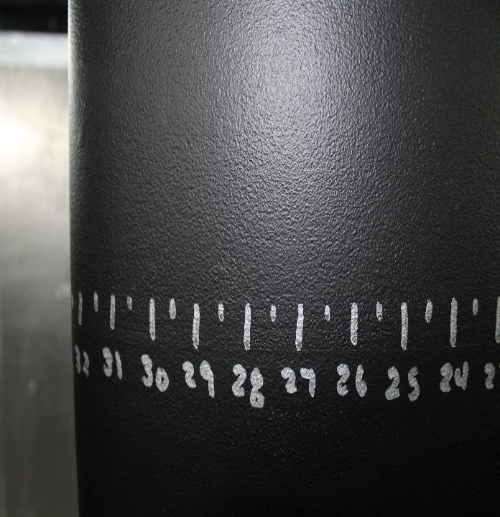
Roughness Fetches
Created by painting Contact© paper with latex paint using rollers of various types
Number of coats and painting direction were also varied
3 configurations created and tested
(a)
(b)
(c)
12.5mm
12.5mm
Images of the Roughness Configurations (a) S1 (b) S2 and (c) S3. The scale of the roughness features is illustrated using the 12.5-mm grid superimposed on the S1 roughness
Notes:
The first step of the study into the effects of this kind of roughness was to replicate this surface roughness and find a way to apply it to wind turbine blade sections.
The roughness fetches were created by painting Contact paper with latex paint. This was done using rollers of various types – which includes, nap sizes and material from which the roller is fabricated.
The number of coats applied and the direction of the application was also varied from one fetch to another.
Finally, three configurations were created for testing. These are shown in the images on this slide. Though one cannot tell from the pictures, or even from touching the surface in some cases, the geometric roughness parameters for each of these fetches are different.
We will refer to these as S1, S2 and S3 throughout this presentation.
The 12.5-mm grid is included on S1 in order to give a sense of scale

Slide 4
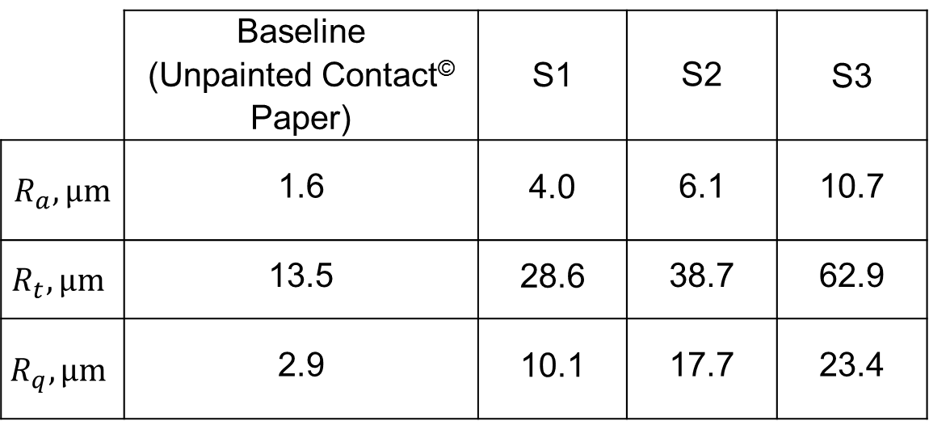
Roughness Fetches
Approximate values of roughness parameters measured using Mahr PS1
In order of increasing roughness heights: baseline, S1, S2, S3
 | Baseline (Unpainted Contact© Paper) | S1 | S2 | S3
$R_{a}, μm$ | 1.6 | 4.0 | 6.1 | 10.7
$$R_{t}, μm$$ | 13.5 | 28.6 | 38.7 | 62.9
$$R_{q}, μm$$ | 2.9 | 10.1 | 17.7 | 23.4
Notes:
The actual heights of the roughness fetches was measured using a MAHR PS1.
This is a surface profilometer which traverses the surface measuring the variation in surface elevation.
This device provides the raw z heights of the surface as well as the typical geometric paramaters such as Ra, Rt and Rq.
Ra is the arithmetic mean of the roughness heights, Rt is the maximum peak to peak value and Rq is the RMS value
All values reported here and used in calculations were taken from the MAHR PS1 directly and not calculated from raw data.
From the table we see that the Ra values increase from S1 to S3 as does the Rt and Rq values. The baseline case is simply unpainted contact paper this has the lowest values of all.
Thus in order of increasing roughness heights we have baseline, S1, S2 and S3

Slide 5

Test Matrix
Two DU96-W-180 models tested, each at 2 chord Reynolds Numbers
Smooth and rough cases tested for each model
Roughness Reynolds Number formulations:
Below Re_{k1,crit} effects are small, above Re_{k1,crit} effects become more noticeable
Chord (m) | Re (x10⁶) | Configuration | Re_{k1}
0.8 | 2 | baseline | 0.4
 |  | S1 | 4.4
 |  | S2 | 12.7
 |  | S3 | 21.3
 | 3 | baseline | 0.7
 |  | S1 | 7.9
 |  | S2 | 22.5
 |  | S3 | 37.5
0.46 | 1.5 | baseline | 0.7
 |  | S3 | 24.0
 | 2 | baseline | 1.1
 |  | S2 | 48.2
$${Re}_{k1}=\frac{R_{q}u_{k}}{ν}$$
Notes:
These roughness fetches along with the baseline case were tested on two DU96-W-180 models, each at 2 chord Reynolds Numbers.
These models had different chord lengths, one a 0.8-m chord and one a 0.46-m chord.
We tested the 0.8-m chord model at Re=2M and 3M for the baseline case and all three roughness fetches.
We tested the 0.46-m chord model at Re=1.5M and 2M for the baseline and one roughness fetch each.
The typical roughness Reynolds Number formulation was used for the analysis and it shown in the equation. Here Rq is the roughness RMS value, uk is the velocity at the RMS height and nu is the kinematic viscosity. The values obtained for each case are also shown in this table.
A useful value to know in analyses such as this is the critical roughness Reynolds number. This, for our purposes, is defined as the roughness Reynolds number below which the effects of roughness are small or non-existent and above which the effects of roughness are apparent and dominant.

Slide 6
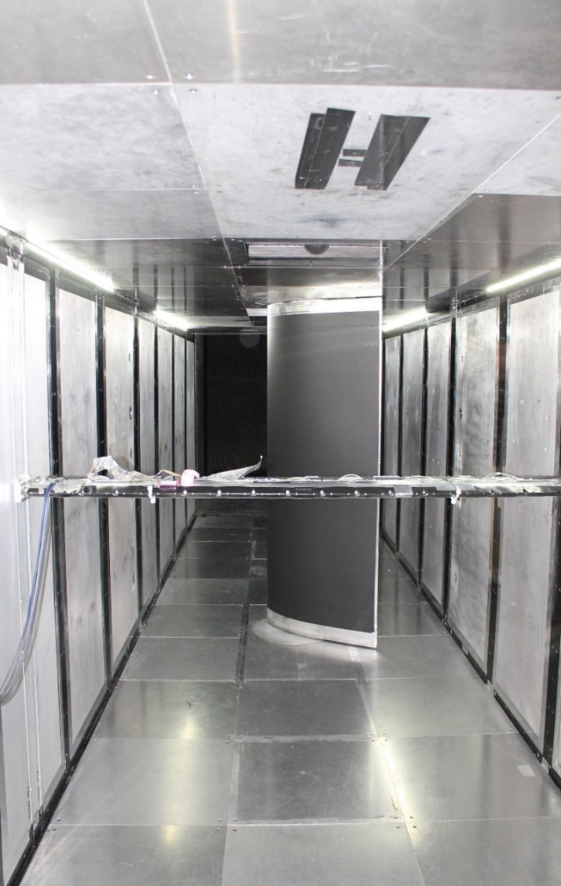
Experimental Set Up
Experiments done in VT stability Wind Tunnel
Lift and drag obtained from pressure measurements from test section wall and drag rake
Transition obtained from infrared transition detection system
Model wrapped in contact paper, 0.8-mm insulator, then roughness fetch
0.8-mm silicone rubber insulator
Port mounted IR camera
Starboard mounted IR camera
Aluminum model with internally mounted heaters
Drag rake
Downstream View of 0.80-m DU96-W-180 Mounted in Wind Tunnel with Infrared Thermography System
Notes:
All experiments were carried out in the Virginia Tech Stability Wind Tunnel.
The picture on the right shows a downstream view looking upstream of the inside of the test section (so flow would be coming out of the page toward us).
The 0.8-m chord model is mounted vertically in the test section. the span is 1.82-m.
Also seen is the drag rake erected in the wake of the model so as to measure the pressure in the wake which is then used to calculate the drag.
Along the length of the test section walls are pressure taps which are used to estimate the lift.
The black covering on the model in the picture is part of the infrared transition detection system.
The model is wrapped in a layer of contact paper and then a layer of 0.8-mm silicone rubber insulator.
This insulator regulates heat from inside the model, where heaters are mounted and used to heat the model, to the model surface.
The roughness fetches, or baseline clean contact paper, is then applied over the insulator.
In the walls of the test section are infrared cameras which take pictures of the pressure and suction side of the model independently. These pictures will show the transition region.

Slide 7
Results
Positive stall: α_{c}~ 9°to10°
Negative stall: α_{c}~-14°
Zero-lift α_{c}~ -2°
Baseline cases for two models of different chord lengths agree
Variation of Lift and Drag for Different Chord Length Models, in Baseline Configuration, at Fixed Chord Reynolds Number of 2.0x10⁶
Notes:
We now look at the lift, drag and transition results from these experiments.
Presented here is the lift and drag coefficient plots vs angle of attack for both the 0.8-m chord DU96 and the 0.46-m chord DU96.
In both cases the model is not covered in a roughness fetch but is in the baseline configuration.
Positive stall occurs between 9-10 degrees angle of attack for both models and negative stall occurs at about -14 degrees.
In both cases the zero lift angle of attack is -2 degrees
For both models, the lift and drag plots show good agreement, within an uncertainty of 0.012 for the lift and 5% for the drag. This tells us that the effect of the different chord can be assumed negligible for lift and drag.

Slide 8
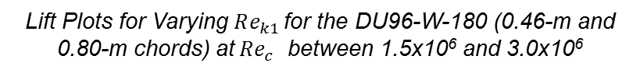
Effect of Roughness on Lift
Max lift and lift curve slope decrease with increasing Re_{k1}
effect most apparent at positive α_{c}, especially above α_{c}=5°
Above Re_{k1} ~ 23 effect of roughness becomes much larger than below this value
Re_{k1crit} ~ 23
Lift Plots for Varying $Re_{k1 }$for the DU96-W-180 (0.46-m and 0.80-m chords) at$Re_{c}$ between 1.5x10⁶ and 3.0x10⁶
Notes:
Adding roughness to the model produces significant effects on the lift.
In this plot we show the lift variation with angle of attack for each case tested, in order of increasing roughnes Reynolds number.
The baseline cases have the smallest roughness Reynolds number and it is seen that they have the highest lift curve slope and maximum lift.
The cases with roughness added show marked decreases in maximum lift and lift curve slope, as roughness Reynolds number increases.
This effect is most apparent at positive angles of attack, particularly above 5 degrees.
The variation with roughness Reynolds number does not appear to be linear however. At a roughness Reynolds number above 23, the lift curve slope and maximum lift appear to be affected more by the roughness than at lower roughness Reynolds numbers.
This points to a critical roughness Reynolds number of about 23, under which the effects of roughness on the lift is small and above which they become dominant.

Slide 9
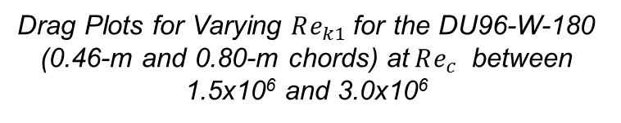
Effect of Roughness on Drag
Drag in bucket increases with increasing Re_{k1}
effect most dominant at positive α_{c}
Above Re_{k1} ~ 24 effect of roughness becomes much larger than below this value
Re_{k1crit} is between 20-25 (accounting for 10% uncertainty)
Drag Plots for Varying $Re_{k1}$for the DU96-W-180 (0.46-m and 0.80-m chords) at$Re_{c}$ between 1.5x10⁶ and 3.0x10⁶
Notes:
The drag plots tell a similar story.
Plotted here is the drag coefficient against angle of attack for all the cases tested.
It is seen that the drag in the drag bucket increases with increasing roughness Reynolds number.
Again the effect of roughness is very apparent at positive angles of attack.
In the case of the drag, the effect of roughness appears to grow rapidly above a roughness Reynolds number of 24 suggesting that this is the critical roughness Reynolds number.
Considering the lift results and a 10% uncertainty in the roughness Reynolds number, this gives a range of 20-25 for the critical roughness Reynolds number.

Slide 10
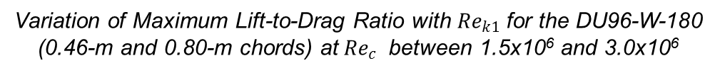
Effect of Roughness on Lift-to-Drag Ratio
Below Re_{k1}~23 L/D_{max} slowly declines
Large decrease in L/D_{max} after Re_{k1}~23
Re_{k1crit} ~ 20-25
Variation of Maximum Lift-to-Drag Ratio with $Re_{k1}$for the DU96-W-180 (0.46-m and 0.80-m chords) at$Re_{c}$ between 1.5x10⁶ and 3.0x10⁶
Notes:
Combining the results of lift and drag, the maximum lift-to-drag ratio was plotted against roughness Reynolds number.
We see that below roughness Reynolds number of ~23 the L/D max declines slowly.
Then at about roughness Reynolds number of 23, the decrease in max L/D becomes very much larger.
This supports our hypothesis that the critical roughness Reynolds number is between 20-25

Slide 11
Effect of Roughness on Transition
Infrared transition detection system used to detect transition
Gradient observed in images is onset of transition
Image processing techniques used to extract %chord location
(a)
(b)
FLOW
Infrared Images of the Pressure Side of the 0.46-m DU96-W-180 at AoA=0° showing the Forward Movement of the Transition Front from the (a) Baseline case with R_{a}=1.58 to (b) S3 Roughness case with R_{a}=6.78
Notes:
We now look at the effects of roughness on transition.
Transition is detected using the infrared transition detection system described earlier.
Images are obtained of the pressure and suction side of the model.
The images on this slide are examples of results for the pressure side of the 0.46-m DU96 model at zero degrees and Reynolds number of 1.5M.
On these images white regions are warmer and cold regions are darker.
Since we are heating the model this means that the warmer regions are laminar flow and the darker regions are turbulent flow.
The gradient between these two regions is the transition front.
Image processing techniques are used to identify and extract the chordwise location of this gradient. This is shown by the red dots on the images and reported in the boxes at the top left of the image.
In this case, the image on the left is of the clean baseline run and we see that transition occurs at about 61% chord.
The image on the right shows the same model but with the roughness configuration S3 added.
Now we see that the transition is moved upstream to 56% chord.
This demonstrates the effect of the roughness to move the transition upstream or to initiate early transition.
An interesting point to note here is that the transition front in both cases appear to be mostly straight. Except for the wedge in the image on the right which was caused by an isolated imperfection, the transition line is linear.
This tells us that the transition in both these cases is caused by the growth of TS waves and not by transition over individual roughness elements.

Slide 12
Effect of Roughness on Transition
0.8-m DU96-W-180
Suction Side
Pressure Side
Variation of transition location with angle of attack on the (a) Suction and (b) Pressure Side of the 0.8-m for all Re_{k1}
Notes:
Plotted on this slide is the transition results for the 0.8-m DU96 for all cases, in order of increasing roughness Reynolds number.
On the left are the results for the suction side and on the right are the results for the pressure side.
On the y axis is the transition location in percent chord and on the x axis is the angle of attack.
the blue symbols represent the results at 2M Reynolds number and the red symbols represent the results at 3M.
We see that in all cases, for the pressure side the transition moves from leading to trailing edge with increasing angle of attack and for the pressure side the transition moves from trailing to leading edge.
Another distinct trend is that there appears to be a chord Reynolds number grouping.
The results at 2M are further upstream than the results for 3M in almost all cases.
Within this Reynolds number grouping though, there is a trend with roughness Reynolds number.
All the baseline cases occur further downstream than the rough cases.
The case of the highest roughness Reynolds numbers also undergoes transition earlier than all other cases.
It is a bit difficult to point to a critical roughness Reynolds number here as there is only one case which is above 23. however, this case of 37.5 does stand out from the other cases which might support the critical roughness Reynolds number as bring between 20-25

Slide 13
Effect of Roughness on Transition
Suction Side
0.46-m DU96-W-180
Pressure Side
Variation of transition location with angle of attack on the (a) Suction and (b) Pressure Side of the 0.46-m for all Re_{k1}
Notes:
Looking at the smaller chord model, the critical roughness Reynolds number dependence is clearer here.
The case of Rek=48.2 is much further upstream than all other cases.
There again appears to be a chord Reynolds number dependence because we see the grouping of the results by Reynolds number. Green being Re=1.5M and blue being Re=2M.
At all angles of attack and for all cases, we see that as the roughness Reynolds number increases the transition moves further upstream.

Slide 14
Conclusions
Orange-peel type painted surface roughness on wind turbine blades have an effect on the performance
It was found that:
Roughness effects show dependence on Re_{c} and Re_{k}
The effect of the roughness is more pronounced at positive angles of attack
Lift decreases gradually with increasing Re_{k}, up to the critical Re_{k}
Drag increases gradually with increasing Re_{k}, up to the critical Re_{k}
Transition moves forward slightly with increasing Re_{k}, up to the critical Re_{k}
Critical Re_{k} for orange-peel roughness is between 20 and 25.

Slide 15

Q&A

Slide 16
Supporting Slides

Slide 17
Effect of Roughness on T-S Waves
Roughness induced disturbances grow and overtake natural T-S waves
Roughness-induced T-S waves cause linear transition front upstream of natural transition
(a)
(b)
Averaged wavelength spectra of the painted roughness surfaces
Wavelengths of unstable Tollmien-Schlichting disturbances for (a) 0.46-m DU96-W-180 at Re=1.5x10⁶ and (b) 0.80-m DU96-W-180 at Re=1.5x10⁶
Notes:
On the left we have the wavelength spectra of the orange peel type roughness.
Here we see that the primary wavelengths between are 3-5mm.
Using boundary layer profiles to do a linear instability calculation, it is found that the highest growth rate of the TS waves occur between 3-mm and 16-mm.
This evidence suggests the wavy, orange-peel roughness is acting as a receptivity mechanism for T-S waves.
The roughness induced disturbances grow and overtake the natural T-S waves and then produce a linear transition front upstream of the natural transition.
This gives us some insight into the source of the change in transition which occurs as we add roughness. Lets now look at this change more in depth.

Slide 18
Analysis of Effect on Performance
XFOIL used to investigate whether changes in lift and drag are from changes in transition
XFOIL ‘tripped’ at where transition is observed on IRT images for rough cases
Differences compared to that observed between clean and rough results
(a)
(b)
XFOIL analysis of the effect of transition location on lift and drag. XFOIL transition locations were set from IR transition measurements for the 0.46-m DU96-W-180 Model at Re = 1.5x10⁶. Differences in (a) lift and (b) drag are between the clean model (covered in insulator) and the S3 roughness condition.

