Slide 1
CTE Final
Vaishnavi Alavala, Smera Sheik, Corbin Strine, Aren Waheed
CS 4624 CRN: 13416
Multimedia, Hypertext, and Information Access
Instructor: Edward A. Fox
Virginia Tech
Blacksburg VA 24061
05/08/2024

Slide 2
Agenda
01
05
02
06
03
07
04
Overview
Timeline
CTE Website Project Design
Next Steps
Research Project Design
Acknowledgements & References
Challenges

Slide 3
Project Overview
CTE Website
  Transitioning pages from current website to WordPress
  Creating forms to update website
  Using plugins for website and removing plugins not required
Dr.Murali's Website
  Updating appearance of website

Slide 4
CTE Website

Slide 5
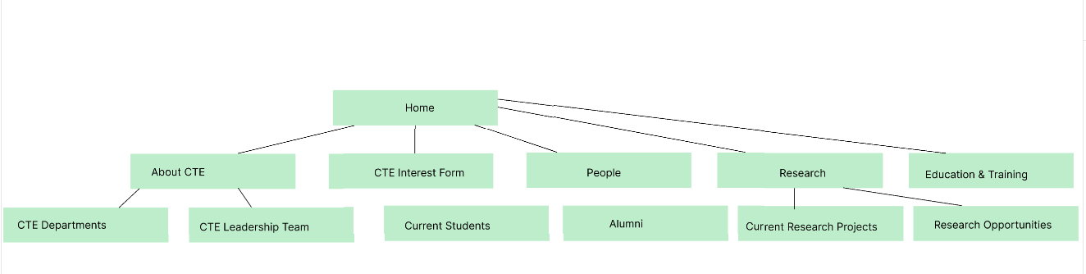
Architecture Model for CTE Website

Slide 6
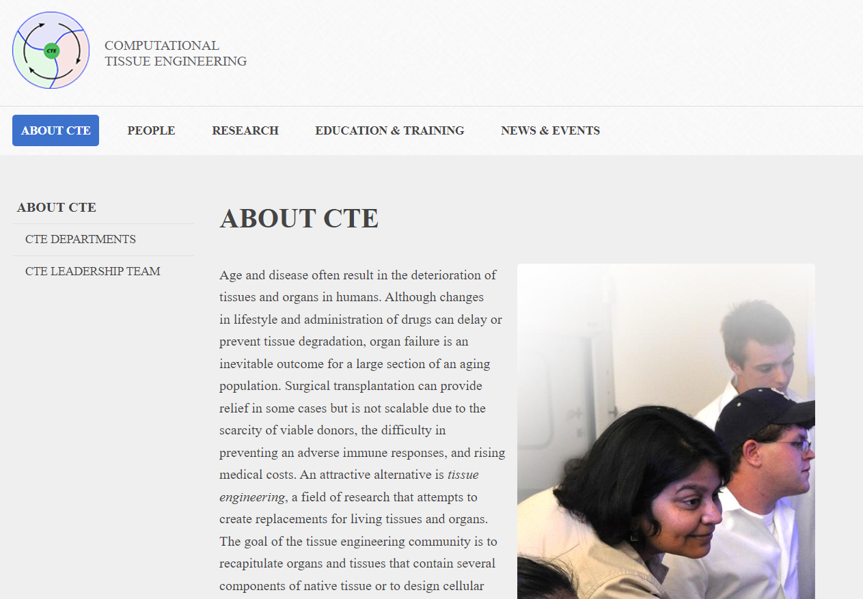
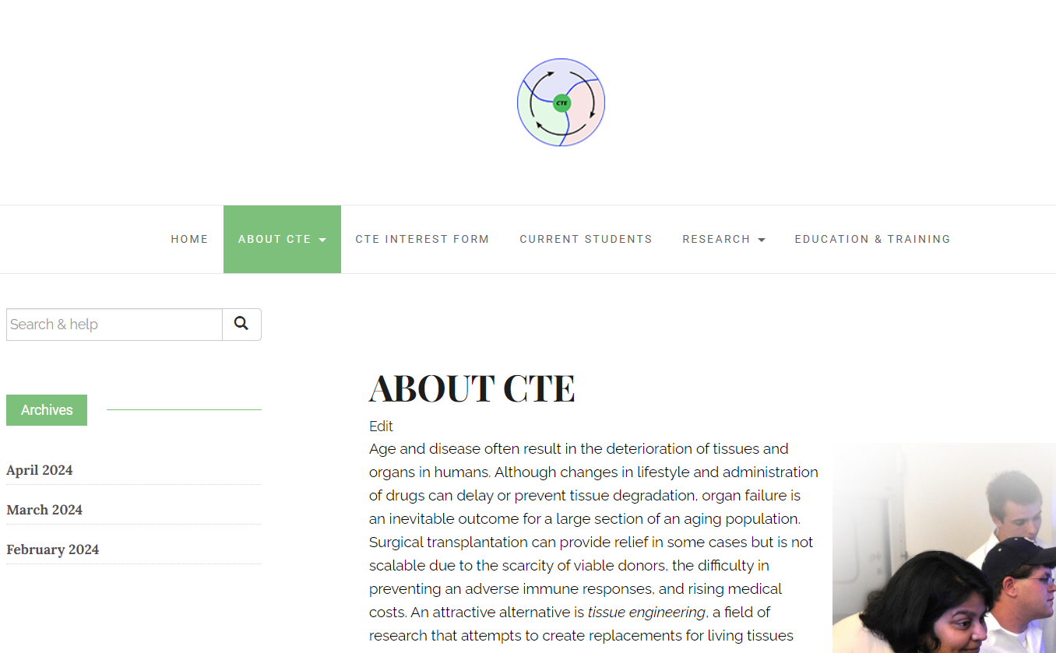
Static Pages
Old CTE Website
New CTE Website

Slide 7
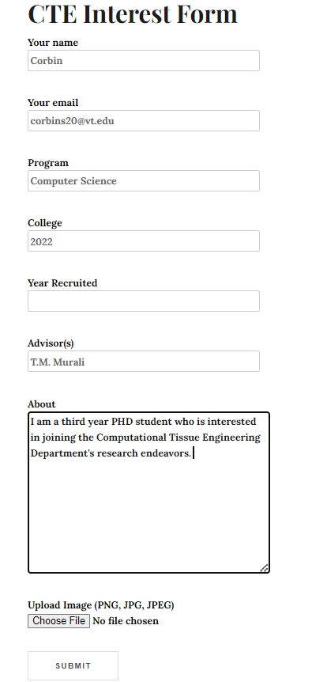
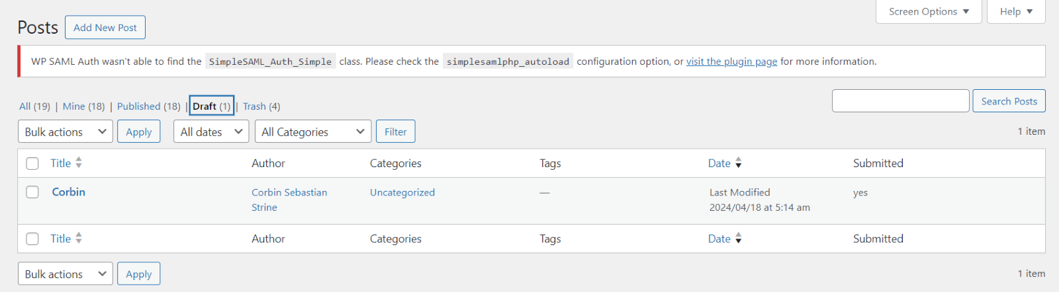
Form Functionality
CTE interest form
Filtering posts
Adds post to list of current students
Admin forms

Slide 8
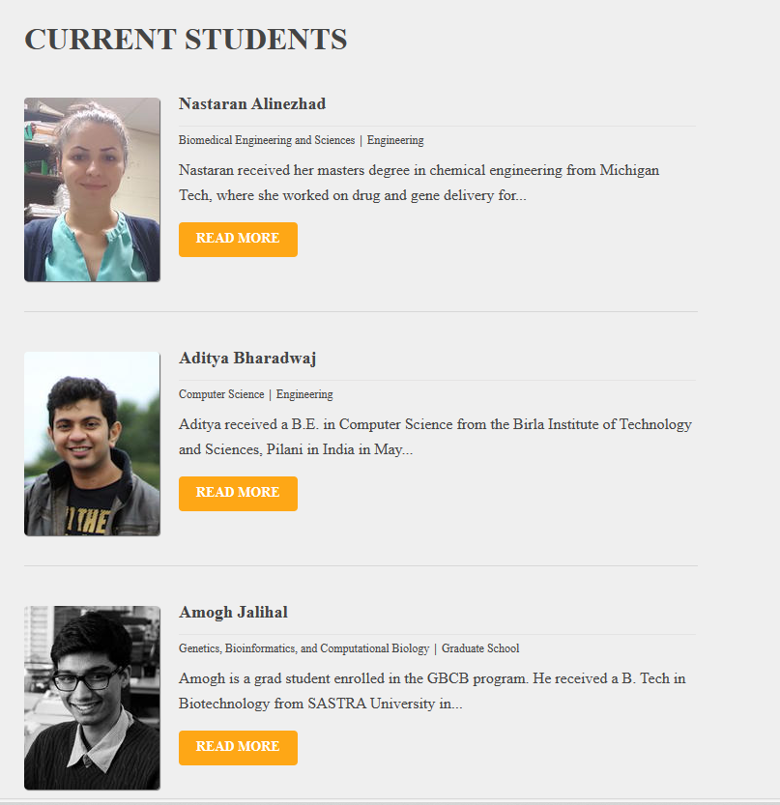
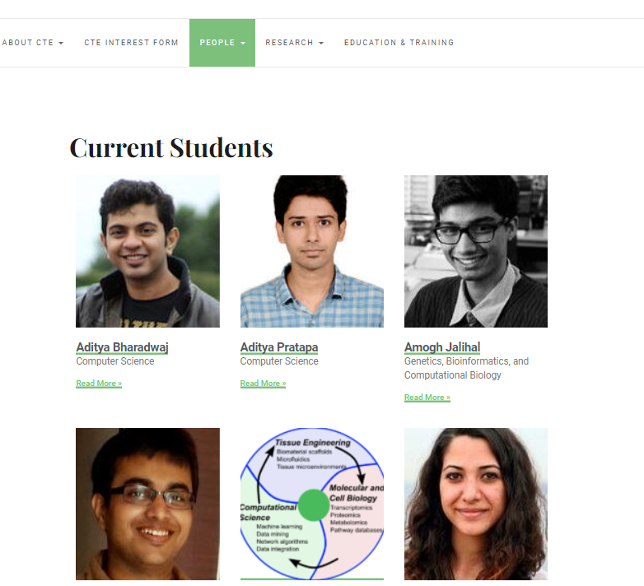
Current Students Page

Slide 9
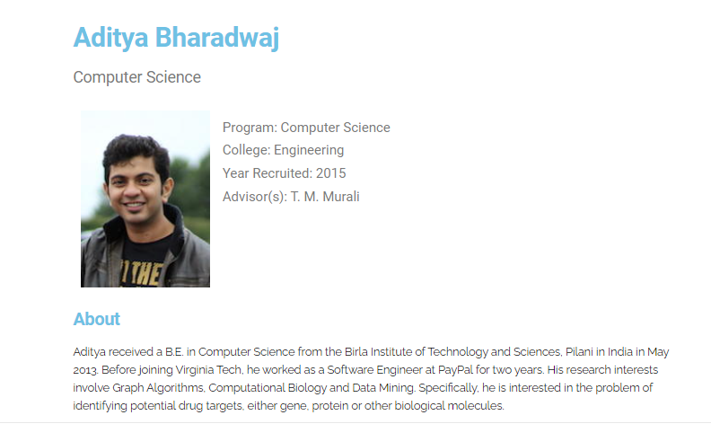
Individual Person’s Page

Slide 10
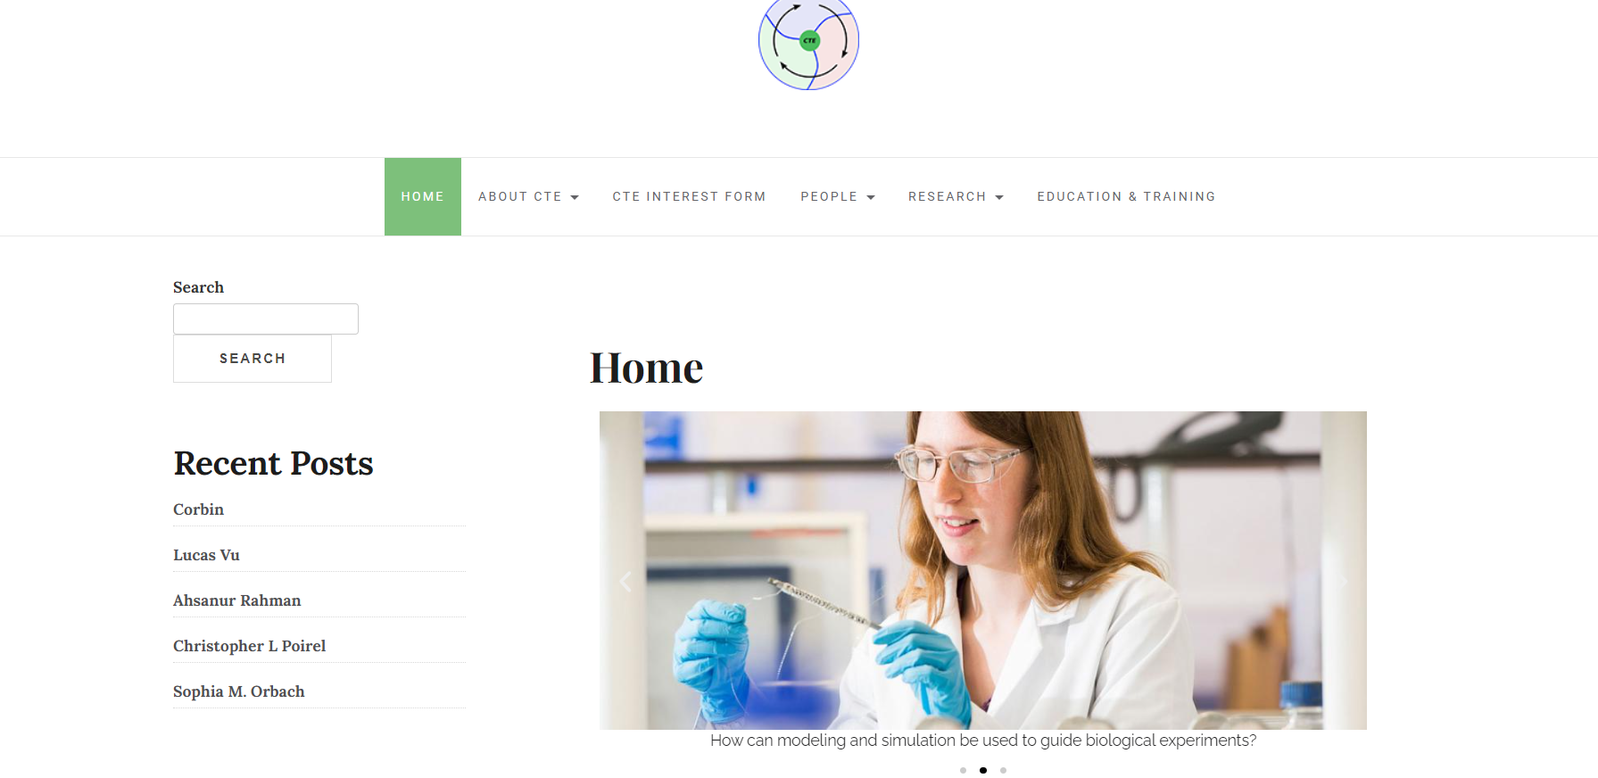
Home Page Image Carousel/Navigation Menu
The home page contains an image carousel that cycles through three images.
Each image contains a caption with questions related to the CTE program.

Slide 11

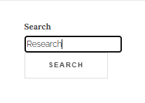
Search Bar
The search bar at the side of the page allows for the user to search specific keywords and populates the results to the user.

Slide 12
Research Website

Slide 13
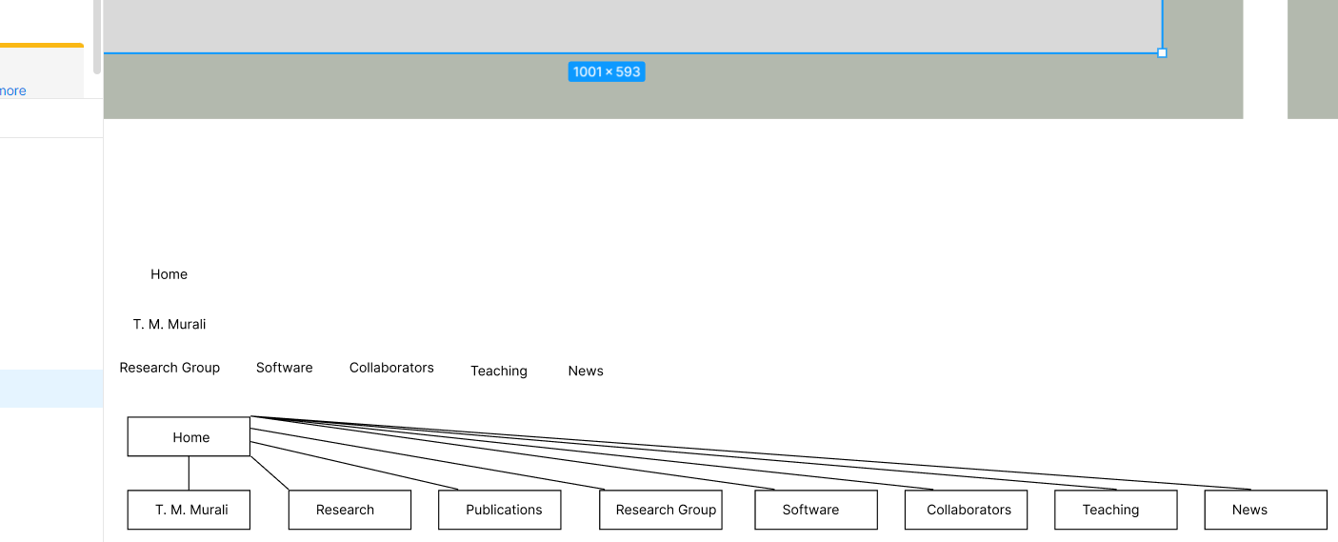
Architecture Model for Research Website

Slide 14
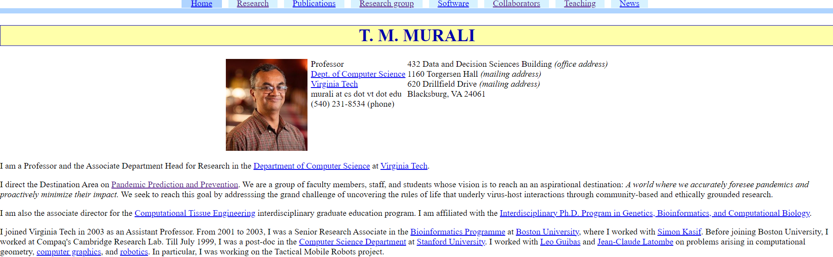
Previous Research Website

Slide 15
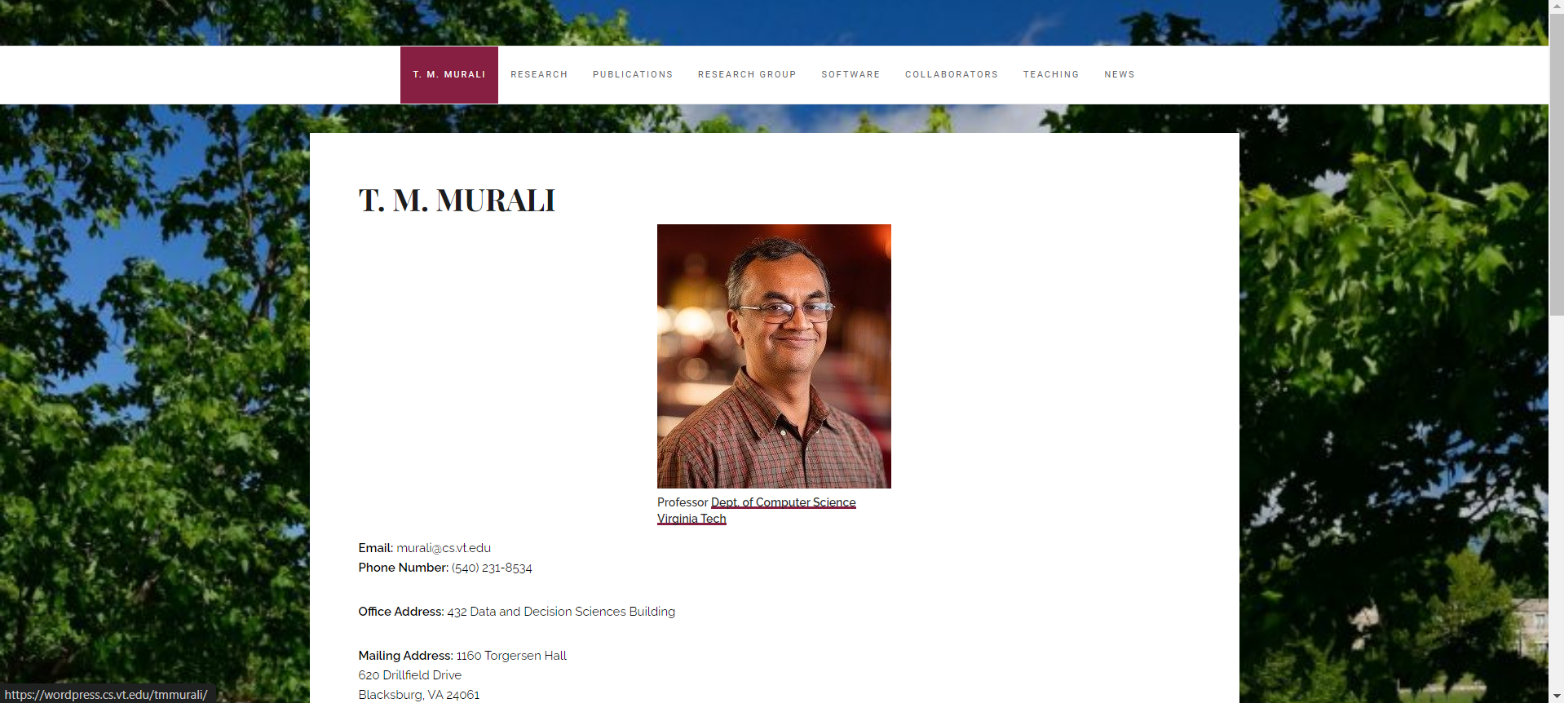
Updated Research Website

Slide 16

Challenges
Difficulty finding the proper plugins that met functionality required for CTE Website
Turnaround on downloading plugins
Finding a way to implement form mapping functionality

Slide 17
Timeline
February
April
-Met with clients to get high-level understanding of project
-Research about WordPress as CMS, plugins needed
-Finished form functionality, reports, presentation
-Completed Documentation and Testing
Day 1
Day 2
Day 3
March
-Implemented Research Website
-Implemented bare bones of CTE Website

Slide 18

Future Work
Finishing Touches
Randomization of Spotlighting Students
Adding CSS elements to CTE Website

Slide 19
Acknowledgments
Client: Dr. T. M. Murali
Professor: Dr. Edward A. Fox
TechStaff: Chris Arnold

Slide 20
References
[1] Forbes Tech Council. "How Will the No-Code Market Grow in 2023?" *Forbes*Forbes Magazine, 4 Apr. 2023, www.forbes.com/sites/forbestechcouncil/2023/04/04/how-will-the-no-code-market-grow-in-2023/?sh=3e93a2a17043. Accessed 23 Feb. 2024.
[2] Automattic Inc. “WordPress, Your Way.” WordPress.Com, 30 Mar. 2024, wordpress.com/. Accessed 08 Feb. 2024.
[3] 37Signals. “Project Management Software, Online Collaboration.” Basecamp, 30 April 2024, https://basecamp.com/. Accessed 9. Feb. 2024.
[4] Graduate School at Virginia Tech. “Computational Tissue Engineering Interdisciplinary Graduate Education Program at Virginia Tech.” Computational Tissue Engineering Interdisciplinary Graduate Education Program at Virginia Tech, 10 May 2023, https://cte.cs.vt.edu/. Accessed 09 Feb. 2024.
[5] Looking Forward Software, et al. “WordPress Plugins.” WordPress.Org, 1 March 2024, wordpress.org/plugins/. Accessed 10 Feb. 2024.
[6] Miyoshi, Takayuki. “Contact Form 7.” WordPress.Org, 21 Mar. 2024, wordpress.org/plugins/contact-form-7/. Accessed 23 Feb. 2024.
[7] V., Aurovrata. “Post My CF7 Form.” WordPress.Org, 30 Mar. 2024, wordpress.org/plugins/post-my-contact-form-7/. Accessed 23 Feb. 2024
[8] Molly Tyler. “What Is WPForms? +How the Form Builder Works (Ultimate Guide).” WPForms, LLC., 15 Feb. 2024, https://wpforms.com/what-is-wpforms/#:~:text=WPForms%20is%20an%20easy%2Dto,code%20or%20hiring%20a%20developer. Accessed 27 Mar. 2024.
[9] Elementor.com. “Elementor Website Builder – More than Just a Page Builder.” WordPress.Org, 15 Apr. 2024, wordpress.org/plugins/elementor/. Accessed 19 Mar. 2024.
[10] WordPress. “[Elementor Custom Skin] Support.” WordPress.Org Forums, 1 March 2024, wordpress.org/support/plugin/ele-custom-skin/. Accessed 19 Mar. 2024.
[11] WebDevStudios. “Custom Post Type UI.” WordPress.Org, 8 Apr. 2024, “Wordpress, Your Way.” WordPress.Com, wordpress.com/. Accessed 08 Feb. 2024.
wordpress.org/plugins/custom-post-type-ui/. Accessed 19 Mar. 2024.
[12] PublishPress. “PublishPress Capabilities Is the Plugin for WordPress Permissions.” PublishPress, 12 Feb. 2024, publishpress.com/capabilities/. Accessed 19 Mar. 2024.
[13] WordPress Administrator. (2017, November 16). Computer Science WordPress. https://wordpress.cs.vt.edu/. Accessed 9 Feb. 2024

