Slide 1
Knowledge Graph Aided Retrieval System for Electronic Theses and Dissertations (ETDs)
Keenan Clemmitt, Andrew Hill, Kash Kondaka
CS 4994 Undergraduate Research
Subject matter expert: Satvik Chekuri
Instructor: Professor Edward A. Fox
Virginia Tech, Blacksburg VA 24061
August 14, 2024

Slide 2
Outline
Overview
Design Of Previous Teams
Work In Progress
URI Resolution
Future Work
Acknowledgements
References
QA

Slide 3
Overview
Goal: Make ETDs widely accessible by building on previous work.
Initial challenge: Understand the entire pipeline from PDF to knowledge graph.
Task: Review previous groups' code repositories to understand their thought process.
Task: Find a way to overcome issues with the Postgres database and API calls for object detection.
Task: Find a way to successfully upload detected objects to the database.
Task: Convert XML files to RDF triples and upload them to Virtuoso without persisting troubles.
Task: Use an annotation tool to correct bounding boxes in object detection, improving the knowledge graph's accuracy.

Slide 4
Design of Previous Teams
Postgres Database
RDF Pipeline

Slide 5
Postgres Database

Slide 6
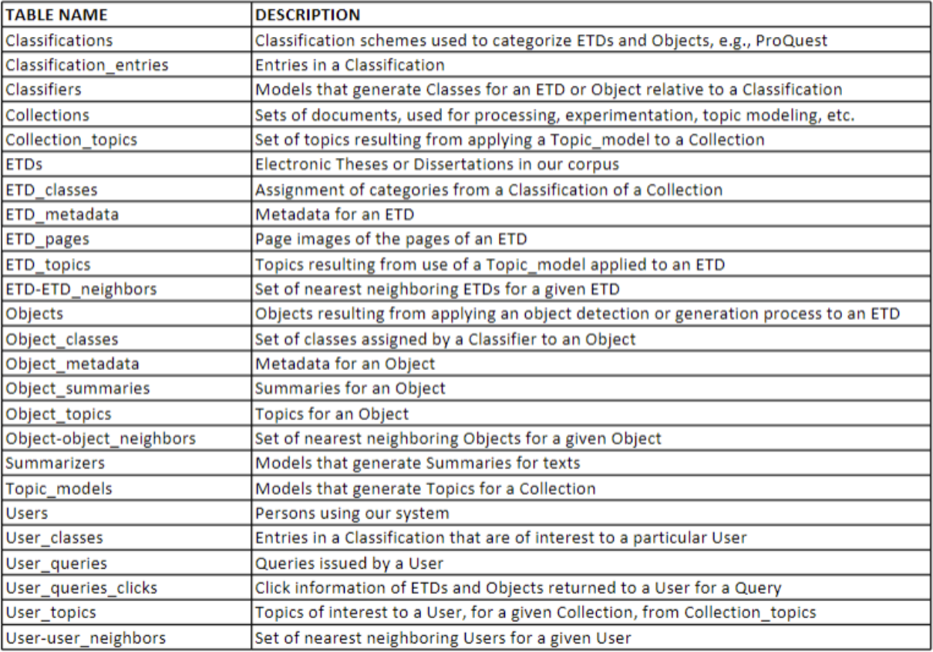
Postgres Design
Notes:
I just put the screenshots of the ER diagram in Dbeaver. There might be too much to show. Their diagram is also on page 30 of team5 report

Slide 7
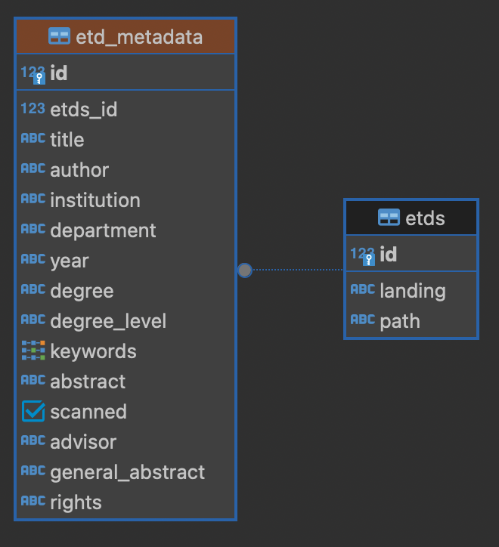
ETD_Metadata ER Diagram
Notes:
I just put the screenshots of the ER diagram in Dbeaver. There might be too much to show. Their diagram is also on page 30 of team5 report

Slide 8
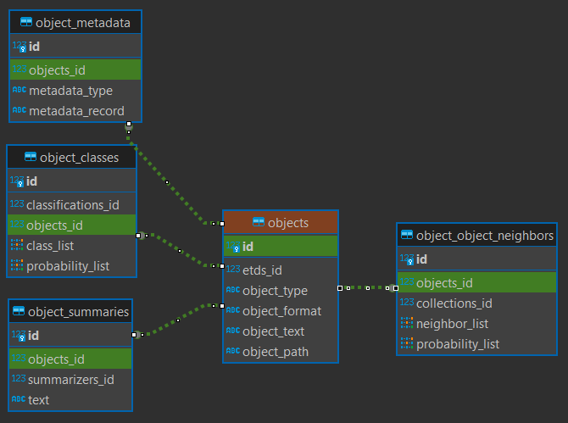
Objects ER Diagram
Notes:
I just put the screenshots of the ER diagram in Dbeaver. There might be too much to show. Their diagram is also on page 30 of team5 report

Slide 9
RDF Pipeline

Slide 10
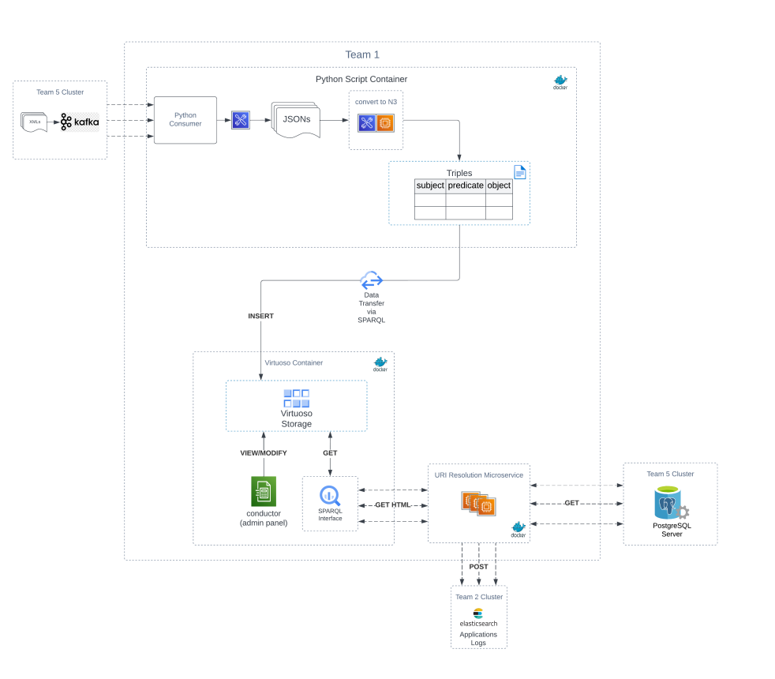
Previous Team’s RDF Pipeline

Slide 11
Work In Progress
Annotation Tool
API Calls
Uploading to Virtuoso DB

Slide 12
Annotation Tool

Slide 13
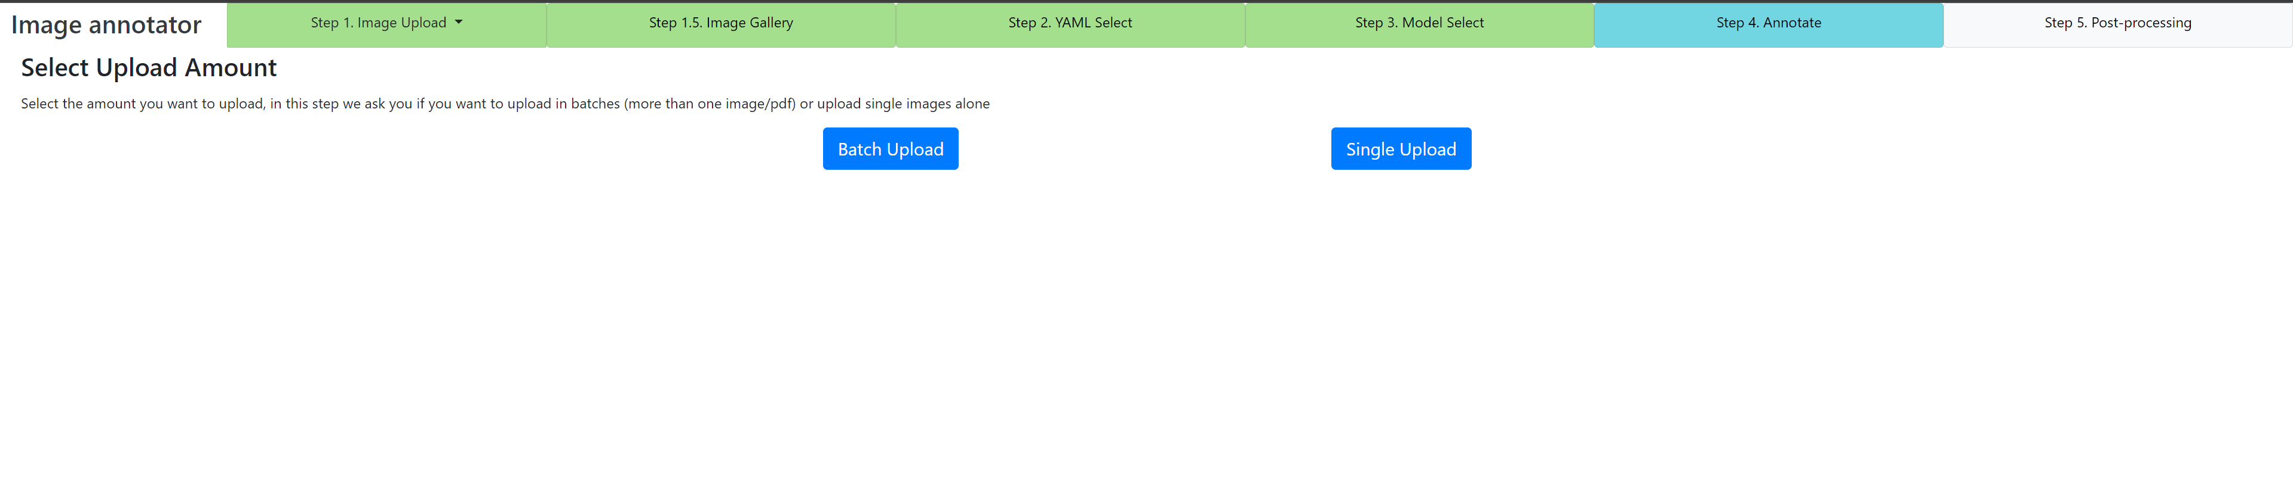

Slide 14
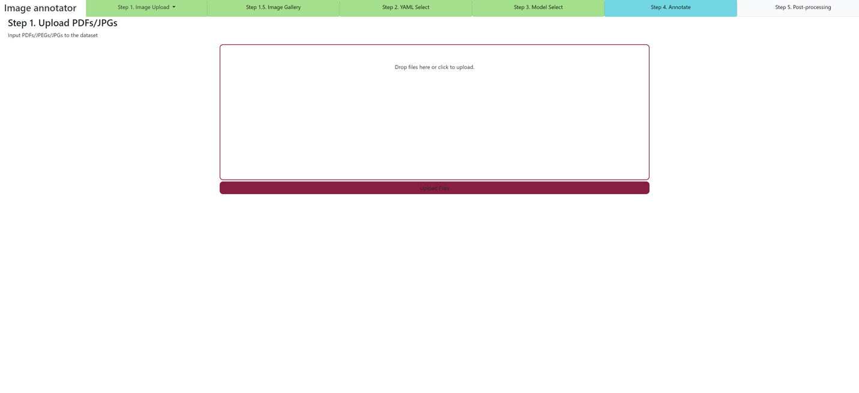

Slide 15
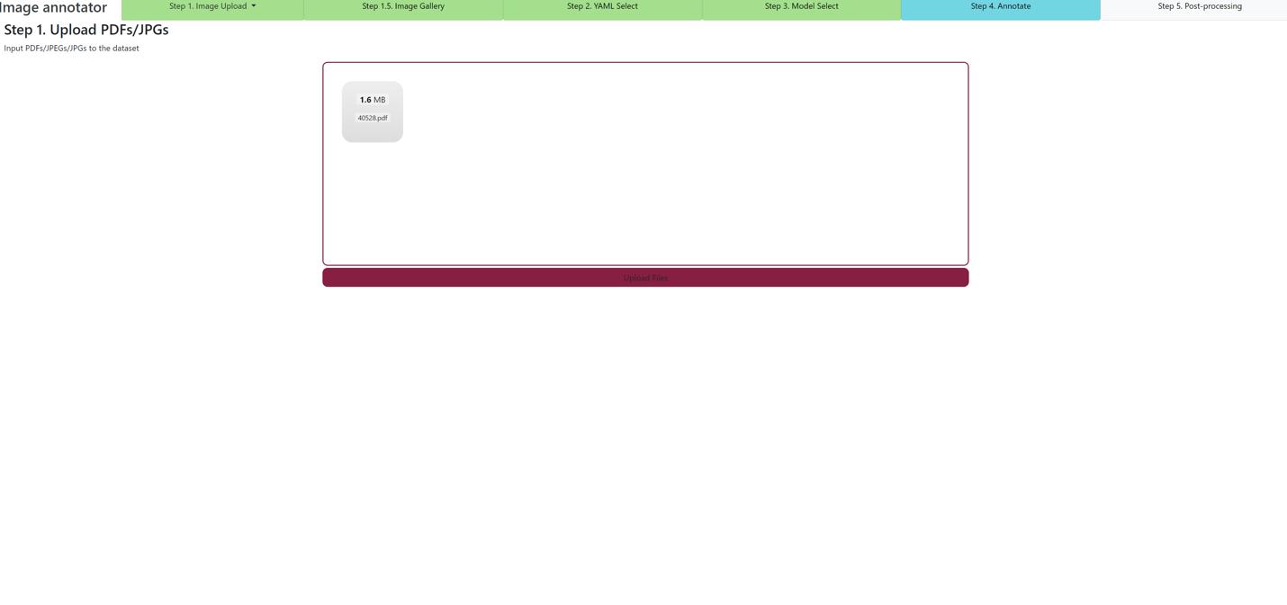

Slide 16
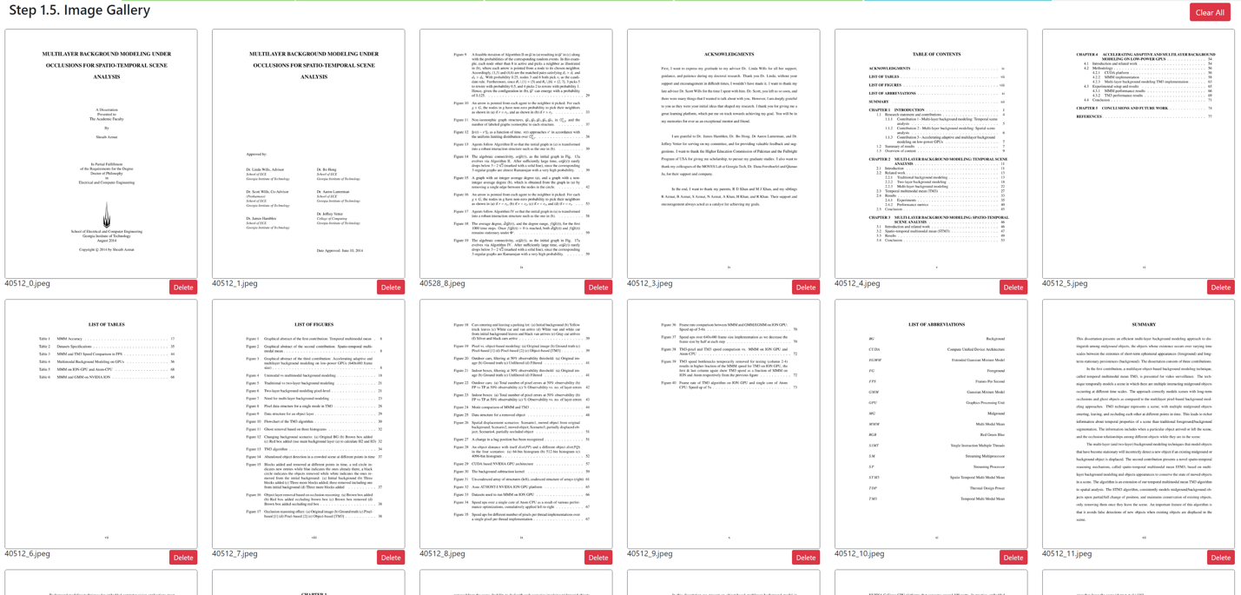

Slide 17
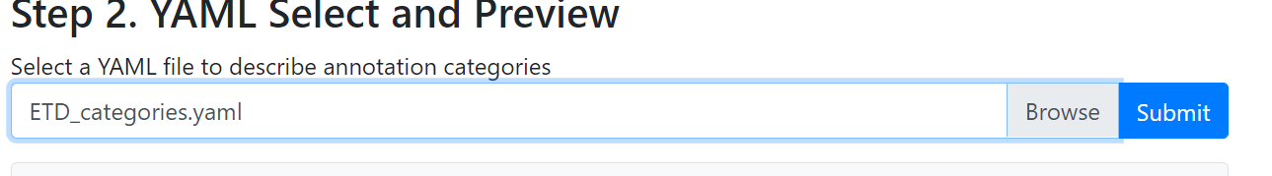

Slide 18
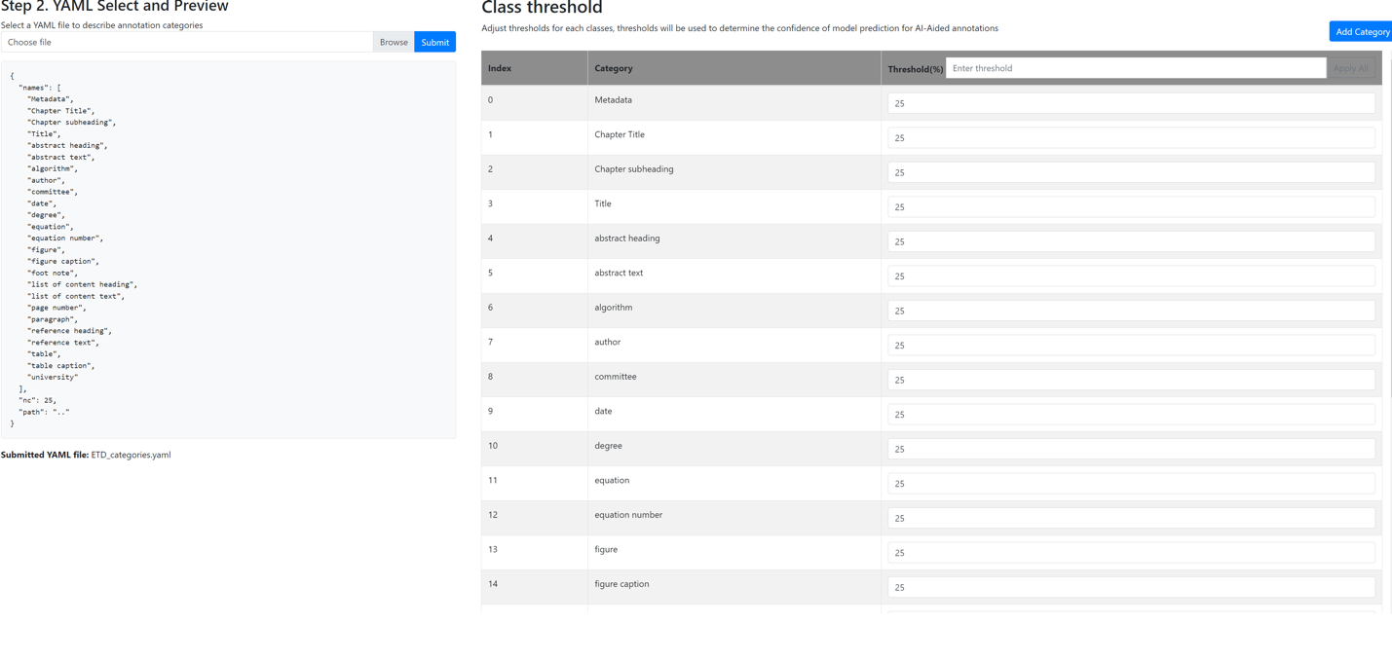

Slide 19
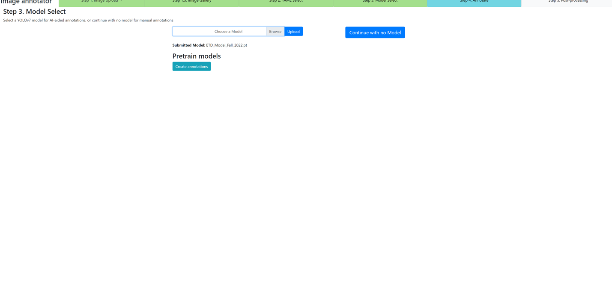

Slide 20
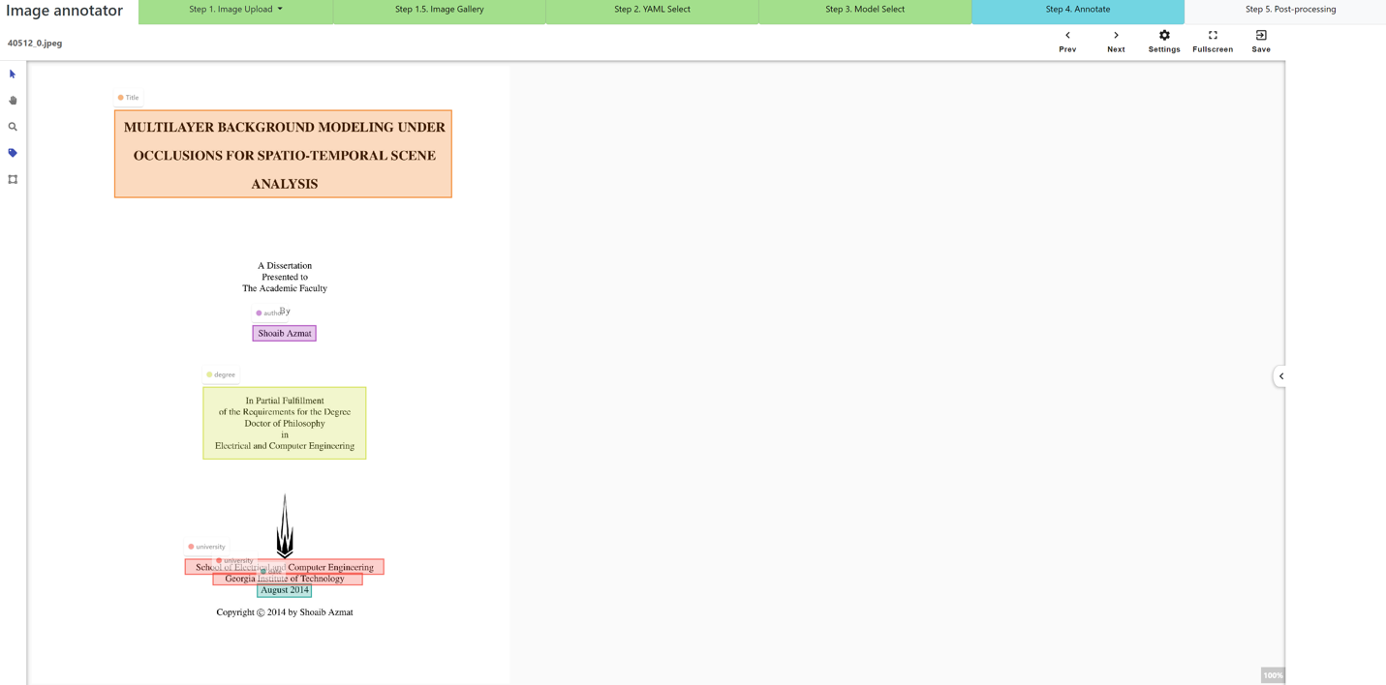

Slide 21
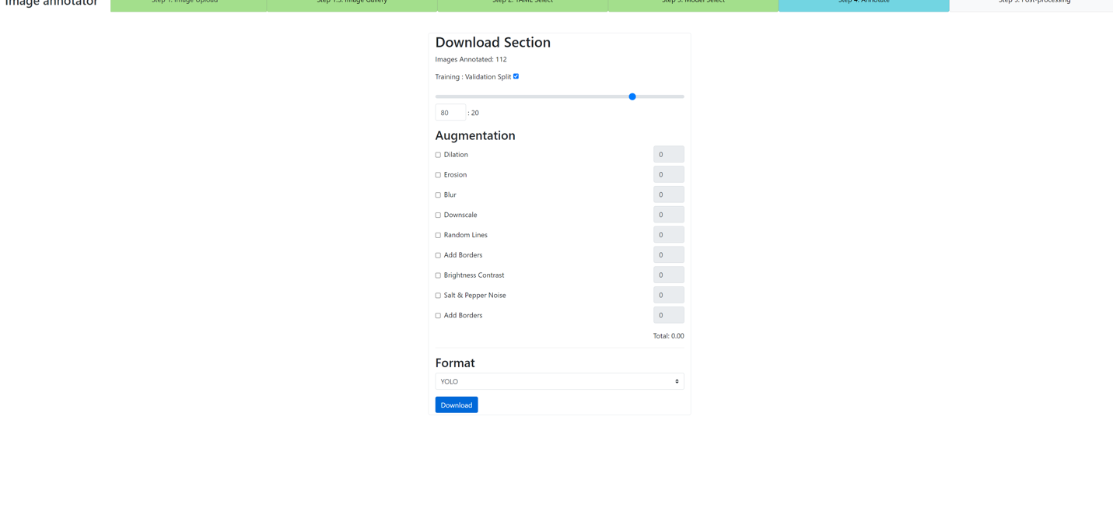

Slide 22
Annotation Assessment
Annotated 7 PDFs
Model is mostly accurate (usually no more than 5-10 changes per ETD)
Common Errors:
  Duplicate Bounding Boxes on page numbers/paragraphs
  Inability to read proofs
  Department/Degree conflict

Slide 23
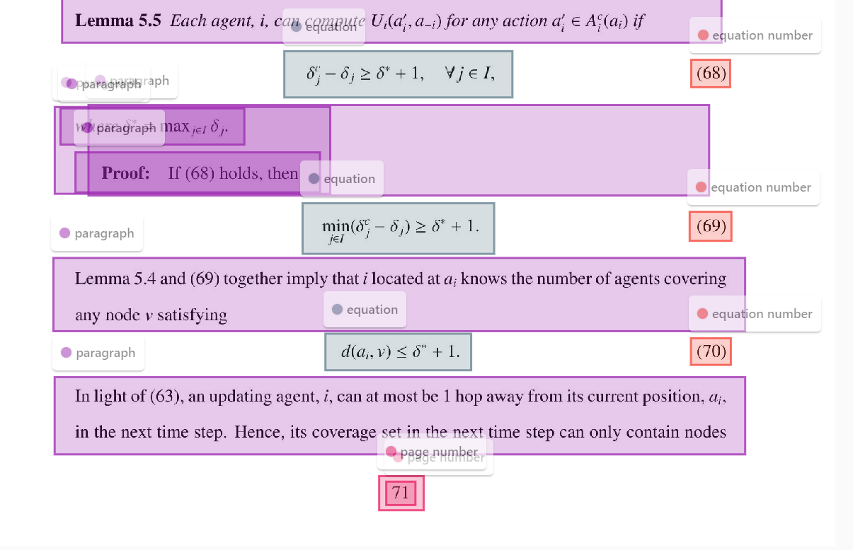

Slide 24
API Calls

Slide 25

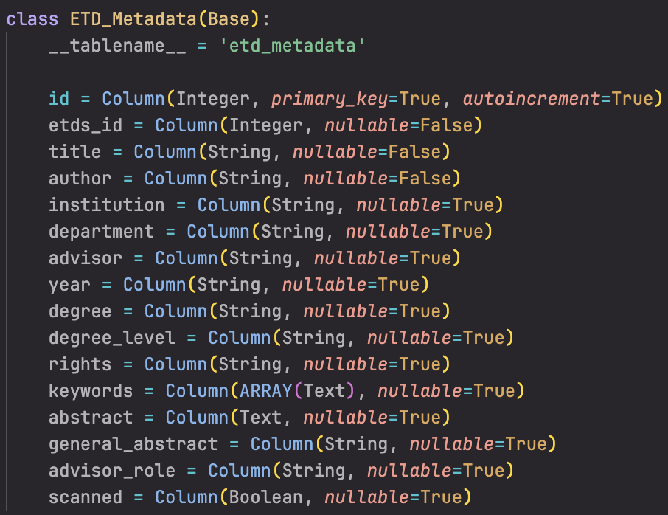
Altering ETD_Metadata Schema
Removed composite value types
Removed contributors
Added general abstract
Added advisors
Added advisor roles
Note: Multiple advisors are stored as a single string separated by commas (i.e., "Advisor 1, Advisor 2, Advisor 3...") and their roles are stored in the parallel string Advisor Role (i.e., "Advisor 1 role, Advisor 2 role...").

Slide 26
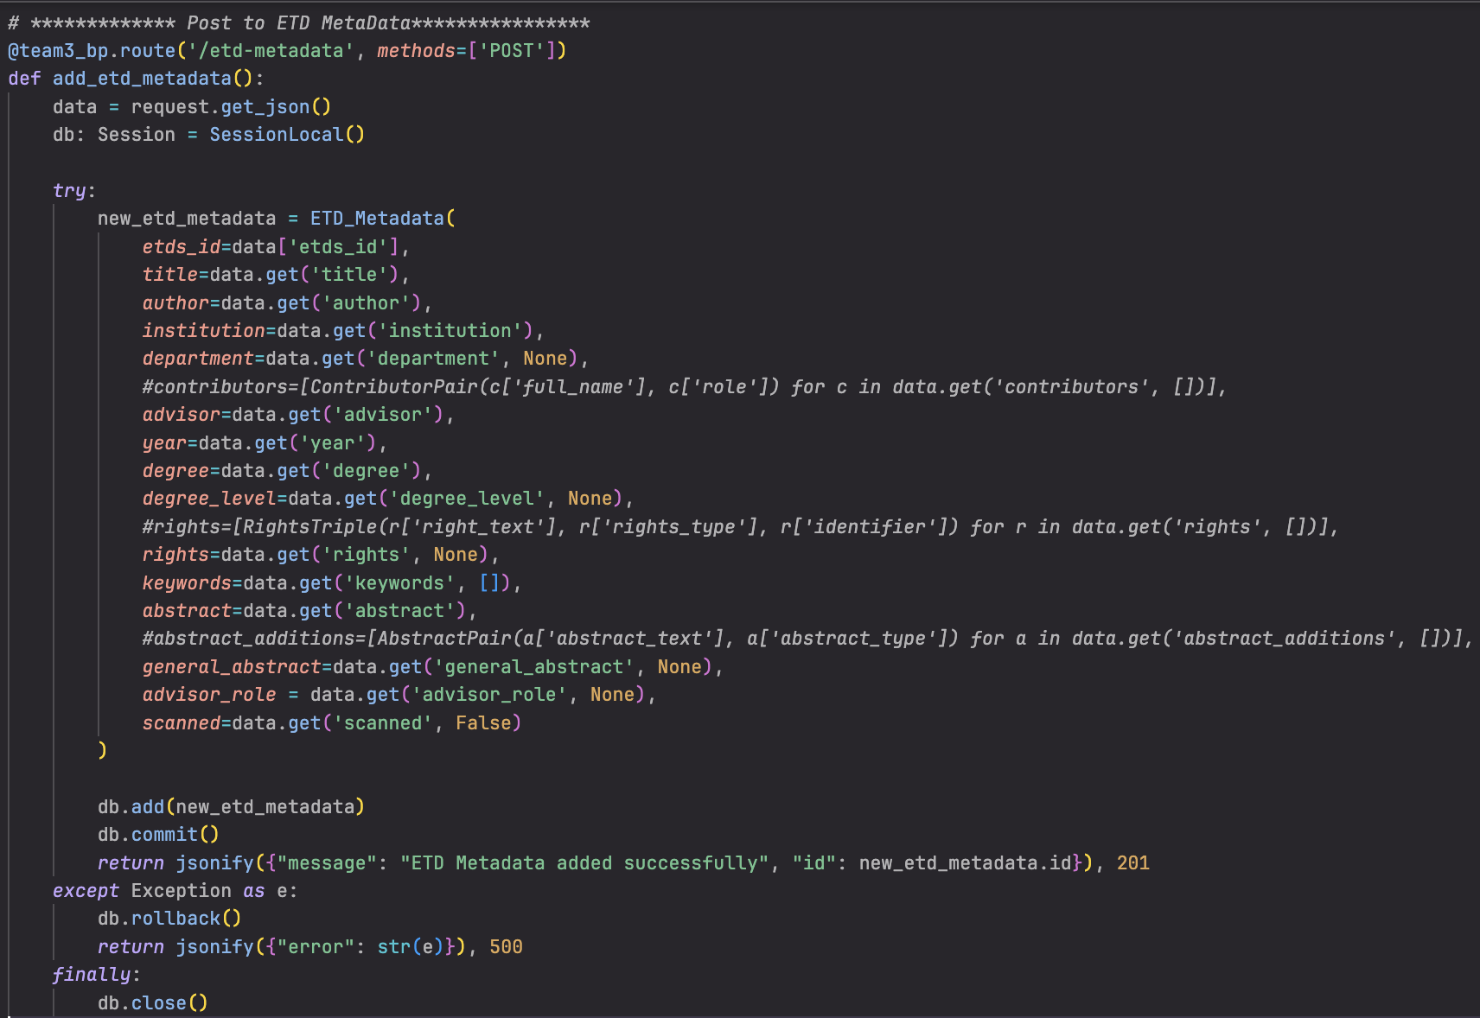
Post to ETD_Metadata Table

Slide 27
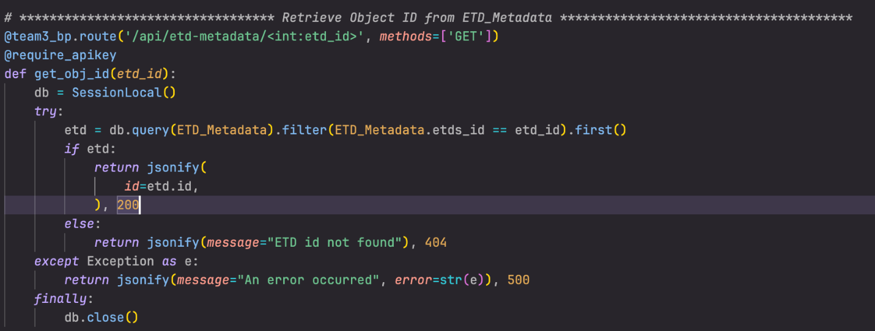
Get Object ID of ETD

Slide 28
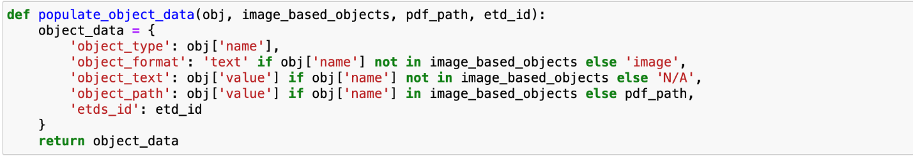
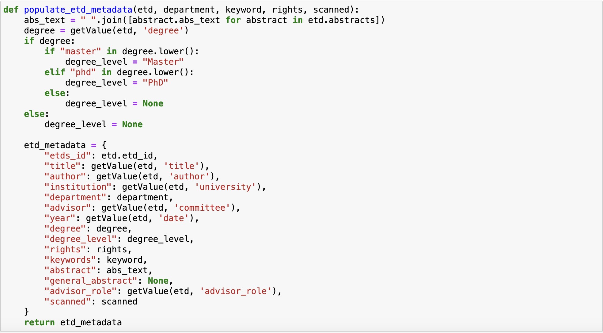
Collecting Fields from OD

Slide 29
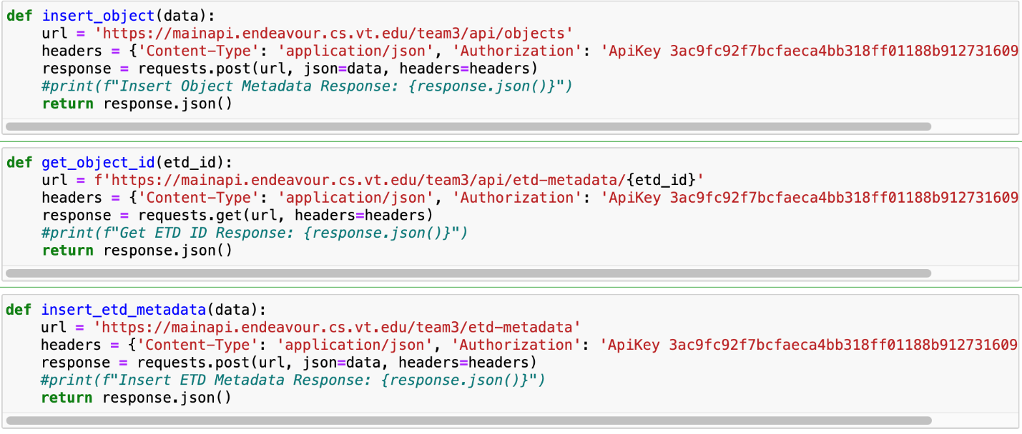
Integrating Calls to PDF->XML script

Slide 30
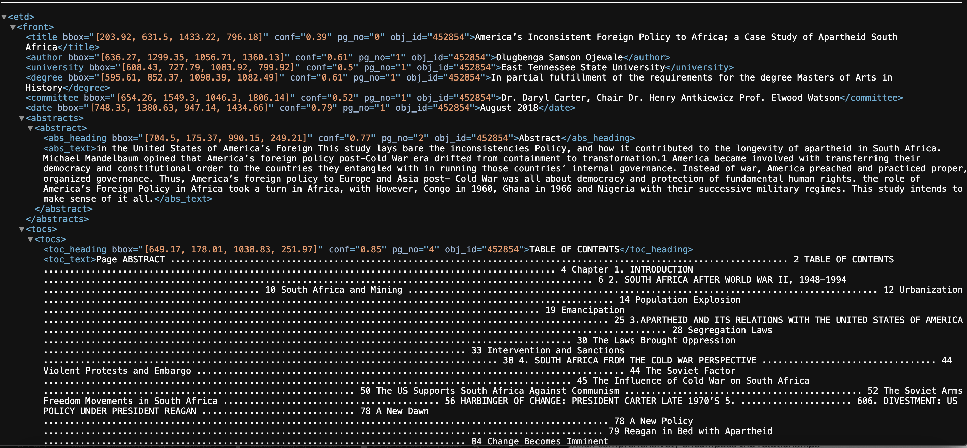
XML Result

Slide 31
XML to RDF and Virtuoso DB

Slide 32
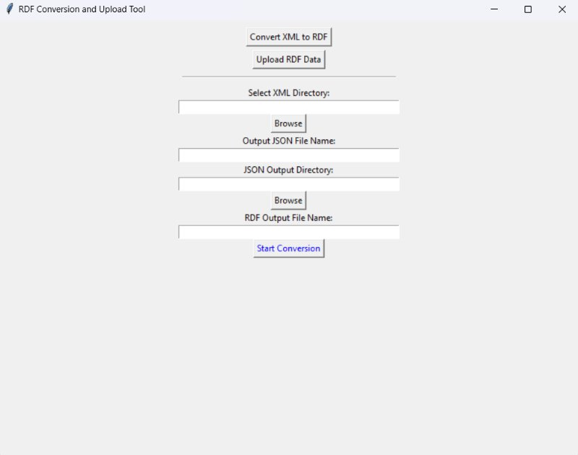
XML to RDF

Slide 33
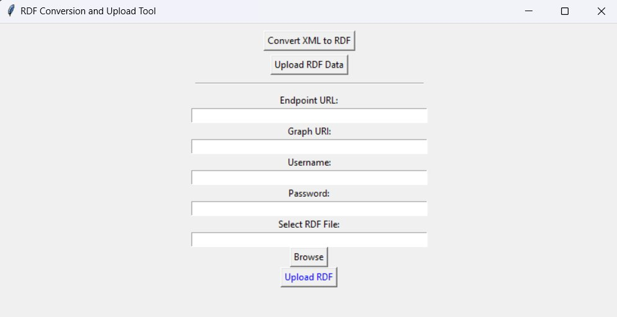
RDF Upload To Virtuoso

Slide 34
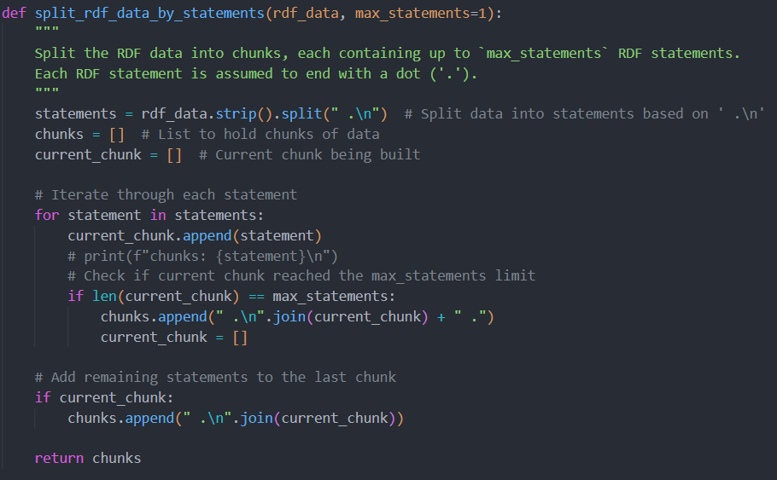
RDF Uploading Efficiency

Slide 35

Virtuoso DB URI Resolution

Slide 36
Future Work
Short Term:
  URI Resolution
  Upload Triples To Virtuoso Quickly
Long Term:
  Integrate IR System With KG
  Experiment With Llama 3.1 To Test LLM With KG

Slide 37
Acknowledgements
We would like to thank Satvik Chekuri for his technical assistance and guidance throughout this project. His dedication and problem-solving skills were invaluable in overcoming various challenges that impeded our progress. Additionally, we extend our heartfelt thanks to Dr. Fox for facilitating the course, sourcing relevant articles, offering background information, and insightful commentary, which greatly enhanced our understanding and direction. We also wish to acknowledge the work and documentation of the previous teams, whose contributions laid the foundation for our efforts

Slide 38
References
Aina, A., Subramanian, A., Hsu, H.-W., Rama, S., Gowrishankar, V., & Cheng, Y.-C. (2024, January 17). Team 5 - Infrastructure and DevOps Fall 2023. VTechWorks Repository, Virginia Tech, CS5604 Fall 2023 project submission. https://hdl.handle.net/10919/118666
Hao, Q., & Xing, H. (2024, May 9). Knowledge Graph Building. VTechWorks Repository, Virginia Tech, CS4624 Spring 2024 project submission. https://hdl.handle.net/10919/118938
Gaugler, D., & Aggarwal, A. (2023, December 4). Information Storage and Retrieval - CS5604 Final Report Team 1 (Knowledge Graphs). VTechWorks Repository, Virginia Tech, Fall 2023 project submission. https://hdl.handle.net/10919/118698
Ahuja, A. (2023, July 21). Analyzing and navigating electronic theses and dissertations. VTechWorks Repository, Virginia Tech, Department of Computer Science doctoral dissertation. https://hdl.handle.net/10919/115817
Devera, A., Nader, M., Zhang, Z., Keegan, E., Gunn, T., Nguyen, G., & Wevley, L. (2023, May 10). Object Detection and Document Accessibility. VTechWorks Repository, Virginia Tech, CS4624 Spring 2023 project submission. https://hdl.handle.net/10919/115644

Slide 39
References
Fox, E. A. (2024). Knowledge Graph aided Retrieval System for Electronic Theses and Dissertations (ETDs) Course Syllabus. Virginia Tech. https://fox.cs.vt.edu/CS4994Syllabus2024Summer2Fox.pdf (Accessed August 8, 2024).
Virginia Tech. (2024). Endeavour Cluster. Virginia Tech, Department of Computer Science, Launch web page. https://launch.cs.vt.edu/dashboard/auth/login (Accessed August 8, 2024).
Serge Rider. (2011). DBeaver. https://dbeaver.io/download/ (Accessed August 8, 2024).
Keenan Clemmitt, Kash Kondaka, Andrew Hill. (2024, August). Enhanced Virtuoso Knowledge Graph. Virginia Tech Department of Computer Science Container, https://virtuoso.endeavour.cs.vt.edu/sparql-auth (Accessed August 8, 2024).
Aina, A., Subramanian, A., Hsu, H.-W., Rama, S., Gowrishankar, V., & Cheng, Y.-C. , (2023, September). Team 5 Main API Repository, https://code.vt.edu/cs5604-f2023/team5-int/main_api (Accessed August 8, 2024).

Slide 40
References
Yazicioglu, Ahmet Yasin. (2017). Adaptive fault-tolerant framework for dependable distributed computing. Georgia Tech Research Repository. https://repository.gatech.edu/entities/publication/a8a419f9-6188-497e-bf62-ed6969514d58 (Accessed August 8, 2024).
SQL Alchemy. (2024). The Python SQL Toolkit and Object Relational Mapper. https://www.sqlalchemy.org/ (Accessed August 12, 2024).
PyTorch Foundation. (2024). PyTorch Get Started. https://pytorch.org/ (Accessed August 12, 2024).
Cloud Native Computing Foundation. (2024). Kubernetes. https://kubernetes.io/ (Accessed August 12, 2024).
PostgresSQL Global Development Group. (2024). Postgres. https://www.postgresql.org/ (Accessed August 12, 2024).
Scrum.org (2024). What is Scrum. https://www.scrum.org/learning-series/what-is-scrum/ (Accessed August 12, 2024).
Atlassian. (2024). Trello. https://trello.com/ (Accessed August 12, 2024).

Slide 41





Questions

