Slide 1
Team Text Analytics and Machine Learning (TML)
CS 5604 Information Storage and Retrieval (Fall 2019)
Instructor: Dr. Edward Fox (fox@vt.edu)
TA: Ziqian Song (ziqian@vt.edu)
Virginia Tech
Blacksburg, VA - 24061
December 05, 2019
Adheesh Sunil Juvekar (juvekaradheesh@vt.edu)
Jiaying Gong (gjiaying@vt.edu)
Prathamesh Mandke (pkmandke@vt.edu)
Rifat Sabbir Mansur (rifatsm@vt.edu)
Sandhya M Bharadwaj (sandhyamb@vt.edu)
Sharvari Chougule (sharvarisc@vt.edu)

Slide 2
Outline
System Overview
Clustering
Text Summarization
Named Entity Recognition
Sentiment Analysis
Recommender Systems

Slide 3
System Architecture
Kibana
logs
FEK
User
ELS
Recommender System
Clustering
ETD Storage
Tobacco Files Storage
Text Summarization
Ingest ETD
INT
Preprocess ETD
Named-Entity Recognition
CME
Ingest Tobacco docs
Preprocess Tobacco Documents
CEPH
Sentiment Analysis
CMT
TML

Slide 4
System Diagram
Search Results:
Result list prioritized by Recommender Systems
Document Title
keywords: person, location, date, etc.
Keywords received by Name Entity Recognition (NER)
more like this… sentiment
Summary of the Document in 2 lines
Sentiment of the document
2. Document Title
Similar documents suggested by Clustering
keywords: person, location, date, etc.
more like this… sentiment
Showing a 2 line summary using Text Summarization
Summary of the Document in 2 lines

Slide 5
Clustering Workflow - A bird’s eye-view!
Elastic
Search
ETDs
Cleaning & Pre-processing
Vectorization
TFIDF, Doc2Vec
Clustering
Frontend
TSRs*
Containerize
*TSRs: Tobacco Settlement Records
Doc2Vec: Le, Quoc, and Tomas Mikolov. "Distributed representations of sentences and documents." International conference on machine learning. 2014.

Slide 6
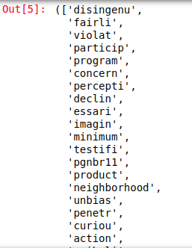
Pre-Processing
Step 1: Cleansing
  Remove invalid UTF-8 characters
  Remove punctuation and convert all characters/letters to lowercase
Step 2: Tokenization
  Punkt Sentence Tokenizer
  Treebank Word Tokenizer
Step 3: Stemming
  Porter Stemmer
We also removed common English stopwords from the tokens
NLTK: https://www.nltk.org/api/nltk.chunk.html

Slide 7
Clustering TSRs with TF-IDF vectors
Cluster # | # of Documents
1 | 94
2 | 107
3 | 4806
4 | 283
5 | 283
6 | 320
7 | 340
8 | 123
9 | 529
10 | 259
Issues
  Imbalanced cluster allocation.
  Results not very interpretable.
Possible causes
  Uncleaned/raw documents containing invalid characters -> leading to noisy TF-IDF vectors.
  Highly sparse TF-IDF representations with only ~1% values in a vector being non-zero.
Result
  Unable to get good results with either K-Means or Agglomerative Clustering.

Slide 8
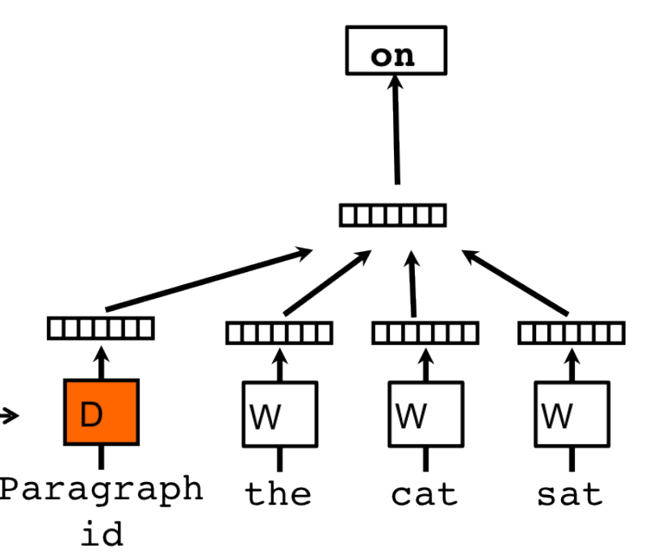
Doc2Vec [1]
From relative frequency counts to distributed representations that capture semantics.
Specifics
  128-d document vectors for a total of 30961 ETDs.
  Abstracts used to generate the document vectors.
  Model trained for 15 epochs in a distributed memory setting using 5 parallel threads for data fetching on the ECE Guacamole servers.
Why 128-d vectors?
  Neither too big, nor to small!
  Conducive to GPU implementations of downstream tasks that can use these document vectors.
  Enough to capture information/semantics from the abstracts, entire documents will require higher dimensional vectors.
[1] Doc2Vec: Le, Quoc, and Tomas Mikolov. "Distributed representations of sentences and documents." International conference on machine learning. 2014. (Image source)

Slide 9
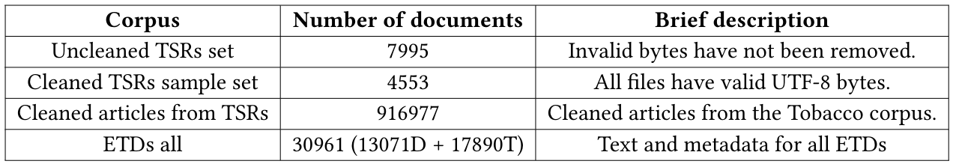
Outline of Clustering Experiments
K-Means Clustering
Hierarchical - Agglomerative Clustering
DBSCAN
BIRCH
Summary of Data Corpora

Slide 10
A word about metrics
Hard to evaluate clustering algorithms when true labels are not available. We use the following metrics.
The Calinski-Harabasz Index (CH score)
  The index is the ratio of the sum of between-clusters dispersion and of inter-cluster dispersion for all clusters.
  Intuitively, the score is higher when clusters are dense and well separated, which relates to a standard concept of a cluster.
Silhouette Coefficient
  The score is bounded between -1 for incorrect clustering and +1 for highly dense clustering.
Davies-Bouldin Index
  This index signifies the average ‘similarity’ between clusters, where the similarity is a measure that compares the distance between clusters with the size of the clusters themselves.
  Values close to zero indicate a better partitioning.
Much of the content of this slide is borrowed from: https://scikit-learn.org/stable/modules/clustering.html Last Accessed: 12/05/2019

Slide 11
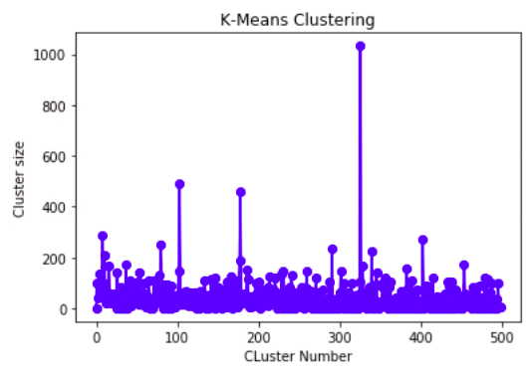

K-Means Clustering
Meta
  Algorithm: EM based K-Means “full” algorithm. [1]
  Cluster Centroids initialized with k-means++. [2]
  Trained with 5 different random initializations and chosen best of 5.
  10 parallel threads used for data fetching.
Average documents per cluster = 46.28
[1] Lloyd, Stuart P. "Least squares quantization in PCM." Information Theory, IEEE Transactions on 28.2 (1982): 129-137.
[2] Arthur, David, and Sergei Vassilvitskii. "k-means++: The advantages of careful seeding." Proceedings of the eighteenth annual ACM-SIAM symposium on Discrete algorithms. Society for Industrial and Applied Mathematics, 2007.

Slide 12
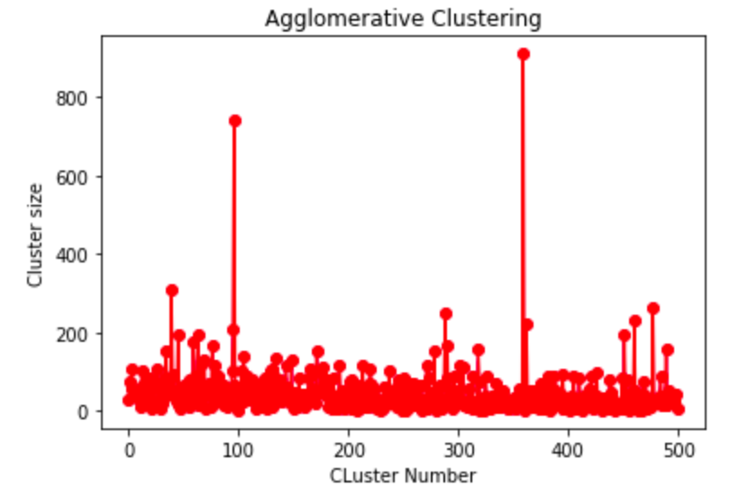
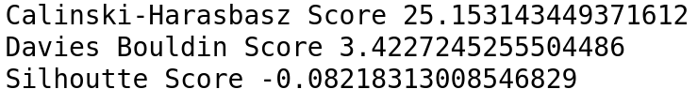
Agglomerative Clustering
Meta
  Dendrogram based Hierarchical Agglomerative clustering. [1]
  Ward based linkage with a Euclidean distance measure.
  Constructed dendrogram to obtain 500 clusters.
Average documents per cluster = 46.28
[1] Rokach, Lior, and Oded Maimon. "Clustering methods." Data mining and knowledge discovery handbook. Springer US, 2005. 321-352.

Slide 13
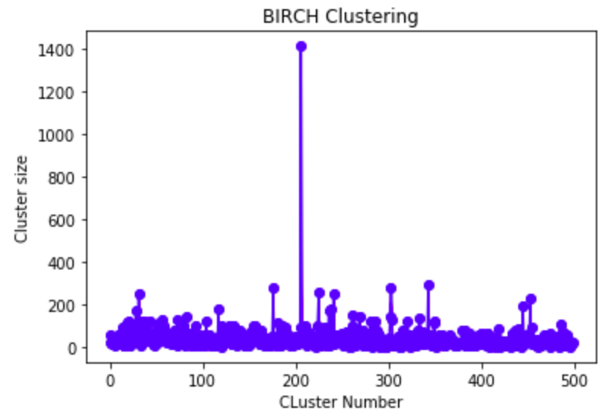
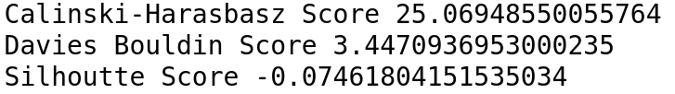
BIRCH [1]
Meta
  Threshold: 0.5 -> Setting this value to be very low promotes splitting of clusters. [2]
  Branching Factor: 50 -> max subclusters in a node. Additional nodes are spawned when this number is exceeded.
Benefits
  Suited for large scale databases.
  Designed with low memory and computation footprint in mind.
  Scales elegantly to increasing data-size. (Read easier to accommodate new incoming docs.)
Average documents per cluster = 46.28
[1] Zhang, Tian, Raghu Ramakrishnan, and Miron Livny. "BIRCH: an efficient data clustering method for very large databases." ACM Sigmod Record. Vol. 25. No. 2. ACM, 1996.
[2] https://scikit-learn.org/stable/modules/generated/sklearn.cluster.Birch.html

Slide 14
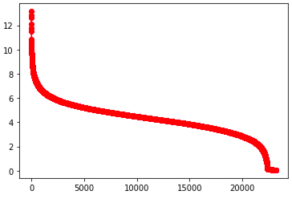
DBSCAN [1]
TL;DR
  Does not work for ETDs!
  All documents allocated to a single cluster.
Benefits
  Designed to deal with large scale spatial databases with noise.
  Detects and discards noisy data (Read: helpful for docs with OCR errors/garbage data).
  Very few data specific hyper-parameters to be tuned.
[1] Ester, Martin, et al. "A density-based algorithm for discovering clusters in large spatial databases with noise." Kdd. Vol. 96. No. 34. 1996.

Slide 15
A word about system integration
Clustering will augment the metadata in ELS to include a cluster ID field.
This will be used by FEK to have a “Documents similar to this” or alike button in the front-end.
Containerized API for assigning cluster ID to new documents.
Notes:
Clustering ends here!

Slide 16
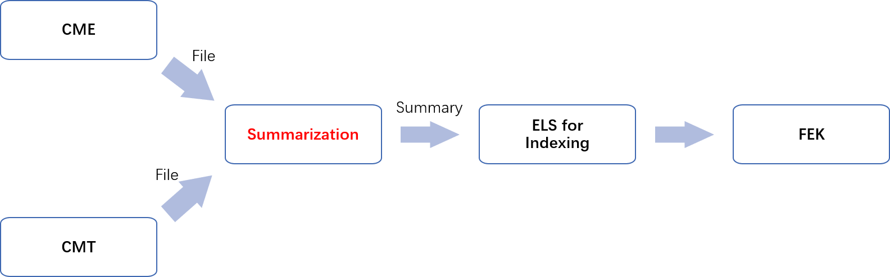
Text Summarization
Outline for text summarization
  Pre-processed the data for the file with too small size or too large size.
  Built a new model for text summarization based on three different models. (Feature-based model, Graph-based model, Topic-based model)
  Provided real summaries based on the above model for tobacco 1 million dataset.
  Did text summarization on 20 sample dataset provided from CME team.

Slide 17
Why pre-processing
Eliminate Noise
  There are some garbage characters which may influence the result for text summarization. So we eliminate these garbage characters. (\r, \n, ~, ...)
Improve Efficiency
  For text file which includes less than 4 sentences, we don’t do any summarization and just copy the original file as the summary.
  For text file which is larger than 1Mb, we cut the whole file and do summarization separately. Otherwise, it might cause memory allocation errors.

Slide 18
Three Different Models
Feature-based Model
  The feature-based model will extract the features of the sentence, then a summary will be provided based on the evaluated importance. We use Luhn’s algorithm which is based on TF-IDF and assigns high weights to the sentence near the beginning of the documents.

Slide 19
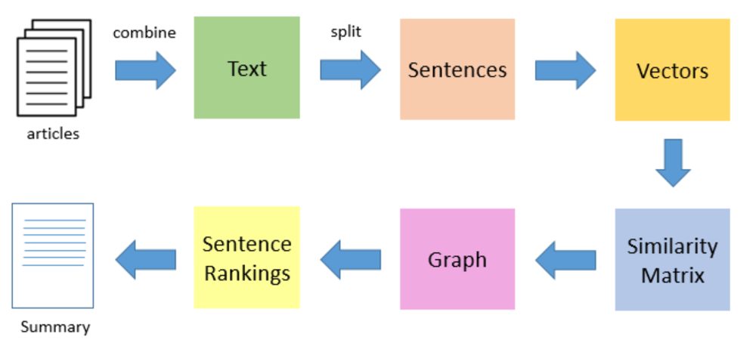
Three Different Models
Graph-based Model
  The graph-based model makes the graph from the document, then summarizes it by considering the relation between the nodes. We use TextRank, an unsupervised text summarization technique, to do summarization.

Slide 20
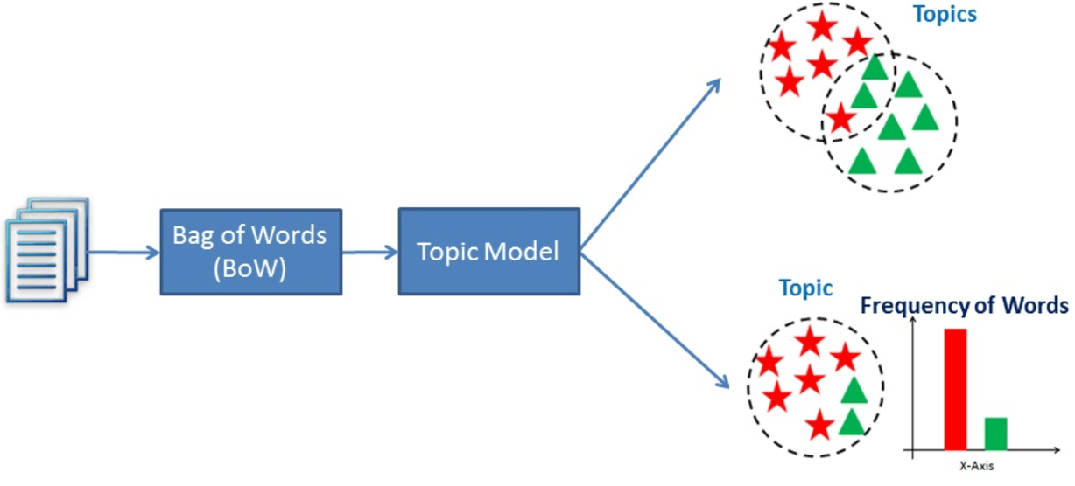
Three Different Models
Topic-based Model
  The topic-based model calculates the topic of the document and evaluates each sentence by the included topics. We use Latent Semantic Analysis, which can extract hidden semantic structures of words and sentences to detect topics.

Slide 21
Example
Feature-based Model
Graph-based Model
Topic-based Model
Shook, Hardy and Bacon
The industry now has
That proposal includes the
We understand that there
During the interim Dr.
The facilities proposed at
Clinical affiliations and facilities
Construction and renovation funds
In our best judgement
Should the decision be
During the interim Dr
The industry now has
Clinical affiliations and facilities
Two methods of financing
The facilities proposed at
The proposal before you
That proposal includes the
We had hoped that the
In our best judgement
In closing, let me
Shook, Hardy and Bacon
We had hoped that
Although no decision was
The industry now has
That proposal includes the
We estimate that such
During the interim Dr.
In our best judgement
In closing, let me
The proposal before you

Slide 22
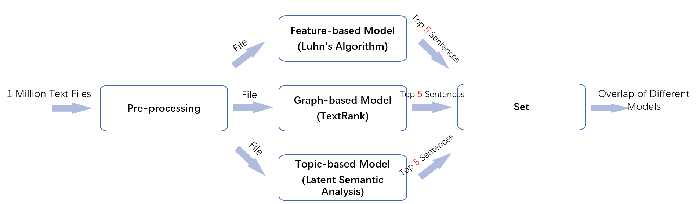
New Model (Old Version)
Number in red is the parameter which can be easily changed.

Slide 23
Example
Feature-based Model
Graph-based Model
Topic-based Model
Breed Sacramento Bee: J
What the really issue
And what we're looking
Dr. ERICKSON: What the
The House is considering
Sharp was one of
After a burst of
Philip Morris USA had
As often occurs with
Plan would force small
Plan would force small
It "would grant FDA
So the current effort
In exchange for the
The tobacco buyout measure
As often occurs with
But Ballin, now a
The most appealing aspect
The thinking being that
Among the key obstacles
David; Fisher, Scott; Gimbel
He says regulation of
Relatively quiet until now
Burr's proposal certainly would
Staff Photos by John
Document RNOB000020031018
Document XSN W000020031018
Philip Morris USA had
While Gregg and Kennedy
Most lawmakers agree it

Slide 24
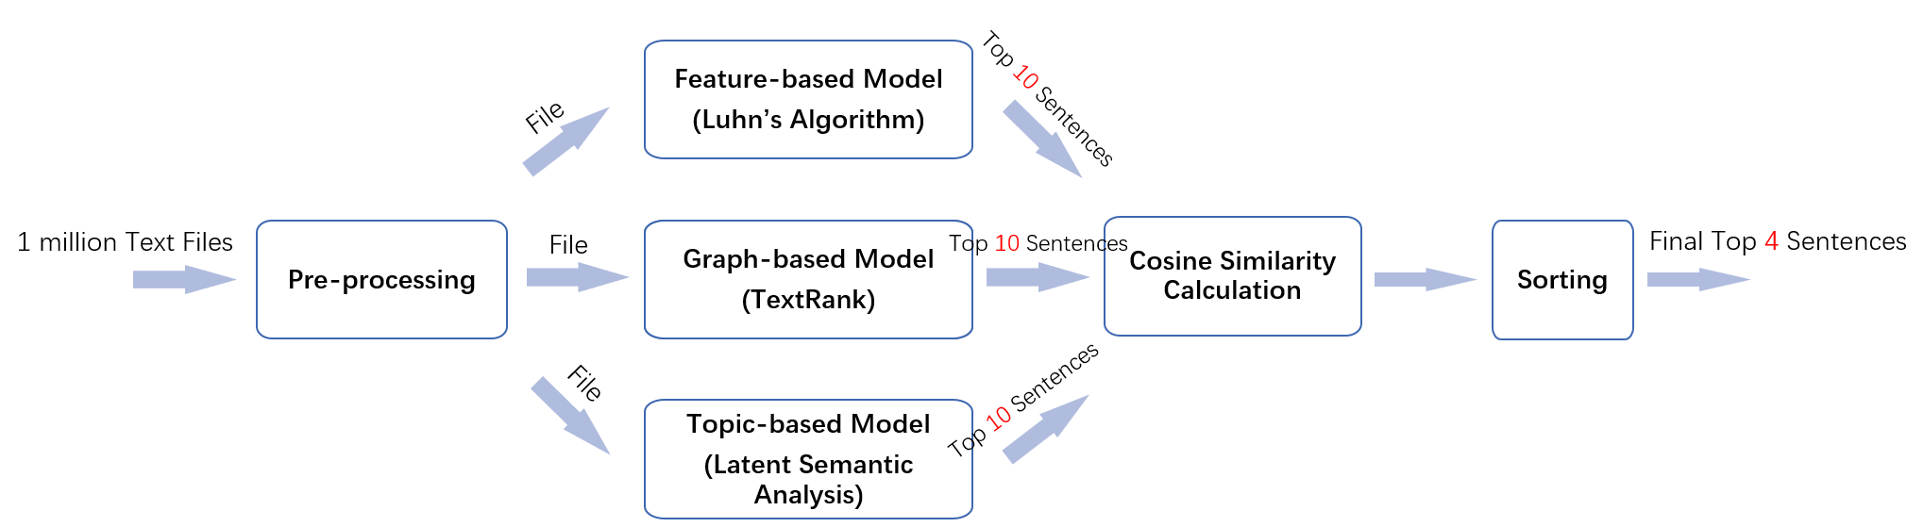
New Model
Number in red is the parameter which can be easily changed.

Slide 25
Named-Entity Recognition (NER)
NER is about locating and classifying named entities in texts in order to recognize places, people, dates, values, organizations, etc.
Explored different NER packages :
Stanford NER [1]
NLTK NE_Chunk [2]
spaCy [3]
4. Blackstone [4]
5. scispaCy [5]
6. Graphbrain [6]
References:
[1] Stanford Named Entity Recognition (NER) and Information Extraction (IE) https://nlp.stanford.edu/ner/
[2] nltk.chunk package, NLTK 3.4.5 documentation https://www.nltk.org/api/nltk.chunk.html
[3] spaCy: Industrial-Strength Natural Language Processing https://spacy.io/
[4] Blackstone: Model for NLP on unstructured legal text https://spacy.io/universe/project/blackstone
[5] scispaCy: Models for scientific/biomedical documents https://spacy.io/universe/project/scispacy
[6] Graphbrain: Automated meaning extraction and text understanding https://spacy.io/universe/project/graphbrain

Slide 26

Named-Entity Recognition (NER)
NER is about locating and classifying named entities in texts in order to recognize places, people, dates, values, organizations, etc.
Explored different NER packages :
Stanford NER [1]
NLTK NE_Chunk [2]
spaCy [3]
4. Blackstone [4]
5. scispaCy [5]
6. Graphbrain [6]
References:
[1] Stanford Named Entity Recognition (NER) and Information Extraction (IE) https://nlp.stanford.edu/ner/
[2] nltk.chunk package, NLTK 3.4.5 documentation https://www.nltk.org/api/nltk.chunk.html
[3] spaCy: Industrial-Strength Natural Language Processing https://spacy.io/
[4] Blackstone: Model for NLP on unstructured legal text https://spacy.io/universe/project/blackstone
[5] scispaCy: Models for scientific/biomedical documents https://spacy.io/universe/project/scispacy
[6] Graphbrain: Automated meaning extraction and text understanding https://spacy.io/universe/project/graphbrain

Slide 27
Named-Entity Recognition (NER)
spaCy provided the best results
spaCy is used for Named-Entity Recognition on the entire Tobacco dataset.

Slide 28
spaCy
Example
Original Sentence:
The witness, senior vice-president and controller at R. J. Reynolds Tobacco Holding Inc., was deposed by the plaintiffs. He described the financial status of the holding company and its economic activities. He indicated that industry changes, corporate changes, market changes, structural changes, and some legal developments have all had an adverse effect on the profitability of the company. The witness also noted that advertising and promotion restrictions placed on them in 1998 by the Master Settlement Agreement had caused a drop in sales volume. He said that punitive damage awards would have a devastating effect on the company, although he declined to say whether bankruptcy was being considered.
Type: ORG, Value: R. J. Reynolds Tobacco Holding Inc.
Type: DATE, Value: 1998
Type: LAW, Value: the Master Settlement Agreement
Extracted Entities

Slide 29
spaCy
Example
Original Sentence:
The witness, senior vice-president and controller at R. J. Reynolds Tobacco Holding Inc., was deposed by the plaintiffs. He described the financial status of the holding company and its economic activities. He indicated that industry changes, corporate changes, market changes, structural changes, and some legal developments have all had an adverse effect on the profitability of the company. The witness also noted that advertising and promotion restrictions placed on them in 1998 by the Master Settlement Agreement had caused a drop in sales volume. He said that punitive damage awards would have a devastating effect on the company, although he declined to say whether bankruptcy was being considered.
Type: ORG, Value: R. J. Reynolds Tobacco Holding Inc. ✔
Type: DATE, Value: 1998 ✔
Type: LAW, Value: the Master Settlement Agreement ✔
Extracted Entities

Slide 30
spaCy
Example
Original Sentence:
The witness, Director of Marketing Research at Philip Morris, was deposed by the plaintiffs. He reviewed his previous depositions and trail testimony, as well as the contract work that he has done for Philip Morris. He explained that the contract work consisted of showing advertising or packaging and obtaining information on consumer reactions. He reviewed the organizational structure of the Marketing and Research department of Philip Morris. The witness listed the various companies from which Philip Morris obtained consumer information. He maintained that Philip Morris only conducted studies on people over the age of 18. He explained the importance of having highly reliable information about legal age smokers in order to accurately project future industry sales and brand sales. He described Philip Morris' use of publicly available information and studies on smoking behavior. He commented on surveys in which adults were asked about their age of smoking initiation.; Roper
Extracted Entities
Type: ORG, Value: Marketing Research
Type: ORG, Value: Philip Morris
Type: ORG, Value: Philip Morris
Type: ORG, Value: the Marketing and Research
Type: ORG, Value: Philip Morris
Type: ORG, Value: Philip Morris
Type: ORG, Value: Philip Morris
Type: DATE, Value: the age of 18
Type: ORG, Value: Philip Morris'
Type: PERSON, Value: Roper

Slide 31
spaCy
Example
Original Sentence:
The witness, Director of Marketing Research at Philip Morris, was deposed by the plaintiffs. He reviewed his previous depositions and trail testimony, as well as the contract work that he has done for Philip Morris. He explained that the contract work consisted of showing advertising or packaging and obtaining information on consumer reactions. He reviewed the organizational structure of the Marketing and Research department of Philip Morris. The witness listed the various companies from which Philip Morris obtained consumer information. He maintained that Philip Morris only conducted studies on people over the age of 18. He explained the importance of having highly reliable information about legal age smokers in order to accurately project future industry sales and brand sales. He described Philip Morris' use of publicly available information and studies on smoking behavior. He commented on surveys in which adults were asked about their age of smoking initiation.; Roper
Extracted Entities
Type: ORG, Value: Marketing Research ✔
Type: ORG, Value: Philip Morris ✔
Type: ORG, Value: Philip Morris ✔
Type: ORG, Value: the Marketing and Research ✔
Type: ORG, Value: Philip Morris ✔
Type: ORG, Value: Philip Morris ✔
Type: ORG, Value: Philip Morris ✔
Type: DATE, Value: the age of 18 ✔
Type: ORG, Value: Philip Morris' ✔
Type: PERSON, Value: Roper ✔

Slide 32
spaCy Models
en_core_web_sm 11 MB
en_core_web_md 91 MB
en_core_web_lg 789 MB
en_trf_bertbaseuncased_lg (Google & Hugging Face) 387 MB
en_trf_robertabase_lg (Facebook & Hugging Face) 278 MB
en_trf_distilbertbaseuncased_lg (Hugging Face) 233 MB
en_trf_xlnetbasecased_lg (CMU & Google Brain) 413 MB
Notes:
Sm = 11 MB
Lg = 789 MB

Slide 33
NER System Architecture
Unit Testing
Pre-processing + filename extraction
Run NER model (spaCy)
Output by filename
Automated Process
CEPH

Slide 34
NER Automation
Scripts for automation of NER on tobacco dataset
Automation has been performed on a sample dataset on local machine.
Results of NER is stored in a text file for ingestion by ELS team.
Kev value pairs of NER

Slide 35
Example: Document ID: jtvf0005
Attendance at PR meeting September 10, 1958; James P. Richards Robert K. He~jnann 0. D. Campbell 6ene L. Cooper W. S. Cutchins Margaret Carson H. C. Robinson Jr. Dan Provost James C. Bowling Jokm Scott Fones Rex Lardner John Jones Richard W. Darrow Carl C. Thompson Leonard S. Zatm Kenneth L. Austin D7alco'-m Jo'nnson W. T. Hoyt The Tobacco Institute, Inc, The Amer:can Tobacco Company Braun and Company, Inc. Braun and Company, Inc. Brown and Williamson Tobacco Corp. M. Carson, Inc. Liggett & Myers Tobacco Company D:cCann-Erickson, Inc. Philip Morris, Inc. Benjamin Sonnenberg Sidney J. Wain, Inc. Sidney J. Wain, Inc. Hill end Hnowlton, Inc. F.111 and Knowlton, Inc. Hill and Knowlton, Inc. Hil'_ and Knowlton, Inc. Hi1= and Kaowlton, Inc. Tobacco Industry Research Conmittee

Slide 36
Example: Document ID: jtvf0005 - NER results
jtvf0005.txt:
[('DATE', September 10, 1958), ('PERSON', James P. Richards), ('PERSON', Robert K.), ('NORP', D.), ('ORG', Campbell), ('PERSON', James C. Bowling), ('PERSON', John Jones Richard W. Darrow), ('PERSON', Carl C. Thompson), ('ORG', The Tobacco Institute), ('PERSON', Inc), ('ORG', The Amer:can Tobacco Company Braun and Company), ('PERSON', M. Carson), ('ORG', Liggett & Myers Tobacco Company D), ('ORG', cCann-Erickson), ('ORG', Philip Morris), ('PERSON', Benjamin Sonnenberg Sidney J. Wain), ('PERSON', Sidney J. Wain), ('ORG', Inc. Hill end), ('GPE', Hnowlton), ('ORG', Inc. F.111), ('GPE', Knowlton), ('ORG', Inc. Hill), ('GPE', Knowlton), ('ORG', Inc. Hil'), ('WORK_OF_ART', _ and Knowlton, Inc. Hi1=), ('GPE', Kaowlton)]

Slide 37
Sentiment Analysis
Flair [1]
Twitter Emotion Recognition [2]
Empath [3]
SenticNet [4]
[1] Flair: Pooled Contextualized Embeddings for Named Entity Recognition, https://github.com/zalandoresearch/flair
[2] Twitter Emotion Recognition, https://github.com/nikicc/twitter-emotion-recognition
[3] Empath: Understanding Topic Signals in Large-Scale Text, https://hci.stanford.edu/publications/2016/ethan/empath-chi-2016.pdf
[4] SenticNet: Emotion Recognition in Conversations, https://github.com/SenticNet/conv-emotion

Slide 38
Sentiment Analysis
Flair [1]
Twitter Emotion Recognition [2]
Empath [3]
SenticNet [4]
[1] Flair: Pooled Contextualized Embeddings for Named Entity Recognition, https://github.com/zalandoresearch/flair
[2] Twitter Emotion Recognition, https://github.com/nikicc/twitter-emotion-recognition
[3] Empath: Understanding Topic Signals in Large-Scale Text, https://hci.stanford.edu/publications/2016/ethan/empath-chi-2016.pdf
[4] SenticNet: Emotion Recognition in Conversations, https://github.com/SenticNet/conv-emotion

Slide 39
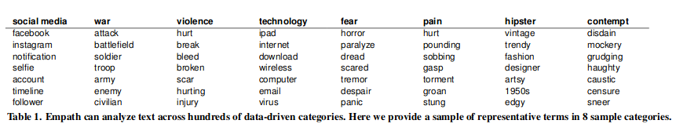
Empath: Categories
Total categories: 194
Total models: 3

Slide 40
Empath: Lexical Categorization
[('achievement', 0.0), ('affection', 0.002036659877800407), ('aggression', 0.002036659877800407), ('air_travel', 0.0), ('alcohol', 0.0), ('ancient', 0.0), ('anger', 0.0), ('animal', 0.0), ('anonymity', 0.0), ('anticipation', 0.0), ('appearance', 0.0), ('art', 0.012219959266802444), ('attractive', 0.0), ('banking', 0.0), ('beach', 0.0), ('beauty', 0.0), ('blue_collar_job', 0.0), ('body', 0.0), ('breaking', 0.0), ('business', 0.0), ('car', 0.0), ('celebration', 0.0), ('cheerfulness', 0.0), ('childish', 0.0), ('children', 0.0), ('cleaning', 0.0), ('clothing', 0.0), ('cold', 0.0), ('college', 0.006109979633401222), ('communication', 0.008146639511201629), ('competing', 0.0), ('computer', 0.006109979633401222), ('confusion', 0.0), ('contentment', 0.002036659877800407), ('cooking', 0.0), ('crime', 0.0), ('dance', 0.002036659877800407), ('death', 0.0), ('deception', 0.0), ('disappointment', 0.0), ('disgust', 0.0), ('dispute', 0.004073319755600814), ('divine', 0.0), ('domestic_work', 0.0), ('dominant_heirarchical', 0.0), ('dominant_personality', 0.0), ('driving', 0.0), ('eating', 0.0), ('economics', 0.002036659877800407), ('emotional', 0.0), ('envy', 0.0), ('exasperation', 0.0), ('exercise', 0.004073319755600814), ('exotic', 0.0), ('fabric', 0.0), ('family', 0.0), ('farming', 0.0), ('fashion', 0.0), ('fear', 0.004073319755600814), ('feminine', 0.0), ('fight', 0.006109979633401222), ('fire', 0.0), ('friends', 0.002036659877800407), ('fun', 0.0), ('furniture', 0.0), ('gain', 0.002036659877800407), ('giving', 0.0), ('government', 0.0), ('hate', 0.002036659877800407), ('healing', 0.006109979633401222), ('health', 0.0), ('hearing', 0.0), ('help', 0.004073319755600814), ('heroic', 0.004073319755600814), ('hiking', 0.0), ('hipster', 0.006109979633401222), ('home', 0.0), ('horror', 0.0), ('hygiene', 0.0), ('independence', 0.002036659877800407), ('injury', 0.0), ('internet', 0.006109979633401222), ('irritability', 0.0), ('journalism', 0.002036659877800407), ('joy', 0.002036659877800407), ('kill', 0.0), ('law', 0.0), ('leader', 0.0), ('legend', 0.0), ('leisure', 0.0), ('liquid', 0.0), ('listen', 0.002036659877800407), ('love', 0.002036659877800407), ('lust', 0.002036659877800407), ('magic', 0.0), ('masculine', 0.0), ('medical_emergency', 0.0), ('medieval', 0.0), ('meeting', 0.018329938900203666), ('messaging', 0.0), ('military', 0.004073319755600814), ('money', 0.002036659877800407), ('monster', 0.0), ('morning', 0.0), ('movement', 0.008146639511201629), ('music', 0.002036659877800407), ('musical', 0.002036659877800407), ('negative_emotion', 0.0), ('neglect', 0.0), ('negotiate', 0.0), ('nervousness', 0.002036659877800407), ('night', 0.0), ('noise', 0.0), ('occupation', 0.0), ('ocean', 0.0), ('office', 0.0), ('optimism', 0.008146639511201629), ('order', 0.0), ('pain', 0.002036659877800407), ('party', 0.0), ('payment', 0.002036659877800407), ('pet', 0.0), ('philosophy', 0.004073319755600814), ('phone', 0.0), ('plant', 0.0), ('play', 0.0), ('politeness', 0.002036659877800407), ('politics', 0.0), ('poor', 0.0), ('positive_emotion', 0.010183299389002037), ('power', 0.004073319755600814), ('pride', 0.0), ('prison', 0.0), ('programming', 0.006109979633401222), ('rage', 0.0), ('reading', 0.008146639511201629), ('real_estate', 0.0), ('religion', 0.0), ('restaurant', 0.0), ('ridicule', 0.0), ('royalty', 0.0), ('rural', 0.0), ('sadness', 0.002036659877800407), ('sailing', 0.0), ('school', 0.014256619144602852), ('science', 0.006109979633401222), ('sexual', 0.0), ('shame', 0.002036659877800407), ('shape_and_size', 0.002036659877800407), ('ship', 0.0), ('shopping', 0.0), ('sleep', 0.0), ('smell', 0.0), ('social_media', 0.016293279022403257), ('sound', 0.0), ('speaking', 0.008146639511201629), ('sports', 0.0), ('stealing', 0.0), ('strength', 0.002036659877800407), ('suffering', 0.002036659877800407), ('superhero', 0.0), ('surprise', 0.0), ('swearing_terms', 0.0), ('swimming', 0.0), ('sympathy', 0.004073319755600814), ('technology', 0.006109979633401222), ('terrorism', 0.0), ('timidity', 0.0), ('tool', 0.0), ('torment', 0.0), ('tourism', 0.0), ('toy', 0.0), ('traveling', 0.0), ('trust', 0.002036659877800407), ('ugliness', 0.0), ('urban', 0.0), ('vacation', 0.0), ('valuable', 0.002036659877800407), ('vehicle', 0.0), ('violence', 0.0), ('war', 0.0), ('warmth', 0.0), ('water', 0.0), ('weakness', 0.0), ('wealthy', 0.004073319755600814), ('weapon', 0.0), ('weather', 0.0), ('wedding', 0.0), ('white_collar_job', 0.0), ('work', 0.0), ('worship', 0.0), ('writing', 0.002036659877800407), ('youth', 0.0), ('zest', 0.002036659877800407)]

Slide 41
Empath: Lexical Categorization
[('meeting', 0.018329938900203666), ('social_media', 0.016293279022403257), ('school', 0.014256619144602852), ('art', 0.012219959266802444), ('positive_emotion', 0.010183299389002037), ('optimism', 0.008146639511201629), ('reading', 0.008146639511201629), ('movement', 0.008146639511201629), ('communication', 0.008146639511201629), ('speaking', 0.008146639511201629), ('computer', 0.006109979633401222), ('college', 0.006109979633401222), ('hipster', 0.006109979633401222), ('internet', 0.006109979633401222), ('healing', 0.006109979633401222), ('programming', 0.006109979633401222), ('fight', 0.006109979633401222), ('science', 0.006109979633401222), ('technology', 0.006109979633401222), ('help', 0.004073319755600814), ('dispute', 0.004073319755600814), ('wealthy', 0.004073319755600814), ('exercise', 0.004073319755600814), ('fear', 0.004073319755600814), ('heroic', 0.004073319755600814), ('military', 0.004073319755600814), ('sympathy', 0.004073319755600814), ('power', 0.004073319755600814), ('philosophy', 0.004073319755600814), ('dance', 0.002036659877800407), ('money', 0.002036659877800407), ('hate', 0.002036659877800407), ('aggression', 0.002036659877800407), ('nervousness', 0.002036659877800407), ('suffering', 0.002036659877800407), ('journalism', 0.002036659877800407), ('independence', 0.002036659877800407), ('zest', 0.002036659877800407), ('love', 0.002036659877800407), ('trust', 0.002036659877800407), ('music', 0.002036659877800407), ('politeness', 0.002036659877800407), ('listen', 0.002036659877800407), ('gain', 0.002036659877800407), ('valuable', 0.002036659877800407), ('sadness', 0.002036659877800407), ('joy', 0.002036659877800407), ('affection', 0.002036659877800407), ('lust', 0.002036659877800407), ('shame', 0.002036659877800407), ('economics', 0.002036659877800407), ('strength', 0.002036659877800407), ('shape_and_size', 0.002036659877800407), ('pain', 0.002036659877800407), ('friends', 0.002036659877800407), ('payment', 0.002036659877800407), ('contentment', 0.002036659877800407), ('writing', 0.002036659877800407), ('musical', 0.002036659877800407), ('office', 0.0), ('wedding', 0.0), ('domestic_work', 0.0), ('sleep', 0.0), ('medical_emergency', 0.0), ('cold', 0.0), ('cheerfulness', 0.0), ('occupation', 0.0), ('envy', 0.0), ('anticipation', 0.0), ('family', 0.0), ('vacation', 0.0), ('crime', 0.0), ('attractive', 0.0), ('masculine', 0.0), ('prison', 0.0), ('health', 0.0), ('pride', 0.0), ('government', 0.0), ('weakness', 0.0), ('horror', 0.0), ('swearing_terms', 0.0), ('leisure', 0.0), ('royalty', 0.0), ('tourism', 0.0), ('furniture', 0.0), ('magic', 0.0), ('beach', 0.0), ('morning', 0.0), ('banking', 0.0), ('night', 0.0), ('kill', 0.0), ('blue_collar_job', 0.0), ('ridicule', 0.0), ('play', 0.0), ('stealing', 0.0), ('real_estate', 0.0), ('home', 0.0), ('divine', 0.0), ('sexual', 0.0), ('irritability', 0.0), ('superhero', 0.0), ('business', 0.0), ('driving', 0.0), ('pet', 0.0), ('childish', 0.0), ('cooking', 0.0), ('exasperation', 0.0), ('religion', 0.0), ('surprise', 0.0), ('worship', 0.0), ('leader', 0.0), ('body', 0.0), ('noise', 0.0), ('eating', 0.0), ('medieval', 0.0), ('confusion', 0.0), ('water', 0.0), ('sports', 0.0), ('death', 0.0), ('legend', 0.0), ('celebration', 0.0), ('restaurant', 0.0), ('violence', 0.0), ('dominant_heirarchical', 0.0), ('neglect', 0.0), ('swimming', 0.0), ('exotic', 0.0), ('hiking', 0.0), ('hearing', 0.0), ('order', 0.0), ('hygiene', 0.0), ('weather', 0.0), ('anonymity', 0.0), ('ancient', 0.0), ('deception', 0.0), ('fabric', 0.0), ('air_travel', 0.0), ('dominant_personality', 0.0), ('vehicle', 0.0), ('toy', 0.0), ('farming', 0.0), ('war', 0.0), ('urban', 0.0), ('shopping', 0.0), ('disgust', 0.0), ('fire', 0.0), ('tool', 0.0), ('phone', 0.0), ('sound', 0.0), ('injury', 0.0), ('sailing', 0.0), ('rage', 0.0), ('work', 0.0), ('appearance', 0.0), ('warmth', 0.0), ('youth', 0.0), ('fun', 0.0), ('emotional', 0.0), ('traveling', 0.0), ('fashion', 0.0), ('ugliness', 0.0), ('torment', 0.0), ('anger', 0.0), ('politics', 0.0), ('ship', 0.0), ('clothing', 0.0), ('car', 0.0), ('breaking', 0.0), ('white_collar_job', 0.0), ('animal', 0.0), ('party', 0.0), ('terrorism', 0.0), ('smell', 0.0), ('disappointment', 0.0), ('poor', 0.0), ('plant', 0.0), ('beauty', 0.0), ('timidity', 0.0), ('negotiate', 0.0), ('negative_emotion', 0.0), ('cleaning', 0.0), ('messaging', 0.0), ('competing', 0.0), ('law', 0.0), ('achievement', 0.0), ('alcohol', 0.0), ('liquid', 0.0), ('feminine', 0.0), ('weapon', 0.0), ('children', 0.0), ('monster', 0.0), ('ocean', 0.0), ('giving', 0.0), ('rural', 0.0)]

Slide 42
Empath: Lexical Categorization
[('meeting', 0.018329938900203666), ('social_media', 0.016293279022403257), ('school', 0.014256619144602852), ('art', 0.012219959266802444), ('positive_emotion', 0.010183299389002037), ('optimism', 0.008146639511201629), ('reading', 0.008146639511201629), ('movement', 0.008146639511201629), ('communication', 0.008146639511201629), ('speaking', 0.008146639511201629), ('computer', 0.006109979633401222), ('college', 0.006109979633401222), ('hipster', 0.006109979633401222), ('internet', 0.006109979633401222), ('healing', 0.006109979633401222), ('programming', 0.006109979633401222), ('fight', 0.006109979633401222), ('science', 0.006109979633401222), ('technology', 0.006109979633401222), ('help', 0.004073319755600814), ('dispute', 0.004073319755600814), ('wealthy', 0.004073319755600814), ('exercise', 0.004073319755600814), ('fear', 0.004073319755600814), ('heroic', 0.004073319755600814), ('military', 0.004073319755600814), ('sympathy', 0.004073319755600814), ('power', 0.004073319755600814), ('philosophy', 0.004073319755600814), ('dance', 0.002036659877800407), ('money', 0.002036659877800407), ('hate', 0.002036659877800407), ('aggression', 0.002036659877800407), ('nervousness', 0.002036659877800407), ('suffering', 0.002036659877800407), ('journalism', 0.002036659877800407), ('independence', 0.002036659877800407), ('zest', 0.002036659877800407), ('love', 0.002036659877800407), ('trust', 0.002036659877800407), ('music', 0.002036659877800407), ('politeness', 0.002036659877800407), ('listen', 0.002036659877800407), ('gain', 0.002036659877800407), ('valuable', 0.002036659877800407), ('sadness', 0.002036659877800407), ('joy', 0.002036659877800407), ('affection', 0.002036659877800407), ('lust', 0.002036659877800407), ('shame', 0.002036659877800407), ('economics', 0.002036659877800407), ('strength', 0.002036659877800407), ('shape_and_size', 0.002036659877800407), ('pain', 0.002036659877800407), ('friends', 0.002036659877800407), ('payment', 0.002036659877800407), ('contentment', 0.002036659877800407), ('writing', 0.002036659877800407), ('musical', 0.002036659877800407)]
How many categories to consider?
Total categories: 194
Total models: 3

Slide 43
Basic Emotions
Ekman's six basic emotions [1]
Plutchik's eight basic emotions [2]
Profile of Mood States (POMS) six mood states [3]
References:
[1] Ekman, Paul. "Basic emotions." Handbook of cognition and emotion 98.45-60 (1999): 16.
[2] Plutchik, Robert. "Emotions: A general psychoevolutionary theory." Approaches to emotion 1984 (1984): 197-219.
[3] Curran, Shelly L., Michael A. Andrykowski, and Jamie L. Studts. "Short form of the profile of mood states (POMS-SF): psychometric information." Psychological assessment 7.1 (1995): 80.

Slide 44
Six basic emotions
Love
Hate
Joy
Fear
Surprise
Envy

Slide 45
Sentiment Analysis System Architecture
Unit Testing
Pre-processing + filename extraction
Run Sentiment Analysis (empath)
Select sentiment categories
Select the highest sentiments
Output by filename
Automated Process
CEPH

Slide 46
Recommender System
System that is capable of predicting the future preference of a set of items for a user, and recommend the top items.
Implementation details :
Identified a sample dataset of user logs
Implemented content based and collaborative filtering recommendation techniques on this sample dataset
Notes:
packages needed to implement such as sklearn, scikit
We have chosen this sample dataset since our entire system was not completely integrated at that time and we wanted to show how a prototype of implementation

Slide 47
Why this sample dataset ?
Our entire search engine was not completely integrated at that time and we wanted to show a prototype of implementation
The selected dataset is based on real logs and has fields similar to our search logs
SAMPLE DATASET: CI&T's Internal Communication platform (DeskDrop)[1]
Contains a real sample of 12 months logs (Mar. 2016 - Feb. 2017) and 73k logged users interactions
1140 total users, 2926 documents
Has fields such as Person ID, Content ID, Session ID, Timestamp, etc
[1] https://www.kaggle.com/gspmoreira/articles-sharing-reading-from-cit-deskdrop

Slide 48
Content based recommendation
Recommends items that are similar to those that a user liked in the past
STEPS:
Build user profile by constructing item profile for all the items the user has interacted with using TF-IDF.
Get items which are similar to the user profile - Cosine Similarity between user profile and TF-IDF Matrix
Sort the similar items and recommend items to the user.
Evaluation result of Content based filtering :
Recall@5 = 0.4145
Recall@10 = 0.5241

Slide 49
Collaborative Filtering Model
User-based Approach: Uses memory of previous users interactions to compute similarity based on items they have interacted with.
Item-based Approach: Compute item similarities based on users that have interacted with them.
Matrix Factorization:
User-item matrix is compressed to low-dimensional representation in terms of latent factors.
SVD (Singular value decomposition) Latent factor model is used.
Evaluation Result of Collaborative Filtering
Recall@5 = 33.4%
Recall@10 = 46.81%

Slide 50
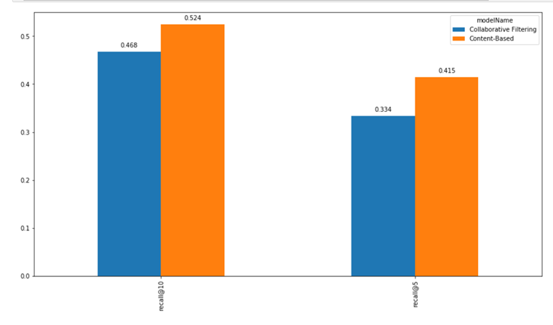
Performance comparison:
Content based : Clustering ✔
Collaborative filtering : User logs
Notes:
Collaborative filtering is based on user logs and requires user search history

Slide 51
User Logs: What we have currently
ELS Logs:
{ "type": "index_search_slowlog",
"timestamp": "2019-12-04T01:09:09,002Z",
"level": "WARN",
"component": "i.s.s.query",
"cluster.name": "elasticsearch",
"node.name": "elasticsearch-master-0",
"message": "[etd_metadata][0]",
"took": "930.9ms",
"took_millis": "930",
"total_hits": "19 hits",
"search_type": "QUERY_THEN_FETCH",
"total_shards": "1",
"source": "{\"query\"
:{\"term\":{\"title-none\":{\"value\":\"data\",\"boost\":1.0}}}}",
"cluster.uuid": "M7gJSQVkSYi3THDYCTvIew",
"node.id": "nXkX9qONS2y0g5WB8NGezQ"}
FEK Logs :
{
"status": 200,
"message": "Success",
"data": {
"user": {
"username": "Eddy",
"email": "no email given"
},
"activity": {
"url": "http://localhost:9200/etd_metadata/_msearch?",
"search_text": "title-none: Immersion",
"filters": {}
},
"dataset": "etd",
"time": "2019-11-08 19:26:49.530631",
"ip": "127.0.0.1"
}
}

Slide 52
Comparison between log fields
User logs from sample datasets:
User Log Fields obtained from FEK and ELS logs:
Event Type { ‘View’ : 1.0, ‘Like’ : 2.0, ‘Bookmark’:2.5, ‘Follow’: 3.0, ‘Comment Created’: 4.0} | Content ID | Person ID | Session ID
User ID | Search Query
Missing Field:
Document ID/ List of Documents viewed per query

Slide 53
Recommender System: Future scope
Add ‘document viewed’ field in FEK/ELS metadata
Collect significant number of user logs
Create user item matrix
Recommend items tailored to the user’s preference
Notes:
We need a sample user log file from ELS team with the required fields so that we can create a dataset using these fields and run our

Slide 54
Thank you

