Slide 1
CS 5984: Team 5 Final Presentation
New Zealand Earthquakes
Edward A. Fox
Virginia Tech, Blacksburg, VA, 24061
Thanks to NSF: IIS-1619028
November 29, 2018
Alex Bochel, Jun Lee, Rohit Kumar, William Edmisten

Slide 2
Overview
Approach and Implementation
Evaluation and Assessment
Final Results

Slide 3
High Level Approach
Technologies
  Hadoop
  NLTK
  PySpark
  Python 2.7
  Zeppelin
Division of work
  Per task
  Gold summary
  Report

Slide 4
Task 1 - Most Frequent Important Words
New | town | would | ground | Key
earthquake | Monday | 19 | areas | new
Zealand | hit | Sep | Google | road
quake | 2016 | Twitter | country | Read
said | Share | city | reports | hours
Kaikoura | buildings | 14 | 3 | large
people | read | reported | use | news
Christchurch | around | may | Zealand's | many
Wellington | 2011 | north | 7.8 | Image
1 | minutes | first | region | km
Notes:
We first used a simple Python script to find the most common words. However, this task required some iterative development, because we ran into problems with noise in the data. Some of this noise contained things like javascript code, website boilerplate, and random punctuation. We tried openNLP and JustText to filter out this noise, which was fairly successful. We also used a rudimentary rule-based classifier to filter out irrelevant documents. This script simply filtered out websites that did not contain the string “quake” along with a relevant location, like “zealand”, “wellington”, or “christchurch”. We also found that some domains polluted the corpus with the same empty boilerplate on every document, so we manually filtered these out, too. This resulted in filtering out around 70% of the documents We also used NLTK’s stop words corpus, augmented with words we found manually, to remove stop words from the most frequent words list. To determine important words, we used PySpark’s TF-IDF function to rank words by their importance. A sample of the results can be seen in this table. We also manually compared these results to the dataset and determined it was fairly accurate.

Slide 5
Task 2 - Wordnet Synsets
Synset('new.a.01') | Synset('christchurch.n.01') | Synset('smitten.s.01')
Synset('fresh.s.04') | Synset('wellington.n.01') | Synset('magnitude.n.01')
Synset('raw.s.12') | Synset('wellington.n.02') | Synset('orderofmagnitude.n.02')
Synset('new.s.04') | Synset('hessian_boot.n.01') | Synset('magnitude.n.03')
Synset('new.s.05') | Synset('one.n.01') | Synset('damage.n.01')
Synset('new.a.06') | Synset('one.s.01')] | Synset('damage.n.02')
Synset('newfangled.s.01') | Synset('island.n.01') | Synset('damage.n.03')
Synset('new.s.08') | Synset('island.n.02') | Synset('price.n.02')
Synset('modern.s.05') | Synset('south.n.01') | Synset('wrong.n.02')
Synset('new.s.10') | Synset('confederacy.n.01') | Synset('damage.v.01')
Synset('new.s.11') | Synset('south.n.03') | Synset('damage.v.02')
Notes:
Once we had a list of most important words, task 2 was relatively simple. We used NLTK’s WordNet Synset library to get the synsets for each of the most important words from task 1. The top few words were examined manually, and their synsets appear good.

Slide 6
Task 3: Nouns
New | time | Google
earthquake | area | country
Zealand | water | reports
quake | miles | buildings
Kaikoura | aftershocks | residents
people | Facebook | region
Christchurch | coast | Defence
Wellington | Monday | years
Island | Twitter | morning
South | city | ZEALAND
damage | November | Key
tsunami | News | road
town | North

Slide 7
Task 3: Verbs
struck | email | see
hit | following | expected
read | warning | went
damaged | closed | set
reported | told | metres
cut | stranded | make
caused | east | collapsed
left | help | reserved
felt | affected | recorded
killed | died | used
evacuated | confirmed | affected
km | triggered | move
know | work | took

Slide 8
Task 4: Discriminating features
We applied lemmatization and stemming to the most frequent words that we got from our task 1 to get discriminating feature words
new | zealand | earthquake | kaikoura | people
read | share | sep | wellington | christchurch
news | south | island | 2018 | image
damage | minutes | tsunami | facebook | twitter
magnitude | water | monday | minute | caption
Notes:
After applying stemming and lemmatization to the most important frequent words we got the most important Discriminating features. With these results we are able to build a rule based classification for getting relevant documents.

Slide 9
Task 5: Frequent Named Entities
('GPE', u'New') | ('ORGANIZATION', u'NEWS')
('PERSON', u'Zealand') | ('ORGANIZATION', u'SHARE')
('PERSON', u'Kaikoura South') | ('ORGANIZATION', u'USGS')
('ORGANIZATION', u'Christchurch') | ('PERSON', u'Tsunami')
('PERSON', u'Wellington') | ('PERSON', u'March')
('PERSON', u'Island Facebook') | ('ORGANIZATION', u'GeoNet')
('PERSON', u'Twitter') | ('GPE', u'Australian')
('GPE', u'North') | ('PERSON', u'Survey Government')

Slide 10
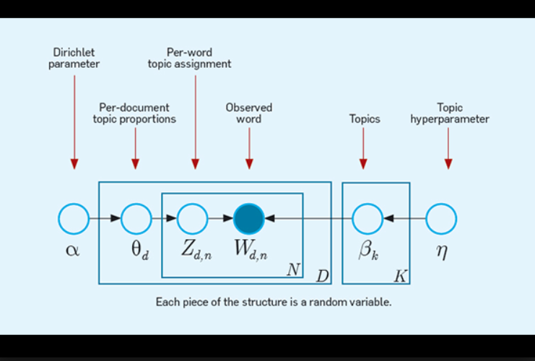
Task 6: A set of important topics

Slide 11
Task 6: A set of important topics
We initially used LDA to generate important topics but it is not giving consistent results for every run due to its unsupervised learning.
We then found an alternate method to LDA which is LSA which works similarly and gives consistent and understandable results.

Slide 12
Task 6: A set of important topics
(1, u'0.504*"volcano" + 0.222*"nyamuragira" + 0.183*"volcanoes" + 0.153*"kermadec" + 0.147*"volcanodiscovery"')
(2, u'0.213*"est" + -0.212*";" + -0.195*"1931-02-02" + -0.195*"176.9" + -0.195*"-39.5"')
(3, u'0.300*"est" + 0.155*"id" + 0.127*"kilometers" + 0.086*")" + -0.085*"school"')
(4, u'-0.237*"cows" + 0.179*"she" + 0.158*"her" + -0.151*"cattle" + -0.145*"grass"')
(5, u'0.131*"cattle" + 0.126*"cows" + 0.116*"grass" + 0.110*"she" + 0.108*"million"')
(6, u'0.118*"cattle" + -0.117*"kaikoura" + 0.100*"million" + -0.097*"hide" + 0.095*"son"')
(7, u'0.203*"cattle" + 0.164*"million" + -0.131*"abc" + 0.108*"outnumber" + 0.105*"ravines"')
(8, u'0.118*"son" + 0.116*"usar" + 0.112*"school" + 0.107*"taitapanui" + 0.097*"rescue"')
(9, u'-0.258*"hide" + -0.205*"shakes" + 0.192*"cows" + -0.153*"caption" + -0.148*"photos"')
(10, u'-0.128*"photo" + 0.118*"spared" + 0.117*"largely" + 0.106*"cracked" + -0.102*"kilometres"')
Notes:
We started with LDA but due to inconsistent results every time which is due to unsupervised learning. We moved to LSA to get a consistent results and understandable.

Slide 13
Task 7: Sentence Clustering
HUGE 5.5 magnitude earthquake has hit central New Zealand just weeks after the country was rocked by two massive quakes. GEONET The quake hit central New Zealand at around 3.30pm local time More than 7,000 people claim the earth beneath them shook as the quake hit the town of Kaikoura, the same area that was hit by a 7.8 magnitude earthquake last month. Local people have reported feeling aftershocks following the main earthquake, which struck at around 3.30pm local time (2.30am GMT). TWITTER New Zealanders took to social media after feeling the tremors The earthquake was felt in major cities including the capital Wellington and even Christchurch, almost 500km away.

Slide 14
Task 8-9: Template Based Summary
0 - day | 4 - time | 7 - epicenter | 10 - aftershock
1 - month | 5 - magnitude | 8 - deaths | 11 - tsunami
2 - year | 6 - location | 9 - injuries | 12 - landslide
“On {0} {1}, {2} at {4}, a earthquake with magnitude of {5} struck {6}.
The epicenter of the earthquake was located at {7}. The earthquake caused
number of casualties, reported to be {8} deaths and {9} injuries.
There {10} aftershocks reported, and there {11} tsunami caused by the
earthquake reported. Reports mentioned there {12} landslides caused by this earthquake.”

Slide 15
Task 9: Template Based Summary
On {November, 2016} at {11:02}, a earthquake with magnitude of {7.5} struck {Wellington}. The epicenter of the earthquake was located at {Wellington}. The earthquake caused number of casualties, reported to be {185} deaths and {20} injuries. There {were} aftershocks reported, and there {was} tsunami caused by the earthquake reported. Reports mentioned there {were} landslides caused by this earthquake.

Slide 16
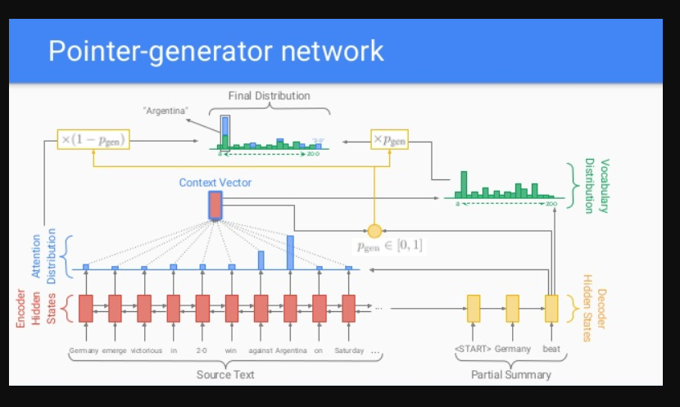
Task 10: Abstractive summary

Slide 17
Task 10: Abstractive summary
We used pointer generator model (PGM) to get abstractive summaries using deep learning algorithm.
Steps we have followed for generating abstractive summary
Applied PGM on all the documents and got summaries on each document we had.
And applied KMeans to cluster documents that are similar.
We took one document from each cluster which is close to cluster centroid which represents most of the cluster and appended these documents to generate abstractive summary.

Slide 18
Task 10: Abstractive summary
the earthquake hit at 4.40 am on friday , about 80 miles -lrb- 130 km -rrb- north-east of the east cape community of te araroa .
the 7.5-magnitude earthquake in the south island killed at least two people and triggered a tsunami alert for the entire east coast . seven aftershocks have been registered .
civil defence evacuated low-lying coastal areas after a tsunami warning was issued.
mountjoy suspects that the unique nature of the earthquake is behind the eerie exposure of the sea bed in the coastal town of kaikoura .
the effects can be seen all over kaikoura , with some areas rising a metre above the ground .
earthquake geologist nicola litchfield from gns science told michael daly from stuff that the uplift would have happened during the 90 seconds to 2 minutes the quake .
a state of emergency was declared in the town of kaikoura , a whale-watching destination and home to 2,000 people that has been completely cut off .
Notes:
We applied Pointer generator model on each document and got summaries on each document and applied KMeans on the sentences to get similar sentences and got one file from each cluster which is more close to cluster and appended all these files to get an abstractive summary.

Slide 19
Questions?

