Slide 1

Sustainability of the Wind Turbine Blade Manufacturing Process: A Bio-based Alternative
http://canadianawareness.org/2014/01/metrolinx-wind-turbine-only-producing-9-of-projected-energy/
SEP Collaborative: Achieving a Sustainable Energy Pathway for Wind Turbine Blade Manufacturing¹
University of Massachusetts Lowell
June 2015
¹This project is funded by a grant from the National Science Foundation (NSF) Sustainable Energy Partnership Program

Slide 2
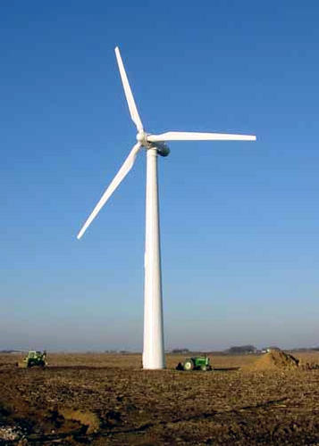
Context
Wind installed capacity will need to increase by an average of 15 GW annually to achieve the 20% wind production goal by 2030 (U.S. DOE, 2008).
Which we estimate could translate into the use of more than 150,000 tons of blade materials per year.
To meet the increasing demand, not only are more blades being manufactured, but also longer blades are being produced.
http://plainswindeis.anl.gov/guide/basics/index.cfm
Notes:
Sources and comments:
See the U.S. Department of Energy’s (July 2008) report: “20% Wind Energy by 2030, Increasing Wind Energy’s Contribution to U.S. Electricity Supply”. A new report by the DOE (Wind Vision, 2015) concludes that such scenario (20% by 2030) is possible under very specific circumstances, such as continue technological innovation and cost reductions. On the other hand, the U.S. Energy Information Administration (EIA) projected much lower wind deployments by 2030. Using one of the EIA projections, the average blade material would be about 14,000 tons per year (instead of 140,000 from DOE). None of those figures include material from existing blades. The point can be made, HOWEVER, that it is still an important issue that needs to be addressed for the sustainability of the wind energy sector and that 14,000 tons per year is a very conservative estimate.
The use of blade materials is estimated based on the assumption that each kW of installed capacity needs about 10 kg of blade material (so 15 GW of installation would use 150,000,000 kg or 150,000 tons of blade material).
The current commercialized larger blade is about 80 meters long (80m Vestas and 75m Siemens). Most of the 100-meters blades are prototypes.

Slide 3

Context
The current stock of blades and the actual manufacturing process use petroleum-based thermoset composites as the primary materials.
Industry does not manufacture blades in a sustainable manner and has no optimal way to recycle them.
Available technologies and key economic constraints result in some undesirable disposal methods as the only feasible options. All of them carry negative health, environmental and economic concerns.
Notes:
Notes:
1. Wind turbine blades are made of thermoset composites material, a resin-matrix material reinforced with carbon, glass or other fibers. In particular, the blades are commonly made from a combination of epoxy resin, a thermosetting polymer produced by a reaction of epichlorohydrin and bisphenol-A, and glass fiber reinforcement, plus other fillers.

Slide 4
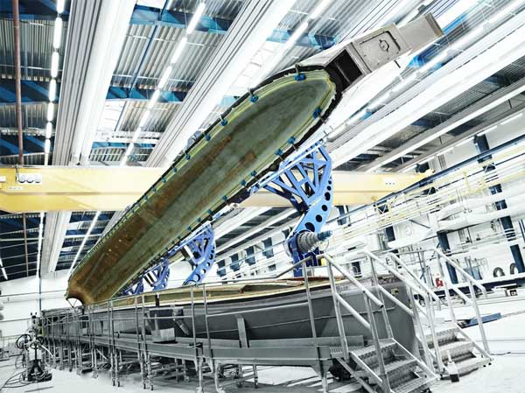
Context The Conventional Manufacturing Process
The wind turbine blades are made from a combination of epoxy resin, glass fiber reinforcement and other fillers.
Once cured, thermoset composites cannot be melted and therefore cannot be reshaped. As a result, any attempt of reshaping the blades risks compromising the properties of the material through damage or destruction of the reinforcing fibers.
Moreover, petroleum-based Epoxy Resin is produced by a reaction of two potentially toxic components:
Bisphenol-A (BPA)
Epichlorohydrin (ECH)

Slide 5

Context The Bio-based Alternative
Current findings indicate that the Epoxidized Linseed Oil (ELO) is a good prospect for the substitution of the petroleum-based resin in the manufacturing process of wind turbine blades.
The Anhydride ELO system has:
Similar hardness
Improved toughness
Lower density vs. traditional amine-cured
It may be more amenable to being reworked due to
their structure, though that remains to be proven.
Linseed Oil and Flax Seeds
http://www.shivorganics.com/castor-oil.html
SUSTAINABILITY OF THE WIND TURBINE BLADE MANUFACTURING PROCESS: A BIO-BASED ALTERNATIVE
Notes:
Sources and comments:
See “Achieving a Sustainable Energy Pathway for Wind Turbine Blade Manufacturing: Summary of Sustainable Resin Technologies” (PPT by Daniel Schmidt and Emmanuelle Reynaud).
Current findings indicate that anhydride-cured, the epoxidized linseed oil-based system has the capacity to give similar hardness, improved toughness, and between 5-10% lower density in the epoxy resin, compared with traditional amine-cured, petroleum-based system.
Reworkability characterizes the capacity of a set material to reorganize itself under heat and pressure, and therefore flow on a macroscopic level. It would give the ability to permanently deform these materials without loss in properties.
“The viscosity (density) of the systems should be lower than those based on conventional epoxies, absolutely. This is a double-edged sword, though, when it comes to composite processing; infusion is faster, but this also makes it easier to squeeze the resin out of the fiber mat - and if there's not enough resin in the fiber mat to hold things together, the composite properties are worse. Basically, we think this is likely to be good, on balance, but it would require some definite process optimization to realize the benefits.” (Dan)

Slide 6
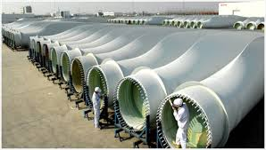
Objective
The main objective of this project is to create an energy pathway for the sustainability of wind energy. Specifically, we want:
To understand the economic, environmental and health implications of the bio-based alternative, compared to the conventional petroleum-based manufacturing process of the wind turbine blades.
To assess the impact of switching to bio-based wind turbine blades manufacturing on job creation, education and skills requirements.
http://www.worldindustrialreporter.com/bayer-polyurethane-infusion-resins-found-suitable-for-wind-turbine-rotor-blades/

Slide 7
Approach to Evaluation
Life Cycle Cost Analysis (LCCA)
Assuming they (bio-based and conventional) have similar performance in terms of energy production, but differ in terms of the health, environmental and economic implications over their life cycle.
A LCCA should tell us the least costly or most cost-effective manufacturing process of the wind turbine blades over their life cycle.
Toxic Use Reduction Analysis (TUR)
Is it truly more environmentally friendly?
We want to measure the impact of changes toward less toxic chemicals and resources conservation.

Slide 8
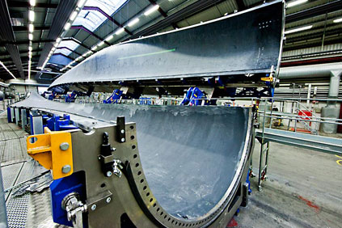
Preliminary Findings
Initial cost
Switching cost (to a bio-based system) is very sensitive to curing temperature.
If the curing temperature is much higher, then new tooling, molds and materials would be needed.
http://www.windpowermonthly.com/article/1109760/close---lms-735-metre-blade
Material costs
Epoxidized linseed oil system seems to be slightly cheaper than conventional epoxy resins.
Petroleum-based epoxy resin raises concern about price volatility and declining supply
Notes:
Notes and sources:
If you want, you can just mention the cost of new tooling and molds. Assuming the cost of new set of tooling is 3,000,000 and the output is 750 blades/per set of tooling, then we could say that the capital investment would be of US$4,000 per blade (for a 40m blade). The cost is based entirely on information from the cost estimator of Sandia. TPI produces bigger blades (47m) and so the cost of their set of tooling is higher (about 8,000 per blade).
We expect a cost reduction of approximately 50% in the epoxy system, or about 9% of the total material cost.

Slide 9
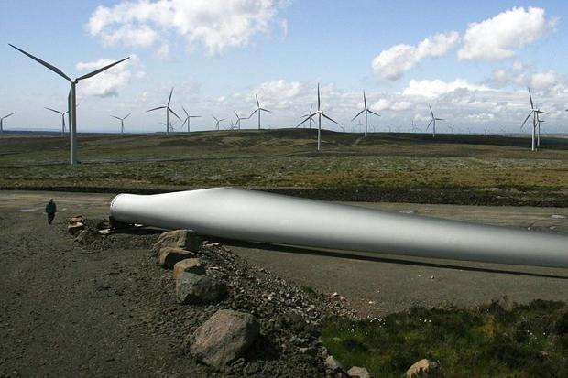
Preliminary Findings
Environmental and Health Aspects
ELO is much safer than conventional: less reactive and more stable at room temperature
Significant concerns about occupational exposure to Bisphenol-A and Epichlorohydrin in the manufacturing process of conventional epoxy resin.
ELO production is a relatively clean, efficient process, with no highly toxic reagents or byproducts involved.
http://www.thetimes.co.uk/tto/news/uk/scotland/article3975567.ece
Other materials found in the blades have not yet been found to be significantly different.
Notes:
Sources and notes:
There is data to support the statement that ELO is less reactive and more stable at room temperature. Source: Daniel Smidth
“Exposure to bisphenol-A is a known issue among workers who work with conventional epoxies, and while not everyone agrees as to how harmful this is, bisphenol A is getting a lot of scrutiny over its potential health effects” (Dan). All the papers I’ve read about occupational safety of Bisphenol-A have found harmful effects, but they are not conclusive and argue that more research is needed. However, I think it is pretty safe to argue that it would definitely be more harmful than bio-derived epoxies in the manufacturing process, specially over the long-term.
3. None of the hardeners - neither the amines nor the anhydrides- are particularly nice, comparatively speaking (Dan).

Slide 10
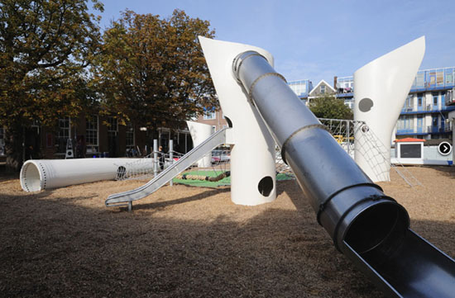
Preliminary Findings
Recycling
Current disposal practices are suboptimal and carries negative health, environmental and economic concerns. See table in next slide:
A reworkable, bio-based alternative, would allow for optimal recycling, with an efficient recovery of all the materials in the fiber-reinforced plastic.
http://www.treehugger.com/urban-design/recycled-windmill-playground-2012-architecten.html
However, the development of a new recycling industry is challenging due to low value of end product.
Notes:
Notes:
1. The picture is a Recycled Wind Turbine Blade used in a Playground in the Netherlands. The point is that even if we can find other uses for the blades, there are going to be so many blades to be disposed that none of them will cover the whole supply. Therefore, other recycling methods will be still needed.

Slide 11
Existing Disposal Methods and Some of their Environment, Health and Economic Concerns
Disposal method |  | Health and Environment | Economic
Landfill |  | Organic components can release methane and other volatile organic compound that contribute to climate change | Opportunity cost of unrecovered material and concerns of long-term space availability
Thermal Recycling | Incineration with energy and/or material recovery | Pollutant ash after the incineration process, possible emissions of hazardous flue gasses and other pollutant byproducts | Significant energy and machinery requirements to cut and transport the blades before the incineration process
 | Pyrolysis | Emission of environmentally hazardous off-gases | Low market value of resulting fibers
 | Fluidized Bed Combustion | Unknown | Low market value of resulting fibers
Chemical Recycling |  | Environmental impact of using potentially hazardous chemicals | Unknown economic viability
Mechanical Recycling |  | Dust emission during the grinding process of glass and carbon fiber thermoset composites | Low market value of resulting fibers
Notes:
Notes:
1. The thermal processes mainly require external heating to decompose the scrap composites into different products (e.g. solid, liquid, and gas). Every polymeric material has a calorific value, so the composite waste can also be converted into heat to produce electricity.
1.1. Pyrolysis is a treatment that decomposes organic material by applying heat in the absence of oxygen. The main objective of the pyrolysis process is to degrade the organic part of the composite by means of external heat into simpler molecules in an oxygen deficit environment. The simpler molecules can be gas or liquid, depending on the pyrolysis process, while the remaining part will be the fibers and filler materials from the composites.
1.2. Fluidized bed combustion is a method of mixing fuel and air in a specific proportion for obtaining combustion. It can be used to combust organic material and recover energy. This method works at elevated temperatures (450–500 C) to thermally decompose the chopped fiber-reinforced composites in a silica sand bed that is thermally heated and fluidized by hot air.
2. In the chemical recycling process, the solid composite is dissolved into different liquid products using solvents and then used as raw materials for different applications. Chemical recycling does the best job at maintaining the mechanical properties of the resulting fibers.

Slide 12
Preliminary Findings
Workforce Education and Skills Requirement
Will the introduction of an ELO-based manufacturing process require training and skill development? What would the implication be in terms of job creation?
Preliminary findings suggest that workforce education and training will not change with the introduction of ELO into the blade manufacturing process.
Potential for a new recycling industry
Potential job creation at all levels
Education and skills for recycling composite thermoset
Notes:
Notes:
The potential for job creation depends entirely on the reworkability property, which, I have the feeling, is the most challenging part on this project. However, the goal is to get the reworkability property in any thermoset composites –bio-based or conventional-, which means that even if we don’t get a feasible bio-based system, we could still get a reworkable conventional system.

Slide 13
Main Challenge Bio-based System
High curing temperature, which might substantially increase the cost in manufacturing process:
Conventional: 6 hours at 80°C
Bio-based: Two Step curing process ~4 hours at 90°C and ~4 hours at 180°C
35°C < Tc < 100°C (elevated temperature)
100°C < Tc < 135°C (high elevation)
135°C < Tc < 190°C (very high elevated)
Do not require different consumables and “low cost” materials to the ones being used actually.
A whole new set of plugs, molds, consumables and core materials would be needed.
Notes:
Sources:
Steve Nolet from TPI provided the data on the curing temperature levels for conventional system.
Daniel Schmidt and Emmanuelle Reynaud provided curing temperatures for bio-based.

Slide 14
Different Scenarios
Assuming different scenarios depending on the most critical variables gives us an idea for the comparison of the bio-based vs the conventional.
Worst Scenario
High curing temperature in ELO (high costs)
Good Scenario
High curing temperature in ELO (high cost)
Better Scenario
Low curing temperature in ELO (low cost)
Best Scenario
Low curing temperature in ELO (low cost)
Low residual value of end product
High residual value of end product
Low residual value of end product
High residual value of end product

Slide 15
Preliminary Conclusions
Overall, findings suggest that petroleum-based epoxy system seems to have higher negative health and environmental impacts compared with the bio-based epoxy system.
The bio-based system could be at least as competitive, economically, as the conventional petroleum-based system.
The ELO system and reworkability property could potentially lead to job creation with a new recycling industry.
Overall, findings indicate that a reworkable, high performance bio-based epoxy is a promising and more sustainable alternative to the current petroleum-based epoxy resins.

Slide 16
Thank you!
Contact Information:
David Turcotte
David_Turcotte@uml.edu
Katerin Ramirez
Katerin_RamirezTejeda@student.ul.edu
Center for Wind Energy
University of Massachusetts Lowell
SUSTAINABILITY OF THE WIND TURBINE BLADE MANUFACTURING PROCESS: A BIO-BASED ALTERNATIVE

