Slide 1
Cloud Digital Repo Optimization
CS 4624 Multimedia, Hypertext, and Information Access Professor: Edward A. Fox
Christian Howe, Tom Fowler
Virginia Tech, Blacksburg VA 24061 4/26/18

Slide 2
Outline
Recap
Current Work
Testing
Cost Evaluation

Slide 3
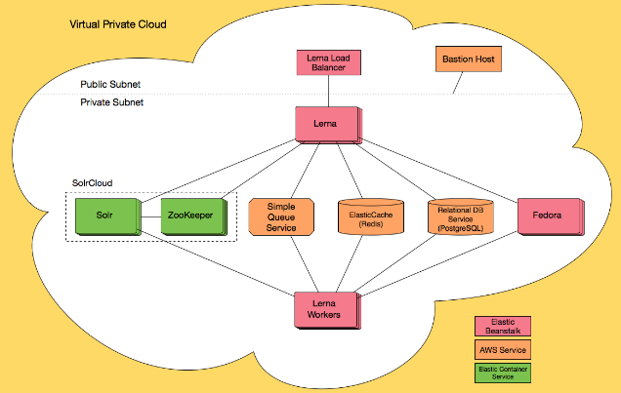

Recap
https://n2ws.com/blog/backup-and-recovery/backup-your-aws-cloud-environment-using-cloudformation-part-2
Architecture diagram from: https://cloud.githubusercontent.com/assets/111218/16077301/e8a0dc6c-32ef-11e6-80b4-e9e74c18973e.png
Notes:
Recap what CloudFormation is
Explain Elastic Beanstalk and Elastic Container Service
Talk about the Hybox CloudFormation template
Deploys the Hyku application

Slide 4
Problems with Deployment
Previously had a green deployment
  Application was running
  Some features like upload were in a known failure state
CloudFormation template isn’t being supported by creators
  Pull request to GitHub repository to fix deployment issues

Slide 5
Scaling Down Instances
Scaled down all instances except Solr and Fedora to the minimum t2.micro
Solr and Fedora scaled down to t2.medium
  Fedora requires 4GB of memory
    Caused a failure in creating a repository
  Solr fails to scale down below t2.medium
Reduced cost by $243.14

Slide 6
Scaling Down Databases
Both databases scaled down to t2.micro
  Still using PostgreSQL
  Could not find option to scale down standby in Multi-AZ
Reduced cost by $161.04

Slide 7
Testing
Manually checking metrics on original and new applications
Creating metrics based on the user guide and features list

Slide 8
Testing Results
Metric | Original application | Scaled-down application
Home page loads in under 10 seconds | True | True
New repositories appear in DB | True | True
New users appear in DB | True | True
Files successfully upload to Fedora repository | False | False

Slide 9
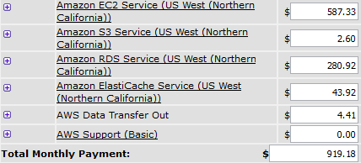
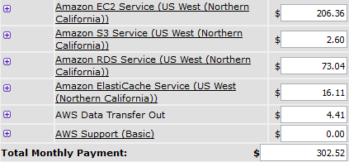
Cost Evaluation
Original
Improved

Slide 10
Cost Reduction
$616.66 reduction
33% of original cost

Slide 11
Continued Work
Add more tests/requirements
Complete documentation on our overall process
Scale down number of Solr instances
  Doesn’t apply the changes to the AutoScalingGroup

Slide 12

Acknowledgements
Resources
Client: Yinlin Chen
University Libraries
https://wiki.duraspace.org/display/hyku/Hyku+Product+Beta+-+Frequently+Asked+Questions
https://calculator.s3.amazonaws.com/index.html
https://github.com/hybox/aws
http://hydrainabox.samvera.org/
https://lucene.apache.org/solr/
https://aws.amazon.com/rds/aurora/
http://fedorarepository.org

Slide 13
Questions?

