Slide 1

How the Sausage Gets Made:
Building State-Wide Support
for Open Education Initiatives
Open Education Conference, November 2017
Notes:
Photo by Kirsty TG on Unsplash
https://unsplash.com/photos/LCtc9qhBXoQ

Slide 2
Today’s panelists:
Sarah Faye Cohen (moderator)
  Open Textbook Network
Robert Butterfield
  University of Wisconsin, Stout
Teri Gallaway
  LOUIS: The Louisiana Library Network
Glenda Thornton
  Cleveland State University / OhioLink+
Anita Walz
  Virginia Tech / VIVA: Virtual Library of Virginia

Slide 3

How did you ignite action in your state?
Stories from Wisconsin, Louisiana, Ohio, and Virginia
Notes:
Each panelist will share a five minute story about how they instigated action in their state. Panelists may address some of the questions below. Sarah will then ask you to address questions 3 & 7 below before taking questions from the audience.
Photo by Andrew Walton on Unsplash

Slide 4
Robert Butterfield
Assistant Library Director and Director of Instructional Resources Services

Slide 5
University of Wisconsin-Stout
1 of 13 University of Wisconsin System four year campuses
Wisconsin’s Polytechnic University
About 9500 students
Laptop Campus
Long history of innovation

Slide 6
Stout’s Affordability Program
Textbook rental school since 1910
Initiated digital resources program in 2012
Included access codes as part of program in 2014
Initiated our OER program in 2015
Vocal advocate for content affordability in Wisconsin
and nationally

Slide 7

LOUIS: THE LOUISIANA LIBRARY NETWORK

Slide 8
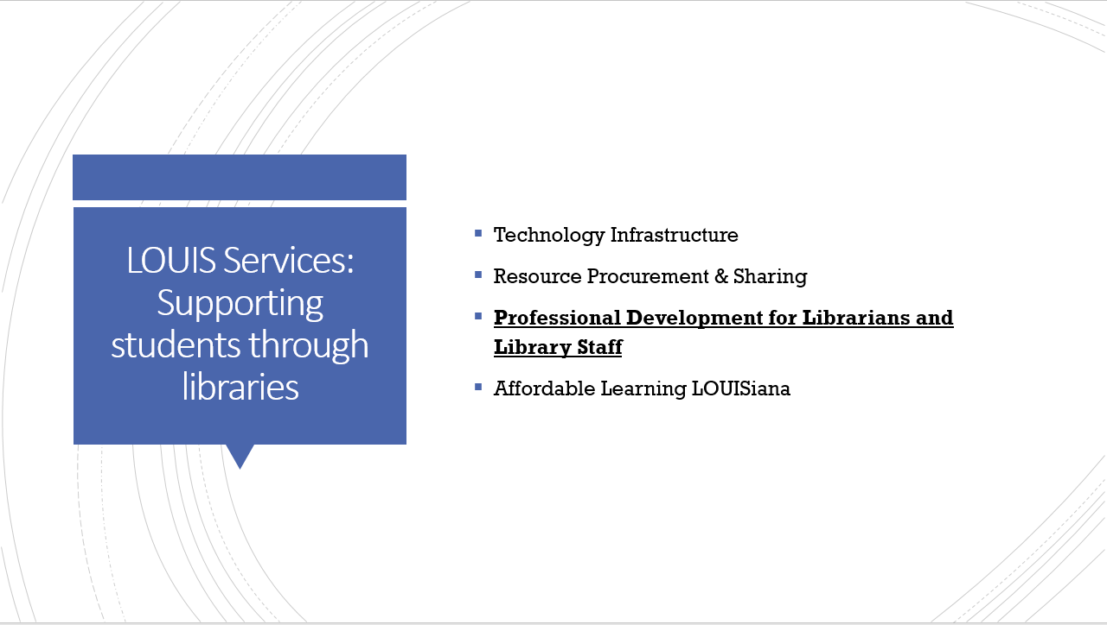
LOUIS SERVICES: SUPPORTING STUDENTS THROUGH LIBRARIES

Slide 9
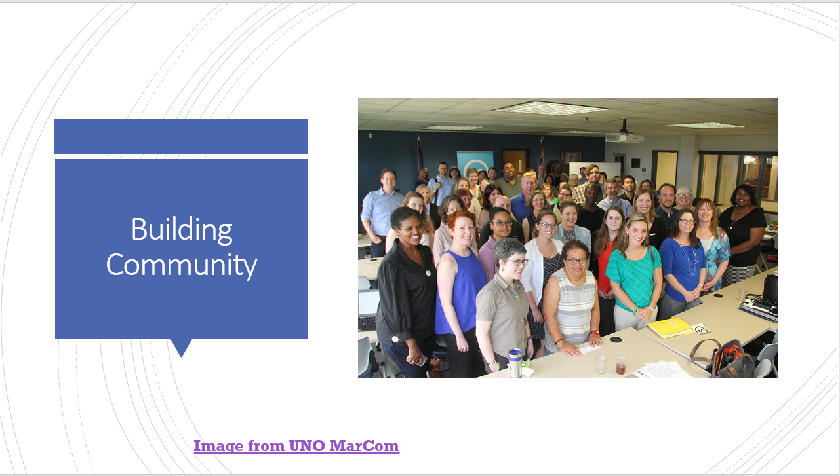
BUILDING COMMUNITY

Slide 10
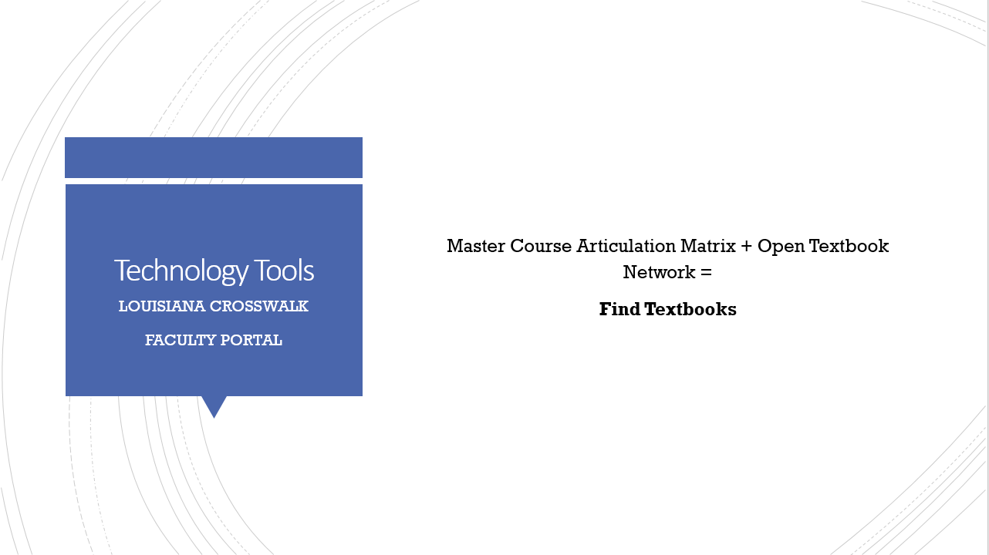
LOUISIANA CROSSWALK
Master Course Articulation Matrix + Open Textbook Network =
Find Textbooks

Slide 11
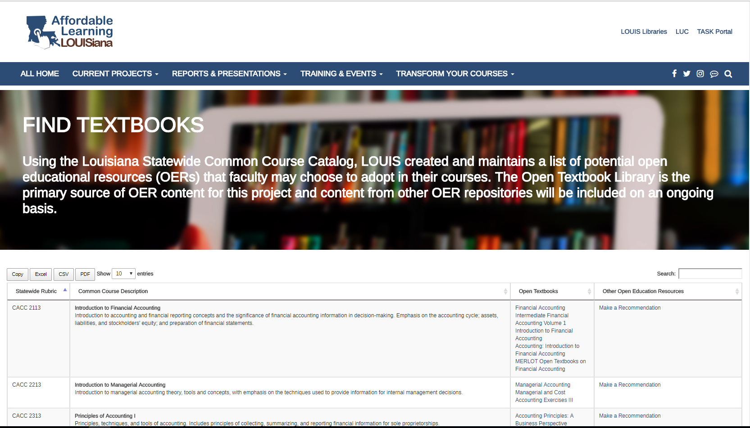

Slide 12
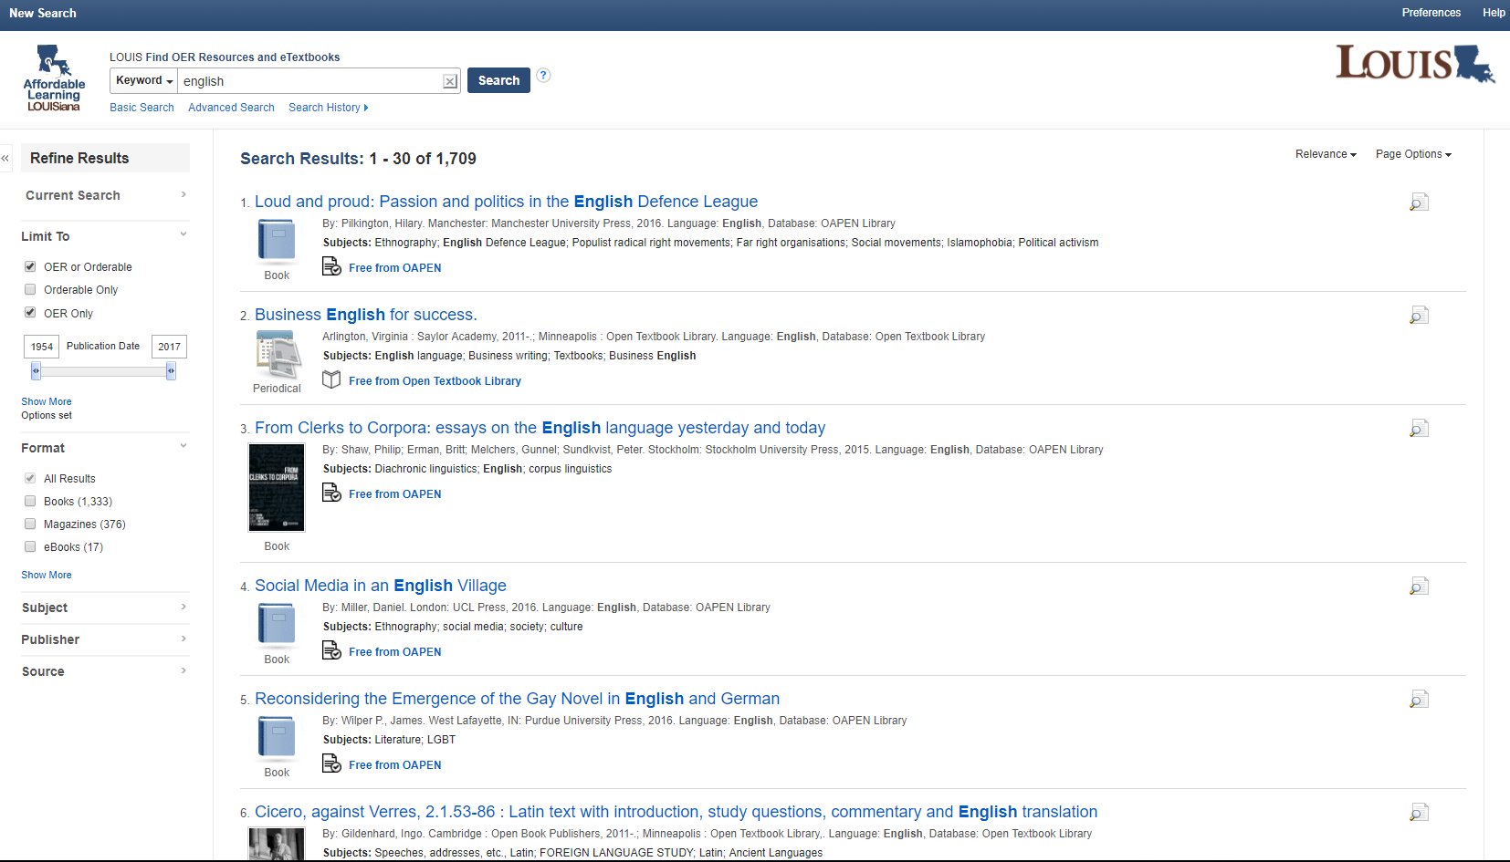

Slide 13
Ohio Link + Affordable Learning Materials
Glenda Thornton

Slide 14
Right Place, Right Time, Right Background
Several years experience with Open and Digital Commons
Introduction to OTN by Dave Ernest talk, March 2014
Became motivated to learn & do more & queried peers around Ohio
Talked with my Provost (who supports Open)
Provost appointed me to a State Taskforce on Affordability and Efficiency in early 2016 charged with exploring textbook costs
Volunteered to chair a group to explore open textbooks; submitted a plan in March 2016 for OhioLINK to assume management of Statewide efforts
Plan was adopted & is supported by the Ohio Dept. of Higher Education

Slide 15
Hurdles
Traditional values of libraries—we don’t provide textbooks!
Concern that library budgets would be diverted to textbook purchases; OhioLINK's budget would be diverted away from traditional resources
Skepticism concerning open resources from everyone—faculty, librarians, university administrators
Educating colleagues about what open resources are, how they can be used, their quality, when they are appropriate, how they make a difference, and their drawbacks
Helping colleagues develop a campus program to support the use of open resources; figuring out who will lead the charge on a campus

Slide 16
Factors that worked
Politicians and government officials are looking for ways to reduce the high cost of education for their constituents—an opportunity to those with solutions
Librarians are organizers: have skills to develop solutions and plans
An appropriate network, OhioLINK in my case, existed
Librarians have sympathy for student’s complaints about high prices
Made the case that promoting affordable & open textbooks would help reaffirm the Role and Value of the Library in this time of change and decreasing budgets

Slide 17


VIVA:
Virtual Library of Virginia
Anita Walz
© Maria Darron “Virginia” CC BY 3.0

Slide 18
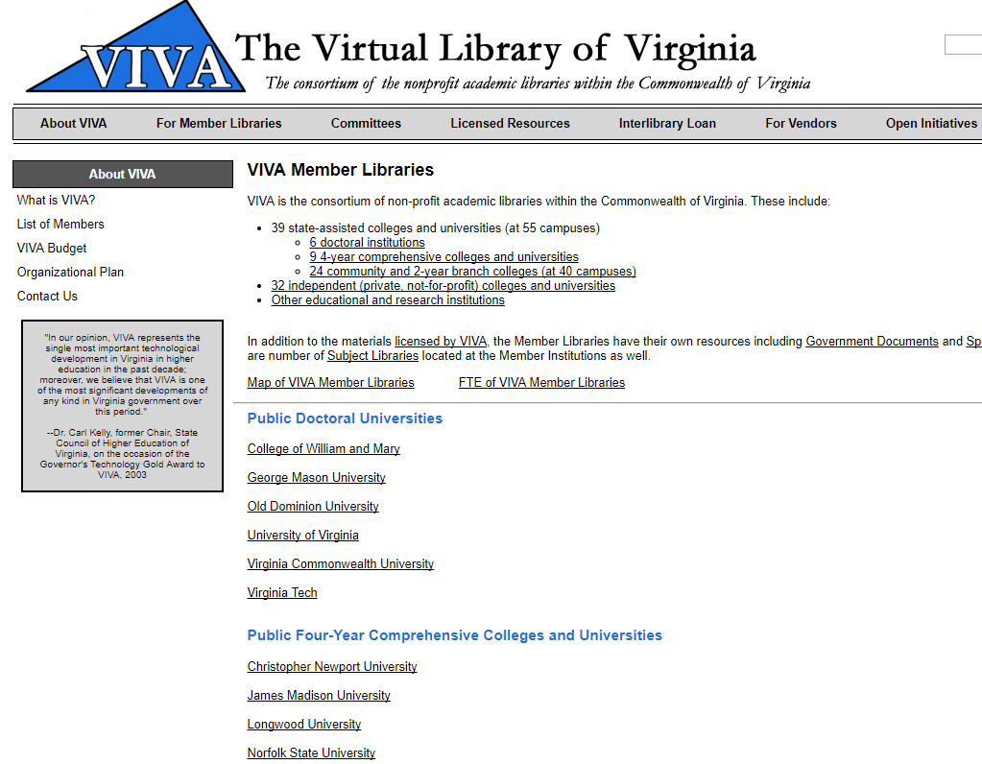
CONTACT

Slide 19
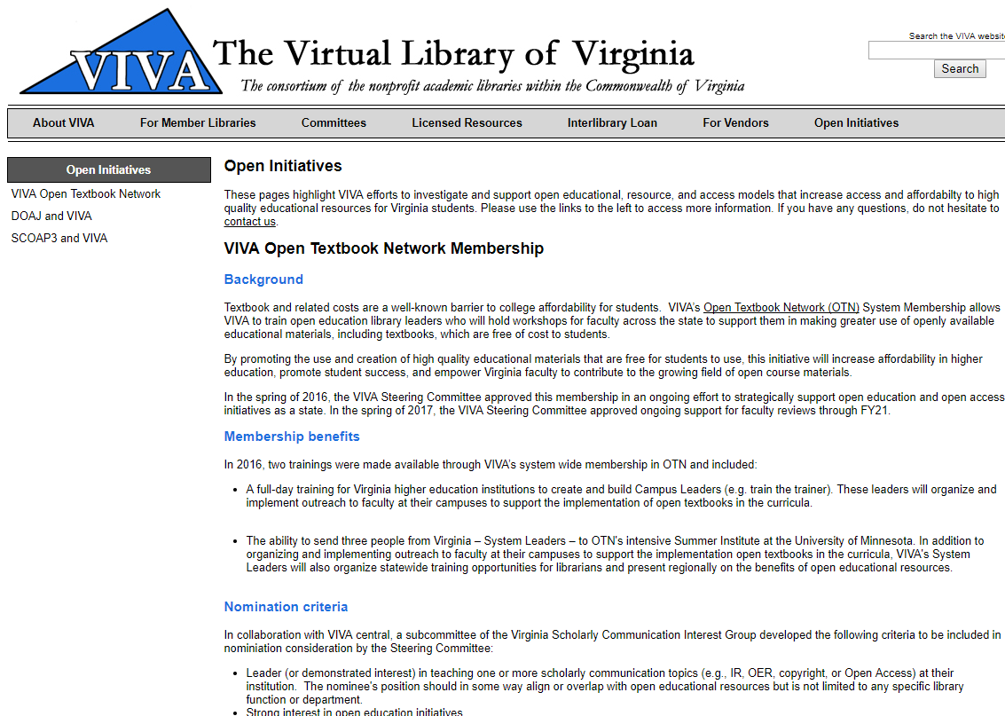
VIVA joined the Open Textbook Network in
Spring 2016.
http://www.vivalib.org/openinitiatives/otn.html

Slide 20
2016 2017
~ 35 Campus Leaders trained 7 replacement Campus Leaders trained
3 new System Leaders (OTNSI) 2 additional System Leaders (OTNSI)
18 campuses + 5 campuses
___ workshops __ workshops
$20,000 for review stipends Agreement to fund for 4 more years

Slide 21
Invitations
Recruitment
Innovative approaches
Assessment / Follow up
Encouraging communication via VIVA-OER Listserv
Monthly teleconferences - VIVA & System Leaders
Sharing “what worked” / templates / assessments
Training of replacement leaders
Support for Campus & System leaders
Fall 2017 refresh/connect workshop
VIVA Goals: Faculty adoption of open textbooks
VIVA “dipping toes into” open

Slide 22

Behind the curtain . . .

Slide 23
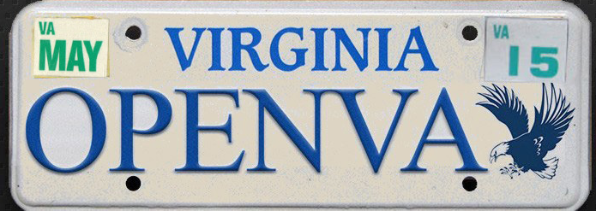
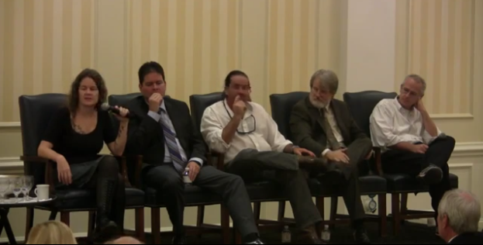
2013
Tidewater Z Degree
OpenVA/Minding the Future - 2013

Slide 24

2013 2014
OPENVA Listserv

Slide 25
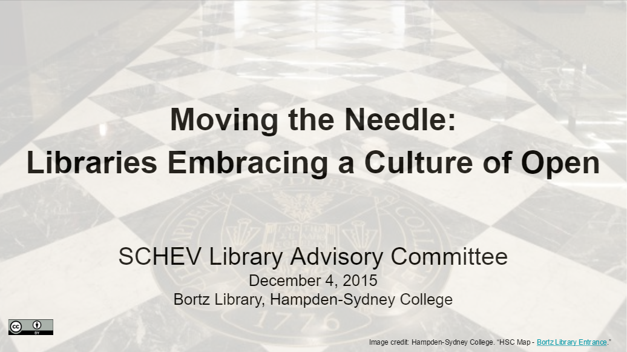


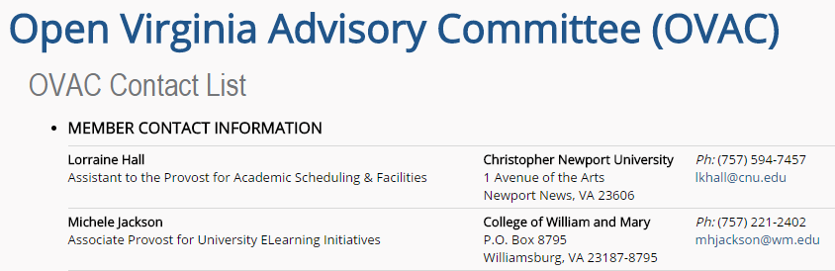
2013 2014 2015
http://hdl.handle.net/10919/73233
VIVA Libraries OER Survey
Summer 2015

Slide 26

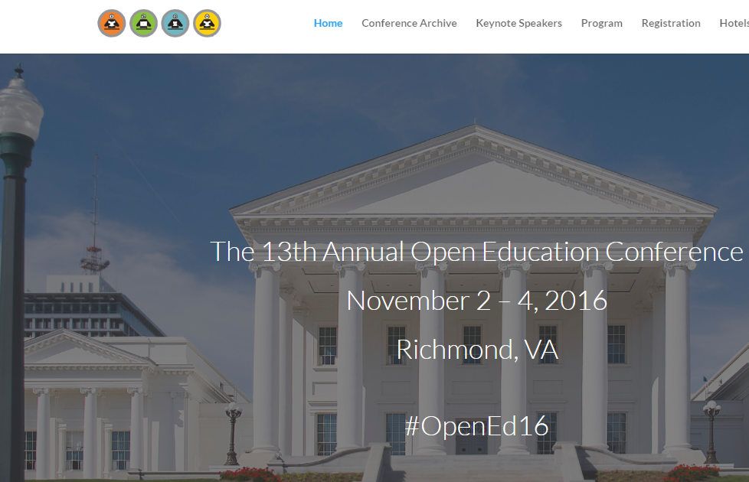
2013 2014 2015 2016
+
UMW OER Summit
http://umw-oer-summit.economooc.com/stream

Slide 27

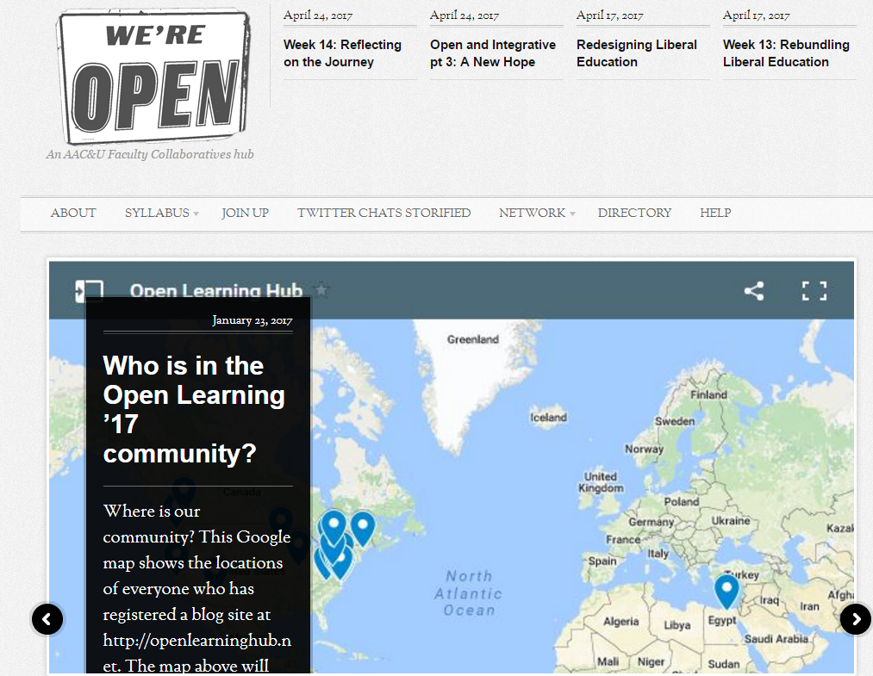
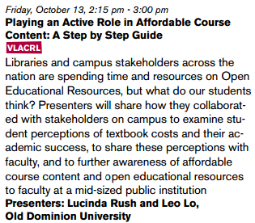
2013 2014 2015 2016 2017
+
?
Possible legislative
response to VIVA Proposals?
Virginia AAC&U Open Learning Hub

Slide 28

What was the greatest hurdle you faced in building state-wide support and how did you overcome it?
Notes:
Photo by Namroud Gorguis on Unsplash

Slide 29

What advice would you give to advocates looking to build state-wide action around open education?
Notes:
What advice would you give to advocates looking to build state-wide action around open education?
Photo by Jared Sluyter on Unsplash

Slide 30
Questions from the audience?

Slide 31
Thank you!
Be in touch with any further questions!
Sarah Cohen: sfcohen@umn.edu
Bob Butterfield: butterfieldr@uwstout.edu
Teri Gallaway: teri.gallaway@regents.la.gov
Glenda Thornton: g.thornton@csuohio.edu
Anita Walz: arwalz@vt.edu

