Slide 1
Horse Judging Practice
Hunter Under Saddle

Slide 2
Horse Judging Contest at Virginia Tech
Friday, February 10 is Hippology
Saturday, February 11 is Horse Judging
Do you want to go?
If we do go, we should ramp practices up to once a week!

Slide 3
Chesterfield Equine Connection
Collaboration with Chesterfield Farm Bureau
Facebook page being created
Intended to create a more connected horse community in Chesterfield
Important legislative information will be disseminated
Educational programming announcements

Slide 4
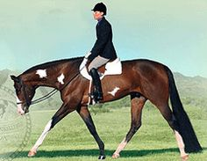
What are we looking for with HUS classes?
Correctness of gait
Speed of travel (cadence and rhythm)
Temperament
Head Carriage

Slide 5
Take Notes on This Horse
https://www.youtube.com/watch?v=0iZfT3uCE1I
How would you talk about this horse if it was 1st place in a set of reasons?

Slide 6
Take Notes on This Horse
https://www.youtube.com/watch?v=yJQLcOZdaPo
How would you compare this horse to the first horse?
How would you write them out in a top pair?

Slide 7
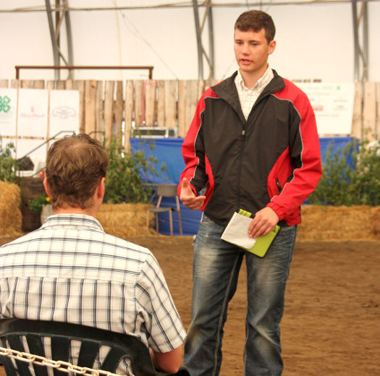
Talking Time!
Take 10 minutes to write out your top pair for HUS and then memorize. You can spread out throughout the office if you need to! Come find me in my office when you’re ready to “present” :-)

Slide 8
One More to Watch
https://www.youtube.com/watch?v=BtDl9lsqSdo

Slide 9
Equitation
Now you can judge the rider!

Slide 10
What do you focus on when YOU are riding in an equitation class?
We’re going to put the answers on the white board.

Slide 11
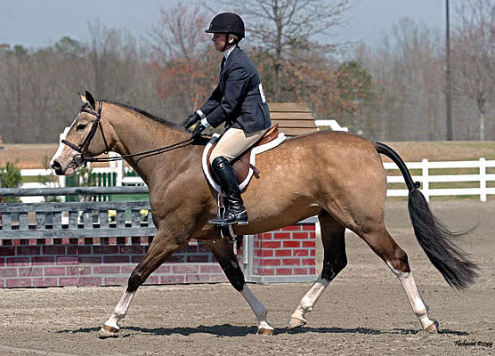
What Should You Focus on When Judging?
Communication between horse and rider should not be obvious.
The rider’s seat
Sitting straight down over the center of balance
Sitting behind the center of leaning too far forward.
Rider’s Back
Straight, relaxed and supple
Super stiff, unnatural arching or slumping
Shoulders
Level and Square
Too far forward or drooping

Slide 12
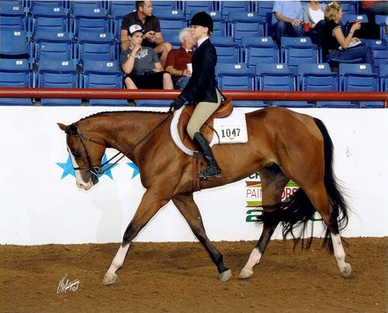
What Should You Focus on When Judging?
The rider’s head
Looking straight ahead
Looking down or looking really far up
Arms/Hands
Straight line from elbow to horses mouth
Contact with the reins
Firm hands that are relaxed
Hands too low or too high
Too much contact
Reins too long

Slide 13
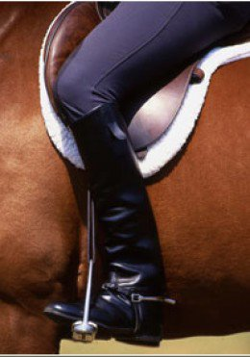
What Should You Focus on When Judging?
Legs
Straight line from ear-shoulder-hip-boot heel
Straight ankles
Too far forward or back
Irons too short or too long
Ankles too far in or out
Feet
Feet on iron and resting on the ball of the foot
Heels down, Toes straight ahead or slightly out.
Just toes in the iron, heels up, toes really far out

Slide 14
From a Judge’s Perspective
https://www.youtube.com/watch?v=HkuPKgzK5L4

Slide 15
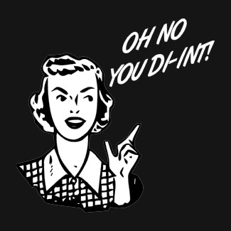
Disqualifications
Failure to wear the correct number in a visible manner
Willful abuse
Excessive schooling or training
Fall by horse or rider
Illegal use of hands on reins
Use of prohibited equipment

Slide 16
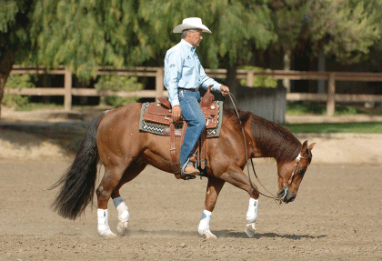
Faults and Severe Faults
Touching horse
Grabbing the Saddle
Cropping or Spurring in Front of the Shoulder
Omission or Addition of Maneuvers
Turning the Wrong Way
Knocking Over a Cone or Working it the Wrong Way
Severe Disobedience
Head Too Low/Too High
Excessive Nosing Out
Head Carried Too Low
Over-flexing or Straining the Neck so the Nose is Constantly Behind the Vertical

Slide 17
Hunter Equitation Videos
https://www.youtube.com/watch?v=CIa1IdQ7ffQ
https://www.youtube.com/watch?v=2jn91F3uFPE

