Slide 1

Effectiveness of stormwater management practices in protecting stream channel stability
Tess Thompson, Associate Professor
Biological Systems Engineering

Slide 2
Project partners and contributors
Tess Wynn Thompson, Associate Professor, Biological Systems Engineering, Virginia Tech
David Sample, Professor and Extension Specialist Biological Systems Engineering, Virginia Tech
Mohammad Al-Smadi, Consultant
Sami Towsif Khan, Center for Watershed Protection
Mina Shahed Behrouz, Water Resources Designer, Stantec
Andrew Miller, Professor, Geography and Environmental Systems, University of Maryland, Baltimore County

Slide 3










Acknowledgment Slide
We thank the many partners who support the Restoration Research program for their funding and interest. Major funding for this phase of the work was provided by the U.S. Environmental Protection Agency. We also thank the US Geological Survey and Montgomery County for sharing data and their personal observations of Tributary 109.

Slide 4

How can we develop land and protect streams?
Do Maryland stormwater regulations protect channel stability?
While the 2000 and 2007 regulations reduce the impact of urban development, neither protect channel stability long term.
Why?
How can the regulations be improved?

Slide 5
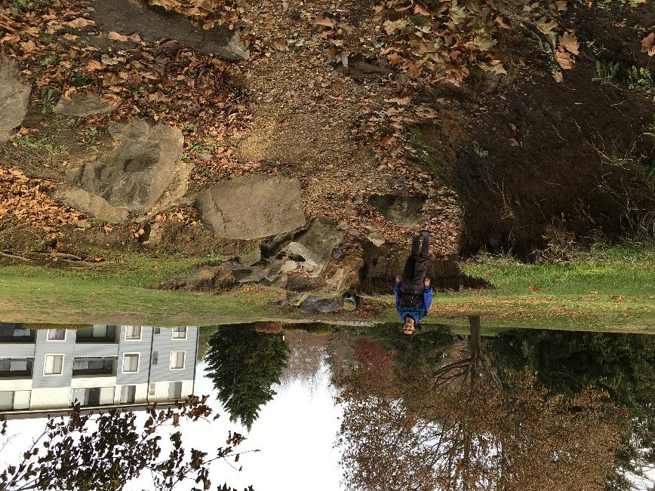
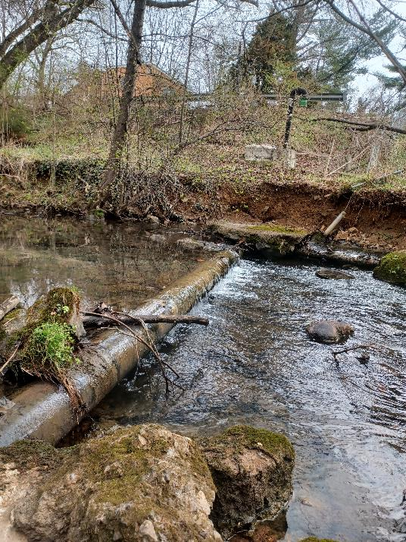
Paying for good stormwater management now means you don’t pay to fix things later.
Notes:
Quote from 1971 TV commercial for the FRAM oil filter company

Slide 6

Before we talk research…
Notes:
Before we talk research, I want to give a brief overview of Maryland’s stormwater regulations for the non-stormwater folks and a brief overview of how streams “work” from a physical standpoint.

Slide 7

Maryland stormwater history in brief…
Before 1984
No statewide stormwater regulations
Local regulations largely focused on flood control
1984-2000
Statewide stormwater regulations for flood control
Local regulations to treat runoff for water quality
2000-2007: Unified stormwater sizing criteria (USC)
Water quality volume - capture and treat runoff from 1" (25 mm) of rainfall
Channel protection volume – detain runoff from 1-yr, 24-hr design storm
2008+ Environmental site design (ESD)
Required better site planning and use of LID/GI before traditional stormwater ponds
Changed method for calculating required storage/infiltration volume, resulting in reduced storage
Thanks Stew Comstock!!

Slide 8
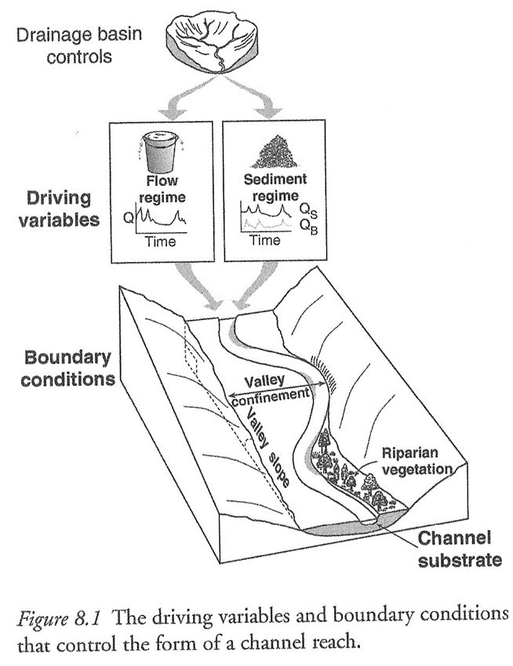
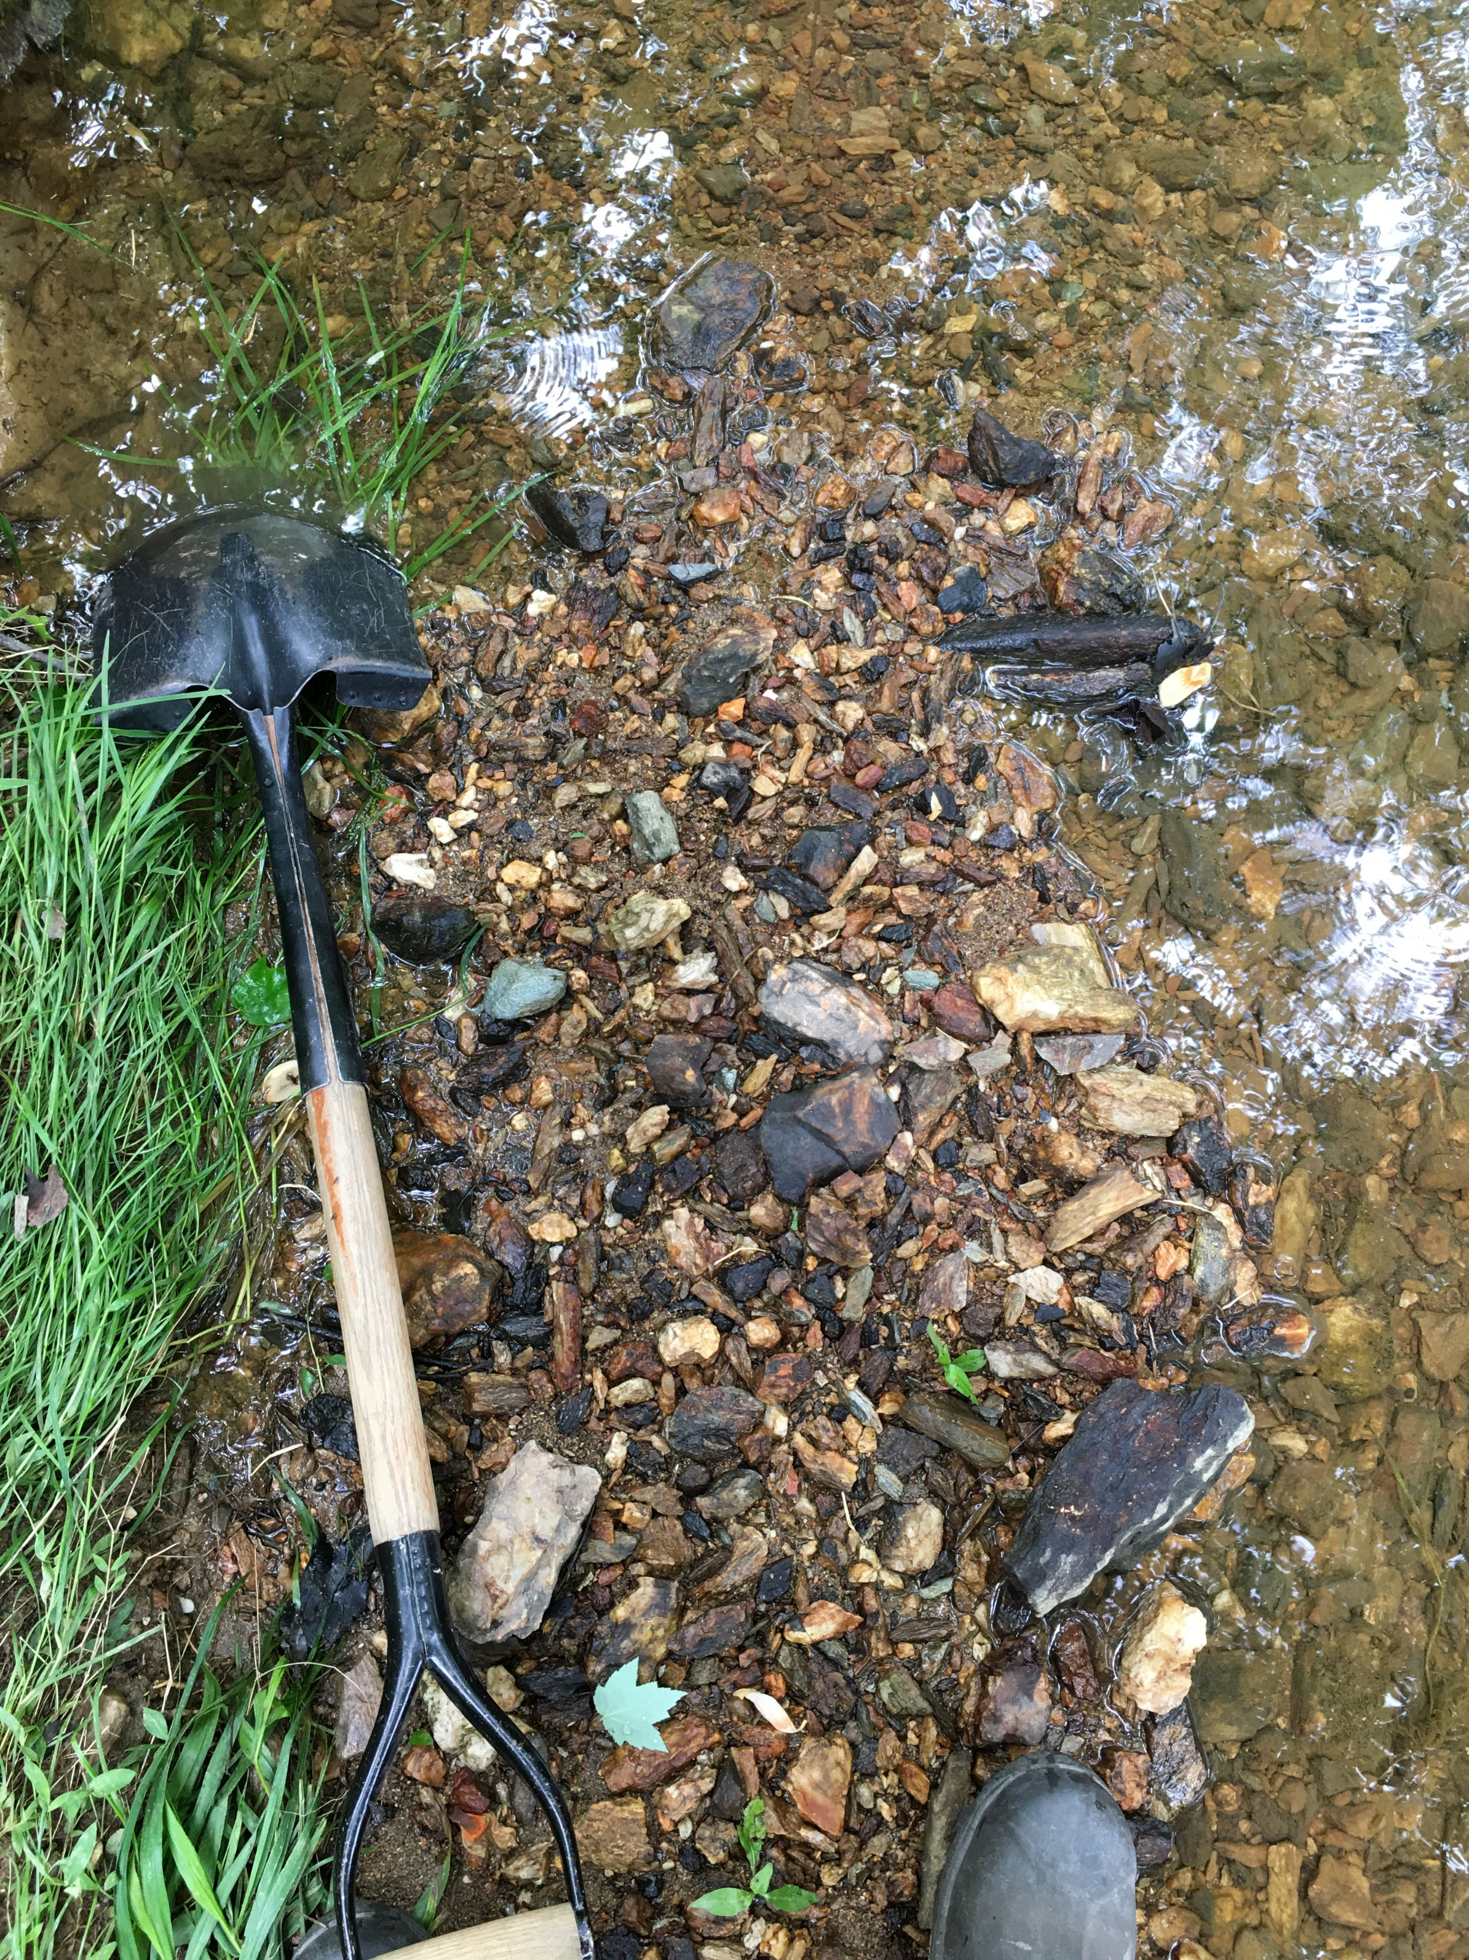
How do streams “work”?
Source: Fundamentals of Fluvial Geomorphology by Ro Charlton.
Notes:
In this talk, “sediment” does not refer to fine-grained sediments that can carry pollutants and harm biota. I use the term to refer to coarse sediment that makes up the bottom of stream channels and that only moves during high flows. Stream channels have been described as “jerky conveyor belts.” With each flood (flows greater than baseflow), that bed material is picked up and moved a short distance downstream – we refer to this as sediment transport. Over geologic time scales, this sediment transport is the reason the Appalachians no longer look like the Rockies and there is an Eastern Shore. If watershed hydrology changes, sediment transport will change, causing the channel to adjust. How the stream responds depends on the shape of the channel and valley and the size of the bed sediment.

Slide 9
Ok, let’s talk research…

Slide 10
Tributary 109 to Little Seneca Creek served as a case study
0.3 mi² drainage area, 44% TIA
Developed 2006 - 2016
USGS stream gage (2004)
USGS rain gage
Montgomery County data
  Cross sections
  Longitudinal profiles
  Pebble counts
Multiple lidar datasets

Slide 11
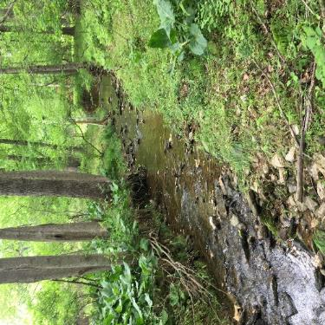
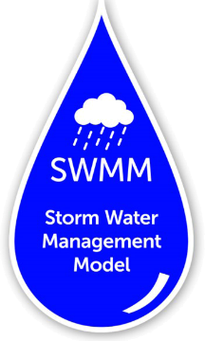

Channel stability is a two-part problem
Water
Sediment
HEC-RAS 6.3
Notes:
To evaluate the impact of development and stormwater management on channel stability, we needed to first ask what the role of development and stormwater management is on stream flows and then what is the effect of those flows on sediment transport in a given stream. To do this, we used two different models. SWMM simulated the hydrologic response of the Trib 109 watershed to continuous precipitation time series. We also used SWMM to evaluate how different stormwater management designs affected flows from both types of precipitation time series. The stream flows output by SWMM served as input to HEC-RAS to simulate changes in sediment transport and channel form over time.

Slide 12
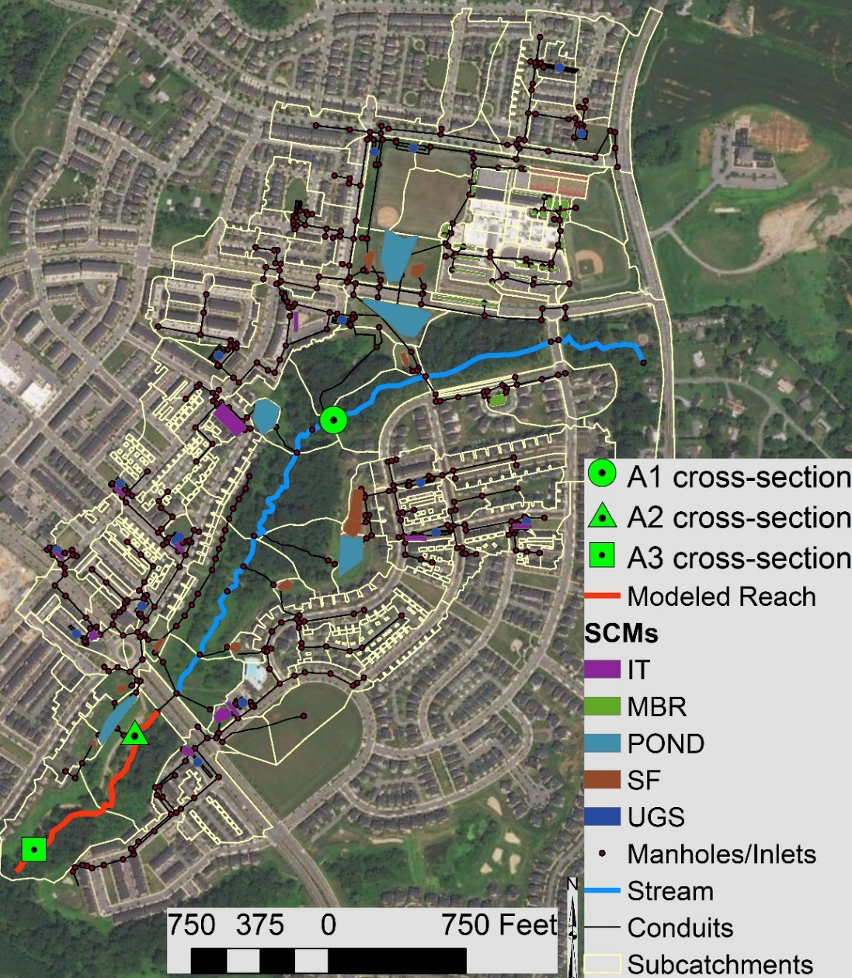
Stormwater system was designed to meet the 2000 Unified Stormwater Sizing Criteria (USC):
5 ponds
26 micro bioretention (MBR)
10 infiltration trenches (IT)
11 sand filters (SF)
18 underground storage facilities (UGS)
Notes:
The stormwater management for this development was designed based on the Unified Stormwater Sizing Criteria from 2000. ESD requires less storage than USC. As a result, stormwater management in this watershed is overdesigned as compared to ESD. To compare the relative impact of the infiltration practices versus the traditional storage practices, we took the calibrated model and then removed some stormwater practices from the watershed to see what the hydrologic response would be. We input the stream discharge from the SWMM model and input it into a 1-D, quasi-unsteady calibrated HEC-RAS model.

Slide 13
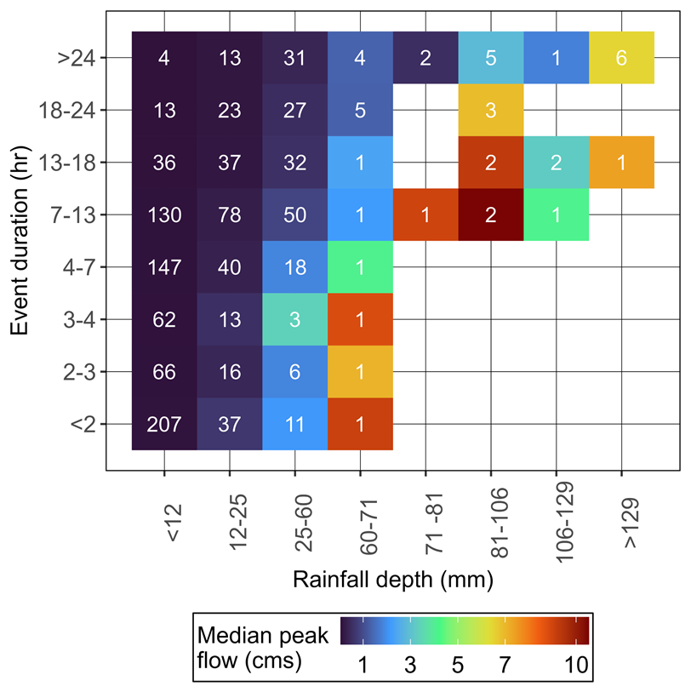
Cp_{v}
1141 individual rainfall events over 16 years
81% of the storm events had depths <1”
The water quality volume will treat the majority of storm events
Wide range of runoff rates from the 1-yr recurrence interval storm event (Cp_{v})
Regulations and extended detention pond design standard focus on detaining runoff volume, not reducing peak flows
24-hr duration storm events produce lower peak runoff than shorter-duration, higher intensity storms
In small, urban watersheds, runoff rate depends most on rainfall intensity, not rainfall depth over 24 hrs
WQ_{v}
Notes:
First, we examined measured rainfall characteristics and the predicted runoff from Trib 109 and then compared that to the regulations. Let me walk you through this. Sami identified over 1100 individual rainfall events over a 16 year period. He then grouped them based on the total amount of rainfall that fell and the storm duration. Then, he counted the number of storm events that fit into each range, which are the numbers in the colored boxes. For reference, 25 mm is 1 inch. The then looked at the stream flow predicted by SWMM for each storm event in each grouping and used the color of the boxes to indicate the median peak flow

Slide 14
Channel stability is a two-part problem
Water
Sediment
HEC-RAS 6.3
Notes:
To evaluate the impact of development, stormwater management, and climate change on channel stability, we needed to first ask what the role of development and stormwater management is on stream flows and then what is the effect of those flows on sediment transport in a given stream. To do this, we used two different models. SWMM simulated the hydrologic response of the Trib 109 watershed to continuous precipitation time series, both measured rainfall and downscaled climate data from TetraTech. We also used SWMM to evaluate how different stormwater management designs affected flows from both types of precipitation time series. The stream flows output by SWMM served as input to HEC-RAS to simulate changes in sediment transport and channel form over time.

Slide 15
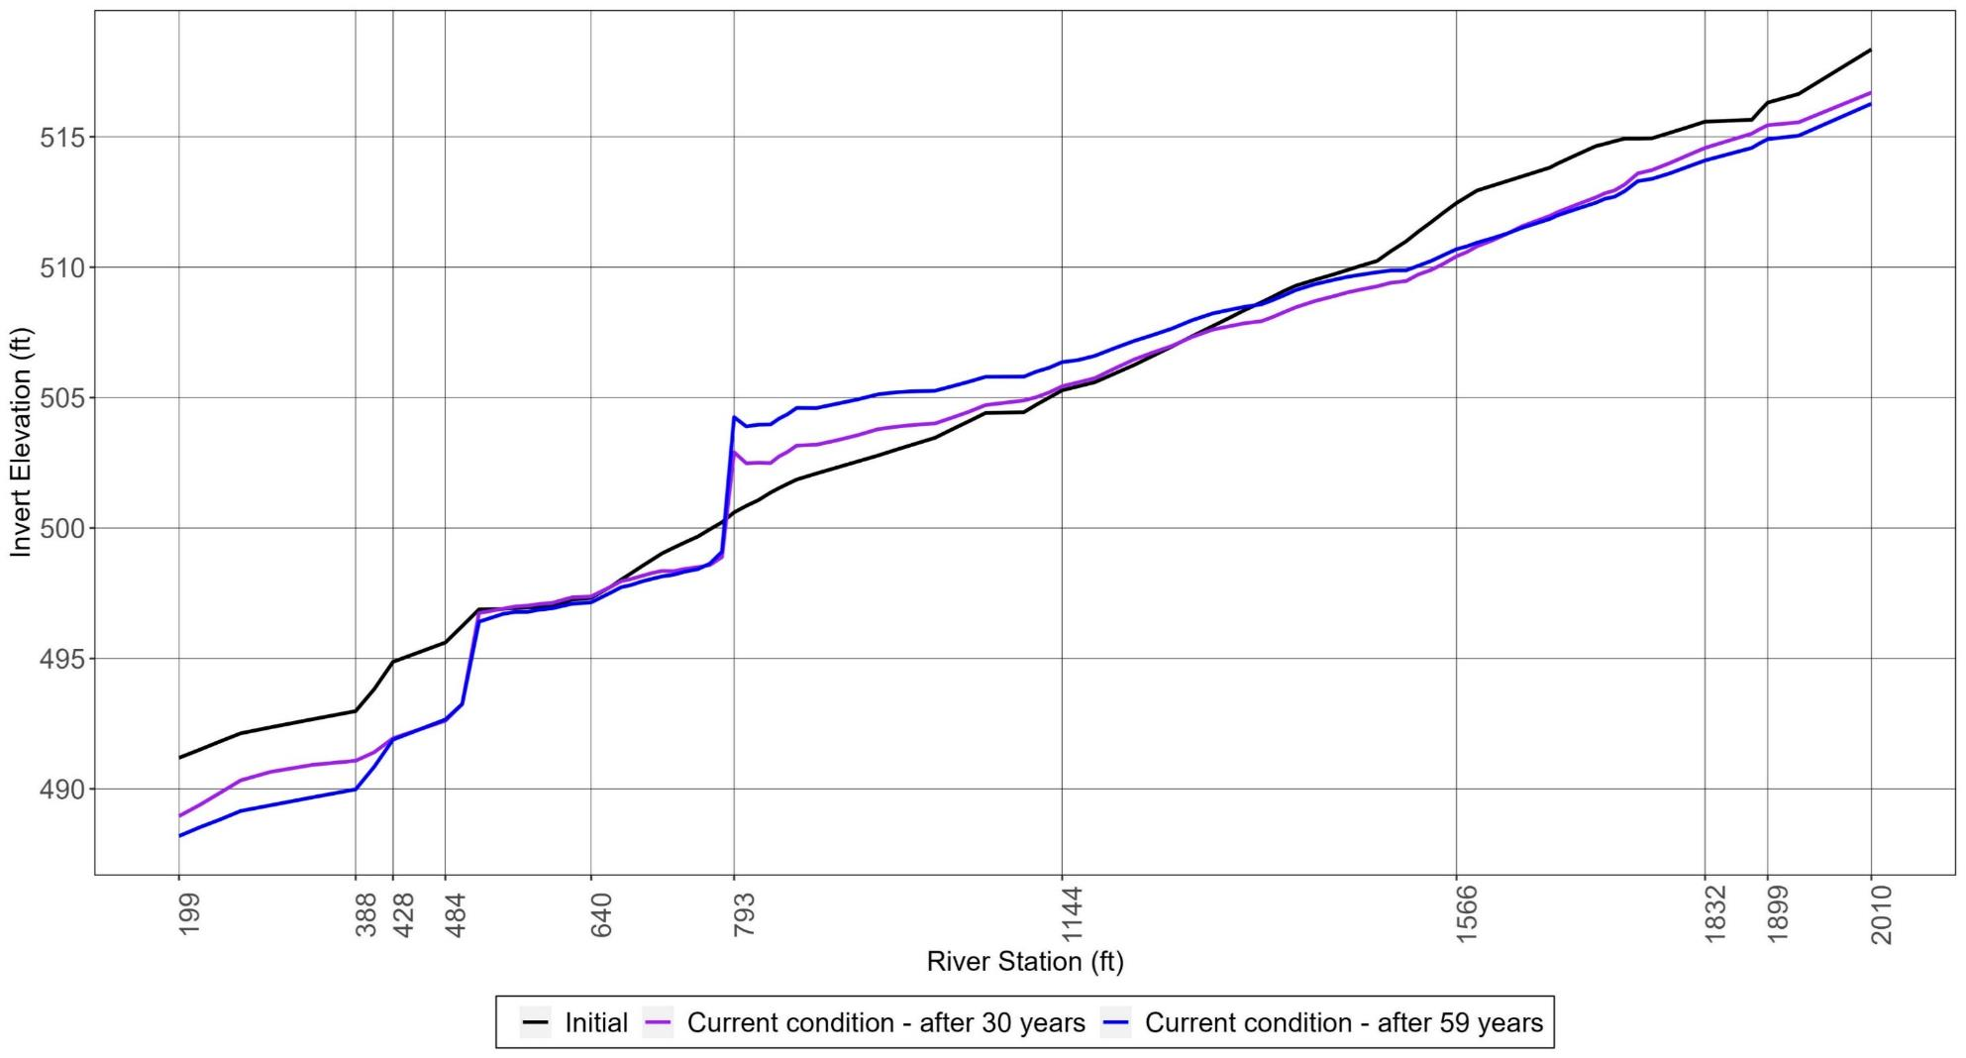
Unified storm sizing criteria will not protect channel stability long-term.
Snowden Farm Parkway
Channel Bed Elevation (ft)
With current regulations, channel degradation will be worse because less stormwater storage is required.
Confluence with tributary
Aggradation
Degradation
Knickpoint (headcut)
climate
climate
Notes:
While these exact changes may not occur, the model does predict that the channel will degrade over time.

Slide 16
Ratio of sediment transported after development to before development
Notes:
For USC, sediment transport amounts are more than double the amounts pre-development for a 1-yr, 24-hr design storm, which is why channel degradation is occurring. Comparison of erosion potential values for USC, Ep, and Ew designs, with only adjustments of the outlet structures – did not quite meet a value of 1.0 – next step is to increase the pond size slightly.

Slide 17
Summary
Unified stormwater sizing criteria (and environmental site design) is an improvement over conventional (ponds only) stormwater management, but will not protect channel stability long term.
To protect channel stability, stormwater management needs to be designed to meet both water and sediment targets.
An investment in good stormwater management now will mean fewer repairs to sewer lines, culverts, and bridges and maintaining existing stream physical integrity.

Slide 18
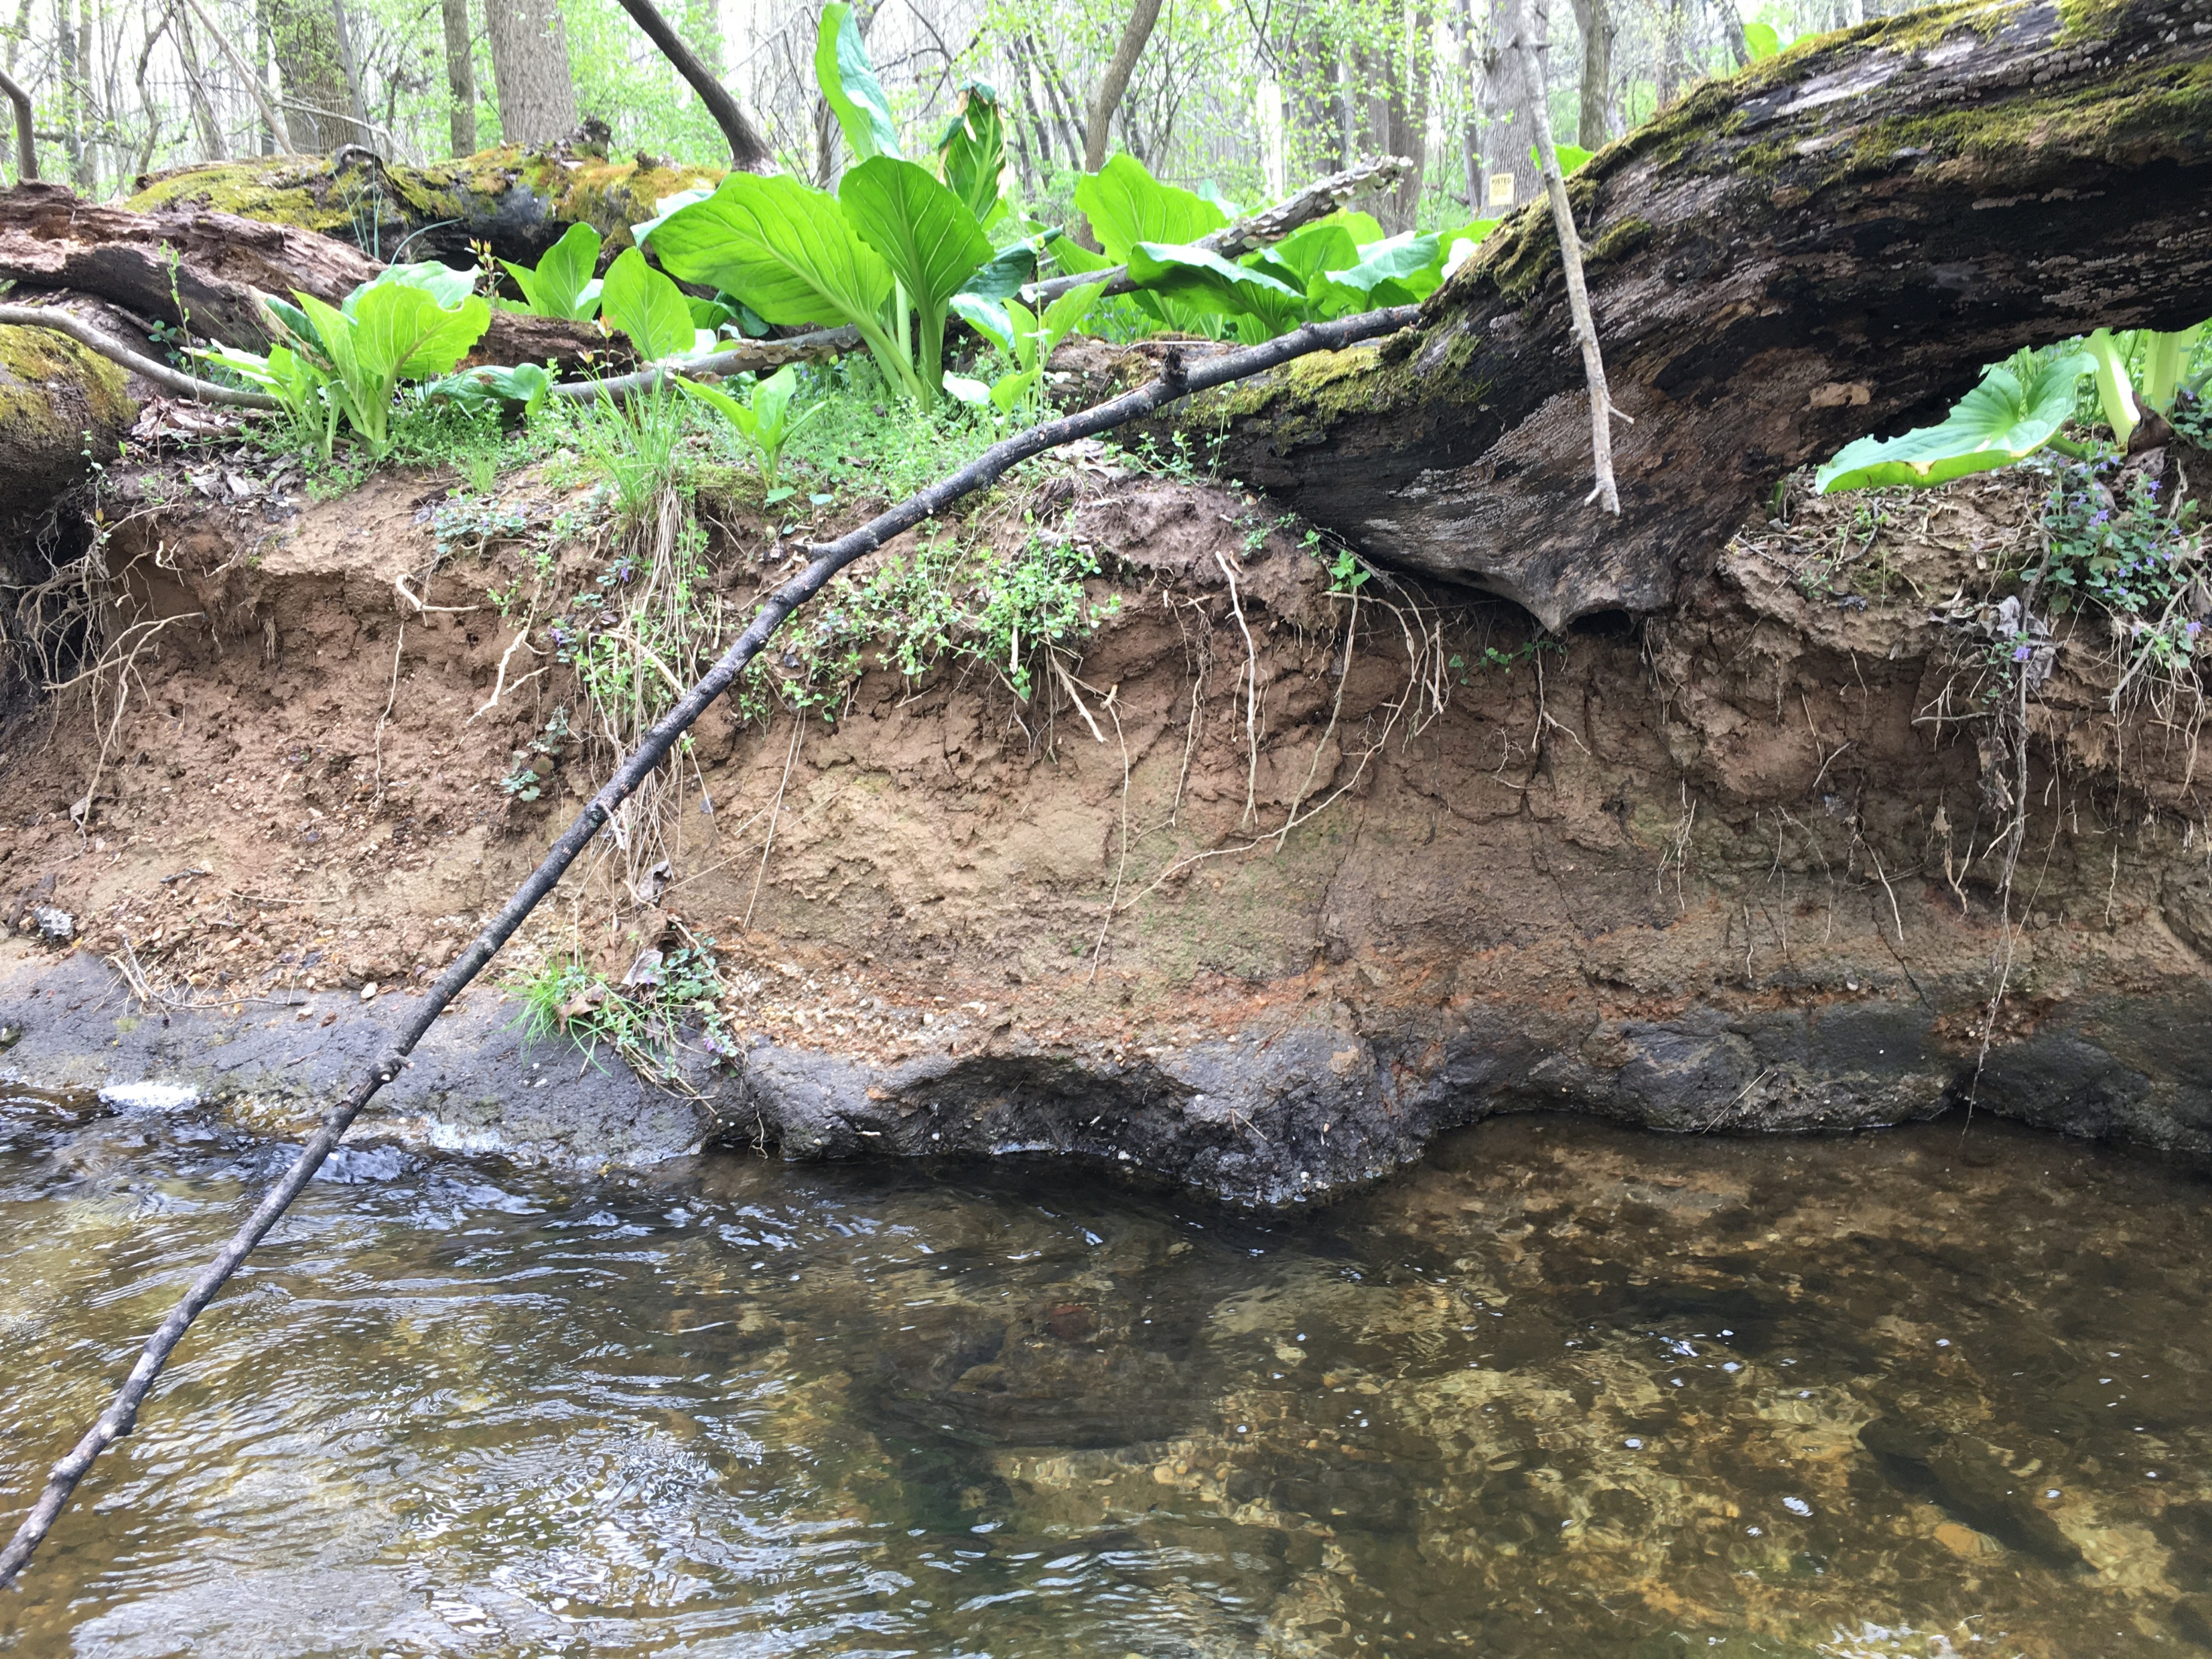
Caveat:
We assume streams are “stable” prior to development.

