Slide 1
Behind Density Lines
CS 4624: Hypertext/Multimedia
Dr. Farag
Virginia Tech, Blacksburg VA 24061
November 14th, 2023
Alex Lin, Anthony Nguyen, John Siegel, Luke DiGiovanna
Notes:
Alex

Slide 2
Outline
Project Background
Clients
Deliverables
Timeline
Features
System Architecture
Demo
Future Work
Acknowledgements
References
Notes:
Alex

Slide 3
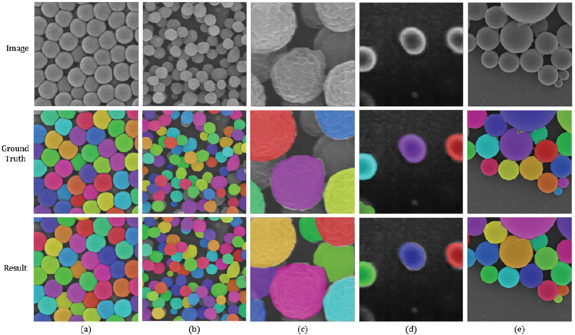

Project Background
Web-based game that allows multiple users to color and segment SEM images together
Users’ segmentations is compared to a reference for scoring
Display at Virginia Tech Science Festival to increase awareness and engagement towards bioengineering

Slide 4

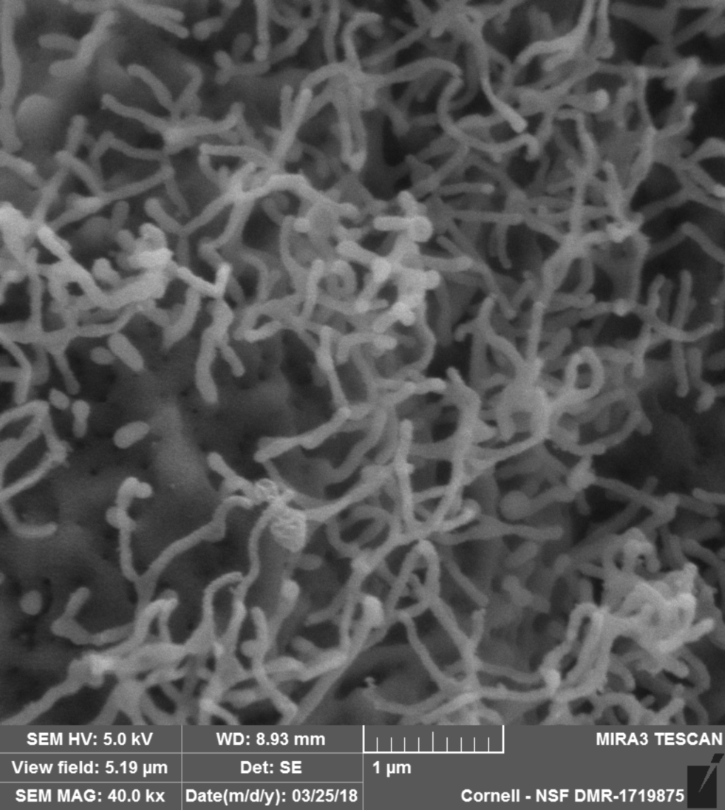
About the Clients
Monet Roberts, Ph.D.
Segmented SEM images manually as a bioengineering researcher
Sourced SEM images
Looking to draw attraction to VT’s bioengineering department
Notes:
Anthony

Slide 5


About the Clients
Yinlin Chen, Ph.D.
Researcher in Digital Libraries, Machine Learning, and CS Applications
Interested in how machine learning can be leveraged in the biomedical field
Notes:
Anthony

Slide 6

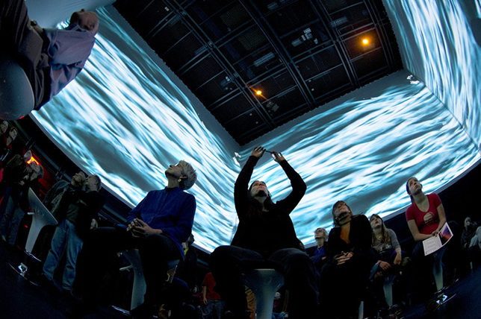
About the Clients
Tanner Upthegrove
Immersive Audio Specialist
Integrating and displaying our project to VT’s The Cube
Interested in integrating community outreach in our project
Notes:
Anthony

Slide 7
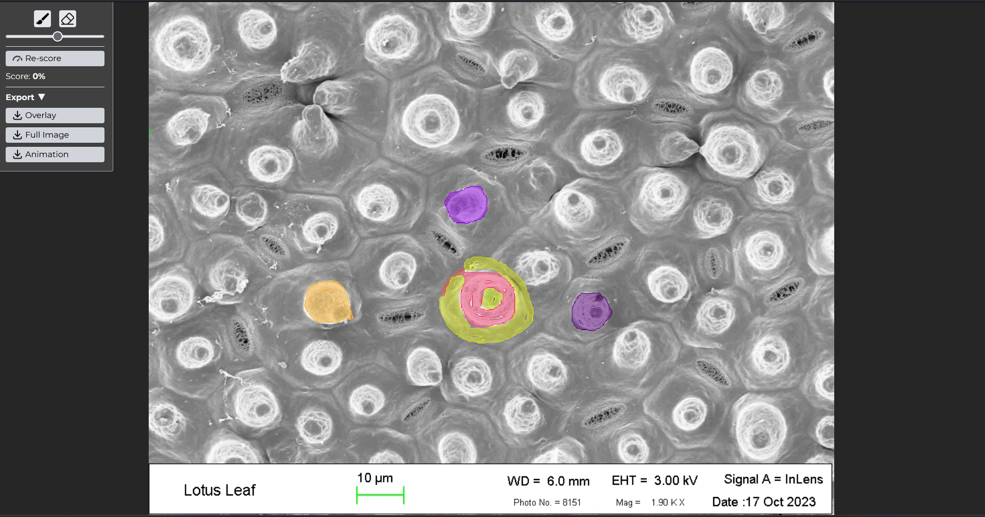
Deliverables
Web application that includes:
  SEM image painter
  Image/GIF export
  Multiplayer server

Slide 8
Timeline
August
September
October
November
Stage 1
Stage 2
Stage 3
VT Science Festival
Next.js skeleton
THREE.js painter functionalities
Socket.io setup
Scoring microservice
Complete web UI
Simultaneous painting for multiple users
GIF export microservice
Display at Virginia Tech Science Festival
Segment splitting algorithm
Adjustable brush
Eraser

Slide 9
Features
Multiplayer
Painter
Interface
Scoring
GIF Export

Slide 10
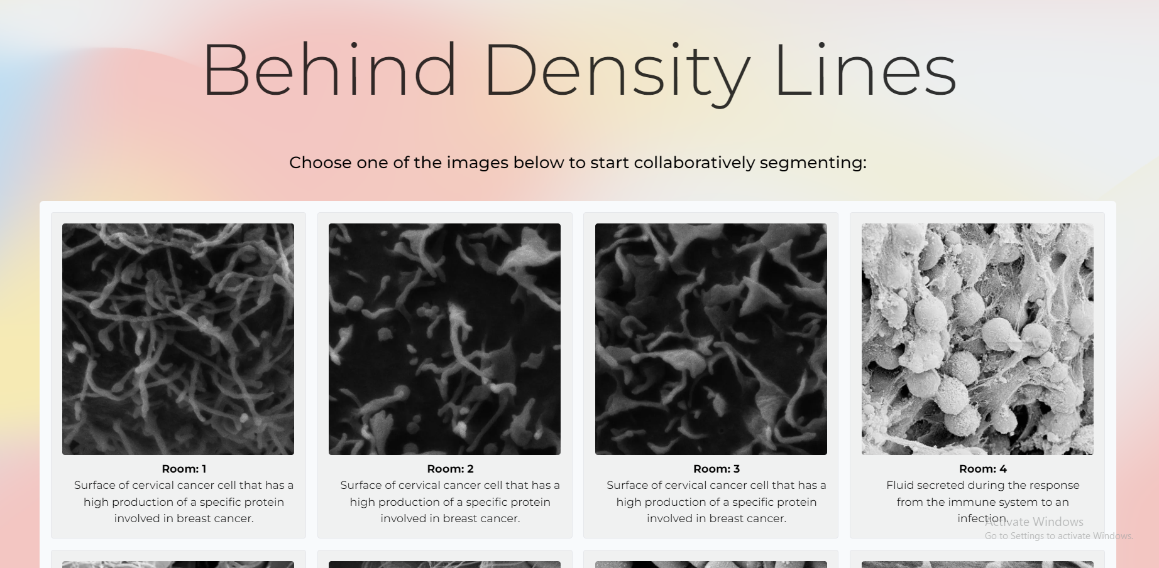
Feature: Multiplayer
Home page where user can join a room

Slide 11
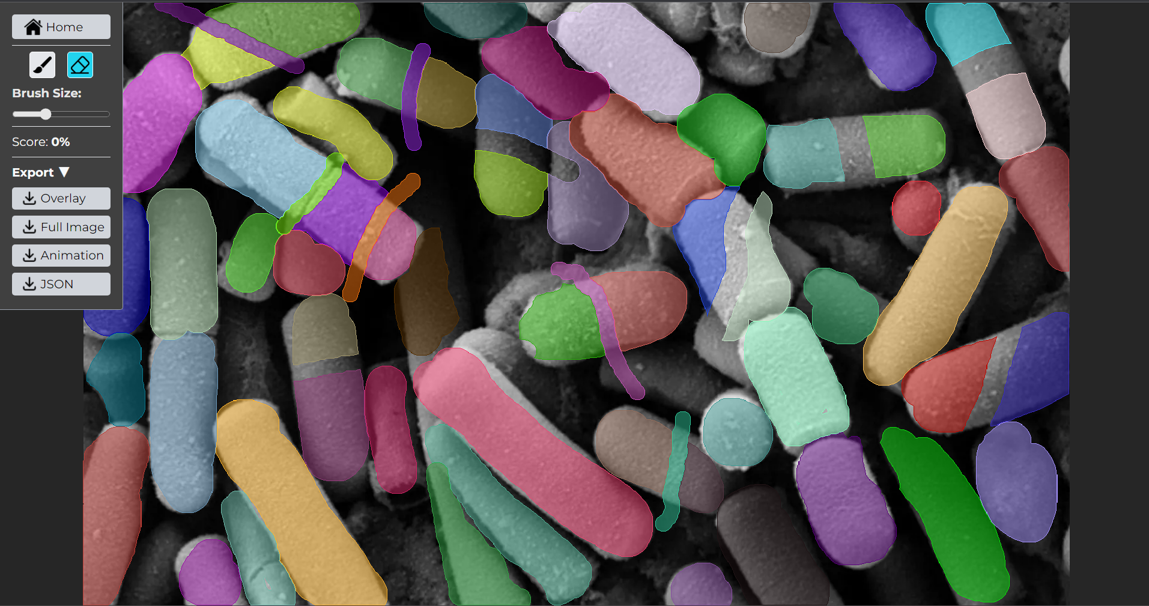
Feature: Painter
Painter UI

Slide 12



Feature: Multiplayer/Painter
Next.js for the the UI and fullstack framework
Socket.io to synchronize state
Painter built with THREE.js to render image and overlay
Developed mobile-first to support iPads

Slide 13
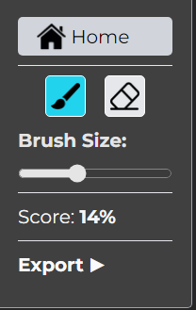
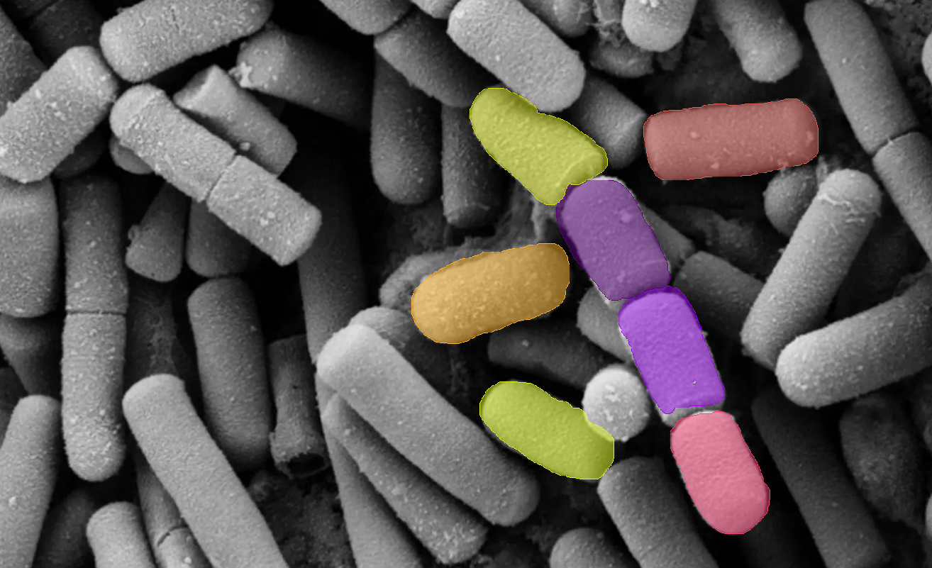
Feature: Scoring

Slide 14
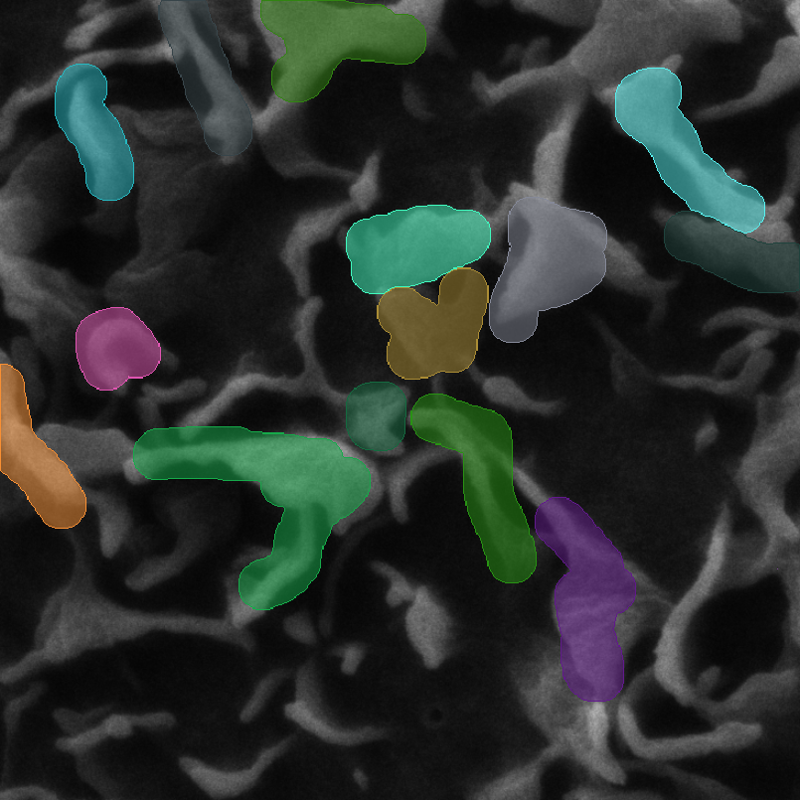
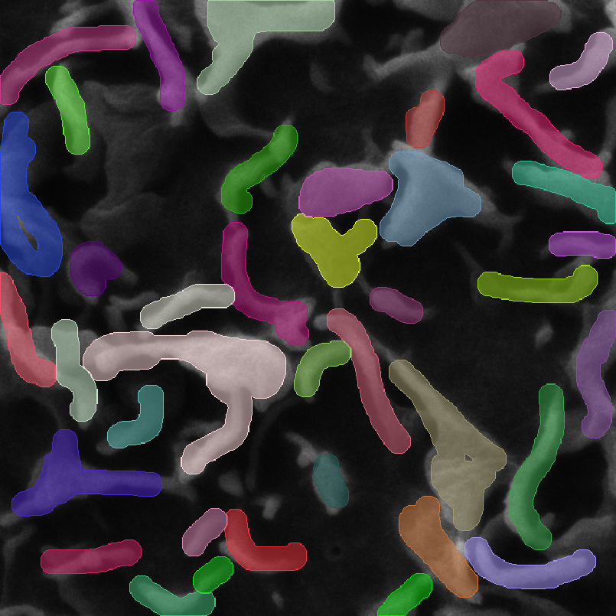
Feature: Scoring
Input
Reference
Input segments are associated with reference segments to determine correctness

Slide 15
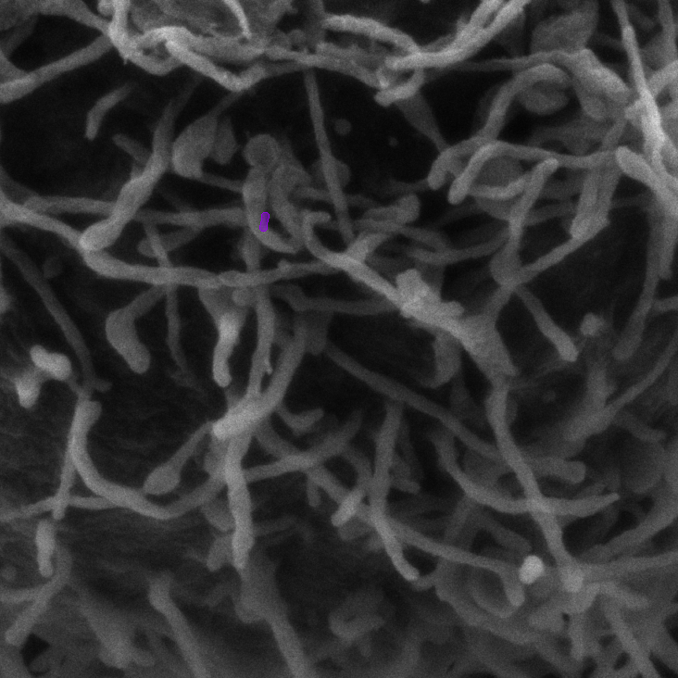
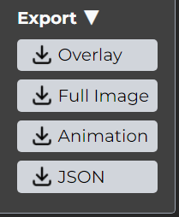
Feature: GIF Export
Example exported GIF

Slide 16
Feature: GIF Export
Room {i} on GIF encoder:
Draw Event
Update Internal State
Add frame to GIF

Slide 17



System Architecture
State
State
Join
Join
Scoring
Microservice
GIF Encoder Microservice
Server
Room ID
Room ID
Room ID/
Draw Events
State/
Image
GIF
Score
Client
Notes:
Plan after

Slide 18
Demo

Slide 19
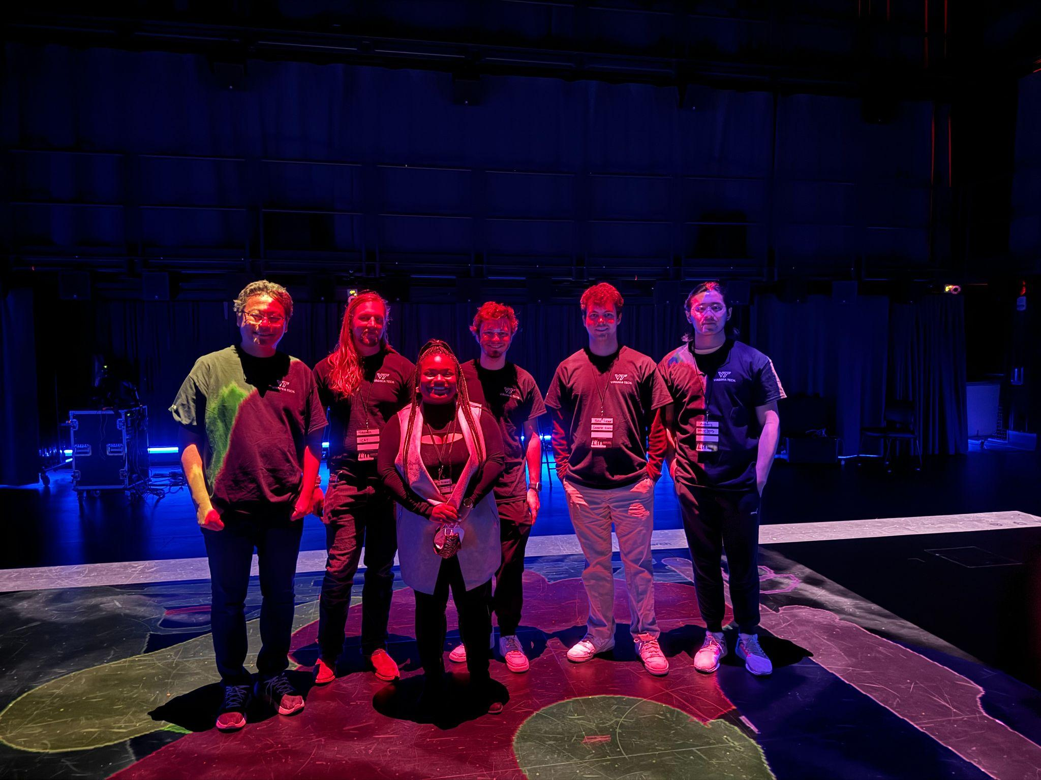
Demo: VT Science Festival
The team standing on the display at the Cube

Slide 20
Future Work
1.
Scaling the application
2.
Automated Segmentation
3.
Researcher Features

Slide 21
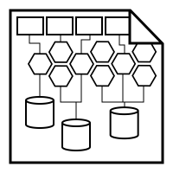
Future Work: Scaling
Scale the application to support tens to hundreds of simultaneous users
Had a maximum of 10 users at the VT Science Festival, so not immediately necessary

Slide 22
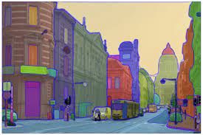
Future Work: Automatic Segmentation
AI automated segmentation and analysis
Attempted but unsuccessful this semester
Segment Anything Model (SAM)

Slide 23
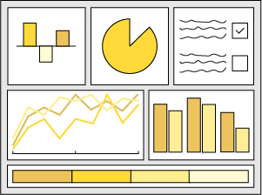
Future Work: Researcher Features
Dashboard of segmentations
Database of images
Attempted but dropped due to focus on VT Festival exhibit

Slide 24
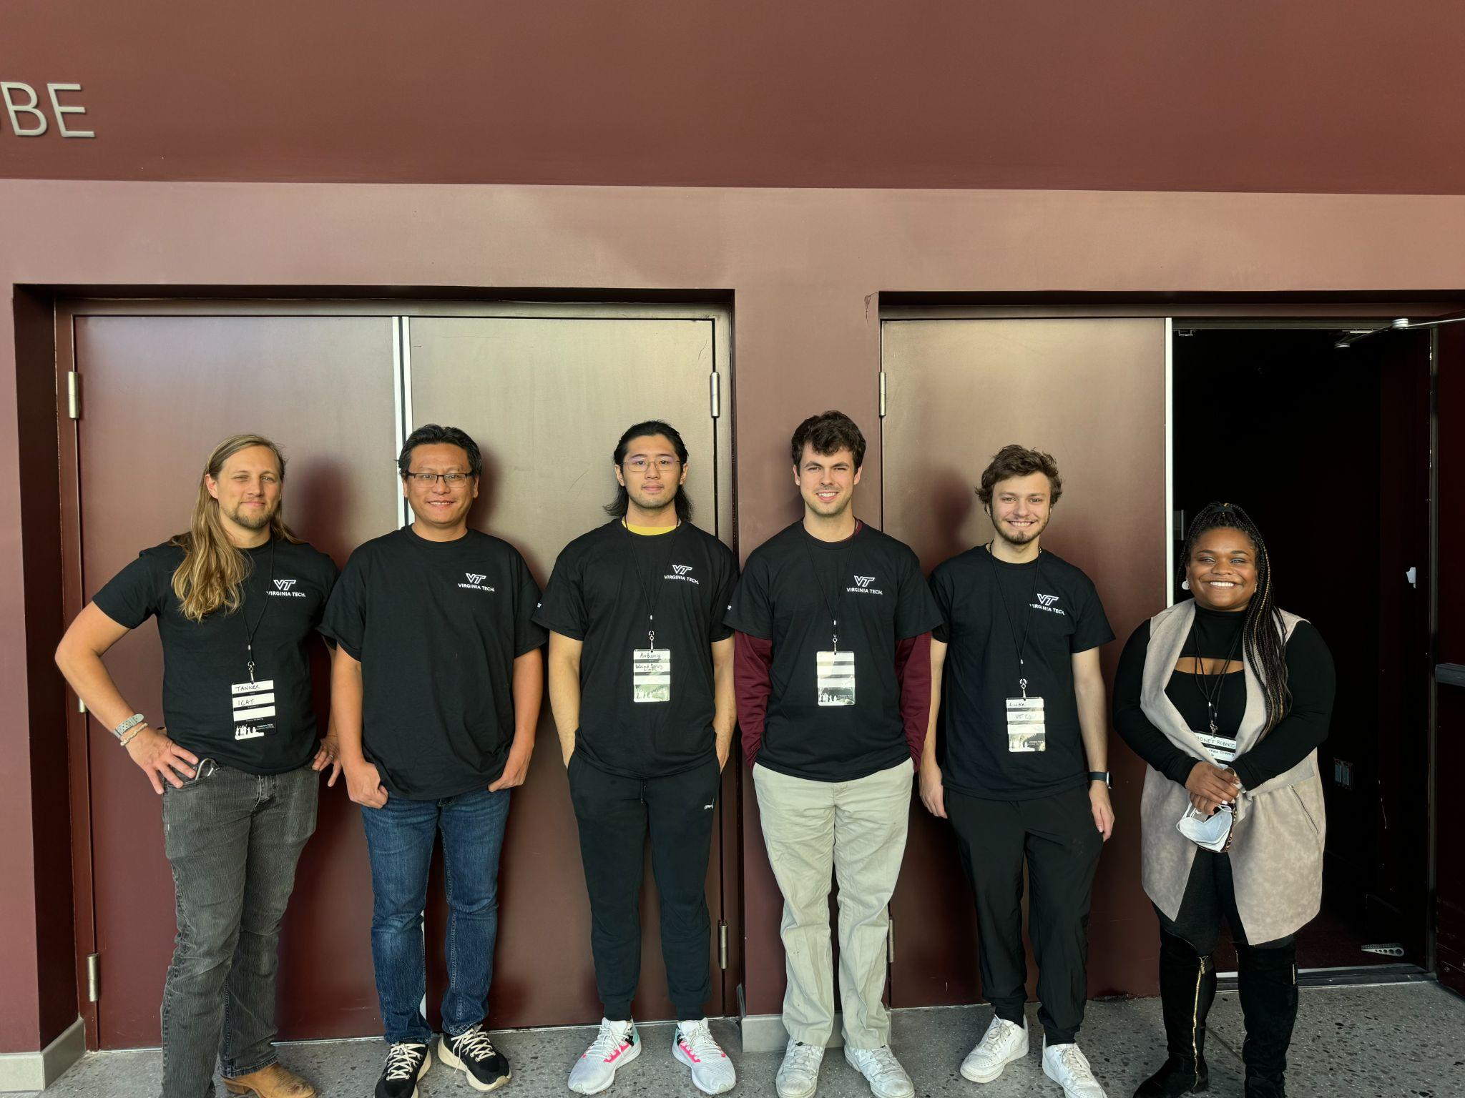
Acknowledgements
Monét Roberts
Yinlin Chen
Tanner Upthegrove
Mohammed Farag
Notes:
Alex
Tanner - CUBE
Monet - Images
Yinlin - Assistance, Mentors ML +:D

Slide 25
References
Kirillov, A., Mintun, E., Ravi, N., Mao, H., Rolland, C., Gustafson, L., Xiao, T., Whitehead, S., Berg, A. C., Lo, W.-Y., Dollár, P., & Girshick, R. (2023). Segment anything. arXiv. https://doi.org/10.48550/arXiv.2304.02643

Slide 26
Questions?
Notes:
Alex

