Slide 1


What is the Impact of Livelihood Strategies on Farmers’ Climate Risk Perceptions in the Bolivian Highlands?
Lisa Rees
Department of Agricultural Economics
University of Missouri-Columbia
December 5, 2008

Slide 2
Introduction
Risk Management Strategies → Climate Risk Perceptions
Ordinal Logistic Regression
  Dread
  Diversification
  Access to Credit
  Climate Knowledge
Focus Groups conducted
  Weather/Climate Change
  Weather Event Severity
  Ex-Ante Risk Management Strategies
  Ex-Post Risk Management Strategies

Slide 3
Objectives
Main objective- Understand how farmers’ climate risk perceptions are impacted by livelihood strategies
  Perceptions are linked to their assets (financial capital and social capital) within their livelihood
Specific objective 1- Identify and describe farmers’ climate risk perceptions of climate hazards
  Identify differences by region

Slide 4
Literature
Livelihood and Risk Management Strategy
  Livelihoods are created by livelihood resources
    natural capital, financial capital, human capital and social capital
  Ex-Ante Risk Management Strategies (Morduch, 1995)
    Diversification
    Off-Farm Income
  Ex-Post Risk Management Strategies (Morduch, 1995
    Credit
    Insurance
Risk Perception
  Psychometric model is risk perception being a function of the properties of the hazard (Sjoberg, 2000)
  Slovic (1987) identified dread and unknown

Slide 5
Conceptual
Framework
Household
Unknown
Dread
Initial Risk Perception
Risk
Management
Risk Attitude
TIME
Livelihood
Strategies
Unknown
Dread
Actual Risk Level
Risk Perception

Slide 6
Hypotheses
H1: diversified portfolio → lower climate risk perceptions
H2: access to credit → lower climate risk perceptions
H3: access to climate information → lower climate risk perceptions
H4: lower dread feelings→ lower climate risk perceptions

Slide 7
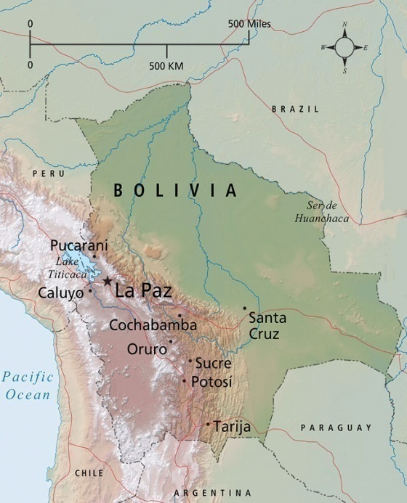
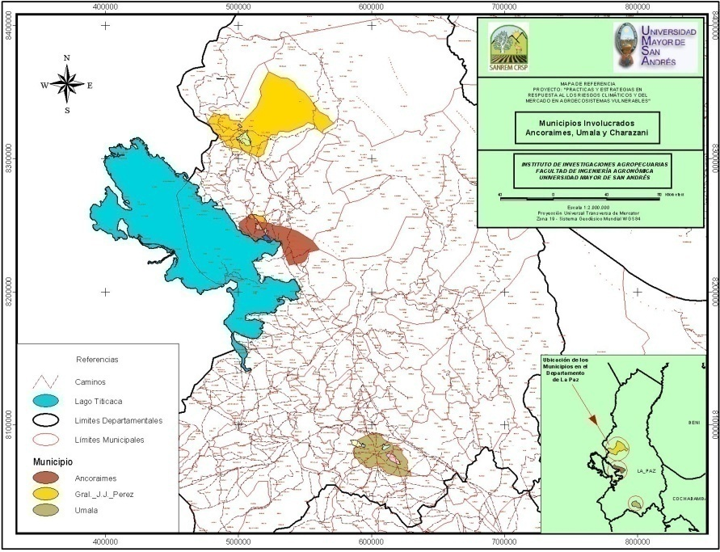
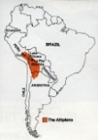
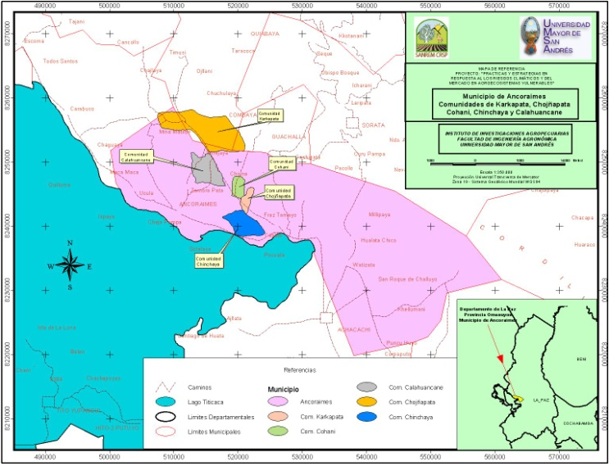
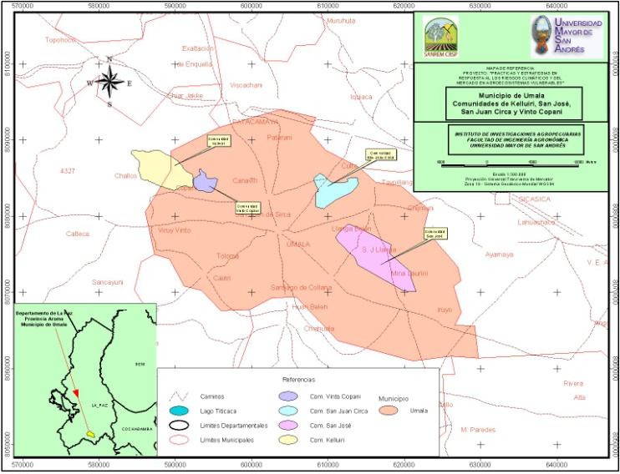
Overview of Ancoraimes & Umala
A.
B.
Lake
Titicaca
Ancoraimes
La Paz
Umala
Altiplano
C. Ancoraimes
D. Umala
Chojňapata
Kellhuiri
Calahuancani
Cohani
Vinto Coopani
Karcapata
San Juan Cerca
Chinchaya
San José de Llanga
Lake Titicaca

Slide 8
Objective vs. Subjective Risk
Garcia, Raes, Jacobsen and Michel (1997)
Notes:
4 very high risk

Slide 9
Focus Group Findings
Weather/Climate Change
Hazard Severity
Experience Weather/Climate Change
  Umala- drier conditions, more wind, lower temperatures and fewer frosts
  Ancoraimes- drier conditions
Weather Event Severity
  hail, frost, drought
Notes:
No longer able to predict using indicators
Umala-
Our livestock has always been affected by frosts and coldness. How? It produces pneumonia (khoto) in young cows and sheep. It is like the altitude disease, but when it affects them we already know we will lose them. We don’t know how to cure them, and we have just a few barns to protect them. In the flat plains located far away from the house, yards are made only from stones, which makes possible only for native livestock to survive.
Chojnapata no drought

Slide 10
Focus Group Findings
Ex-Ante Risk Management Strategies
Frost and Hail- rituals
Planting in three different areas
  Umala
    Frost- chemicals, varieties
    Drought- planting multiple times
    Flooding- higher elevation, vertical furrows
  Ancoraimes
    Relatives
    Drought- certain areas, higher elevation, plow deep, store more products
Notes:
We also have field agents (authority in charge of taking care of the crops around the community). He walks around the plots, makes smoke; this happens in my community (Kellhuiri). He always has to stir fire, make smoke; if he doesn’t do it there is a sanction and a fine he has to pay. When it is about to hail, the field agent has to make smoke the entire week. It is clear that when the day is sunny you feel a cold breeze, so before it comes we make smoke. This is how we protect ourselves.

Slide 11
Focus Group Findings
Ex-Post Risk Management Strategies
Rituals
Can’t Cope
  Umala
    Institutions, government
    Children- jobs
    Migrate
    Works for neighbors
      Drought- chuno
  Ancoraimes
    Don’t ask government
    Migrate
Notes:
“Regarding drought, when it does not rain we do K’uanchar (Andean ritual), which consists in bringing water from different places located far away and put it together with a sheep’s blood. With these two elements we go around the churches several times, while we pray at the same time.”

Slide 12
Model
Other Income + Total Cattle + Total Sheep + Location + Dread + Access to Credit + Shock Experience + Contact Family Outside + Spanish Speaking → Climate Risk Perceptions

Slide 13
Ordinal Logistic Regression Findings

Slide 14
Ordinal Logistic Regression Findings

Slide 15
Conclusion
Significant Explanatory Variables
  Diversification- income
  Access to credit
  Trusted Knowledge
Non-Significant Explanatory Variables
  Dread
  Livestock
Further Research
  Gender
  Individual hazards
  Rituals
Notes:
Dread- risk perception literature looking hazard like nuclear explosion or aid dread? Difference when people are living with the hazard making it less significant in explaining perception of risk
Dread translation?
Livestock more effected by climate hazards-- in addition, focus group chemical fear of chemicals- using antibiotics on animals greater risk
Promotoming income diver, access credit
Institutions and policy lower risk percpetion actual efficient decision--- throught communication network focus groups revealed climate wasn’t mixed feeling trust over the radio… more trust local biological indicators however radio (many believe information isn’t specific to their area)… explain those aren’t working anymore get information from elders know indicators, people markets, community members, watching others.
Mediums that are trusted bottom down approach compared top-down….

Slide 16
References
Morduch, J. (1995). "Income Smoothing and Consumption Smoothing." The Journal of
Economic Perspectives 9(3): 103-114.
Slovic, P. (1987). “Perception of Risk.” Science 236: 280-285.
Sjoberg, L. (2000). "Factors in Risk Perception." Risk Analysis 20(1): 1-12.

