Slide 1


TaxData 2
Maleehah Zafar
CS 4624 Multimedia, Hypertext and Information Access
Dr. Fox
Virginia Tech, Blacksburg VA 24061
12/13/2022

Slide 2
Table of Contents
01 Project Overview
02 Important Terms
03 Deliverables
04 Timeline
05 Tools
06 Work Completed
07 Future Work
08 Challenges
09 Solutions
10 Lessons Learned
11 Acknowledgements
12 References

Slide 3
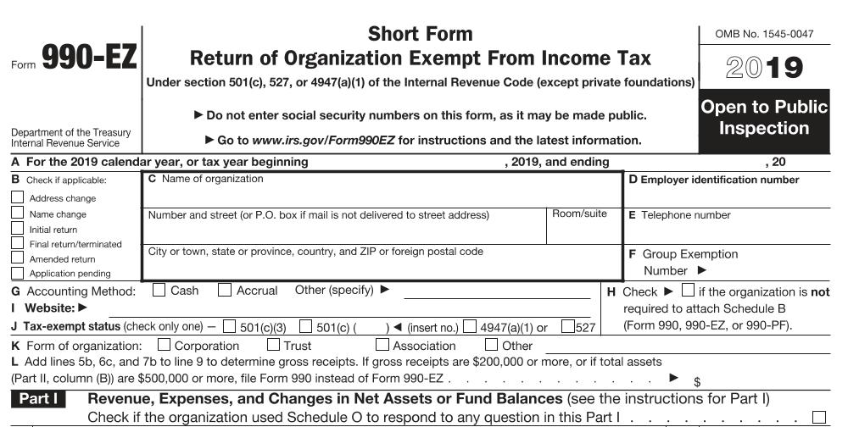
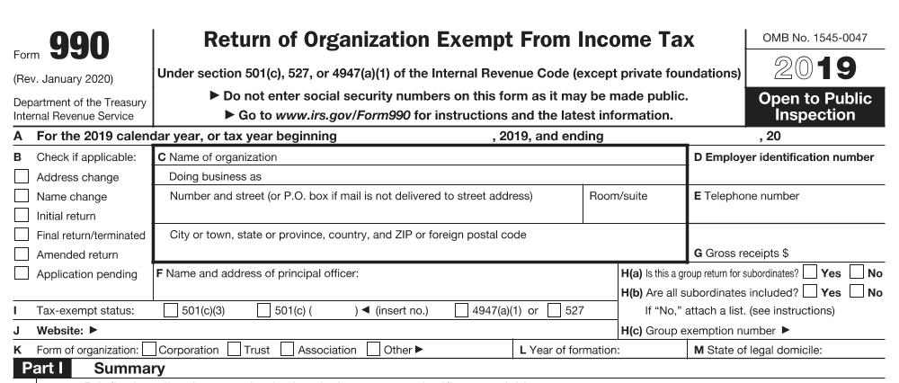
Project Overview
Converting 20 years of tax data in flat file and XML file format into a readable format and run some preliminary analysis

Slide 4
Important Terms
Form 990 and Form 990-EZ
Tax-exempt organizations, nonexempt charitable trusts, and section 527 political organizations file this form. Depending on the amount the organization earned, they will fill out either Form 990 or Form 990-EZ.
Schedule A-O, R
If an organization fills out Form 990, then they may be required to fill out one of the many Schedules which gives more information about the organization.
Schedule J gives information about compensation of officers at organizations

Slide 5




Deliverables
Create a new database with at least IRS Form 990 and Schedule J
Visualize the data in a meaningful way
Add comments and instructions in the repository
Program a universal parser for all types of forms

Slide 6
Timeline
Initial contact with Dr. Zach
Make improvements to previous work
Test parser on other tax forms
Data Analysis
October 2022
December 2022
September 2022
November 2022
Parse 1 Schedule J file
Parse a directory of Schedule J files
Add documentation

Slide 7


Tools
Programming Language
Python
Python Libraries
xml, lxml, sqlite3, pandas
Storage System
Advanced Research Computing (ARC)

Slide 8
Work Completed
Universal Parser
Created a parser that can parse IRS 990, IRS 990-EZ, IRS 990-PF, and Schedules A-O/R
Tested the parser on a subset of files in order to ensure correct functionality
New Database
Created a new database called NPTR (nonprofit tax records) in ARC
Uploaded data from Form 990, Form 990-EZ, and Schedule J
Documentation
Added a detailed README in git repository

Slide 9
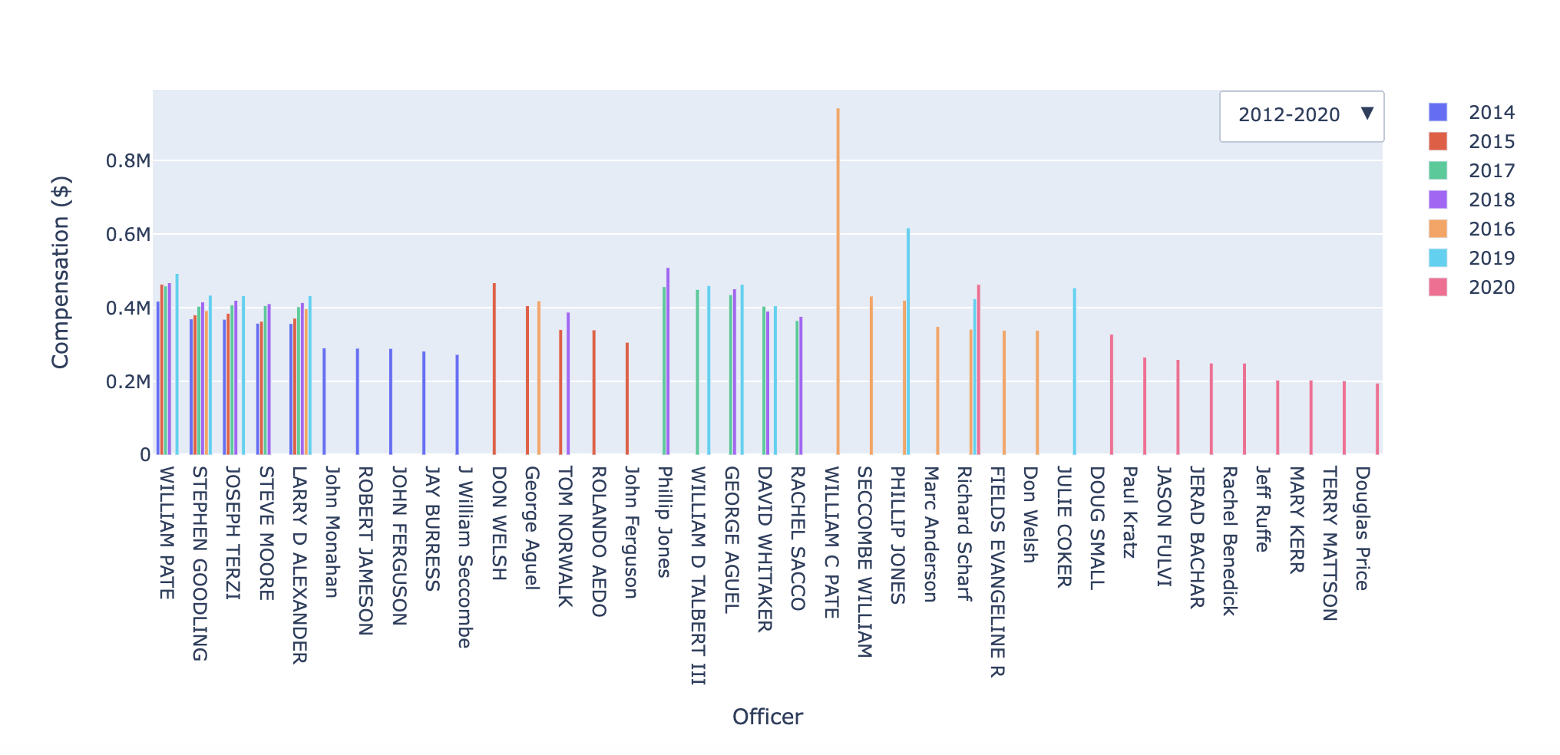
Work Completed
Visualization: Top 10 Highest Paid Officers in Tourism Offices

Slide 10
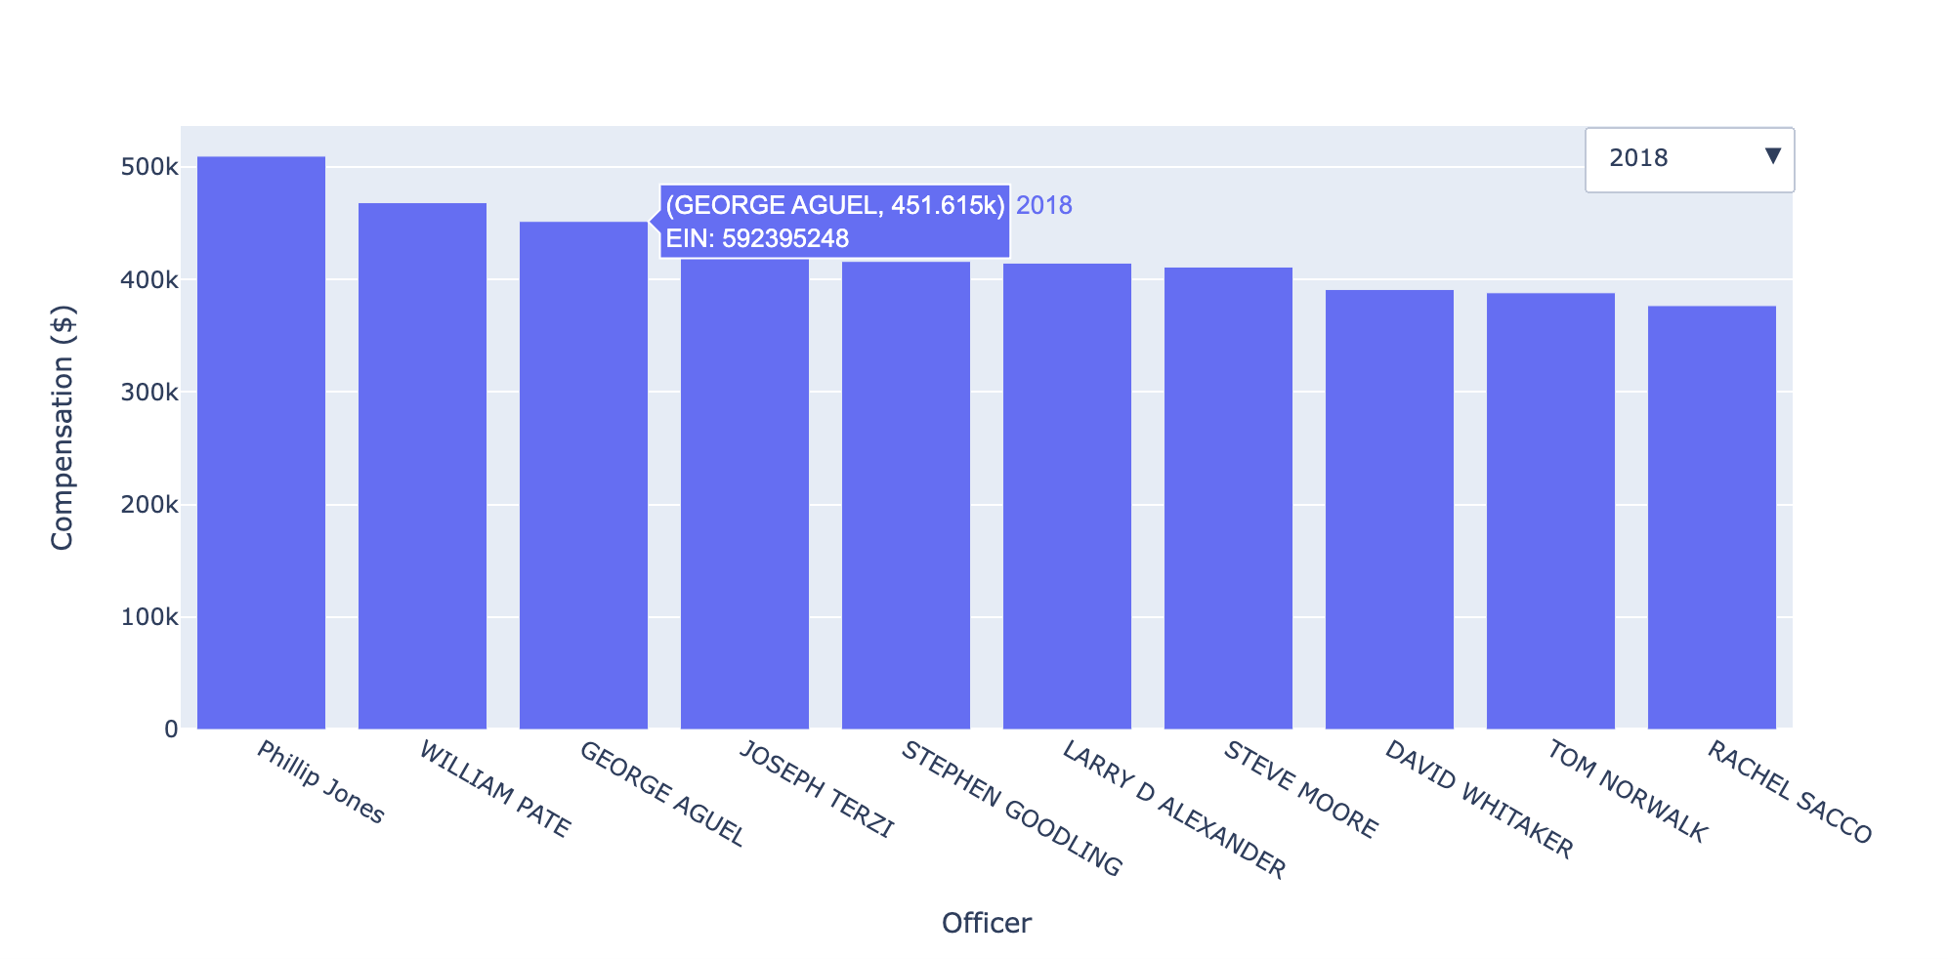
Work Completed
Visualization: Top 10 Highest Paid Officers in Tourism Offices

Slide 11
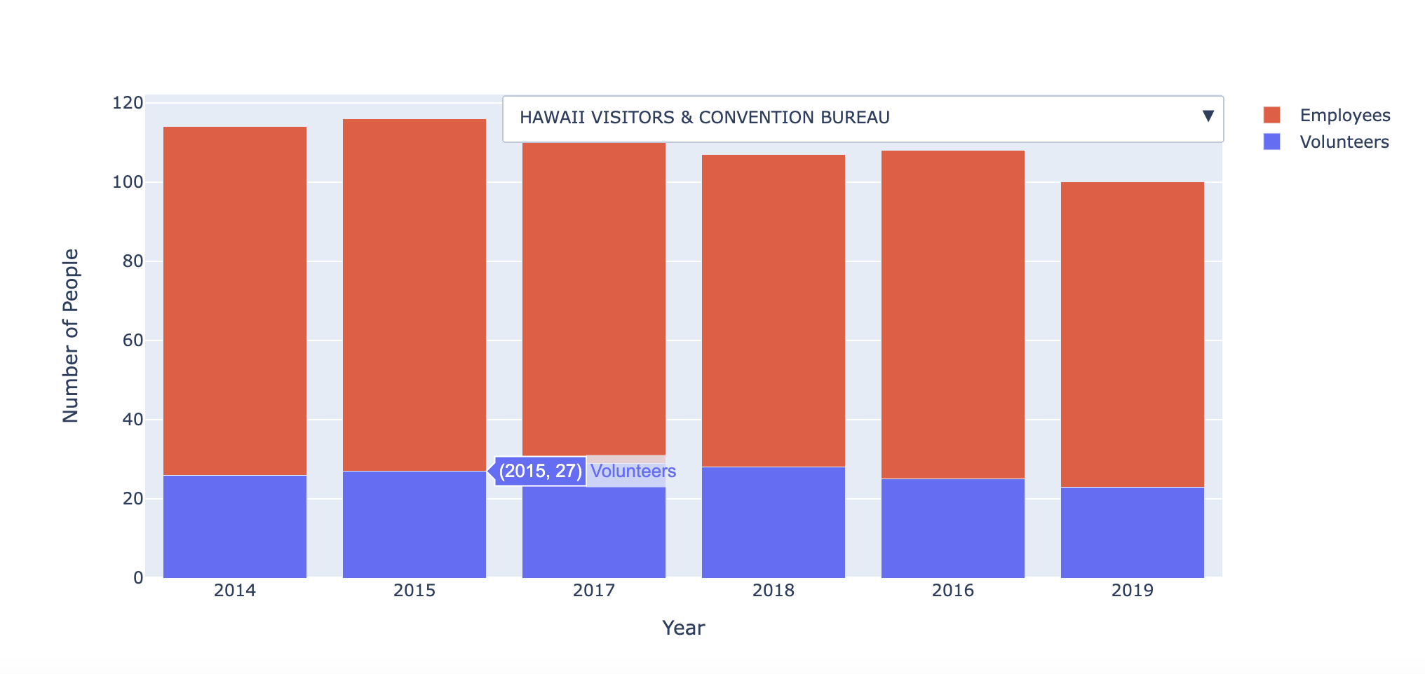
Work Completed
Visualization: Number of Employees and Volunteers in Tourism Offices

Slide 12
Future Work
Update Database
Parse the remaining files which are IRS 990-PF and the other Schedules
Nonprofit Tax Records Website
Design a website where a user can search for specific information about nonprofit organizations
Searching for a nonprofit organizations Schedule J file from 2015
ML Algorithm
Create a machine learning algorithm that can predict which nonprofit organization is a tourism office

Slide 13
Challenges
Minimal Documentation
The team in Spring 2022 did not document their code well
Ineffective Database
The database created in Spring 2022 was not well structured
Duplicate Data
While working on the visualizations, it was discovered that there is duplicate data in the new database

Slide 14
Solutions
Minimal Documentation
Try to document what they have done and document my code extensively
Ineffective Database
Change deliverables of project to create a universal parser and create a new database
Duplicate Data
Create a python script that goes into the database and removes any duplicate data

Slide 15
Lessons Learned
Documentation
Having well-documented code is vital to any project because other people need to know what you did
Flexibility
Being able to pivot in a different direction if the original objectives of a project are unattainable

Slide 16
Acknowledgements
Dr. Florian Zach
an assistant professor in the Pamplin College of Business, specifically the Howard Feiertag Department of Hospitality and Tourism Management, at Virginia Tech
Huihui Zhang
a PhD student in the Pamplin College of Business
Dr. Edward A. Fox

Slide 17
References
https://aws.amazon.com/public-datasets/irs-990/
https://www.irs.gov/charities-non-profits/form-990-series-downloads
https://images.google.com/
https://www.irs.gov/forms-pubs/about-form-990
https://arc.vt.edu/

