Slide 1
IDEAL Webpages
CS6604 Digital Libraries
Presented by
Ahmed Elbery, Mohammed Farghally
Project client
Mohammed Magdy
Virginia Tech, Blacksburg

Slide 2
Agenda
Project overview
Solr and SolrCloud
Solr for indexing the events
Hadoop
Indexing using Hadoop and SolrCloud
Web Interface
Overall Architecture
Screen Shots

Slide 3
Overview
A tremendous amount ≈ 10TB of data is available about a variety of events crawled from the web.
It is required to make this big data accessible and searchable conveniently through the web.
≈ 10TB of .warc.
Use only HTML files.
Notes:
Services :
Browsing :
Descriptions, Locations, date,

Slide 4


Big picture
Crawled Data
Hadoop
Index
Solr

Slide 5
Solr
Solr is an open source enterprise search server based on the Lucene Java search library.
Solr can be integrated with, among others…
PHP
Java
Python
JSON
Request
Solr Server
Reply

Slide 6
SolrCloud
Whet will happen if the server becomes full?
Request
Solr Server
Reply
Shard 2
Shard 1
Solr Server
Solr Server
Solr Server
Solr Server
Solr Server
Solr Server
Notes:
Whet will happen if the server becomes full? In terms of either storage capacity or processing capability

Slide 7
SolrCloud
What is SolrCloud?
Shard 2
Shard 1
Shard & Replicate
Leader
Leader
Scalability
Fault Tolerance and Throughput
Replica
Replica
Replica
Replica
Notes:
Whet will happen if the server becomes full? In terms of either storage capacity or processing capability
A leader is a node that can accept write requests without consulting with other nodes
ZooKeeper server that helps manage the overall structure so that both indexing and search requests can be routed properly

Slide 8
Schema
schema.xml is usually the first file we configure when setting up a new Solr installation.
The schema declares:
what kinds of fields there are
which field should be used as the unique/primary key
which fields are required
how to index and search each field

Slide 9
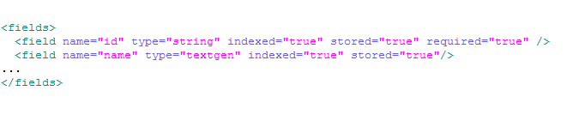



Schema (Cont.)
Notes:
We use the following fields
category: the event category or type
name: the event name
title: the file name
content: the file content
URL: the file path on the HDFS system
id: document ID
version:

Slide 10
SolrCloud control
solrctl instancedir --generate $HOME/solr_configs
solrctl instancedir --create collection1 $HOME/solr_configs
solrctl collection --create collection1 -s numOfShards
http://128.173.49.32:8983/solr/#/~cloud

Slide 11
Event Fields
We use the following fields
category: the event category or type
name: the event name
title: the file name
content: the file content
URL: the file path on the HDFS system
id: document ID
text: copy of the previous fields

Slide 12
Hadoop
What is Hadoop?
Features:-
Scalable
Economical
Efficient
Reliable
Uses 2 main Services
HDFS
Map-Reduce
Notes:
Hadoop is an open-source software framework for storage and large-scale processing of data-sets on clusters of commodity hardware.
Scalable: It can reliably store and process petabytes.
Economical: It distributes the data and processing across clusters of commonly available computers (in thousands).
Efficient: By distributing the data, it can process it in parallel on the nodes where the data is located.
Reliable: It automatically maintains multiple copies of data and automatically redeploys computing tasks based on failures.

Slide 13
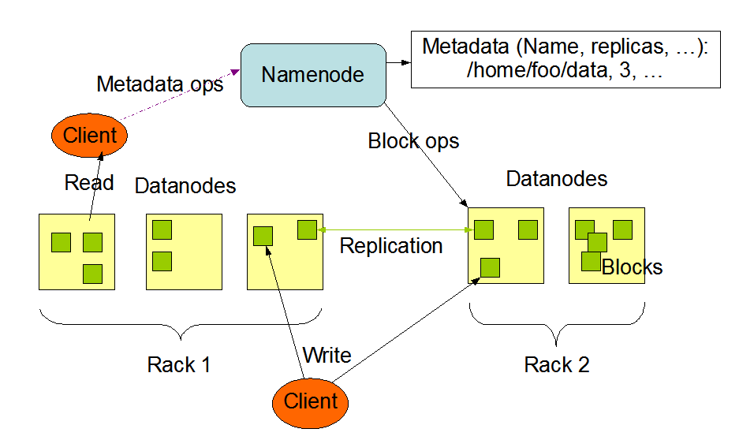
HDFS Architecture
http://archive.cloudera.com/cdh4/cdh/4/hadoop/hadoop-project-dist/hadoop-hdfs/HdfsDesign.html
Notes:
Master/slave architecture
HDFS cluster consists of a single Namenode, a master server that manages the file system namespace and regulates access to files by clients.
There are a number of DataNodes usually one per node in a cluster.
The DataNodes manage storage attached to the nodes that they run on.
HDFS exposes a file system namespace and allows user data to be stored in files.
A file is split into one or more blocks and set of blocks are stored in DataNodes.
DataNodes: serves read, write requests, performs block creation, deletion, and replication upon instruction from Namenode.

Slide 14
Some Terminology
Job – A “full program” - an execution of a Mapper and Reducer across a data set
Task – An execution of a Mapper or a Reducer on a slice of data
Task Attempt – A particular instance of an attempt to execute a task on a machine

Slide 15
MapReduce Overview
User
Program
fork
fork
fork
Master
assign
map
assign
reduce
Input Data
Worker
write
Output
File 0
local
write
Worker
Split 0
read
Split 1
Worker
Split 2
Output
File 1
Worker
Worker
remote
read,
sort

Slide 16
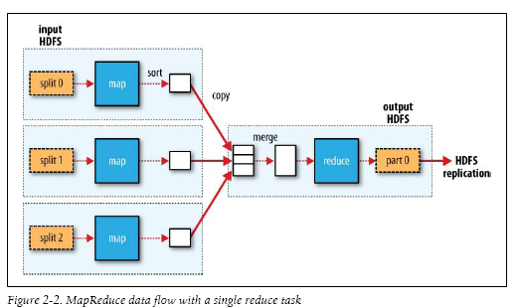
MapReduce in Hadoop (1)

Slide 17
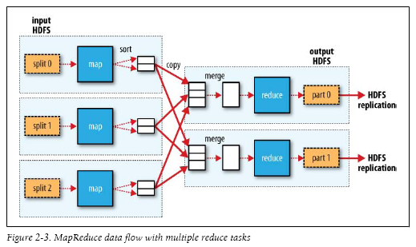
MapReduce in Hadoop (2)

Slide 18
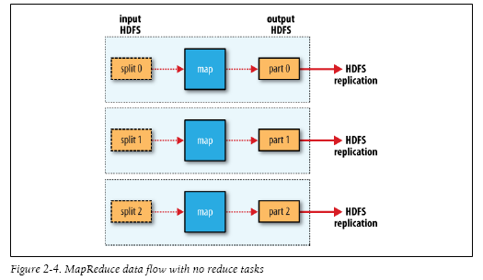
MapReduce in Hadoop (3)

Slide 19
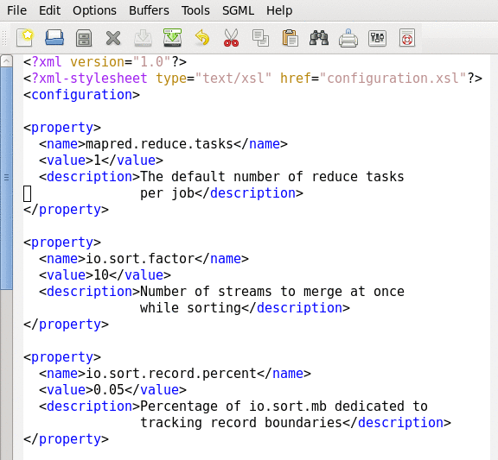
Job Configuration Parameters
On cloudera
/user/lib/hadoop-*-mapreduce/conf/mapred-site.xm

Slide 20
Map TO Reduce
Combiners
Often a map task will produce many pairs of the form (k,v1), (k,v2), … for the same key k (e.g., popular words in Word Count)
Can save network time by pre-aggregating at mapper
combine(k1, list(v1)) → v2
Usually same as reduce function
Partition Function
For reduce, we need to ensure that records with the same intermediate key end up at the same worker
System uses a default partition function e.g., hash(key) mod R

Slide 21
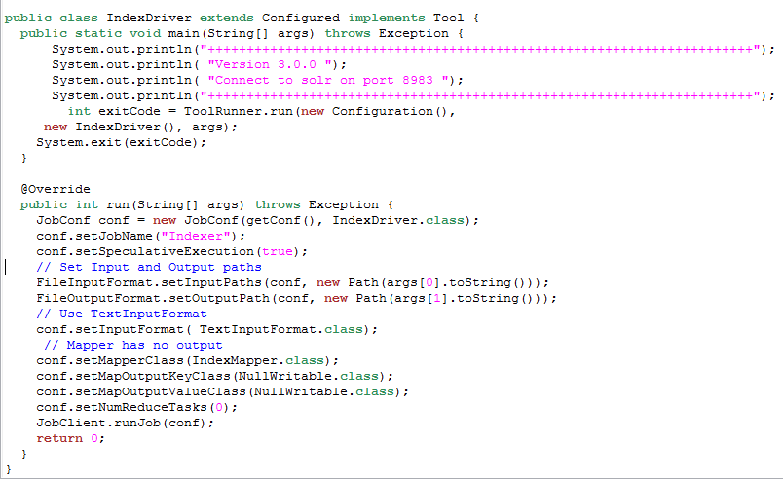
IndexerDriver.java

Slide 22
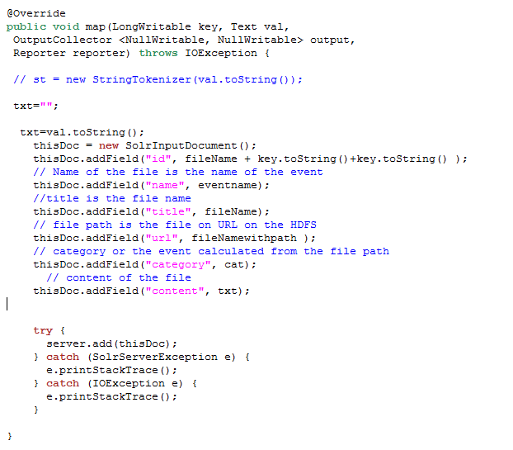
Indexer,aper

Slide 23
Solr REST API
Solr is accessible through HTTP requests by using Solr’s REST API.
Hard to create complex queries
Results are returned as strings which requires some form of parsing.
http://preston.dlib.vt.edu:8983/solr/collection1/select?q=Sisters&wt=json&indent=true&hl=true&hl.simple.pre=%3Cem%3E&hl.simple.post=%3C%2Fem%3E
Notes:
Hadoop: required for distributed processing and speeding up the process of extracting data from archive files (.warc) and place it in html files.
Solr: required for parsing and indexing the html files to make them available and searchable through the web.
PHP: for server side web development.
Solarium: which is a PHP client for Solr to allow easy communication between PHP programs and the Solr server containing the data.

Slide 24
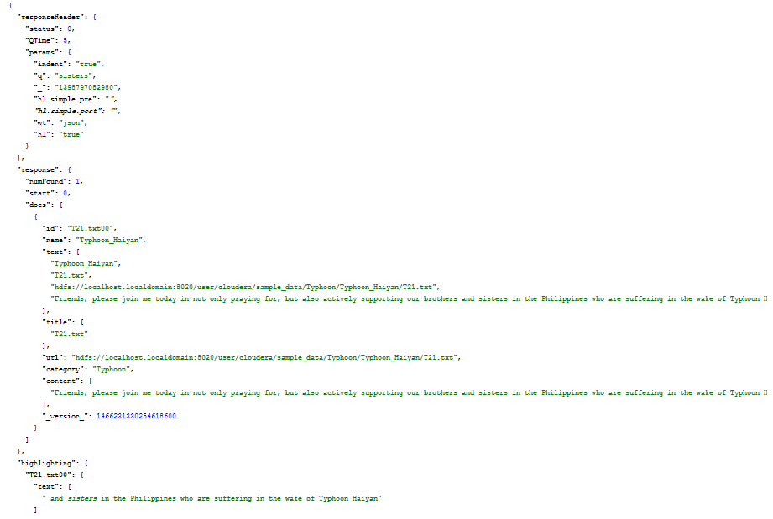
Solr REST API (Cont.)
Notes:
Hadoop: required for distributed processing and speeding up the process of extracting data from archive files (.warc) and place it in html files.
Solr: required for parsing and indexing the html files to make them available and searchable through the web.
PHP: for server side web development.
Solarium: which is a PHP client for Solr to allow easy communication between PHP programs and the Solr server containing the data.

Slide 25
Solarium
Solarium is a PHP client for Solr to allow easy communication between PHP programs and the Solr server containing the indexed data.
Solarium provides an Object Oriented interface to Solr which makes it easier for developers than the Solr’s REST API.
Current version 3.2.0.
Notes:
Hadoop: required for distributed processing and speeding up the process of extracting data from archive files (.warc) and place it in html files.
Solr: required for parsing and indexing the html files to make them available and searchable through the web.
PHP: for server side web development.
Solarium: which is a PHP client for Solr to allow easy communication between PHP programs and the Solr server containing the data.

Slide 26
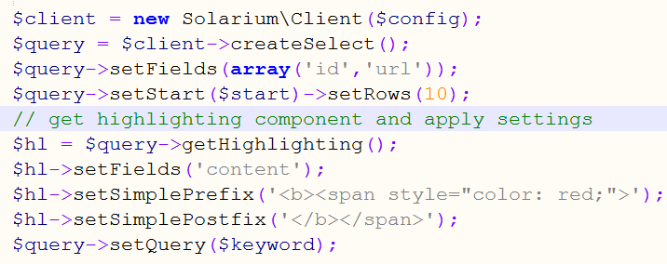
Why Solarium
Solarium makes it easier for creating queries.
Object Oriented interface rather than URL REST interface.
Notes:
Hadoop: required for distributed processing and speeding up the process of extracting data from archive files (.warc) and place it in html files.
Solr: required for parsing and indexing the html files to make them available and searchable through the web.
PHP: for server side web development.
Solarium: which is a PHP client for Solr to allow easy communication between PHP programs and the Solr server containing the data.

Slide 27
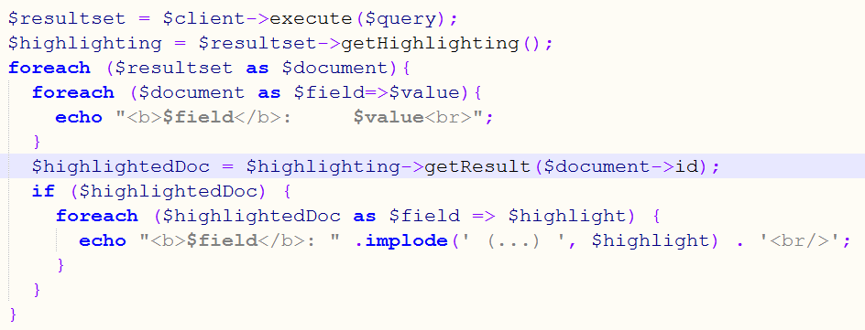
Why Solarium (Cont.)
Solarium makes it easier for getting results
Rather than parsing JSON or XML strings results are returned as a PHP associative arrays.
Notes:
Hadoop: required for distributed processing and speeding up the process of extracting data from archive files (.warc) and place it in html files.
Solr: required for parsing and indexing the html files to make them available and searchable through the web.
PHP: for server side web development.
Solarium: which is a PHP client for Solr to allow easy communication between PHP programs and the Solr server containing the data.

Slide 28
Interface Architecture
Search requests(AJAX)
Web Interface
(HTML)
Query
Server
(PHP)
Query
Solr Server
Solarium
Results
Events Information
Response
(Assoc. Array)
Response
(JSON or XML)
Events Information
Index
MYSQL DB
Notes:
Hadoop: required for distributed processing and speeding up the process of extracting data from archive files (.warc) and place it in html files.
Solr: required for parsing and indexing the html files to make them available and searchable through the web.
PHP: for server side web development.
Solarium: which is a PHP client for Solr to allow easy communication between PHP programs and the Solr server containing the data.

Slide 29
Overall Architecture
Search requests(AJAX)
Web Interface
PHP Module
Query
Query
Solr Server
Results
Solarium
Response
(Assoc. Array)
Response
(JSON or XML)
Events Information
MYSQL DB
Events Information
WARC Files
Hadoop Uploader
Module
Map/Reduce
Extraction/
Filtering Module
.html Files
Indexer
Module
Index

Slide 30
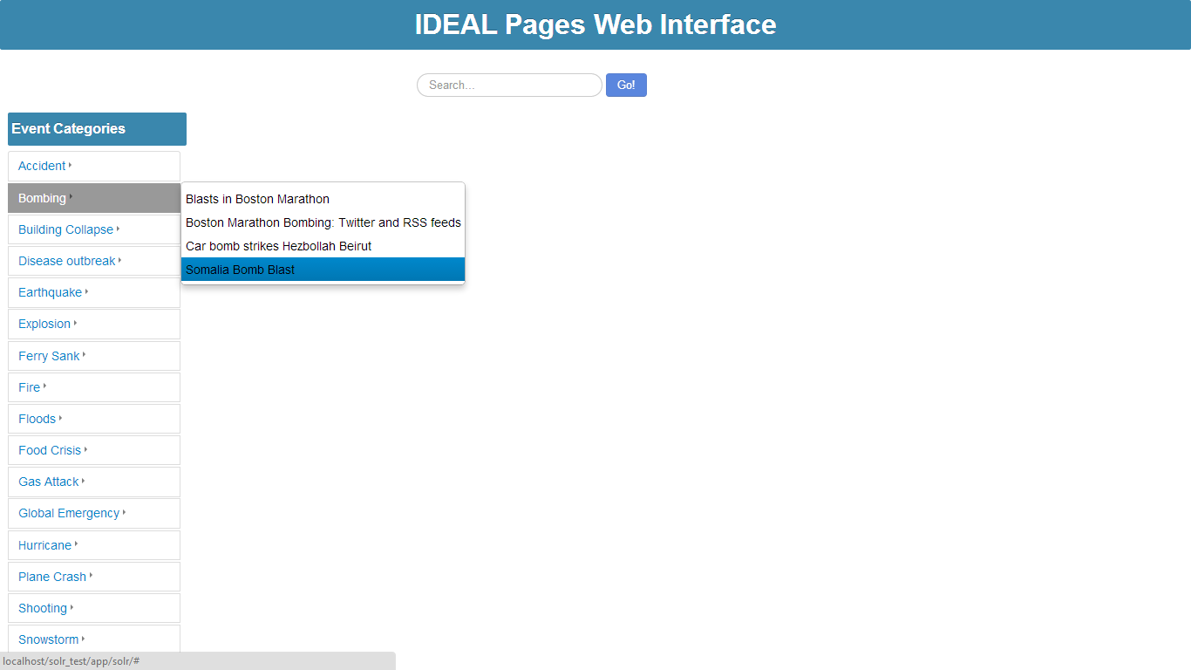
Screen Shots
Notes:
Hadoop: required for distributed processing and speeding up the process of extracting data from archive files (.warc) and place it in html files.
Solr: required for parsing and indexing the html files to make them available and searchable through the web.
PHP: for server side web development.
Solarium: which is a PHP client for Solr to allow easy communication between PHP programs and the Solr server containing the data.

Slide 31
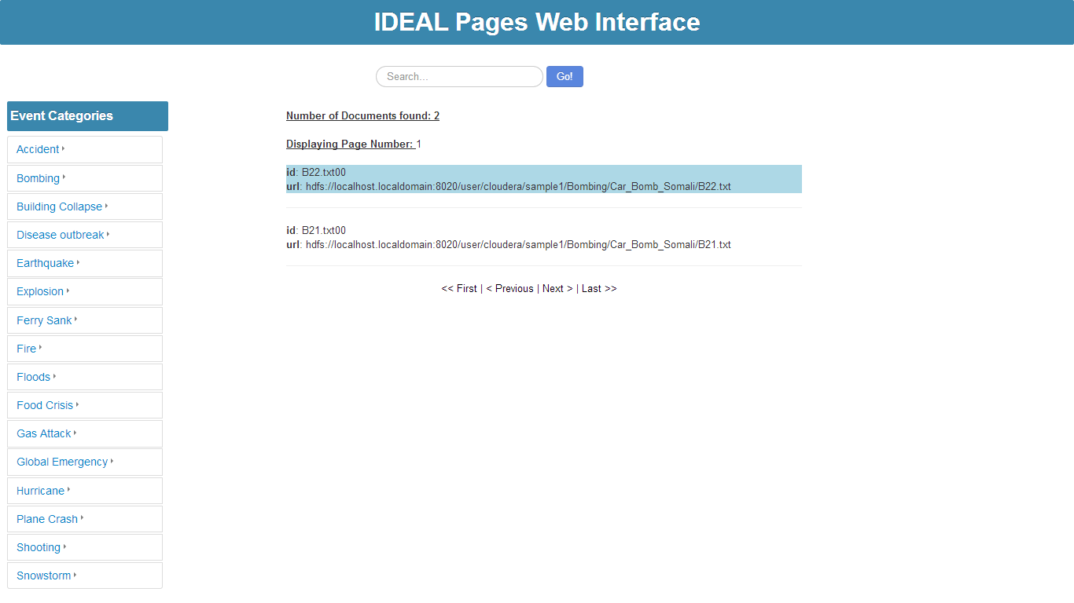
Screen Shots (Cont.)
Notes:
Hadoop: required for distributed processing and speeding up the process of extracting data from archive files (.warc) and place it in html files.
Solr: required for parsing and indexing the html files to make them available and searchable through the web.
PHP: for server side web development.
Solarium: which is a PHP client for Solr to allow easy communication between PHP programs and the Solr server containing the data.

Slide 32
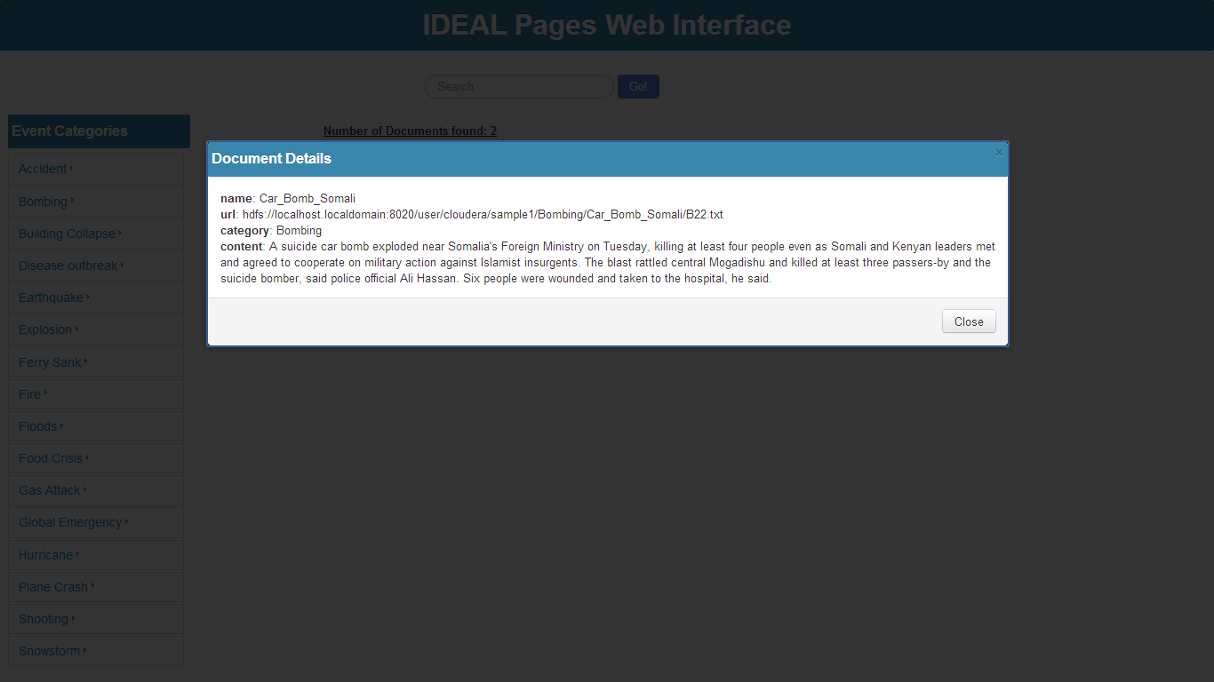
Screen Shots (Cont.)
Notes:
Hadoop: required for distributed processing and speeding up the process of extracting data from archive files (.warc) and place it in html files.
Solr: required for parsing and indexing the html files to make them available and searchable through the web.
PHP: for server side web development.
Solarium: which is a PHP client for Solr to allow easy communication between PHP programs and the Solr server containing the data.

Slide 33
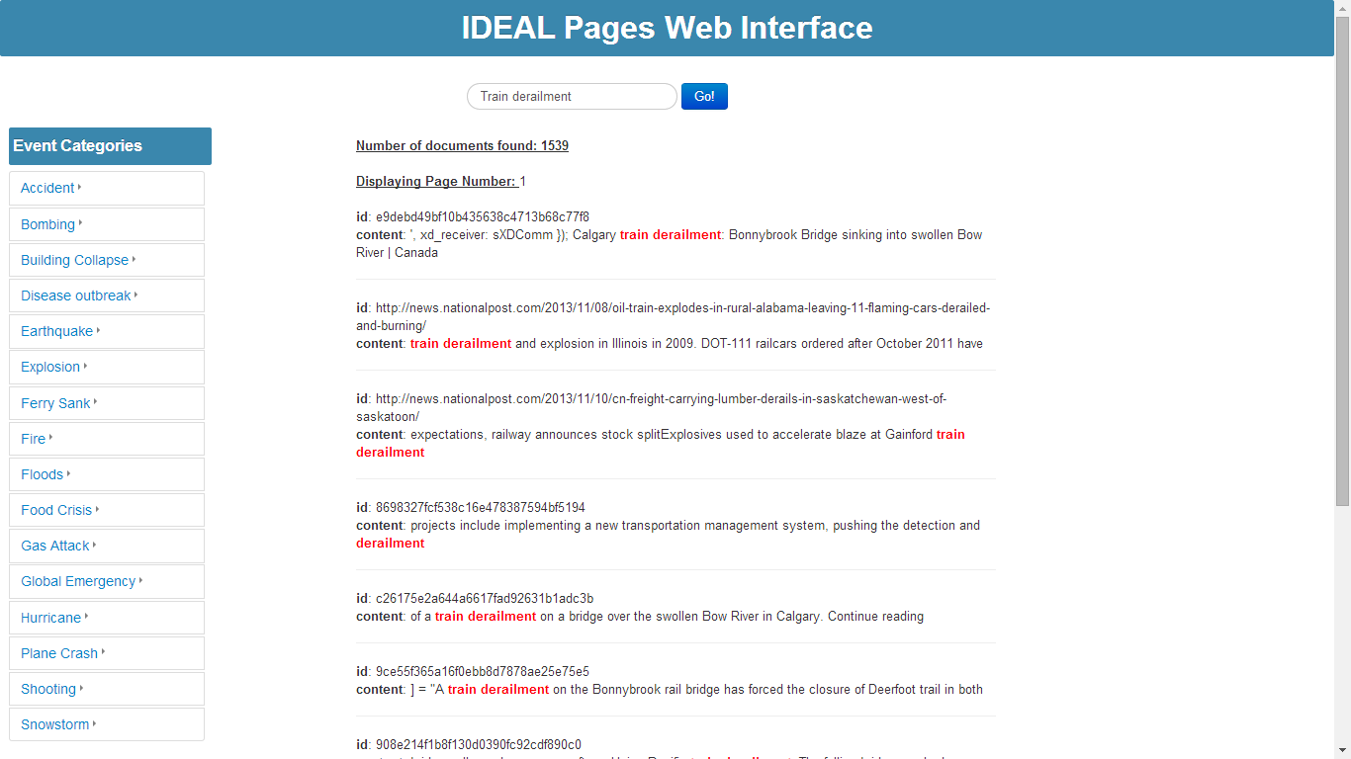
Screen Shots (Cont.)
Notes:
Hadoop: required for distributed processing and speeding up the process of extracting data from archive files (.warc) and place it in html files.
Solr: required for parsing and indexing the html files to make them available and searchable through the web.
PHP: for server side web development.
Solarium: which is a PHP client for Solr to allow easy communication between PHP programs and the Solr server containing the data.

Slide 34
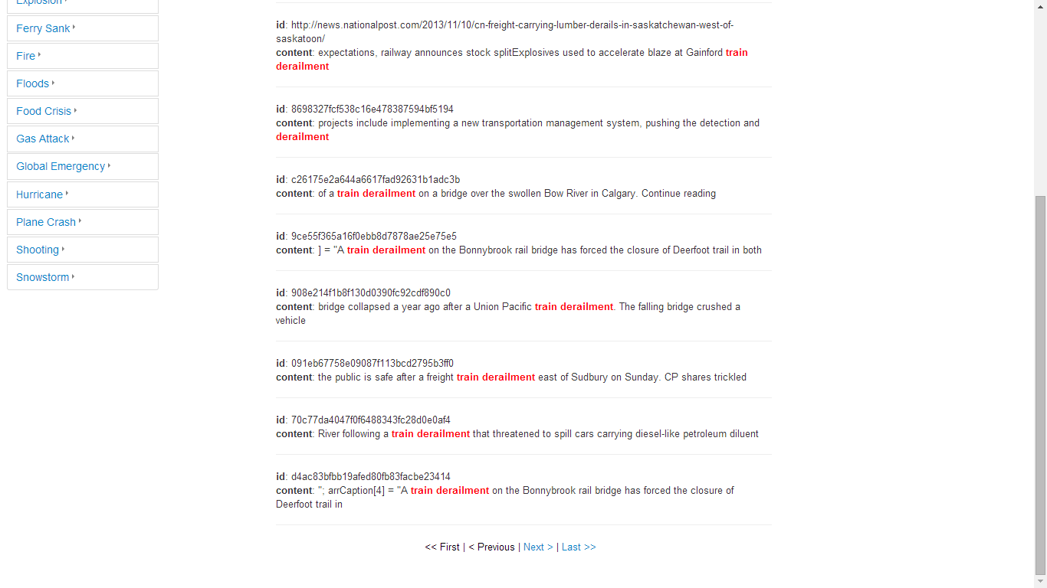
Screen Shots (Cont.)
Notes:
Hadoop: required for distributed processing and speeding up the process of extracting data from archive files (.warc) and place it in html files.
Solr: required for parsing and indexing the html files to make them available and searchable through the web.
PHP: for server side web development.
Solarium: which is a PHP client for Solr to allow easy communication between PHP programs and the Solr server containing the data.

Slide 35
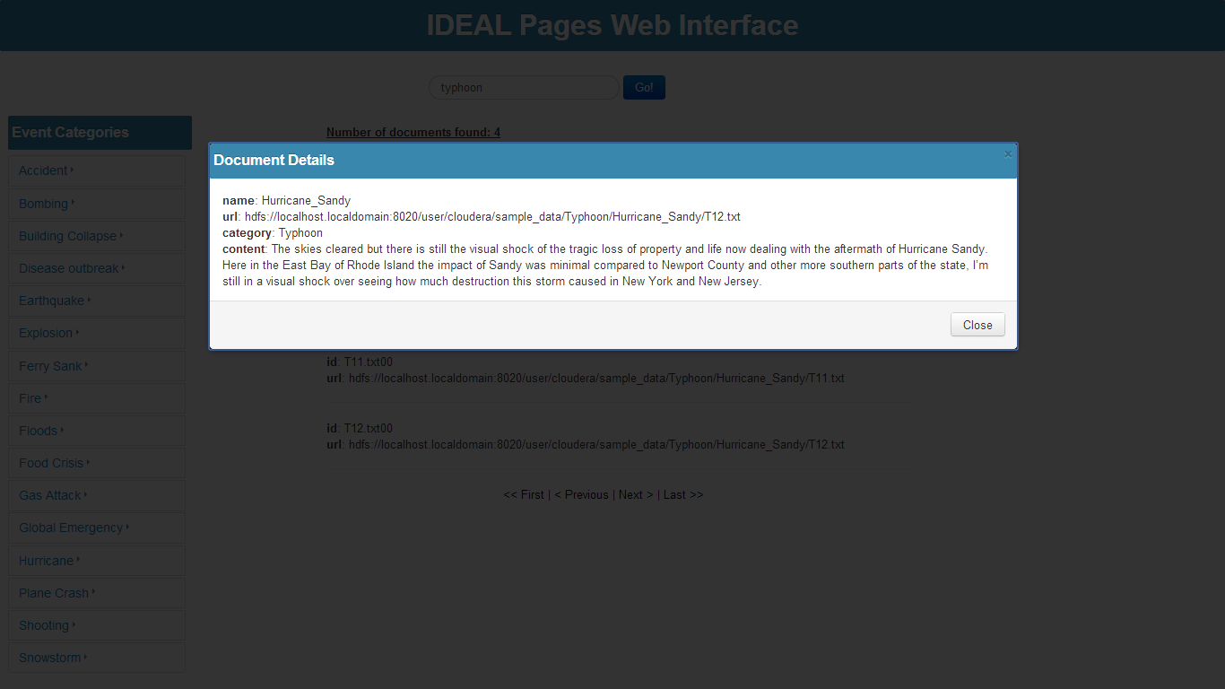
Screen Shots (Cont.)
Notes:
Hadoop: required for distributed processing and speeding up the process of extracting data from archive files (.warc) and place it in html files.
Solr: required for parsing and indexing the html files to make them available and searchable through the web.
PHP: for server side web development.
Solarium: which is a PHP client for Solr to allow easy communication between PHP programs and the Solr server containing the data.

Slide 36
Mohammed Farghally
&
Ahmed Elbery

