Slide 1
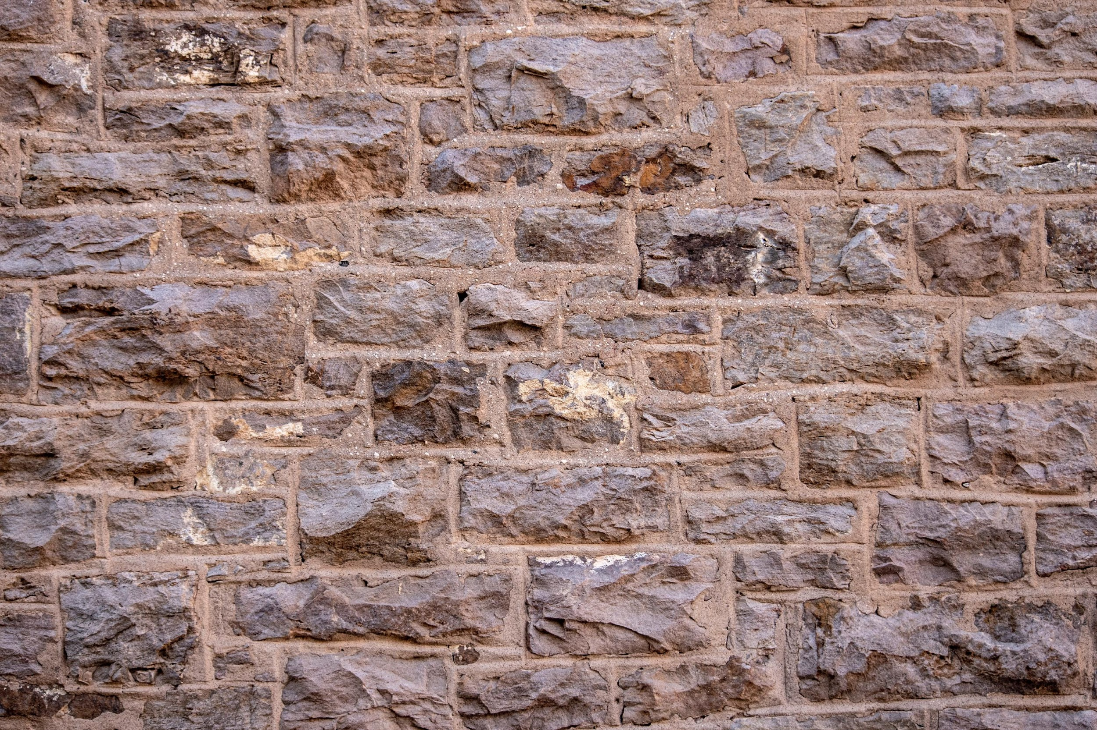

Strategic Management
Exercises
External & Internal Analysis
Unless otherwise noted, this slide deck is (c) Virginia Polytechnic Institute and State University. It is released under a Creative Commons Attribution Noncommercial ShareAlike 3.0 license (CC BY NC-SA 3.0)
Instructor Name | Name of Institution
http://hdl.handle.net/10919/102735
Photo by Jon Sailer on Unsplash

Slide 2
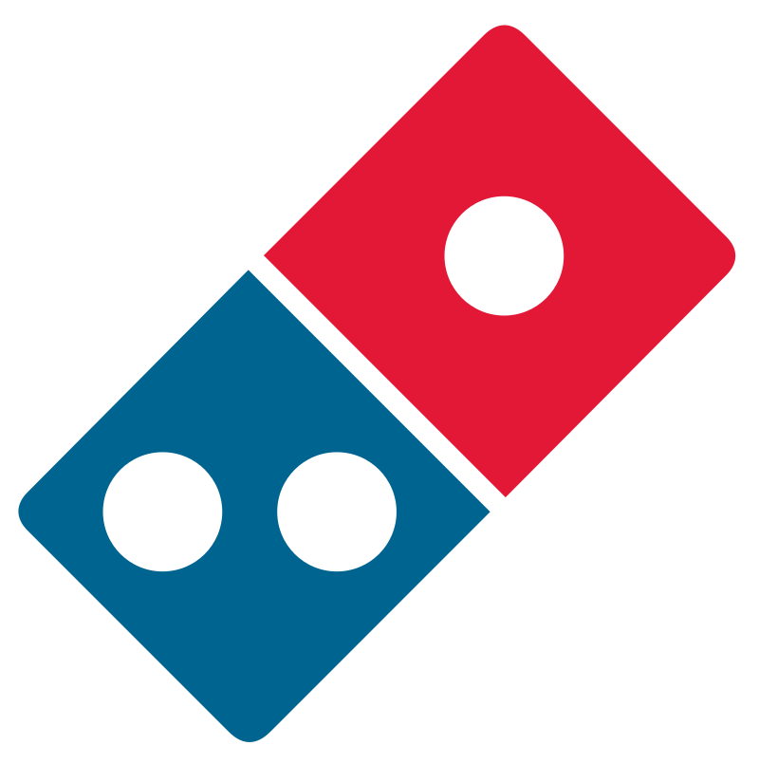
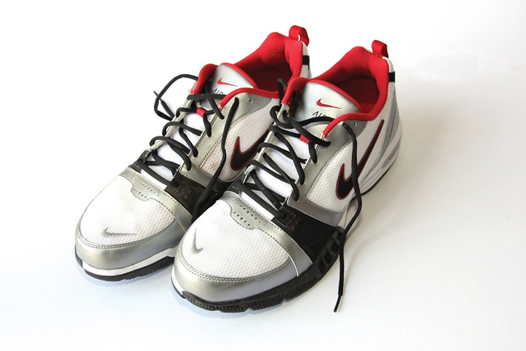
Class Exercise: External and Internal Analyses
Image Source: https://pixabay.com/photos/sneakers-runners-shows-sports-nike-71623/
Image Source: https://en.wikipedia.org/wiki/Domino's_Pizza#/media/File:Domino's_pizza_logo.svg
Athletic Shoes
Teams 1-4
Domino’s Pizza
Teams 5-8
http://hdl.handle.net/10919/102735
Trademarks are property of their respective owners and are not subject to the Creative Commons license on this overall slide deck.

Slide 3
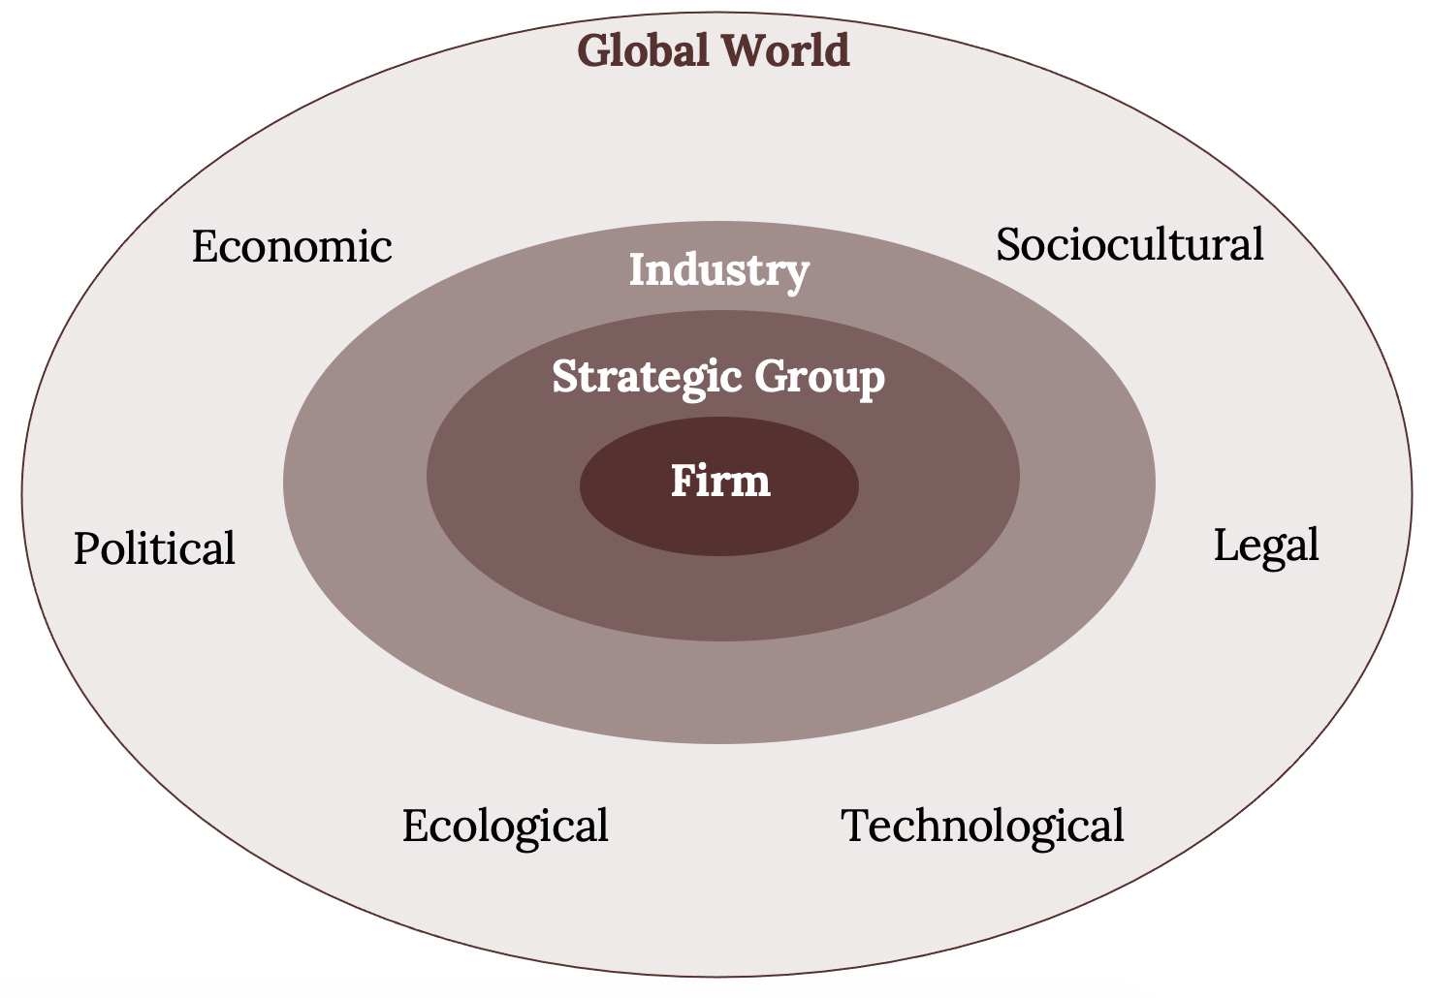
External Analysis
The Firm Embedded in its External Environment
http://hdl.handle.net/10919/102735

Slide 4
Industry: _________________ Identify the strength of the force and changes in the general environment that are impacting this industry for each category below. | How is each change you identify impacting this industry? | How does the firm’s position influence the impact?
Political _____________
Economic ___________
Sociocultural /Demographic __________
Technological __________
Ecological ____________
Legal ____________
Team #___
Salient Findings & Implications:
http://hdl.handle.net/10919/102735
Notes:
INSTRUCTORS: PROVIDE A HARD COPY OF THIS TO EACH TEAM

Slide 5
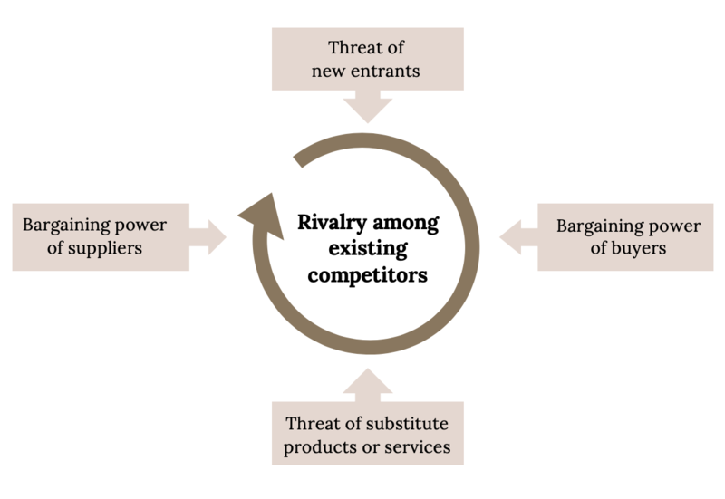
Porter’s Five Forces of Competition Framework
Kindred Grey (2020). “Porter’s Five Forces.” CC BY-SA 4.0. Retrieved from https://commons.wikimedia.org/wiki/File:Porter%27s_Five_Forces.png.
http://hdl.handle.net/10919/102735

Slide 6
Industry: _________________ | Strength | What (from checklist)
Threat of Entry
Power of Suppliers
Power of Buyers
Threat of Substitutes
Rivalry
FIVE FORCES COMPETITIVE ANALYSIS CHECKLIST
The threat of entry is high when:
The minimum efficient scale to compete in an industry is low.
Network effects are not present.
Customer switching costs are low.
Capital requirements are low.
Incumbents do not possess:
  Brand loyalty
  Proprietary technology
  Preferential access to raw materials.
  Preferential access to distribution channels.
  Favorable geographic locations.
  Cumulative learning and experience effects.
Restrictive government regulations do not exist
New entrants expect that incumbents will not or cannot retaliate.
The power of suppliers is high when:
Suppliers’ industry is more concentrated than the industry it sells to.
Suppliers do not depend heavily on the industry for their revenues.
Incumbent firms face significant switching costs when changing suppliers.
Suppliers offer products that are differentiated.
There are no readily available substitutes for the products or services that the suppliers offer.
Suppliers can credible threated to forward-integrate into the industry.
The power of buyers is high when:
There are a few buyers and each buyer purchases large quantities relative to the size of a single seller.
The industry's products are standardized or undifferentiated commodities.
Buyers face low or no switching costs.
Buyers can credibly threaten to backwardly integrate into the industry.
The threat of substitutes is high when:
The substitute offers an attractive price-performance trade-off.
The buyers' cost of switching to the substitute is low.
The rivalry among existing competitors is high when:
There are many competitors in the industry.
The competititors are roughly of equal size.
Industry growth is slow, zero, or even negative.
Exit barriers are high.
Incumbent firms cannot read or understand each other's strategies well.
Products and services are direct substitutes.
Fixed costs are high and marginal costs are low.
Excess capacity exists in the industry.
The product or service is perishable.
Team #___
Salient Findings & Implications:
Checklist adapted from: Porter, M.E. (Jan 2008) “The Five Competitive forces that shape strategy.” Harvard Business Review.
http://hdl.handle.net/10919/102735
Notes:
INSTRUCTORS: PROVIDE A HARD COPY OF THIS TO EACH TEAM

Slide 7
Overall Conclusions
Constraints or assumptions that cannot be influenced
Issues to address (problems that need to be addressed/solved)
Alternatives to consider for each issue
Strategic issue?
Team # _____
http://hdl.handle.net/10919/102735
Notes:
INSTRUCTORS: PROVIDE A HARD COPY OF THIS TO EACH TEAM

Slide 8
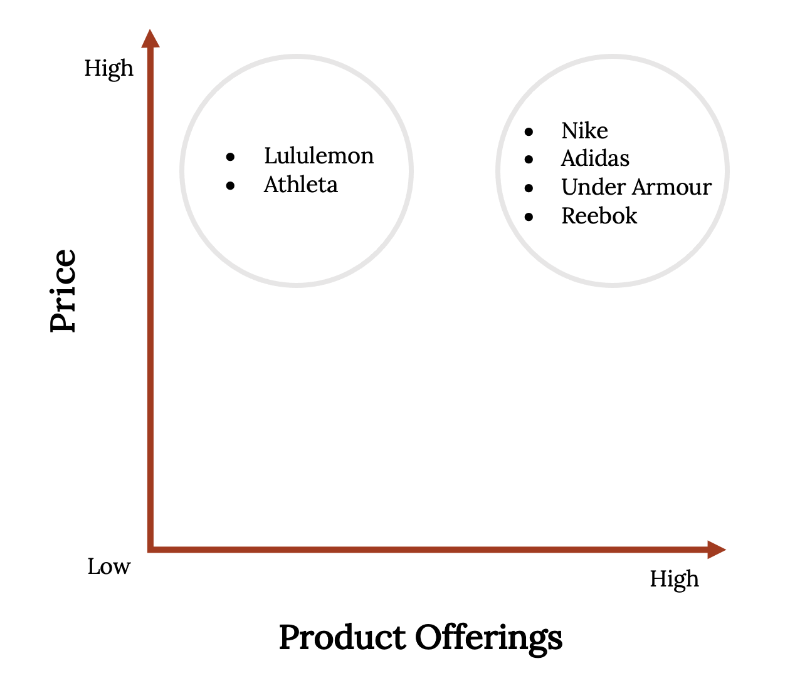
Strategic Groups and the Mobility Barrier in the Activewear Industry
http://hdl.handle.net/10919/102735

Slide 9
Industry _____________
Strategic
Groups?
Team #___
http://hdl.handle.net/10919/102735
Notes:
INSTRUCTORS: PROVIDE A HARD COPY OF THIS TO EACH TEAM

Slide 10
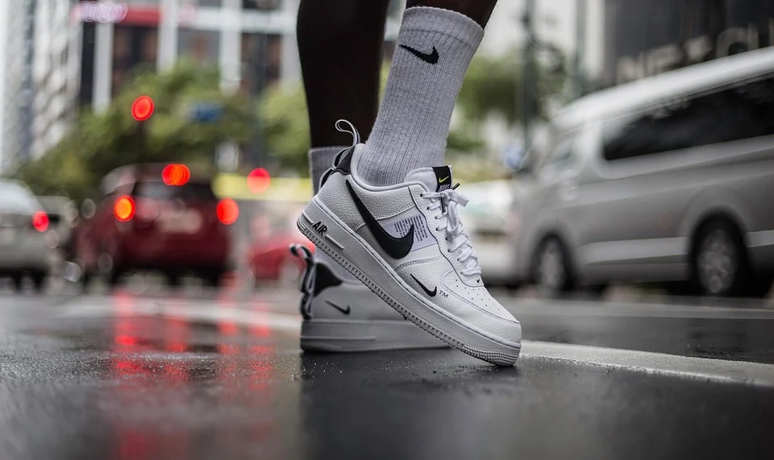
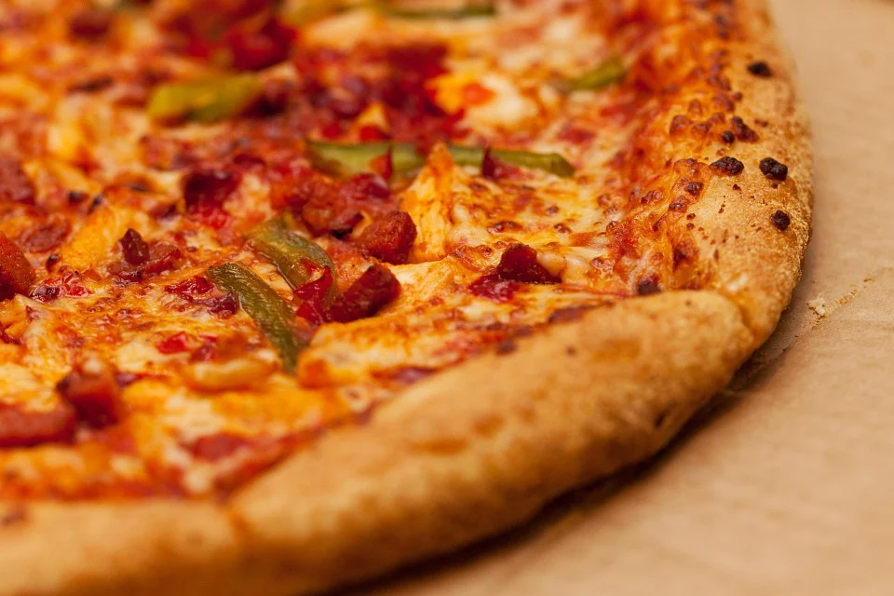
Internal Analysis
VRIO
VALUE CHAIN
Image Source: https://pixabay.com/photos/nike-air-force-manilla-street-shoot-5126389/
Image Source: https://pixabay.com/photos/cheese-crust-delicious-dinner-eat-164872
http://hdl.handle.net/10919/102735

Slide 11
Team Exercise: Nike and VRIO Analysis
Evaluate the following using the VRIO Tool
Resources
  Athletic Shoes Technology
  Brand – “Just Do It” mythical brand image
  Athlete Sponsors like Michael Jordan, Tiger Woods
Capabilities
  Capability to design new shoes
  Capability to Create Heroes as Athletic Sponsors
Based on your VRIO analysis above, which are more sustainable for competitive advantage?
http://hdl.handle.net/10919/102735

Slide 12
Nike VRIO Analysis
Team # _____
Resource or Capability | Valuable? | Rare? | Difficult to Imitate? | Organized to capture value? | Type of Competitive Advantage?
Athletic Shoes Technology
Brand – “Just Do It” mythical brand image
Athlete Sponsors like Michael Jordan, Tiger Woods
Capability to design new shoes
Capability to Create Heroes as Athletic Sponsors
http://hdl.handle.net/10919/102735
Notes:
INSTRUCTORS: PROVIDE A HARD COPY OF THIS TO EACH TEAM

Slide 13

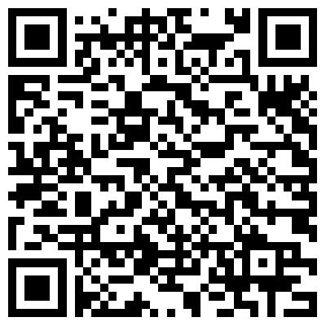

Quick Nike Research Options
Nike’s Value Chain
https://sustainability.nike.com/value-chain-stages
Nike’s Brand
https://conceptdrop.com/blog/27-the-importance-of-branding-how-nike-re-defined-the-power-of-brand-image/
Nike Innovation and Scaling
https://www.forbes.com/sites/greatspeculations/2016/05/18/heres-how-nike-is-innovating-to-scale-up-its-manufacturing/#4501dec81497
http://hdl.handle.net/10919/102735
Notes:
INSTRUCTORS: PROVIDE A HARD COPY OF THIS TO TEAMS 1-4

Slide 14
Team Exercise: Domino’s and VRIO Analysis
Evaluate the following using the VRIO Tool
Resources
  Operations Technology
  Brand Image
Capabilities
  Capability to produce pizzas at low cost
  Capability to advertise nationally
Based on your VRIO analysis above, which are more sustainable for competitive advantage?
http://hdl.handle.net/10919/102735

Slide 15
Domino’s VRIO Analysis
Team # _____
Resource or Capability | Valuable? | Rare? | Difficult to Imitate? | Organized to capture value? | Type of Competitive Advantage?
Operations Technology
Brand Image
Capability to produce pizzas at low cost
Capability to advertise nationally
http://hdl.handle.net/10919/102735
Notes:
INSTRUCTORS: PROVIDE A HARD COPY OF THIS TO EACH TEAM

Slide 16
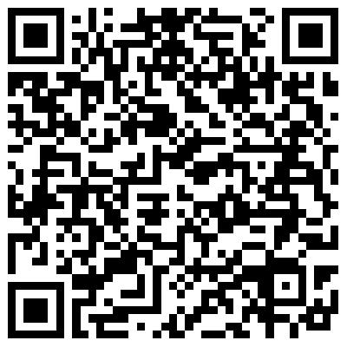


Quick Domino’s Research Options
Domino’s Competition
https://www.forbes.com/sites/nathankontny/2017/12/07/how-dominos-pizza-stands-out-in-a-world-awash-in-pizza/#818c8956316d
Domino’s Dominance
https://conceptdrop.com/blog/27-the-importance-of-branding-how-nike-re-defined-the-power-of-brand-image/
Domino’s & E-Commerce
https://www.forbes.com/sites/kylewong/2018/01/26/how-dominos-transformed-into-an-ecommerce-powerhouse-whose-product-is-pizza/#73fc67e37f76
http://hdl.handle.net/10919/102735
Notes:
INSTRUCTORS: PROVIDE A HARD COPY OF THIS TO TEAMS 5-8

Slide 17
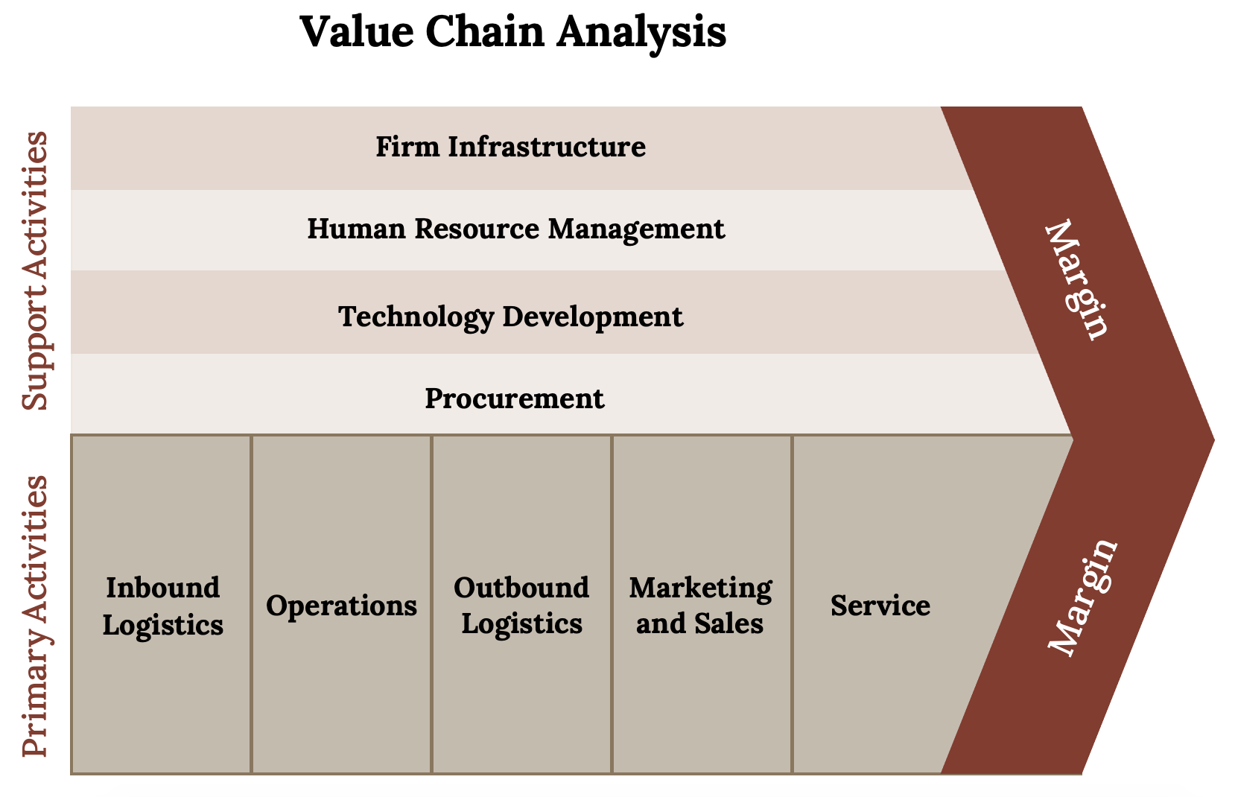
Kindred Grey (2020). “The value chain.” CC BY NC SA 4.0. Adaptation of Figure 4.11 from Mastering Strategic Management (2015) (CC BY NC SA 4.0). Retrieved from https://open.lib.umn.edu/app/uploads/sites/11/2015/04/b38d1270a489c447e16e30df24d931aa.jpg.
http://hdl.handle.net/10919/102735

Slide 18
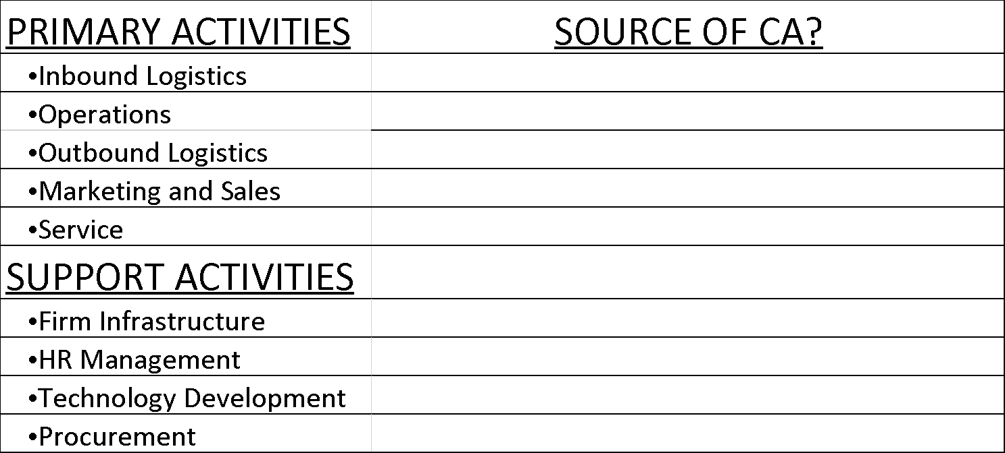
Value Chain Analysis: Nike and Dominoes
Company____________
Team # _____
http://hdl.handle.net/10919/102735
Notes:
INSTRUCTORS: PROVIDE A HARD COPY OF THIS TO EACH TEAM

Slide 19
Internal Analysis Conclusions
What do the VRIO and Value Chain analyses tell you about any competitive advantage Nike or Dominoes may have?
What is the source of that competitive advantage?
Is it a sustainable competitive advantage?
What strategy can Nike or Dominoes employ to best leverage their competitive advantage for the future?
Team # _____
http://hdl.handle.net/10919/102735
Notes:
INSTRUCTORS: PROVIDE A HARD COPY OF THIS TO EACH TEAM

