Slide 1
ETDs Knowledge Graph Building
Big Data
Samantha Zheng, Sidney Fredericks, Dashiell Budd, Junsoo Kim
CS 4624 – Multimedia, Hypertext, and Information Access
Virginia Tech, Blacksburg, VA 24061
Presentation date: 04/24/2025
Professor Farag

Slide 2
Outline
1
2
3
4
5
6
7
Introduction
Data Structure
Implementation
User Interface
Results
Future Enhancements
Acknowledgements

Slide 3
Introduction
Purpose: Transform Electronic Theses & Dissertations (ETDs) metadata into a searchable knowledge graph.
Why? Traditional databases make it hard to explore relationships
General Approach
Use graph databases to model connections.
Support both Virtuoso and Neo4j for flexibility.
Develop Streamlit web app for ETD metadata.
Ensure scalability handle 500k ETDS

Slide 4
Data Structure
Each ETD is represented by a core node containing:
Title, URL, and ID
Connected to key metadata nodes:
Author, Advisor, Year, Abstract
University, Department, Discipline, Degree
Relationships follow meaningful predicates (e.g., hasAbstract, academicAdvisorOf, issuedDate)
Designed for clear graph traversal and flexible querying in both Virtuoso and Neo4j

Slide 5
Year
University
issuedDate
Department
hasTitle
academicDepartment
TITLE
URL
ID
Degree
degreeType
academicDisciplineOf
academicAdvisorOf
Discipline
hasAbstract
Advisor
Abstract

Slide 6



Virtuoso and Neo4j Implementation - Overview
CSV to JSON
Define Relationships
Load to DB
Both: Converts ETD metadata from CSV to JSON format for processing
Virtuoso: Structures ETD metadata into RDF triples for the triple store
Neo4j: Structures ETD metadata into relational nodes
Virtuoso: Loads JSON data using SPARQL INSERT queries
Neo4j: Loads JSON data using Cypher MERGE and MATCH queries

Slide 7
Virtuoso Implementation - Achievements
01
⚙️Batch Processing
Efficiency
02
⚡Parallel loading
Speed
System
03
👁️Process tracking
Transparency

Slide 8


Virtuoso Implementation - Challenges & Solutions
CHALLENGES
SOLUTIONS
Large SPARQL queries causing HTTP 413 errors
Non-printable characters in metadata breaking queries.
Reduced batch size to 100 ETDs
Added escape_for_sparql to clean text (handles \n, \”, etc.)

Slide 9
Neo4j Implementation- Achievements
Purpose: Store and manage ETD metadata in a Property Graph Database
01
⚙️Flexible Schema
Efficiency
02
⚡Data Traversal
Speed
System
03
👁️Relational Relevance
Transparency

Slide 10
Neo4j Implementation - Challenges & Solutions
CHALLENGES
SOLUTIONS
Discerning between the correct node relationships versus properties
Trouble identifying metadata to display due to node arrangement
Track relationships between node to access needed information
Track relationships between node to access needed information

Slide 11
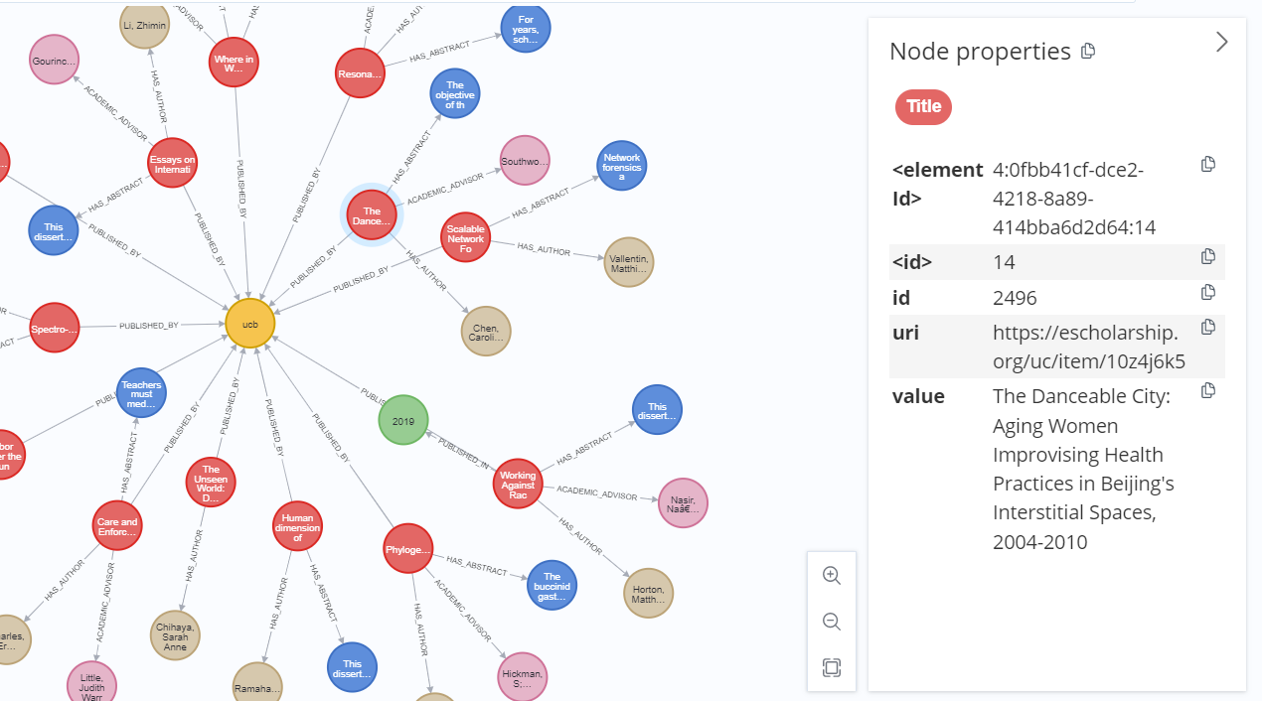
Neo4j Graph- Visualization

Slide 12
User Interface - Overview
User Authentication
login/register with SHA-256 hashword passwords
60%
Backend Selector
Virtuoso or Neo4j
Keyword Search
title, author, advisor, abstract, etc.
Display
ETD count, search results, metadata

Slide 13
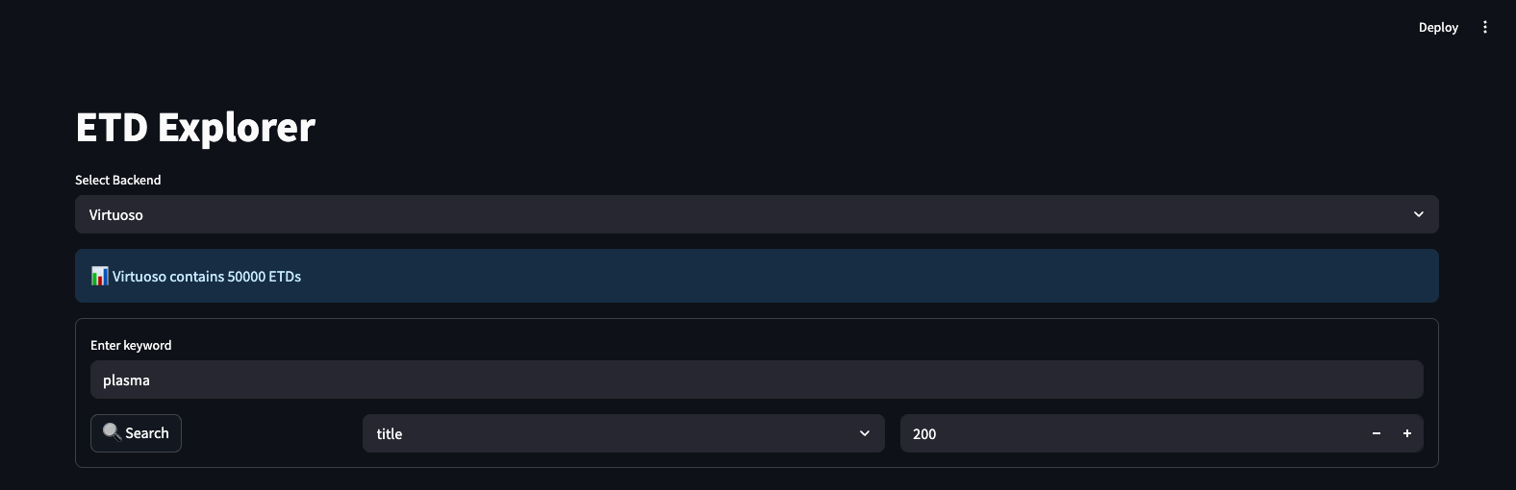
User Interface - Visual Example

Slide 14
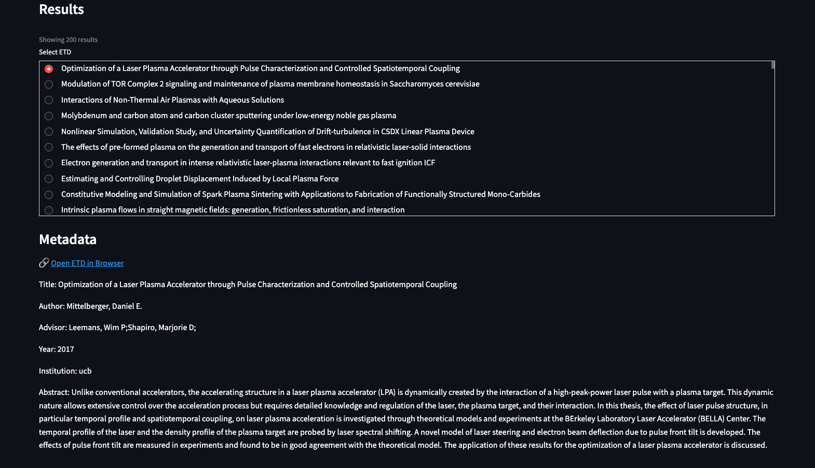
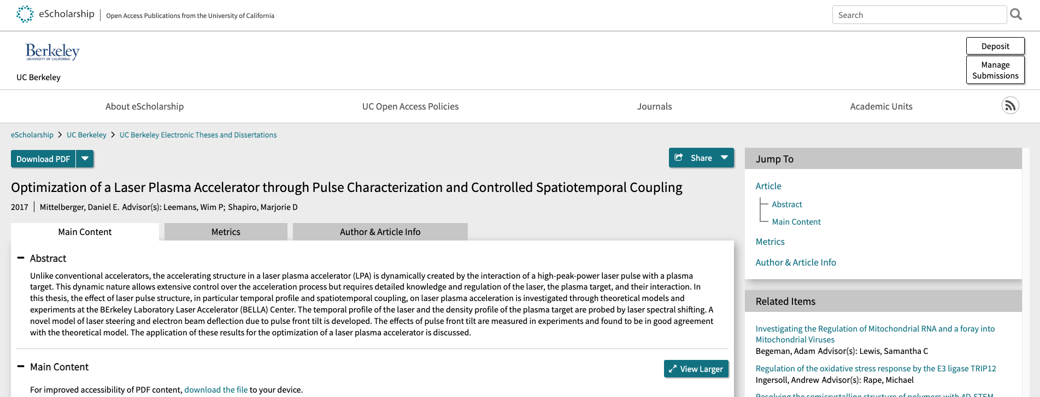
User Interface - Visual Example

Slide 15
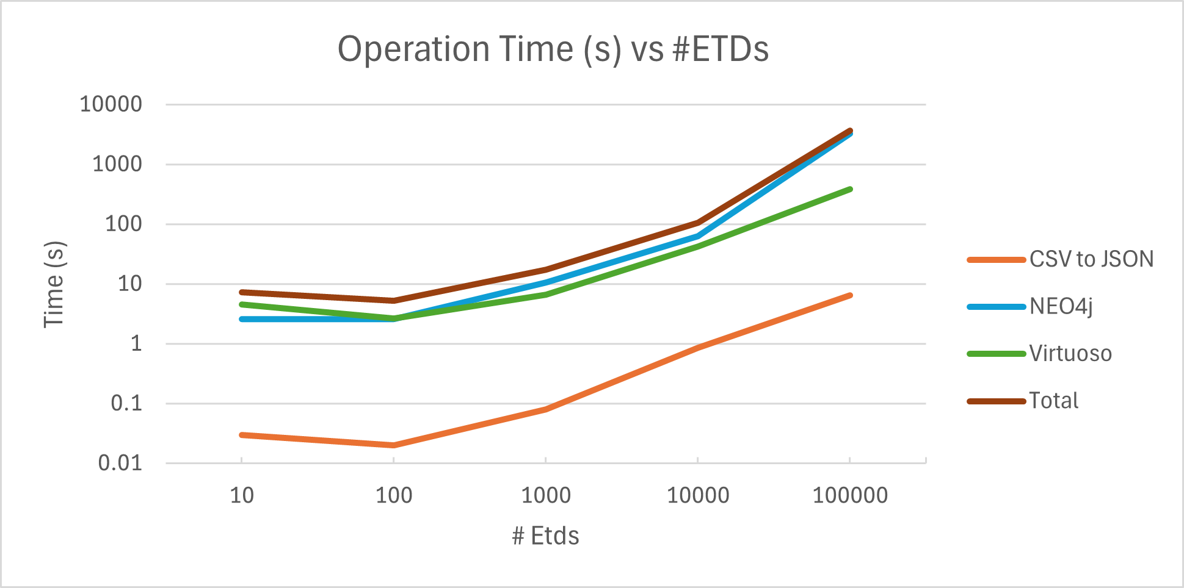
Loading Speed Results

Slide 16
DEMO

Slide 17
Future Enhancements
Deploy Streamlit App
Deploy Neo4j
Optimize Data Loading
Host publicly using Streamlit Cloud or Docker for easier access.
Host Neo4j on a cloud platform (e.g., AWS, or Azure, for remote team access)
Further improve batch loading speed for large dataset

Slide 18


Acknowledgements
Thank you Satvik and Dr. Farag for your support!

Slide 19
References
Neo4j. (n.d.). Neo4j Desktop installation guide. Neo4j. Retrieved March 24, 2025, from https://neo4j.com/docs/desktop-manual/current/installation/download-installation/
Neo4j. (n.d.). Neo4j browser manual. Neo4j. Retrieved March 24, 2025, from https://neo4j.com/docs/browser-manual/current/
Neo4j. (n.d.). Getting started: Data import. Neo4j. Retrieved March 24, 2025, from https://neo4j.com/docs/getting-started/data-import/
OpenLink software product documentation. OpenLink Software RSS. (n.d.). https://docs.openlinksw.com/

