Slide 1
Adoption of Energy Efficient Technology
Bradford Mills
Department of Agricultural and Applied Economics
Virginia Tech
bfmills@vt.edu

Slide 2
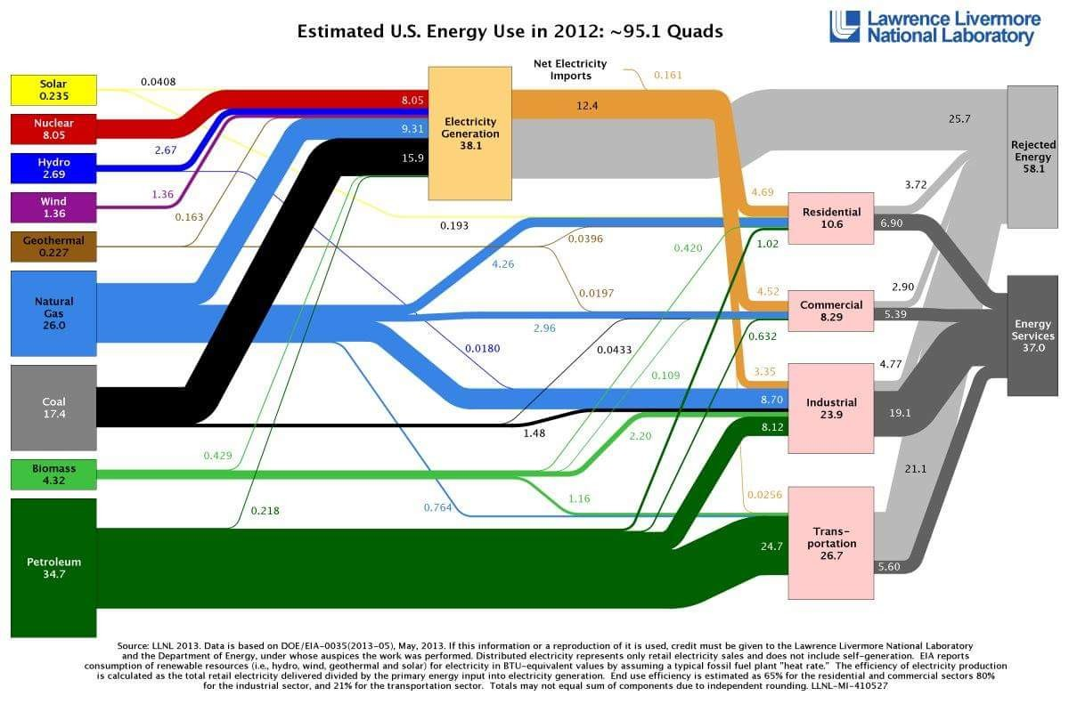

Slide 3
Take home messages
Energy efficiency is, on average, low: 39%
End use efficiency
65% residential and commercial sectors
80% industrial sector
21% transportation sector
Two ways to reduce energy use
Reduce demand
Improve efficiency
Both involve economic decisions

Slide 4
Residential Energy Efficiency
Residential sector - 15% of total energy demand
Bulbs 10% of residential electricity consumption
White appliances > 20% residential end use energy
Dramatic energy-efficiency gains available
Low hanging fruits
Adoption is the issue

Slide 5
The Adoption Paradox
Many energy efficient technologies are cost effective over their life times (benefits > additional costs)
But not adopted
Why?
Putting some structure to the question

Slide 6
The Household Adoption Decision
People (households) make choices they perceive as giving them more benefits (utils)
More likely to adopt with:
$ Benefits >
$ Costs <
Life is not all about $s
Valuation of environmental benefits
Factors that influence util levels
Level of information
Discount rate
Social/ cultural preferences

Slide 7
Research agenda
Understand barriers to adoption of energy efficient residential technologies
Appliances
Light bulbs
Why?
Design policies to address relevant adoption constraints
Understand country successes that can build confidence and feasible targets for multilateral climate accords:
E.g. COP 21 Paris

Slide 8
Outputs
Bradford Mills and Joachim Schleich. “Household Transitions to Energy Efficient Lighting.” Energy Economics. 46 (November 2014) 151-160.
Anthony Murray and Bradford Mills. “The Impact of Low-Income Home Energy Assitance Program Participation on Household Energy Insecurity.” Contemporary Economic Policy. 32:4 (October 2014) 811-825.
Joachim Schleich, Bradford Mills, Elisabeth Dutschke. “A Brighter Future? Quantifying the Rebound Effect in Energy Efficient Lighting.” Energy Policy. 72 (September 2014) 35-42.
Bradford Mills and Joachim Schleich. “Residential Energy-Efficient Technology Adoption, Energy Conservation, Knowledge, and Attitudes: An Analysis of European Countries.” Energy Policy. 49 (October 2012): 616-628.
Anthony G. Murray*, Bradford F. Mills. “An application of dichotomous and polytomous Rasch models for scoring energy insecurity.” Energy Policy. 51 (December 2012): 946-956.
Anthony Murray and Bradford Mills. Read the Label! Energy Star Appliance Label Awareness and Uptake Among U.S. Consumers. Energy Economics. 33:6 (November 2011): 1103-1110.
Bradford Mills and Joachim Schleich. “Why Don’t Households See the Light? Explaining the Diffusion of Compact Fluorescent Lamps”. Resource & Energy Econ.32 (Aug. 2010): 363-378.
Bradford Mills and Joachim Schleich. “What’s Driving Energy Efficient Appliance Label Awareness and Purchase Propensity?” Energy Policy. 38:2 (February 2010): 814-825.
Bradford Mills and Joachim Schleich. “Profits or Preferences? Assessing the Adoption of Residential Solar Thermal Technologies.” Energy Policy. 37:10 (October 2009): 4145-4154.

Slide 9
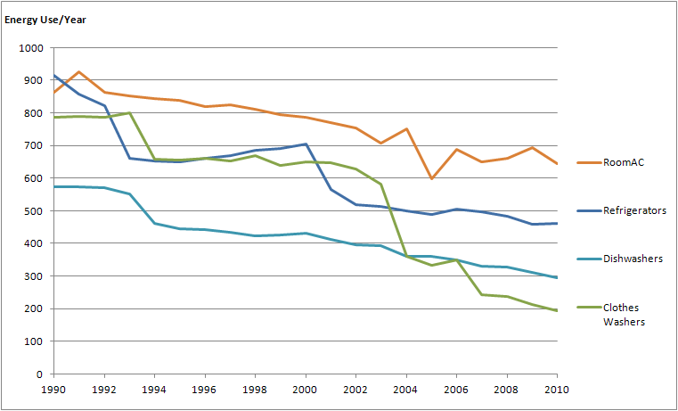
What do we know? – Increasing Appliance Energy Efficiency

Slide 10
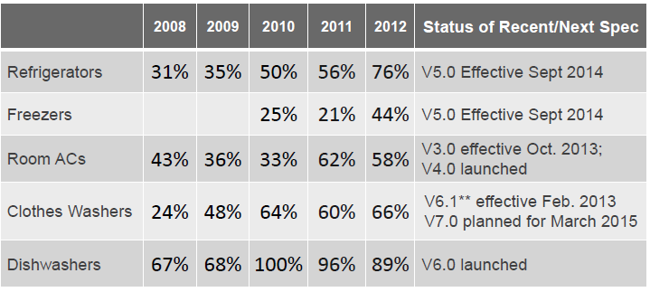
Energy Star Program

Slide 11
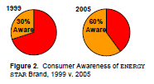
Energy Star – Increasing awareness

Slide 12
Lower Energy Star appliance uptake among
Renters
Benefit attribution
Poorer households
Liquidity constraints
Hispanics
Language barriers
Reducing these adoption differentials:
Annual monetary savings of over $165,000,000
Annual reductions in CO2 emissions 1,130,000 metric tons!
Emissions reductions equal removing 216,015 cars off the road!

Slide 13
Energy Efficient Bulbs
CFL and LED Bulbs – Low hanging fruits
80 - 85% less electricity than ILs
Last 6 to 25 times longer
Initial cost substantially more, but large long-run savings
Adoption Slow
ILs retain 50% market share into 2010
Policies
Information campaigns and promotions
Ban (EU)
Bulb efficiency standard legislation (USA)
Research questions
What increases household propensity to replace ILs with CFLs or LEDs?

Slide 14
Energy Efficient Bulb Adoption
German Data:
EU ban did foster transitions to energy efficient lighting (but with household welfare losses in low use lamps)
Higher income households less likely to adopt
Willing to pay for perceived higher IL lighting quality
Part of anticipated energy savings are lost (6%) by switches to higher luminosity bulbs
Rebound effect
USA Data:
Efficiency standards generate technology response from suppliers
Rapid decline in CFL and LED prices
Increased adoption over time in lower usage lamps (2005 – 2009)
Profitable use threshold declines
Late adopters
Very high and very low education levels

Slide 15
Summarizing
National successes in adoption of energy efficient technologies
Technology generation and adoption will be the basis for current and future GHG reductions
Important basis for climate accord GHG reduction commitments

Slide 16
Looking forward
Cross-country comparisons
Within EU
Significant country differences in:
Energy efficient adoption
Energy conservation
Highlights need to balance EU-wide policies with country-specific interventions
USA – Germany
Are differences in household energy behavior due to:
Differences in country characteristics
Differences in propensities, given characteristics
Eco-system management impacts
Indonesia
Guinea

