Slide 1
METHODS IN CONSTRUCTION RESEARCH:
LITERATURE SEARCHING & CITATION MANAGEMENT
Leslie Mathews
lesliem2@vt.edu | 540.231.4986

Slide 2
Just so you know…
Today is not the end of our relationship! I am here for you to answer any questions you may have as you continue forward on your research journey.
Feel free to make an appointment with me. My office is in Cowgill 100 A in the A+A Library around the corner from the Circulation desk.
Today is an informal workshop – please stop me and ask questions and we will work through some database searches together

Slide 3
Topics we will cover
Choosing a topic
Search strategies
  Where to search: Library databases
  Gray literature: conference proceedings, white papers, reports, Government docs
  How to search
  What to look for
Literature reviews
What is peer review
Evaluating information
Getting published
Citation management / avoiding plagiarism / staying organized
Any others of interest?

Slide 4
Choosing a topic
Choose a topic -- what are you interested in? You’re going to be studying this for a long time, so make sure it can truly hold your interest!
Think about what perspective will you use to approach this question
  Community, individual, infrastructure, policy, psychological, humanitarian, technical, another?
  This needs to be unique! Either an area that has not been studied or a perspective or argument that has not been used yet
  Some preliminary searching will help you hone your topic

Slide 5
What are some of your topics?
Water infrastructure
Service learning for sustainability

Slide 6
Preliminary Research on topic
Summon (searches all library databases and materials, including books and e-books*)
* Summon is the only place where you can find e-books. The library catalog does not search e-books
This is the time to get ideas, so it’s fine to use news sources and web searches
Also need to find out if your topic has been “done” before
Web sites, newspapers, magazines, blogs, other sources

Slide 7
Preliminary Research with Library Databases
  Let’s try a search in Summon
  Topic is natural disaster housing solutions
    "natural disaster" and housing and displacement
    War and housing and displacement
    “housing solutions” and disaster
    Add geographic location or event to narrow down
      Limit to scholarly articles
      Limit to e-books
      Using the Get VText button to find out if full text available
      A reminder about Interlibrary Loan – we can get it electronically if it’s an article, in the mail if it’s a book

Slide 8
What have you done so far?

Slide 9
Search strategies
Determine keywords and preliminary search query based on research question
Figure out where to start your search
Keep track of where you have searched as well as the searches you have used and keep track of which searches have been effective
  Google sheets or some other cloud based produced is a good idea. Have a backup
  Make accounts in the different databases. You can save your searches within the databases, but it’s a good idea to save them in a document of your own, too.
Don’t reinvent the wheel – look for literature reviews

Slide 10
How to search
After you have determined where to search, now you need to know how to search
What is your research question
Break your question down into components
Think of synonyms, different ways of searching for the same thing, different words that might be used in different disciplines

Slide 11
Creating a Research Question
Sample topic: Hurricane Katrina and failure to provide adequate/timely disaster housing
Research Question: What policy decisions before and after Hurricane Katrina caused a lack of timely housing for the people affected by the disaster and how could this be prevented in the future?
Of course, you would want to take this a step further for graduate research

Slide 12
Basic formula for creating a search query
main concept
AND
main concept
keywords
keywords
keywords
keywords
keywords
keywords

Slide 13
Formulate a Search Query
Identify keywords based on the main concepts of your question
Start simple and add complexity – see what’s out there first. Don’t want to be too limiting or you might miss something.
  “hurricane Katrina” AND housing AND displacement
  Then add more terms based on your research question, for example, you could add AND policy
  You could also add terms like “temporary housing” or “emergency shelters”
  Know some database tricks such as hous*

Slide 14
Search tips
Use off campus sign on if you live off campus!
Pay attention to special search fields within the databases. Some databases have unique search fields
Combining synonyms with OR will broaden your search. Put all synonyms into parentheses to tell the database to search for them as ONE concept
  (dolphin OR whale)
Combining concepts with AND will narrow your search
  (dolphin OR whale) AND (echolocation OR sonar) AND boat*
Use quotation marks to search for “exact phrases”
Use asterisk to search for all the variations of a word, but be careful!
  librar* will search for library, libraries, librarian, librarians [this is good]
  cat* will search for category, catastrophe, cat, cats, caterpillar, etc. [this is not so good!]
Web searching tip: Use site:.edu to limit to just .edu domains. Can use this to limit to any domain. This will give you different results than if you search Google Scholar
  Hurricane Katrina example

Slide 15
Worksheet
Take a moment to fill out the worksheet

Slide 16
Where to look: sources
Note: check out subject guides for ideas of subject-specific databases http://guides.lib.vt.edu/subject-guides
Current events, news databases: LexisNexis, ProQuest historical newspapers, Opposing Viewpoints Resource Center
Building Construction databases: Buildingreen, Urban Land Institute (ULI), Material ConneXion, ASTM, MADCAD
Engineering databases: Compendex, ASCE Library, Engineering Village, IEEE, Safari Books Online
Other subject-specific databases – endless depending on your subject matter
General interest databases – Academic Search Complete, Business Source Complete
Dissertation database: ProQuest Dissertations & Theses.
To see what other VT students (and faculty) have done, look at VTech Works, our institutional repository http://vtechworks.lib.vt.edu/
Note: there is a subject librarian for Engineering who can help you as well

Slide 17
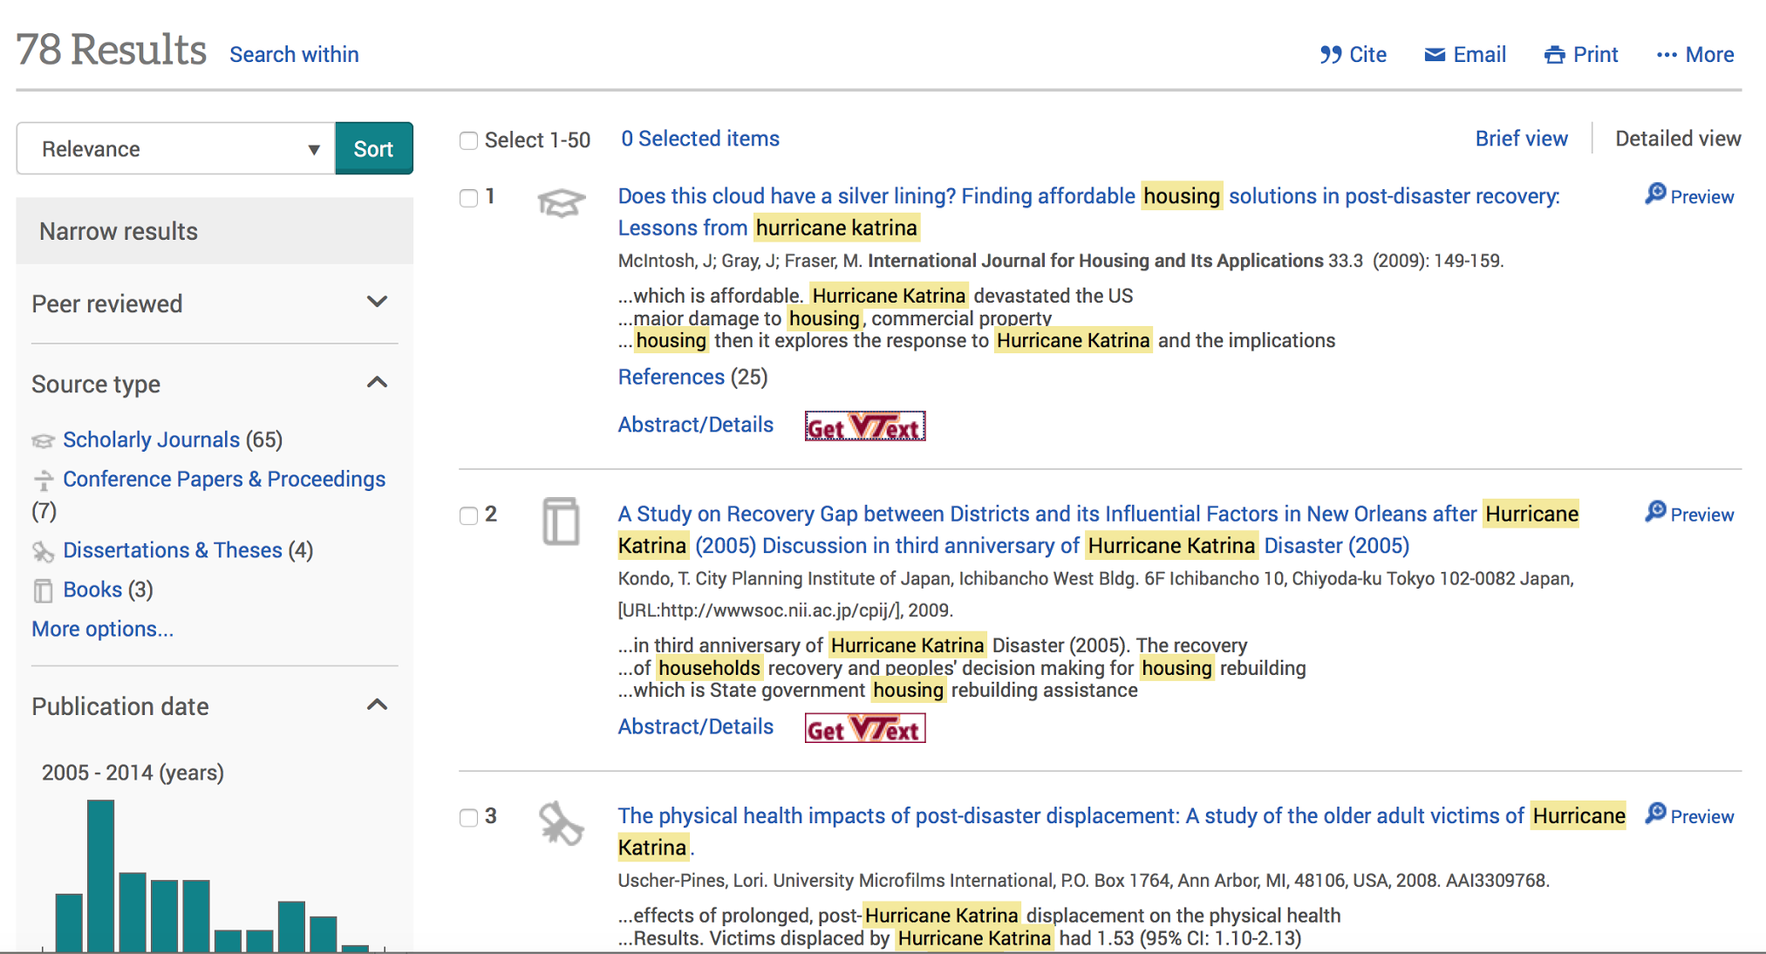
ProQuest ASCE Library Abstracts – note source type

Slide 18
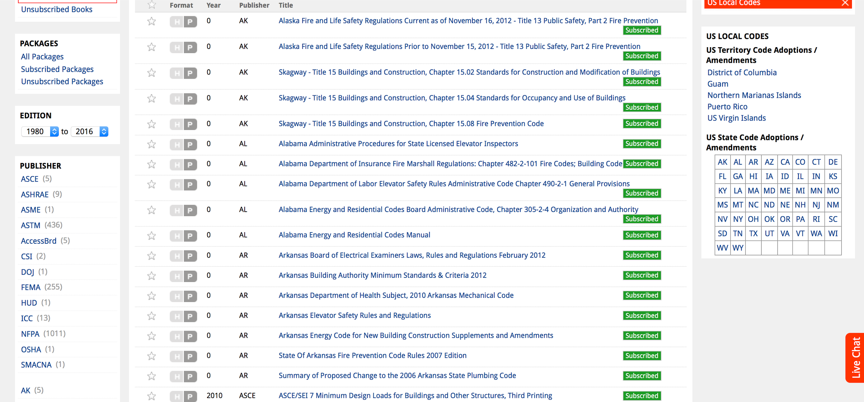
MADCAD – narrow by publisher

Slide 19
What to look for
Most cited articles – use Web of Science and Google Scholar
Most cited journals – Journal Citation Reports (JCR) from Web of Science
Important journals, books, and web sources in the field, can be found via Literature reviews

Slide 20
Demo
Web of Science
Google Scholar

Slide 21
Think beyond databases
Gray literature: conference proceedings, white papers, blog posts, newsletters, government documents
  Some of these can be found in the databases
  Others through searching the web
  Examples of Government web sites:
    GPO https://www.gpo.gov/fdsys/
    EPA Green Building http://archive.epa.gov/greenbuilding/web/html/
    HUD User https://www.huduser.gov/portal/
    Research Roadmap https://www.huduser.gov/portal/about/pdr_roadmap.html
Web searches using .edu domain limiter can be a good way to find resources created by educational institutions and librarians for finding these types of materials

Slide 22
What is a literature review?

Slide 23
Literature review
Now that you have chosen a topic, you will need to do a literature review
What is a literature review?
A literature review can be just a simple summary of the sources, but it usually has an organizational pattern and combines both summary and synthesis. A summary is a recap of the important information of the source, but a synthesis is a re-organization, or a reshuffling, of that information. It might give a new interpretation of old material or combine new with old interpretations. Or it might trace the intellectual progression of the field, including major debates. And depending on the situation, the literature review may evaluate the sources and advise the reader on the most pertinent or relevant.
  UNC Writing Center http://writingcenter.unc.edu/handouts/literature-reviews/
A great place to start:
  Search for existing literature reviews on your topic

Slide 24
Literature reviews
Can help you identify the most important articles (seminal articles) in your field quickly
Can give you a summary of what has been done and what hasn’t been covered
Give you some examples of different approaches to this as you think about doing your own
To find existing literature reviews: search for “literature review” AND your topic in any database. It’s best to use a subject-specific database

Slide 25
Let’s search for a literature review
Use a sample class topic
Pick a subject-specific database
Keywords AND “literature review”
Sometimes the database even has a field for document type = literature review and some have it listed as a methodology
In Web of Science, the term for this is document type = review
Use the Annual Reviews database

Slide 26
Use the journal finder tool
To find out of Virginia Tech subscribes to a journal https://www.lib.vt.edu/find/journals/index.html
If not, you can request an interlibrary loan through the ILLiad system

Slide 27
Seminal articles – essential articles in your field
Once you identify a seminal article, you will want to see all the articles that have cited it. This is called “cited reference searching”
Tracking citations to find related articles – who has cited this?
Web of Science
  Has a lot of citation analysis tools
Google Scholar
  Click on “cited by” button
Mine the bibliographies of important/useful articles you find. You can find a lot of information easily this way

Slide 28
Let’s try one together
Volunteers?

Slide 29
Peer review
What is peer review?

Slide 30
Peer review is:
When an article is submitted to a peer reviewed journal, the editors send it out to other scholars in the same field (the author's peers) to get their opinion on the quality of the scholarship, its relevance to the field, its appropriateness for the journal, etc.
  https://www.lib.utexas.edu/lsl/help/modules/peer.html

Slide 31
Evaluating information
What do you look for when you are trying to decide whether or not to read a particular article?

Slide 32
Evaluating a Scholarly Journal: for research and getting published
Evaluating a Scholarly Journal
from the VT University Libraries online Information Skills tutorial:
http://info-skills.lib.vt.edu/evaluating_info/24.html
To truly explore an information source and learn more about scholarly journals and other key publications in your field, consider some of these criteria. Evaluate a journal where you’ve found one or more articles of interest, or consider a key online information source with on­going content.
Publication Structure
● Are volumes and issues, or a Table of Contents shown with links to each issue or to articles?
● Is there an archive of past issues, or is this a new journal?
● Have issues been published regularly?
● Are there advertisements? What kind?
Publisher / Organization
● Is the publisher or sponsoring organization listed?
● What information can you find out about them?
Statement of Purpose or ‘Aims & Scope’
● Is there information about the publication’s purpose (‘Aims & Scope’), including topic areas of focus and/or intended audience?

Slide 33
Evaluating a Scholarly Journal Continued…
Editorial Policies and/or Submission Guidelines
● Is there an Editor or a list of Editorial Board members? Who are they and what is their expertise?
● Are the editorial policies and/or submission guidelines described?
● Does this publication require peer review of submissions prior to publication?
Overall ­ scan through the website and articles within an issue
● Do the articles represent the publication’s stated purpose, scope, and editorial policies?
● Are there typographical errors or misspellings?
● Are links to outside content or within the text current and easy to follow?
● Is the font and format easy to read?

Slide 34
Evaluating a Source
Handout from Scientific Writing Workshop offered by Newman Library, created by Ginny Pannabecker
Searching the Literature: Authoritative Sources January 2016
Evaluating a Source ­ The Basics
As you appraise sources of information to use in research projects, consider the following:
Authority:
● Who wrote it?
● What sort of expertise do they have in this area?
Coverage
● Is it relevant to your topic?
Objectivity
● Is there any bias?
● If so, how much?
Accuracy
● Is the information correct?
● Is it in alignment with other research findings or articles?
Currency
● When was the resource produced?
● Does the time period of research or publication of results matter for your topic?

Slide 35
Citation Management
Library guide on this topic http://guides.lib.vt.edu/allaboutcitations
We have a group of experts on this topic. If you would like a workshop from them, you can request it

Slide 36
Avoiding plagiarism
Cite your sources
Paraphrase using your own words
If you’re unsure of something, you can ask the writing center or a librarian

Slide 37
Publishing your own work
Find the right journal
  Look at the requirements
  Does your article fit in?
  What kind of articles do they publish?
  What is the review process? How rigorous is it? Will you meet the criteria?
  What is the acceptance rate? My story about the journal Cell
Try to get published in lower reputation journals at first
Consider self publishing to get your name out there – blogging
Consider publishing in newsletters in your field
Attend the upcoming CAUS Research Symposium session on getting published on Feb. 25

