Slide 1


Strategic Management
Chapter 3 External Analysis
Unless otherwise noted, this slide deck is (c) Virginia Polytechnic Institute and State University. It is released under a Creative Commons Attribution NonCommercial ShareAlike 3.0 license (CC BY NC-SA 3.0)
Instructor Name | Name of Institution
http://hdl.handle.net/10919/102735
Photo by Jon Sailer on Unsplash

Slide 2
Today’s Learning Objectives – Date Here
Determine the impact of external macro-environmental trends on an industry [PESTEL]
Use the Porter’s 5-forces tool to evaluate an industry
  Be able to define the 5 forces in an industry
  Be able to evaluate the 5 forces in an industry
  Be able to draw out implications from a 5 forces analysis for a specific firm in that industry
  Be able to evaluate whether or not to enter an industry based on your analysis
Plot and analyze strategic groups on a strategic group map
http://hdl.handle.net/10919/102735

Slide 3
Question: What’s the #1 reason CEOs are fired?
http://hdl.handle.net/10919/102735
Notes:
Not that they don’t develop strategies, but that they don’t accomplish the strategies they develop.

Slide 4
What Explains Firm Profitability?
The research
  Industry (10-20%) Attractive to unattractive industry structures
  Firm (30-45%) Range is:
    Sustainable competitive disadvantage
    to
    Sustainable competitive advantage
  Other/Environmental (35-60%)
Strategic Management is interested in improving firm profitability, must understand these operational environments.
http://hdl.handle.net/10919/102735

Slide 5
Levels of Environmental Analysis
External / General Environment
Macro-environment / PESTEL (Political, Economic, Social, Technological, Ecological, Legal)
Global (Porter’s Diamond)
Competitive Environment / Industry Environment / “Task” Environment
  Structure of the industry / Porter’s Five Forces analysis
  Strategic groups
  Life cycle
  Competitor analysis
Internal Environment
  Firm strengths & weaknesses, capabilities, core competencies, and sustainable competitive advantage, V.R.I.O.
  Value chain
http://hdl.handle.net/10919/102735

Slide 6
External or General Environment / PESTEL Tool
Significance of External Environmental - firms cannot control them directly.
Elements:
  Political – the arena in which organizations and interest groups compete for attention and resources.
  Economic – the nature and direction of the economy.
  Sociocultural and demographic – encompasses society’s attitudes and cultural values and consists of attributes such as population size, age structure, geographic distribution, ethnic mix, and income distribution.
  Technological – emerging products & processes which may translate knowledge into products, processes, and materials.
  Environmental/Ecological – broad environmental issues such as the natural environment, global warming, and sustainable economic growth
  Legal – laws, regulations, litigious environment, risk management
Fundamental Issues:
  What is the strength of the force? Strong, Moderate, or Weak. Positive or Negative?
  Implications? What effect does it have on the firm and its industry?
  What will/can the firm do?
http://hdl.handle.net/10919/102735

Slide 7
Political Forces
Tort reform
Americans with Disabilities Act (ADA)
Deregulation of utility and other industries
Increases in federally mandated minimum wages
Taxation at local, state, federal levels
Legislation on corporate governance reforms (Sarbanes-Oxley Act)
Consumer protection laws
General Environment
Sociocultural
Political/Legal
Technological
Economic
Ecological
http://hdl.handle.net/10919/102735

Slide 8
Economic Forces
Interest rates
Unemployment
Consumer Price index
Trends in GDP
Changes in stock market valuations
General Environment
Sociocultural
Political/Legal
Technological
Economic
Ecological
http://hdl.handle.net/10919/102735

Slide 9
Sociocultural/Demographic Forces
Aging population
Rising affluence
Changes in ethnic composition
Geographic distribution of population
Greater disparities in income levels
More women in the workforce
Increase in temporary workers
Greater concern for fitness
Greater concern for environment
Postponement of family formation
General Environment
Sociocultural
Political/Legal
Technological
Economic
Ecological
http://hdl.handle.net/10919/102735

Slide 10
Technological Forces
Genetic engineering
Emergence of Internet technology
Computer-aided design/computer-aided manufacturing systems (CAD/CAM)
Research in synthetic and exotic materials
Pollution/global warming
Miniaturization of computing technologies
Wireless communication
Nanotechnology
General Environment
Sociocultural
Political/Legal
Technological
Economic
Ecological
Legal
http://hdl.handle.net/10919/102735

Slide 11
Environmental/Ecological Segment
Environmental Impact of operations
Environmental impact of product/service
Natural Resource availability
Climate change
Environmental Regulation
Recycling
General Environment
Sociocultural
Political/Legal
Technological
Economic
Environmental/Ecological
http://hdl.handle.net/10919/102735

Slide 12
Legal Forces
Local, state, federal laws
Property rights
Intellectual property rights
Regulations, ex. OSHA
No-discrimination
Case law
General Environment
Sociocultural
Political/Legal
Technological
Economic
Ecological
Legal
http://hdl.handle.net/10919/102735

Slide 13
Competitive Environment / Industry Environment
http://hdl.handle.net/10919/102735

Slide 14
Competitive Environment
Sometimes called the task or industry environment
Includes
  Competitors (existing and potential)
  Customers
  Suppliers
  Substitutes
Porter’s Five Forces model
Competitive Environment
Competitors
Customers
Suppliers
http://hdl.handle.net/10919/102735

Slide 15
Competitive Environment / Industry Environment
Threat of
New Entrants
Supplier
Power
Rivalry
Customer
Power
Threat of
Substitutes
http://hdl.handle.net/10919/102735

Slide 16

Porter’s Five Forces of Competition Framework
SUPPLIERS
Bargaining power of suppliers
INDUSTRY
COMPETITORS
Threat of
substitutes
POTENTIAL
ENTRANTS
Threat of
new entrants
SUBSTITUTES
Rivalry among
existing firms
Bargaining power of buyers
BUYERS
http://hdl.handle.net/10919/102735

Slide 17
The Threat of New Entrants
Profits of established firms in the industry may be eroded by new competitors
High entry barriers lead to low threat of new entries
  Economies of scale
  Product differentiation
  Capital requirements
  Switching costs
  Access to distribution channels
  Cost disadvantages independent of scale
http://hdl.handle.net/10919/102735

Slide 18
The Bargaining Power of Buyers
Buyers threaten an industry
  Force down prices
  Bargain for higher quality or more services
  Play competitors against each other
  Ex: Walmart as a buyer
http://hdl.handle.net/10919/102735

Slide 19
The Bargaining Power of Buyers (Cont.)
A buyer group is powerful when
  It is concentrated or purchases large volumes relative to seller sales
  The products it purchases from the industry are standard or undifferentiated
  The buyer faces few switching costs
  It earns low profits
  The buyers pose a credible threat of backward integration
  The industry’s product is unimportant to the quality of the buyer’s products or services
http://hdl.handle.net/10919/102735

Slide 20
The Bargaining Power of Suppliers
Suppliers can exert power by threatening to raise prices or reduce the quality of purchased goods and services
http://hdl.handle.net/10919/102735

Slide 21
The Bargaining Power of Suppliers (Cont.)
A supplier group will be powerful when
  The supplier group is dominated by a few companies and is more concentrated than the industry it sells to
  The supplier group is not obliged to contend with substitute products for sale to the industry
  The industry is not an important customer of the supplier group
http://hdl.handle.net/10919/102735

Slide 22
The Bargaining Power of Suppliers (Cont.)
A supplier group will be powerful when
  The supplier’s product is an important input to the buyer’s business
  The supplier group’s products are differentiated, or it has built up switching costs for the buyer
  The supplier group poses a credible threat of forward integration
http://hdl.handle.net/10919/102735

Slide 23
The Threat of Substitute Products and Services
Substitutes limit the potential returns of an industry
  Ceiling on the prices that firms in that industry can profitably charge
  A substitute is a product/service which provides the same function as the product/service, but in a different form.
http://hdl.handle.net/10919/102735

Slide 24
The Intensity of Rivalry among Competitors in an Industry
Jockeying for position
Price competition
Advertising battles
Product introductions
Increased customer service or warranties
http://hdl.handle.net/10919/102735

Slide 25
The Intensity of Rivalry among Competitors in an Industry (Cont.)
Interacting factors lead to intense rivalry
  Numerous or equally balanced competitors
  Slow industry growth
  High fixed costs
  Lack of differentiation or switching costs
  Capacity augmented in large increments
  High exit barriers
http://hdl.handle.net/10919/102735

Slide 26
Strategic Groups within Industries
Two unassailable assumptions in industry analysis
  No two firms are totally different
  No two firms are exactly the same
Strategic groups
Cluster of firms that share similar strategies
  Breadth of product and geographic scope
  Price/quality
  Degree of vertical integration
  Type of distribution system
http://hdl.handle.net/10919/102735

Slide 27
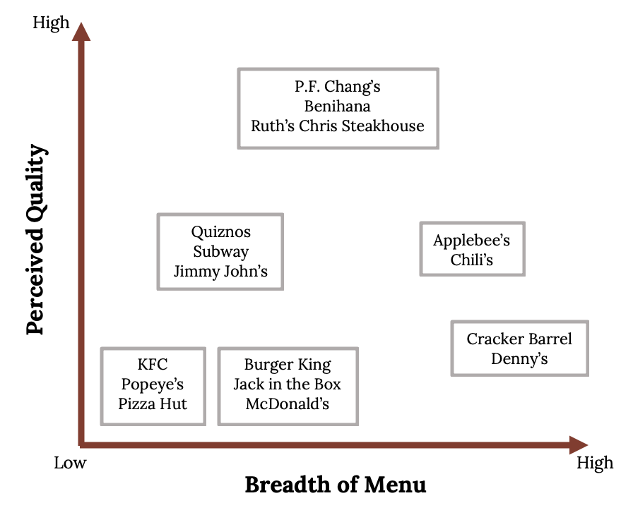
The World Automobile Industry: Strategic Groups
Figure 3.15: Kindred Grey (2020). “Breadth of menu vs. Quality” CC BY-SA 4.0. Retrieved from https://commons.wikimedia.org/wiki/File:Breadth_of_menu_vs._Quality.png.
http://hdl.handle.net/10919/102735

Slide 28
Strategic Groups within Industries (Cont.)
Rivalry is strongest in the same strategic group
Environmental and competitive forces impact the strategic groups differently
Some strategic groups are more profitable than others
Mobility barriers restrict movement between strategic groups
http://hdl.handle.net/10919/102735

Slide 29
Strategic Groups within Industries (Cont.)
Value of strategic groups as an analytical tool
  Identify barriers to mobility that protect a group from attacks by other groups
  Identify groups whose competitive position may be marginal or tenuous
  Chart the future direction of firms’ strategies
  Thinking through the implications of each industry trend for the strategic group as a whole
http://hdl.handle.net/10919/102735

Slide 30
Strategic Groups within Industries (Cont.)
Value of strategic groups as an analytical tool
  Identify barriers to mobility that protect a group from attacks by other groups
  Identify groups whose competitive position may be marginal or tenuous
  Chart the future direction of firms’ strategies
  Thinking through the implications of each industry trend for the strategic group as a whole
http://hdl.handle.net/10919/102735

Slide 31
Team Exercise
External Analysis
PESTEL
Porter’s Five Forces
http://hdl.handle.net/10919/102735

Slide 32
PESTEL
Factor | Strong>Moderate> Weak | Impact on Industry
Political
Economic
Socio-cultural
Technological
Ecological
Legal
http://hdl.handle.net/10919/102735
Notes:
See teaching notes

Slide 33
Five Forces
Factor/ Strength Of Force | Low>>>High? | Ability to Raise and/or Capture Profits
Rivalry
Suppliers
Customers
Potential Entrants
Substitutes
http://hdl.handle.net/10919/102735
Notes:
See teaching notes

Slide 34
Conclusions regarding your external analysis
Issues/problems to address
What should the firm do?
http://hdl.handle.net/10919/102735
Notes:
Much of what was discussed previously should show up here. The tools provide a means for doing a more in-depth analysis and a way to draw out implications for firms.
Evaluate the implications for the firm. What does this mean regarding the future profitability and competitive advantage for firms?

