Slide 1
Pd-L2Ork
Final Presentation
Nam Nguyen, Tyler Johnson, Haylin Kwok, Daniel Moreno
CS 4624 Multimedia Hypertext & Information Access
Dr. Edward Fox
Virginia Tech, Blacksburg, VA 24061
12/1/2022

Slide 2
Outline
Project Overview
Tooltips Implementation
K-12 Mode Implementation
Future Work
Acknowledgements/References

Slide 3
Project Overview
About Pd-L2Ork
Interactive visual programming environment
Designed for live manipulation of multimedia/digital signals
Primary focus on sound manipulation
What to Implement
Tooltips for objects
Menu bar for K-12 mode
Web browser support (Emscripten)

Slide 4
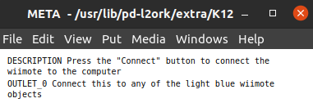
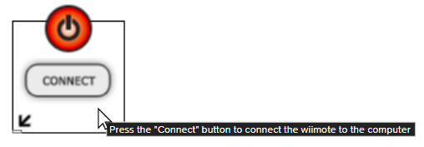
Tooltips - Recap
Extract object metadata from help.pd files
Place metadata into tooltip arrays
Display tooltips when hovering over objects

Slide 5
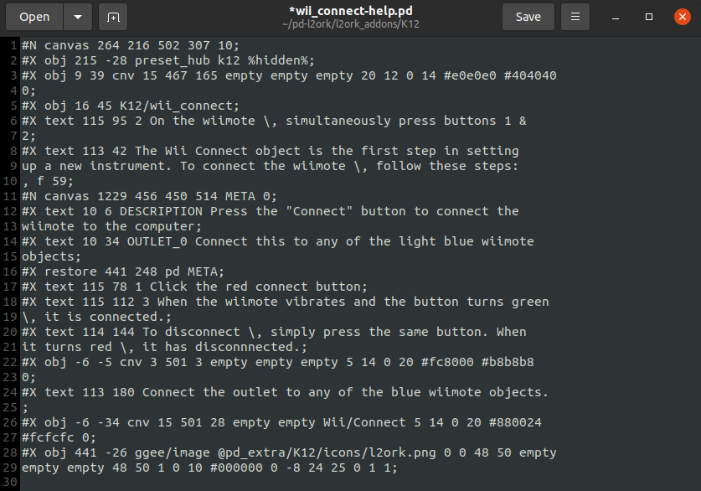
Tooltips - Extracting Metadata
Find object metadata in given files
  Each object has a help.pd file
Extract metadata and place into tooltip arrays
  Tooltip array for each object

Slide 6
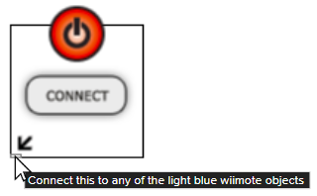
Tooltips - Displaying Tips
Description tooltip
Outlet tooltip

Slide 7
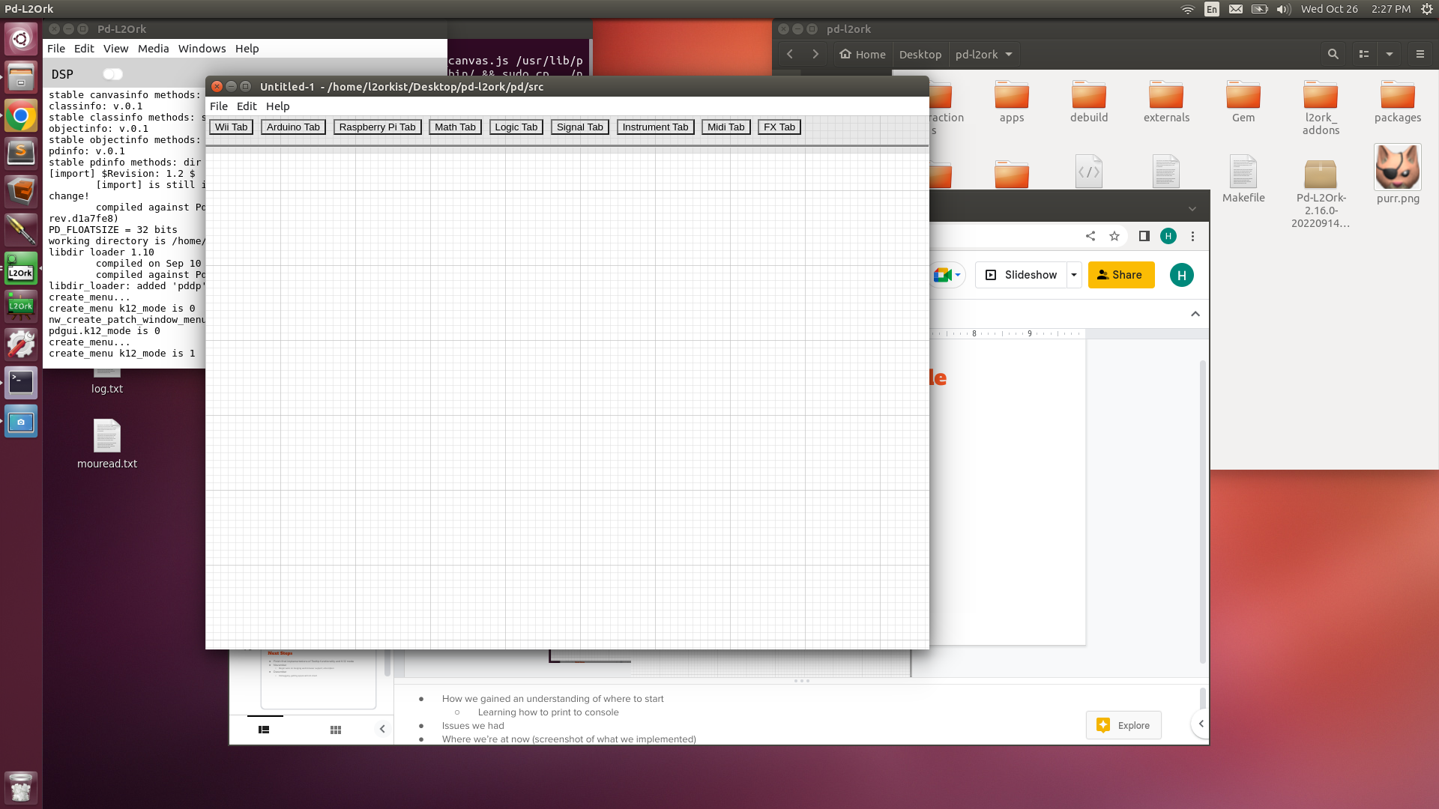
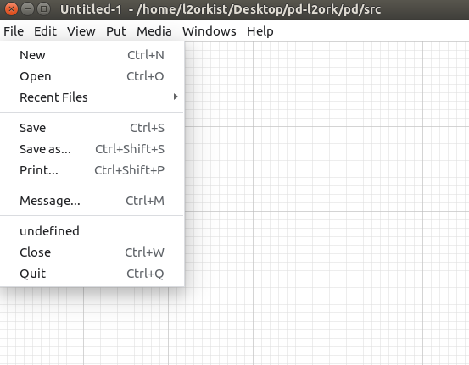
K-12 Mode - Recap
Removed menus from top bar
Button in file menu to switch between modes
  No label
Initial K12 menu

Slide 8
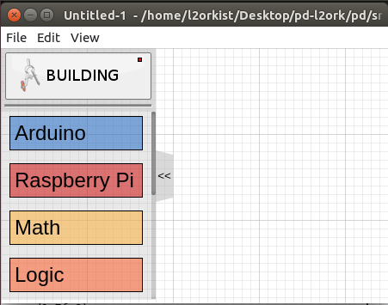
K-12 Mode - Work Done
Changed the look of the K12 menu
  Side menu instead of a top menu
  Added suitable images
Old New

Slide 9
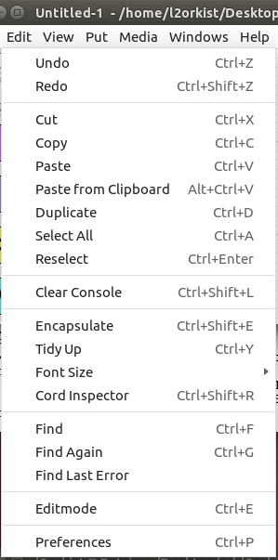
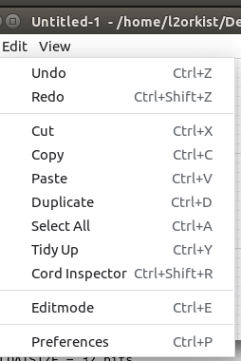
K-12 Mode - Work Done
Normal Edit menu
Edited submenus
  Fewer options so as to not overwhelm users
K12 Edit menu

Slide 10
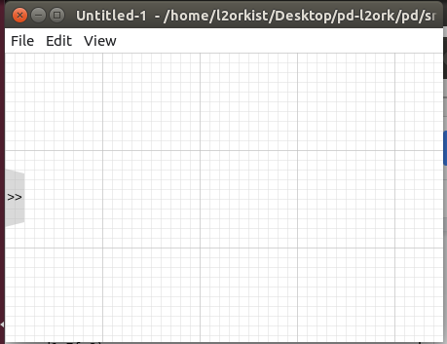
K-12 Mode - Work Done
Side button to hide menu
  Menu hidden as shown on the right
  Concerned with K12 menu taking up too much space

Slide 11
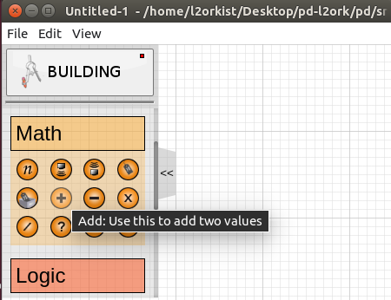
K-12 Mode - Work Done
K12 objects
  Added suitable icons
  Displays a description of the object when hovered over
  Objects are placed when clicked on

Slide 12
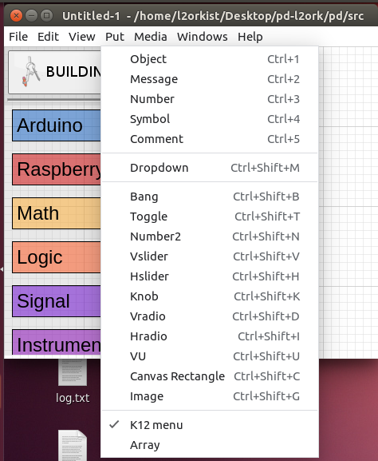
K-12 Mode - Work Done
Option to display K12 menu in normal mode (in the Put menu)
  Has a variety of useful widgets
  Help new users ease into using the full program

Slide 13
K-12 Mode - Future Work
Descriptions in other languages
  Pd-L2Ork also supports German and French
  Need descriptions of the K12 objects in those languages
K12 flag in the backend
  Never touched the backend
  Will need to make sure that backend works with our implementation (if the K12 flag is used in the backend)

Slide 14
Future Work (of the entire project)
Web browser support
  Never got around to doing
  Client seemed more interested in tooltips and K12-mode
  Something another team will need to do

Slide 15
Acknowledgements/References
Acknowledgements
Professor Ivica Ico Bukvic - ico@vt.edu
References
https://l2ork.music.vt.edu/main/no-really-what-is-l2ork/

