Slide 1


Impact assessment of technological innovation and dissemination under the Consortium for Unfavourable Rice Environments (CURE) in Southeast Asia (SEA)
Project Overview
Jeffrey Alwang, Bradford Mills, Robert Andrade, Ricardo Labarta, Rowell Dikatanan, Dun Phoung Le

Slide 2
Project overview
IFAD-funded project designed to examine impacts on outcomes of CURE-related technologies
18-month project beginning 1 January 2018
Field work will be conducted in Philippines, Vietnam and Nepal
External partners: Virginia Tech, CIAT, iDE (Nepal)
Local partners include CURE stakeholders

Slide 3
Presentation objectives
Introduce evaluation project, its objectives and proposed methods
Describe focus in the Philippines: An RCT for SSNM
  Discuss unknowns and the potential for inclusion into an RCT
  Potential arms of the RCT
  Timing and field structure
Solicit information on CURE-related technologies
Gather information and finalize how to proceed

Slide 4
Project objectives
Analyze the incidence and intensity of adoption of STRVs and BMPs and factors affecting technology diffusion and who adopts (all three countries)
Assess the farm- and household-level effects of adopting STRVs and BMPs on yields, household income streams, and food security, as well as impacts on key potential production externalities (Nepal and Vietnam)
Analyze determinants of sustainability and spread of CSBs (Nepal)
Inform policies and strategies to enhance technology delivery in unfavourable rice eco-systems in Asia.
Develop a methodology for assessing impacts of similar agricultural research for development programs beyond the specific examples in this study

Slide 5
Three country objectives (overview)
Nepal: Analyze the spread and impacts of CSBs, STRVs, and BMPs using household analysis and institutional analysis (what factors affect the viability/spread of CSBs?)
Vietnam: Technology adoption and impact analysis of salinity-tolerant rice varieties
Philippines: Conduct a baseline survey and establish a randomized control trial (RCT) to examine the impacts of SSNM on input use, field/farm productivity and other outcomes

Slide 6
Impacts of technology diffusion
First order effects are critical determinants of overall impacts, but are not often measured effectively
Examples: Yields gains, cost savings, labor savings, changes in input use and cropping patterns to spread resource use (land and labor) over formerly idle periods, water use in rice production
Can lead to higher household incomes or lower income risks or both, but are difficult to measure with accuracy

Slide 7
Theory of change
Technologies
Seeds
Adoption
Household characteristics
First-order impacts
Productivity
Management practices
HYV
Drought/salinity tolerant
Site-specific factors
Yield, cost of production
Input allocation
Labor, land
Production stability
Second-order impacts
Higher-order impacts
Income
Consumption
Risk reduction
Food security
Sales
Market/price
Consumers
Aggregate environmental impacts
Rural instensification
etc.
Institutions
Networks

Slide 8
Methods: Identifying causal effects
“No causation without manipulation”
Selection on observables ←→ Selection on unobservables
Examples of selection on observables: OLS, flexible nonparametric regression, matching estimators, and propensity score estimators (assume: I know everything about every thing)
Estimate effect of SSNM information → adoption of new management practices
If comparing treated units (those who received SSNM extension) with control units (those who did not receive SSNM extension) using OLS, face problem
  maybe SSNM extension only available to/ targeted to wealthy people:
    wealth → adoption
  maybe SSNM extension only has an effect on people with higher levels of education: education→ adoption
Instrumental variable (IV) (“I know a little bit about a little bit”)
  Focus group discussions (FGDs) and key informant interviews (KII) to provide local and institutional contexts related to factors driving adoption
  Factors that drive adoption but are not otherwise correlated with outcomes
Propensity score matching
  Used (mainly) to test robustness of IV results
Vary focus/methods in each country

Slide 9
Data
Farm-household and community surveys
CURE-produced and other (farm trial) data on yields, cost of production
FGDs to help frame analysis, identify IVs and additional first-order effects and understand how conditions affect their magnitudes

Slide 10
Methods: Nepal
From proposal: Analyse the spread and impacts of Community Seed Banks (CSBs), STRVs, and best management practices (BMPs)
Evaluate determinants of success of CSBs using institutional records and econometric models of survival/expansion
Evaluate farmer willingness to pay (WTP) for CSB seeds
Use IV and PSM to estimate the treatment effect of adoption of STRVs and BMPs at the household level and CSBs at the community level
  Candidate IVs will be identified through focus group discussions (FGDs) and key informant interviews (KII) regarding determinants of STRV and BMP adoption
  For PSM, similar communities with and without seedbanks will be compared

Slide 11
Methods: Vietnam
Key – Salinity-tolerant varieties can reduce income variability in addition to increasing mean yields
  We are interested in this additional benefit pathway
Need to characterize how variance of rice yield changes with new varieties
  Distribution of salinity risks
  Variety response with and without exposure
Impacts
  Higher income streams
  Lower variance in yield and income
Adoption is endogenous to expected impact
Use IV methods to control for endogenous adoption

Slide 12
Methods: Philippines
From proposal: Conduct a baseline survey and establish an RCT to examine the impacts of SSNM
Analysis of baseline survey will provide information about spread and adoption of CURE-related technologies
Proposed RCT will provide an assessment of impact of SSNM outreach on farm operations, productivity and other outcomes
Use randomly assigned text message reminders to “encourage” use of the nutrient management tool
Content of text messages will be varied to help identify causes of under-use of SSNM tool
Post-experiment survey will allow analysis of changes in behavior

Slide 13
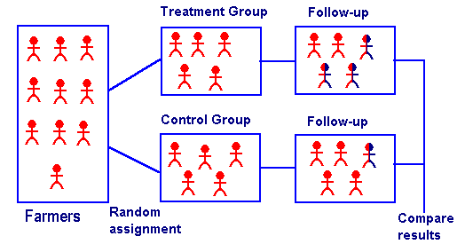
Randomized control trial
‘Gold standard of impact evaluation because they are inarguably the most rigorous—meaning they require the fewest assumptions, or leaps of faith, when drawing conclusions from the results.’
Randomize units into treatment or control: all units should have the same likelihood on getting selected into treatment
Baseline survey and at least one follow-up survey
Compare outcome variable
between treatment and
control group: regress
outcome on treatment
dummy using OLS

Slide 14
Randomized control trial (2)
Various treatment arms
  T 1: improved maize available
  T 2: improved maize
  + agricultural extension
  Control group
Compare T1 and C → effect of making DT maize available
Compare T2 and C → effect of making DT maize available and having agricultural extension
Compare T1 and T2 → effect of agricultural extension
T
C
C
T
T
T
C
C
C

Slide 15
Philippines: Conceptual framework (e.g.)
Mechanism by which information/text messages may affect farmer behvior
Assume that farmers act so as to maximize their returns from farm management decisions
Management decisions are assumed to made based on perceptions about the state of nature (s_{t}) and its probability distribution
In this context, state of nature includes the returns to use of the SSNM application
Deviations from this standard economic model using psychological constructs
  Nonstandard preferences
  Nonstandard beliefs about the state of nature
  Nonstandard decision making
    Limited attention
    Sub-optimal heuristics
Notes:
-We follow DellaVigna, who uses the psychology literature to explain not standard decision making

Slide 16
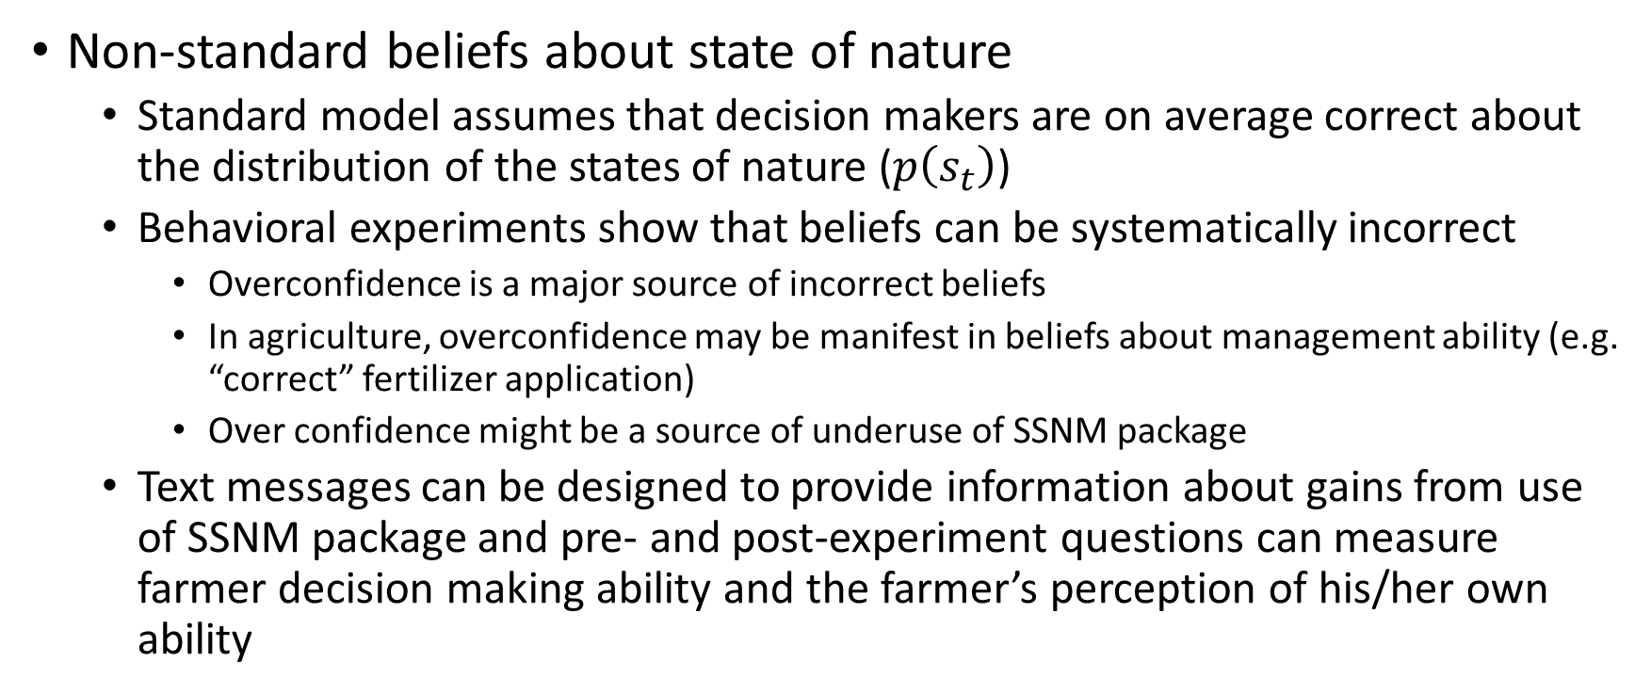
Conceptual framework
Non-standard beliefs about state of nature
  Standard model assumes that decision makers are on average correct about the distribution of the states of nature ($p\left(s_{t}\right)$)
  Behavioral experiments show that beliefs can be systematically incorrect
    Overconfidence is a major source of incorrect beliefs
    In agriculture, overconfidence may be manifest in beliefs about management ability (e.g. “correct” fertilizer application)
    Over confidence might be a source of underuse of SSNM package
  Text messages can be designed to provide information about gains from use of SSNM package and pre- and post-experiment questions can measure farmer decision making ability and the farmer’s perception of his/her own ability
Notes:
sub-optimal decision

Slide 17
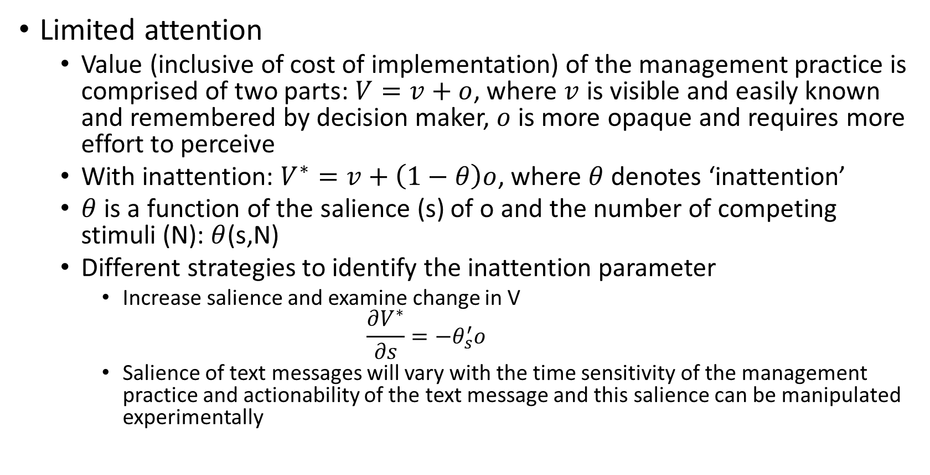
Conceptual framework
Limited attention
  Value (inclusive of cost of implementation) of the management practice is comprised of two parts: $V=v+o$, where $v$ is visible and easily known and remembered by decision maker, $o$ is more opaque and requires more effort to perceive
  With inattention: $V^{∗}=v+\left(1−θ\right)o$, where $θ$ denotes ‘inattention’
  $θ$ is a function of the salience (s) of o and the number of competing stimuli (N): $θ$(s,N)
  Different strategies to identify the inattention parameter
    Increase salience and examine change in V
    $$\frac{∂V^{∗}}{∂s}=−θ_{s}^{′}o$$
    Salience of text messages will vary with the time sensitivity of the management practice and actionability of the text message and this salience can be manipulated experimentally
Notes:
V = visible, known and remember by decision maker
O more opaque component, require more effort and attention to process
Attention is a scare resource and due to inattention
O some of the benefits of IPM are harder to perceive-not a direct increase in yield– like positive impact on health and environment, might take time to occur, and might be disperse.
texts messages might have greater impact on the inattention parameter than others.

Slide 18
Conceptual framework
Sub-optimal heuristics
  Situation where the decision maker faces a large menu of options
    Behavioral results: Preference for the familiar to sort out complexities
  The SSNM package includes numerous and (somewhat) complex choices
    Knowledgeable farmers are less likely to be overwhelmed by the complex choice sets and less likely to choose the default option (do not adopt recommendations of package)
    Text messages can be manipulated to simplify use of the package, pointing out simple messages that can be gleaned from the package
      Impact of such messages on use of package will be greater for less knowledgeable farmers
Notes:
sub-optimal decision

Slide 19
Implementation plan
Inception workshop (this week)
Design RCT—spatial specificity, determine arms and optimal size of the experiment
Baseline survey (prior to major rice planting season)
Implementation of RCT (activities condensed prior to and around timing of major rice management activities)
Analysis
Reporting on results

Slide 20
Issues
Is SSNM proper focus of RCT? Alternatives we have heard include work to improve “seed networks”
Is Rice Crop Manager the proper SSNM practice to evaluate?
Potential “arms” of the RCT (examples)
  Different message content
    Best information on state of nature—returns from SSNM
    Simple reminders to overcome inattention—increase flow of reminders as critical management decisions are approached
    Simplifying reminders—e.g. just use the nitrogen application recommendation
  Enhancements to SSNM application
    Pair text messages with offer of free soil test to make recommendations more site-specific
    Subsidized delivery of inputs paired with SSNM app use

Slide 21
Issues: Treatment arms are limited
Impact of treatment on use of RCM
Control-no stimulus (n=400)
Treatment
Stimulus 1 (n=200)
Stimulus 2 (n=200)

Slide 22
Questions
What factors might limit SSNM use/uptake?
  Specificity of recommendations/heterogeneity of farming?
  Returns to adoption of the recommendations? Skepticism of farmers?
  Message content/message design
What factors might constrain impacts of SSNM on farming operations?
Where (spatially) has SSNM been most widely promoted & in what form? Where has it been least promoted?
What STRVs have been disseminated in Philippines and to what degree has their dissemination been paired with SSNM recommendations?
Which areas of Philippines have CURE STRVs been widely disseminated?

Slide 23
Additional queries
STRVs by country and relevant to our study? E.g. salinity tolerance in Vietnam

