Slide 1
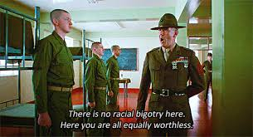
Hate speech any derogatory or unkind word(s) used to refer one’s race, color, class, gender, sex, or sexual orientation.

Slide 2
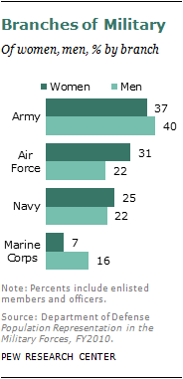
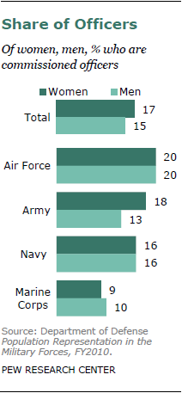
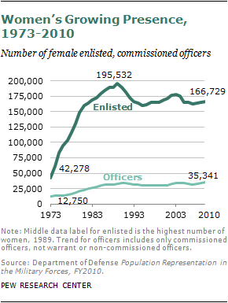
Female Representation in the Military
Women make up 15% of the military, serving in all military branches (“Background”).

Slide 3
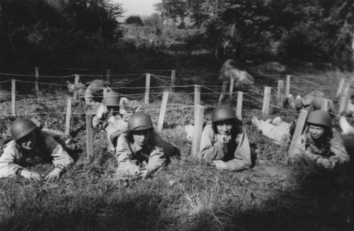
Statistics
Women make up 1.8 million (8 percent) of the 22 million U.S. veterans [nationwide].
The male veteran population is expected to decrease by 4 million by 2020,
Women veterans are projected to grow by 2.7 percent, making them 10.7 percent of the veteran population by 2020 (Biank 330).

Slide 4
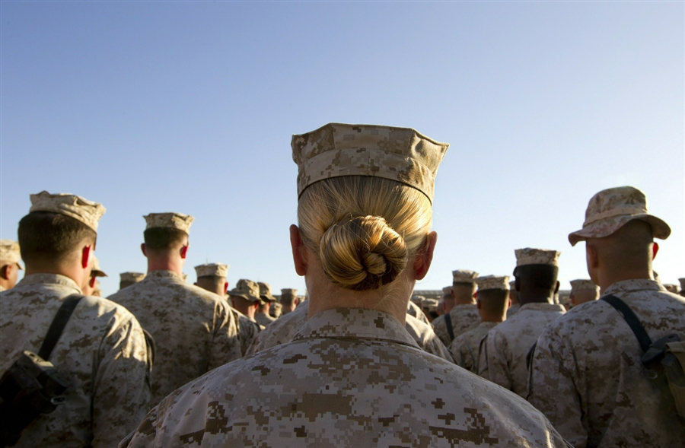
Statistics
A servicewoman is 180x more likely to be raped than to have died while deployed during the last 11 years of combat in Iraq & Afghanistan.
The Pentagon estimates the number of MST occurring annually in all branches of the U.S. Armed forces @ 19,000.
3,158 cases were reported in 2010
15, 842 sexual assaults went unreported.

Slide 5
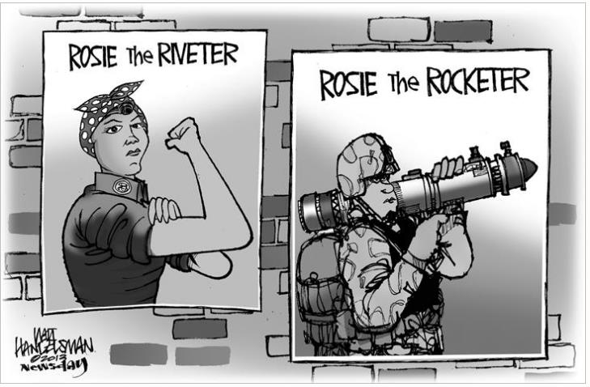
Verbal Imagery
Visual Imagery
Mary Sheridan-Rabideau
“verbal images of students as deficient or gifted or as active or passive clearly impact the learning and learners of the classroom” (106).
Kristie Fleckenstein
“static mental snapshots[which] orient” us within culture (917).

Slide 6
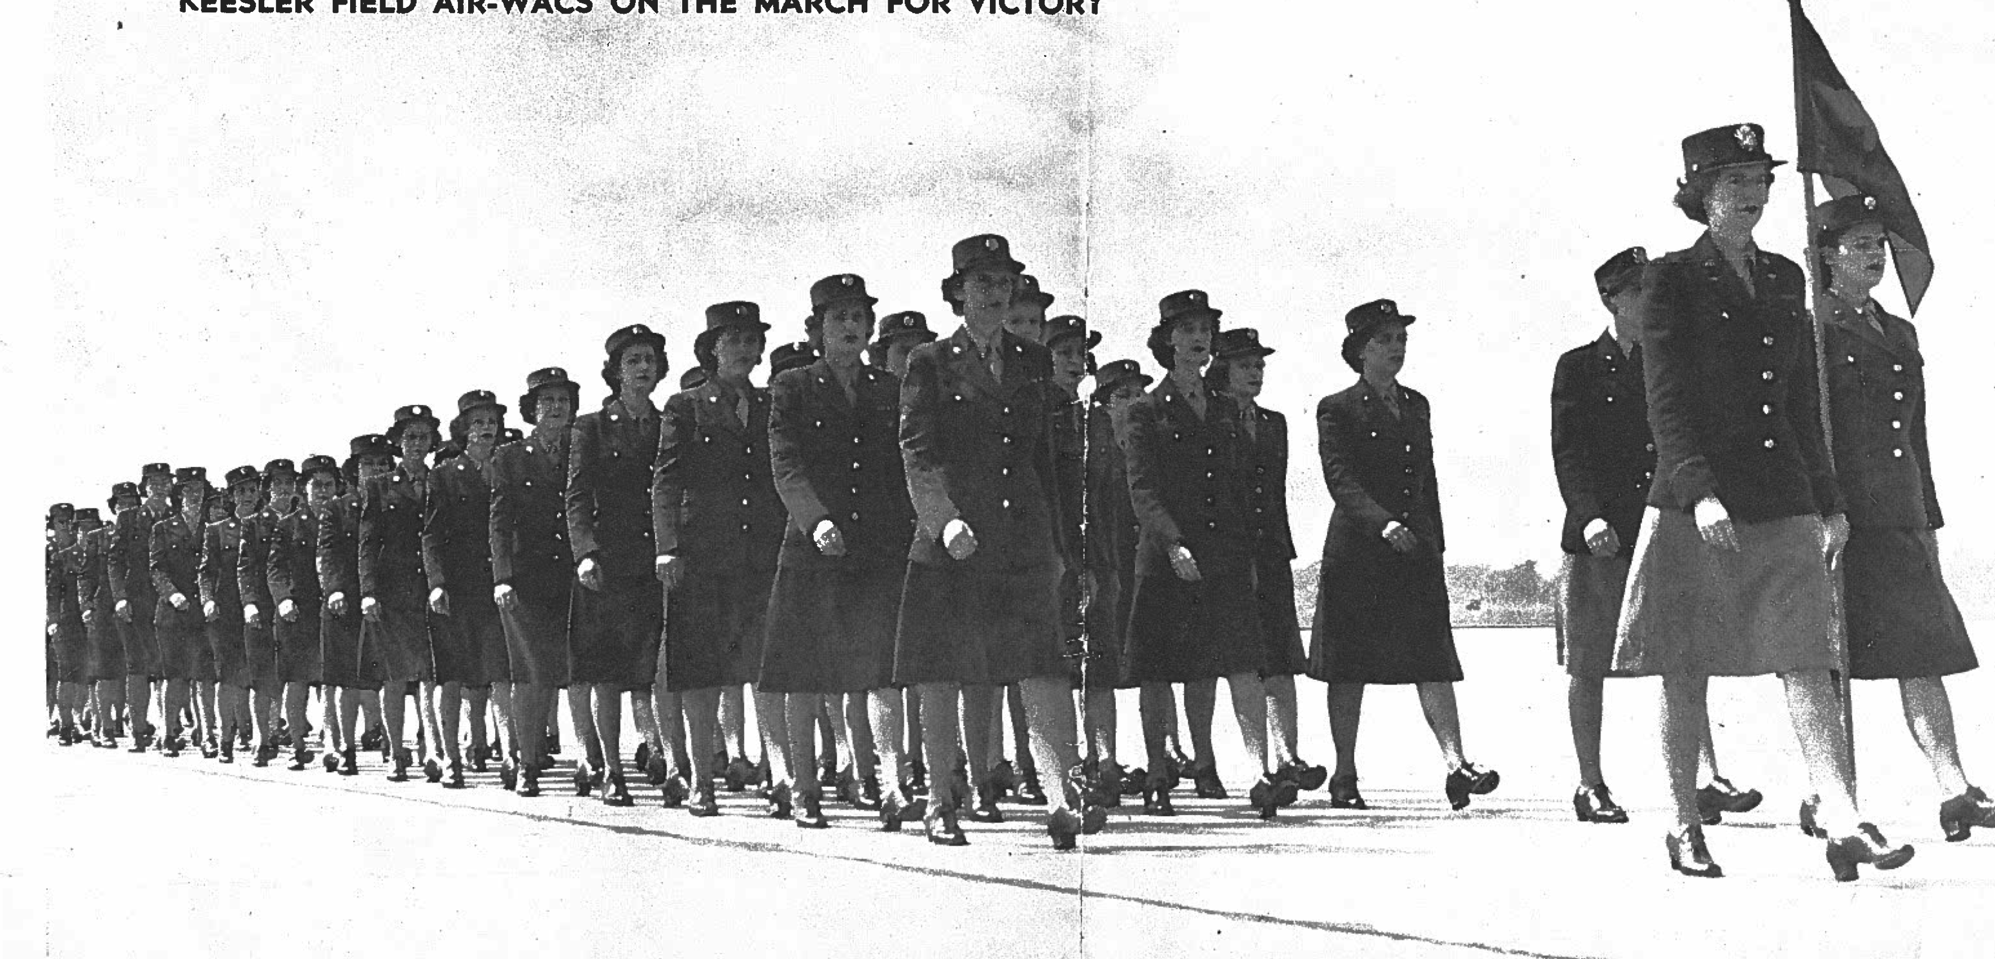
Moving Words/Words that Move: An Analysis of the Discursive Practices Plaguing U.S. Service Women
Mariana Grohowski
Bowling Green State University
mgrohow@bgsu.edu

Slide 7
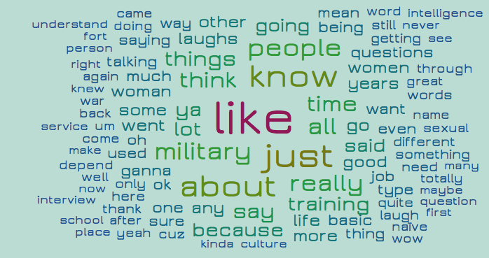

Slide 8


Shade It Black
Jess Goddell
Love My Rifle More Than You
Kayla Williams

Slide 9
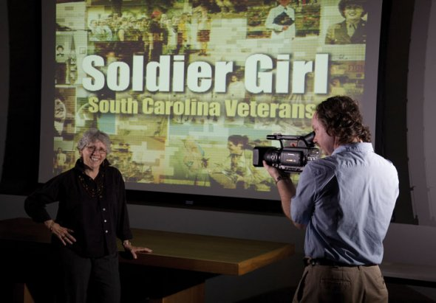

Slide 10
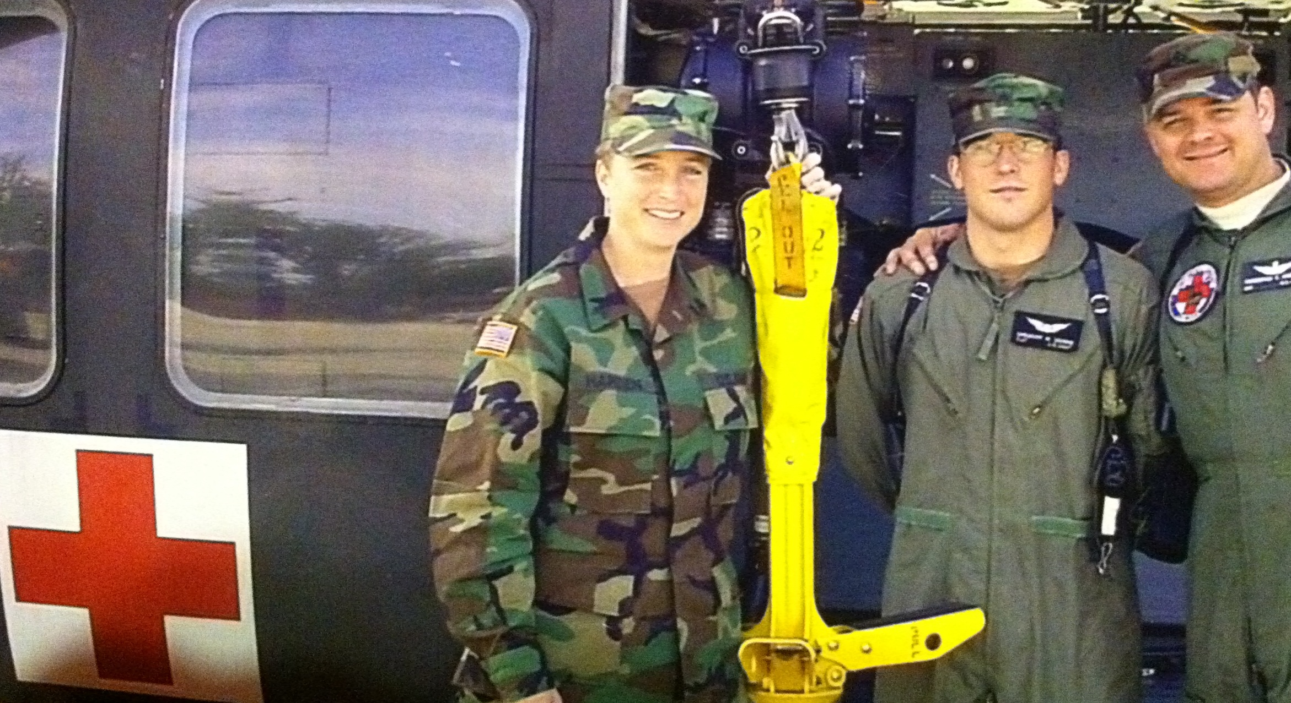
“Women’s sexuality, is socially, a thing to be stolen, sold, bought, bartered, or exchanged by others…women never own or possess it, and men never treat it…with the solicitude with which they treat property. To be property would be an improvement” (Catherine MacKinnon)
“We cannot hope to transform rape culture without committing ourselves fully to resisting and eradicating patriarchy" (bell hooks).

Slide 11
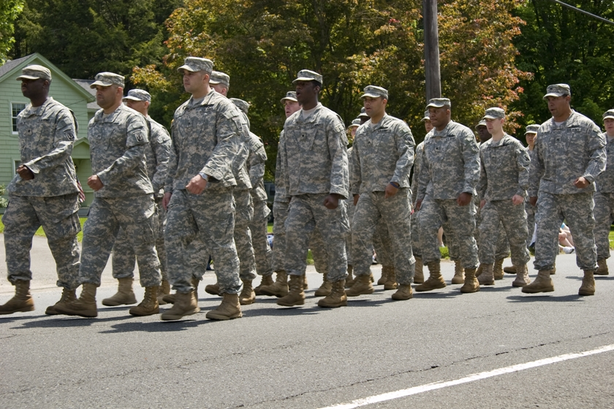
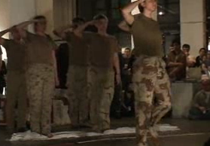
War
Is it a place young men, targets in uniform, fight in a far off land
Or is it my walk home at night, womanhood my uniform and target.
'Momma and poppa were lying in bed, poppa rolled over and this is what he said, 'Give me some! PT!'
Notes:
http://www.warriorwriters.org/Artists/JenH.html

Slide 12
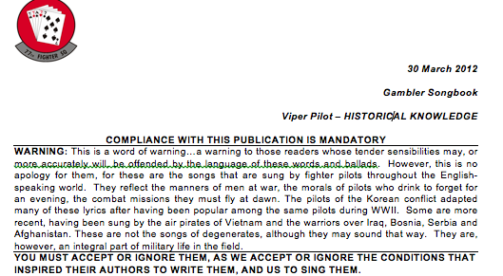
Notes:
http://www.youtube.com/watch?v=56AB-VnC_Eo

Slide 13





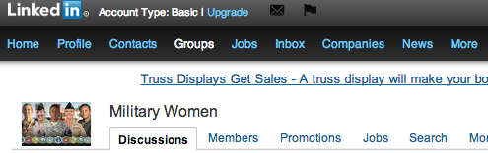




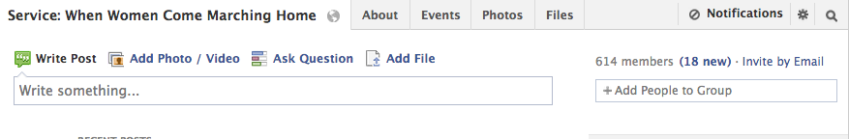


Slide 14
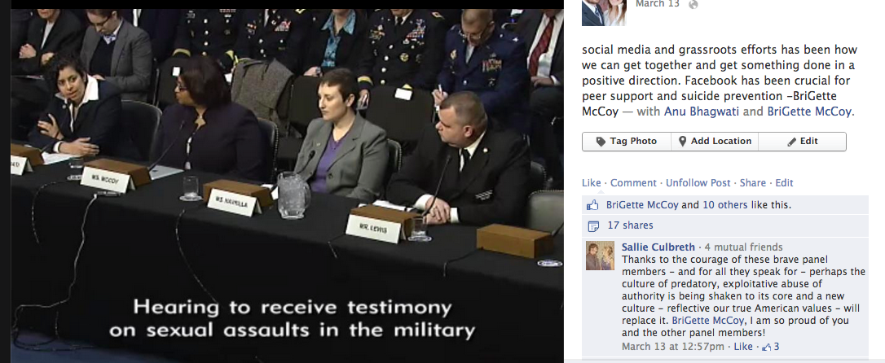
Armed Services Subcommittee (SH-216) Senate, Capital Hill, Washington D.C. 03-13-2013

Slide 15
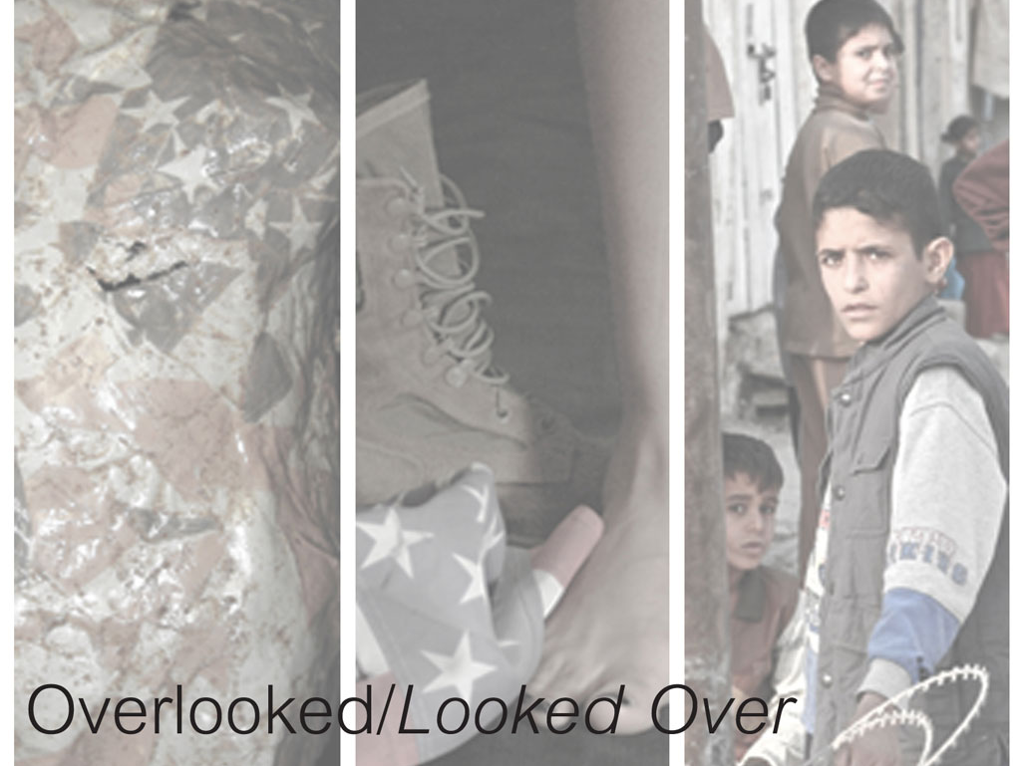
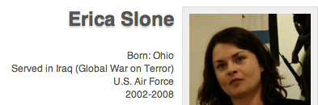


Slide 16
Implications
1. Speak up: Our silence about rape and hate speech is also our acceptance of these forms of violence. We cannot remain silent if we want such violence to cease.
2. Share: Transitioning veterans cannot be expected to know about the various resources available to them for support and other services. Share information about resources with veterans; suggest a wide variety of platforms for services and outreach—not just face-to-face—but also online—not just traditional medicine—but various kinds of approaches for health and human services.
3. Listen: The best favor we can do to any one, especially our female veterans is to listen to them. Many servicewomen admit to feeling silenced during the military careers. We cannot permit their continued silence; we must invite them to speak, while we listen attentively and without judgment. Listening is a powerful act of personal and social change.

Slide 17
Thank you

